Slide 1
Combining Keyword Search and Forms for Ad Hoc Querying of Databases
Eric Chu, Akanksha Baid, Xiaoyong Chai, AnHai Doan, Jeffrey Naughton
University of Wisconsin-Madison

Slide 2
More and more untrained users querying DBMSs
E-commerce applications
Structured wikipedia (e.g., DBpedia)
Increasing demand for richer queries
Attr = value, range, sorting, aggregation, etc.
Writing SQL queries doesn’t work
Need to know SQL and the schema

Slide 3
Keyword Search over Databases
Input: Keywords
Output: Ranked list of joined-tuples containing the keywords
Has made much progress in recent years
Disadvantage: limited query expressiveness
Field selection
Range queries
Aggregation

Slide 4
Augmenting Keyword Search
Augment keyword search with new constructs
Field selection not so bad
“Attr = value”
But users need to know field names
Now consider adding range queries, aggregation…
Keyword search becomes a new language for a subset of SQL

Slide 5
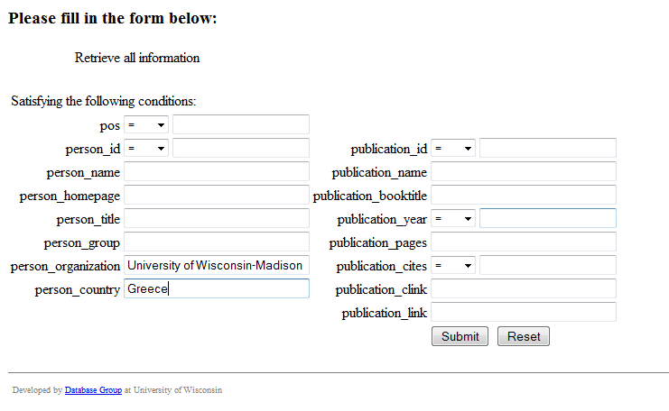
Building Query with Forms Is Simple
“Finding publications by UW-Madison researchers who are originally from Greece”

Slide 6
Making Forms Support Many Queries
Arbitrarily customizable
Users can select tables, columns, values…
Example: QBE
Filling in values in skeleton tables
Ultimately it’s close to asking them to generate SQL again

Slide 7
So, we need more-specific forms
Forms that are closer to the user intent
But we would need many forms to support many queries
How do we get the correct form to a user?

Slide 8
Our Approach
Combining keyword search and query forms:
Offline:
Generate and index (potentially many) forms
At query time:
User submits keyword query
System returns relevant forms
User selects desired form to finish query

Slide 9
Challenges
Form generation
How specific/general should forms be?
How to systematically generate forms and good form descriptions?
Keyword search over forms
What makes forms different from documents?
What issues arise in retrieval and ranking?
Do users find it useful?

Slide 10
Challenges
Form generation
How specific/general should forms be?
How to systematically generate forms and good form descriptions?
Keyword search over forms
What makes forms different from documents?
What issues arise in retrieval and ranking?
Do users find it useful?

Slide 11
Forms VS Documents
Forms have parameters
Query keywords could be
Terms on a form
Parameter values
Not part of the query until users specify them

Slide 12
“Naïve” Keyword Search
Query: “author Madison”
Author => a term on a form
Madison => a data value
Naïve-AND: return forms with ALL keywords
No results
Naïve-OR: Return forms with ANY keywords
“Madison” is ignored
Put data values on forms
High storage and maintenance costs

Slide 13
Solution: Query Rewrite
If query Q contains data value d and d is in relation R, rewrite Q to consider R
“author Madison”
Madison is in tables conference, publication, …
Alternatives
DI-OR
DI-AND
DIJ

Slide 14
DI-OR: Query rewrite with OR semantics
DI-OR
Create Q’ = Q + R
Then search for forms with Q’ using OR-semantics
Example
Q: “author Madison”
Q’: “author Madison conference publication”
Handles terms that refer to data values
Results often too inclusive

Slide 15
DI-AND: Query rewrite with AND semantics
Example
Q: “Eric Madison”
“Eric” => author
“Madison” => conference, publication
Enumerate new queries using AND semantics:
“author AND conference”
“author AND publication”

Slide 16
“Dead” Forms
Some returned forms give empty results with respect to the keywords
Example: a table referenced by many
Person (id, name, …)
Tutorial(rid, pid, cid)
ConferenceTalk(rid, pid, cid)
ServeConf(rid, pid, …)
WritePub(rid, pid, …)
“Eric” => forms for all 5 tables
But Eric has only written a paper…

Slide 17
DIJ: Filtering “Dead” Forms
Example
“Eric” => Table = Person, PID = P1
On forms having Person table
Check if other tables referencing Person have tuples with PID = 1
WritePub(W7, P1, …)
Return forms for Person and WritePub tables

Slide 18
Ranking
Using only Lucene’s TF-IDF function is not good enough
Many similar forms
Similar form summaries
For a given query, similar forms often have same ranking scores
When query is not very specific, the best form may be hidden in a bunch of logically similar forms

Slide 19
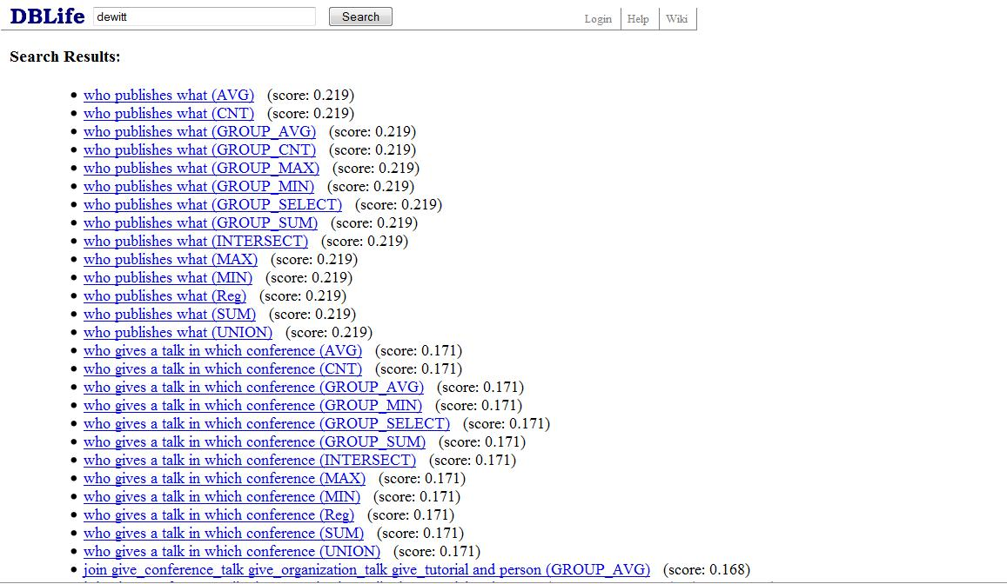
Returning a flat list of forms is unclear
The query “dewitt” returns a list of 210 forms

Slide 20
Presenting groups of forms in the results
1st-level group: consecutive forms having the same score and based on the same relation.
In each first-level group, group forms by the types of queries they support
Select-From-Where, Aggregation, Union/Intersect
Display 2nd level groups of forms in fixed order
Forms in the same 1st level group have the same ranking scores.

Slide 21
Returning a flat list of forms is unclear
Instead of showing a flat list of 210 forms

Slide 22
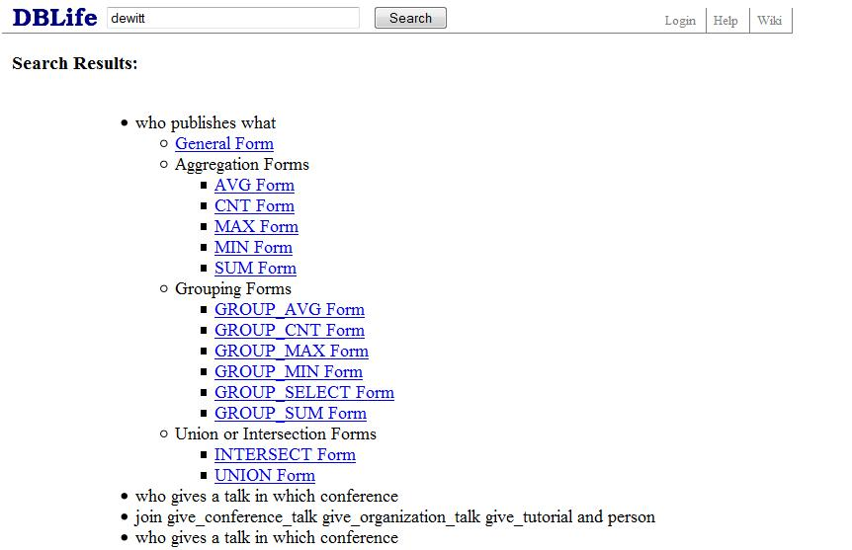
Returning groups of forms
Shows 23 groups of logically similar forms
Users can drill down a “right” group to find the “right” form

Slide 23
User Study
Data Set: DBLife
5 entity tables, 9 relationship tables, 196 forms
7 CS grad students
6 information needs
Alternatives
Naive-OR, Naïve-AND, DI-OR, DI-AND, DIJ
Observing
# forms returned
Rank of “right” form
Time

Slide 24
Information Needs
Find all people who have given a tutorial at VLDB.
Find topics of areas related to Jeff Naughton.
Find people who have served as the SIGMOD PC chair.
Find the first author of all papers cited more than 5 times. (Range query)
Find the number of people who have co-authored a paper with David Dewitt. (Count query)
Find people who have published with David DeWitt or Jeff Naughton (Union query)

Slide 25
Queries of a User
Q1: “tutorial vldb”
Q2: “jeff naughton research area”
Q3: “sigmod chair” (data terms only)
Q4: “paper citation”
Q5: “david dewitt coauthor”
Q6: “dewitt naughton” (data terms only)

Slide 26
Comparing # Forms Returned
 | Number of Forms Returned
 | Naive-OR | Naive-And | DI-OR | DI-AND | DIJ
Q1 | 14 | 0 | 168 | 42 | 42
Q2 | 28 | 0 | 182 | 28 | 28
Q3 | 0 | 0 | 142 | 28 | 28
Q4 | 28 | 28 | 142 | 28 | 28
Q5 | 14 | 0 | 196 | 14 | 14
Q6 | 0 | 0 | 196 | 182 | 168

Slide 27
DI-AND VS DIJ on # Forms Returned
DIJ eliminates dead forms
# dead forms depends on the specific schema and query
 | Average Number of Forms Returned
 | T1 | T2 | T3 | T4 | T5 | T6
DI-AND | 44 | 48 | 38 | 28 | 129 | 64
DIJ | 44 | 46 | 38 | 28 | 116 | 56

Slide 28
Flat VS Group Ranks
Highest, median, and lowest based on 7 users
 | Flat Rank |  |  |  | Group Rank
 | H | M | L | #F | H | M | L | #G
T1 | 1 | 1 | 1 | 44 | 1 | 1 | 1 | 3.14
T2 | 1 | 1 | 69 | 46 | 1 | 1 | 7 | 3.7
T3 | 1 | 1 | 1 | 38 | 1 | 1 | 1 | 2.7
T4 | 1 | 15 | 15 | 28 | 1 | 2 | 2 | 2
T5 | 4 | 21 | 21 | 116 | 1 | 2 | 4 | 11.57
T6 | 1 | 12 | 12 | 56 | 1 | 1 | 6 | 4

Slide 29
Breakdown of End-to-End Time
Time by 7 users on 6 information needs
 | Pose query (sec) | Find the right form (sec) | Fill out the form (sec) | Total average time (sec) | Standard Deviation (sec) | Median (sec)
T1 | 7.0 | 12.3 | 5.3 | 24.6 | 13.1 | 23.0
T2 | 7.5 | 23.9 | 14.8 | 46.1 | 48.0 | 26.0
T3 | 7.5 | 18.0 | 25.6 | 51.1 | 31.4 | 36.0
T4 | 12.0 | 79.7 | 15.2 | 106.9 | 56.6 | 123.0
T5 | 19.0 | 46.9 | 7.7 | 73.6 | 29.9 | 80.0
T6 | 14.0 | 64.0 | 15.2 | 93.2 | 47.8 | 78.0

Slide 30
Conclusion
Help untrained users pose wide variety of structured queries
Keyword search => forms
Generating forms for wide variety of queries
Keyword search of forms
Query rewrite to handle parameter values
Presenting forms in groups
Many issues should be further explored

