Slide 1

Reconstruction of infectious bronchitis virus quasispecies from 454 pyrosequencing reads
CAME 2011
Ion Mandoiu
Computer Science & Engineering Dept.
University of Connecticut

Slide 2
Infectious Bronchitis Virus (IBV)
Group 3 coronavirus
Biggest single cause of economic loss in US poultry farms
Young chickens: coughing, tracheal rales, dyspnea
Broiler chickens: reduced growth rate
Layers: egg production drops 5-50%, thin-shelled, watery albumin
Worldwide distribution, with dozens of serotypes in circulation
Co-infection with multiple serotypes is not uncommon, creating conditions for recombination
Notes:
Signs occur after an incubation period of 18-48 hr. Spread to other birds is rapid, and morbidity may be nearly 100%. The nature and severity of the disease are influenced by the age and immune status of the flock and virulence of the causal strain. Young chickens cough, sneeze, and have tracheal rales for 10-14 days. Wet eyes and dyspnea may be seen, and facial swelling may also occur ccasionally, particularly with concurrent bacterial infection of the sinuses. In broiler chickens, IBV infection is a major cause of poor feed conversion, reduced growth rate, and condemnation of meat at processing. Nephropathogenic strains can produce interstitial nephritis with high mortality (up to 60%) in young chickens. In most outbreaks, however, mortality is 5%, although secondary bacterial infections may cause higher losses.
In layers, egg production may drop 5-50%, and eggs are often misshapen, thin-shelled, and contain watery albumen. Egg production and egg quality generally return to near normal levels in most birds on recovery.

Slide 3
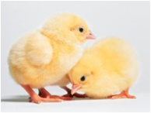
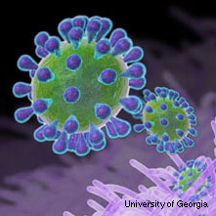
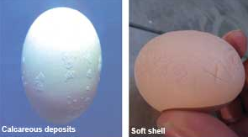
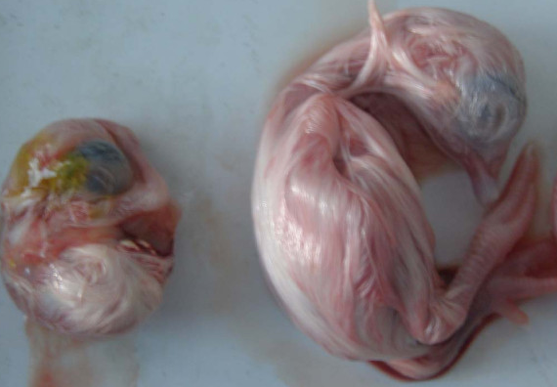
IBV
healthy chicks
IBV-infected
egg defect
IBV-infected
embryo
normal
embryo
Notes:
Signs occur after an incubation period of 18-48 hr. Spread to other birds is rapid, and morbidity may be nearly 100%. The nature and severity of the disease are influenced by the age and immune status of the flock and virulence of the causal strain. Young chickens cough, sneeze, and have tracheal rales for 10-14 days. Wet eyes and dyspnea may be seen, and facial swelling may also occur ccasionally, particularly with concurrent bacterial infection of the sinuses. In broiler chickens, IBV infection is a major cause of poor feed conversion, reduced growth rate, and condemnation of meat at processing. Nephropathogenic strains can produce interstitial nephritis with high mortality (up to 60%) in young chickens. In most outbreaks, however, mortality is 5%, although secondary bacterial infections may cause higher losses.
In layers, egg production may drop 5-50%, and eggs are often misshapen, thin-shelled, and contain watery albumen. Egg production and egg quality generally return to near normal levels in most birds on recovery.

Slide 4
IBV Vaccination
Broadly used, most commonly with attenuated live vaccine
Short lived protection
Layers need to be re-vaccinated multiple times during their lifespan
Vaccines might undergo selection in vivo and regain virulence [Hilt, Jackwood, and McKinley 2008]

Slide 5
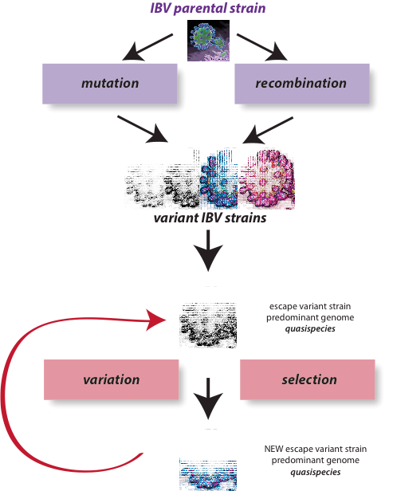
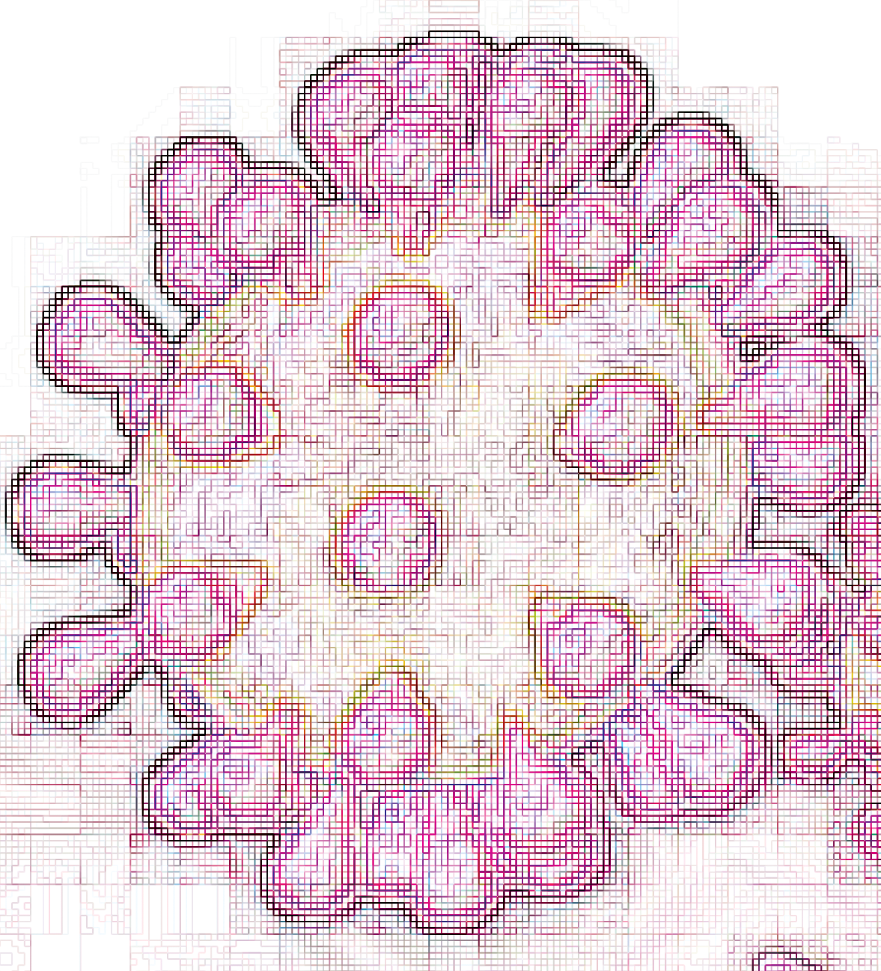
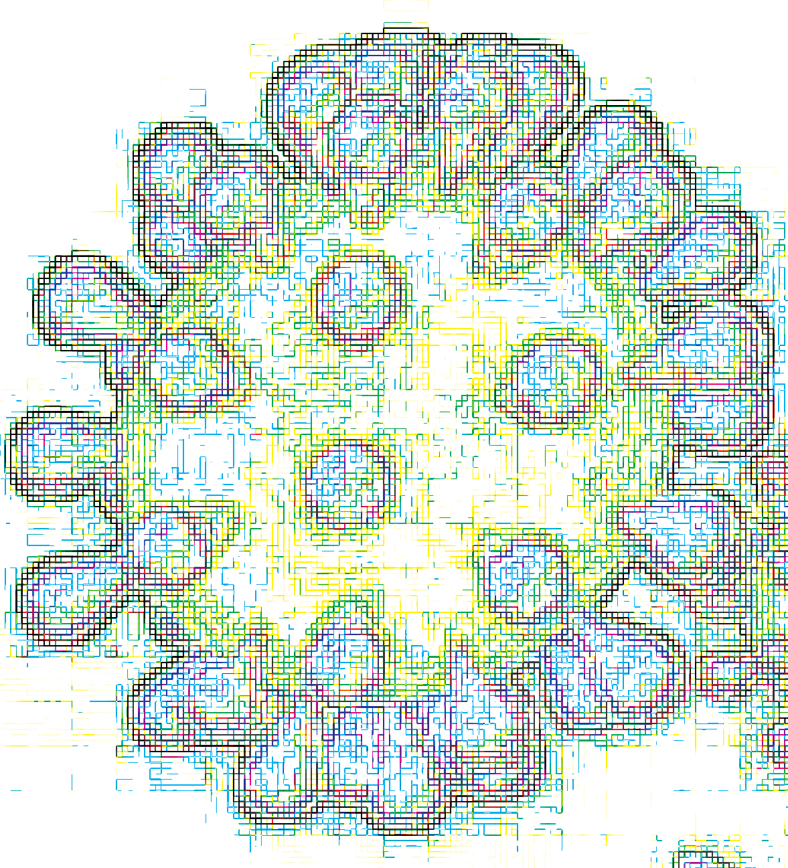
Evolution of IBV
Quasispecies identified by cloning and Sanger sequencing in both IBV infected poultry and commecial vaccines [Jackwood, Hilt, and Callison 2003; Hilt, Jackwood, and McKinley 2008]

Slide 6
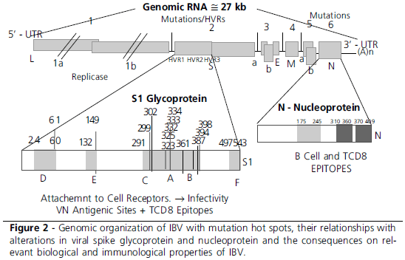
Evolution of IBV
Taken from Rev. Bras. Cienc. Avic. vol.12 no.2 Campinas Apr./June 2010

Slide 7
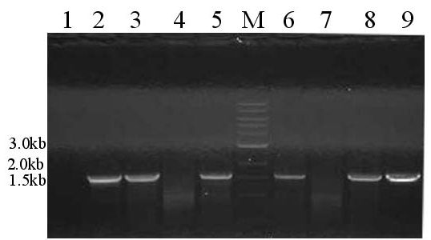
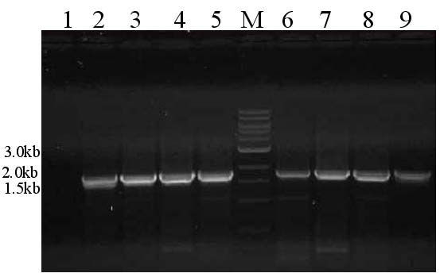
S1 Gene RT-PCR
Published Primers
Primers redesigned using PrimerHunter

Slide 8
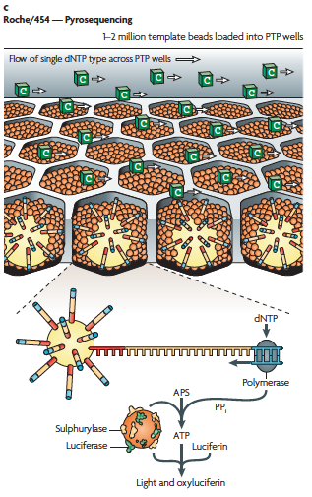
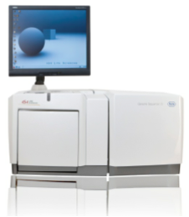

Slide 9
ViSpA: Viral Spectrum Assembler [Astrovskaya et al. 2011]
Error Correction
Read Alignment
Preprocessing of Aligned Reads
Shotgun 454 reads
Frequency Estimation
Contig Assembly
Read Graph Construction
Quasispecies sequences w/ frequencies

Slide 10
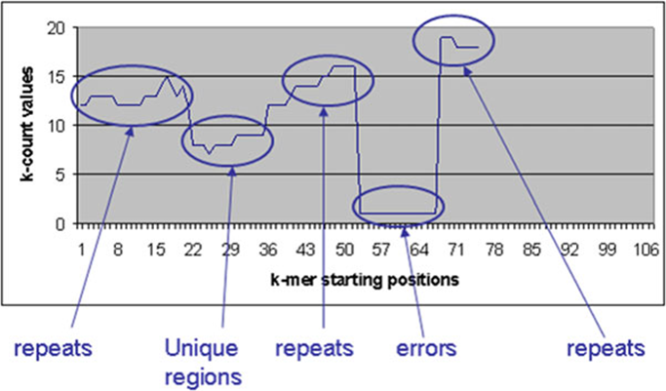

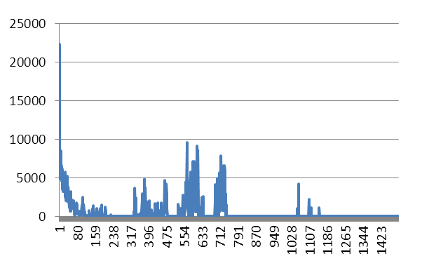
k-mer Error Correction [Skums et al.]
Calculate k-mers and their frequencies kc(s) (k-counts). Assume that kmers with high k-counts (“solid” k-mers) are correct, while k-mers with low k-counts (“weak” k-mers) contain errors.
Determine the threshold k-count (error threshold), which distinguishes solid kmers from weak k-mers.
Find error regions.
Correct the errors in error regions
Zhao X et al 2010

Slide 11
Iterated Read Alignment
Read Alignment vs Reference
Build Consensus
Read Re-Alignment vs. Consensus
Yes
More Reads Aligned?
No
Post-
processing

Slide 12
Read Coverage
145K 454 reads of avg. length 400bp (~60Mb) sequenced from 2 samples (M41 vaccine and M42 isolate)

Slide 13
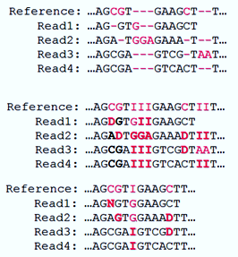
Post-processing of Aligned Reads
Deletions in reads: D
Insertions into reference: I
Additional error correction:
Replace deletions supported by a single read with either the allele present in all other reads or N
Remove insertions supported by a single read

Slide 14
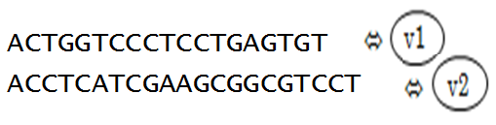
Read Graph: Vertices
ACTGGTCCCTCCTGAGTGT
GGTCCCTCCT
TGGTCACTCGTGAG
ACCTCATCGAAGCGGCGTCCT
Subread = completely contained in some read with ≤ n mismatches. Superread = not a subread => the vertex in the read graph.

Slide 15
Read Graph: Edges
Edge b/w two vertices if there is an overlap between superreads and they agree on their overlap with ≤ m mismatches
Transitive reduction
Several paths may represent the same sequence.

Slide 16
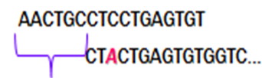
Edge Cost
Cost measures the uncertainty that two superreads belong to the same quasispecies.
Overhang Δ is the shift in start positions of two overlapping superreads.
Δ
where j is the number of mismatches
in overlap o, ε is 454 error rate.

Slide 17
Contig Assembly - Path to Sequence
The s-t-Max Bandwidth Path per vertex (maximizing minimum edge cost)
Build coarse sequence out of path’s superreads:
For each position: >70%-majority if it exists, otherwise N
Replace N’s in coarse sequence with weighted consensus obtained on all reads
Select unique sequences out of constructed sequences.
Repetitive sequences = evidence of real qsps sequence

Slide 18
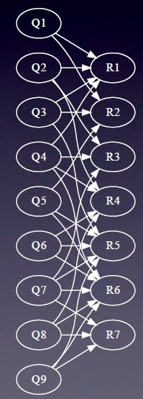
Frequency Estimation – EM Algorithm
Bipartite graph:
Q_{q} is a candidate with frequency f_{q}
R_{r} is a read with observed frequency o_{r}
Weight h_{q,r} = probability that read r is produced by quasispecies q with j mismatches
E step:
M step:

Slide 19
User-Specified Parameters
Number of mismatches allowed to cluster reads around super reads
Usually small integer in range [0,6]. The smaller genomic diversity is expected, the smaller value should be used. If reads are corrected by read correction software, then it should be in the range [0,2].
Mutation-Based Range
Its value depends on expected underlying genomic diversity. In general, the value varies over [80, 450]. If reads are corrected by read correction software, the value varies over range [0,20].
Number of reconstructed quasispecies varies between 2-172 for M41 Vaccine, and between 101-3627 for M42 isolate

Slide 20
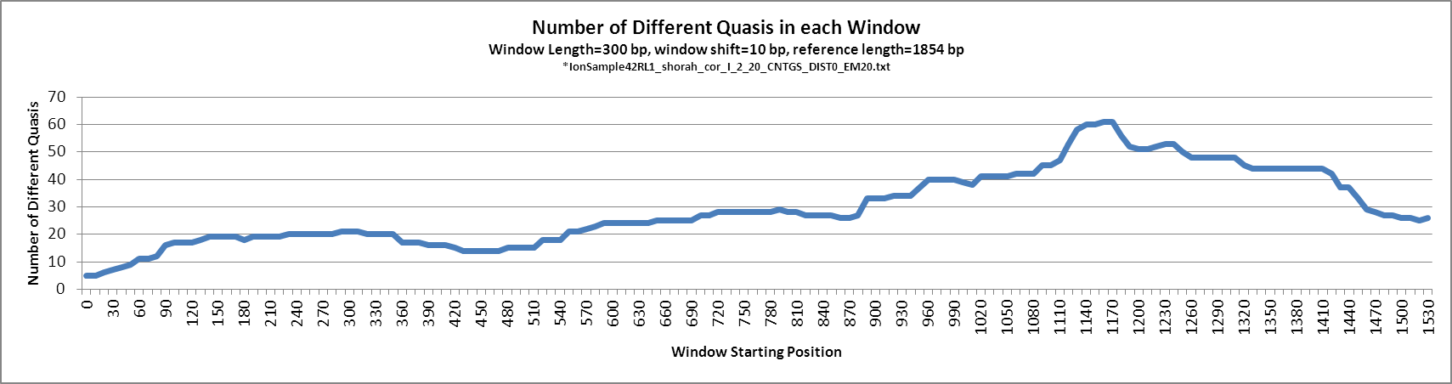
Reconstructed Quasispecies Variability
*IonSample42RL1.fas_KEC_corrected_I_2_20_CNTGS_DIST0_EM20.txt
Sequencing primer ATGGTTTGTGGTTTAATTCACTTTC
122 clones of avg. length 500bp sequenced using Sanger

Slide 21
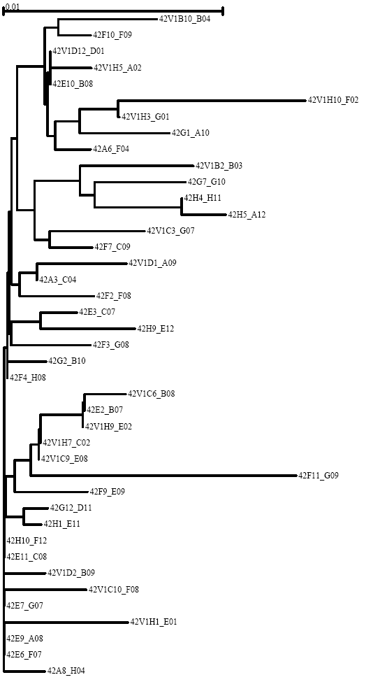
M42 Sanger Clones NJ Tree

Slide 22
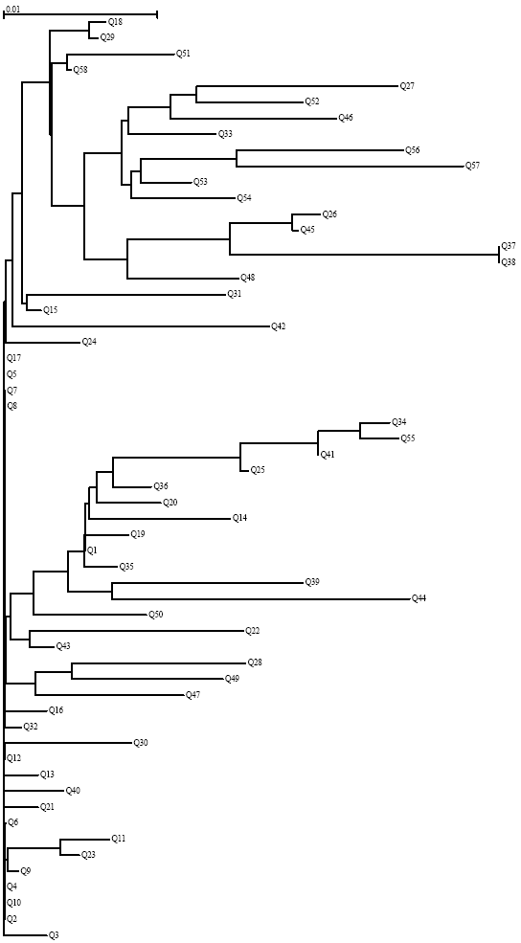
M42 Vispa Qsps NJ Tree

Slide 23
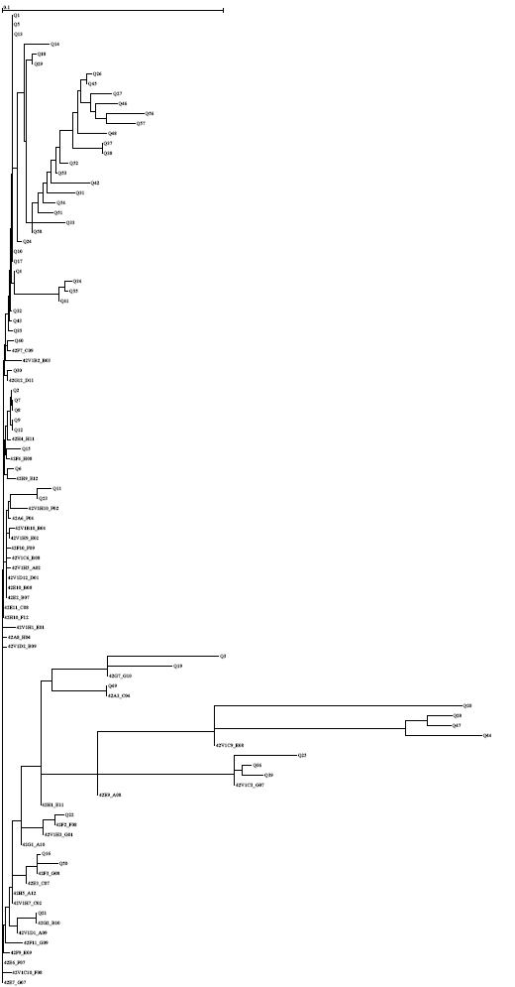
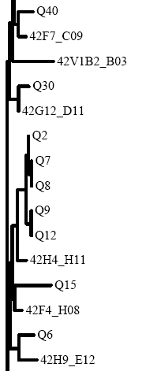
M42 Sanger + Vispa NJ Tree

Slide 24
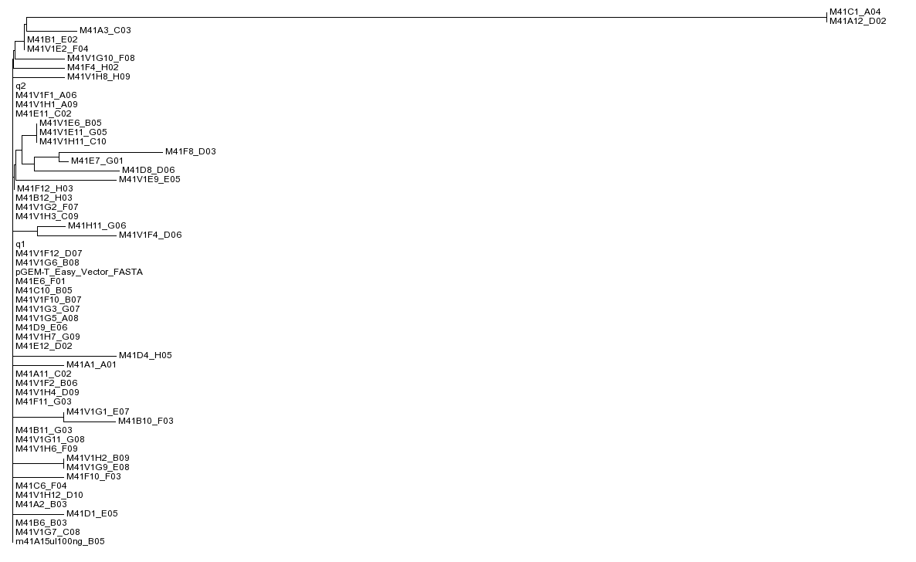
MA41 Vaccine Sanger Clones

Slide 25
Summary
Viral Spectrum Assembler (ViSpA) tool
Error correction both pre-alignment (based on k-mers) and post-alignment (unique indels)
Quasispecies assembly based on maximum-bandwidth paths in weighted read graphs
Frequency estimation via EM on all reads
Freely available at http://alla.cs.gsu.edu/software/VISPA/vispa.html
Currently under validation on IBV samples

Slide 26
Ongoing Work
Correction for coverage bias
Comparison of shotgun and amplicon based reconstruction methods
Quasispecies reconstruction from Ion Torrent reads
Combining long and short read technologies
Study of quasispecies persistence and evolution in layer flocks following administration of modified live IBV vaccine
Optimization of vaccination strategies

Slide 27
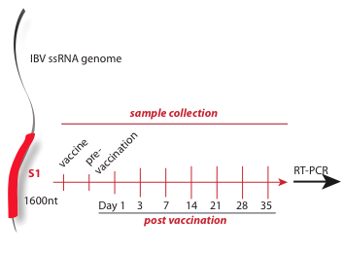
Longitudinal Sampling
Amplicon / shotgun sequencing

Slide 28





Acknowledgements
Georgia State University
Alex Zelikovsky, Ph.D.
Bassam Tork
Serghei Mangul
University of Connecticut:
Rachel O’Neill, PhD.
Mazhar Kahn, Ph.D.
Hongjun Wang, Ph.D.
Craig Obergfell
Andrew Bligh
University of Maryland
Irina Astrovskaya, Ph.D.

