Slide 1
COUNTEREXAMPLES to Hardness Amplification beyond negligible
Yevgeniy Dodis, Abhishek Jain, Tal Moran, Daniel Wichs

Slide 2
Hardness Amplification
Go from “weak” security to “strong” security.
50% Defective
Weakly Secure
Strongly Secure

Slide 3
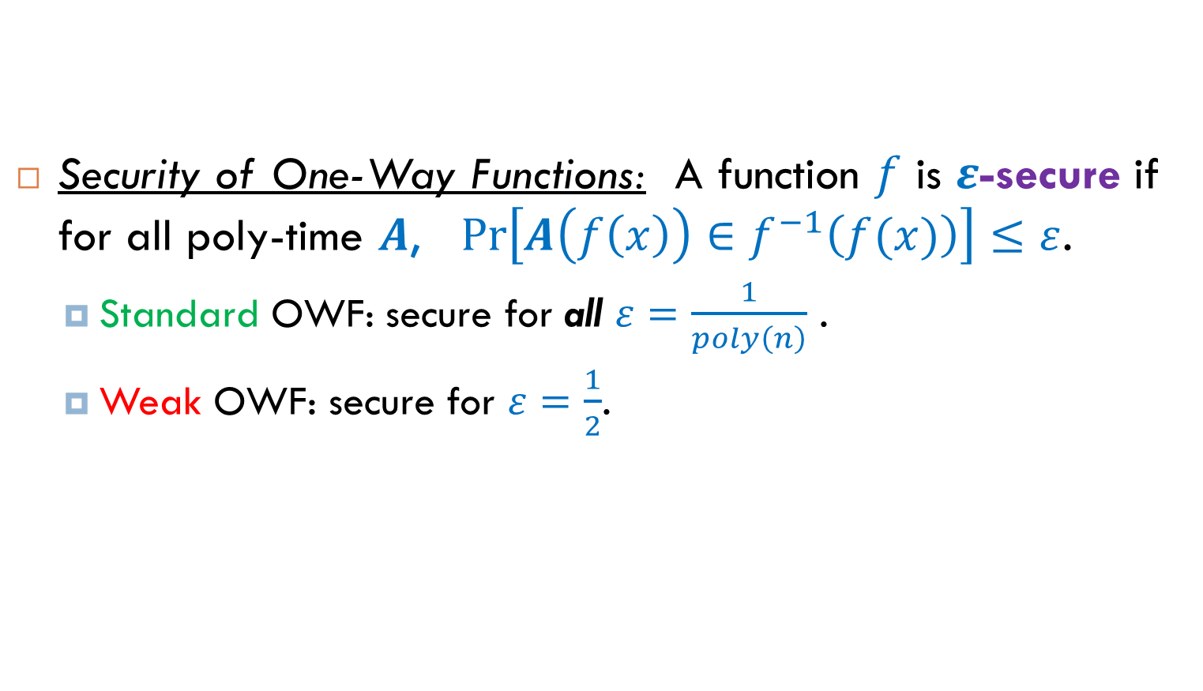
Hardness Amplification for OWFs
Security of One-Way Functions: A function $f$ is $ε$-secure if for all poly-time $A$, $Pr\left[A\left(f\left(x\right)\right)∈f^{−1}\left(f(x)\right)\right]≤ε$.
Standard OWF: secure for all $ε=\frac{1}{poly\left(n\right)}$ .
Weak OWF: secure for $ε=\frac{1}{2}$.

Slide 4
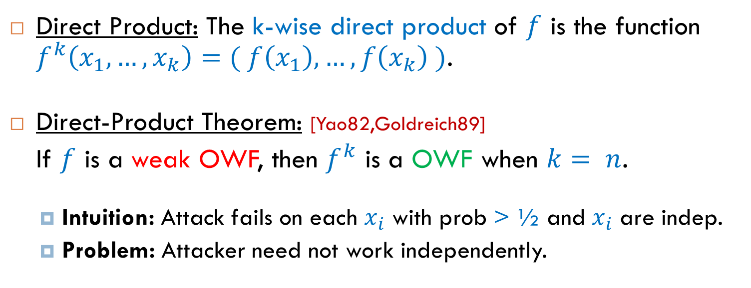
Hardness Amplification for OWFs
Direct Product: The k-wise direct product of $f$ is the function $f^{k}\left(x_{1},…,x_{k}\right)=( f\left(x_{1}\right),…,f\left(x_{k}\right) )$.
Direct-Product Theorem: [Yao82,Goldreich89]
If $f$ is a weak OWF, then $f^{k}$ is a OWF when $k= n$.
Intuition: Attack fails on each $x_{i}$ with prob > ½ and $x_{i}$ are indep.
Problem: Attacker need not work independently.

Slide 5
Direct-Product Theorems
Direct-product theorems hold for:
One-way functions, weakly verifiable puzzles, hard functions,
signatures, MACs, public-coin interactive games, etc.
[Yao82,Lev87,Gold89,Imp95,GNW95,CHS05,PW07,PV07,IJK08,IJKW09,DIJK09,
Hait09,Jutla10,HPPW10,MT10,Hol11]
Direct-Product theorems do not hold in general for interactive games. [BIN97,PW07]

Slide 6
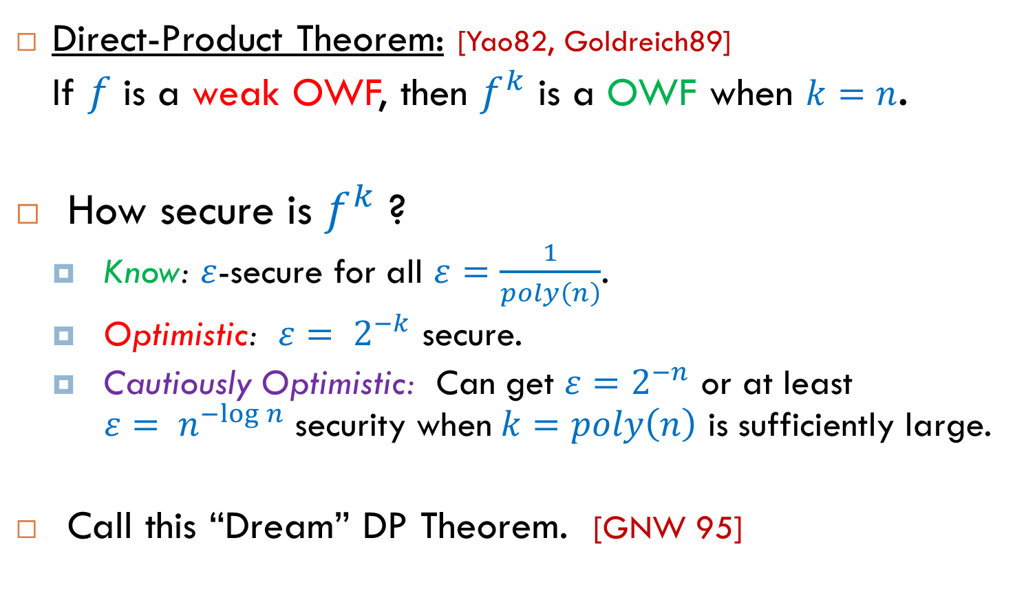
Direct-Product Theorems (Closer Look)
Direct-Product Theorem: [Yao82, Goldreich89]
If $f$ is a weak OWF, then $f^{k}$ is a OWF when $k=n$.
How secure is $f^{k}$ ?
Know: $ε$-secure for all $ε=\frac{1}{poly\left(n\right)}$.
Optimistic: $ε= 2^{−k}$ secure.
Cautiously Optimistic: Can get ${ε=2}^{−n}$ or at least $ε= n^{−log⁡n}$security when$k=poly\left(n\right)$ is sufficiently large.
Call this “Dream” DP Theorem. [GNW 95]

Slide 7
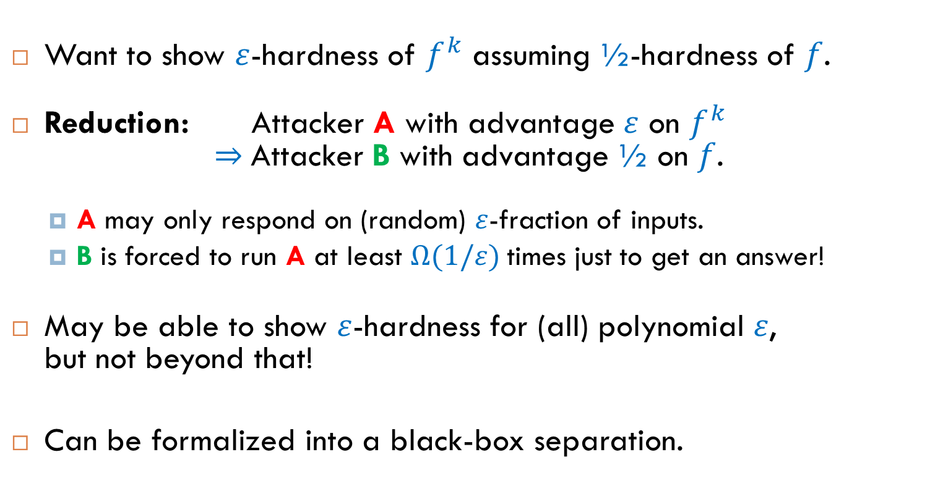
Difficult to prove “dream” DP Theorem
[Rudich]
Want to show $ε$-hardness of $f^{k}$ assuming ½-hardness of $f$.
Reduction: Attacker A with advantage $ε$ on $f^{k}$ $⇒$Attacker B with advantage ½ on $f$.
A may only respond on (random) $ε$-fraction of inputs.
B is forced to run A at least $Ω(1/ε)$times just to get an answer!
May be able to show $ε$-hardness for (all) polynomial $ε$, but not beyond that!
Can be formalized into a black-box separation.

Slide 8
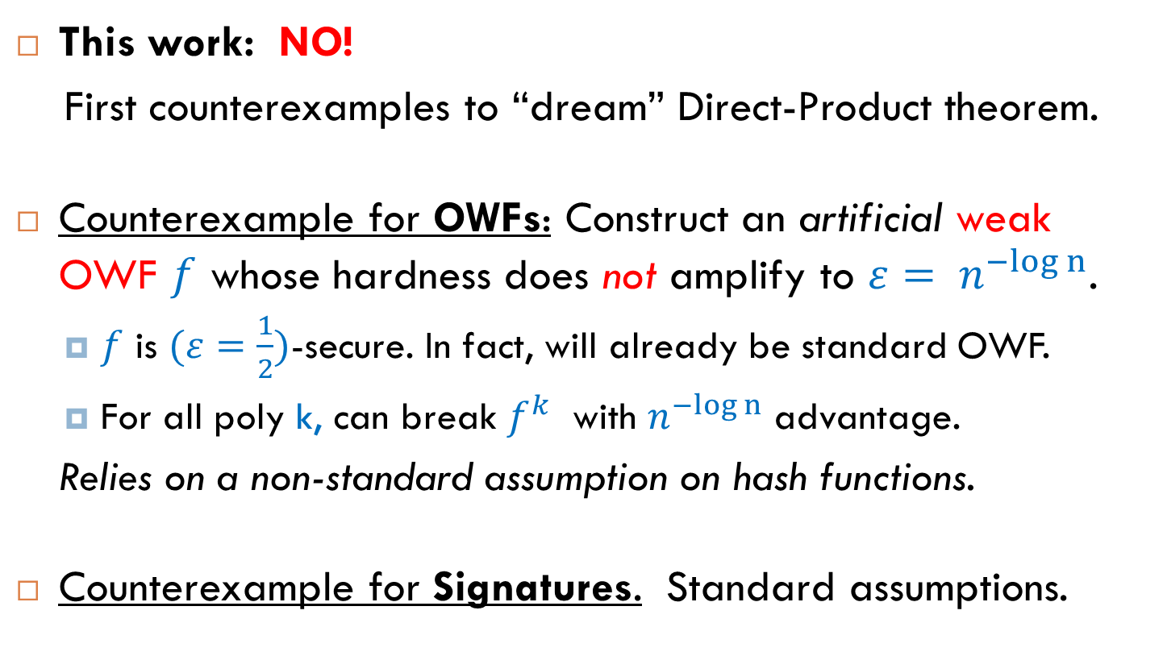
Is “dream” DP Theorem true?
This work: NO!
First counterexamples to “dream” Direct-Product theorem.
Counterexample for OWFs: Construct an artificial weak OWF $f$ whose hardness does not amplify to $ε= n^{−log n}$.
$f$ is $(ε=\frac{1}{2})$-secure. In fact, will already be standard OWF.
For all poly k, can break $f^{k}$ with $n^{−log n}$ advantage.
Relies on a non-standard assumption on hash functions.
Counterexample for Signatures. Standard assumptions.

Slide 9
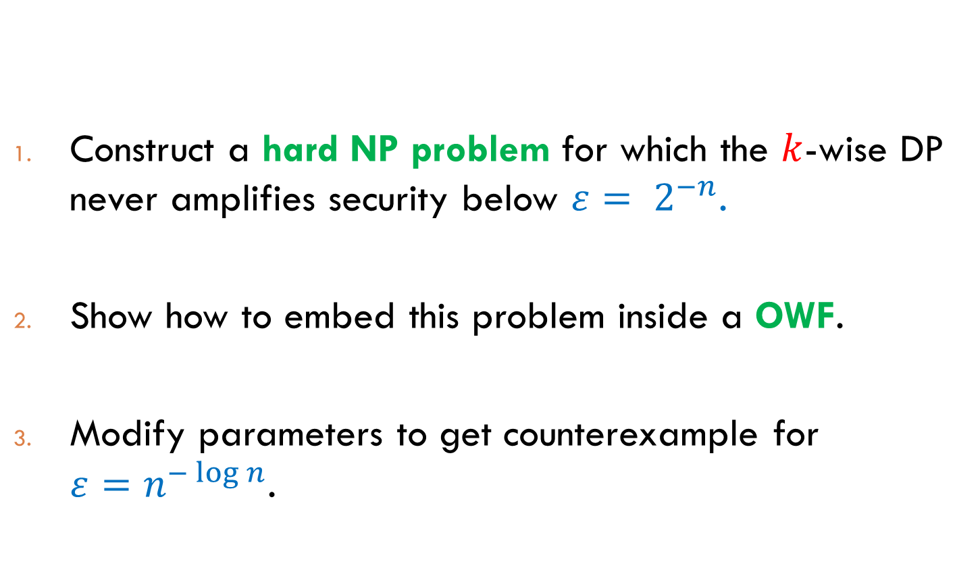
Counterexample for OWFs
Construct a hard NP problem for which the $k$-wise DP never amplifies security below ${ε= 2}^{−n}$.
Show how to embed this problem inside a OWF.
Modify parameters to get counterexample for ${ε=n}^{−\log{n}}$.

Slide 10






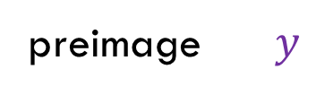
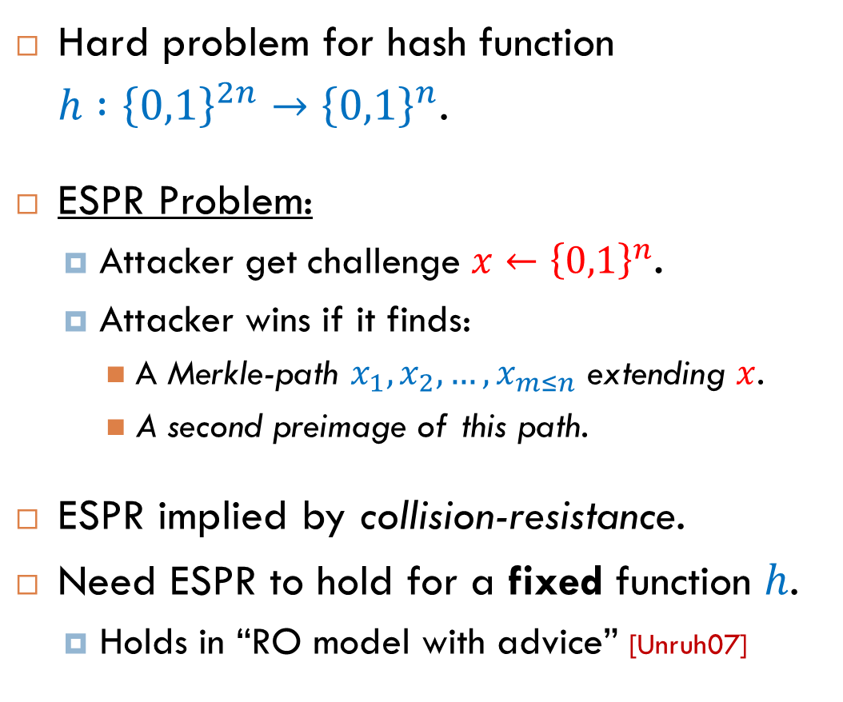

Extended Second-Preimage Resistance
output $z$
Hard problem for hash function
$h :{\left\{0,1\right\}}^{2n}→{\left\{0,1\right\}}^{n}$.
ESPR Problem:
Attacker get challenge $x←{\left\{0,1\right\}}^{n}$.
Attacker wins if it finds:
A Merkle-path $x_{1},x_{2},…, x_{m≤n}$ extending $x$.
A second preimage of this path.
ESPR implied by collision-resistance.
Need ESPR to hold for a fixed function $h$.
Holds in “RO model with advice” [Unruh07]
h
preimage $y$
$$x_{4}$$
h
h
$$x_{3}$$
: $y^{′}≠y$ ss.t..t. $h\left(y^{′}\right)=z$..
h
$$x_{2}$$
$$x_{1}$$
$$x$$

Slide 11




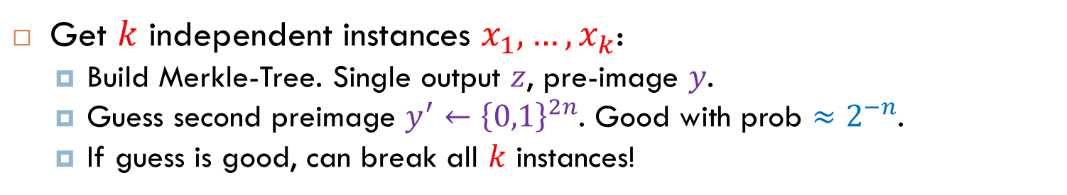






ESPR Does Not Amplify
Get $k$ independent instances $x_{1},…,x_{k}$:
Build Merkle-Tree. Single output $z$, pre-image $y$.
Guess second preimage $y^{′}←{\left\{0,1\right\}}^{2n}$. Good with prob $≈2^{−n}$.
If guess is good, can break all $k$ instances!
$$z$$
h
h
$$y$$
h
h
h
h
h
$$x_{1}$$
$$x_{2}$$
$$x_{3}$$
$$x_{4}$$
$$x_{5}$$
$$x_{6}$$
$$x_{7}$$
$$x_{8}$$

Slide 12


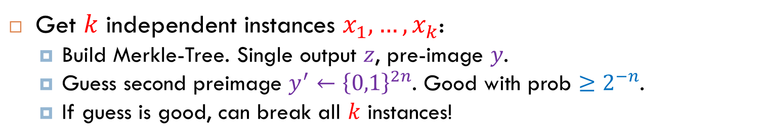

ESPR Does Not Amplify
Get $k$ independent instances $x_{1},…,x_{k}$:
Build Merkle-Tree. Single output $z$, pre-image $y$.
Guess second preimage $y^{′}←{\left\{0,1\right\}}^{2n}$. Good with prob $≥2^{−n}$.
If guess is good, can break all $k$ instances!
$$z$$
h
$$h(…)$$
$$y$$
h
h
$$h(x_{7},x_{8})$$
$$x_{5}$$
$$x_{6}$$

Slide 13
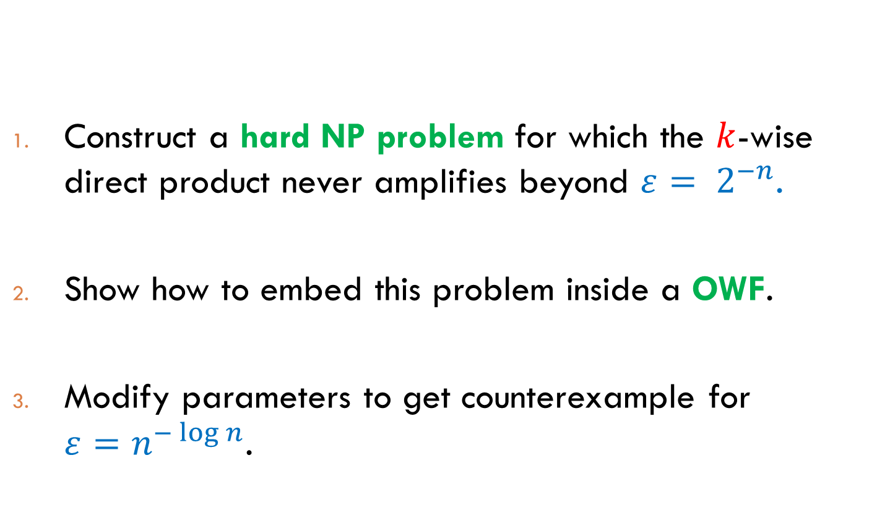
Counterexample for OWFs
Construct a hard NP problem for which the $k$-wise direct product never amplifies beyond ${ε= 2}^{−n}$.
Show how to embed this problem inside a OWF.
Modify parameters to get counterexample for ${ε=n}^{−\log{n}}$.

Slide 14
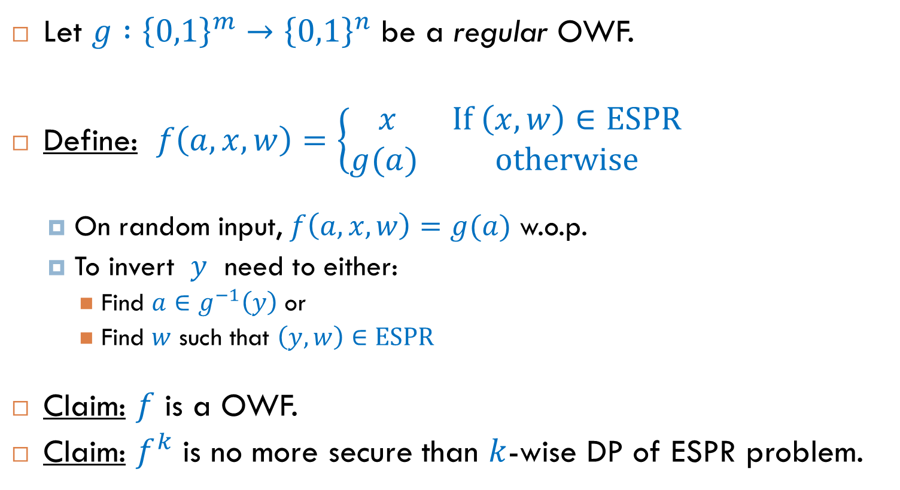
Embed ESPR Problem in OWF
Let $g :{\left\{0,1\right\}}^{m}→{\left\{0,1\right\}}^{n}$ be a regular OWF.
Define: $f\left(a,x,w\right)=\left\{\begin{matrix} x & \text{If} \left(x,w\right)∈\text{ESPR} \\ g(a) & \text{otherwise}\end{matrix}\right.$
On random input, $f\left(a,x,w\right)=g(a)$ w.o.p.
To invert $y$ need to either:
Find $a∈g^{−1}\left(y\right)$ or
Find $w$ such that $\left(y,w\right)∈\text{ESPR}$
Claim: $f$ is a OWF.
Claim: $f^{k}$ is no more secure than $k$-wise DP of ESPR problem.

Slide 15
Counterexample for OWFs
Construct a hard NP problem for which the $k$-wise direct product never amplifies beyond ${ε= 2}^{−n}$.
Show how to embed this problem inside a OWF.
Modify parameters to get counterexample for ${ε=n}^{−\log{n}}$.

Slide 16
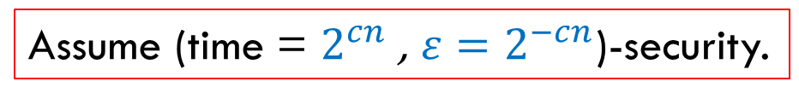
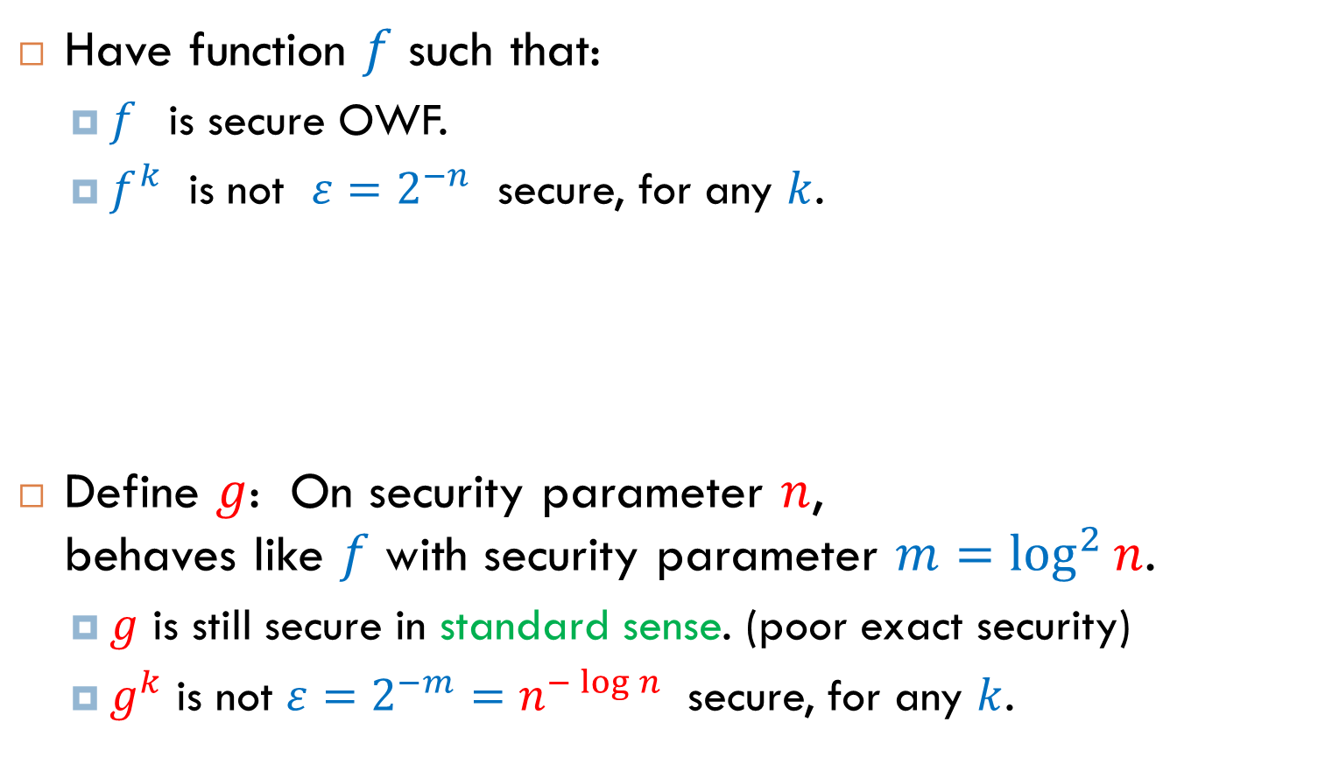
Counterexample for OWFs
Have function $f$ such that:
$f$ is secure OWF.
$f^{k}$ is not $ε=2^{−n}$ secure, for any $k$.
Define $g$: On security parameter $n$, behaves like $f$ with security parameter $m=\log^{2}{n}$.
$g$ is still secure in standard sense. (poor exact security)
$g^{k}$ is not $ε=2^{−m}=n^{−\log{n}}$ secure, for any $k$.
Assume (time = $2^{cn}$ , $ε=2^{−cn}$)-security.
Scale Down

Slide 17
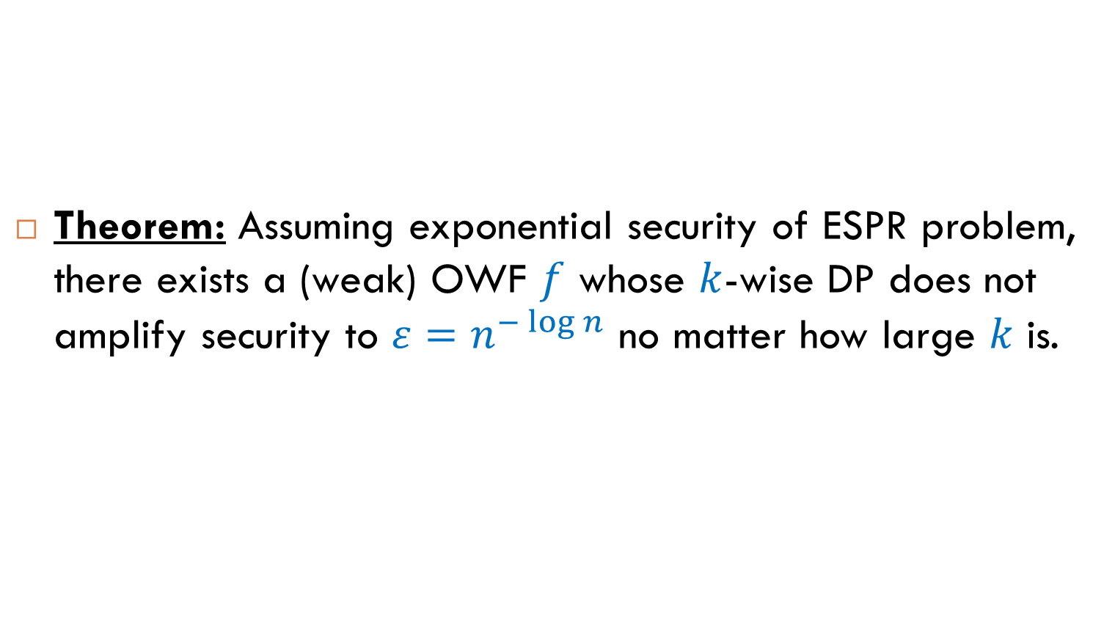
Counterexample for OWFs
Theorem: Assuming exponential security of ESPR problem, there exists a (weak) OWF $f$ whose $k$-wise DP does not amplify security to $ε=n^{−\log{n}}$ no matter how large $k$ is.

Slide 18
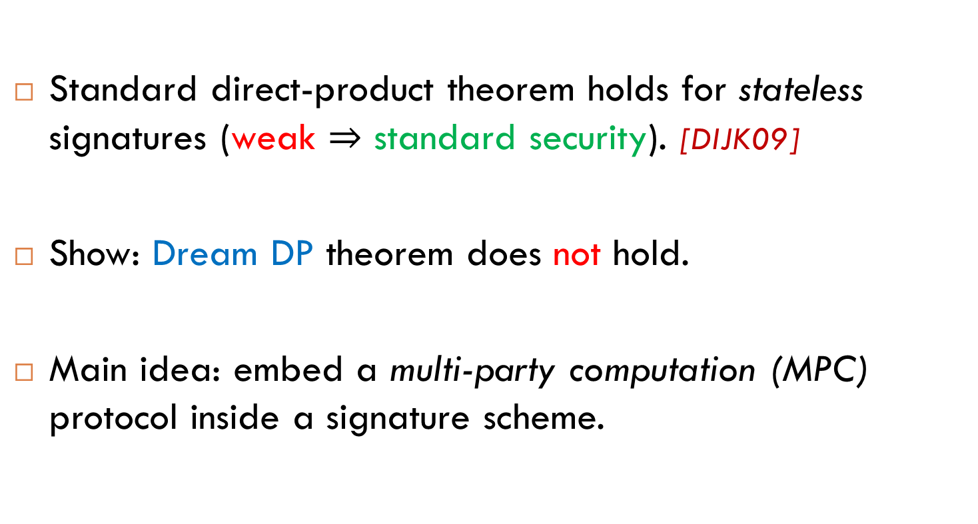
Counterexample for Signatures
Standard direct-product theorem holds for stateless signatures (weak $⇒$ standard security). [DIJK09]
Show: Dream DP theorem does not hold.
Main idea: embed a multi-party computation (MPC) protocol inside a signature scheme.

Slide 19

Toy Example: Stateful Signatures
Take any signature scheme, and a multi-party coin-tossing protocol $Π$.
Modify signature algorithm. On message m:
Sign m using original scheme.
If m = “init_prot: parties=$k$, role=$P_{i}$” begin executing $k$ party protocol $Π$ acting as party $P_{i}$. (stateful)
For future m, run $P_{i}$ on m and append output to the signature.
If $Π$ terminates with output $0^{n}$: output sk with signature.
Stand-alone scheme is secure.
Attacker can’t cause execution of $Π$ to output $0^{n}$.

Slide 20




Toy Example: Stateful Signatures
To break $k$-wise DP, pass messages between the $k$ signing oracles to execute a single (honest) instance of $Π$.
With probability $2^{−n}$ can break all instances!
$$Sign_{sk_{1}}(⋅)$$
$$Sign_{sk_{2}}(⋅)$$
$$Sign_{sk_{k}}(⋅)$$
…

Slide 21
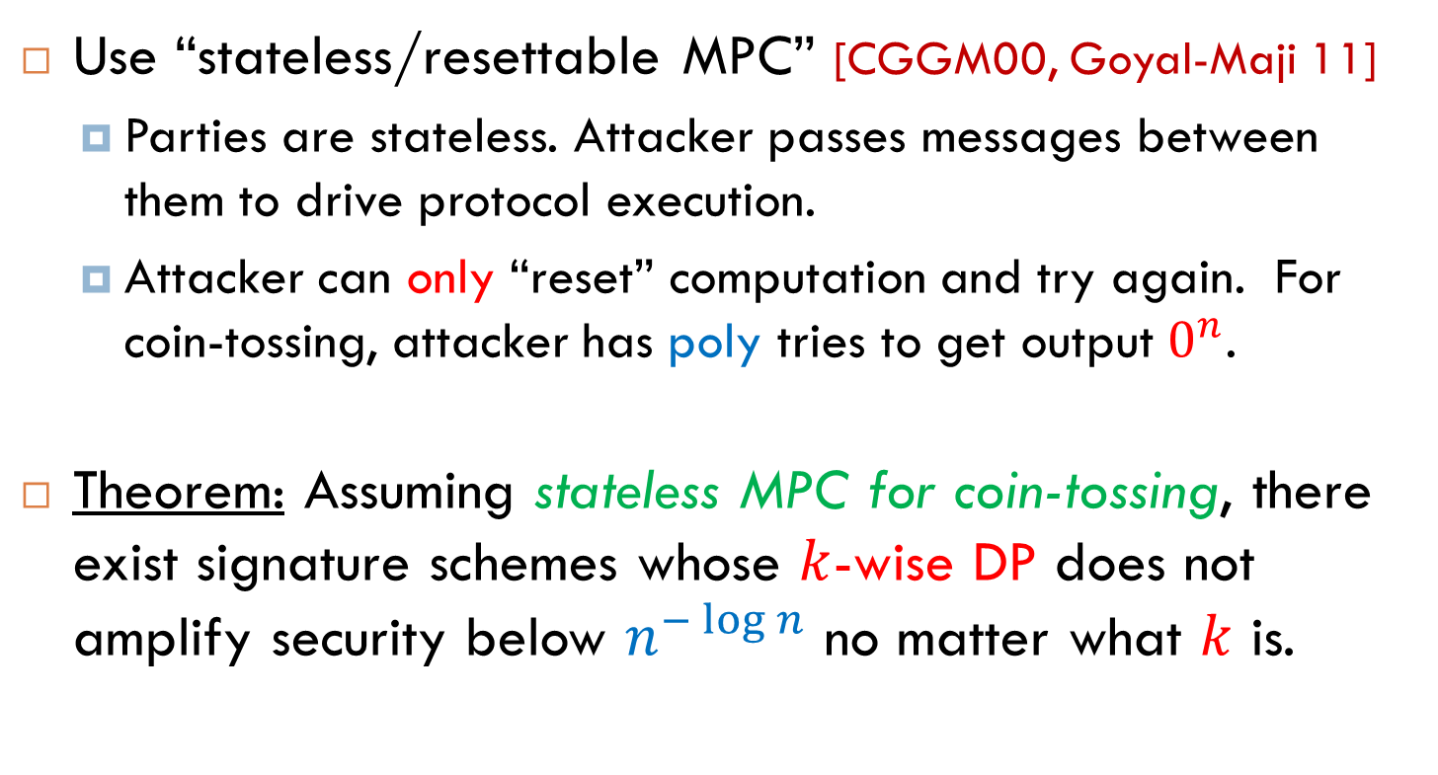
Stateful to Stateless Signatures
Use “stateless/resettable MPC” [CGGM00, Goyal-Maji 11]
Parties are stateless. Attacker passes messages between them to drive protocol execution.
Attacker can only “reset” computation and try again. For coin-tossing, attacker has poly tries to get output $0^{n}$.
Theorem: Assuming stateless MPC for coin-tossing, there exist signature schemes whose $k$-wise DP does not amplify security below $n^{−\log{n}}$ no matter what $k$ is.

Slide 22
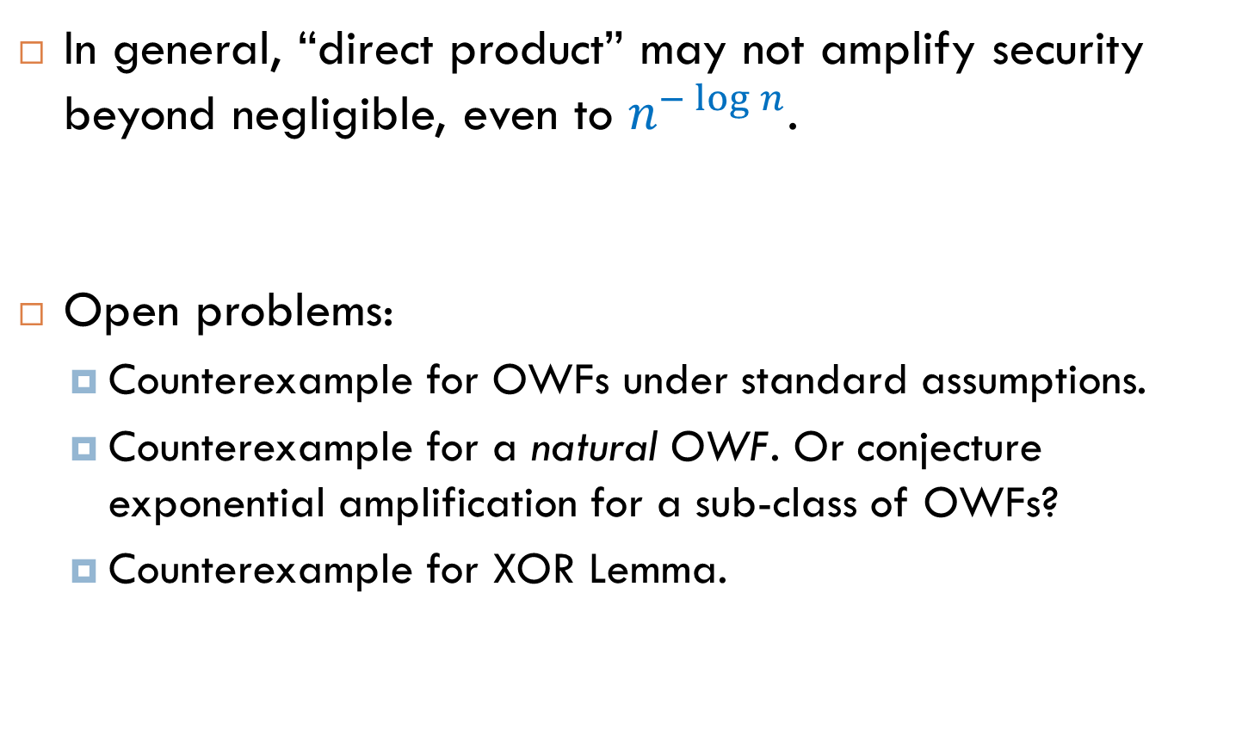
Conclusions
In general, “direct product” may not amplify security beyond negligible, even to $n^{−\log{n}}$.
Open problems:
Counterexample for OWFs under standard assumptions.
Counterexample for a natural OWF. Or conjecture exponential amplification for a sub-class of OWFs?
Counterexample for XOR Lemma.

Slide 23
THANK YOU

