Slide 1
Following the Carrot: Heart-Focused Game Development for Kids
Master’s Final Project Presentation
Spring 2011
Ian McDowell
Daniel Perry

Slide 2


The Problem
Children are tuning out
Notes:
8% of children ages 3 -17 are diagnosed with attention deficit disorder
Classrooms are overcrowded with limit greater distractions
Federal funding has been cut for numerous programs to help children manage their attention and learn

Slide 3
Project Purpose
Develop a bio-feedback game that is enjoyable and fun while teaching methods of emotional management that are helpful for learning and focus within the classroom.

Slide 4
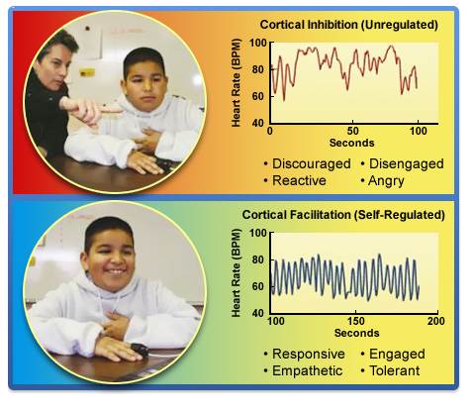
Why Bio-feedback
Notes:
SCHOOLS ARE TRYING A VARIETY A RANGE OF METHODS SUCH AS PEACE CORNERS (one calss kid directed) AND HOWS MY ENGINE RUNNING (school wide initiative emotional training check in with how I’m feeling) AND SOME SCHOOLS ARE TRYING BIOFEEDBACK Studies show that 3rd grade class in N. California student proficiency grew in English –language arts increased 21% points and in Math 11%points
Types of bio-feedback, EEG galvanic skin response
We chose HRV because reliable and non-invasive

Slide 5
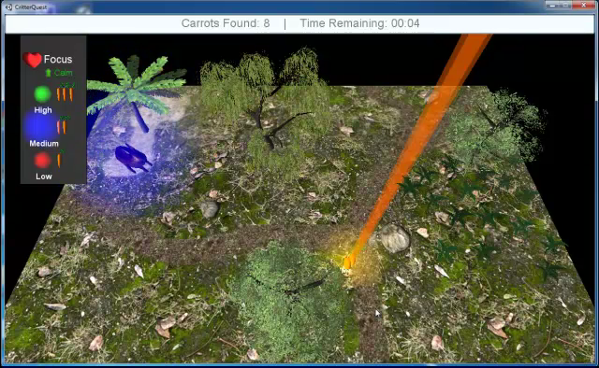
Game Demo
Notes:
Explain colors, speed, choice, focus

Slide 6
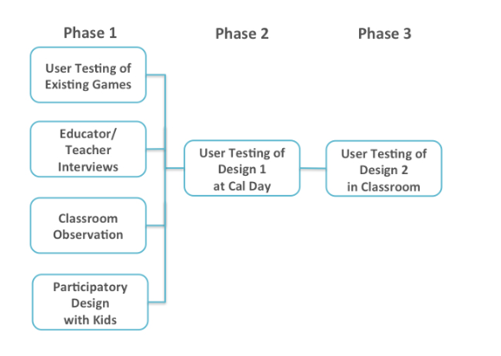
Our Methods
Notes:
Our approach: Review the current state of games, learn more about the current classroom environment, then use what we learned to guide a participatory design session.
Test, iterate, retest.

Slide 7

Educator Interviews
Image From: http://www.flickr.com/photos/nshepard/3845220/
CC BY-NC-ND 2.0
Notes:
Talked to teachers, school psychologist, education consultant, director of national program on violence prevention

Slide 8
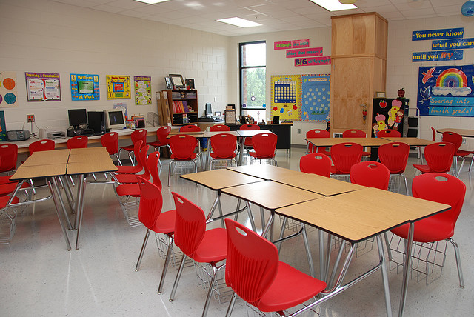
Classroom Observation
Image From: http://www.flickr.com/photos/besphotos/2702599176
CC BY-NC-SA 2.0

Slide 9
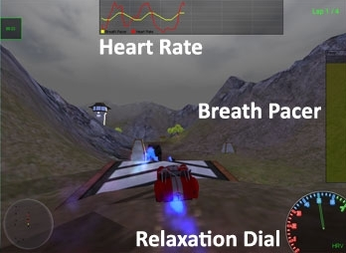
Testing Existing Games

Slide 10
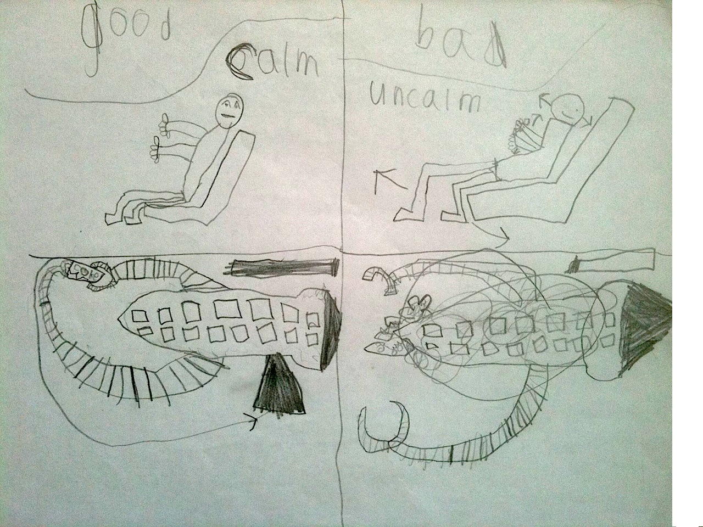
Participatory Design
Notes:
Choice in characters, Free form Exploration, collection theme as being rewarding, some not so great – dogs kill you

Slide 11
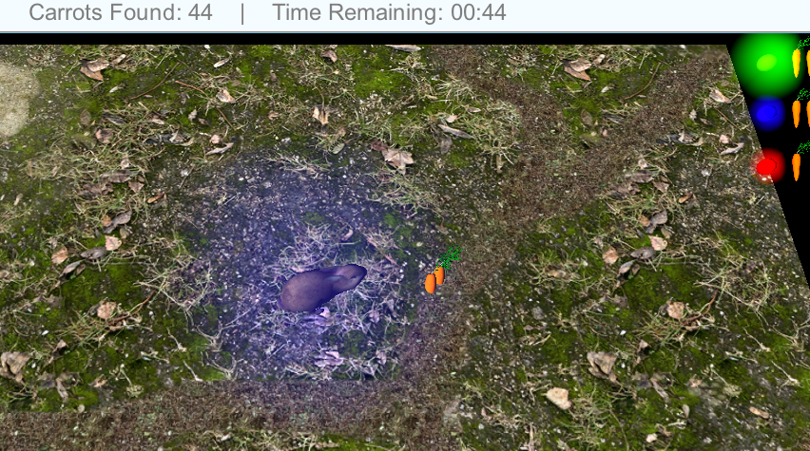
CalDay Testing

Slide 12
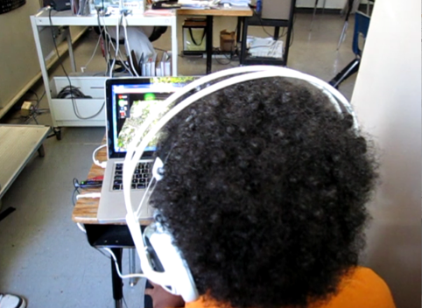
In-Classroom Testing

Slide 13
Findings – Classrooms & Educators
Technology varied
Training necessary but problematic
Existing self-regulation programs
Reward not punish
Sessions need to be short
Notes:
4 Teachers, education consultant, school psychologist, director of federally funded program on violence prevention.

Slide 14

Findings - Children
Simple Controls Work
Clear feedback on performance
Choice was important
Reward not Punish
Narrative and Ambiance
Kids Got It
Notes:
Simple Controls: Testing existing games “driving” – our game has minimal input but no one found it boring
Feedback: Existing games kids didn’t know how they were doing. Color schemes didn’t always make sense. Clear hierarchy of the levels, fine-grained feedback.
Choice: participatory design. CalDay wanted to be able to choose more animals, Kids were clearly excited about choice in demo
Reward: Lay out that can reward or punish. One of the games punished and made kids frustrated. Echoes educators opinions.
Narrative: Participatory design, kids had strong stories about their games. CalDay kids wanted sound and music.

Slide 15
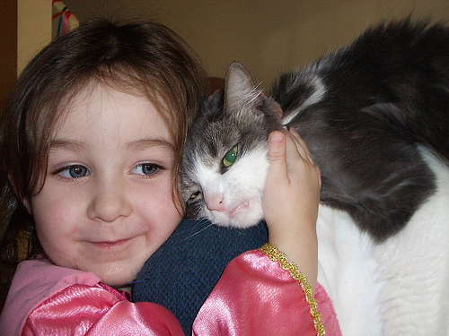
Findings - Children
Kids Love Animals
Image From http://www.flickr.com/photos/shoppingdiva/74242089/
CC BY-ND-NC 2.0
Notes:
Mostly understood the feedback system
Good performance.
A few that had more trouble getting going, the game was not providing enough help.

Slide 16
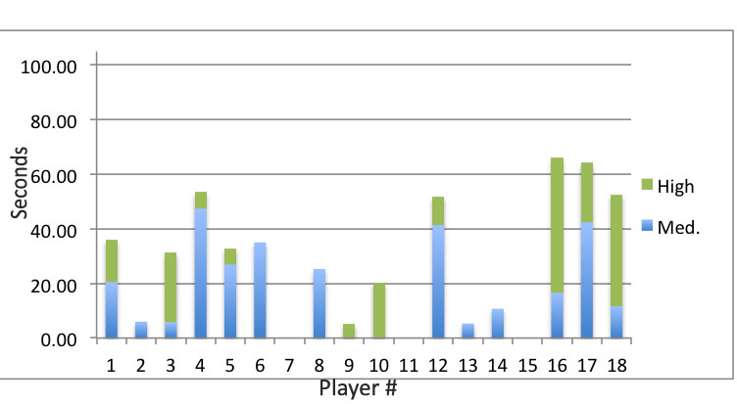
Final Results
Notes:
That the KIDS DID GET IT, THAT ANYWHERE THERE IS A BAR THEY ‘GOT IT’ 89% of students were able to obtain medium to high coherence. Reiterate 2 minute findings.

Slide 17
Testing Results
“I would try different emotions, and it would change when I did that.” – Ryan, age 12
Short sessions, but a surprising amount of success
Self-guidance seemed to work well - everyone was able to play without assistance
Notes:
We didn’t do actual test score CORRELATION analysis, could be for a future test. Give transition to Dan on “two conclusions”

Slide 18
Implications for Design
Guide for future game development in education:
Engage diverse stakeholders early on
Use multi-method process to triangulate key design decisions
Iteration is good
Location, location, location.

Slide 19

Questions?

