Slide 1
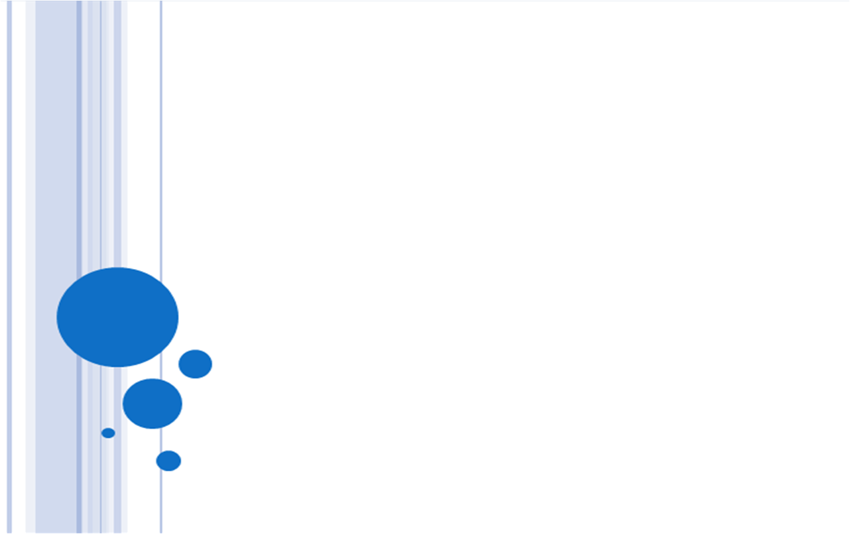
Bars Removal by Multiview Images
-- 6.865 Final Project
Team: YiChang Shih
Hsin-Jung Yang
Date: 05/11/2011

Slide 2
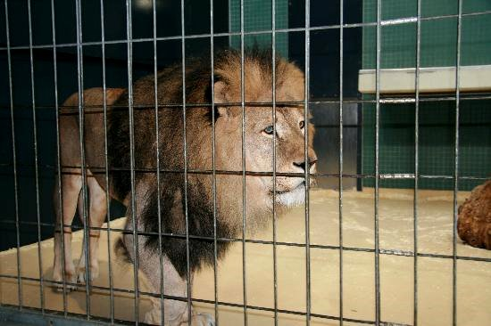
Removing Bars from Multiview
Bars are annoying
You can’t put your hand in the bars
Remove bars from multiview images
Bars

Slide 3
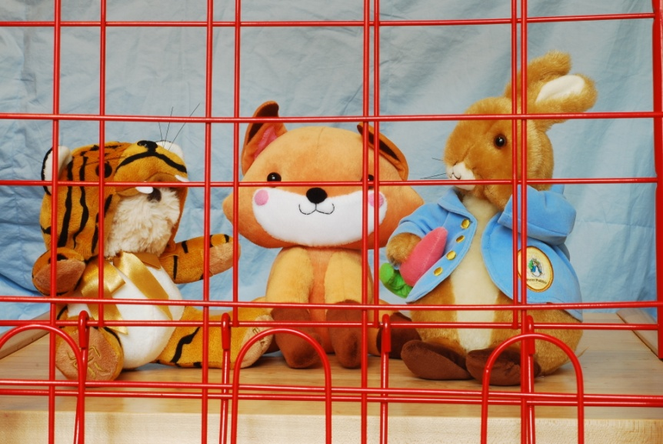
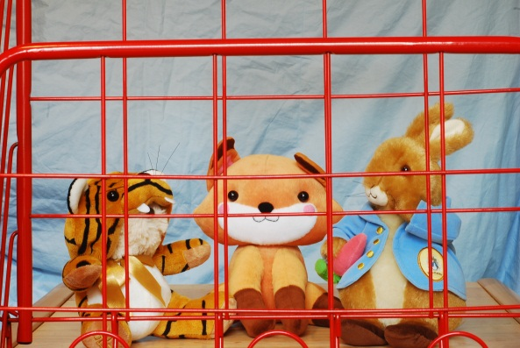
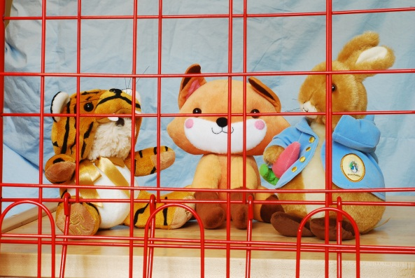
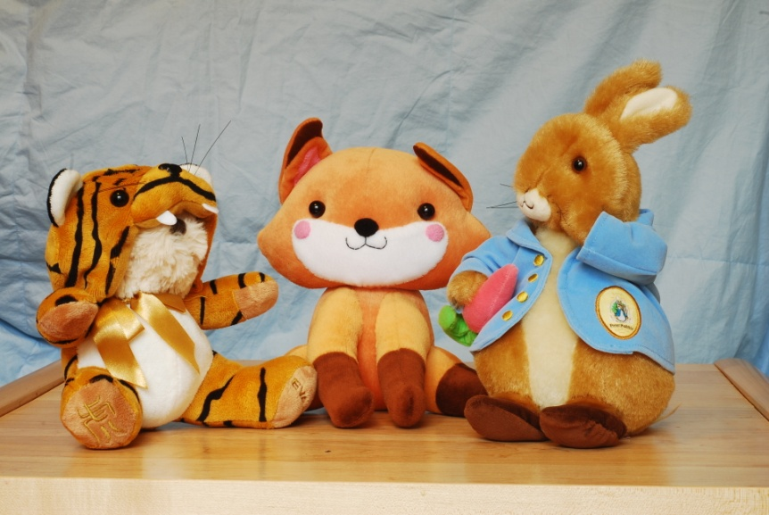
A Toy Example
view1
view2
view3

Slide 4
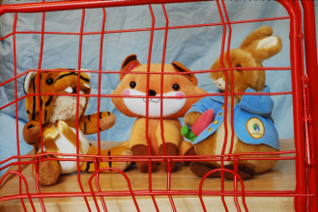
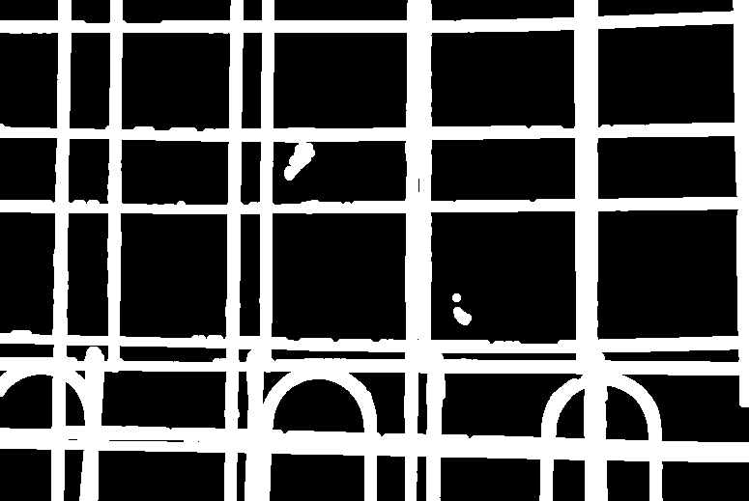
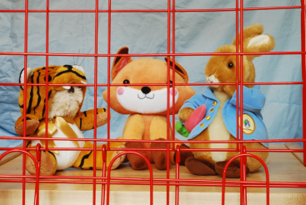
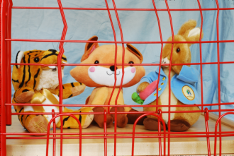
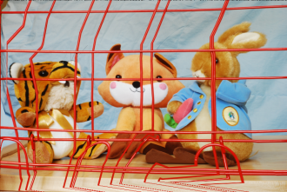
Algorithm Overview
Bar
Segmentation
Image Alignment
Patch Matching
SIFT Feature Matching
Feature Selection
Warping
Bar Mask
Reference Image
Aligned Images

Slide 5
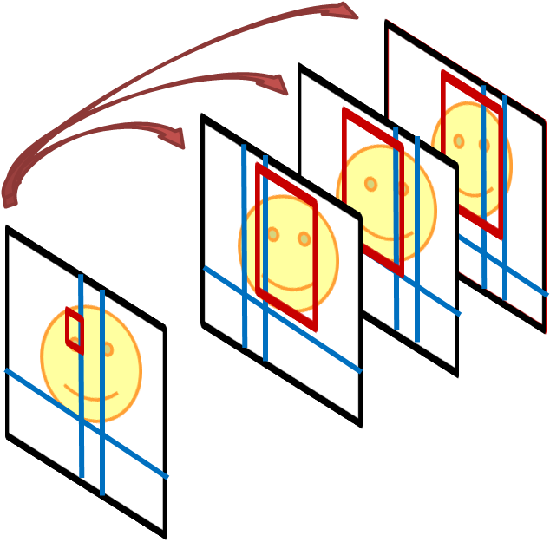
Patch Matching
Aligned images
source image patch
Min SSD Selection
Reference Image
replace pixel

Slide 6
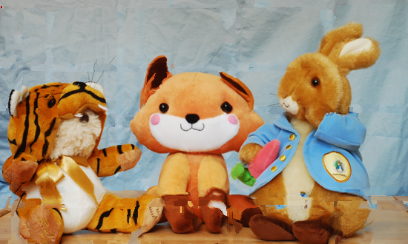
Result ( use 4 views)
Reference Image
Our Result
Ground Truth

Slide 7
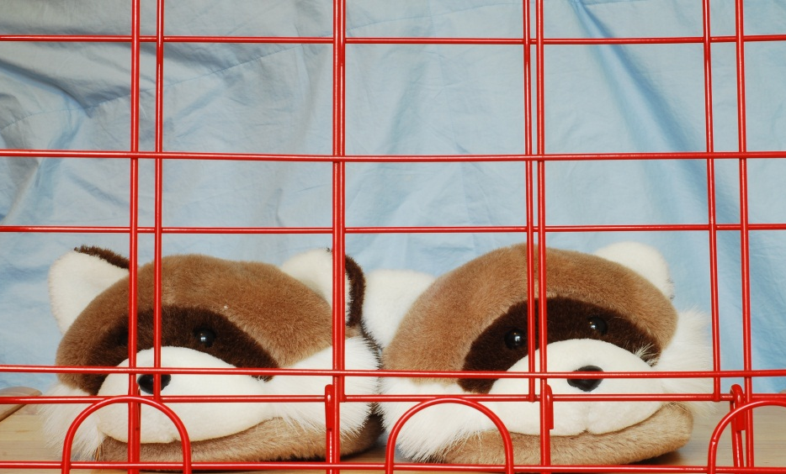
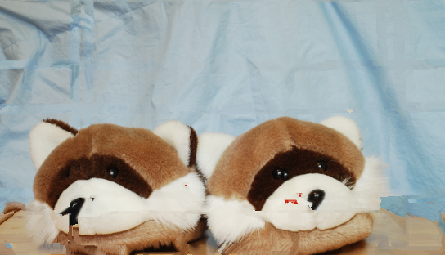
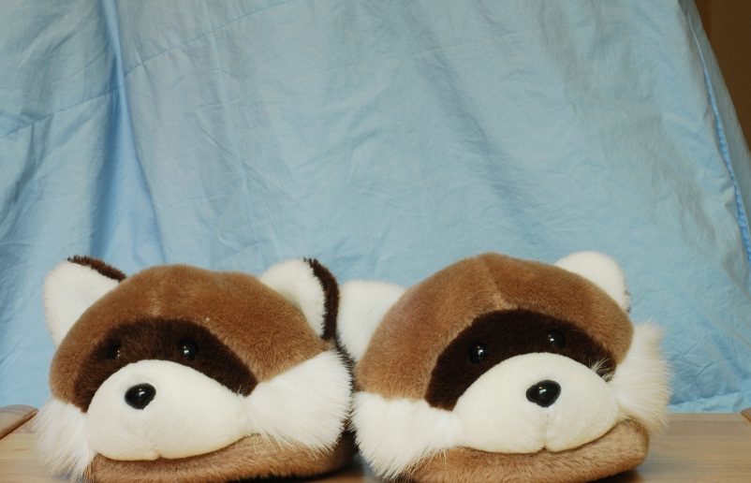
Result 2 ( Use 3 views)
Reference
Image
Our Result
Ground Truth

Slide 8

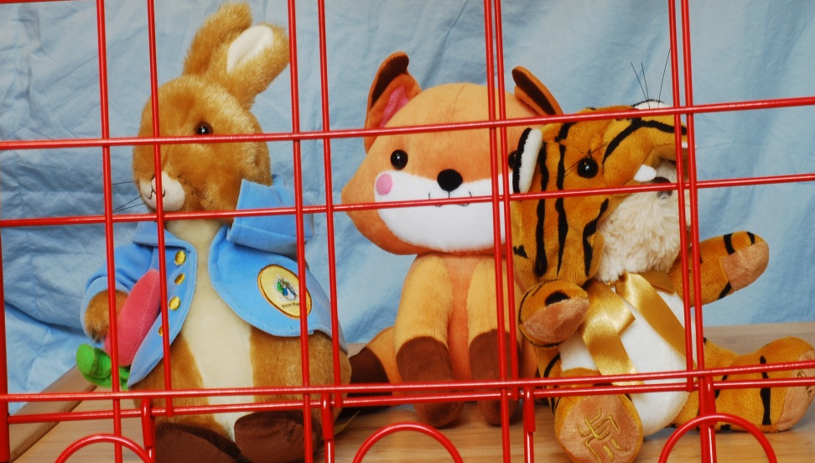
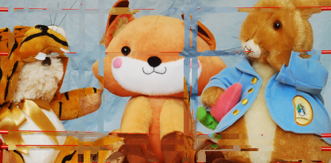
Non-static scene
view1
view2
Result

