Slide 1
Proving Acceptability Properties of Relaxed Nondeterministic Approximate Programs
Michael Carbin
Deokhwan Kim, Sasa Misailovic, and Martin C. Rinard

Slide 2
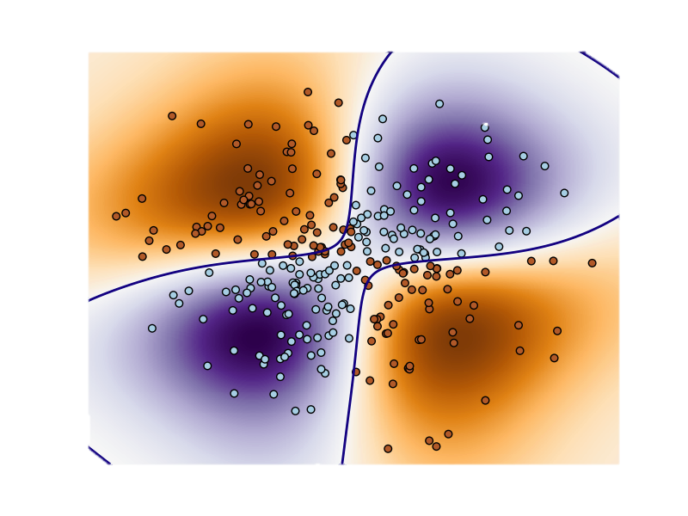


Approximate Computing
Media Processing, Machine Learning, Search
Notes:
Change center picture to something else

Slide 3


Solution Space: Accuracy versus Cost
100%
Highly Accurate,
Expensive
Accuracy
Less accurate,
Inexpensive
0%
Time/Resources/Cost

Slide 4
Standard Program
100%
Accuracy
One point in tradeoff space
0%
Time/Resources/Cost
Notes:
What I mean by approximation is there is larger space of potential solutions to a problem, each with differing accuracy versus cost, where cost is in terms of time, or power, or storage. A developer’s task is often to identify some set of solutions that gives the majority of the accuracy for some given or reasonable amount of time.

Slide 5
How Do I Access Other Points in Tradeoff Space?

Slide 6
Approximate Program Transformations
Task Skipping (Rinard ICS ‘06)
Loop Perforation (Misailovic, Hoffmann, Sidiroglou, Rinard MIT-TR ’09; ICSE’10; SAS’11; FSE’11).
Dynamic Knobs (Hoffmann, Sidiroglou, Carbin, Misailovic, Rinard ASPLOS’11)
Function Substitution (Zhu, Misailovic, Kelner, Rinard POPL ’12)
Approximate Memories (Lui, Pattabiraman, Moscibroda, Zorn ASPLOS’11; Sampson, Dietl, Fortuna, Gnanapragasam, Ceze, Grossman PLDI ‘11)
Approximate Memoization (Chaudhuri, Gulwani, Lublinerman, NavidPour FSE ’11)
Statistical Parallelization (Misailovic , Kim, Rinard MIT-TR ’10,’12)
Notes:
Function Substitution (Zhu, Misailovic, Klener, Rinard POPL ’12)
Sampling Reductions (Zhu, Misailovic, Klener, Rinard POPL ’12)
Tasking skipping. Drop tasks that are part of large, distributed computations
Function Substitution. Substitute alternative approximate implementations of a function
Approximate Memoization. Return previously computed answers for inputs that are similar to things that we’ve seen before.

Slide 7
Relaxed Program
100%
Accuracy
Admits executions at multiple points in tradeoff space
0%
Time/Resources/Cost
Relaxed programs can dynamically and automatically adapt
Notes:
What I mean by approximation is there is larger space of potential solutions to a problem, each with differing accuracy versus cost, where cost is in terms of time, or power, or storage. A developer’s task is often to identify some set of solutions that gives the majority of the accuracy for some given or reasonable amount of time.

Slide 8
Loop Perforation
Profile program, find loops that take most time
Perforate the loops (skip some iterations)
for (i = 0; i < n; i++) { … }
Nondeterministically choose loop increment
relax s st (s == 1 || s == 2);
for (i = 0; i < n; i += s) { … }
Execute subset of loop iterations

Slide 9
Common Reaction
OK, I agree program should run faster
But you can’t do this because you’ll get the wrong result!

Slide 10
Our Response
OK, I agree program should run faster
But you can’t do this because you’ll get the wrong result!
You won’t get the wrong result
You’ll get a different result

Slide 11
We Tried It, And It Works! (ICSE 2010, FSE 2011)
Parsec Benchmark Suite
x264 (H.264 video encoding)
bodytrack
(human movement tracking)
swaptions (swaption pricing)
ferret (image search)
canneal
(digital circuit place and route)
blackscholes
(European option pricing)
streamcluster
(online point clustering)
Results
Performance improvement
Typically over a factor of two
Up to a factor of seven
Less than 10% change in output
But no guarantees…

Slide 12
What This Paper Is About
Expressing relaxed programs
Specifying acceptability of relaxed programs
Proving relaxed programs are acceptable

Slide 13
Key Insights
Relax statement introduces nondeterminism
Subject to a relaxation condition
Original and relaxed programs share structure
Use relational reasoning
To transfer specification/verification effort from original program to relaxed program

Slide 14
Methodology for Safe and Acceptable Relaxed Programs

Slide 15
Step #1: Develop a Program
100%
Accuracy
0%
Time/Resources/Cost
Notes:
What I mean by approximation is there is larger space of potential solutions to a problem, each with differing accuracy versus cost, where cost is in terms of time, or power, or storage. A developer’s task is often to identify some set of solutions that gives the majority of the accuracy for some given or reasonable amount of time.

Slide 16
Step #2: Define and Verify/Validate Acceptability
100%
Define safety and acceptable levels of accuracy
Accuracy
0%
Time/Resources/Cost

Slide 17
Defining Acceptable
Acceptability Properties
Safety
Integrity
Accuracy
Key: any implementation that satisfies the stated acceptability properties is acceptable
Notes:
Define acceptability better

Slide 18
Acceptability Specification
assert P: verified assertion
assume P: assumption
Original program: established through any means
Relaxed program: must be preserved
relate : relational assertion
Relates values in relaxed program to original

Slide 19
Example Acceptability Properties
Safety:
assert x != 0
assume x >= 0
Integrity:
relate y<r> == y<o>
Accuracy:
relate |z<r> - z<o>| <= .1 * z<o>
Notes:
Using a relational program logic opens of a new avenue to design and specify a wide range of relational acceptability properties for relaxed programs. These relate statement constraint the set of acceptable relaxations that may be applied.

Slide 20
Step #3: Relax Program
100%
Accuracy
Insert relax statements to introduce nondeterministic behaviors at other points
0%
Time/Resources/Cost
Notes:
TODO: Other color for introduced points
TODO: Function Substitution.

Slide 21
Relax Statement
relax (s) st (s == 1 || s == 2)
Modified Variables
Relaxation Predicate

Slide 22

Relaxed Program Semantics
Shared Structure, Two Semantics
Original semantics (relax statements have no effect)
Relaxed semantics (relax statements modify state)
Nondeterministic
Approximate
Notes:
TODO: change these colors

Slide 23
Step #4: Verify that Relaxation Preserves Acceptability
100%
Accuracy
Verify that
is a subset of
0%
Time/Resources/Cost
Notes:
What I mean by approximation is there is larger space of potential solutions to a problem, each with differing accuracy versus cost, where cost is in terms of time, or power, or storage. A developer’s task is often to identify some set of solutions that gives the majority of the accuracy for some given or reasonable amount of time.

Slide 24
How do we verify relaxed programs?
(Verification Strategies)
Notes:
How do we verify properties like these for relaxed programs in general?

Slide 25
Program Logic (Hoare Logic)
If we know P is true of the program, then after execution of s, Q is also true
{x = 1} x = x + 1 {x = 2}

Slide 26
Strategy #1: Verify Relaxed Program Outright
<...>
{ P(x, y) && Q(y) }
relax (x) st (true);
{ Q(y) }
<...>
{ R(x, y) && S(y)}
assert R(x, y) && S(y);
Lose P because x is modified
Prove both R and S
Note: relaxation doesn’t modify y
If S(y) is true in the original program, then it’s also true in relaxed
Notes:
As we can see, it’s entirely possible to verify the program outright. Let P, Q, and R be properties in first order logic describing states of the program. The relax statement has the semantics of a non-deterministic assignment

Slide 27
Relational Program Logic
{x<r> == x<o> && y<r> == y<o>}
relax (x) st (true);
{y<r> == y<o>}
Notes:
Keep track of relations between original and relaxed program.

Slide 28
Strategy #2: Relational Reasoning
<...>
{x<r> == x<o> && y<r> == y<o>}
relax (x) st (true);
{ y<r> == y<o> }
<...>
{R(x<r>, y<r>) && y<r> == y<o> }
assert R(x, y) && S(y) ;
x different but y the same
Only prove R
and y<r> == y<o>
If S(y<o>) is true
then S(y<r>) is true
Relational reasoning is the bridge
Notes:
FOCUS: Don’t need to restablish S(y).
This is great. Relational reasoning allows us to transfer properties we’ve proved of the original program to the relaxed program in cases where we do not interfere.

Slide 29
Guarantee: Relative Progress
Established through any means: verification, testing, code review
If original program satisfies all assertions, then
the relaxed program satisfies all assertions
Notes:
This addresses the key problem. Address how we can hope to verify large programs, because we can using whatever means necessary to verfy

Slide 30
Formalization
Notes:
We’ve formalized each of these three strategies

Slide 31
Language

Slide 32
Inference Rules

Slide 33
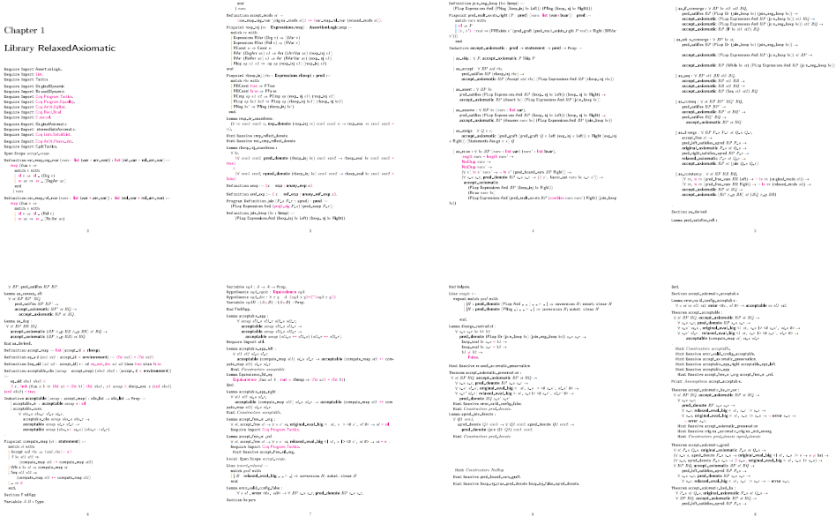
Coq Formalization
Notes:
Need to replace this slide. Original caused powerpoint to hang.

Slide 34
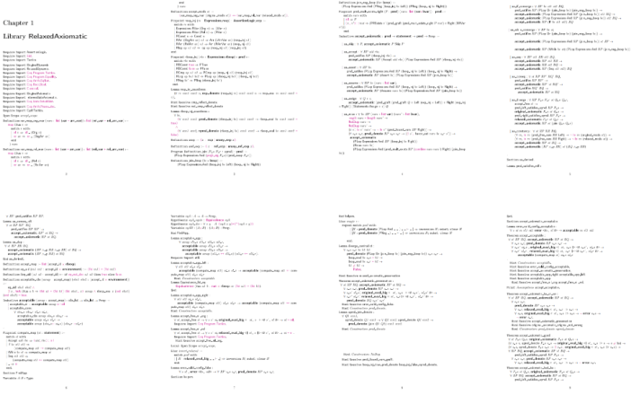
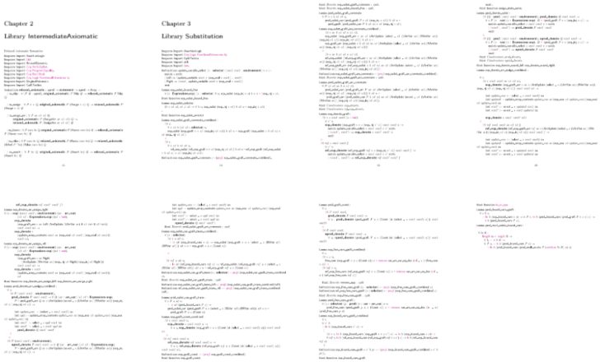
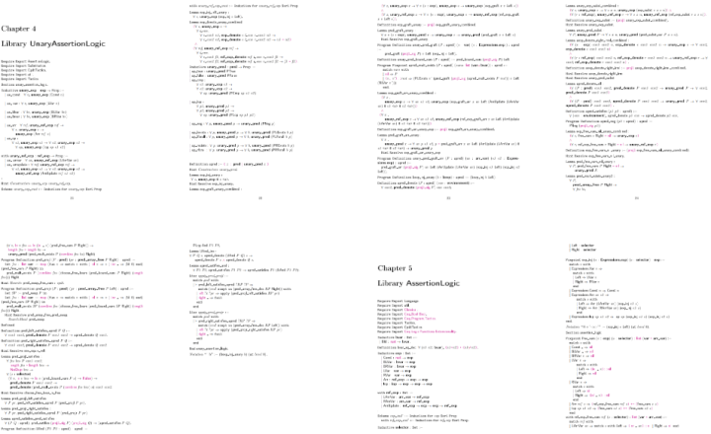
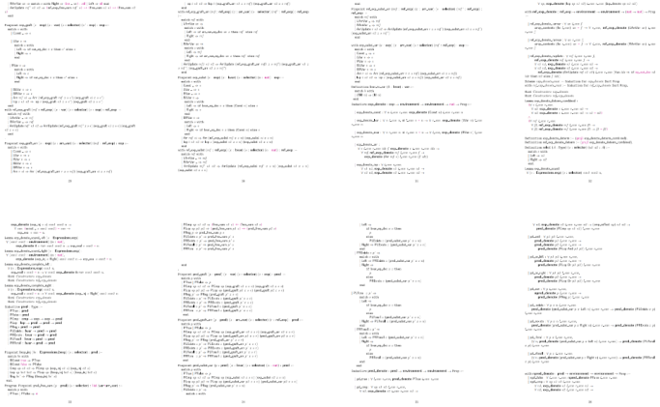
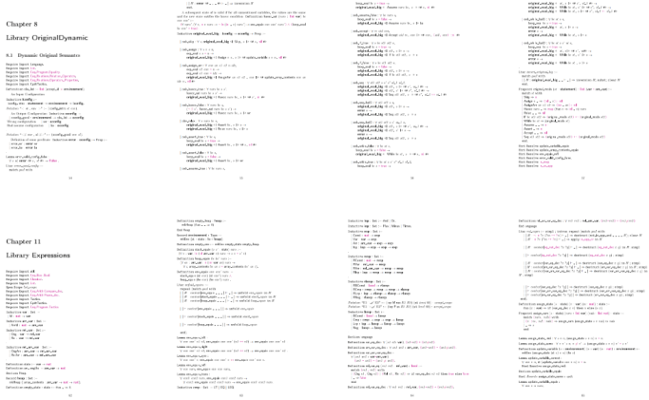
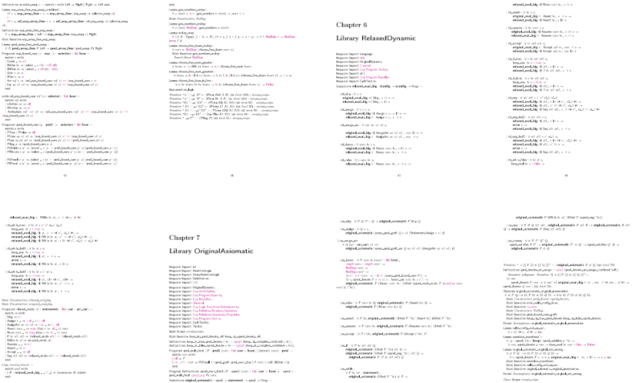
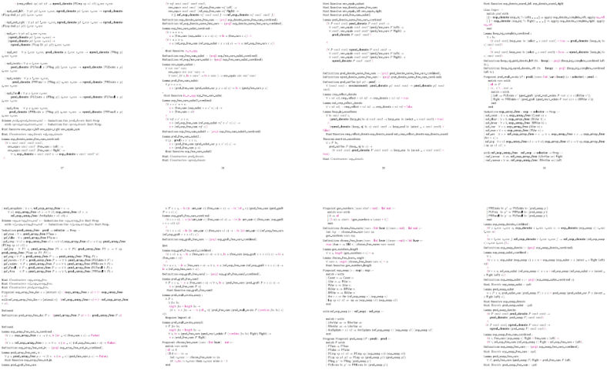
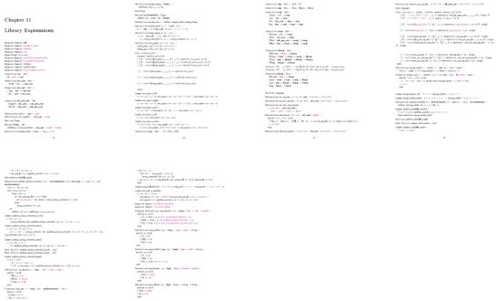
A Lot of Coq
Formalization is sound.
Relative progress guaranteed

Slide 35
Case Studies
Dynamic Knobs
Dynamically choose different implementations
Statistical Parallelization
Reduce synchronization of parallelized algorithm
Approximate Memory
Relax memory integrity of a stored matrix
In the paper!

Slide 36
Future Work (In Progress/Submission)
Termination
Relaxation may interfere
Relative termination perhaps powerful
Scalability
Larger language; verified with static analysis
Synthesizing Relaxations
Derive relaxations from acceptability properties

Slide 37
Related Work
Executable Specifications
Specification Statement (Morgan TOPLAS ‘88)
Relational Reasoning/Program Logics
Translation Validation (Pnueli TACAS ’98)
Relational Hoare Logic (Benton POPL ’04)
Developed for verifying traditional compiler optimizations – i.e., semantic equivalence
Safe Approximate Computations
Critical Region Identification (Carbin ISSTA ‘10)
EnerJ: Approximate Data Types (Sampson PLDI ’11)

Slide 38
Takeaway
Relaxation is a powerful technique
Increased performance
Reduced power
Dynamic adaptation
Relational reasoning is the key to verifying acceptability of relaxed programs
Notes:
Relaxation is a very powerful technique. We can achieve increase performance, reduced power, or dynamic adaption by adding very simple statements to the program. What we also hope to show in this work is that relational reasoning is the key to unlocking the power of relaxed programs because it allows us to transfer properties that we have established about the original program to the relaxed program without the need to duplicate all the effort we put into to prove these properties for the original program.

