Slide 1
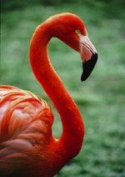
The Flamingo Software Package on Approximate String Queries
Chen Li
UC Irvine and Bimaple
http://flamingo.ics.uci.edu/

Slide 2
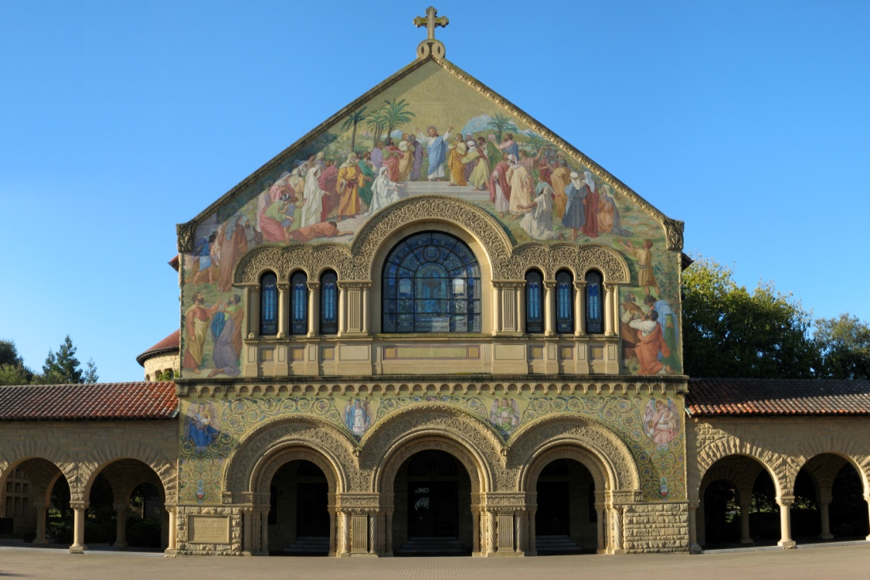
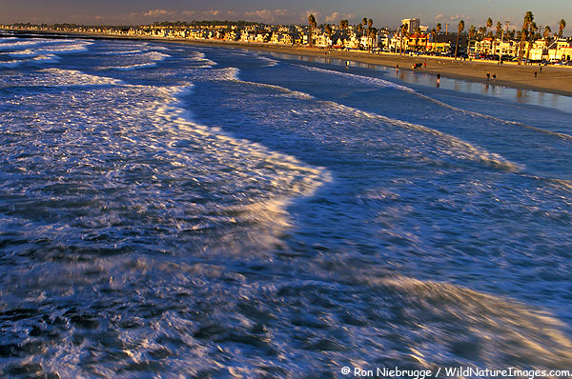


Personal Journey: 2001 …

Slide 3

Data Integration Problems?
Talking to medical doctors…

Slide 4
Example
Table R
Table S
Name | SSN | Addr
Jack Lemmon | 430-871-8294 | Maple St
Harrison Ford | 292-918-2913 | Culver Blvd
Tom Hanks | 234-762-1234 | Main St
… | … | …
Name | SSN | Addr
Ton Hanks | 234-162-1234 | Main Street
Kevin Spacey | 928-184-2813 | Frost Blvd
Jack Lemon | 430-817-8294 | Maple Street
… | … | …
Find records from different datasets that could be the same entity

Slide 5
Another Example
P. Bernstein, D. Chiu: Using Semi-Joins to Solve Relational Queries. JACM 28(1): 25-40(1981)
Philip A. Bernstein, Dah-Ming W. Chiu, Using Semi-Joins to Solve Relational Queries, Journal of the ACM (JACM), v.28 n.1, p.25-40, Jan. 1981

Slide 6
Challenges
How to define good similarity functions?
Many functions proposed (edit distance, cosine similarity, …)
Domain knowledge is critical
Names: “Wall Street Journal” and “LA Times”
Address: “Main Street” versus “Main St”
How to do matching efficiently

Slide 7
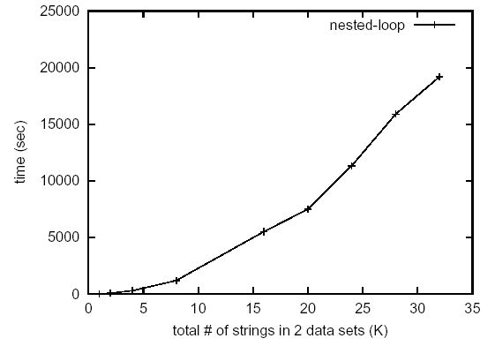
Nested-loop?
Not desirable for large data sets
5 hours for 30K strings! (in 2002)

Slide 8
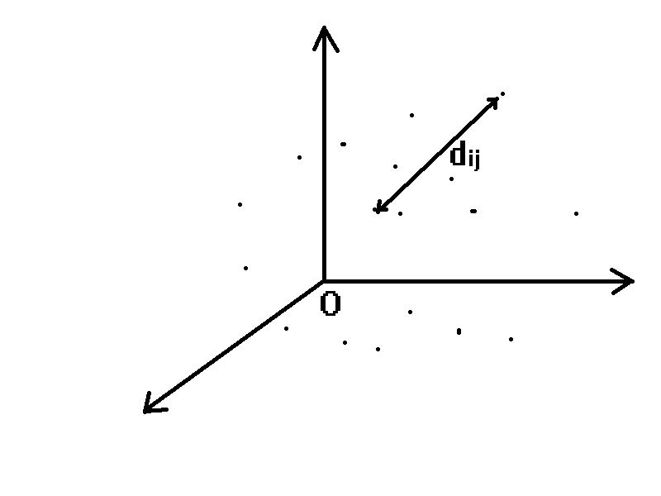
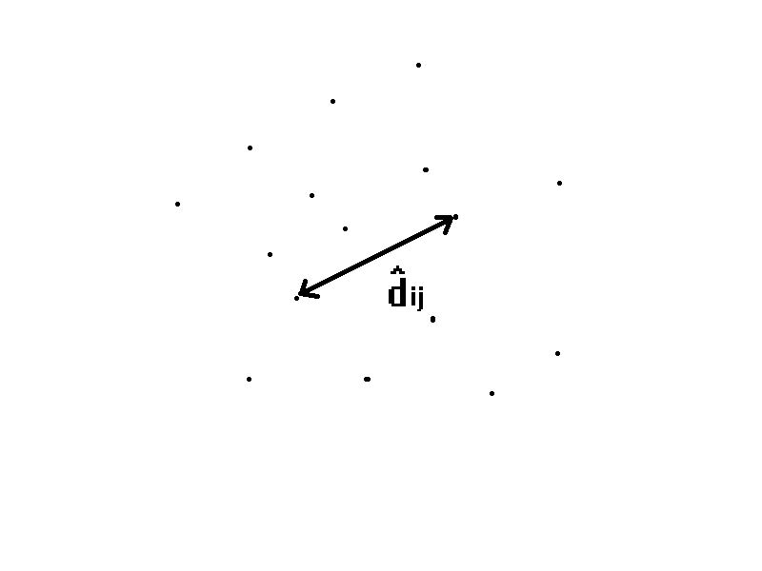

Our first attempt (DASFAA 2003)
- Map strings into a high-dimensional Euclidean space
- Do a similarity join in the Euclidean space
Metric Space
Euclidean Space

Slide 9
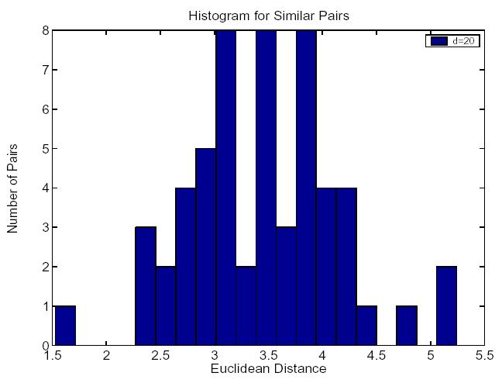
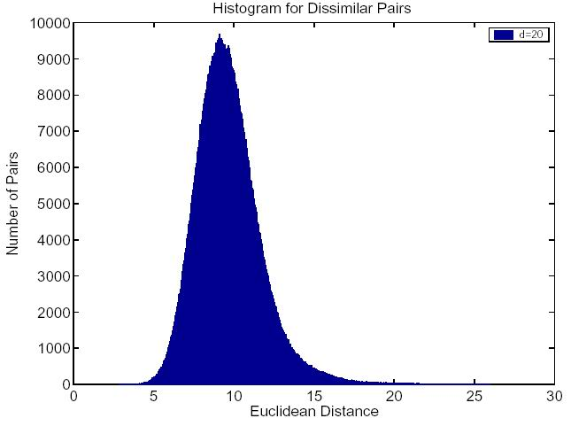
Can it preserve distances?
Use data set 1 (54K names) as an example
k=2, d=20
Use k’=5.2 to differentiate similar and dissimilar pairs.

Slide 10
2nd Problem: Selectivity Estimation
Input: fuzzy string predicate P(q, δ)
star SIMILARTO ’Schwarrzenger’
A bag of strings
Output: # of strings s that satisfy dist(s,q) <= δ

Slide 11
SEPIA: Intuition (VLDB 2005)
11

Slide 12
Story of “1-1-10-10”
1M strings in 1ms
10M strings in 10ms

Slide 13
String → Grams
q-grams
For example: 2-gram
u | n | i | v | e | r | s | a | l
(un),(ni),(iv),(ve),(er),(rs),(sa),(al)
13
Notes:
13

Slide 14
Inverted lists
Convert strings to gram inverted lists
at
ch
ck
ic
ri
st
ta
ti
tu
uc
4
0
2
id strings
0
1
2
3
4
rich
stick
stich
stuck
static
1
3
2-grams
0
1
2
4
0
1
2
3
4
4
1
2
4
3
3
14

Slide 15
Main Example
Query
ed(s,q)≤1
stick
(st,ti,ic,ck)
Data
Grams
Candidates
id | strings
0 | rich
1 | stick
2 | stich
3 | stuck
4 | static
ck
ic
st
ta
ti
…
1,3
1,2,4
0,
1,2,3,4
Merge
count >=2
4
1,2,4
15

Slide 16
Problem definition:
Merge
Ascending
order
Find elements whose occurrences ≥ T
16

Slide 17
Example
T = 4
1
3
5
10
13
10
13
15
5
7
13
13
15
Result: 13
17

Slide 18
Five Merge Algorithms (icde2008)
HeapMerger
[Sarawagi,SIGMOD 2004]
MergeOpt
[Sarawagi,SIGMOD 2004]
Previous
New
ScanCount
MergeSkip
DivideSkip
18

Slide 19
Story of “1-1-10-10”
1M strings in 1ms ➔ ☺
10M strings in 10ms
Next: VGRAM

Slide 20
Observation 1: dilemma of choosing “q”
Increasing “q” causing:
Longer grams → Shorter lists
Smaller # of common grams of similar strings
at
ch
ck
ic
ri
st
ta
ti
tu
uc
4
0
2
id strings
0
1
2
3
4
rich
stick
stich
stuck
static
1
3
2-grams
0
1
2
4
0
1
2
3
4
4
1
2
4
3
3

Slide 21
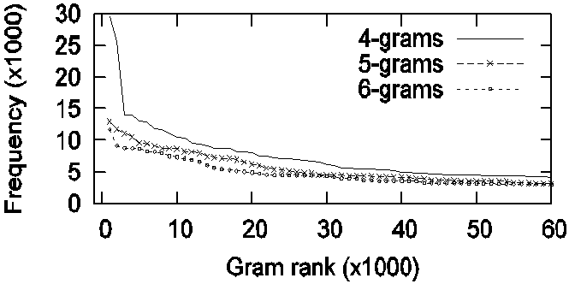
Observation 2: skew distributions of gram frequencies
DBLP: 276,699 article titles
Popular 5-grams: ation (>114K times), tions, ystem, catio

Slide 22
VGRAM: Main idea
Grams with variable lengths (between q_{min} and q_{max})
zebra
ze(123)
corrasion
co(5213), cor(859), corr(171)
Advantages
Reduce index size ☺
Reducing running time ☺
Adoptable by many algorithms ☺

Slide 23

Challenges
Generating variable-length grams?
Constructing a high-quality gram dictionary?
Relationship between string similarity and their gram-set similarity?
Adopting VGRAM in existing algorithms?

Slide 24
Story of “1-1-10-10”
1M strings in 1ms ➔ ☺
10M strings in 10ms
Challenge: large index size

Slide 25
Contributions (icde2009)
Proposed two lossy compression techniques
Answer queries exactly
Index fits into a space budget
Queries → faster on the compressed indexes ☺
Flexibility to choose space / time tradeoff
Existing list-merging algorithms: re-use + compression specific optimizations

Slide 26
Intuition of compression techniques
Merge
Ascending
order
Find elements whose occurrences ≥ T

Slide 27
Content of Flamingo Package
List mergers
SEPIA
Stringmap
Location-based fuzzy search
PartEnum (fuzzy join)
Fuzzy join using MapReduce
…

Slide 28
Development of Flamingo
C++
Contributors: 9 people (different times)
Four releases
Well received by various communities

Slide 29

Making an impact?

Slide 30
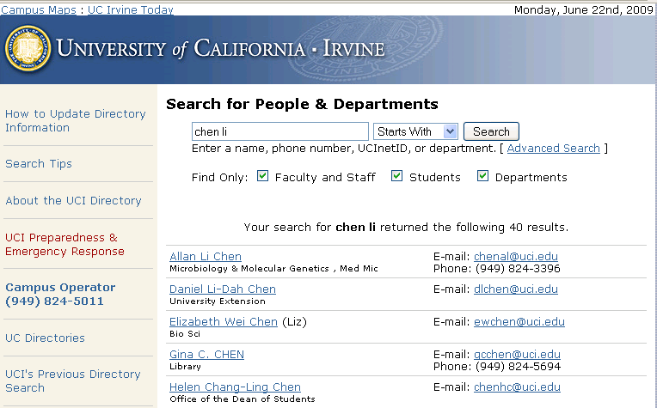
UCI People Search

Slide 31
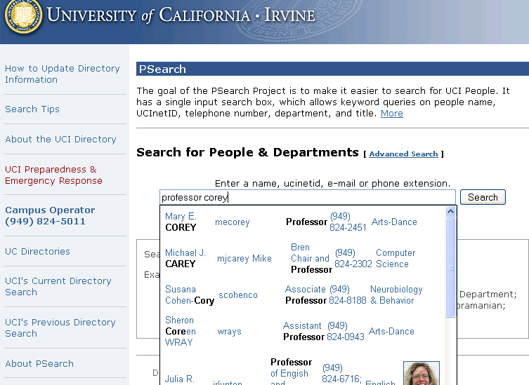
PSearch

Slide 32
Other systems built
iPubmed: http://ipubmed.ics.uci.edu
Location-based instant search
…
Started a company: Bimaple

Slide 33

Lessons learned
Hands-on experiences …

Slide 34
Lessons learned
Research management
Software development: code sharing
Tools: svn, wiki, etc.
Team environment
Research continuity

Slide 35
Lessons learned
Impact
Outreach activities

Slide 36
Thank you!
http://flamingo.ics.uci.edu/

