Slide 1
Bioinformatics Pipelines for RNA-Seq Data Analysis
Ion Măndoiu and Sahar Al Seesi
Computer Science & Engineering Department
University of Connecticut
BIBM 2011 Tutorial

Slide 2
Outline
Background
RNA-Seq read mapping
Variant detection and genotyping from RNA-Seq reads
Transcriptome quantification using RNA-Seq
Implementing RNA-Seq analysis pipelines using Galaxy
Novel transcript reconstruction
Conclusions

Slide 3
Outline
Background
NGS technologies
RNA-Seq read mapping
Variant detection and genotyping from RNA-Seq reads
Transcriptome quantification using RNA-Seq
Implementing RNA-Seq analysis pipelines using Galaxy
Novel transcript reconstruction
Conclusions

Slide 4
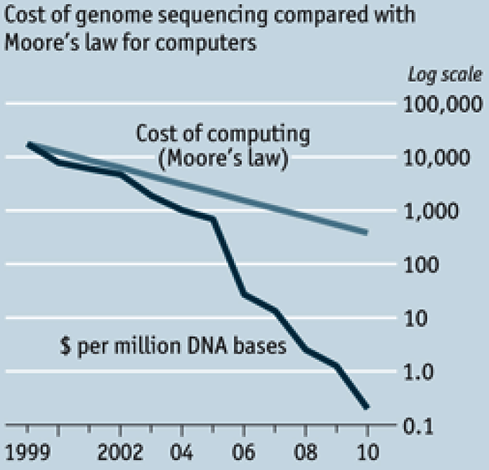
Cost of DNA Sequencing
http://www.economist.com/node/16349358
Notes:
4

Slide 5
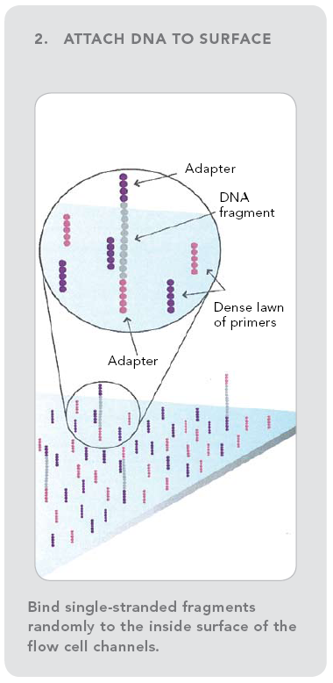
2nd Gen. Sequencing: Illumina
Notes:
5
-SBS: Sequencing by Synthesis
-SBL: Sequencing by Ligation
-Challenges in Genome Assembly: The short read lengths and absence of paired ends make it difficult for assembly software to disambiguate repeat regions, therefore resulting in fragmented assemblies.
-New Type of sequencing error: in 454 including incorrect estimates of homopolymer lengths,
‘transposition-like’ insertions (a base identical to a nearby homopolymer is inserted in a nearby nonadjacent location) and errors caused by multiple templates attached to the same bead

Slide 6
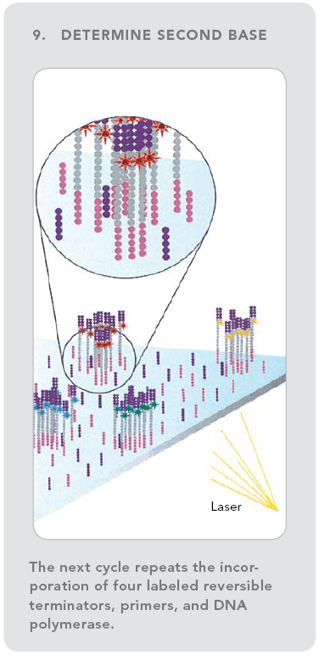
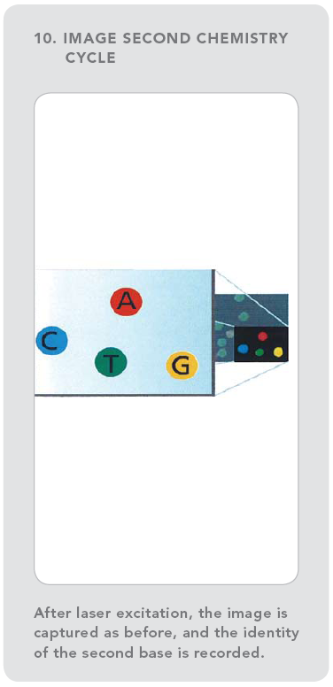
2nd Gen. Sequencing: Illumina
Notes:
6
-SBS: Sequencing by Synthesis
-SBL: Sequencing by Ligation
-Challenges in Genome Assembly: The short read lengths and absence of paired ends make it difficult for assembly software to disambiguate repeat regions, therefore resulting in fragmented assemblies.
-New Type of sequencing error: in 454 including incorrect estimates of homopolymer lengths,
‘transposition-like’ insertions (a base identical to a nearby homopolymer is inserted in a nearby nonadjacent location) and errors caused by multiple templates attached to the same bead

Slide 7
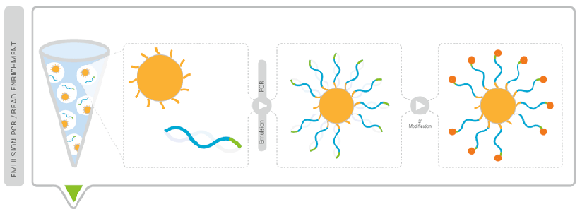
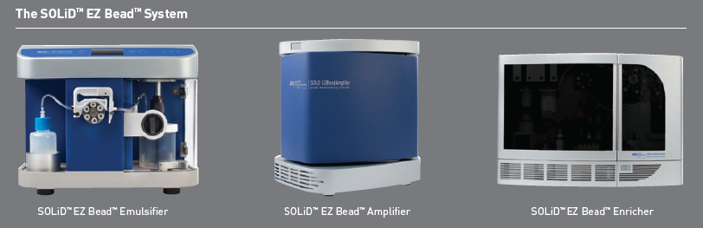
2nd Gen. Sequencing: SOLiD
Emulsion PCR used to perform single molecule amplification of pooled library onto magnetic beads

Slide 8
2nd Gen. Sequencing: SOLiD

Slide 9
2nd Gen. Sequencing: SOLiD

Slide 10
2nd Gen. Sequencing: SOLiD

Slide 11
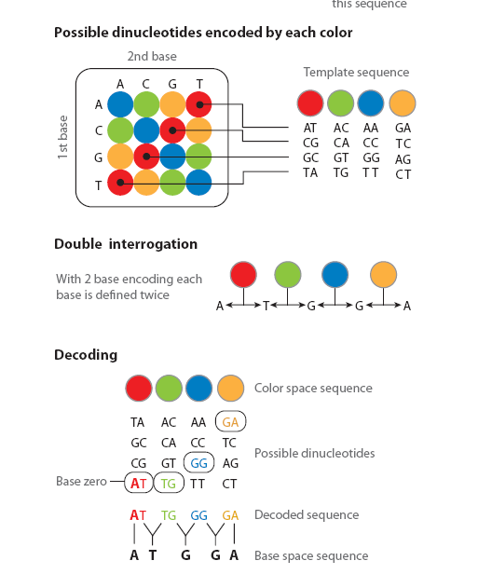
2nd Gen. Sequencing: SOLiD

Slide 12
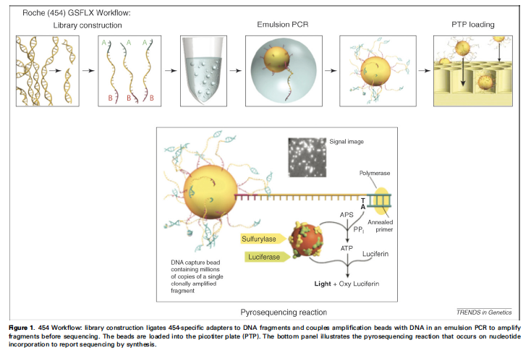
2nd Gen. Sequencing: 454

Slide 13
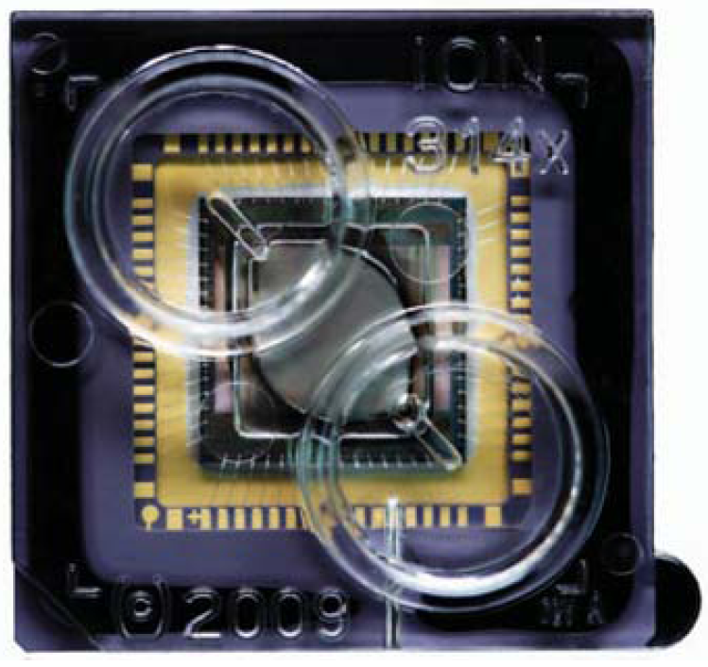
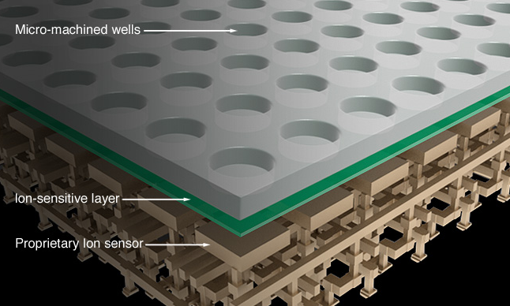
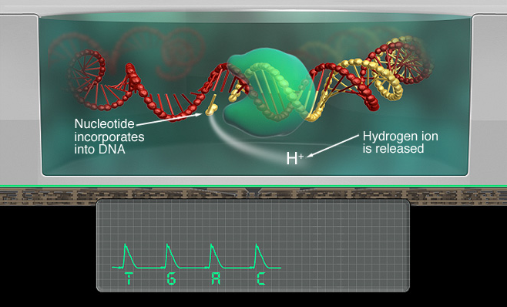
2nd Gen. Sequencing: Ion Torrent PGM
High-density array of micro-machined wells
Each well holds a different clonally amplified DNA template generated by emulsion PCR
Beneath the wells is an ion-sensitive layer and beneath that a proprietary Ion sensor
The sequencer sequentially floods the chip with one nucleotide after another (natural nucleotides)
If currently flooded nucleotide complements next base on template, a voltage change is recorded

Slide 14
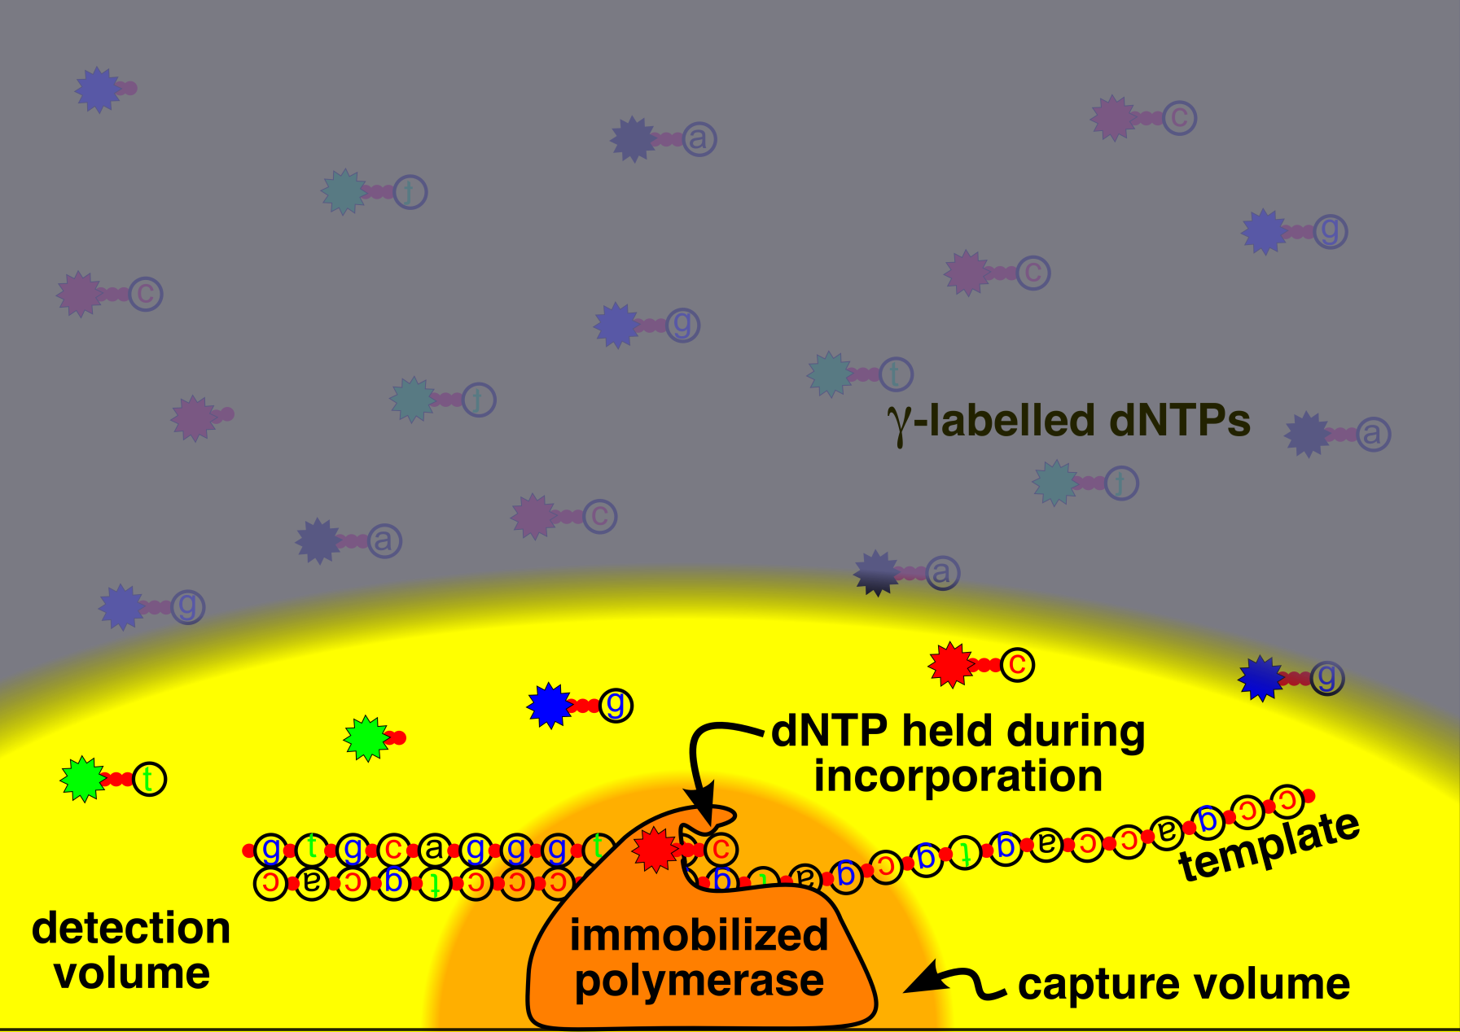
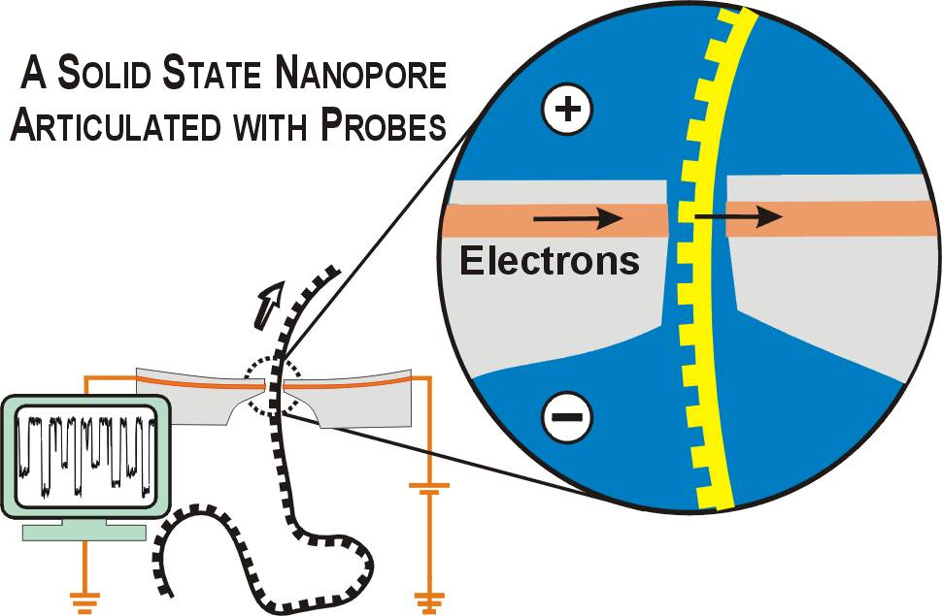
3nd Gen. Sequencing
PacBio SMRT
Nanopore sequencing
Notes:
Gamma labelled dNTPs release label after incorporation. Product is not labelled; detect the base
Key is small detection volume ( illuminated with laser beam)
Signal from dNTP held in place while it is being incorporated (“tens of milliseconds”)
Background from unincorporated dNTPs diffusing in and out of detection volume (“a few microseconds”)

Slide 15
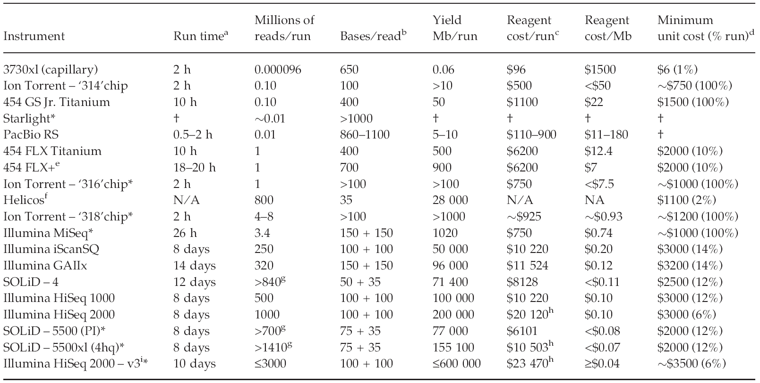
Cost/Performance Comparison [Glenn 2011]

Slide 16
A transformative technology
Re-sequencing
De novo genome sequencing
RNA-Seq
Non-coding RNAs
Structural variation
ChIP-Seq
Methyl-Seq
Metagenomics
Viral quasispecies
Shape-Seq
… many more biological measurements “reduced” to NGS sequencing
Notes:
16

Slide 17
Outline
Background
RNA-Seq read mapping
Mapping strategies
Merging read alignments
Variant detection and genotyping from RNA-Seq reads
Transcriptome quantification using RNA-Seq
Implementing RNA-Seq analysis pipelines using Galaxy
Novel transcript reconstruction
Conclusions

Slide 18
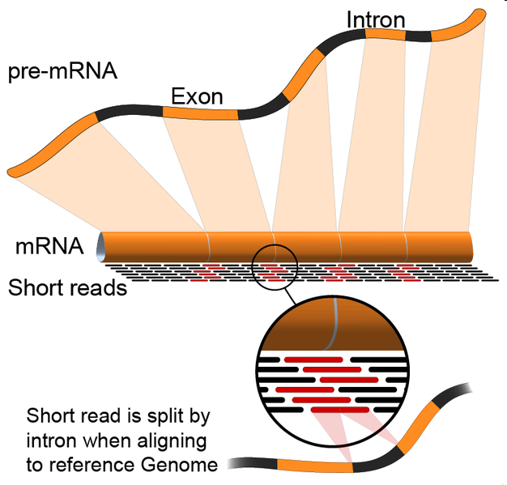
Mapping RNA-Seq Reads
http://en.wikipedia.org/wiki/File:RNA-Seq-alignment.png
Notes:
18

Slide 19
Mapping Strategies for RNA-Seq reads
Short reads (Illumina, SOLiD)
Ungapped mapping (with mismatches) on genome
Leverages existing tools: bowtie, BWA, …
Cannot align reads spanning exon-junctions
Mapping on transcript libraries
Cannot align reads from un-annotated transcripts
Mapping on exon-exon junction libraries
Cannot align reads overlapping un-annotated exons
Spliced alignment on the genome
Similar to classic EST alignment problem, but harder due to short read length and large number of reads
Tools: QPLAMA [De Bona et al. 2008], Tophat [Trapnell et al. 2009], MapSplice [Wang et al. 2010]
Hybrid approaches
Long read mapping (454, ION Torrent)
Local alignment (Smith-Waterman) to the genome
Handles indel errors characteristic of current long read technologies

Slide 20
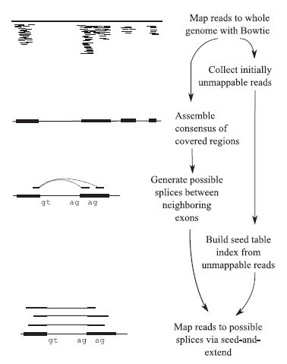
Spliced Read Alignment with Tophat
C. Trapnell, L. Pachter, and S.L. Salzberg. TopHat: discovering splice junctions with RNA-Seq. Bioinformatics, 25(9):1105–1111, 2009.

Slide 21
Hybrid Approach Based on Merging Alignments
Transcript Library
Mapping
Transcript mapped reads
mRNA reads
Read Merging
Mapped reads
Genome Mapping
Genome mapped reads

Slide 22
Alignment Merging for Short Reads
Genome | Transcripts | Agree? | Hard Merge | Soft Merge
Unique | Unique | Yes | Keep | Keep
Unique | Unique | No | Throw | Throw
Unique | Multiple | No | Throw | Keep
Unique | Not Mapped | No | Keep | Keep
Multiple | Unique | No | Throw | Keep
Multiple | Multiple | No | Throw | Throw
Multiple | Not Mapped | No | Throw | Throw
Not mapped | Unique | No | Keep | Keep
Not mapped | Multiple | No | Throw | Throw
Not mapped | Not Mapped | Yes | Throw | Throw

Slide 23
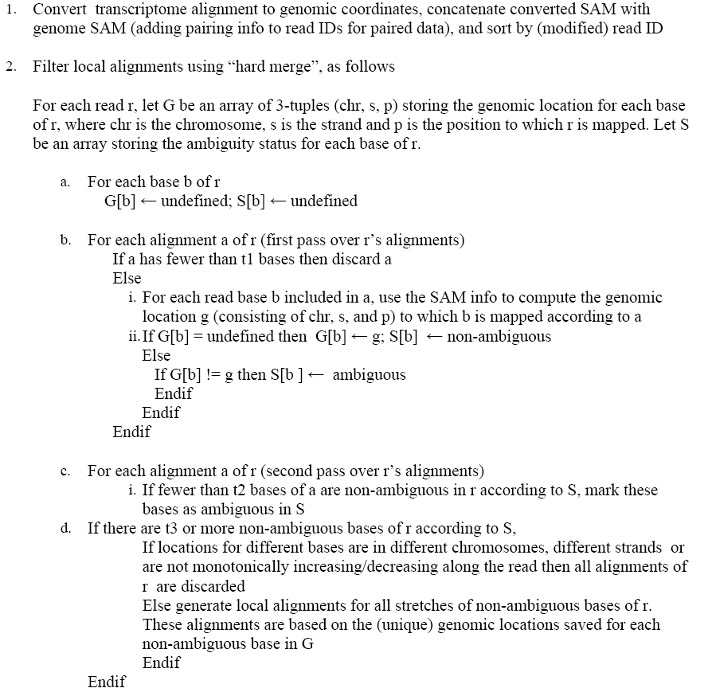
Merging Of Local Alignments

Slide 24
Outline
Background
RNA-Seq read mapping
Variant detection and genotyping from RNA-Seq reads
SNVQ algorithm
Experimental results
Transcriptome quantification using RNA-Seq
Implementing RNA-Seq analysis pipelines using Galaxy
Novel transcript reconstruction
Conclusions

Slide 25
Motivation
RNA-Seq is much less expensive than genome sequencing
Can sequence variants be discovered reliably from RNA-Seq data?
SNVQ: novel Bayesian model for SNV discovery and genotyping from RNA-Seq data [Duitama et al., ICCABS 2011 ]
Particularly appropriate when interest is in expressed mutations (cancer immunotherapy)

Slide 26
SNP Calling from Genomic DNA Reads
Read sequences &
quality scores
Reference genome
sequence
@HWI-EAS299_2:2:1:1536:631
GGGATGTCAGGATTCACAATGACAGTGCTGGATGAG
+HWI-EAS299_2:2:1:1536:631
::::::::::::::::::::::::::::::222220
@HWI-EAS299_2:2:1:771:94
ATTACACCACCTTCAGCCCAGGTGGTTGGAGTACTC
+HWI-EAS299_2:2:1:771:94
:::::::::::::::::::::::::::2::222220
>ref|NT_082868.6|Mm19_82865_37:1-3688105 Mus musculus chromosome 19 genomic contig, strain C57BL/6J
GATCATACTCCTCATGCTGGACATTCTGGTTCCTAGTATATCTGGAGAGTTAAGATGGGGAATTATGTCA
ACTTTCCCTCTTCCTATGCCAGTTATGCATAATGCACAAATATTTCCACGCTTTTTCACTACAGATAAAG
AACTGGGACTTGCTTATTTACCTTTAGATGAACAGATTCAGGCTCTGCAAGAAAATAGAATTTTCTTCAT
ACAGGGAAGCCTGTGCTTTGTACTAATTTCTTCATTACAAGATAAGAGTCAATGCATATCCTTGTATAAT
Read Mapping
SNP calling
1 4764558 G T 2 1
1 4767621 C A 2 1
1 4767623 T A 2 1
1 4767633 T A 2 1
1 4767643 A C 4 2
1 4767656 T C 7 1
Notes:
26

Slide 27
SNV Detection and Genotyping
Locus i
Reference
AACGCGGCCAGCCGGCTTCTGTCGGCCAGCAGCCAGGAATCTGGAAACAATGGCTACAGCGTGC
AACGCGGCCAGCCGGCTTCTGTCGGCCAGCCGGCAG
CGCGGCCAGCCGGCTTCTGTCGGCCAGCAGCCCGGA
GCGGCCAGCCGGCTTCTGTCGGCCAGCCGGCAGGGA
GCCAGCCGGCTTCTGTCGGCCAGCAGCCAGGAATCT
GCCGGCTTCTGTCGGCCAGCAGCCAGGAATCTGGAA
CTTCTGTCGGCCAGCCGGCAGGAATCTGGAAACAAT
CGGCCAGCAGCCAGGAATCTGGAAACAATGGCTACA
CCAGCAGCCAGGAATCTGGAAACAATGGCTACAGCG
CAAGCAGCCAGGAATCTGGAAACAATGGCTACAGCG
GCAGCCAGGAATCTGGAAACAATGGCTACAGCGTGC
R_{i}
r(i) : Base call of read r at locus i
ε_{r(i)} : Probability of error reading base call r(i)
G_{i} : Genotype at locus i

Slide 28
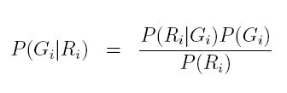

SNV Detection and Genotyping
Use Bayes rule to calculate posterior probabilities and pick the genotype with the largest one

Slide 29
Current Models
Maq:
Keep just the alleles with the two largest counts
Pr (R_{i} | G_{i}=H_{i}H_{i}) is the probability of observing k alleles r(i) different than H_{i}
Pr (R_{i} | G_{i}=H_{i}H’_{i}) is approximated as a binomial with p=0.5
SOAPsnp
Pr (r_{i} | G_{i}=H_{i}H’_{i}) is the average of Pr(r_{i}|H_{i}) and Pr(r_{i}|G_{i}=H’_{i})
A rank test on the quality scores of the allele calls is used to confirm heterozygocity

Slide 30

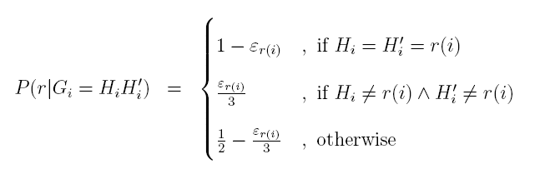
SNVQ Model
Calculate conditional probabilities by multiplying contributions of individual reads

Slide 31
Experimental Setup
113 million 32bp Illumina mRNA reads generated from blood cell tissue of Hapmap individual NA12878 (NCBI SRA database accession numbers SRX000565 and SRX000566)
We tested genotype calling using as gold standard 3.4 million SNPs with known genotypes for NA12878 available in the database of the Hapmap project
True positive: called variant for which Hapmap genotype coincides
False positive: called variant for which Hapmap genotype does not coincide

Slide 32
Comparison of Mapping Strategies

Slide 33
Comparison of Variant Calling Strategies

Slide 34
Data Filtering

Slide 35
Data Filtering
Allow just x reads per start locus to eliminate PCR amplification artifacts
[Chepelev et al. 2010] algorithm:
For each locus groups starting reads with 0, 1 and 2 mismatches
Choose at random one read of each group

Slide 36
Comparison of Data Filtering Strategies

Slide 37
Accuracy per RPKM bins

Slide 38
Outline
Background
RNA-Seq read mapping
Variant detection and genotyping from RNA-Seq reads
Transcriptome quantification using RNA-Seq
Background
IsoEM algo
Experimental results
Alternative protocols and inference problems
DGE protocol
Inference of allele specific expression levels
Implementing RNA-Seq analysis pipelines using Galaxy
Novel transcript reconstruction
Conclusions

Slide 39
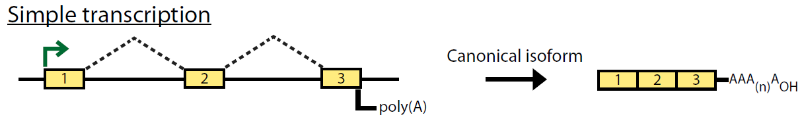
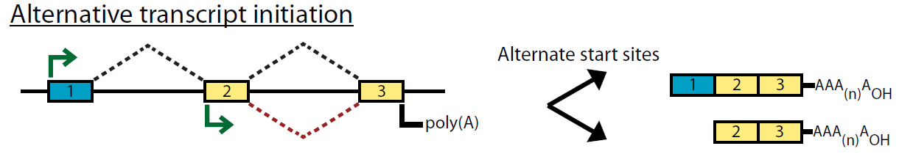
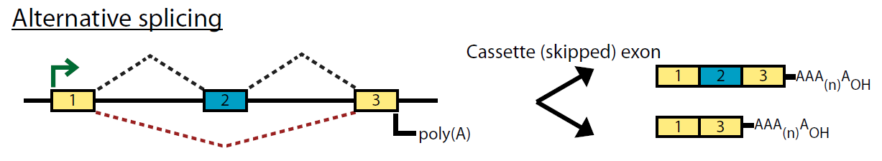
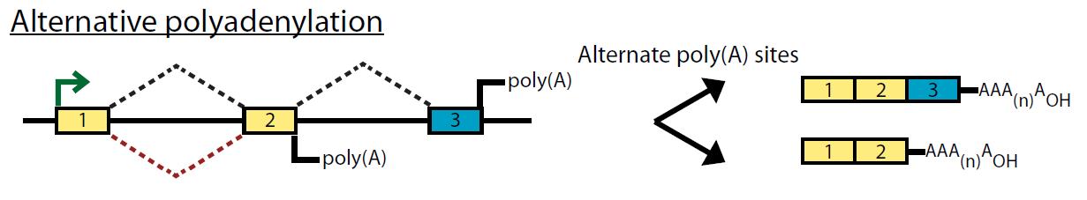
Alternative splicing
[Griffith and Marra 07]

Slide 40
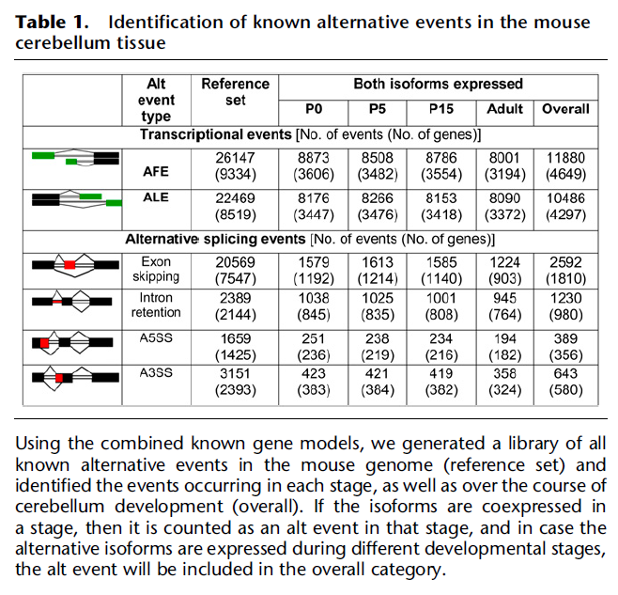
Alternative Splicing
Pal S. et all , Genome Research, June 2011

Slide 41
Computational Problems
Make cDNA & shatter into fragments
Sequence fragment ends
Map reads
A
B
C
D
E
Gene Expression (GE)
Isoform Expression (IE)
Isoform Discovery (ID)
A
B
C
A
C
D
E

Slide 42
Challenges to accurate estimation of gene expression levels
Read ambiguity (multireads)
What is the gene length?
A
B
C
D
E

Slide 43
Previous Approaches to GE
Ignore multireads
[Mortazavi et al. 08]
Fractionally allocate multireads based on unique read estimates
[Pasaniuc et al. 10]
EM algorithm for solving ambiguities
Gene length: sum of lengths of exons that appear in at least one isoform
➔ Underestimates expression levels for genes with 2 or more isoforms [Trapnell et al. 10]

Slide 44
Read Ambiguity in IE
A
B
C
D
E
A
C

Slide 45
Previous Approaches to IE
[Jiang&Wong 09]
Poisson model + importance sampling, single reads
[Richard et al. 10]
EM Algorithm based on Poisson model, single reads in exons
[Li et al. 10]
EM Algorithm, single reads
[Feng et al. 10]
Convex quadratic program, pairs used only for ID
[Trapnell et al. 10]
Extends Jiang’s model to paired reads
Fragment length distribution

Slide 46
IsoEM algorithm [Nicolae et al. 2011]
Unified probabilistic model and Expectation-Maximization Algorithm (IsoEM) for IE considering
Single and/or paired reads
Fragment length distribution
Strand information
Base quality scores
Repeat and hexamer bias correction

Slide 47
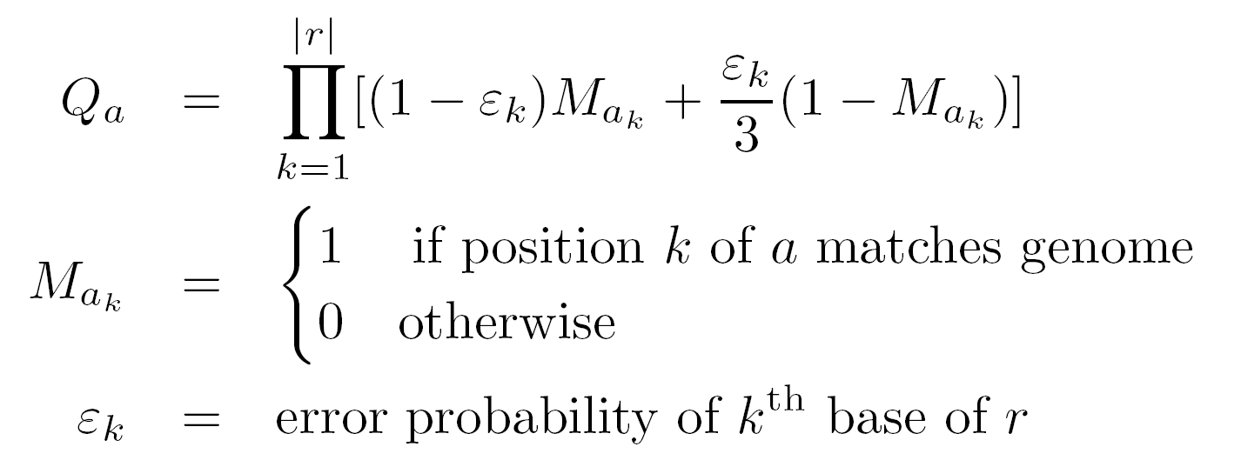
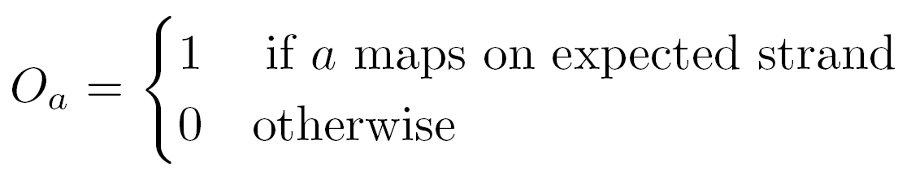
Read-isoform compatibility

Slide 48
Fragment length distribution
Paired reads
F_{a}(i)
i
A
A
A
B
B
B
C
C
C
j
A
A
A
C
C
C
F_{a} (j)

Slide 49
Fragment length distribution
Single reads
i
A
A
A
B
B
B
C
C
C
j
A
A
A
C
C
C
F_{a}(i)
F_{a} (j)

Slide 50
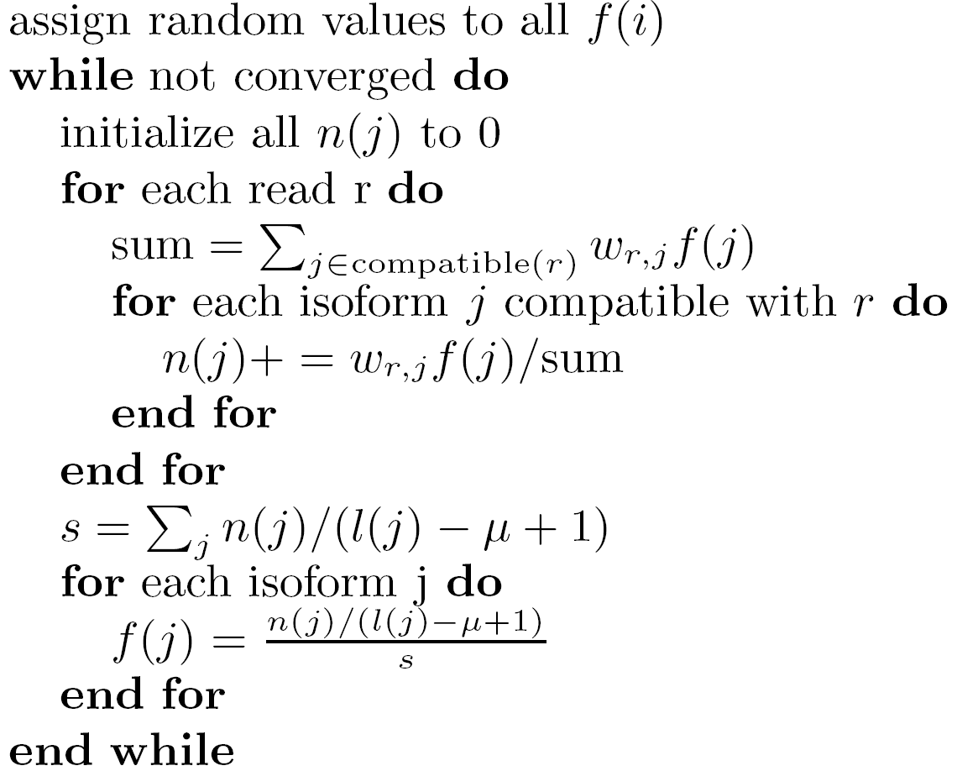
IsoEM pseudocode
E-step
M-step

Slide 51
Implementation details
Collapse identical reads into read classes
(i1,i2)
Reads
(i3,i4)
(i3,i5)
(i3,i4)
LCA(i3,i4)
i1
i2
i3
i4
i5
i6
Isoforms

Slide 52
Implementation details
Run EM on connected components, in parallel
i2
i4
i1
i3
i5
i6
Isoforms

Slide 53
Simulation setup
Human genome UCSC known isoforms
GNFAtlas2 gene expression levels
Uniform/geometric expression of gene isoforms
Normally distributed fragment lengths
Mean 250, std. dev. 25

Slide 54
Accuracy measures
Error Fraction (EF_{t})
Percentage of isoforms (or genes) with relative error larger than given threshold t
Median Percent Error (MPE)
Threshold t for which EF is 50%
r²

Slide 55
Error fraction curves - isoforms
30M single reads of length 25 (simulated)

Slide 56
Error fraction curves - genes
30M single reads of length 25 (simulated)

Slide 57
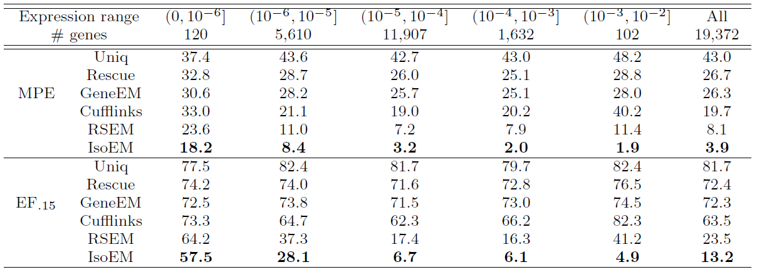
MPE and EF₁₅ by gene expression level
30M single reads of length 25

Slide 58
Read length effect on IE MPE
Fixed sequencing throughput (750Mb)
Single Reads Paired Reads

Slide 59
Read length effect on IE r²
Fixed sequencing throughput (750Mb)

Slide 60
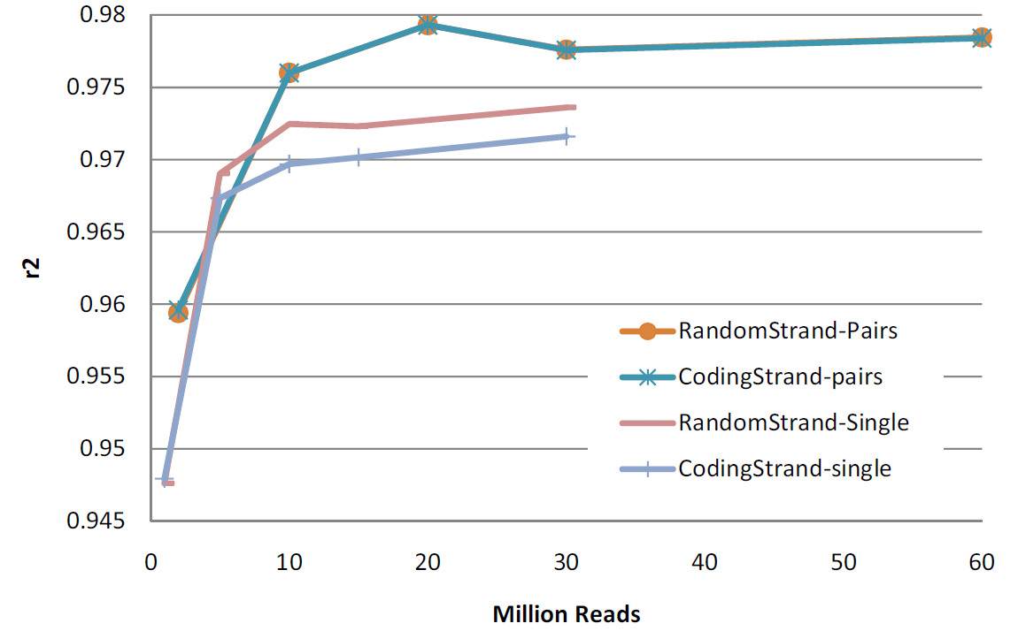
Effect of pairs & strand information
75bp reads

Slide 61
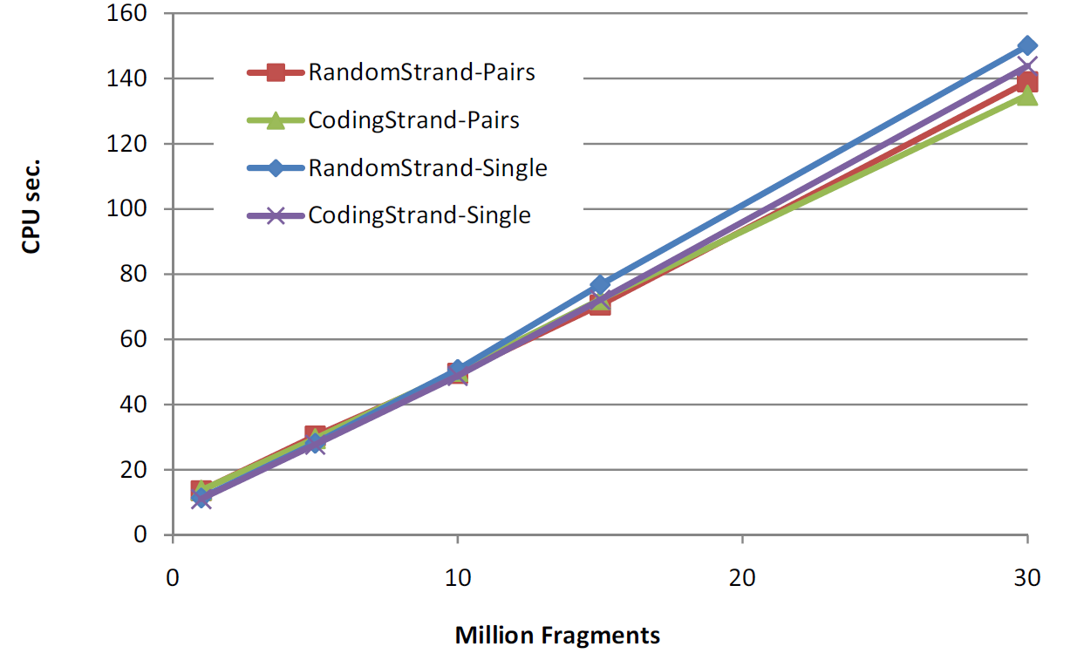
Runtime scalability
Scalability experiments conducted on a Dell PowerEdge R900
Four 6-core E7450Xeon processors at 2.4Ghz, 128Gb of internal memory

Slide 62
MAQC data
RNA samples: UHRR, HBRR
6 libraries, 47-92M 35bp reads each [Bullard et al. 10]
Bases called using both auto and phi X calibration for 2 libraries
qPCR
Quadruplicate measurements for 832 Ensembl genes [MAQC Consortium 06]

Slide 63
MPE comparison for MAQC samples

Slide 64
r² comparison for MAQC samples

Slide 65
R² of IsoEM estimates from ION Torrent & Illumina HBR reads
Average R² for 5 ION Torrent MAQC HBR Runs (avg. 1,559,842 reads)
R² for combined reads from 5 ION Torrent MAQC HBR Runs (7,799,210 reads)

Slide 66
DGE/SAGE-Seq protocol
AAAAA
Cleave with anchoring enzyme (AE)
CATG
AAAAA
AE
Attach primer for tagging enzyme (TE)
TCCRAC
CATG
AAAAA
TE
AE
Cleave with tagging enzyme
CATG
Map tags
A
B
C
D
E
Gene Expression (GE)

Slide 67
Inference algorithms for DGE data
Discard ambiguous tags [Asmann et al. 09, Zaretzki et al. 10]
Heuristic rescue of some ambiguous tags [Wu et al. 10]
DGE-EM algorithm [Nicolae & Mandoiu, ISBRA 2011]
Uses all tags, including all ambiguous ones
Uses quality scores
Takes into account partial digest and gene isoforms

Slide 68
Tag formation probability

Slide 69
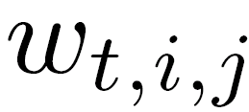


Tag-isoform compatibility

Slide 70
DGE-EM algorithm
assign random values to all f(i)
while not converged
init all n(i,j) to 0
for each tag t
for (i,j,w) in t
E-step
for each isoform i
M-step

Slide 71
MAQC data
DGE
9 Illumina libraries, 238M 20bp tags [Asmann et al. 09]
Anchoring enzyme DpnII (GATC)
RNA-Seq
6 libraries, 47-92M 35bp reads each [Bullard et al. 10]
qPCR
Quadruplicate measurements for 832 Ensembl genes [MAQC Consortium 06]

Slide 72
DGE-EM vs. Uniq on HBRR Library 4

Slide 73
DGE vs. RNA-Seq

Slide 74
DGE vs. RNA-Seq

Slide 75
Synthetic data
1-30M tags, lengths 14-26bp
UCSC hg19 genome and known isoforms
Simulated expression levels
Gene expression for 5 tissues from the GNFAtlas2
Geometric expression for the isoforms of each gene
Anchoring enzymes from REBASE
DpnII (GATC) [Asmann et al. 09]
NlaIII (CATG) [Wu et al. 10]
CviJI (RGCY, R=G or A, Y=C or T)
Notes:
75

Slide 76
Anchoring enzyme statistics

Slide 77
MPE for 30M 21bp tags
RNA-Seq: 8.3 MPE

Slide 78
DGE vs. RNA-Seq Summary
RNA-Seq and DGE based estimates have comparable cost-normalized accuracy on MAQC data
When using best inference algorithm for each type of data
Simulations suggest possible DGE protocol improvements
Enzymes with degenerate recognition sites (e.g. CviJI)
Optimizing cutting probability

Slide 79
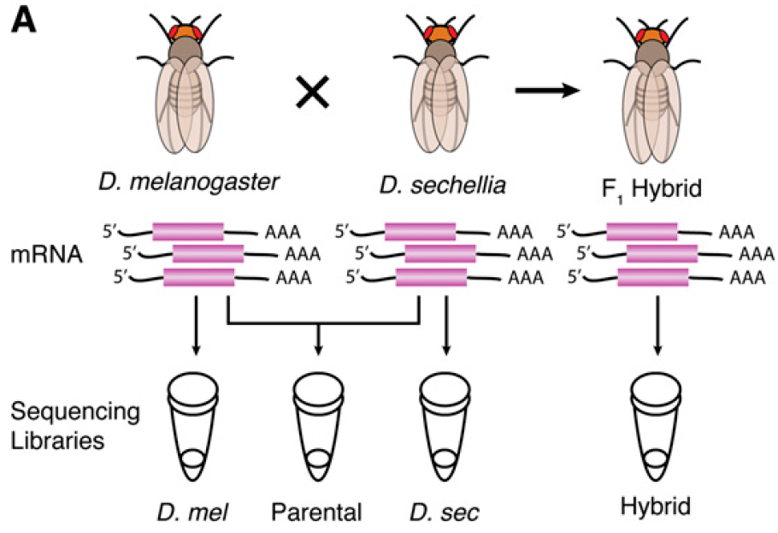
Allele Specific Expression in F1 Hybrids
[McManus et al. 10]
26M 42M 31M 78M
Paired-end reads (37bp)

Slide 80
Analysis Pipeline for Allele-Specific Isoform Expression in F1 Hybrids

Slide 81
Allele Specific Expression on Drosophila RNA-Seq data from [McManus et al. 10]

Slide 82
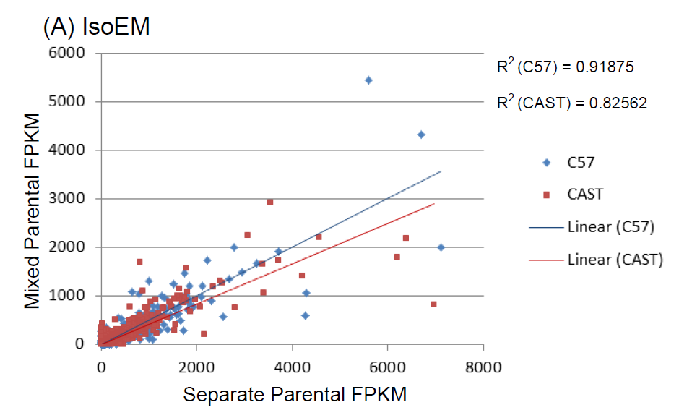
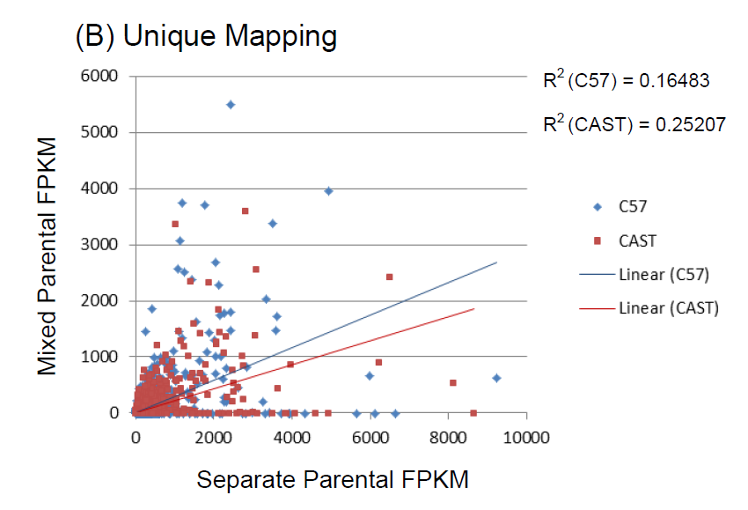
Allele Specific Expression for Mouse RNA-Seq Data from [Gregg et al. 2010]

Slide 83
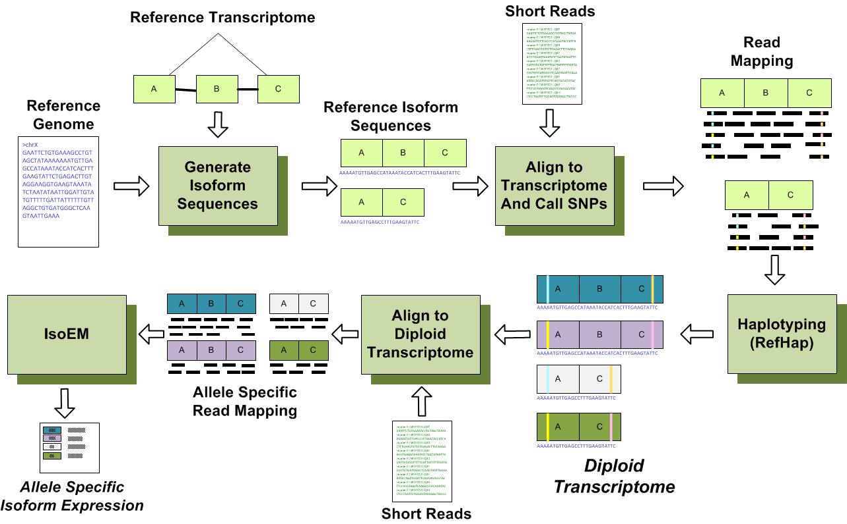
General Pipeline for Allele-Specific Isoform Expression

Slide 84
Outline
Background
RNA-Seq read mapping
Variant detection and genotyping from RNA-Seq reads
Transcriptome quantification using RNA-Seq
Implementing RNA-Seq analysis pipelines using Galaxy
Running analyses, creating flows, and adding tools in Galaxy
Hands on exercise
Novel transcript reconstruction
Conclusions

Slide 85
Galaxy
Web-based platform for bioinformatics analysis
Aims to facilitate reproducing results
Provides user friendly interface to many available tools
Free public server (maintained by PSU)
Downloadable galaxy instance for installation and expansion (adding tools)

Slide 86
Local Galaxy Instance
http://rna1.engr.uconn.edu:7474/
Lab Tools
NGS: IsoEM
SNVQ
Tools available on the PSU server

Slide 87
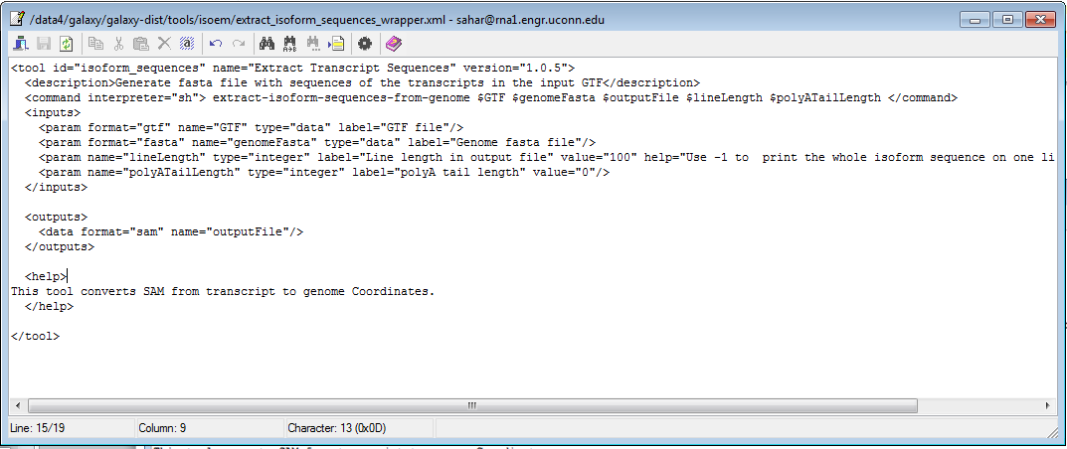
Adding Tools to Local Galaxy Instances
Galaxy Wiki for tool configuration syntax
http://wiki.g2.bx.psu.edu/Admin/Tools/Tool%20Config%20Syntax

Slide 88
Outline
Background
RNA-Seq read mapping
Variant detection and genotyping from RNA-Seq reads
Transcriptome quantification using RNA-Seq
Implementing RNA-Seq analysis pipelines using Galaxy
Novel transcript reconstruction
Overview of existing approaches
DRUT algorithm
Conclusions

Slide 89
Existing approaches
Genome-guided reconstruction (ab initio)
Exon identification
Genome-guided assembly
Genome independent (de novo) reconstruction
Genome-independent assembly
Annotation-guided reconstruction
Explicitly use existing annotation during assembly

Slide 90
Genome-guided reconstruction
Scripture (2010), IsoLasso (2011)
Reports “all” isoforms
Cufflinks (2010)
Reports a minimal set of isoforms
Trapnell, M. et al May 2010, Guttman, M. et al May 2010

Slide 91
Genome independent reconstruction
Trinity (2011),Velvet (2008), TransABySS (2008)
Euler/de Brujin k-mer graph
Grabherr, M. et al. Nat. Biotechnol. July 2011

Slide 92
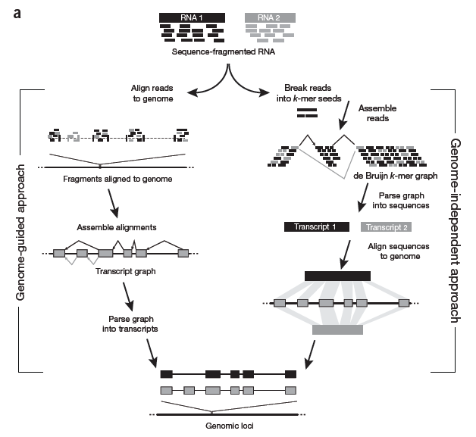
GGR vs GIR
Garber, M. et al. Nat. Biotechnol. June 2011
Notes:
(a) Reads originating from two different isoforms of the
same genes are colored black and gray. In genome-guided assembly, reads are first mapped to a reference
genome, and spliced reads are used to build a transcript graph, which is then parsed into gene annotations.
In the genome-independent approach, reads are broken into k-mer seeds and arranged into a de Bruijn
graph structure. The graph is parsed to identify transcript sequences, which are aligned to the genome to
produce gene annotations.

Slide 93
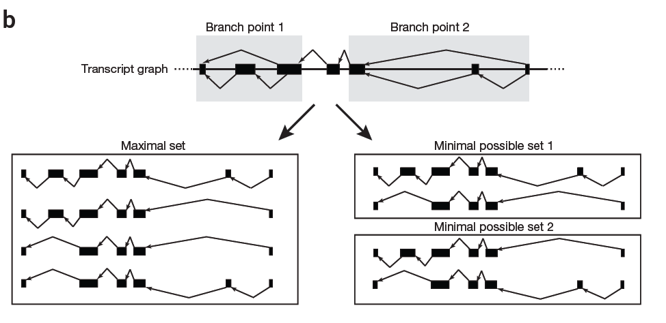
Max Set vs Min Set
Garber, M. et al. Nat. Biotechnol. June 2011
Notes:
Spliced reads give rise to four possible transcripts, but only two transcripts
are needed to explain all reads; the two possible sets of minimal isoforms are depicted.

Slide 94
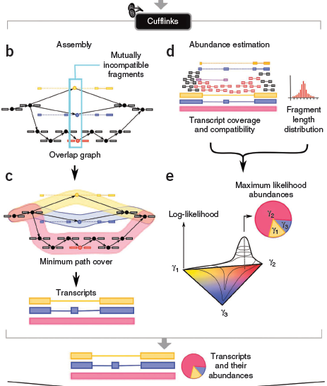
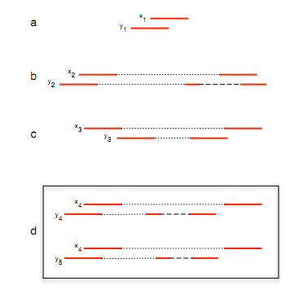
Cufflinks
G(V,E)
V – pe reads
E – compatible reads
Fragment x₄ in (d) is uncertain, because y4 and y5 are incompatible with each other
Notes:
Figure 6. Compatibility and incompatibility of fragments. End-reads
are solid lines, unknown sequences within fragments are shown by dotted
lines and implied introns are dashed lines. The reads in (a) are compatible,
whereas the fragments in (b) are incompatible. The fragments in (c) are
nested. Fragment x4 in (d) is uncertain, because y4 and y5 are incompatible
with each other

Slide 95
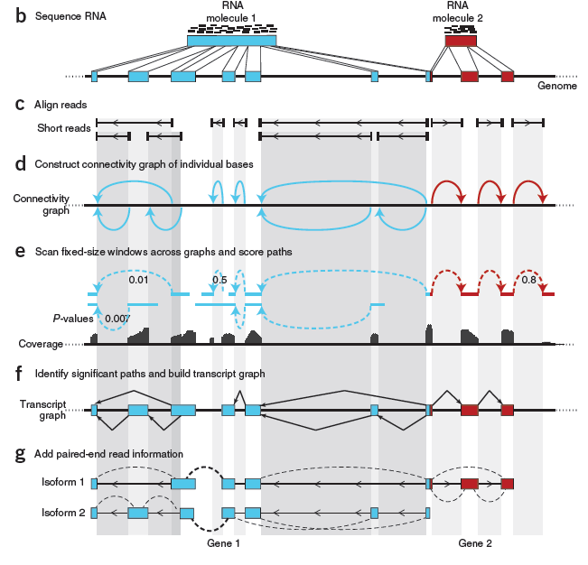
Scripture
Connectivity graph
V – bases
E – spliced event
Filter isoforms
Coverage (p-value)
Insert length

Slide 96
Other statistical assembly
IsoLasso
multivariate regression method – Lasso
balance between the maximization of prediction accuracy and the minimization of interpretation
SLIDE
sparse estimation as a modified Lasso
limiting the number of discovered isoforms and favoring longer isoforms
Li, W. et al. RECOMB 2011, Li J et all Proc Natl Acad Sci. USA 2011

Slide 97
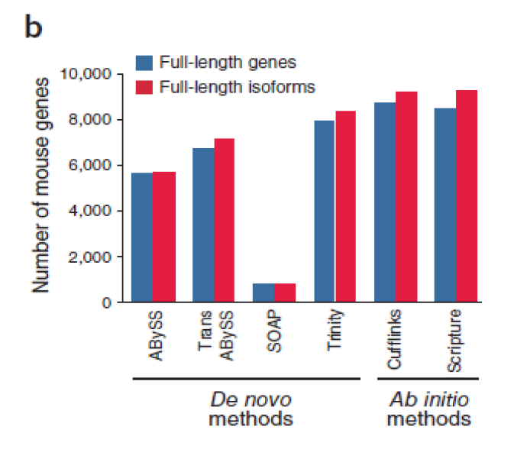
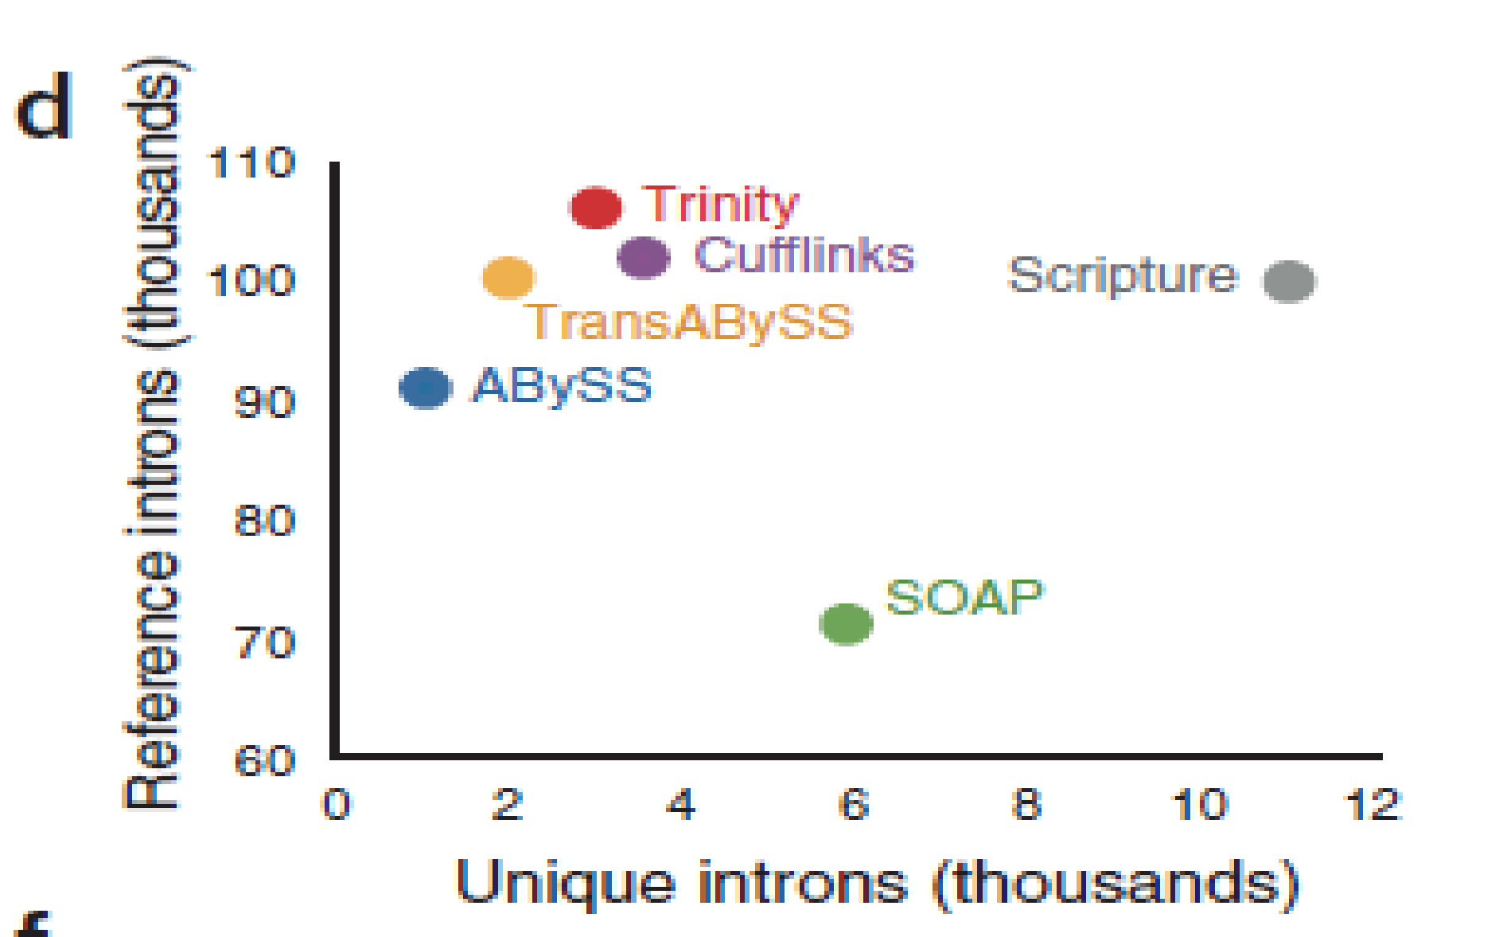
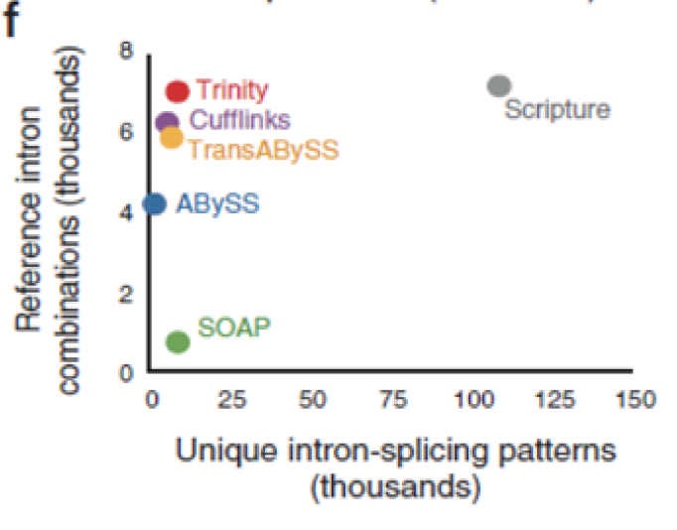
Reconstruction Strategies Comparison
Grabherr, M. et al. Nat. Biotechnol. May 2011

Slide 98
Detection and Reconstruction of Unannotated Transcripts
a) Map reads to annotated
transcripts (using Bowtie)
b) VTEM: Identify overexpressed
exons (possibly from unannotated
transcripts)
c) Assemble Transcripts (e.g., Cufflinks)
using reads from “overexpressed” exons
and unmapped reads
d) Output: annotated transcripts + novel
transcripts

Slide 99
Virtual Transcript Expectation Maximization (VTEM)
VTEM is based on a modification of Virtual String Expectation Maximization (VSEM) Algorithm [Mangul et al. 2011]).
the difference is that we consider in the panel exons instead of reads
Calculate observed exon counts based on read mapping
each read contribute to count of either one exon or two exons (depending if it is a unspliced spliced read or spliced read)
reads
reads
exon counts
R1
R1
exons
1
3
3
E1
R2
R2
transcripts
transcripts
T1
T1
E2
R3
R3
T2
T2
E3
R4
R4
Notes:
-
How?
We can see that R1, R2, 3 and 4 were emitted by Transcript 1 and also T3 also emitts 2,3,4. but each tr. consists of several exons and tr. shares exons -> for a more accurate estimation we will consider exons
Transcripts consists of exons and reads can be emitted from a single exon or from two exons if they are spliced reads.

Slide 100
Input: Complete vs Partial Annotations
Complete Annotations
Partial Annotations
O
0.25
0.25
0.25
0.25
exons
O
0.25
0.25
0.25
0.25
exons
E1
E1
transcripts
transcripts
T1
T1
E2
E2
T2
T2
E3
E3
T3
E4
E4
Observed exon frequencies
Transcript T3 is missing
from annotations

Slide 101
Virtual Transcript Expectation Maximization (VTEM)
(Partially) Annotated
Genome
+ Virtual Transcript
with 0-weights
in virtual transcript
ML estimates
of transcript
frequencies
Update weights
of reads in
virtual transcript
EM
EM
Virtual Transcript frequency change>ε?
Output
overexpressed
exons
(expressed by
virtual transcripts)
Compute
expected exons
frequencies
NO
YES
Overexpressed exons belong to unknown transcripts
Notes:
Use reads from overexpressed exons as input in Cufflinks for reconstruction of unknown transcripts.

Slide 102
Simulation Setup
Reads simulated from UCSC known genes
19, 372 genes
66, 803 isoforms
Single end, error-free
60M reads of length 100bp
To simulate incomplete annotation, remove from every gene exactly one isoform

Slide 103
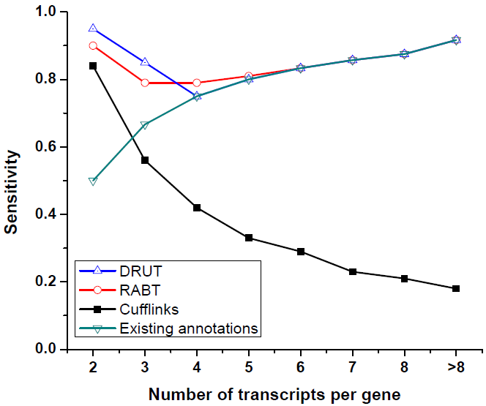
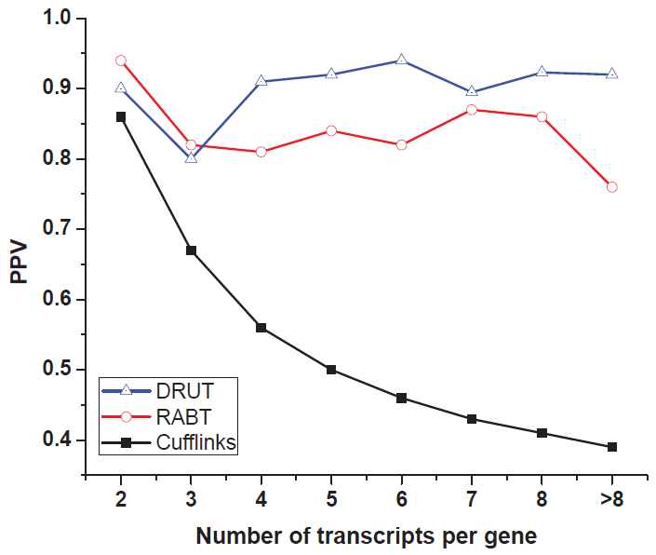
Comparison Between Methods
Notes:
Sensitivity - portion of the annotated transcript sequences being captured by candidate transcript sequences

Slide 104
Outline
Background
RNA-Seq read mapping
Variant detection and genotyping from RNA-Seq reads
Transcriptome quantification using RNA-Seq
Implementing RNA-Seq analysis pipelines using Galaxy
Novel transcript reconstruction
Conclusions

Slide 105
Conclusions
The range of NGS applications continues to expand, fueled by advances in technology
Improved sample prep protocols
3rd generation: Pacific Biosciences, Ion Torrent
Development of sophisticated analysis methods remains critical for fully realizing the potential of sequencing technologies
Notes:
Comparison with alternative protocol for measuring gene expr called digital gene expr
The techniques behind isoem are applicable to reconstruction & freq est for virus quasispecies

Slide 106
Further readings
Read mapping
Langmead B, Trapnell C, Pop M, Salzberg S: Ultrafast and memory-efficient alignment of short DNA sequences to the human genome. Genome Biology 2009, 10(3):R25
Heng Li andRichard Durbin, Fast and accurate short read alignment with Burrows-Wheeler transform, Bioinformatics (2009) 25(14): 1754-1760
Kurtz S, Sharma CM, Khaitovich P, Vogel J., Stadler, PF, Hoffmann S, Otto C, and Hackermuller J. Fast mapping of short sequences with mismatches, insertions and deletions using index structures. PLoS Comput Biol, 5(9):e1000502, 2009
Trapnell C, Pachter L, Salzberg S: TopHat: discovering splice junctions with RNA-Seq. Bioinformatics 2009, 25(9):1105–1111

Slide 107
Further readings
SNV discovery and genotyping
H. Li, J. Ruan, and R. Durbin. Mapping short DNA sequencing reads and calling variants using mapping quality scores. Genome Research, 18(1):1851–1858, 2008.
R. Li, Y. Li, X. Fang, H. Yang, J. Wang, K. Kristiansen, and J. Wang. SNP detection for massively parallel whole-genome resequencing. Genome Research, 19:1124–1132, 2009.
I. Chepelev, G. Wei, Q. Tang, and K. Zhao. Detection of single nucleotide variations in expressed exons of the human genome using RNA-Seq. Nucleic Acids Research, 37(16):e106, 2009.
J. Duitama and J. Kennedy and S. Dinakar and Y. Hernandez and Y. Wu and I.I. Mandoiu, Linkage Disequilibrium Based Genotype Calling from Low-Coverage Shotgun Sequencing Reads, BMC Bioinformatics 12(Suppl 1):S53, 2011.
J. Duitama and P.K. Srivastava and I.I. Mandoiu, Towards Accurate Detection and Genotyping of Expressed Variants fromWhole Transcriptome Sequencing Data, Proc. 1st IEEE International Conference on Computational Advances in Bio and Medical Sciences, pp. 87-92, 2011.
S.Q. Le and R. Durbin: SNP detection and genotyping from low-coverage sequencing data on multiple diploid samples. Genome research, to appear.

Slide 108
Further readings
Estimation of gene expression levels from RNA-Seq data
Mortazavi A, Williams BA, McCue K, Schaeffer L, Wold B: Mapping and quantifying mammalian transcriptomes by RNA-Seq. Nature Methods 2008, 5(7):621–628.
Jiang H, Wong WH: Statistical inferences for isoform expression in RNA-Seq. Bioinformatics 2009, 25(8):1026–1032.
Li B, Ruotti V, Stewart R, Thomson J, Dewey C: RNA-Seq gene expression estimation with read mapping uncertainty. Bioinformatics 2010, 26(4):493–500.
Trapnell C, Williams B, Pertea G, Mortazavi A, Kwan G, van Baren M, Salzberg S, Wold B, Pachter L: Transcript assembly and quantification by RNA-Seq reveals unannotated transcripts and isoform switching during cell differentiation. Nature biotechnology 2010, 28(5):511–515.
M. Nicolae, S. Mangul, I.I. Mandoiu, and A. Zelikovsky. Estimation of alternative splicing isoform frequencies from RNA-Seq data. Algorithms for Molecular Biology, 6:9, 2011.
Roberts A, Trapnell C, Donaghey J, Rinn J, Pachter L: Improving RNA-Seq expression estimates by correcting for fragment bias. Genome Biology 2011, 12(3):R22.

Slide 109
Further readings
Estimation of gene expression levels from DGE data
Y. Asmann, E.W. Klee, E.A. Thompson, E. Perez, S. Middha, A. Oberg, T. Therneau, D. Smith, G. Poland, E. Wieben, and J.-P. Kocher. 3’ tag digital gene expression profiling of human brain and universal reference RNA using Illumina Genome Analyzer. BMC Genomics, 10(1):531, 2009.
Z.J. Wu, C.A. Meyer, S. Choudhury, M. Shipitsin, R. Maruyama, M. Bessarabova, T. Nikolskaya, S. Sukumar, A. Schwartzman, J.S. Liu, K. Polyak, and X.S. Liu. Gene expression profiling of human breast tissue samples using SAGE-Seq. Genome Research, 20(12):1730–1739, 2010.
M. Nicolae and I.I. Mandoiu. Accurate estimation of gene expression levels from DGE sequencing data. In Proc. 7th International Symposium on Bioinformatics Research and Applications, pp. 392-403, 2011.

Slide 110
Further readings
Novel transcript reconstruction
Manuel Garber, Manfred G Grabherr, Mitchell Guttman, and Cole Trapnell, Computational methods for transcriptome annotation and quantification using RNA-seq, Nature Methods 8, 469-477, 2011
Trapnell C, Williams B, Pertea G, Mortazavi A, Kwan G, van Baren M, Salzberg S, Wold B, Pachter L: Transcript assembly and quantification by RNA-Seq reveals unannotated transcripts and isoform switching during cell differentiation. Nature biotechnology 2010, 28(5):511–515.
Mitchell Guttman, Manuel Garber, Joshua Z Levin, Julie Donaghey, James Robinson, Xian Adiconis, Lin Fan, Magdalena J Koziol, Andreas Gnirke, Chad Nusbaum, John L Rinn, Eric S Lander, and Aviv Regev. Ab initio reconstruction of cell type specific transcriptomes in mouse reveals the conserved multi-exonic structure of lincRNAs. Nature Biotechnology 28, 503-510, 2010
S. Mangul, A. Caciula, I. Mandoiu, and A. Zelikovsky. RNA-Seq based discovery and reconstruction of unannotated transcripts in partially annotated genomes, Proc. BIBM 2011, pp.118-123

Slide 111
Software packages
SNV detection and genotyping from RNA-Seq reads: http://dna.engr.uconn.edu/software/NGSTools
Inference of gene expression levelsFrom RNA-Seq reads: http://dna.engr.uconn.edu/software/IsoEM/
Inference of gene expression levels from DGE reads: http://www.dna.engr.uconn.edu/software/DGE-EM

Slide 112
Galaxy References
Goecks, J, Nekrutenko, A, Taylor, J and The Galaxy Team. Galaxy: a comprehensive approach for supporting accessible, reproducible, and transparent computational research in the life sciences. Genome Biol. 2010 Aug 25;11(8):R86.
Blankenberg D, Von Kuster G, Coraor N, Ananda G, Lazarus R, Mangan M, Nekrutenko A, Taylor J. "Galaxy: a web-based genome analysis tool for experimentalists". Current Protocols in Molecular Biology. 2010 Jan; Chapter 19:Unit 19.10.1-21.
UCONN Galaxy instance: http://rna1.engr.uconn.edu:7474/
Main Galaxy server at PSU: http://galaxy.psu.edu/

Slide 113


Acknowledgments
Jorge Duitama (KU Leuven)
Marius Nicolae (Uconn)
Pramod Srivastava (UCHC)
Alex Zelikovsky (GSU)
Serghei Mangul (GSU)
Adrian Caciula (GSU)
Dumitru Brinza (Life Tech)

