Slide 1



Supercomputing in Plain English Grab Bag: Scientific Libraries, I/O Libraries, Visualization
Henry Neeman, Director
OU Supercomputing Center for Education & Research
University of Oklahoma Information Technology
Tuesday May 3 2011

Slide 2
This is an experiment!
It’s the nature of these kinds of videoconferences that FAILURES ARE GUARANTEED TO HAPPEN! NO PROMISES!
So, please bear with us. Hopefully everything will work out well enough.
If you lose your connection, you can retry the same kind of connection, or try connecting another way.
Remember, if all else fails, you always have the toll free phone bridge to fall back on.

Slide 3
Access Grid
If you aren’t sure whether you have AG, you probably don’t.
Tue May 3 | Helium
Many thanks to Patrick Calhoun of OU for setting these up for us.

Slide 4
H.323 (Polycom etc)
From an H.323 device (e.g., Polycom, Tandberg, Lifesize, etc):
If you ARE already registered with the OneNet gatekeeper: Dial 2500409
If you AREN'T registered with the OneNet gatekeeper (probably the case):
Dial: 164.58.250.47
Bring up the virtual keypad. On some H.323 devices, you can bring up the virtual keypad by typing: #
When asked for the conference ID, enter: 0409
On some H.323 devices, you indicate the end of conference ID with: #
Many thanks to Roger Holder and OneNet for providing this.

Slide 5
H.323 from Internet Explorer
From a Windows PC running Internet Explorer:
You MUST have the ability to install software on the PC (or have someone install it for you).
Download and install the latest Java Runtime Environment (JRE) from here: http://www.oracle.com/technetwork/java/javase/downloads/ (Click on the Java Download icon, because that install package includes both the JRE and other components.)
Download and install this video decoder: http://164.58.250.47/codian_video_decoder.msi
Start Internet Explorer.
Copy-and-paste this URL into your IE window: http://164.58.250.47/
When that webpage loads, in the upper left, click on “Streaming.”
In the textbox labeled Sign-in Name, type your name.
In the textbox labeled Conference ID, type this: 0409
Click on “Stream this conference.”
When that webpage loads, you may see, at the very top, a bar offering you options. If so, click on it and choose “Install this add-on.”

Slide 6
H.323 from XMeeting (MacOS)
From a Mac running MacOS X:
Download XMeeting from http://xmeeting.sourceforge.net/
Install XMeeting as follows:
Open the .dmg file.
Drag XMeeting into the Applications folder.
Open XMeeting from Applications.
Skip the setup wizard.
In the call box, type 164.58.250.47
Click the Call button.
From the Remote Control window, when prompted to join the conference, enter : 0409#

Slide 7
EVO
There’s a quick tutorial on the OSCER education webpage.

Slide 8
QuickTime Broadcaster
If you cannot connect via the Access Grid, H.323 or EVO, then you can connect via QuickTime:
rtsp://129.15.254.141/test_hpc09.sdp
We recommend using QuickTime Player for this, because we’ve tested it successfully.
We recommend upgrading to the latest version at:
http://www.apple.com/quicktime/
When you run QuickTime Player, traverse the menus
File -> Open URL
Then paste in the rstp URL into the textbox, and click OK.
Many thanks to Kevin Blake of OU for setting up QuickTime Broadcaster for us.

Slide 9
WebEx
We have only a limited number of WebEx connections, so please avoid WebEx unless you have NO OTHER WAY TO CONNECT.
Instructions are available on the OSCER education webpage.
Thanks to Tim Miller of Wake Forest U.

Slide 10
Phone Bridge
If all else fails, you can call into our toll free phone bridge:
US: 1-800-832-0736, *6232874#
International: 303-330-0440, *6232874#
Please mute yourself and use the phone to listen.
Don’t worry, we’ll call out slide numbers as we go.
Please use the phone bridge ONLY if you cannot connect any other way: the phone bridge is charged per connection per minute, so our preference is to minimize the number of connections.
Many thanks to Amy Apon and U Arkansas for providing the previous toll free phone bridge.

Slide 11
Please Mute Yourself
No matter how you connect, please mute yourself, so that we cannot hear you.
At OU, we will turn off the sound on all conferencing technologies.
That way, we won’t have problems with echo cancellation.
Of course, that means we cannot hear questions.
So for questions, you’ll need to send some kind of text.

Slide 12
Questions via Text: E-mail
Ask questions via e-mail to sipe2011@yahoo.com.
All questions will be read out loud and then answered out loud.

Slide 13
Thanks for helping!
OSCER operations staff: Brandon George, Dave Akin, Brett Zimmerman, Josh Alexander
Horst Severini, OSCER Associate Director for Remote & Heterogeneous Computing
OU Research Campus staff (Patrick Calhoun, Mark McAvoy)
Kevin Blake, OU IT (videographer)
John Chapman, Jeff Pummill and Amy Apon, U Arkansas
James Deaton and Roger Holder, OneNet
Tim Miller, Wake Forest U
Jamie Hegarty Schwettmann, i11 Industries

Slide 14
This is an experiment!
It’s the nature of these kinds of videoconferences that FAILURES ARE GUARANTEED TO HAPPEN! NO PROMISES!
So, please bear with us. Hopefully everything will work out well enough.
If you lose your connection, you can retry the same kind of connection, or try connecting another way.
Remember, if all else fails, you always have the toll free phone bridge to fall back on.

Slide 15
Supercomputing Exercises
Want to do the “Supercomputing in Plain English” exercises?
The first exercise is already posted at:
http://www.oscer.ou.edu/education.php
If you don’t yet have a supercomputer account, you can get a temporary account, just for the “Supercomputing in Plain English” exercises, by sending e-mail to:
hneeman@ou.edu
Please note that this account is for doing the exercises only, and will be shut down at the end of the series.
The Grab Bag exercise has been posted.

Slide 16
Summer Workshops 2011
Introduction to Computational Thinking
Modeling and Simulation Across the Curriculum
June 19 - 25, Wayne State College, Wayne NE
July 10 - 16, Texas State Technical College, Waco
Preparing In-service and Pre-service Educators for Computational Thinking
July 24 - 30, Oregon State University, Corvallis
Computational Thinking from a Parallel Perspective
July 31 - Aug 6, Louisiana State University, Baton Rouge

Slide 17
Summer Workshops 2011 (cont’d)
Computational Biology for Biology Educators
June 12 - 18, Lafayette College, Easton PA
June 26 - July 2, Calvin College, Grand Rapids MI
Computational Chemistry for Chemistry Educators
July 24 - 30, Washington and Lee University, Lexington VA
JOINTLY PRESENTED VIA VIDEOCONFERENCING WITH
July 24 - 30, Oklahoma State University, Stillwater
Data-driven Computational Science: Modeling and Visualization
June 19 - 25, Richard Stockton College of New Jersey, Pomona

Slide 18
Summer Workshops 2011 (cont’d)
Introduction to Parallel Programming & Cluster Computing
June 26 - July 1, Idaho State University, Pocatello
JOINTLY PRESENTED VIA VIDEOCONFERENCING WITH
June 26 - July 1, University of Washington, Seattle
Intermediate Parallel Programming & Cluster Computing
July 31 - Aug 6, University of Oklahoma, Norman
JOINTLY PRESENTED VIA VIDEOCONFERENCING WITH
July 31 - Aug 6, Polytechnic University of Puerto Rico, Hato Rey

Slide 19
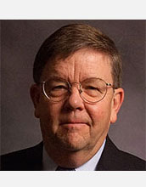
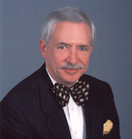
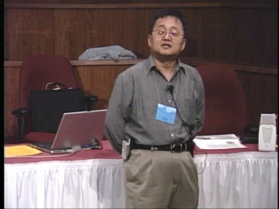
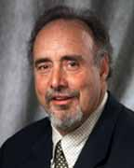
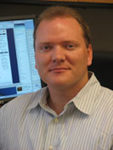
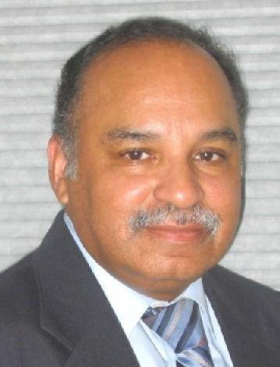
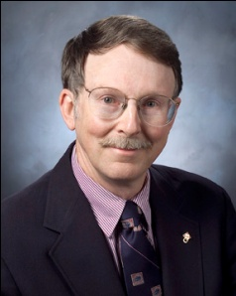
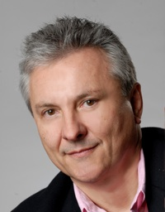
OK Supercomputing Symposium 2011
2003 Keynote:
Peter Freeman
NSF
Computer & Information
Science & Engineering
Assistant Director
2004 Keynote:
Sangtae Kim
NSF Shared
Cyberinfrastructure
Division Director
2005 Keynote:
Walt Brooks
NASA Advanced
Supercomputing
Division Director
2006 Keynote:
Dan Atkins
Head of NSF’s
Office of
Cyberinfrastructure
2007 Keynote:
Jay Boisseau
Director
Texas Advanced
Computing Center
U. Texas Austin
2008 Keynote: José Munoz Deputy Office Director/ Senior Scientific Advisor NSF Office of Cyberinfrastructure
?
FREE! Wed Oct 12 2011 @ OU
Over 235 registratons already!
Over 150 in the first day, over 200 in the first week, over 225 in the first month.
http://symposium2011.oscer.ou.edu/
Parallel Programming Workshop FREE! Tue Oct 11 2011 @ OU
FREE! Symposium Wed Oct 12 2011 @ OU
REGISTRATION IS NOW OPEN!
2009 Keynote: Douglass Post Chief Scientist US Dept of Defense HPC Modernization Program
2010 Keynote: Horst Simon Deputy Director Lawrence Berkeley National Laboratory
2011 Keynote to be announced

Slide 20
SC11 Education Program
At the SC11 supercomputing conference, we’ll hold our annual Education Program, Sat Nov 12 – Tue Nov 15.
You can apply to attend, either fully funded by SC11 or self-funded.
Henry is the SC11 Education Chair.
We’ll alert everyone once the registration website opens.

Slide 21
Outline
Scientific Computing Pipeline
Scientific Libraries
I/O Libraries
Scientific Visualization

Slide 22
Scientific Computing Pipeline
Real World
Physics
Mathematical Representation (continuous)
Numerical Representation (discrete)
Algorithm
Implementation (program)
Port (to a specific platform)
Result (run)
Analysis
Verification
Thanks to Julia Mullen of MIT Lincoln Lab for this concept.

Slide 23
Five Rules of Scientific Computing
Know the physics.
Control the software.
Understand the numerics.
Achieve expected behavior.
Question unexpected behavior.
Thanks to Robert E. Peterkin for these.

Slide 24
Scientific Libraries

Slide 25
Preinvented Wheels
Many simulations perform fairly common tasks; for example, solving systems of equations:
Ax = b
where A is the matrix of coefficients, x is the vector of unknowns and b is the vector of knowns.

Slide 26
Scientific Libraries
Because some tasks are quite common across many science and engineering applications, groups of researchers have put a lot of effort into writing scientific libraries: collections of routines for performing these commonly-used tasks (for example, linear algebra solvers).
The people who write these libraries know a lot more about these things than we do.
So, a good strategy is to use their libraries, rather than trying to write our own.

Slide 27
Solver Libraries
Probably the most common scientific computing task is solving a system of equations
Ax = b
where A is a matrix of coefficients, x is a vector of unknowns, and b is a vector of knowns.
The goal is to solve for x.

Slide 28
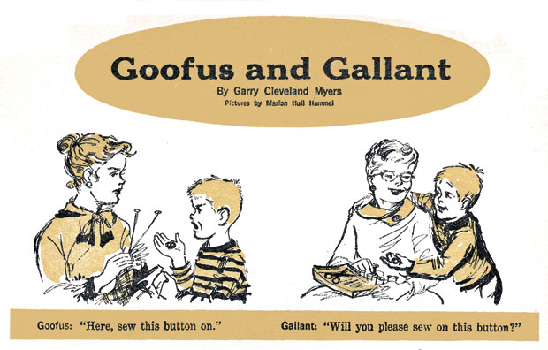
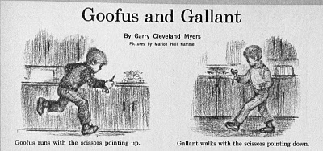
Solving Systems of Equations
Don’ts:
Don’t invert the matrix (x = A⁻¹b). That’s much more costly than solving directly, and much more prone to numerical error.
Don’t write your own solver code. There are people who devote their whole careers to writing solvers. They know a lot more about writing solvers than we do.

Slide 29
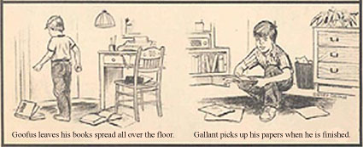
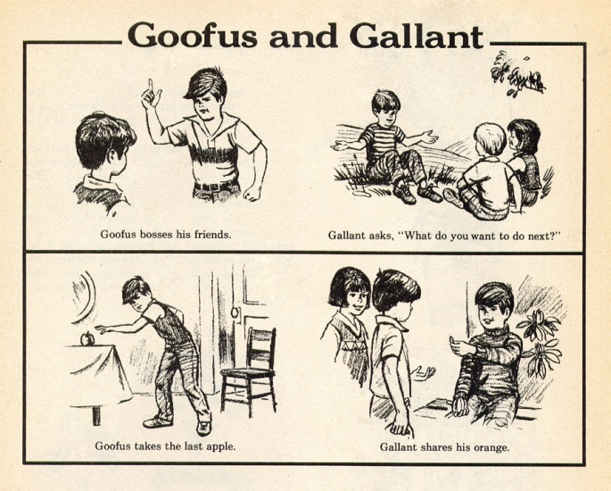
Solving Do’s
Do’s:
Do use standard, portable solver libraries.
Do use a version that’s tuned for the platform you’re running on, if available.
Do use the information that you have about your system of equations to pick the most efficient solver.

Slide 30
All About Your Matrix
If you know things about your matrix, you maybe can use a more efficient solver.
Symmetric: a_{i,j} = a_{j,i}
Positive definite: x^{T}Ax > 0 for all x ≠ 0 (for example, if all eigenvalues are positive)
Banded:
zero
except
on the
bands
Tridiagonal:
0
and …
0

Slide 31
Sparse Matrices
A sparse matrix is a matrix that has mostly zeros in it. “Mostly” is vaguely defined, but a good rule of thumb is that a matrix is sparse if more than, say, 90-95% of its entries are zero. (A non-sparse matrix is dense.)

Slide 32
Linear Algebra Libraries
BLAS ^{[1],[2]}
ATLAS^{[3]}
LAPACK^{[4]}
ScaLAPACK^{[5]}
PETSc^{[6],[7],[8]}

Slide 33
BLAS
The Basic Linear Algebra Subprograms (BLAS) are a set of low level linear algebra routines:
Level 1: Vector-vector (for example, dot product)
Level 2: Matrix-vector (for example, matrix-vector multiply)
Level 3: Matrix-matrix (for example, matrix-matrix multiply)
Many linear algebra packages, including LAPACK, ScaLAPACK and PETSc, are built on top of BLAS.
Most supercomputer vendors have versions of BLAS that are highly tuned for their platforms.

Slide 34
ATLAS
The Automatically Tuned Linear Algebra Software package (ATLAS) is a self-tuned version of BLAS (it also includes a few LAPACK routines).
When it’s installed, it tests and times a variety of approaches to each routine, and selects the version that runs the fastest.
ATLAS is substantially faster than the generic version of BLAS.
And, it’s FREE!

Slide 35
Goto BLAS
In the past several years, a new version of BLAS has been released, developed by Kazushige Goto (currently at UT Austin).
This version is unusual, because instead of optimizing for cache, it optimizes for the Translation Lookaside Buffer (TLB), which is a special little cache that often is ignored by software developers.
Goto realized that optimizing for the TLB would be more efficient than optimizing for cache.

Slide 36
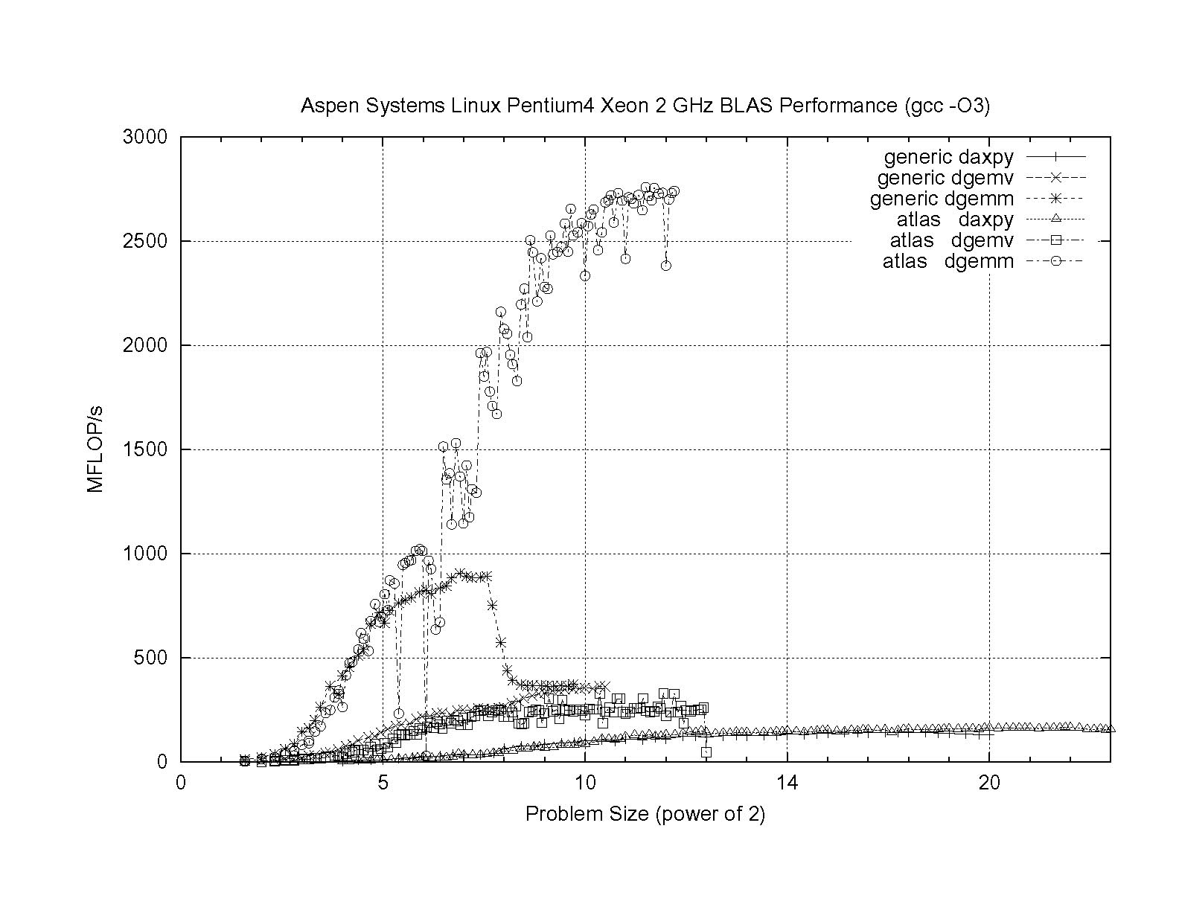
ATLAS vs. Generic BLAS
BETTER
ATLAS DGEMM: 2.76 GFLOP/s = 69% of peak
Generic DGEMM: 0.91 GFLOP/s = 23% of peak
DGEMM: Double precision GEneral Matrix-Matrix multiply
DGEMV: Double precision GEneral Matrix-Vector multiply

Slide 37
LAPACK
LAPACK (Linear Algebra PACKage) solves dense or special-case sparse systems of equations depending on matrix properties such as:
Precision: single, double
Data type: real, complex
Shape: diagonal, bidiagonal, tridiagonal, banded, triangular, trapezoidal, Hesenberg, general dense
Properties: orthogonal, positive definite, Hermetian (complex), symmetric, general
LAPACK is built on top of BLAS, which means it can benefit from ATLAS.

Slide 38
LAPACK Example
REAL,DIMENSION(numrows,numcols) :: A
REAL,DIMENSION(numrows) :: B
REAL,DIMENSION(numcols) :: X
INTEGER,DIMENSION(numrows) :: pivot
INTEGER :: row, col, info, numrhs = 1
DO row = 1, numrows
B(row) = …
END DO
DO col = 1, numcols
DO row = 1, numrows
A(row,col) = …
END DO
END DO
CALL sgesv(numrows, numrhs, A, numrows, pivot, &
& B, numrows, info)
DO col = 1, numcols
X(col) = B(col)
END DO

Slide 39
LAPACK: A Library and an API
LAPACK is a library that you can download for free from the Web:
www.netlib.org
But, it’s also an Application Programming Interface (API): a definition of a set of routines, their arguments, and their behaviors.
So, anyone can write an implementation of LAPACK.

Slide 40
It’s Good to Be Popular
LAPACK is a good choice for non-parallelized solving, because its popularity has convinced many supercomputer vendors to write their own, highly tuned versions.
The API for the LAPACK routines is the same as the portable version from NetLib, but the performance can be much better, via either ATLAS or proprietary vendor-tuned versions.
Also, some vendors have shared memory parallel versions of LAPACK.

Slide 41
LAPACK Performance
Because LAPACK uses BLAS, it’s about as fast as BLAS.
For example, DGESV (Double precision General SolVer) on a 2 GHz Pentium4 using ATLAS gets 65% of peak, compared to 69% of peak for Matrix-Matrix multiply.
In fact, an older version of LAPACK, called LINPACK, is used to determine the top 500 supercomputers in the world.

Slide 42
ScaLAPACK
ScaLAPACK is the distributed parallel (MPI) version of LAPACK. It actually contains only a subset of the LAPACK routines, and has a somewhat awkward Application Programming Interface (API).
Like LAPACK, ScaLAPACK is also available from
www.netlib.org.

Slide 43
PETSc
PETSc (Portable, Extensible Toolkit for Scientific Computation) is a solver library for sparse matrices that uses distributed parallelism (MPI).
PETSc is designed for general sparse matrices with no special properties, but it also works well for sparse matrices with simple properties like banding and symmetry.
It has a simpler, more intuitive Application Programming Interface than ScaLAPACK.

Slide 44
Pick Your Solver Package
Dense Matrix
Serial: LAPACK
Shared Memory Parallel: threaded LAPACK
Distributed Parallel: ScaLAPACK
Sparse Matrix: PETSc

Slide 45
I/O Libraries

Slide 46
I/O Challenges
I/O presents two important challenges to scientific computing:
Performance
Portability
The performance issue arises because I/O is much more time-consuming than computation, as we saw in the “Storage Hierarchy” session.
The portability issue arises because different kinds of computers can have different ways of representing real (floating point) numbers.

Slide 47
Storage Formats
When you use a PRINT statement in Fortran or a printf in C or output to cout in C++, you are asking the program to output data in human-readable form:
x = 5
PRINT *, x
But what if the value that you want to output is a real number with lots of significant digits?
1.3456789E+23

Slide 48
Data Output as Text
1.3456789E+23
When you output data as text, each character takes 1 byte.
So if you output a number with lots of digits, then you’re outputting lots of bytes.
For example, the above number takes 13 bytes to output as text.
Jargon: Text is sometimes called ASCII (American Standard Code for Information Interchange).

Slide 49
Output Data in Binary
Inside the computer, a single precision real number (Fortran REAL, C/C++ float) typically requires 4 bytes, and a double precision number (DOUBLE PRECISION or double) typically requires 8.
That’s less than 13.
Since I/O is very expensive, it’s better to output 4 or 8 bytes than 13 or more.
Happily, Fortran, C and C++ allow you to output data as binary (internal representation) rather than as text.

Slide 50
Binary Output Problems
When you output data as binary rather than as text, you output substantially fewer bytes, so you save time (since I/O is very expensive) and you save disk space.
But, you pay two prices:
Readability: Humans can’t read binary.
Portability: Different kinds of computers have different ways of internally representing numbers.

Slide 51
Binary Readability: No Problem
Readability of binary data isn’t a problem in scientific computing, because:
You can always write a little program to read in the binary data and display its text equivalent.
If you have lots and lots of data (that is, MBs or GBs), you wouldn’t want to look at all of it anyway.

Slide 52
Binary Portability: Big Problem
Binary data portability is a very big problem in scientific computing, because data that’s output on one kind of computer may not be readable on another, and so:
You can’t output the data on one kind of computer and then use them (for example, visualize, analyze) on another kind.
Some day the kind of computer that output the data will be obsolete, so there may be no computer in the world that can input it, and thus the data are lost.

Slide 53
Portable Binary Data
The HPC community noticed this problem some years ago, and so a number of portable binary data formats were developed.
The two most popular are:
HDF (Hierarchical Data Format) from the National Center for Supercomputing Applications:
http://www.hdfgroup.org/
NetCDF (Network Common Data Form) from Unidata:
http://www.unidata.ucar.edu/software/netcdf

Slide 54
Advantages of Portable I/O
Portable binary I/O packages:
give you portable binary I/O;
have simple, clear APIs;
are available for free;
run on most platforms;
allow you to annotate your data (for example, put into the file the variable names, units, experiment name, grid description, etc).
Also, both HDF and netCDF support distributed parallel I/O.

Slide 55
Scientific Visualization

Slide 56
Too Many Numbers
A typical scientific code outputs lots and lots of data.
For example, the ARPS weather forecasting code, running a 5 day forecast over the continental U.S. with a resolution of 1 km horizontal and 0.25 km vertical outputting data for every hour would produce about 10 terabytes (10¹³ bytes).
No one can look at that many numbers.

Slide 57
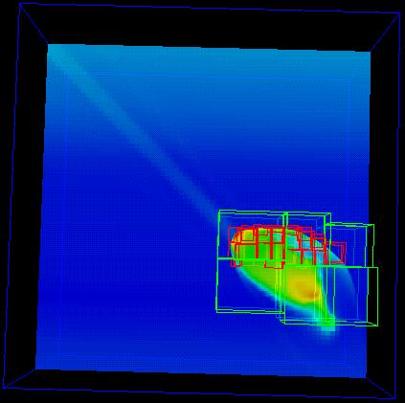
A Picture is Worth …
… millions of numbers.
This is Comet Shoemaker-Levy 9, which hit Jupiter in 1994; the image is from 35 seconds after hitting Jupiter’s inner atmosphere.^{[9]}

Slide 58
Types of Visualization
Contour lines
Slice planes
Isosurfaces
Streamlines
Volume rendering
… and many others.
Note: except for the volume rendering, the following images were created by Vis5D,^{[10]} which you can download for free.

Slide 59
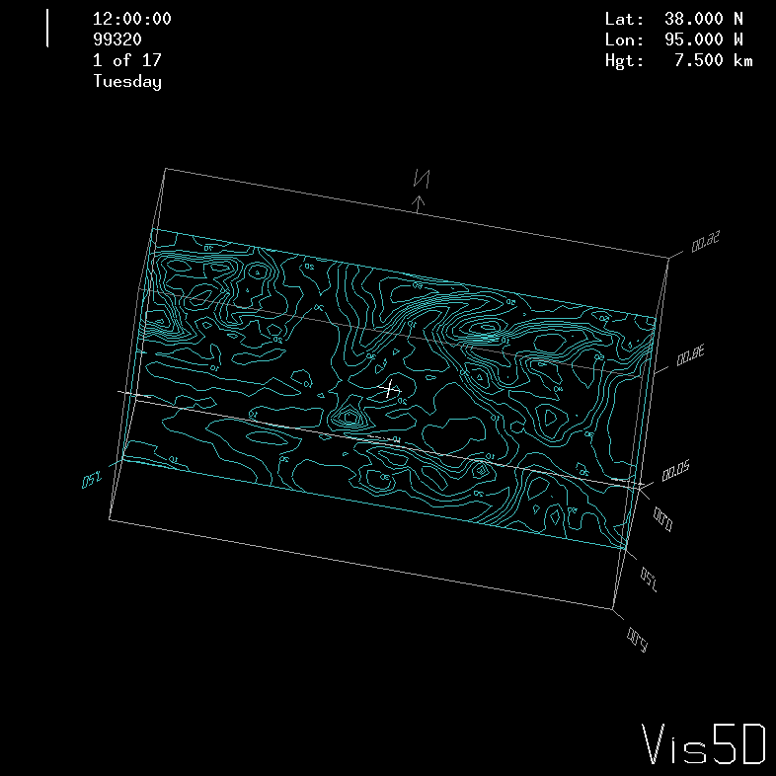
Contour Lines
This image shows contour lines of relative humidity. Each contour line represents a single humidity value.

Slide 60
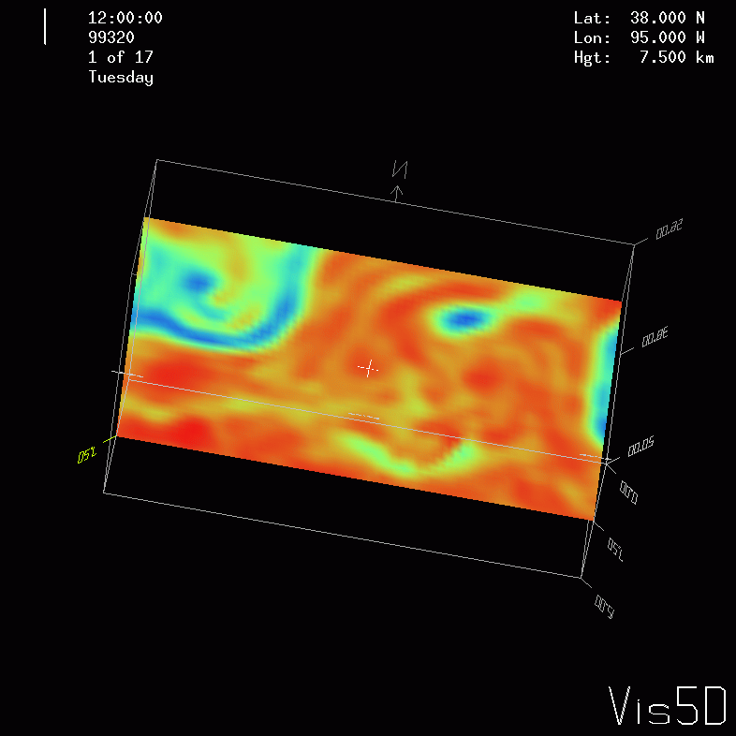
Slice Planes
A slice plane is a single plane passed through a 3D volume. Typically, it is color coded by mapping some scalar variable to color (for example, low vorticity to blue, high vorticity to red).

Slide 61
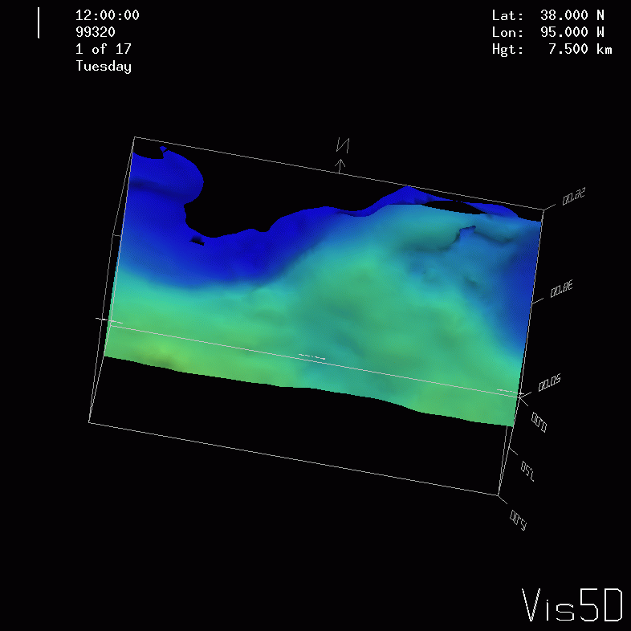
Isosurfaces
An isosurface is a surface that has a constant value for some scalar quantity. This image shows an isosurface of temperature at 0º Celsius, colored with pressure.

Slide 62
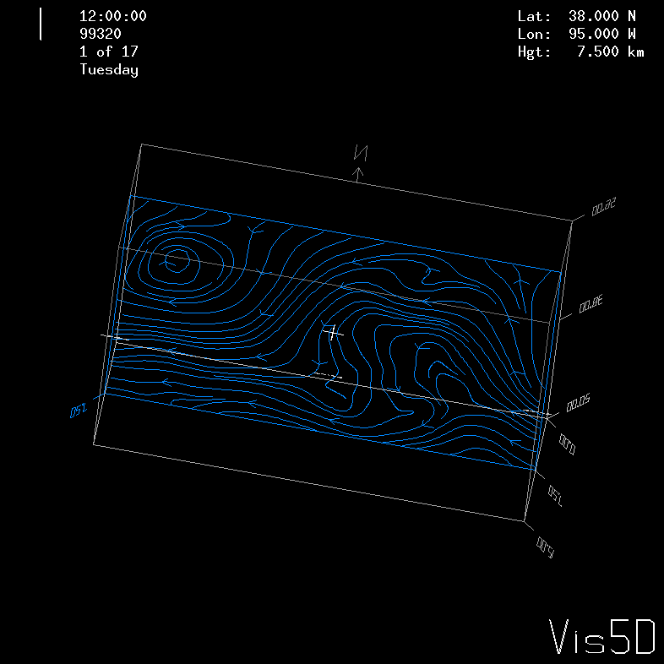
Streamlines
A streamline traces a vector quantity (for example, velocity).

Slide 63
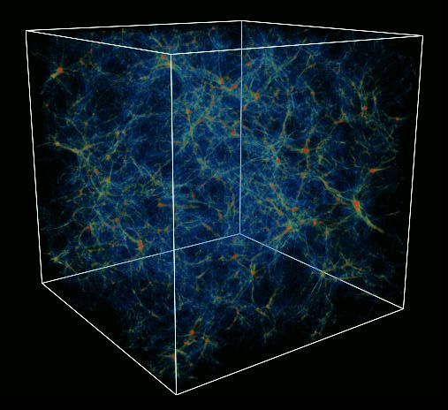
Volume Rendering
A volume rendering is created by mapping some variable (for example, energy) to color and another variable (for example, density) to opacity.
This image shows the overall structure of the universe.^{[11]}
Notice that the image looks like thick colored smoke.

Slide 64
Summer Workshops 2011
Introduction to Computational Thinking
Modeling and Simulation Across the Curriculum
June 19 - 25, Wayne State College, Wayne NE
July 10 - 16, Texas State Technical College, Waco
Preparing In-service and Pre-service Educators for Computational Thinking
July 24 - 30, Oregon State University, Corvallis
Computational Thinking from a Parallel Perspective
July 31 - Aug 6, Louisiana State University, Baton Rouge

Slide 65
Summer Workshops 2011 (cont’d)
Computational Biology for Biology Educators
June 12 - 18, Lafayette College, Easton PA
June 26 - July 2, Calvin College, Grand Rapids MI
Computational Chemistry for Chemistry Educators
July 24 - 30, Washington and Lee University, Lexington VA
JOINTLY PRESENTED VIA VIDEOCONFERENCING WITH
July 24 - 30, Oklahoma State University, Stillwater
Data-driven Computational Science: Modeling and Visualization
June 19 - 25, Richard Stockton College of New Jersey, Pomona

Slide 66
Summer Workshops 2011 (cont’d)
Introduction to Parallel Programming & Cluster Computing
June 26 - July 1, Idaho State University, Pocatello
JOINTLY PRESENTED VIA VIDEOCONFERENCING WITH
June 26 - July 1, University of Washington, Seattle
Intermediate Parallel Programming & Cluster Computing
July 31 - Aug 6, University of Oklahoma, Norman
JOINTLY PRESENTED VIA VIDEOCONFERENCING WITH
July 31 - Aug 6, Polytechnic University of Puerto Rico, Hato Rey

Slide 67
OK Supercomputing Symposium 2011
2003 Keynote:
Peter Freeman
NSF
Computer & Information
Science & Engineering
Assistant Director
2004 Keynote:
Sangtae Kim
NSF Shared
Cyberinfrastructure
Division Director
2005 Keynote:
Walt Brooks
NASA Advanced
Supercomputing
Division Director
2006 Keynote:
Dan Atkins
Head of NSF’s
Office of
Cyberinfrastructure
2007 Keynote:
Jay Boisseau
Director
Texas Advanced
Computing Center
U. Texas Austin
2008 Keynote: José Munoz Deputy Office Director/ Senior Scientific Advisor NSF Office of Cyberinfrastructure
?
FREE! Wed Oct 12 2011 @ OU
Over 235 registratons already!
Over 150 in the first day, over 200 in the first week, over 225 in the first month.
http://symposium2011.oscer.ou.edu/
Parallel Programming Workshop FREE! Tue Oct 11 2011 @ OU
FREE! Symposium Wed Oct 12 2011 @ OU
REGISTRATION IS NOW OPEN!
2009 Keynote: Douglass Post Chief Scientist US Dept of Defense HPC Modernization Program
2010 Keynote: Horst Simon Deputy Director Lawrence Berkeley National Laboratory
2011 Keynote to be announced

Slide 68
SC11 Education Program
At the SC11 supercomputing conference, we’ll hold our annual Education Program, Sat Nov 12 – Tue Nov 15.
You can apply to attend, either fully funded by SC11 or self-funded.
Henry is the SC11 Education Chair.
We’ll alert everyone once the registration website opens.

Slide 69
Thanks for your attention! Questions? www.oscer.ou.edu

Slide 70
References
[1] C. L. Lawson, R. J. Hanson, D. Kincaid, and F. T. Krogh, Basic Linear Algebra Subprograms for FORTRAN Usage, ACM Trans. Math. Soft., 5 (1979), pp. 308--323.
[2] http://www.netlib.org/blas/
[3] http://math-atlas.sourceforge.net/
[4] E. Anderson, Z. Bai, C. Bischof, S. Blackford, J. Demmel, J. Dongarra, J. Du Croz, A. Greenbaum, S. Hammarling, A. McKenney, D. Sorensen, LAPACK Users' Guide, 3rd ed, 1999. http://www.netlib.org/lapack/
[5] L. S. Blackford, J. Choi, A. Cleary, E. D'Azevedo, J. Demmel, I. Dhillon, J. Dongarra, S. Hammarling, G. Henry, A. Petitet, K. Stanley, D. Walker, R. C. Whaley, ScaLAPACK Users' Guide, 1997. http://www.netlib.org/scalapack/
[6] S. Balay, K. Buschelman, W. D. Gropp, D. Kaushik, L. Curfman McInnes and B. F. Smith, PETSc home page, 2001. http://www.mcs.anl.gov/petsc
[7] S. Balay, W. D. Gropp. L. Curfman McInnes and B. Smith, PETSc Users Manual, ANL-95/11 - Revision 2.1.0, Argonne National Laboratory, 2001.
[8] S. Balay, W. D. Gropp, L. Curfman McInnes and B. F. Smith, "Efficient Management of Parallelism in Object Oriented Numerical Software Libraries", in Modern Software Tools in Scientific Computing, E. Arge, A. M. Bruaset and H. P. Langtangen, editors, Birkhauser Press, 1997, 163-202.
[9] http://hneeman.oscer.ou.edu/hamr.html
[10] http://www.ssec.wisc.edu/~billh/vis5d.html
[11] Image by Greg Bryan, MIT.

