Slide 1



Supercomputing in Plain English Overview: What the Heck is Supercomputing?
Henry Neeman, Director
OU Supercomputing Center for Education & Research
University of Oklahoma Information Technology
Tuesday January 25 2011

Slide 2
This is an experiment!
It’s the nature of these kinds of videoconferences that FAILURES ARE GUARANTEED TO HAPPEN! NO PROMISES!
So, please bear with us. Hopefully everything will work out well enough.
If you lose your connection, you can retry the same kind of connection, or try connecting another way.
Remember, if all else fails, you always have the toll free phone bridge to fall back on.

Slide 3
Access Grid
If you aren’t sure whether you have AG, you probably don’t.
Tue Jan 25 | Platinum
Tue Feb 1 | Cactus
Tue Feb 8 | NO WORKSHOP
Tue Feb 15 | Walkabout
Tue Feb 22 | Optiverse
Tue March 1 | Walkabout
Tue March 8 | NO WORKSHOP
Tue March 15 | NO WORKSHOP
Tue March 22 | Axon
Tue March 29 | NO WORKSHOP
Tue Apr 5 | Axon
Tue Apr 12 | Platinum
Tue Apr 19 | Mosaic
Tue Apr 26 | Monte Carlo
Tue May 3 | Helium
Many thanks to Patrick Calhoun of OU for setting these up for us.

Slide 4
H.323 (Polycom etc)
If you want to use H.323 videoconferencing – for example, Polycom – then:
If you ARE already registered with the OneNet gatekeeper, dial 2500409.
If you AREN’T registered with the OneNet gatekeeper (which is probably the case), then:
Dial 164.58.250.47
When asked for the conference ID, enter:
#0409#
Many thanks to Roger Holder and OneNet for providing this.

Slide 5
H.323 from Internet Explorer
From a Windows PC running Internet Explorer:
You MUST have the ability to install software on the PC (or have someone install it for you).
Download and install the latest Java Runtime Environment (JRE) from here (click on the Java Download icon, because that install package includes both the JRE and other components).
Download and install this video decoder.
Start Internet Explorer.
Copy-and-paste this URL into your IE window: http://164.58.250.47/
When that webpage loads, in the upper left, click on "Streaming".
In the textbox labeled Sign-in Name, type your name.
In the textbox labeled Conference ID, type this: 0409
Click on "Stream this conference".
When that webpage loads, you may see, at the very top, a bar offering you options. If so, click on it and choose "Install this add-on."

Slide 6
EVO
There’s a quick tutorial on the OSCER education webpage.

Slide 7
QuickTime Broadcaster
If you cannot connect via the Access Grid, H.323 or iLinc, then you can connect via QuickTime:
rtsp://129.15.254.141/test_hpc09.sdp
We recommend using QuickTime Player for this, because we’ve tested it successfully.
We recommend upgrading to the latest version at:
http://www.apple.com/quicktime/
When you run QuickTime Player, traverse the menus
File -> Open URL
Then paste in the rstp URL into the textbox, and click OK.
Many thanks to Kevin Blake of OU for setting up QuickTime Broadcaster for us.

Slide 8
WebEx
We have only a limited number of WebEx connections, so please avoid WebEx unless you have NO OTHER WAY TO CONNECT.
Instructions are available on the OSCER education webpage.
Thanks to Tim Miller of Wake Forest U.

Slide 9
Phone Bridge
If all else fails, you can call into our toll free phone bridge:
1-866-285-7778, access code 6483137#
Please mute yourself and use the phone to listen.
Don’t worry, we’ll call out slide numbers as we go.
Please use the phone bridge ONLY if you cannot connect any other way: the phone bridge is charged per connection per minute, so our preference is to minimize the number of connections.
Many thanks to Amy Apon and U Arkansas for providing the toll free phone bridge.

Slide 10
Please Mute Yourself
No matter how you connect, please mute yourself, so that we cannot hear you.
At OU, we will turn off the sound on all conferencing technologies.
That way, we won’t have problems with echo cancellation.
Of course, that means we cannot hear questions.
So for questions, you’ll need to send some kind of text.

Slide 11
Questions via Text: iLinc or E-mail
Ask questions via e-mail to sipe2011@yahoo.com.
All questions will be read out loud and then answered out loud.

Slide 12
Thanks for helping!
OSCER operations staff (Brandon George, Dave Akin, Brett Zimmerman, Josh Alexander)
Horst Severini, OSCER Associate Director for Remote & Heterogeneous Computing
OU Research Campus staff (Patrick Calhoun, Mark McAvoy)
Kevin Blake, OU IT (videographer)
John Chapman, Jeff Pummill and Amy Apon, U Arkansas
James Deaton and Roger Holder, OneNet
Tim Miller, Wake Forest U

Slide 13
This is an experiment!
It’s the nature of these kinds of videoconferences that FAILURES ARE GUARANTEED TO HAPPEN! NO PROMISES!
So, please bear with us. Hopefully everything will work out well enough.
If you lose your connection, you can retry the same kind of connection, or try connecting another way.
Remember, if all else fails, you always have the toll free phone bridge to fall back on.

Slide 14
Supercomputing Exercises
Want to do the “Supercomputing in Plain English” exercises?
The first exercise is already posted at:
http://www.oscer.ou.edu/education.php
If you don’t yet have a supercomputer account, you can get a temporary account, just for the “Supercomputing in Plain English” exercises, by sending e-mail to:
hneeman@ou.edu
Please note that this account is for doing the exercises only, and will be shut down at the end of the series.
This week’s Introductory exercise will teach you how to compile and run jobs on OU’s big Linux cluster supercomputer, which is named Sooner.

Slide 15
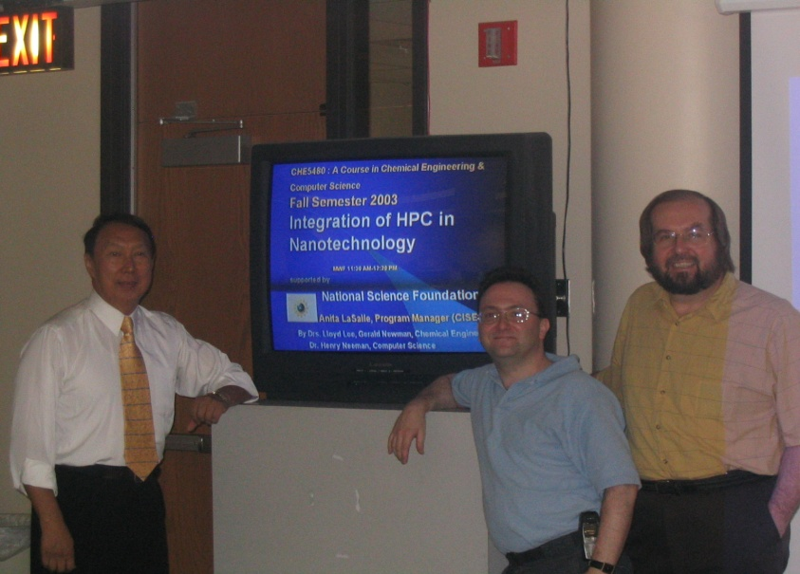
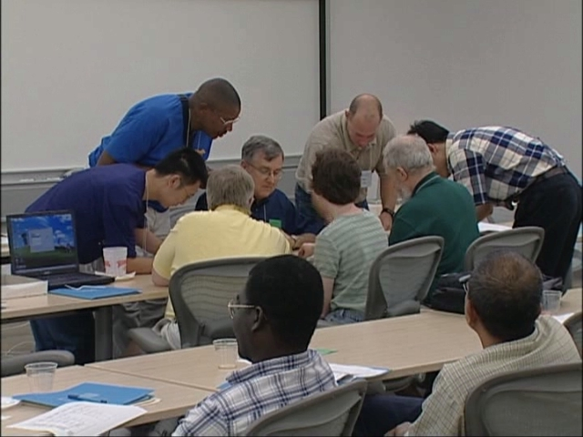
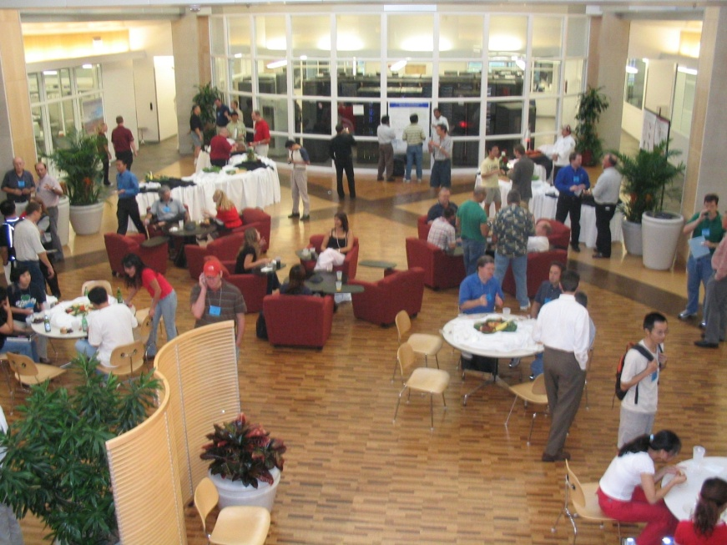
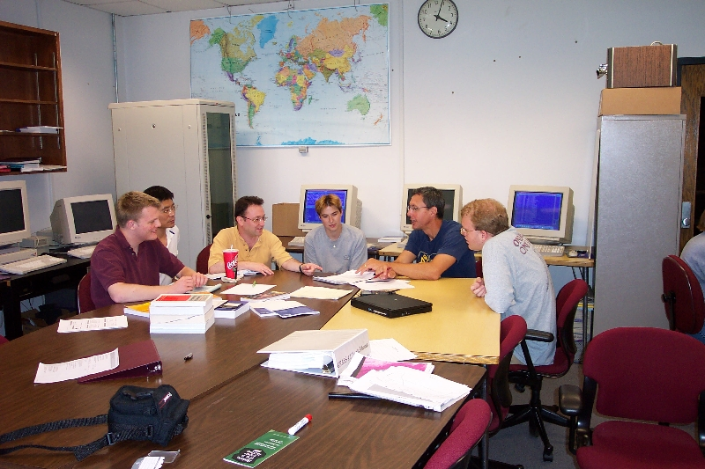
People

Slide 16
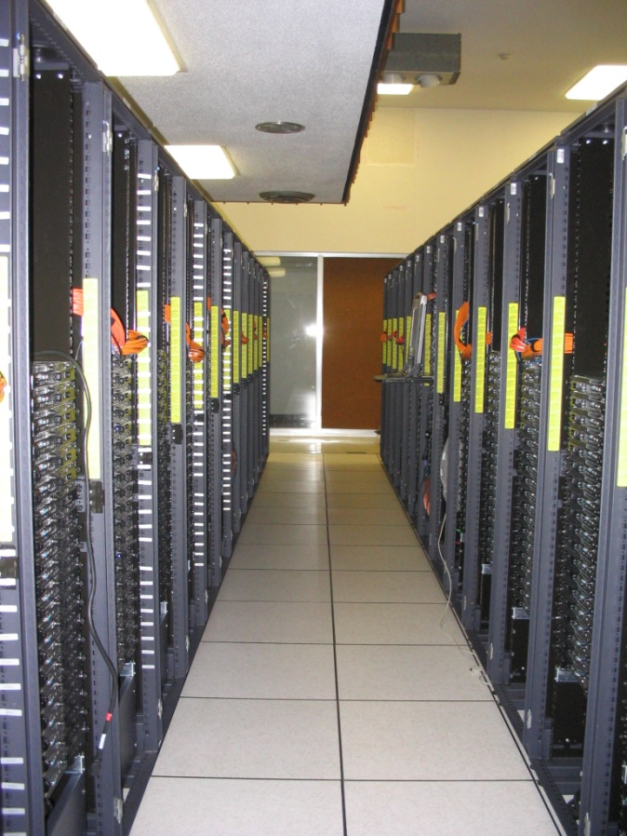
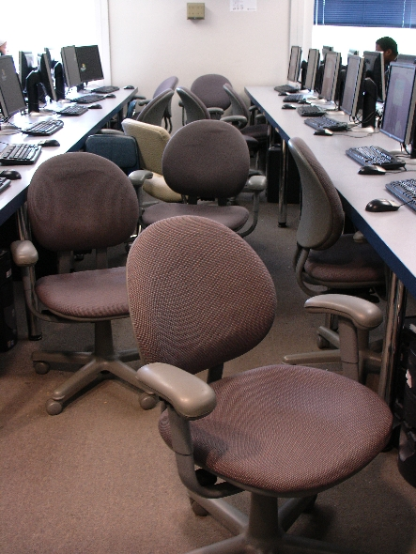
Things

Slide 17
Thanks for your attention! Questions? www.oscer.ou.edu

Slide 18
What is Supercomputing?
Supercomputing is the biggest, fastest computing right this minute.
Likewise, a supercomputer is one of the biggest, fastest computers right this minute.
So, the definition of supercomputing is constantly changing.
Rule of Thumb: A supercomputer is typically at least 100 times as powerful as a PC.
Jargon: Supercomputing is also known as High Performance Computing (HPC) or High End Computing (HEC) or Cyberinfrastructure (CI).

Slide 19
Fastest Supercomputer vs. Moore
GFLOPs:
billions of calculations per second

Slide 20
What is Supercomputing About?
Size
Speed
Laptop

Slide 21
What is Supercomputing About?
Size: Many problems that are interesting to scientists and engineers can’t fit on a PC – usually because they need more than a few GB of RAM, or more than a few 100 GB of disk.
Speed: Many problems that are interesting to scientists and engineers would take a very very long time to run on a PC: months or even years. But a problem that would take a month on a PC might take only a few hours on a supercomputer.

Slide 22
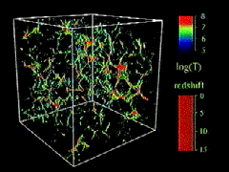
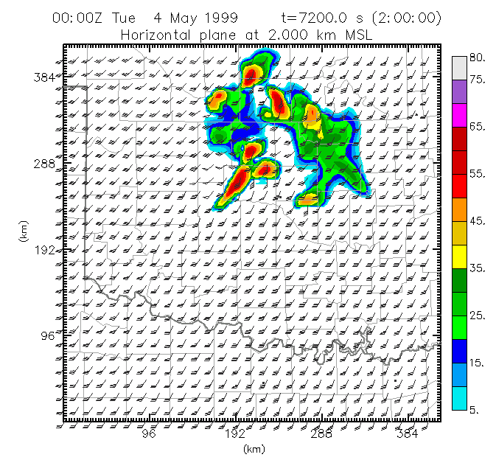
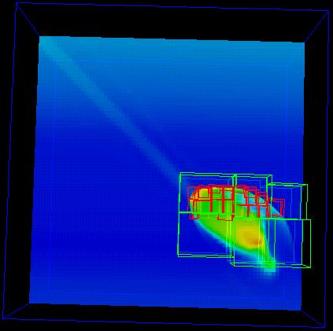
What Is HPC Used For?
Simulation of physical phenomena, such as
Weather forecasting
Galaxy formation
Oil reservoir management
Data mining: finding needles of information in a haystack of data,
such as
Gene sequencing
Signal processing
Detecting storms that might produce tornados
Visualization: turning a vast sea of data into pictures that a scientist can understand
^{[1]}
Moore, OK
Tornadic
Storm
May 3 1999^{[2]}
^{[3]}

Slide 23
Supercomputing Issues
The tyranny of the storage hierarchy
Parallelism: doing multiple things at the same time

Slide 24
OSCER

Slide 25

What is OSCER?
Multidisciplinary center
Division of OU Information Technology
Provides:
Supercomputing education
Supercomputing expertise
Supercomputing resources: hardware, storage, software
For:
Undergrad students
Grad students
Staff
Faculty
Their collaborators (including off campus)

Slide 26
Who is OSCER? Academic Depts
Aerospace & Mechanical Engr
Anthropology
Biochemistry & Molecular Biology
Biological Survey
Botany & Microbiology
Chemical, Biological & Materials Engr
Chemistry & Biochemistry
Civil Engr & Environmental Science
Computer Science
Economics
Electrical & Computer Engr
Finance
Health & Sport Sciences
History of Science
Industrial Engr
Geography
Geology & Geophysics
Library & Information Studies
Mathematics
Meteorology
Petroleum & Geological Engr
Physics & Astronomy
Psychology
Radiological Sciences
Surgery
Zoology
E
E
E
E
More than 150 faculty & staff in 26 depts in Colleges of Arts & Sciences, Atmospheric & Geographic Sciences, Business, Earth & Energy, Engineering, and Medicine – with more to come!

Slide 27
Who is OSCER? Groups
Advanced Center for Genome Technology
Center for Analysis & Prediction of Storms
Center for Aircraft & Systems/Support Infrastructure
Cooperative Institute for Mesoscale Meteorological Studies
Center for Engineering Optimization
Fears Structural Engineering Laboratory
Human Technology Interaction Center
Institute of Exploration & Development Geosciences
Instructional Development Program
Interaction, Discovery, Exploration, Adaptation Laboratory
Microarray Core Facility
OU Information Technology
OU Office of the VP for Research
Oklahoma Center for High Energy Physics
Robotics, Evolution, Adaptation, and Learning Laboratory
Sasaki Applied Meteorology Research Institute
Symbiotic Computing Laboratory
E
E
E
E

Slide 28
Who? External Collaborators
California State Polytechnic University Pomona (masters)
Colorado State University
Contra Costa College (CA, 2-year)
Delaware State University (EPSCoR, masters)
Earlham College (IN, bachelors)
East Central University (OK, EPSCoR, masters)
Emporia State University (KS, EPSCoR, masters)
Great Plains Network
Harvard University (MA)
Kansas State University (EPSCoR)
Langston University (OK, EPSCoR, masters)
Longwood University (VA, masters)
Marshall University (WV, EPSCoR, masters)
Navajo Technical College (NM, EPSCoR, 2-year)
NOAA National Severe Storms Laboratory (EPSCoR)
NOAA Storm Prediction Center (EPSCoR)
Oklahoma Baptist University (EPSCoR, bachelors)
Oklahoma City University (EPSCoR, masters)
Oklahoma Climatological Survey (EPSCoR)
Oklahoma Medical Research Foundation (EPSCoR)
Oklahoma School of Science & Mathematics (EPSCoR, high school)
Oklahoma State University (EPSCoR)
Purdue University (IN)
Riverside Community College (CA, 2-year)
St. Cloud State University (MN, masters)
St. Gregory’s University (OK, EPSCoR, bachelors)
Southwestern Oklahoma State University (EPSCoR, masters)
Syracuse University (NY)
Texas A&M University-Corpus Christi (masters)
University of Arkansas (EPSCoR)
University of Arkansas Little Rock (EPSCoR)
University of Central Oklahoma (EPSCoR)
University of Illinois at Urbana-Champaign
University of Kansas (EPSCoR)
University of Nebraska-Lincoln (EPSCoR)
University of North Dakota (EPSCoR)
University of Northern Iowa (masters)
E
E
E
E

Slide 29
Who Are the Users?
Over 750 users so far, including:
Roughly equal split between students vs faculty/staff (students are the bulk of the active users);
many off campus users (roughly 20%);
… more being added every month.
Comparison: TeraGrid, consisting of 11 resource provide sites across the US, has ~5000 unique users.

Slide 30


Biggest Consumers
Center for Analysis & Prediction of Storms: daily real time weather forecasting
Oklahoma Center for High Energy Physics: simulation and data analysis of banging tiny particles together at unbelievably high speeds
Chemical Engineering: lots and lots of molecular dynamics

Slide 31
Why OSCER?
Computational Science & Engineering has become sophisticated enough to take its place alongside experimentation and theory.
Most students – and most faculty and staff – don’t learn much CSE, because CSE is seen as needing too much computing background, and as needing HPC, which is seen as very hard to learn.
HPC can be hard to learn: few materials for novices; most documents written for experts as reference guides.
We need a new approach: HPC and CSE for computing novices – OSCER’s mandate!

Slide 32
Why Bother Teaching Novices?
Application scientists & engineers typically know their applications very well, much better than a collaborating computer scientist ever would.
Commercial software lags far behind the research community.
Many potential CSE users don’t need full time CSE and HPC staff, just some help.
One HPC expert can help dozens of research groups.
Today’s novices are tomorrow’s top researchers, especially because today’s top researchers will eventually retire.

Slide 33
What Does OSCER Do? Teaching
Science and engineering faculty from all over America learn
supercomputing at OU by playing with a jigsaw puzzle (NCSI @ OU 2004).

Slide 34
What Does OSCER Do? Rounds
OU undergrads, grad students, staff and faculty learn
how to use supercomputing in their specific research.

Slide 35
OSCER Resources

Slide 36
OK Cyberinfrastructure Initiative
All academic institutions in Oklahoma are eligible to sign up for free use of OU’s and OSU’s centrally-owned CI resources.
Other kinds of institutions (government, NGO, commercial) are eligible to use, though not necessarily for free.
Everyone can participate in our CI education initiative.
The Oklahoma Supercomputing Symposium, our annual conference, continues to be offered to all.

Slide 37
Dell Intel Xeon Linux Cluster
1,076 Intel Xeon CPU chips/4288 cores
528 dual socket/quad core Harpertown 2.0 GHz, 16 GB each
3 dual socket/quad core Harpertown 2.66 GHz, 16 GB each
3 dual socket/quad core Clovertown 2.33 GHz, 16 GB each
2 x quad socket/quad core Tigerton, 2.4 GHz, 128 GB each
8,800 GB RAM
~130 TB globally accessible disk
QLogic Infiniband
Force10 Networks Gigabit Ethernet
Red Hat Enterprise Linux 5
Peak speed: 34.5 TFLOPs*
*TFLOPs: trillion calculations per second
sooner.oscer.ou.edu

Slide 38
Dell Intel Xeon Linux Cluster
DEBUTED NOVEMBER 2008 AT:
#90 worldwide
#47 in the US
#14 among US academic
#10 among US academic excluding TeraGrid
#2 in the Big 12
#1 in the Big 12 excluding TeraGrid
sooner.oscer.ou.edu

Slide 39
Dell Intel Xeon Linux Cluster
Purchased mid-July 2008
First friendly user Aug 15 2008
Full production Oct 3 2008
Christmas Day 2008: >~75% of nodes and ~66% of cores were in use.
sooner.oscer.ou.edu

Slide 40

What is a Cluster?
“… [W]hat a ship is … It's not just a keel and hull and a deck and sails. That's what a ship needs. But what a ship is ... is freedom.”
– Captain Jack Sparrow
“Pirates of the Caribbean”

Slide 41
What a Cluster is ….
A cluster needs of a collection of small computers, called nodes, hooked together by an interconnection network (or interconnect for short).
It also needs software that allows the nodes to communicate over the interconnect.
But what a cluster is … is all of these components working together as if they’re one big computer ... a super computer.

Slide 42
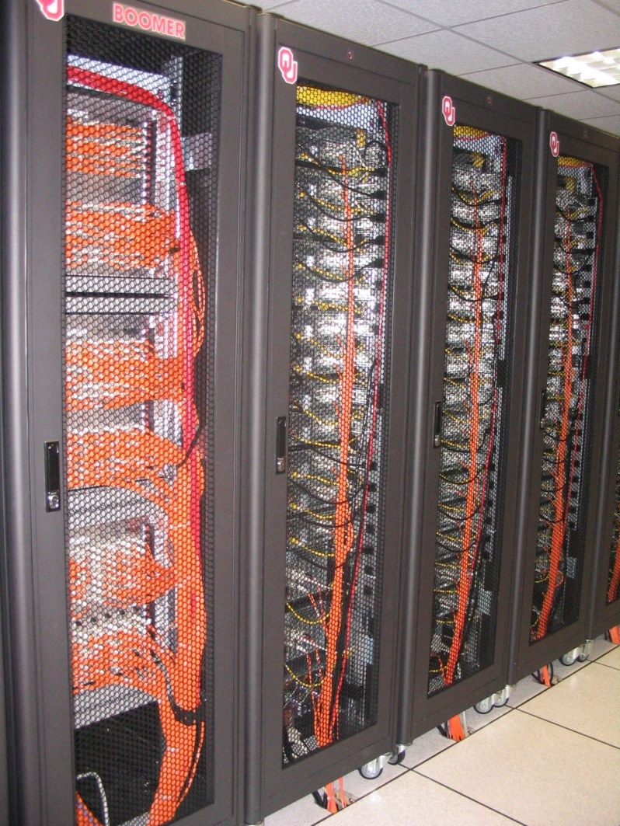
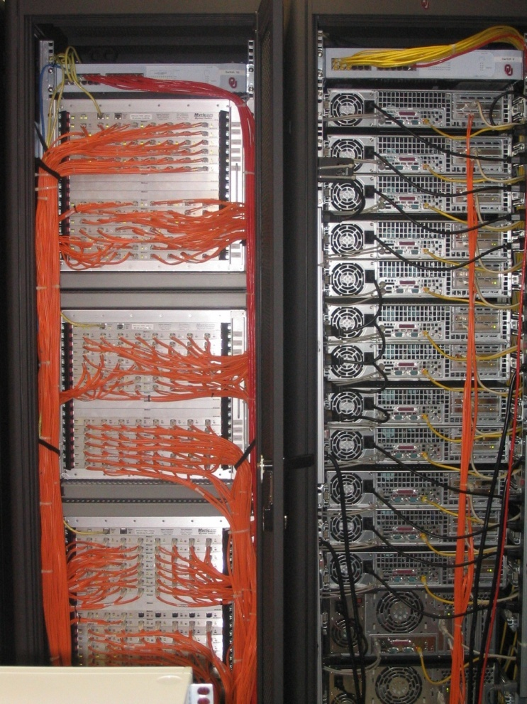
An Actual Cluster
Interconnect
Nodes

Slide 43
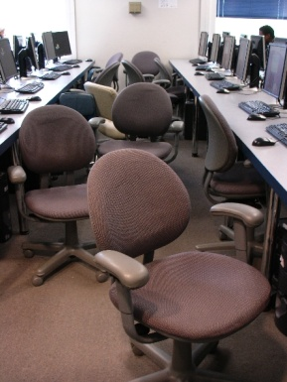
Condor Pool
Condor is a software technology that allows idle desktop PCs to be used for number crunching.
OU IT has deployed a large Condor pool (795 desktop PCs in IT student labs all over campus).
It provides a huge amount of additional computing power – more than was available in all of OSCER in 2005.
20+ TFLOPs peak compute speed.
And, the cost is very very low – almost literally free.
Also, we’ve been seeing empirically that Condor gets about 80% of each PC’s time.

Slide 44
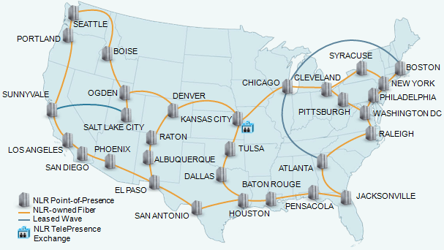
National Lambda Rail

Slide 45
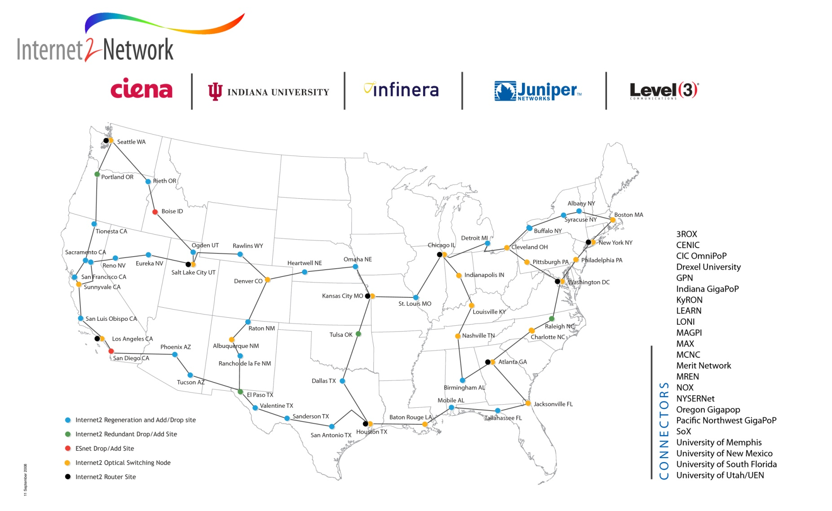
Internet2
www.internet2.edu

Slide 46
NEW GRANT! NSF EPSCoR C2
Oklahoma has been awarded an NSF EPSCoR RII Intra- campus and Inter-campus Cyber Connectivity (C2) grant (PI Neeman), a collaboration among OU, OneNet and several other academic and nonprofit institutions, which will:
upgrade the statewide ring from routed components to optical components, making it straightforward and affordable to provision dedicated “lambda” circuits within the state;
upgrade several institutions’ connections;
provide telepresence capability to institutions statewide;
provide networking professionals to speak to data networks courses about what it’s like to do networking for a living.

Slide 47
NEW GRANT: Petascale Storage
OU has been awarded an NSF Major Research Instrumentation (MRI) grant (PI Neeman).
We’ll purchase and deploy a combined disk/tape bulk storage archive:
the NSF budget will pay for the hardware, software and warranties/maintenance for 3 years;
OU cost share and institutional commitment will pay for space, power, cooling and labor, as well as maintenance after the 3 year project period;
individual users (e.g., faculty across Oklahoma) will pay for the media (disk drives and tape cartridges).

Slide 48
A Quick Primer on Hardware

Slide 49

Henry’s Laptop
Dell Latitude Z600^{[4]}
Intel Core2 Duo SU9600 1.6 GHz w/3 MB L2 Cache
4 GB 1066 MHz DDR3 SDRAM
256 GB SSD Hard Drive
DVD+RW/CD-RW Drive (8x)
1 Gbps Ethernet Adapter

Slide 50
Typical Computer Hardware
Central Processing Unit
Primary storage
Secondary storage
Input devices
Output devices

Slide 51
Central Processing Unit
Also called CPU or processor: the “brain”
Components
Control Unit: figures out what to do next – for example, whether to load data from memory, or to add two values together, or to store data into memory, or to decide which of two possible actions to perform (branching)
Arithmetic/Logic Unit: performs calculations – for example, adding, multiplying, checking whether two values are equal
Registers: where data reside that are being used right now

Slide 52
Primary Storage
Main Memory
Also called RAM (“Random Access Memory”)
Where data reside when they’re being used by a program that’s currently running
Cache
Small area of much faster memory
Where data reside when they’re about to be used and/or have been used recently
Primary storage is volatile: values in primary storage disappear when the power is turned off.

Slide 53
Secondary Storage
Where data and programs reside that are going to be used in the future
Secondary storage is non-volatile: values don’t disappear when power is turned off.
Examples: hard disk, CD, DVD, Blu-ray, magnetic tape, floppy disk
Many are portable: can pop out the CD/DVD/tape/floppy and take it with you

Slide 54
Input/Output
Input devices – for example, keyboard, mouse, touchpad, joystick, scanner
Output devices – for example, monitor, printer, speakers

Slide 55
The Tyranny of the Storage Hierarchy

Slide 56
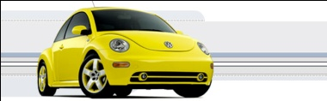
The Storage Hierarchy
Fast, expensive, few
Registers
Cache memory
Main memory (RAM)
Hard disk
Removable media (CD, DVD etc)
Internet
Slow, cheap, a lot
[5]

Slide 57
RAM is Slow
CPU
307 GB/sec^{[6]}
The speed of data transfer
between Main Memory and the
CPU is much slower than the
speed of calculating, so the CPU
spends most of its time waiting
for data to come in or go out.
Bottleneck
4.4 GB/sec^{[7]} (1.4%)

Slide 58
Why Have Cache?
CPU
Cache is much closer to the speed
of the CPU, so the CPU doesn’t
have to wait nearly as long for
stuff that’s already in cache:
it can do more
operations per second!
27 GB/sec (9%)^{[7]}
4.4 GB/sec^{[7]} (1%)

Slide 59
Henry’s Laptop
Dell Latitude Z600^{[4]}
Intel Core2 Duo SU9600 1.6 GHz w/3 MB L2 Cache
4 GB 1066 MHz DDR3 SDRAM
256 GB SSD Hard Drive
DVD+RW/CD-RW Drive (8x)
1 Gbps Ethernet Adapter

Slide 60
Storage Speed, Size, Cost
Henry’s Laptop | Registers (Intel Core2 Duo 1.6 GHz) | Cache Memory (L2) | Main Memory (1066MHz DDR3 SDRAM) | Hard Drive (SSD) | Ethernet (1000 Mbps) | DVD+R (16x) | Phone Modem (56 Kbps)
Speed (MB/sec) [peak] | 314,573^{[6]} (12,800 MFLOP/s*) | 27,276 ^{[7]} | 4500 ^{[7]} | 250 ^{[9]} | 125 | 22 ^{[10]} | 0.007
Size (MB) | 464 bytes** ^{[11]} | 3 | 4096 | 256,000 | unlimited | unlimited | unlimited
Cost ($/MB) | – | $285 ^{[12]} | $0.03 ^{[12]} | $0.002 ^{[12]} | charged per month (typically) | $0.00005 ^{[12]} | charged per month (typically)
* MFLOP/s: millions of floating point operations per second
** 16 64-bit general purpose registers, 8 80-bit floating point registers,
16 128-bit floating point vector registers

Slide 61
Parallelism

Slide 62
Parallelism
Parallelism means doing multiple things at the same time: you can get more work done in the same time.
Less fish …
More fish!

Slide 63
The Jigsaw Puzzle Analogy

Slide 64
Serial Computing
Suppose you want to do a jigsaw puzzle
that has, say, a thousand pieces.
We can imagine that it’ll take you a
certain amount of time. Let’s say
that you can put the puzzle together in
an hour.

Slide 65
Shared Memory Parallelism
If Scott sits across the table from you, then he can work on his half of the puzzle and you can work on yours. Once in a while, you’ll both reach into the pile of pieces at the same time (you’ll contend for the same resource), which will cause a little bit of slowdown. And from time to time you’ll have to work together (communicate) at the interface between his half and yours. The speedup will be nearly 2-to-1: y’all might take 35 minutes instead of 30.

Slide 66
The More the Merrier?
Now let’s put Paul and Charlie on the other two sides of the table. Each of you can work on a part of the puzzle, but there’ll be a lot more contention for the shared resource (the pile of puzzle pieces) and a lot more communication at the interfaces. So y’all will get noticeably less than a 4-to-1 speedup, but you’ll still have an improvement, maybe something like 3-to-1: the four of you can get it done in 20 minutes instead of an hour.

Slide 67
Diminishing Returns
If we now put Dave and Tom and Horst and Brandon on the corners of the table, there’s going to be a whole lot of contention for the shared resource, and a lot of communication at the many interfaces. So the speedup y’all get will be much less than we’d like; you’ll be lucky to get 5-to-1.
So we can see that adding more and more workers onto a shared resource is eventually going to have a diminishing return.

Slide 68
Distributed Parallelism
Now let’s try something a little different. Let’s set up two tables, and let’s put you at one of them and Scott at the other. Let’s put half of the puzzle pieces on your table and the other half of the pieces on Scott’s. Now y’all can work completely independently, without any contention for a shared resource. BUT, the cost per communication is MUCH higher (you have to scootch your tables together), and you need the ability to split up (decompose) the puzzle pieces reasonably evenly, which may be tricky to do for some puzzles.

Slide 69
More Distributed Processors
It’s a lot easier to add more processors in distributed parallelism. But, you always have to be aware of the need to decompose the problem and to communicate among the processors. Also, as you add more processors, it may be harder to load balance the amount of work that each processor gets.

Slide 70
Load Balancing
Load balancing means ensuring that everyone completes their workload at roughly the same time.
For example, if the jigsaw puzzle is half grass and half sky, then you can do the grass and Scott can do the sky, and then y’all only have to communicate at the horizon – and the amount of work that each of you does on your own is roughly equal. So you’ll get pretty good speedup.

Slide 71
Load Balancing
Load balancing can be easy, if the problem splits up into chunks of roughly equal size, with one chunk per processor. Or load balancing can be very hard.

Slide 72
Load Balancing
EASY
Load balancing can be easy, if the problem splits up into chunks of roughly equal size, with one chunk per processor. Or load balancing can be very hard.

Slide 73
Load Balancing
EASY
HARD
Load balancing can be easy, if the problem splits up into chunks of roughly equal size, with one chunk per processor. Or load balancing can be very hard.

Slide 74
Moore’s Law

Slide 75
Moore’s Law
In 1965, Gordon Moore was an engineer at Fairchild Semiconductor.
He noticed that the number of transistors that could be squeezed onto a chip was doubling about every 18 months.
It turns out that computer speed is roughly proportional to the number of transistors per unit area.
Moore wrote a paper about this concept, which became known as “Moore’s Law.”

Slide 76
Fastest Supercomputer vs. Moore
GFLOPs:
billions of calculations per second

Slide 77
Moore’s Law in Practice
CPU
log(Speed)
Year

Slide 78
Moore’s Law in Practice
Network Bandwidth
CPU
log(Speed)
Year

Slide 79
Moore’s Law in Practice
Network Bandwidth
CPU
log(Speed)
RAM
Year

Slide 80
Moore’s Law in Practice
Network Bandwidth
log(Speed)
CPU
RAM
1/Network Latency
Year

Slide 81
Moore’s Law in Practice
Network Bandwidth
CPU
log(Speed)
RAM
1/Network Latency
Software
Year

Slide 82
Why Bother?

Slide 83
Why Bother with HPC at All?
It’s clear that making effective use of HPC takes quite a bit of effort, both learning how and developing software.
That seems like a lot of trouble to go to just to get your code to run faster.
It’s nice to have a code that used to take a day, now run in an hour. But if you can afford to wait a day, what’s the point of HPC?
Why go to all that trouble just to get your code to run faster?

Slide 84
Why HPC is Worth the Bother
What HPC gives you that you won’t get elsewhere is the ability to do bigger, better, more exciting science. If your code can run faster, that means that you can tackle much bigger problems in the same amount of time that you used to need for smaller problems.
HPC is important not only for its own sake, but also because what happens in HPC today will be on your desktop in about 10 to 15 years: it puts you ahead of the curve.

Slide 85
The Future is Now
Historically, this has always been true:
Whatever happens in supercomputing today will be on your desktop in 10 – 15 years.
So, if you have experience with supercomputing, you’ll be ahead of the curve when things get to the desktop.

Slide 86
Thanks for your attention! Questions? www.oscer.ou.edu

Slide 87
References
[1] Image by Greg Bryan, Columbia U.
[2] “Update on the Collaborative Radar Acquisition Field Test (CRAFT): Planning for the Next Steps.”
Presented to NWS Headquarters August 30 2001.
[3] See http://hneeman.oscer.ou.edu/hamr.html for details.
[4] http://www.dell.com/
[5] http://www.vw.com/newbeetle/
[6] Richard Gerber, The Software Optimization Cookbook: High-performance Recipes for the Intel Architecture. Intel Press, 2002, pp. 161-168.
[7] RightMark Memory Analyzer. http://cpu.rightmark.org/
[8] ftp://download.intel.com/design/Pentium4/papers/24943801.pdf
[9] http://www.samsungssd.com/meetssd/techspecs
[10] http://www.samsung.com/Products/OpticalDiscDrive/SlimDrive/OpticalDiscDrive_SlimDrive_SN_S082D.asp?page=Specifications
[11] ftp://download.intel.com/design/Pentium4/manuals/24896606.pdf
[12] http://www.pricewatch.com/

