Slide 1



Supercomputing in Plain English Multicore Madness
Henry Neeman, Director
OU Supercomputing Center for Education & Research
University of Oklahoma Information Technology
Tuesday April 12 2011

Slide 2
This is an experiment!
It’s the nature of these kinds of videoconferences that FAILURES ARE GUARANTEED TO HAPPEN! NO PROMISES!
So, please bear with us. Hopefully everything will work out well enough.
If you lose your connection, you can retry the same kind of connection, or try connecting another way.
Remember, if all else fails, you always have the toll free phone bridge to fall back on.

Slide 3
Access Grid
If you aren’t sure whether you have AG, you probably don’t.
Tue Apr 12 | Platinum
Tue Apr 19 | Mosaic
Tue Apr 26 | Monte Carlo
Tue May 3 | Helium
Many thanks to Patrick Calhoun of OU for setting these up for us.

Slide 4
H.323 (Polycom etc)
From an H.323 device (e.g., Polycom, Tandberg, Lifesize, etc):
If you ARE already registered with the OneNet gatekeeper: Dial 2500409
If you AREN'T registered with the OneNet gatekeeper (probably the case):
Dial: 164.58.250.47
Bring up the virtual keypad. On some H.323 devices, you can bring up the virtual keypad by typing: #
When asked for the conference ID, enter: 0409
On some H.323 devices, you indicate the end of conference ID with: #
Many thanks to Roger Holder and OneNet for providing this.

Slide 5
H.323 from Internet Explorer
From a Windows PC running Internet Explorer:
You MUST have the ability to install software on the PC (or have someone install it for you).
Download and install the latest Java Runtime Environment (JRE) from here: http://www.oracle.com/technetwork/java/javase/downloads/ (Click on the Java Download icon, because that install package includes both the JRE and other components.)
Download and install this video decoder: http://164.58.250.47/codian_video_decoder.msi
Start Internet Explorer.
Copy-and-paste this URL into your IE window: http://164.58.250.47/
When that webpage loads, in the upper left, click on “Streaming.”
In the textbox labeled Sign-in Name, type your name.
In the textbox labeled Conference ID, type this: 0409
Click on “Stream this conference.”
When that webpage loads, you may see, at the very top, a bar offering you options. If so, click on it and choose “Install this add-on.”

Slide 6
H.323 from XMeeting (MacOS)
From a Mac running MacOS X:
Download XMeeting from http://xmeeting.sourceforge.net/
Install XMeeting as follows:
Open the .dmg file.
Drag XMeeting into the Applications folder.
Open XMeeting from Applications.
Skip the setup wizard.
In the call box, type 164.58.250.47
Click the Call button.
From the Remote Control window, when prompted to join the conference, enter : 0409#

Slide 7
EVO
There’s a quick tutorial on the OSCER education webpage.

Slide 8
QuickTime Broadcaster
If you cannot connect via the Access Grid, H.323 or iLinc, then you can connect via QuickTime:
rtsp://129.15.254.141/test_hpc09.sdp
We recommend using QuickTime Player for this, because we’ve tested it successfully.
We recommend upgrading to the latest version at:
http://www.apple.com/quicktime/
When you run QuickTime Player, traverse the menus
File -> Open URL
Then paste in the rstp URL into the textbox, and click OK.
Many thanks to Kevin Blake of OU for setting up QuickTime Broadcaster for us.

Slide 9
WebEx
We have only a limited number of WebEx connections, so please avoid WebEx unless you have NO OTHER WAY TO CONNECT.
Instructions are available on the OSCER education webpage.
Thanks to Tim Miller of Wake Forest U.

Slide 10
Phone Bridge
If all else fails, you can call into our toll free phone bridge:
US: 1-800-832-0736, *6232874#
International: 303-330-0440, *6232874#
Please mute yourself and use the phone to listen.
Don’t worry, we’ll call out slide numbers as we go.
Please use the phone bridge ONLY if you cannot connect any other way: the phone bridge is charged per connection per minute, so our preference is to minimize the number of connections.
Many thanks to Amy Apon and U Arkansas for providing the previous toll free phone bridge.

Slide 11
Please Mute Yourself
No matter how you connect, please mute yourself, so that we cannot hear you.
At OU, we will turn off the sound on all conferencing technologies.
That way, we won’t have problems with echo cancellation.
Of course, that means we cannot hear questions.
So for questions, you’ll need to send some kind of text.

Slide 12
Questions via Text: iLinc or E-mail
Ask questions via e-mail to sipe2011@yahoo.com.
All questions will be read out loud and then answered out loud.

Slide 13
Thanks for helping!
OSCER operations staff: Brandon George, Dave Akin, Brett Zimmerman, Josh Alexander
Horst Severini, OSCER Associate Director for Remote & Heterogeneous Computing
OU Research Campus staff (Patrick Calhoun, Mark McAvoy)
Kevin Blake, OU IT (videographer)
John Chapman, Jeff Pummill and Amy Apon, U Arkansas
James Deaton and Roger Holder, OneNet
Tim Miller, Wake Forest U
Jamie Hegarty Schwettmann, i11 Industries

Slide 14
This is an experiment!
It’s the nature of these kinds of videoconferences that FAILURES ARE GUARANTEED TO HAPPEN! NO PROMISES!
So, please bear with us. Hopefully everything will work out well enough.
If you lose your connection, you can retry the same kind of connection, or try connecting another way.
Remember, if all else fails, you always have the toll free phone bridge to fall back on.

Slide 15
Supercomputing Exercises
Want to do the “Supercomputing in Plain English” exercises?
The first exercise is already posted at:
http://www.oscer.ou.edu/education.php
If you don’t yet have a supercomputer account, you can get a temporary account, just for the “Supercomputing in Plain English” exercises, by sending e-mail to:
hneeman@ou.edu
Please note that this account is for doing the exercises only, and will be shut down at the end of the series.
This week’s N-Body exercise will give you experience parallelizing using hybrid MPI+OpenMP.

Slide 16






Undergraduate Petascale Internships
NSF support for undergraduate internships involving high-performance computing in science and engineering.
Provides a stipend ($5k over the year), a two-week intensive high-performance computing workshop at the National Center for Supercomputing Applications, and travel to the SC11 supercomputing conference in November.
This support is intended to allow you to work with a faculty mentor on your campus. Have your faculty mentor fill out an intern position description at the link below. There are also some open positions listed on our site.
Student applications and position descriptions from faculty are due by March 31, 2011. Selections and notifications will be made by April 15.
http://shodor.org/petascale/participation/internships/

Slide 17
Summer Workshops 2011
In Summer 2011, there will be several workshops on HPC and Computational and Data Enabled Science and Engineering (CDESE) across the US.
These will be weeklong intensives, running from Sunday evening through Saturday morning.
We’re currently working on where and when those workshops will be held.
Once we’ve got that worked out, we’ll announce them and open up the registration website.
One of them will be held at OU.

Slide 18
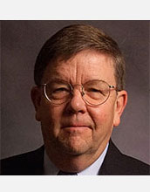

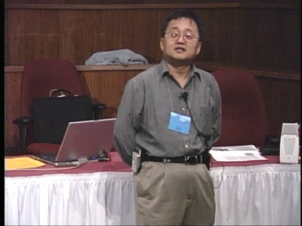
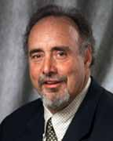
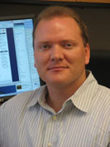
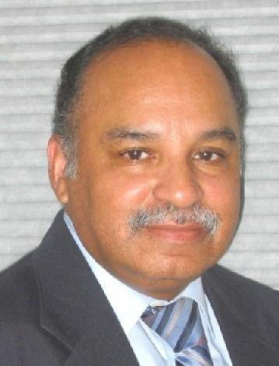
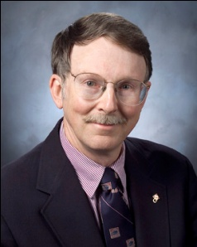
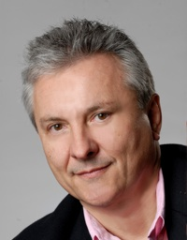
OK Supercomputing Symposium 2011
2003 Keynote:
Peter Freeman
NSF
Computer & Information
Science & Engineering
Assistant Director
2004 Keynote:
Sangtae Kim
NSF Shared
Cyberinfrastructure
Division Director
2005 Keynote:
Walt Brooks
NASA Advanced
Supercomputing
Division Director
2006 Keynote:
Dan Atkins
Head of NSF’s
Office of
Cyberinfrastructure
2007 Keynote:
Jay Boisseau
Director
Texas Advanced
Computing Center
U. Texas Austin
2008 Keynote: José Munoz Deputy Office Director/ Senior Scientific Advisor NSF Office of Cyberinfrastructure
?
FREE! Wed Oct 12 2011 @ OU
Over 235 registratons already!
Over 150 in the first day, over 200 in the first week, over 225 in the first month.
http://symposium2011.oscer.ou.edu/
Parallel Programming Workshop FREE! Tue Oct 11 2011 @ OU
FREE! Symposium Wed Oct 12 2011 @ OU
2009 Keynote: Douglass Post Chief Scientist US Dept of Defense HPC Modernization Program
2010 Keynote: Horst Simon Deputy Director Lawrence Berkeley National Laboratory
2011 Keynote to be announced

Slide 19
SC11 Education Program
At the SC11 supercomputing conference, we’ll hold our annual Education Program, Sat Nov 12 – Tue Nov 15.
You can apply to attend, either fully funded by SC11 or self-funded.
Henry is the SC11 Education Chair.
We’ll alert everyone once the registration website opens.

Slide 20
Outline
The March of Progress
Multicore/Many-core Basics
Software Strategies for Multicore/Many-core
A Concrete Example: Weather Forecasting

Slide 21
The March of Progress

Slide 22
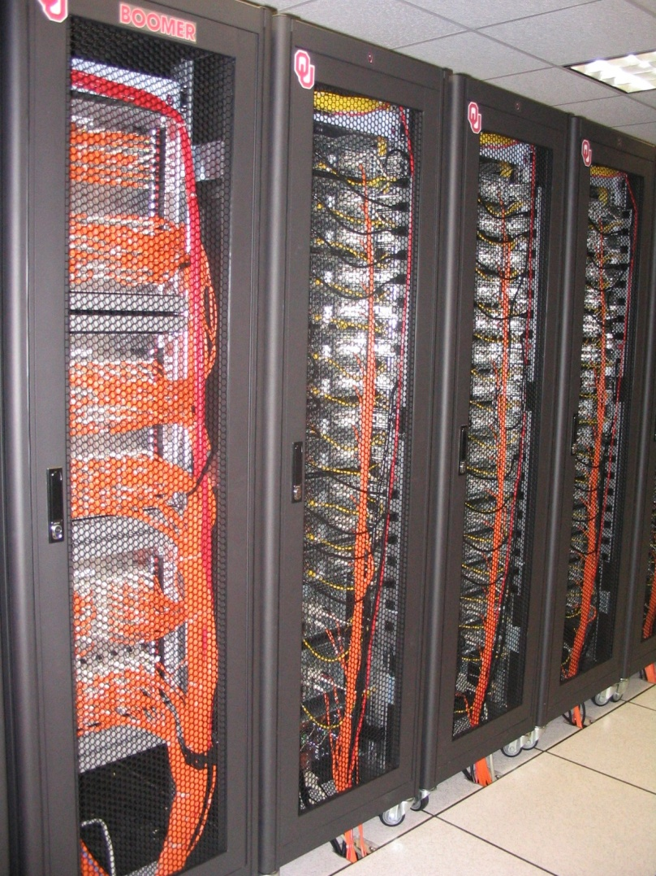
OU’s TeraFLOP Cluster, 2002
10 racks @ 1000 lbs per rack
270 Pentium4 Xeon CPUs, 2.0 GHz, 512 KB L2 cache
270 GB RAM, 400 MHz FSB
8 TB disk
Myrinet2000 Interconnect
100 Mbps Ethernet Interconnect
OS: Red Hat Linux
Peak speed: 1.08 TFLOPs
(1.08 trillion calculations per second)
One of the first Pentium4 clusters!
boomer.oscer.ou.edu

Slide 23
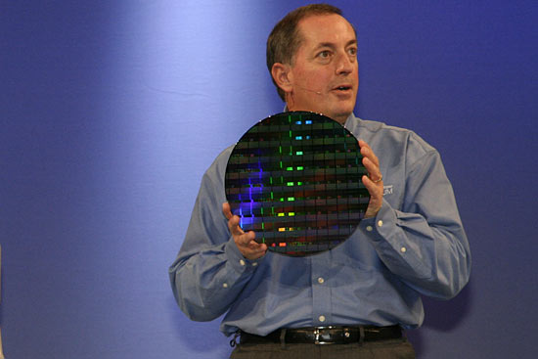
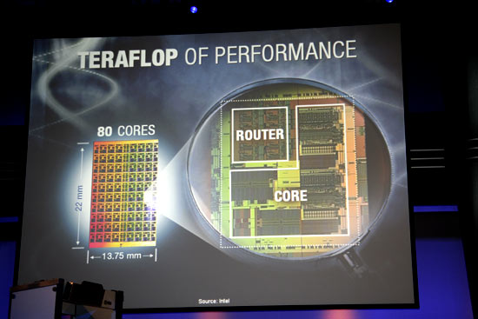
TeraFLOP, Prototype 2006
4 years from room to chip!
http://news.com.com/2300-1006_3-6119652.html

Slide 24
Moore’s Law
In 1965, Gordon Moore was an engineer at Fairchild Semiconductor.
He noticed that the number of transistors that could be squeezed onto a chip was doubling about every 18 months.
It turns out that computer speed is roughly proportional to the number of transistors per unit area.
Moore wrote a paper about this concept, which became known as “Moore’s Law.”

Slide 25
Moore’s Law in Practice
CPU
log(Speed)
Year

Slide 26
Moore’s Law in Practice
Network Bandwidth
CPU
log(Speed)
Year

Slide 27
Moore’s Law in Practice
Network Bandwidth
CPU
log(Speed)
RAM
Year

Slide 28
Moore’s Law in Practice
Network Bandwidth
log(Speed)
CPU
RAM
1/Network Latency
Year

Slide 29
Moore’s Law in Practice
Network Bandwidth
CPU
log(Speed)
RAM
1/Network Latency
Software
Year

Slide 30
Fastest Supercomputer vs. Moore
GFLOPs:
billions of calculations per second

Slide 31
The Tyranny of the Storage Hierarchy

Slide 32
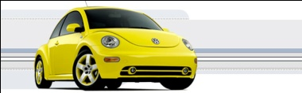
The Storage Hierarchy
Fast, expensive, few
Registers
Cache memory
Main memory (RAM)
Hard disk
Removable media (CD, DVD etc)
Internet
Slow, cheap, a lot
[5]

Slide 33

RAM is Slow
CPU
307 GB/sec^{[6]}
The speed of data transfer
between Main Memory and the
CPU is much slower than the
speed of calculating, so the CPU
spends most of its time waiting
for data to come in or go out.
Bottleneck
4.4 GB/sec^{[7]} (1.4%)

Slide 34
Why Have Cache?
CPU
Cache is much closer to the speed
of the CPU, so the CPU doesn’t
have to wait nearly as long for
stuff that’s already in cache:
it can do more
operations per second!
27 GB/sec (9%)^{[7]}
4.4 GB/sec^{[7]} (1%)

Slide 35
A Laptop
Dell Latitude Z600^{[4]}
Intel Core2 Duo SU9600 1.6 GHz w/3 MB L2 Cache
4 GB 1066 MHz DDR3 SDRAM
256 GB SSD Hard Drive
DVD+RW/CD-RW Drive (8x)
1 Gbps Ethernet Adapter

Slide 36
Storage Speed, Size, Cost
Laptop | Registers (Intel Core2 Duo 1.6 GHz) | Cache Memory (L2) | Main Memory (1066MHz DDR3 SDRAM) | Hard Drive (SSD) | Ethernet (1000 Mbps) | DVD+R (16x) | Phone Modem (56 Kbps)
Speed (MB/sec) [peak] | 314,573^{[6]} (12,800 MFLOP/s*) | 27,276 ^{[7]} | 4500 ^{[7]} | 250 ^{[9]} | 125 | 22 ^{[10]} | 0.007
Size (MB) | 464 bytes** ^{[11]} | 3 | 4096 | 256,000 | unlimited | unlimited | unlimited
Cost ($/MB) | – | $285 ^{[13]} | $0.03 ^{[12]} | $0.002 ^{[12]} | charged per month (typically) | $0.00005 ^{[12]} | charged per month (typically)
* MFLOP/s: millions of floating point operations per second
** 16 64-bit general purpose registers, 8 80-bit floating point registers,
16 128-bit floating point vector registers

Slide 37
Storage Use Strategies
Register reuse: Do a lot of work on the same data before working on new data.
Cache reuse: The program is much more efficient if all of the data and instructions fit in cache; if not, try to use what’s in cache a lot before using anything that isn’t in cache.
Data locality: Try to access data that are near each other in memory before data that are far.
I/O efficiency: Do a bunch of I/O all at once rather than a little bit at a time; don’t mix calculations and I/O.

Slide 38
A Concrete Example
Consider a cluster with Harpertown CPUs: quad core, 2.0 GHz, 1333 MHz Front Side Bus.
The theoretical peak CPU speed is 32 GFLOPs (double precision) per CPU chip, and in practice the benchmark per core as 87% of that (93% for a single core). For a dual chip node, the peak is 64 GFLOPs.
Each double precision calculation is 2 8-byte operands and one 8-byte result, so 24 bytes get moved between RAM and CPU.
So, in theory each node could transfer up to 1536 GB/sec.
The theoretical peak RAM bandwidth is 21 GB/sec (but in practice benchmarks have shown 3.4 GB/sec).
So, even at theoretical peak, any code that does less than 73 calculations per byte transferred between RAM and cache has speed limited by RAM bandwidth.

Slide 39
Good Cache Reuse Example

Slide 40
A Sample Application
Matrix-Matrix Multiply
Let A, B and C be matrices of sizes
nr × nc, nr × nk and nk × nc, respectively:
The definition of A = B • C is
for r ∈ {1, nr}, c ∈ {1, nc}.

Slide 41
Matrix Multiply: Naïve Version
SUBROUTINE matrix_matrix_mult_naive (dst, src1, src2, &
& nr, nc, nq)
IMPLICIT NONE
INTEGER,INTENT(IN) :: nr, nc, nq
REAL,DIMENSION(nr,nc),INTENT(OUT) :: dst
REAL,DIMENSION(nr,nq),INTENT(IN) :: src1
REAL,DIMENSION(nq,nc),INTENT(IN) :: src2
INTEGER :: r, c, q
DO c = 1, nc
DO r = 1, nr
dst(r,c) = 0.0
DO q = 1, nq
dst(r,c) = dst(r,c) + src1(r,q) * src2(q,c)
END DO
END DO
END DO
END SUBROUTINE matrix_matrix_mult_naive

Slide 42
Performance of Matrix Multiply
Better

Slide 43
Tiling

Slide 44
Tiling
Tile: A small rectangular subdomain of a problem domain. Sometimes called a block or a chunk.
Tiling: Breaking the domain into tiles.
Tiling strategy: Operate on each tile to completion, then move to the next tile.
Tile size can be set at runtime, according to what’s best for the machine that you’re running on.

Slide 45
Tiling Code
SUBROUTINE matrix_matrix_mult_by_tiling (dst, src1, src2, nr, nc, nq, &
& rtilesize, ctilesize, qtilesize)
IMPLICIT NONE
INTEGER,INTENT(IN) :: nr, nc, nq
REAL,DIMENSION(nr,nc),INTENT(OUT) :: dst
REAL,DIMENSION(nr,nq),INTENT(IN) :: src1
REAL,DIMENSION(nq,nc),INTENT(IN) :: src2
INTEGER,INTENT(IN) :: rtilesize, ctilesize, qtilesize
INTEGER :: rstart, rend, cstart, cend, qstart, qend
DO cstart = 1, nc, ctilesize
cend = cstart + ctilesize - 1
IF (cend > nc) cend = nc
DO rstart = 1, nr, rtilesize
rend = rstart + rtilesize - 1
IF (rend > nr) rend = nr
DO qstart = 1, nq, qtilesize
qend = qstart + qtilesize - 1
IF (qend > nq) qend = nq
CALL matrix_matrix_mult_tile(dst, src1, src2, nr, nc, nq, &
& rstart, rend, cstart, cend, qstart, qend)
END DO
END DO
END DO
END SUBROUTINE matrix_matrix_mult_by_tiling

Slide 46
Multiplying Within a Tile
SUBROUTINE matrix_matrix_mult_tile (dst, src1, src2, nr, nc, nq, &
& rstart, rend, cstart, cend, qstart, qend)
IMPLICIT NONE
INTEGER,INTENT(IN) :: nr, nc, nq
REAL,DIMENSION(nr,nc),INTENT(OUT) :: dst
REAL,DIMENSION(nr,nq),INTENT(IN) :: src1
REAL,DIMENSION(nq,nc),INTENT(IN) :: src2
INTEGER,INTENT(IN) :: rstart, rend, cstart, cend, qstart, qend
INTEGER :: r, c, q
DO c = cstart, cend
DO r = rstart, rend
IF (qstart == 1) dst(r,c) = 0.0
DO q = qstart, qend
dst(r,c) = dst(r,c) + src1(r,q) * src2(q,c)
END DO
END DO
END DO
END SUBROUTINE matrix_matrix_mult_tile

Slide 47
Reminder: Naïve Version, Again
SUBROUTINE matrix_matrix_mult_naive (dst, src1, src2, &
& nr, nc, nq)
IMPLICIT NONE
INTEGER,INTENT(IN) :: nr, nc, nq
REAL,DIMENSION(nr,nc),INTENT(OUT) :: dst
REAL,DIMENSION(nr,nq),INTENT(IN) :: src1
REAL,DIMENSION(nq,nc),INTENT(IN) :: src2
INTEGER :: r, c, q
DO c = 1, nc
DO r = 1, nr
dst(r,c) = 0.0
DO q = 1, nq
dst(r,c) = dst(r,c) + src1(r,q) * src2(q,c)
END DO
END DO
END DO
END SUBROUTINE matrix_matrix_mult_naive

Slide 48
Performance with Tiling
Better

Slide 49
The Advantages of Tiling
It allows your code to exploit data locality better, to get much more cache reuse: your code runs faster!
It’s a relatively modest amount of extra coding (typically a few wrapper functions and some changes to loop bounds).
If you don’t need tiling – because of the hardware, the compiler or the problem size – then you can turn it off by simply setting the tile size equal to the problem size.

Slide 50
Why Does Tiling Work Here?
Cache optimization works best when the number of calculations per byte is large.
For example, with matrix-matrix multiply on an n × n matrix, there are O(n³) calculations (on the order of n³), but only O(n²) bytes of data.
So, for large n, there are a huge number of calculations per byte transferred between RAM and cache.

Slide 51
Will Tiling Always Work?
Tiling WON’T always work. Why?
Well, tiling works well when:
the order in which calculations occur doesn’t matter much, AND
there are lots and lots of calculations to do for each memory movement.
If either condition is absent, then tiling won’t help.

Slide 52
Multicore/Many-core Basics

Slide 53
What is Multicore?
In the olden days (that is, the first half of 2005), each CPU chip had one “brain” in it.
Starting the second half of 2005, each CPU chip can have up to 2 cores (brains); starting in late 2006, 4 cores; starting in late 2008, 6 cores; in early 2010, 8 cores; in mid 2010, 12 cores.
Jargon: Each CPU chip plugs into a socket, so these days, to avoid confusion, people refer to sockets and cores, rather than CPUs or processors.
Each core is just like a full blown CPU, except that it shares its socket (and maybe some of its cache) with one or more other cores – and therefore shares its bandwidth to RAM with them.

Slide 54
Dual Core
Core Core

Slide 55
Quad Core
Core Core
Core Core

Slide 56
Oct Core
Core Core Core Core
Core Core Core Core

Slide 57
The Challenge of Multicore: RAM
Each socket has access to a certain amount of RAM, at a fixed RAM bandwidth per SOCKET – or even per node.
As the number of cores per socket increases, the contention for RAM bandwidth increases too.
At 2 or even 4 cores in a socket, this problem isn’t too bad. But at 16 or 32 or 80 cores, it’s a huge problem.
So, applications that are cache optimized will get big speedups.
But, applications whose performance is limited by RAM bandwidth are going to speed up only as fast as RAM bandwidth speeds up.
RAM bandwidth speeds up much slower than CPU speeds up.

Slide 58
The Challenge of Multicore: Network
Each node has access to a certain number of network ports, at a fixed number of network ports per NODE.
As the number of cores per node increases, the contention for network ports increases too.
At 2 or 4 cores in a socket, this problem isn’t too bad. But at 16 or 32 or 80 cores, it’s a huge problem.
So, applications that do minimal communication will get big speedups.
But, applications whose performance is limited by the number of MPI messages are going to speed up very very little – and may even crash the node.

Slide 59
A Concrete Example: Weather Forecasting

Slide 60
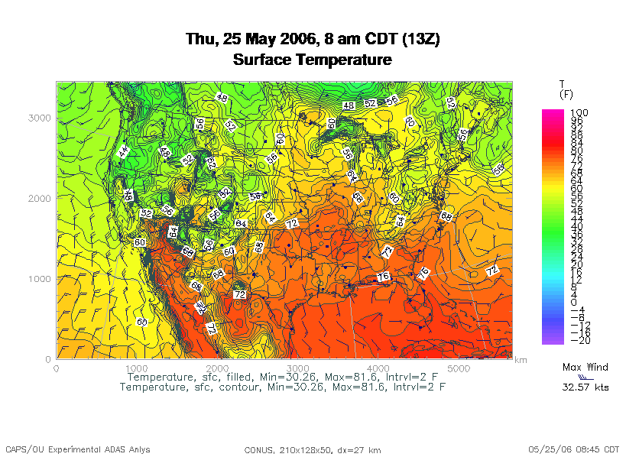
Weather Forecasting
http://www.caps.ou.edu/wx/p/r/conus/fcst/

Slide 61
Weather Forecasting
Weather forecasting is a transport problem.
The goal is to predict future weather conditions by simulating the movement of fluids in Earth’s atmosphere.
The physics is the Navier-Stokes Equations.
The numerical method is Finite Difference.

Slide 62
Cartesian Mesh

Slide 63
Finite Difference
unew(i,j,k) = F(uold, i, j, k, Δt) =
F(uold(i,j,k),
uold(i-1,j,k), uold(i+1,j,k),
uold(i,j-1,k), uold(i,j+1,k),
uold(i,j,k-1), uold(i,j,k+1), Δt)

Slide 64
Ghost Boundary Zones

Slide 65
Virtual Memory

Slide 66
Virtual Memory
Typically, the amount of main memory (RAM) that a CPU can address is larger than the amount of data physically present in the computer.
For example, consider a laptop that can address 16 GB of main memory (roughly 16 billion bytes), but only contains 2 GB (roughly 2 billion bytes).
Supercomputing in Plain English: Multicore
Tue Apr 12 2011

Slide 67
Virtual Memory (cont’d)
Locality: Most programs don’t jump all over the memory that they use; instead, they work in a particular area of memory for a while, then move to another area.
So, you can offload onto hard disk much of the memory image of a program that’s running.
Supercomputing in Plain English: Multicore
Tue Apr 12 2011

Slide 68
Virtual Memory (cont’d)
Memory is chopped up into many pages of modest size (e.g., 1 KB – 32 KB; typically 4 KB).
Only pages that have been recently used actually reside in memory; the rest are stored on hard disk.
Hard disk is typically 0.1% as fast as main memory, so you get better performance if you rarely get a page fault, which forces a read from (and maybe a write to) hard disk: exploit data locality!
Supercomputing in Plain English: Multicore
Tue Apr 12 2011

Slide 69
Cache vs. Virtual Memory
Lines (cache) vs. pages (VM)
Cache faster than RAM (cache) vs. RAM faster than disk (VM)
Supercomputing in Plain English: Multicore
Tue Apr 12 2011

Slide 70
Virtual Memory
Every CPU family today uses virtual memory, in which disk pretends to be a bigger RAM.
Virtual memory capability can’t be turned off.
RAM is split up into pages, typically 4 KB each.
Each page is either in RAM or out on disk.
To keep track of the pages, a page table notes whether each table is in RAM, where it is in RAM (that is, physical address and virtual address are different), and some other information.
So, a 4 GB physical RAM would need over a million page table entries.

Slide 71
Why Virtual Memory is Slow
When you want to access a byte of memory, you have to find out whether it’s in physical memory (RAM) or virtual disk (disk) – and the page table is in RAM!
A page table of a million entries can’t fit in a 2 MB cache.
So, each memory access (load or store) is actually 2 memory accesses: the first for the page table entry, and the second for the data itself.
This is slow!
And notice, this is assuming that you don’t need more memory than your physical RAM.

Slide 72
The Notorious T.L.B.
To speed up memory accesses, CPUs today have a special cache just for page table entries, known as the Translation Lookaside Buffer (TLB).
The size of TLBs varies from 64 entries to 1024 entries, depending on chip families.
At 4 KB pages, this means that the size of cache covered by the TLB varies from 256 KB to 4 MB.

Slide 73
The T.L.B. on a Recent Chip
On Intel Core Duo (“Yonah”):
Cache size is 2 MB per core.
Page size is 4 KB.
A core’s data TLB size is 128 page table entries.
Therefore, D-TLB only covers 512 KB of cache.

Slide 74
The T.L.B. on a Recent Chip
On Intel Core Duo (“Yonah”):
Cache size is 2 MB per core.
Page size is 4 KB.
A core’s data TLB size is 128 page table entries.
Therefore, D-TLB only covers 512 KB of cache.
Mesh: At 100 vertical levels of 150 single precision variables, 512 KB is a 3 x 3 vertical domain – nothing but ghost zones!
The cost of a TLB miss is 49 cycles, equivalent to as many as 196 calculations! (4 FLOPs per cycle)
http://www.digit-life.com/articles2/cpu/rmma-via-c7.html

Slide 75
Software Strategies for Weather Forecasting on Multicore/Many-core

Slide 76
Tiling NOT Good for Weather Codes
Weather codes typically have on the order of 150 3D arrays used in each timestep (some transferred multiple times in the same timestep, but let’s ignore that for simplicity).
These arrays typically are single precision (4 bytes per floating point value).
So, a typical weather code uses about 600 bytes per mesh zone per timestep.
Weather codes typically do 5,000 to 10,000 calculations per mesh zone per timestep.
So, the ratio of calculations to data is less than 20 to 1 – much less than the 73 to 1 needed (on mid-2008 hardware).

Slide 77
Weather Forecasting and Cache
On current weather codes, data decomposition is per process. That is, each process gets one subdomain.
As CPUs speed up and RAM sizes grow, the size of each processor’s subdomain grows too.
However, given RAM bandwidth limitations, this means that performance can only grow with RAM speed – which increases slower than CPU speed.
If the codes were optimized for cache, would they speed up more?
First: How to optimize for cache?

Slide 78
How to Get Good Cache Reuse?
Multiple independent subdomains per processor.
Each subdomain fits entirely in L2 cache.
Each subdomain’s page table entries fit entirely in the TLB.
Expanded ghost zone stencil allows multiple timesteps before communicating with neighboring subdomains.
Parallelize along the Z-axis as well as X and Y.
Use higher order numerical schemes.
Reduce the memory footprint as much as possible.
Coincidentally, this also reduces communication cost.

Slide 79
Cache Optimization Strategy: Tiling?
Would tiling work as a cache optimization strategy for weather forecasting codes?

Slide 80
Multiple Subdomains Per Core
Core 0
Core 2
Core 3
Core 1

Slide 81
Why Multiple Subdomains?
If each subdomain fits in cache, then the CPU can bring all the data of a subdomain into cache, chew on it for a while, then move on to the next subdomain: lots of cache reuse!
Oh, wait, what about the TLB? Better make the subdomains smaller! (So more of them.)
But, doesn’t tiling have the same effect?

Slide 82
Why Independent Subdomains?
Originally, the point of this strategy was to hide the cost of communication.
When you finish chewing up a subdomain, send its data to its neighbors non-blocking (MPI_Isend).
While the subdomain’s data is flying through the interconnect, work on other subdomains, which hides the communication cost.
When it’s time to work on this subdomain again, collect its data (MPI_Waitall).
If you’ve done enough work, then the communication cost is zero.

Slide 83
Expand the Array Stencil
If you expand the array stencil of each subdomain beyond the numerical stencil, then you don’t have to communicate as often.
When you communicate, instead of sending a slice along each face, send a slab, with extra stencil levels.
In the first timestep after communicating, do extra calculations out to just inside the numerical stencil.
In subsequent timesteps, calculate fewer and fewer stencil levels, until it’s time to communicate again – less total communication, and more calculations to hide the communication cost underneath!

Slide 84
An Extra Win!
If you do all this, there’s an amazing side effect: you get better cache reuse, because you stick with the same subdomain for a longer period of time.
So, instead of doing, say, 5000 calculations per zone per timestep, you can do 15000 or 20000.
So, you can better amortize the cost of transferring the data between RAM and cache.

Slide 85
New Algorithm (F90)
DO timestep = 1, number_of_timesteps, extra_stencil_levels
DO subdomain = 1, number_of_local_subdomains
CALL receive_messages_nonblocking(subdomain,
timestep)
DO extra_stencil_level=0, extra_stencil_levels - 1
CALL calculate_entire_timestep(subdomain,
timestep + extra_stencil_level)
END DO
CALL send_messages_nonblocking(subdomain,
timestep + extra_stencil_levels)
END DO
END DO

Slide 86
New Algorithm (C)
for (timestep = 0;
timestep < number_of_timesteps;
timestep += extra_stencil_levels) {
for (subdomain = 0;
subdomain < number_of_local_subdomains;
subdomain++) {
receive_messages_nonblocking(subdomain, timestep);
for (extra_stencil_level = 0;
extra_stencil_level < extra_stencil_levels;
extra_stencil_level++) {
calculate_entire_timestep(subdomain,
timestep + extra_stencil_level);
} /* for extra_stencil_level */
send_messages_nonblocking(subdomain,
timestep + extra_stencil_levels);
} /* for subdomain */
} /* for timestep */

Slide 87
Higher Order Numerical Schemes
Higher order numerical schemes are great, because they require more calculations per mesh zone per timestep, which you need to amortize the cost of transferring data between RAM and cache. Might as well!
Plus, they allow you to use a larger time interval per timestep (dt), so you can do fewer total timesteps for the same accuracy – or you can get higher accuracy for the same number of timesteps.

Slide 88
Parallelize in Z
Most weather forecast codes parallelize in X and Y, but not in Z, because gravity makes the calculations along Z more complicated than X and Y.
But, that means that each subdomain has a high number of zones in Z, compared to X and Y.
For example, a 1 km CONUS run will probably have 100 zones in Z (25 km at 0.25 km resolution).

Slide 89
Multicore/Many-core Problem
Most multicore chip families have relatively small cache per core (for example, 1 - 4 MB per core at the highest/slowest cache level) – and this problem seems likely to remain.
Small TLBs make the problem worse: 512 KB per core rather than 1 - 4 MB.
So, to get good cache reuse, you need subdomains of no more than 512 KB.
If you have 150 3D variables at single precision, and 100 zones in Z, then your horizontal size will be 3 x 3 zones – just enough for your stencil!

Slide 90
What Do We Need?
We need much bigger caches!
16 MB cache ➔ 16 x 16 horizontal including stencil
32 MB cache ➔ 23 x 23 horizontal including stencil
TLB must be big enough to cover the entire cache.
It’d be nice to have RAM speed increase as fast as core counts increase, but let’s not kid ourselves.
Keep this in mind when we get to GPGPU!

Slide 91
Undergraduate Petascale Internships
NSF support for undergraduate internships involving high-performance computing in science and engineering.
Provides a stipend ($5k over the year), a two-week intensive high-performance computing workshop at the National Center for Supercomputing Applications, and travel to the SC11 supercomputing conference in November.
This support is intended to allow you to work with a faculty mentor on your campus. Have your faculty mentor fill out an intern position description at the link below. There are also some open positions listed on our site.
Student applications and position descriptions from faculty are due by March 31, 2011. Selections and notifications will be made by April 15.
http://shodor.org/petascale/participation/internships/

Slide 92
Summer Workshops 2011
In Summer 2011, there will be several workshops on HPC and Computational and Data Enabled Science and Engineering (CDESE) across the US.
These will be weeklong intensives, running from Sunday evening through Saturday morning.
We’re currently working on where and when those workshops will be held.
Once we’ve got that worked out, we’ll announce them and open up the registration website.
One of them will be held at OU.

Slide 93
OK Supercomputing Symposium 2011
2003 Keynote:
Peter Freeman
NSF
Computer & Information
Science & Engineering
Assistant Director
2004 Keynote:
Sangtae Kim
NSF Shared
Cyberinfrastructure
Division Director
2005 Keynote:
Walt Brooks
NASA Advanced
Supercomputing
Division Director
2006 Keynote:
Dan Atkins
Head of NSF’s
Office of
Cyberinfrastructure
2007 Keynote:
Jay Boisseau
Director
Texas Advanced
Computing Center
U. Texas Austin
2008 Keynote: José Munoz Deputy Office Director/ Senior Scientific Advisor NSF Office of Cyberinfrastructure
?
FREE! Wed Oct 12 2011 @ OU
Over 235 registratons already!
Over 150 in the first day, over 200 in the first week, over 225 in the first month.
http://symposium2011.oscer.ou.edu/
Parallel Programming Workshop FREE! Tue Oct 11 2011 @ OU
FREE! Symposium Wed Oct 12 2011 @ OU
2009 Keynote: Douglass Post Chief Scientist US Dept of Defense HPC Modernization Program
2010 Keynote: Horst Simon Deputy Director Lawrence Berkeley National Laboratory
2011 Keynote to be announced

Slide 94
SC11 Education Program
At the SC11 supercomputing conference, we’ll hold our annual Education Program, Sat Nov 12 – Tue Nov 15.
You can apply to attend, either fully funded by SC11 or self-funded.
Henry is the SC11 Education Chair.
We’ll alert everyone once the registration website opens.

Slide 95
Thanks for your attention! Questions? www.oscer.ou.edu

Slide 96
References
[1] Image by Greg Bryan, Columbia U.
[2] “Update on the Collaborative Radar Acquisition Field Test (CRAFT): Planning for the Next Steps.”
Presented to NWS Headquarters August 30 2001.
[3] See http://hneeman.oscer.ou.edu/hamr.html for details.
[4] http://www.dell.com/
[5] http://www.vw.com/newbeetle/
[6] Richard Gerber, The Software Optimization Cookbook: High-performance Recipes for the Intel Architecture. Intel Press, 2002, pp. 161-168.
[7] RightMark Memory Analyzer. http://cpu.rightmark.org/
[8] ftp://download.intel.com/design/Pentium4/papers/24943801.pdf
[9] http://www.seagate.com/cda/products/discsales/personal/family/0,1085,621,00.html
[10] http://www.samsung.com/Products/OpticalDiscDrive/SlimDrive/OpticalDiscDrive_SlimDrive_SN_S082D.asp?page=Specifications
[11] ftp://download.intel.com/design/Pentium4/manuals/24896606.pdf
[12] http://www.pricewatch.com/

