Slide 1



Supercomputing in Plain English GPGPU: Number Crunching in Your Graphics Card
Henry Neeman, Director
OU Supercomputing Center for Education & Research
University of Oklahoma Information Technology
Tuesday April 26 2011

Slide 2
This is an experiment!
It’s the nature of these kinds of videoconferences that FAILURES ARE GUARANTEED TO HAPPEN! NO PROMISES!
So, please bear with us. Hopefully everything will work out well enough.
If you lose your connection, you can retry the same kind of connection, or try connecting another way.
Remember, if all else fails, you always have the toll free phone bridge to fall back on.

Slide 3
Access Grid
If you aren’t sure whether you have AG, you probably don’t.
Tue Apr 26 | Monte Carlo
Tue May 3 | Helium
Many thanks to Patrick Calhoun of OU for setting these up for us.

Slide 4
H.323 (Polycom etc)
From an H.323 device (e.g., Polycom, Tandberg, Lifesize, etc):
If you ARE already registered with the OneNet gatekeeper: Dial 2500409
If you AREN'T registered with the OneNet gatekeeper (probably the case):
Dial: 164.58.250.47
Bring up the virtual keypad. On some H.323 devices, you can bring up the virtual keypad by typing: #
When asked for the conference ID, enter: 0409
On some H.323 devices, you indicate the end of conference ID with: #
Many thanks to Roger Holder and OneNet for providing this.

Slide 5
H.323 from Internet Explorer
From a Windows PC running Internet Explorer:
You MUST have the ability to install software on the PC (or have someone install it for you).
Download and install the latest Java Runtime Environment (JRE) from here: http://www.oracle.com/technetwork/java/javase/downloads/ (Click on the Java Download icon, because that install package includes both the JRE and other components.)
Download and install this video decoder: http://164.58.250.47/codian_video_decoder.msi
Start Internet Explorer.
Copy-and-paste this URL into your IE window: http://164.58.250.47/
When that webpage loads, in the upper left, click on “Streaming.”
In the textbox labeled Sign-in Name, type your name.
In the textbox labeled Conference ID, type this: 0409
Click on “Stream this conference.”
When that webpage loads, you may see, at the very top, a bar offering you options. If so, click on it and choose “Install this add-on.”

Slide 6
H.323 from XMeeting (MacOS)
From a Mac running MacOS X:
Download XMeeting from http://xmeeting.sourceforge.net/
Install XMeeting as follows:
Open the .dmg file.
Drag XMeeting into the Applications folder.
Open XMeeting from Applications.
Skip the setup wizard.
In the call box, type 164.58.250.47
Click the Call button.
From the Remote Control window, when prompted to join the conference, enter : 0409#

Slide 7
EVO
There’s a quick tutorial on the OSCER education webpage.

Slide 8
QuickTime Broadcaster
If you cannot connect via the Access Grid, H.323 or EVO, then you can connect via QuickTime:
rtsp://129.15.254.141/test_hpc09.sdp
We recommend using QuickTime Player for this, because we’ve tested it successfully.
We recommend upgrading to the latest version at:
http://www.apple.com/quicktime/
When you run QuickTime Player, traverse the menus
File -> Open URL
Then paste in the rstp URL into the textbox, and click OK.
Many thanks to Kevin Blake of OU for setting up QuickTime Broadcaster for us.

Slide 9
WebEx
We have only a limited number of WebEx connections, so please avoid WebEx unless you have NO OTHER WAY TO CONNECT.
Instructions are available on the OSCER education webpage.
Thanks to Tim Miller of Wake Forest U.

Slide 10
Phone Bridge
If all else fails, you can call into our toll free phone bridge:
US: 1-800-832-0736, *6232874#
International: 303-330-0440, *6232874#
Please mute yourself and use the phone to listen.
Don’t worry, we’ll call out slide numbers as we go.
Please use the phone bridge ONLY if you cannot connect any other way: the phone bridge is charged per connection per minute, so our preference is to minimize the number of connections.
Many thanks to Amy Apon and U Arkansas for providing the previous toll free phone bridge.

Slide 11
Please Mute Yourself
No matter how you connect, please mute yourself, so that we cannot hear you.
At OU, we will turn off the sound on all conferencing technologies.
That way, we won’t have problems with echo cancellation.
Of course, that means we cannot hear questions.
So for questions, you’ll need to send some kind of text.

Slide 12
Questions via Text: E-mail
Ask questions via e-mail to sipe2011@yahoo.com.
All questions will be read out loud and then answered out loud.

Slide 13
Thanks for helping!
OSCER operations staff: Brandon George, Dave Akin, Brett Zimmerman, Josh Alexander
Horst Severini, OSCER Associate Director for Remote & Heterogeneous Computing
OU Research Campus staff (Patrick Calhoun, Mark McAvoy)
Kevin Blake, OU IT (videographer)
John Chapman, Jeff Pummill and Amy Apon, U Arkansas
James Deaton and Roger Holder, OneNet
Tim Miller, Wake Forest U
Jamie Hegarty Schwettmann, i11 Industries

Slide 14
This is an experiment!
It’s the nature of these kinds of videoconferences that FAILURES ARE GUARANTEED TO HAPPEN! NO PROMISES!
So, please bear with us. Hopefully everything will work out well enough.
If you lose your connection, you can retry the same kind of connection, or try connecting another way.
Remember, if all else fails, you always have the toll free phone bridge to fall back on.

Slide 15
Supercomputing Exercises
Want to do the “Supercomputing in Plain English” exercises?
The first exercise is already posted at:
http://www.oscer.ou.edu/education.php
If you don’t yet have a supercomputer account, you can get a temporary account, just for the “Supercomputing in Plain English” exercises, by sending e-mail to:
hneeman@ou.edu
Please note that this account is for doing the exercises only, and will be shut down at the end of the series.
There isn’t a GPGPU exercise, because we don’t really learn how to do the programming.

Slide 16
Summer Workshops 2011
Introduction to Computational Thinking
Modeling and Simulation Across the Curriculum
June 19 - 25, Wayne State College, Wayne NE
July 10 - 16, Texas State Technical College, Waco
Preparing In-service and Pre-service Educators for Computational Thinking
July 24 - 30, Oregon State University, Corvallis
Computational Thinking from a Parallel Perspective
July 31 - Aug 6, Louisiana State University, Baton Rouge

Slide 17
Summer Workshops 2011 (cont’d)
Computational Biology for Biology Educators
June 12 - 18, Lafayette College, Easton PA
June 26 - July 2, Calvin College, Grand Rapids MI
Computational Chemistry for Chemistry Educators
July 24 - 30, Washington and Lee University, Lexington VA
JOINTLY PRESENTED VIA VIDEOCONFERENCING WITH
July 24 - 30, Oklahoma State University, Stillwater
Data-driven Computational Science: Modeling and Visualization
June 19 - 25, Richard Stockton College of New Jersey, Pomona

Slide 18
Summer Workshops 2011 (cont’d)
Introduction to Parallel Programming & Cluster Computing
June 26 - July 1, Idaho State University, Pocatello
JOINTLY PRESENTED VIA VIDEOCONFERENCING WITH
June 26 - July 1, University of Washington, Seattle
Intermediate Parallel Programming & Cluster Computing
July 31 - Aug 6, University of Oklahoma, Norman
JOINTLY PRESENTED VIA VIDEOCONFERENCING WITH
July 31 - Aug 6, Polytechnic University of Puerto Rico, Hato Rey

Slide 19
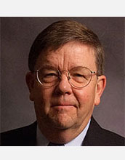

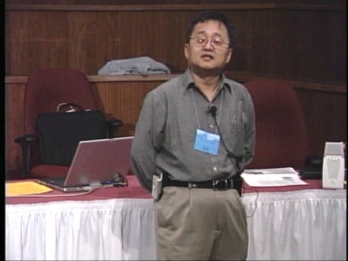
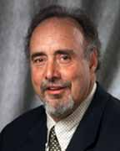
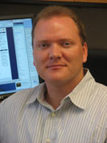
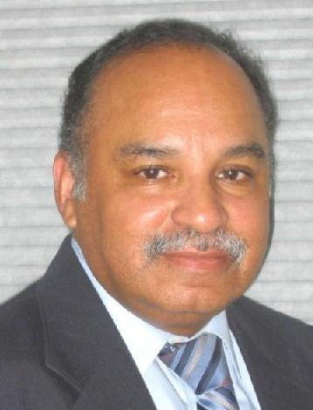
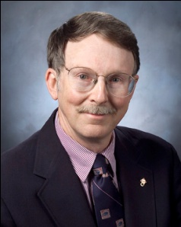
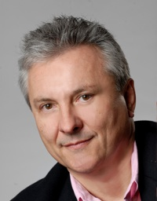
OK Supercomputing Symposium 2011
2003 Keynote:
Peter Freeman
NSF
Computer & Information
Science & Engineering
Assistant Director
2004 Keynote:
Sangtae Kim
NSF Shared
Cyberinfrastructure
Division Director
2005 Keynote:
Walt Brooks
NASA Advanced
Supercomputing
Division Director
2006 Keynote:
Dan Atkins
Head of NSF’s
Office of
Cyberinfrastructure
2007 Keynote:
Jay Boisseau
Director
Texas Advanced
Computing Center
U. Texas Austin
2008 Keynote: José Munoz Deputy Office Director/ Senior Scientific Advisor NSF Office of Cyberinfrastructure
?
FREE! Wed Oct 12 2011 @ OU
Over 235 registratons already!
Over 150 in the first day, over 200 in the first week, over 225 in the first month.
http://symposium2011.oscer.ou.edu/
Parallel Programming Workshop FREE! Tue Oct 11 2011 @ OU
FREE! Symposium Wed Oct 12 2011 @ OU
REGISTRATION IS NOW OPEN!
2009 Keynote: Douglass Post Chief Scientist US Dept of Defense HPC Modernization Program
2010 Keynote: Horst Simon Deputy Director Lawrence Berkeley National Laboratory
2011 Keynote to be announced

Slide 20
SC11 Education Program
At the SC11 supercomputing conference, we’ll hold our annual Education Program, Sat Nov 12 – Tue Nov 15.
You can apply to attend, either fully funded by SC11 or self-funded.
Henry is the SC11 Education Chair.
We’ll alert everyone once the registration website opens.

Slide 21
Outline
What is GPGPU?
GPU Programming
Digging Deeper: CUDA on NVIDIA
CUDA Thread Hierarchy and Memory Hierarchy
CUDA Example: Matrix-Matrix Multiply

Slide 22
What is GPGPU?

Slide 23

Accelerators
No, not this ....
http://gizmodo.com/5032891/nissans-eco-gas-pedal-fights-back-to-help-you-save-gas

Slide 24
Accelerators
In HPC, an accelerator is hardware component whose role is to speed up some aspect of the computing workload.
In the olden days (1980s), supercomputers sometimes had array processors, which did vector operations on arrays, and PCs sometimes had floating point accelerators: little chips that did the floating point calculations in hardware rather than software.
More recently, Field Programmable Gate Arrays (FPGAs) allow reprogramming deep into the hardware.

Slide 25
Why Accelerators are Good
Accelerators are good because:
they make your code run faster.

Slide 26
Why Accelerators are Bad
Accelerators are bad because:
they’re expensive;
they’re hard to program;
your code on them may not be portable to other accelerators, so the labor you invest in programming them has a very short half-life.

Slide 27
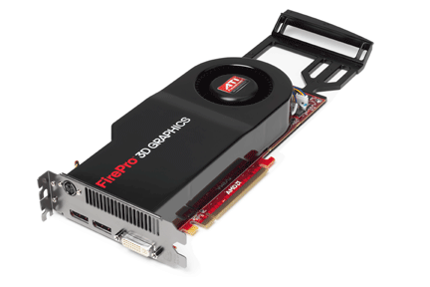
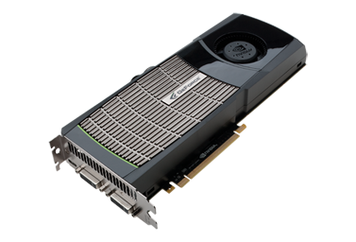
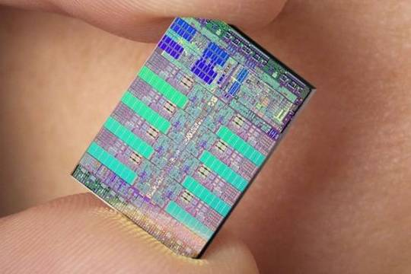
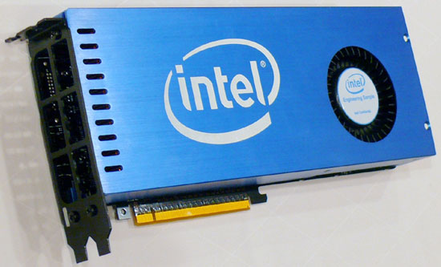
The King of the Accelerators
The undisputed champion of accelerators is:
the graphics processing unit.
http://www.amd.com/us-en/assets/content_type/DigitalMedia/46928a_01_ATI-FirePro_V8700_angled_low_res.gif
http://images.nvidia.com/products/quadro_fx_5800/Quadro_FX5800_low_3qtr.png
http://www.overclockers.ua/news/cpu/106612-Knights-Ferry.jpg
http://www.gamecyte.com/wp-content/uploads/2009/01/ibm-sony-toshiba-cell.jpg

Slide 28
Why GPU?
Graphics Processing Units (GPUs) were originally designed to accelerate graphics tasks like image rendering.
They became very very popular with videogamers, because they’ve produced better and better images, and lightning fast.
And, prices have been extremely good, ranging from three figures at the low end to four figures at the high end.

Slide 29
GPUs are Popular
Chips are expensive to design (hundreds of millions of $$$), expensive to build the factory for (billions of $$$), but cheap to produce.
For example, in 2006 – 2007, GPUs sold at a rate of about 80 million cards per year, generating about $20 billion per year in revenue.
http://www.xbitlabs.com/news/video/display/20080404234228_Shipments_of_Discrete_Graphics_Cards_on_the_Rise_but_Prices_Down_Jon_Peddie_Research.html
This means that the GPU companies have been able to recoup the huge fixed costs.

Slide 30
GPU Do Arithmetic
GPUs mostly do stuff like rendering images.
This is done through mostly floating point arithmetic – the same stuff people use supercomputing for!

Slide 31
GPU Programming

Slide 32
Hard to Program?
In the olden days – that is, until just the last few years – programming GPUs meant either:
using a graphics standard like OpenGL (which is mostly meant for rendering), or
getting fairly deep into the graphics rendering pipeline.
To use a GPU to do general purpose number crunching, you had to make your number crunching pretend to be graphics.
This was hard. So most people didn’t bother.

Slide 33
Easy to Program?
More recently, GPU manufacturers have worked hard to make GPUs easier to use for general purpose computing.
This is known as General Purpose Graphics Processing Units.

Slide 34
How to Program a GPU
Proprietary programming language or extensions
NVIDIA: CUDA (C/C++)
AMD/ATI: StreamSDK/Brook+ (C/C++)
OpenCL (Open Computing Language): an industry standard for doing number crunching on GPUs.
Portland Group Inc (PGI) Fortran and C compilers with accelerator directives; PGI CUDA Fortran (Fortran 90 equivalent of NVIDIA’s CUDA C).
OpenMP version 4.0 may include directives for accelerators.
Others are popping up or in development now ….

Slide 35
NVIDIA CUDA
NVIDIA proprietary
Formerly known as “Compute Unified Device Architecture”
Extensions to C to allow better control of GPU capabilities
Modest extensions but major rewriting of the code
Portland Group Inc (PGI) has released a Fortran implementation of CUDA available in their Fortran compiler.

Slide 36
CUDA Example Part 1
// example1.cpp : Defines the entry point for the console application.
//
#include "stdafx.h"
#include <stdio.h>
#include <cuda.h>
// Kernel that executes on the CUDA device
__global__ void square_array(float *a, int N)
{
int idx = blockIdx.x * blockDim.x + threadIdx.x;
if (idx<N) a[idx] = a[idx] * a[idx];
}
http://llpanorama.wordpress.com/2008/05/21/my-first-cuda-program/

Slide 37
CUDA Example Part 2
// main routine that executes on the host
int main(void)
{
float *a_h, *a_d; // Pointer to host & device arrays
const int N = 10; // Number of elements in arrays
size_t size = N * sizeof(float);
a_h = (float *)malloc(size); // Allocate array on host
cudaMalloc((void **) &a_d, size); // Allocate array on device
// Initialize host array and copy it to CUDA device
for (int i=0; i<N; i++) a_h[i] = (float)i;
cudaMemcpy(a_d, a_h, size, cudaMemcpyHostToDevice);
// Do calculation on device:
int block_size = 4;
int n_blocks = N/block_size + (N%block_size == 0 ? 0:1);
square_array <<< n_blocks, block_size >>> (a_d, N);
// Retrieve result from device and store it in host array
cudaMemcpy(a_h, a_d, sizeof(float)*N, cudaMemcpyDeviceToHost);
// Print results
for (int i=0; i<N; i++) printf("%d %f\n", i, a_h[i]);
// Cleanup
free(a_h); cudaFree(a_d);
}

Slide 38
AMD/ATI Brook+
AMD/ATI proprietary
Formerly known as “Close to Metal” (CTM)
Extensions to C to allow better control of GPU capabilities
No Fortran version available

Slide 39
Brook+ Example Part 1
float4 matmult_kernel (int y, int x, int k,
float4 M0[], float4 M1[])
{
float4 total = 0;
for (int c = 0; c < k / 4; c++)
{
total += M0[y][c] * M1[x][c];
}
return total;
}
http://developer.amd.com/gpu_assets/Stream_Computing_Overview.pdf

Slide 40
Brook+ Example Part 2
void matmult (float4 A[], float4 B’[], float4 C[])
{
for (int i = 0; i < n; i++)
{
for (j = 0; j < m / 4; j+)
{
launch_thread{
C[i][j] =
matmult_kernel(j, i, k, A, B’);}
}
}
sync_threads{}
}

Slide 41
OpenCL
Open Computing Language
Open standard developed by the Khronos Group, which is a consortium of many companies (including NVIDIA, AMD and Intel, but also lots of others)
Initial version of OpenCL standard released in Dec 2008.
Many companies are creating their own implementations.
Apple was first to market, with an OpenCL implementation included in Mac OS X v10.6 (“Snow Leopard”) in 2009.

Slide 42
OpenCL Example Part 1
// create a compute context with GPU device
context =
clCreateContextFromType(NULL, CL_DEVICE_TYPE_GPU, NULL, NULL, NULL);
// create a command queue
queue = clCreateCommandQueue(context, NULL, 0, NULL);
// allocate the buffer memory objects
memobjs[0] = clCreateBuffer(context,
CL_MEM_READ_ONLY | CL_MEM_COPY_HOST_PTR,
sizeof(float)*2*num_entries, srcA, NULL);
memobjs[1] = clCreateBuffer(context,
CL_MEM_READ_WRITE,
sizeof(float)*2*num_entries, NULL, NULL);
// create the compute program
program = clCreateProgramWithSource(context, 1, &fft1D_1024_kernel_src,
NULL, NULL);
http://en.wikipedia.org/wiki/OpenCL

Slide 43
OpenCL Example Part 2
// build the compute program executable
clBuildProgram(program, 0, NULL, NULL, NULL, NULL);
// create the compute kernel
kernel = clCreateKernel(program, "fft1D_1024", NULL);
// set the args values
clSetKernelArg(kernel, 0, sizeof(cl_mem), (void *)&memobjs[0]);
clSetKernelArg(kernel, 1, sizeof(cl_mem), (void *)&memobjs[1]);
clSetKernelArg(kernel, 2, sizeof(float)*(local_work_size[0]+1)*16, NULL);
clSetKernelArg(kernel, 3, sizeof(float)*(local_work_size[0]+1)*16, NULL);
// create N-D range object with work-item dimensions and execute kernel
global_work_size[0] = num_entries; local_work_size[0] = 64;
clEnqueueNDRangeKernel(queue, kernel, 1, NULL,
global_work_size, local_work_size, 0, NULL, NULL);

Slide 44
OpenCL Example Part 3
// This kernel computes FFT of length 1024. The 1024 length FFT is
// decomposed into calls to a radix 16 function, another radix 16
// function and then a radix 4 function
__kernel void fft1D_1024 (__global float2 *in, __global float2 *out,
__local float *sMemx, __local float *sMemy) {
int tid = get_local_id(0);
int blockIdx = get_group_id(0) * 1024 + tid;
float2 data[16];
// starting index of data to/from global memory
in = in + blockIdx;
out = out + blockIdx;
globalLoads(data, in, 64); // coalesced global reads
fftRadix16Pass(data); // in-place radix-16 pass
twiddleFactorMul(data, tid, 1024, 0);

Slide 45
OpenCL Example Part 4
// local shuffle using local memory
localShuffle(data, sMemx, sMemy, tid, (((tid & 15) * 65) + (tid >> 4)));
fftRadix16Pass(data); // in-place radix-16 pass
twiddleFactorMul(data, tid, 64, 4); // twiddle factor multiplication
localShuffle(data, sMemx, sMemy, tid, (((tid >> 4) * 64) + (tid & 15)));
// four radix-4 function calls
fftRadix4Pass(data); // radix-4 function number 1
fftRadix4Pass(data + 4); // radix-4 function number 2
fftRadix4Pass(data + 8); // radix-4 function number 3
fftRadix4Pass(data + 12); // radix-4 function number 4
// coalesced global writes
globalStores(data, out, 64);
}

Slide 46
Portland Group Accelerator Directives
Proprietary directives in Fortran and C
Similar to OpenMP in structure
If the compiler doesn’t understand these directives, it ignores them, so the same code can work with an accelerator or without, and with the PGI compilers or other compilers.
In principle, this will be able to work on a variety of accelerators, but the first instance is NVIDIA; PGI recently announced a deal with AMD/ATI.
The directives tell the compiler what parts of the code happen in the accelerator; the rest happens in the regular hardware.

Slide 47
PGI Accelerator Example
!$acc region
do k = 1,n1
do i = 1,n3
c(i,k) = 0.0
do j = 1,n2
c(i,k) = c(i,k) +
& a(i,j) * b(j,k)
enddo
enddo
enddo
!$acc end region
http://www.pgroup.com/resources/accel.htm

Slide 48
OpenMP 4.0 Accelerator Directives
OpenMP’s 4.0 standard is very much in discussion (and flux).
It may end up with accelerator directives.
It’s too soon to say what the details will be, if it happens at all.
But, if it happens, then codes amenable to accelerator directives will be able to get substantial speedups with very modest coding effort.

Slide 49
OpenMP 4.0 Accelerator Example
!$omp acc_region
do k = 1,n1
do i = 1,n3
c(i,k) = 0.0
do j = 1,n2
c(i,k) = c(i,k) +
& a(i,j) * b(j,k)
enddo
enddo
enddo
!$omp end acc_region
http://www.pgroup.com/resources/accel.htm
http://www.cse.scitech.ac.uk/events/GPU_2010/12_Hart.pdf

Slide 50
Digging Deeper: CUDA on NVIDIA

Slide 51
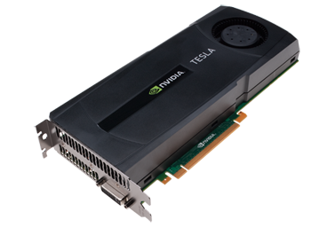
NVIDIA Tesla
NVIDIA now offers a GPU platform named Tesla.
It consists essentially of their highest end graphics card, minus the video out connector.
http://images.nvidia.com/products/geforce_gtx_480/geforce_gtx_480_3qtr_low.png
http://images.nvidia.com/products/tesla_C2050_C2070/Tesla_C2050_C2070_3qtr_low_new.png

Slide 52
NVIDIA Tesla C2050 Card Specs
448 GPU cores
1.15 GHz
Single precision floating point performance: 1030.4 GFLOPs (2 single precision flops per clock per core)
Double precision floating point performance: 515.2 GFLOPs (1 double precision flop per clock per core)
Internal RAM: 3 GB DDR5
Internal RAM speed: 144 GB/sec (compared 21-25 GB/sec for regular RAM)
Has to be plugged into a PCIe slot (at most 8 GB/sec per GPU card)

Slide 53
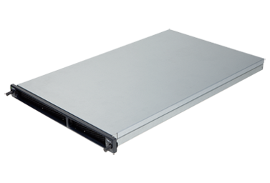
NVIDIA Tesla S2050 Server Specs
4 C2050 cards inside a 1U server (looks like a Sooner node)
1.15 GHz
Single Precision (SP) floating point performance: 4121.6 GFLOPs
Double Precision (DP) floating point performance: 2060.8 GFLOPs
Internal RAM: 12 GB total (3 GB per GPU card)
Internal RAM speed: 576 GB/sec aggregate
Has to be plugged into two PCIe slots (at most 16 GB/sec for 4 GPU cards)

Slide 54
Compare x86 vs S2050
Let’s compare the best dual socket x86 server today vs S2050.
 | Dual socket, AMD 2.3 GHz 12-core | NVIDIA Tesla S2050
Peak DP FLOPs | 220.8 GFLOPs DP | 2060.8 GFLOPs DP (9.3x)
Peak SP FLOPS | 441.6 GFLOPs SP | 4121.6 GFLOPs SP (9.3x)
Peak RAM BW | 25 GB/sec | 576 GB/sec (23x)
Peak PCIe BW | N/A | 16 GB/sec
Needs x86 server to attach to? | No | Yes
Power/Heat | ~450 W | ~900 W + ~400 W (~2.9x)
Code portable? | Yes | No (CUDA) Yes (PGI, OpenCL)

Slide 55
Compare x86 vs S2050
Here are some interesting measures:
 | Dual socket, AMD 2.3 GHz 12-core | NVIDIA Tesla S2050
DP GFLOPs/Watt | ~0.5 GFLOPs/Watt | ~1.6 GFLOPs/Watt (~3x)
SP GFLOPS/Watt | ~1 GFLOPs/Watt | ~3.2 GFLOPs/Watt (~3x)
DP GFLOPs/sq ft | ~590 GFLOPs/sq ft | ~2750 GFLOPs/sq ft (4.7x)
SP GFLOPs/sq ft | ~1180 GFLOPs/sq ft | ~5500 GFLOPs/sq ft (4.7x)
Racks per PFLOP DP | 142 racks/PFLOP DP | 32 racks/PFLOP DP (23%)
Racks per PFLOP SP | 71 racks/PFLOP SP | 16 racks/PFLOP SP (23%)

Slide 56
Kepler and Maxwell
NVIDIA’s 20-series is also known by the codename “Fermi.” It runs at about 0.5 TFLOPs per GPU card (peak).
The next generation, to be released in 2011, is codenamed “Kepler” and will be capable of something like 1.4 TFLOPs double precision per GPU card.
After “Kepler” will come “Maxwell” in 2013, capable of something like 4 TFLOPs double precision per GPU card.
So, the increase in performance is likely to be roughly 2.5x – 3x per generation, roughly every two years.
http://www.vizworld.com/2010/09/thoughts-nvidias-kepler-maxwell-gpus/

Slide 57
What Are the Downsides?
You have to rewrite your code into CUDA or OpenCL or PGI accelerator directives (or someday maybe OpenMP).
CUDA: Proprietary, but maybe portable soon
OpenCL: portable but cumbersome
PGI accelerator directives: not clear whether you can have most of the code live inside the GPUs.
BUT: Many groups are coming out with GPGPU code development tools that may help a lot, such as:
Fortran-to-CUDA-C converter (NCAR)
CUDA C automatic optimizer (memory, threading etc)
OpenMP-to-CUDA converter
CUDA-to-x86 converter (CUDA code on non-CUDA system)

Slide 58
Programming for Performance
The biggest single performance bottleneck on GPU cards today is the PCIe slot:
PCIe 2.0 x16: 8 GB/sec
1600 MHz Front Side Bus: 25 GB/sec
GDDR5 GPU card RAM: 144 GB/sec per card
Your goal:
At startup, move the data from x86 server RAM into GPU RAM.
Do almost all the work inside the GPU.
Use the x86 server only for I/O and message passing, to minimize the amount of data moved through the PCIe slot.

Slide 59
Does CUDA Help?
http://www.nvidia.com/object/IO_43499.html

Slide 60
CUDA Thread Hierarchy and Memory Hierarchy
Some of these slides provided by Paul Gray, University of Northern Iowa

Slide 61
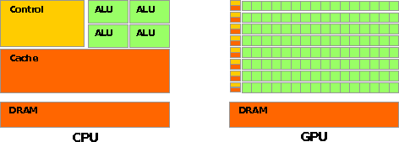
CPU vs GPU Layout
Source: NVIDIA CUDA Programming Guide

Slide 62
Buzzword: Kernel
In CUDA, a kernel is code (typically a function) that can be run inside the GPU.
Typically, the kernel code operates in lock-step on the stream processors inside the GPU.

Slide 63
Buzzword: Thread
In CUDA, a thread is an execution of a kernel with a given index.
Each thread uses its index to access a specific subset of the elements of a target array, such that the collection of all threads cooperatively processes the entire data set.
So these are very much like threads in the OpenMP or pthreads sense – they even have shared variables and private variables.

Slide 64
Buzzword: Block
In CUDA, a block is a group of threads.
Just like OpenMP threads, these could execute concurrently or independently, and in no particular order.
Threads can be coordinated somewhat, using the _syncthreads() function as a barrier, making all threads stop at a certain point in the kernel before moving on en mass. (This is like what happens at the end of an OpenMP loop.)

Slide 65
Buzzword: Grid
In CUDA, a grid is a group of (thread) blocks, with no synchronization at all among the blocks.

Slide 66
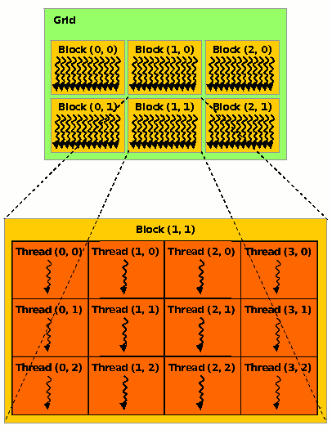
NVIDIA GPU Hierarchy
Grids map to GPUs
Blocks map to the MultiProcessors (MP)‏
Blocks are never split across MPs, but an MP can have multiple blocks
Threads map to Stream Processors (SP)‏
Warps are groups of (32) threads that execute simultaneously
Image Source:
NVIDIA CUDA Programming Guide

Slide 67
CUDA Built-in Variables
blockIdx.x, blockIdx.y, blockIdx.z are built-in variables that returns the block ID in the x-axis, y-axis and z-axis of the block that is executing the given block of code.
threadIdx.x, threadIdx.y, threadidx.z are built-in variables that return the thread ID in the x-axis, y-axis and z-axis of the thread that is being executed by this stream processor in this particular block.
So, you can express your collection of blocks, and your collection of threads within a block, as a 1D array, a 2D array or a 3D array.
These can be helpful when thinking of your data as 2D or 3D.

Slide 68
__global__ Keyword
In CUDA, if a function is declared with the __global__ keyword, that means that it’s intended to be executed inside a GPU.
In CUDA, the term for the GPU is device, and the term for the x86 server is host.
So, a kernel runs on a device, while the main function, and so on, run on the host.
Note that a host can play host to multiple devices; for example, an S2050 server contains 4 C2050 GPU cards, and if a single host has two PCIe slots, then both of the PCIe plugs of the S2050 can be plugged into that same host.

Slide 69
Copying Data from Host to Device
If data need to move from the host (where presumably the data are initially input or generated), then a copy has to exist in both places.
Typically, what’s copied are arrays, though of course you can also copy a scalar (the address of which is treated as an array of length 1).

Slide 70
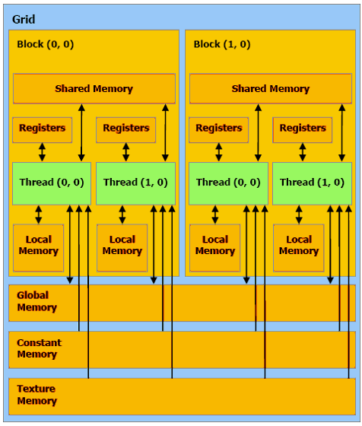
CUDA Memory Hierarchy #1
CUDA has a hierarchy of several kinds of memory:
Host memory (x86 server)
Device memory (GPU)
Global: visible to all threads in all blocks – largest, slowest
Shared: visible to all threads in a particular block – medium size, medium speed
Local: visible only to a particular thread – smallest, fastest

Slide 71
CUDA Memory Hierarchy #2
CUDA has a hierarchy of several kinds of memory:
Host memory (x86 server)
Device memory (GPU)
Constant: visible to all threads in all blocks; read only
Texture: visible to all threads in all blocks; read only

Slide 72
CUDA Example: Matrix-Matrix Multiply
http://developer.download.nvidia.com/compute/cuda/sdk/website/Linear_Algebra.html#matrixMul

Slide 73
Matrix-Matrix Multiply Main Part 1
float* host_A;
float* host_B;
float* host_B;
float* device_A;
float* device_B;
float* device_C;
host_A = (float*) malloc(mem_size_A);
host_B = (float*) malloc(mem_size_B);
host_C = (float*) malloc(mem_size_C);
cudaMalloc((void**) &device_A, mem_size_A);
cudaMalloc((void**) &device_B, mem_size_B);
cudamalloc((void**) &device_C, mem_size_C);
// Set up the initial values of A and B here.
// Henry says: I’ve oversimplified this a bit from
// the original example code.

Slide 74
Matrix-Matrix Multiply Main Part 2
// copy host memory to device
cudaMemcpy(device_A, host_A, mem_size_A,
cudaMemcpyHostToDevice);
cudaMemcpy(device_B, host_B, mem_size_B,
cudaMemcpyHostToDevice);
// setup execution parameters
dim3 threads(BLOCK_SIZE, BLOCK_SIZE);
dim3 grid(WC / threads.x, HC / threads.y);
// execute the kernel
matrixMul<<< grid, threads >>>(device_C,
device_A, device_B, WA, WB);
// copy result from device to host
cudaMemcpy(host_C, device_C, mem_size_C,
cudaMemcpyDeviceToHost);

Slide 75
Matrix Matrix Multiply Kernel Part 1
__global__ void matrixMul( float* C, float* A, float* B, int wA, int wB)
{
// Block index
int bx = blockIdx.x;
int by = blockIdx.y;
// Thread index
int tx = threadIdx.x;
int ty = threadIdx.y;
// Index of the first sub-matrix of A processed by the block
int aBegin = wA * BLOCK_SIZE * by;
// Index of the last sub-matrix of A processed by the block
int aEnd = aBegin + wA - 1;
// Step size used to iterate through the sub-matrices of A
int aStep = BLOCK_SIZE;
// Index of the first sub-matrix of B processed by the block
int bBegin = BLOCK_SIZE * bx;
// Step size used to iterate through the sub-matrices of B
int bStep = BLOCK_SIZE * wB;
// Csub is used to store the element of the block sub-matrix
// that is computed by the thread
float Csub = 0;

Slide 76
Matrix Matrix Multiply Kernel Part 2
// Loop over all the sub-matrices of A and B
// required to compute the block sub-matrix
for (int a = aBegin, b = bBegin;
a <= aEnd;
a += aStep, b += bStep) {
// Declaration of the shared memory array As used to
// store the sub-matrix of A
__shared__ float As[BLOCK_SIZE][BLOCK_SIZE];
// Declaration of the shared memory array Bs used to
// store the sub-matrix of B
__shared__ float Bs[BLOCK_SIZE][BLOCK_SIZE];
// Load the matrices from device memory
// to shared memory; each thread loads
// one element of each matrix
AS(ty, tx) = A[a + wA * ty + tx];
BS(ty, tx) = B[b + wB * ty + tx];
// Synchronize to make sure the matrices are loaded
__syncthreads();

Slide 77
Matrix Matrix Multiply Kernel Part 3
// Multiply the two matrices together;
// each thread computes one element
// of the block sub-matrix
for (int k = 0; k < BLOCK_SIZE; ++k)
Csub += AS(ty, k) * BS(k, tx);
// Synchronize to make sure that the preceding
// computation is done before loading two new
// sub-matrices of A and B in the next iteration
__syncthreads();
}
// Write the block sub-matrix to device memory;
// each thread writes one element
int c = wB * BLOCK_SIZE * by + BLOCK_SIZE * bx;
C[c + wB * ty + tx] = Csub;
}

Slide 78
Would We Really Do It This Way?
We wouldn’t really do matrix-matrix multiply this way.
NVIDIA has developed a CUDA implementation of the BLAS libraries, which include a highly tuned matrix-matrix multiply routine.
(We’ll learn about BLAS next time.)
There’s also a CUDA FFT library, if your code needs Fast Fourier Transforms.

Slide 79
Summer Workshops 2011
Introduction to Computational Thinking
Modeling and Simulation Across the Curriculum
June 19 - 25, Wayne State College, Wayne NE
July 10 - 16, Texas State Technical College, Waco
Preparing In-service and Pre-service Educators for Computational Thinking
July 24 - 30, Oregon State University, Corvallis
Computational Thinking from a Parallel Perspective
July 31 - Aug 6, Louisiana State University, Baton Rouge

Slide 80
Summer Workshops 2011 (cont’d)
Computational Biology for Biology Educators
June 12 - 18, Lafayette College, Easton PA
June 26 - July 2, Calvin College, Grand Rapids MI
Computational Chemistry for Chemistry Educators
July 24 - 30, Washington and Lee University, Lexington VA
JOINTLY PRESENTED VIA VIDEOCONFERENCING WITH
July 24 - 30, Oklahoma State University, Stillwater
Data-driven Computational Science: Modeling and Visualization
June 19 - 25, Richard Stockton College of New Jersey, Pomona

Slide 81
Summer Workshops 2011 (cont’d)
Introduction to Parallel Programming & Cluster Computing
June 26 - July 1, Idaho State University, Pocatello
JOINTLY PRESENTED VIA VIDEOCONFERENCING WITH
June 26 - July 1, University of Washington, Seattle
Intermediate Parallel Programming & Cluster Computing
July 31 - Aug 6, University of Oklahoma, Norman
JOINTLY PRESENTED VIA VIDEOCONFERENCING WITH
July 31 - Aug 6, Polytechnic University of Puerto Rico, Hato Rey

Slide 82
OK Supercomputing Symposium 2011
2003 Keynote:
Peter Freeman
NSF
Computer & Information
Science & Engineering
Assistant Director
2004 Keynote:
Sangtae Kim
NSF Shared
Cyberinfrastructure
Division Director
2005 Keynote:
Walt Brooks
NASA Advanced
Supercomputing
Division Director
2006 Keynote:
Dan Atkins
Head of NSF’s
Office of
Cyberinfrastructure
2007 Keynote:
Jay Boisseau
Director
Texas Advanced
Computing Center
U. Texas Austin
2008 Keynote: José Munoz Deputy Office Director/ Senior Scientific Advisor NSF Office of Cyberinfrastructure
?
FREE! Wed Oct 12 2011 @ OU
Over 235 registratons already!
Over 150 in the first day, over 200 in the first week, over 225 in the first month.
http://symposium2011.oscer.ou.edu/
Parallel Programming Workshop FREE! Tue Oct 11 2011 @ OU
FREE! Symposium Wed Oct 12 2011 @ OU
REGISTRATION IS NOW OPEN!
2009 Keynote: Douglass Post Chief Scientist US Dept of Defense HPC Modernization Program
2010 Keynote: Horst Simon Deputy Director Lawrence Berkeley National Laboratory
2011 Keynote to be announced

Slide 83
SC11 Education Program
At the SC11 supercomputing conference, we’ll hold our annual Education Program, Sat Nov 12 – Tue Nov 15.
You can apply to attend, either fully funded by SC11 or self-funded.
Henry is the SC11 Education Chair.
We’ll alert everyone once the registration website opens.

Slide 84
Thanks for your attention! Questions? www.oscer.ou.edu

