Slide 1
Towards accurate detection and genotyping of expressed variants from whole transcriptome sequencing data
Jorge Duitama¹, Pramod Srivastava², and Ion Mandoiu¹
¹ University of Connecticut. Department of Computer Sciences & Engineering
² University of Connecticut Health Center

Slide 2
Introduction
RNA-Seq is the method of choice for studying functional effects of genetic variability
RNA-Seq poses new computational challenges compared to genome sequencing
In this paper we present:
a strategy to map transcriptome reads using both the genome reference sequence and the CCDS database.
a novel Bayesian model for SNV discovery and genotyping based on quality scores

Slide 3
SNP Calling from Genomic DNA Reads
Read sequences &
quality scores
Reference genome
sequence
@HWI-EAS299_2:2:1:1536:631
GGGATGTCAGGATTCACAATGACAGTGCTGGATGAG
+HWI-EAS299_2:2:1:1536:631
::::::::::::::::::::::::::::::222220
@HWI-EAS299_2:2:1:771:94
ATTACACCACCTTCAGCCCAGGTGGTTGGAGTACTC
+HWI-EAS299_2:2:1:771:94
:::::::::::::::::::::::::::2::222220
>ref|NT_082868.6|Mm19_82865_37:1-3688105 Mus musculus chromosome 19 genomic contig, strain C57BL/6J
GATCATACTCCTCATGCTGGACATTCTGGTTCCTAGTATATCTGGAGAGTTAAGATGGGGAATTATGTCA
ACTTTCCCTCTTCCTATGCCAGTTATGCATAATGCACAAATATTTCCACGCTTTTTCACTACAGATAAAG
AACTGGGACTTGCTTATTTACCTTTAGATGAACAGATTCAGGCTCTGCAAGAAAATAGAATTTTCTTCAT
ACAGGGAAGCCTGTGCTTTGTACTAATTTCTTCATTACAAGATAAGAGTCAATGCATATCCTTGTATAAT
Read Mapping
SNP calling
1 4764558 G T 2 1
1 4767621 C A 2 1
1 4767623 T A 2 1
1 4767633 T A 2 1
1 4767643 A C 4 2
1 4767656 T C 7 1
Notes:
3
NOTE: P(g|r) is NP-Hard…

Slide 4
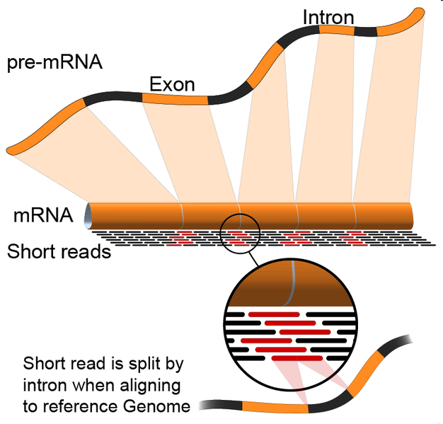
Mapping mRNA Reads
http://en.wikipedia.org/wiki/File:RNA-Seq-alignment.png
Notes:
4

Slide 5
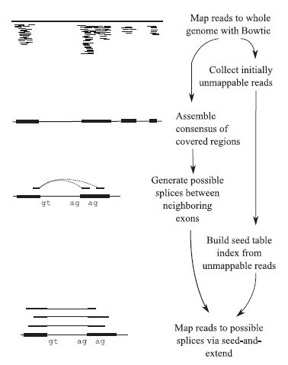
C. Trapnell, L. Pachter, and S.L. Salzberg. TopHat: discovering splice junctions with RNA-Seq. Bioinformatics, 25(9):1105–1111, 2009.

Slide 6
Mapping and Merging Strategy
CCDS
Mapping
CCDS mapped reads
Tumor mRNA reads
Read Merging
Mapped reads
Genome Mapping
Genome mapped reads

Slide 7
Read Merging
Genome | CCDS | Agree? | Hard Merge | Soft Merge
Unique | Unique | Yes | Keep | Keep
Unique | Unique | No | Throw | Throw
Unique | Multiple | No | Throw | Keep
Unique | Not Mapped | No | Keep | Keep
Multiple | Unique | No | Throw | Keep
Multiple | Multiple | No | Throw | Throw
Multiple | Not Mapped | No | Throw | Throw
Not mapped | Unique | No | Keep | Keep
Not mapped | Multiple | No | Throw | Throw
Not mapped | Not Mapped | Yes | Throw | Throw

Slide 8
SNV Detection and Genotyping
Locus i
Reference
AACGCGGCCAGCCGGCTTCTGTCGGCCAGCAGCCAGGAATCTGGAAACAATGGCTACAGCGTGC
AACGCGGCCAGCCGGCTTCTGTCGGCCAGCCGGCAG
CGCGGCCAGCCGGCTTCTGTCGGCCAGCAGCCCGGA
GCGGCCAGCCGGCTTCTGTCGGCCAGCCGGCAGGGA
GCCAGCCGGCTTCTGTCGGCCAGCAGCCAGGAATCT
GCCGGCTTCTGTCGGCCAGCAGCCAGGAATCTGGAA
CTTCTGTCGGCCAGCCGGCAGGAATCTGGAAACAAT
CGGCCAGCAGCCAGGAATCTGGAAACAATGGCTACA
CCAGCAGCCAGGAATCTGGAAACAATGGCTACAGCG
CAAGCAGCCAGGAATCTGGAAACAATGGCTACAGCG
GCAGCCAGGAATCTGGAAACAATGGCTACAGCGTGC
R_{i}
r(i) : Base call of read r at locus i
ε_{r(i)} : Probability of error reading base call r(i)
G_{i} : Genotype at locus i

Slide 9
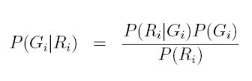

SNV Detection and Genotyping
Use Bayes rule to calculate posterior probabilities and pick the genotype with the largest one

Slide 10
Current Models
Maq:
Keep just the alleles with the two largest counts
Pr (R_{i} | G_{i}=H_{i}H_{i}) is the probability of observing k alleles r(i) different than H_{i}
Pr (R_{i} | G_{i}=H_{i}H’_{i}) is approximated as a binomial with p=0.5
SOAPsnp
Pr (r_{i} | G_{i}=H_{i}H’_{i}) is the average of Pr(r_{i}|H_{i}) and Pr(r_{i}|G_{i}=H’_{i})
A rank test on the quality scores of the allele calls is used to confirm heterozygocity

Slide 11

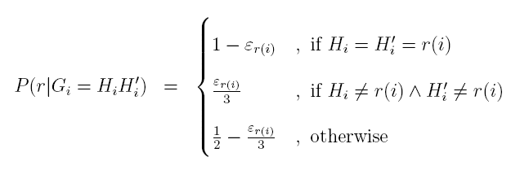
SNV Detection and Genotyping
Calculate conditional probabilities by multiplying contributions of individual reads

Slide 12
Accuracy Assessment of Variants Detection
113 million Illumina mRNA reads generated from blood cell tissue of Hapmap individual NA12878 (NCBI SRA database accession numbers SRX000565 and SRX000566)
We tested genotype calling using as gold standard 3.4 million SNPs with known genotypes for NA12878 available in the database of the Hapmap project
True positive: called variant for which Hapmap genotype coincides
False positive: called variant for which Hapmap genotype does not coincide

Slide 13
Comparison of Mapping Strategies

Slide 14
Comparison of Variant Calling Strategies

Slide 15
Data Filtering

Slide 16
Data Filtering
Allow just x reads per start locus to eliminate PCR amplification artifacts
Chepelev et. al. algorithm:
For each locus groups starting reads with 0, 1 and 2 mismatches
Choose at random one read of each group

Slide 17
Comparison of Data Filtering Strategies

Slide 18
Accuracy per RPKM bins

Slide 19
Conclusions
We presented a new strategy to map mRNA reads using both the reference genome and the CCDS database and a new bayesian model for SNV detection and genotyping
Experiments on publicly available datasets show that our methods outperform widely used SNV detection methods
Future Work:
Improve genotype calling by adapting our model to differential allelic expression
Use our methods on RNA-Seq data from cancer tumor data

Slide 20
Acknowledgments
Brent Graveley and Duan Fei (UCHC)
NSF awards IIS-0546457, IIS-0916948, and DBI-0543365
UCONN Research Foundation UCIG grant

