Slide 1
Introduction to Communication-Avoiding Algorithms www.cs.berkeley.edu/~demmel/SC11_tutorial
Jim Demmel
EECS & Math Departments
UC Berkeley

Slide 2
Why avoid communication? (1/2)
Algorithms have two costs (measured in time or energy):
Arithmetic (FLOPS)
Communication: moving data between
levels of a memory hierarchy (sequential case)
processors over a network (parallel case).
CPU
Cache
CPU
DRAM
CPU
DRAM
DRAM
CPU
DRAM
CPU
DRAM

Slide 3
Why avoid communication? (2/2)
Running time of an algorithm is sum of 3 terms:
# flops * time_per_flop
# words moved / bandwidth
# messages * latency
communication
Time_per_flop << 1/ bandwidth << latency
Gaps growing exponentially with time [FOSC]
Annual improvements
Time_per_flop |  | Bandwidth | Latency
 | Network | 26% | 15%
 | DRAM | 23% | 5%
59%
Goal : reorganize algorithms to avoid communication
Between all memory hierarchy levels
L1 L2 DRAM network, etc
Very large speedups possible
Energy savings too!
Notes:
2008 DARPA Exascale report has similar prediction:
Gap between DRAM access time and flops will increase
100x over coming decade to balance power usage between
processors, DRAM

Slide 4
President Obama cites Communication-Avoiding Algorithms in the FY 2012 Department of Energy Budget Request to Congress:
“New Algorithm Improves Performance and Accuracy on Extreme-Scale Computing Systems. On modern computer architectures, communication between processors takes longer than the performance of a floating point arithmetic operation by a given processor. ASCR researchers have developed a new method, derived from commonly used linear algebra methods, to minimize communications between processors and the memory hierarchy, by reformulating the communication patterns specified within the algorithm. This method has been implemented in the TRILINOS framework, a highly-regarded suite of software, which provides functionality for researchers around the world to solve large scale, complex multi-physics problems.”
FY 2010 Congressional Budget, Volume 4, FY2010 Accomplishments, Advanced Scientific Computing Research (ASCR), pages 65-67.
CA-GMRES (Hoemmen, Mohiyuddin, Yelick, JD)
“Tall-Skinny” QR (Grigori, Hoemmen, Langou, JD)

Slide 5
Summary of CA Linear Algebra
“Direct” Linear Algebra
Lower bounds on communication for linear algebra problems like Ax=b, least squares, Ax = λx, SVD, etc
New algorithms that attain these lower bounds
Being added to libraries: Sca/LAPACK, PLASMA, MAGMA
Large speed-ups possible
Autotuning to find optimal implementation
Ditto for “Iterative” Linear Algebra

Slide 6
Lower bound for all “direct” linear algebra
Let M = “fast” memory size (per processor)
#words_moved (per processor) = Ω(#flops (per processor) / M^{1/2} )
#messages_sent (per processor) = Ω(#flops (per processor) / M^{3/2} )
Parallel case: assume either load or memory balanced
Holds for
Matmul, BLAS, LU, QR, eig, SVD, tensor contractions, …
Some whole programs (sequences of these operations, no matter how individual ops are interleaved, eg A^{k})
Dense and sparse matrices (where #flops << n³ )
Sequential and parallel algorithms
Some graph-theoretic algorithms (eg Floyd-Warshall)

Slide 7
Lower bound for all “direct” linear algebra
Let M = “fast” memory size (per processor)
#words_moved (per processor) = Ω(#flops (per processor) / M^{1/2} )
#messages_sent ≥ #words_moved / largest_message_size
Parallel case: assume either load or memory balanced
Holds for
Matmul, BLAS, LU, QR, eig, SVD, tensor contractions, …
Some whole programs (sequences of these operations, no matter how individual ops are interleaved, eg A^{k})
Dense and sparse matrices (where #flops << n³ )
Sequential and parallel algorithms
Some graph-theoretic algorithms (eg Floyd-Warshall)

Slide 8
Lower bound for all “direct” linear algebra
Let M = “fast” memory size (per processor)
#words_moved (per processor) = Ω(#flops (per processor) / M^{1/2} )
#messages_sent (per processor) = Ω(#flops (per processor) / M^{3/2} )
Parallel case: assume either load or memory balanced
Holds for
Matmul, BLAS, LU, QR, eig, SVD, tensor contractions, …
Some whole programs (sequences of these operations, no matter how individual ops are interleaved, eg A^{k})
Dense and sparse matrices (where #flops << n³ )
Sequential and parallel algorithms
Some graph-theoretic algorithms (eg Floyd-Warshall)

Slide 9
Can we attain these lower bounds?
Do conventional dense algorithms as implemented in LAPACK and ScaLAPACK attain these bounds?
Mostly not
If not, are there other algorithms that do?
Yes, for much of dense linear algebra
New algorithms, with new numerical properties, new ways to encode answers, new data structures
Not just loop transformations
Only a few sparse algorithms so far
Lots of work in progress
Case study: Matrix Multiply

Slide 10
Naïve Matrix Multiply
{implements C = C + A*B}
for i = 1 to n
for j = 1 to n
for k = 1 to n
C(i,j) = C(i,j) + A(i,k) * B(k,j)
C(i,j)
C(i,j)
A(i,:)
=
+
*
B(:,j)

Slide 11
Naïve Matrix Multiply
{implements C = C + A*B}
for i = 1 to n
{read row i of A into fast memory}
for j = 1 to n
{read C(i,j) into fast memory}
{read column j of B into fast memory}
for k = 1 to n
C(i,j) = C(i,j) + A(i,k) * B(k,j)
{write C(i,j) back to slow memory}
C(i,j)
C(i,j)
A(i,:)
=
+
*
B(:,j)

Slide 12
Naïve Matrix Multiply
{implements C = C + A*B}
for i = 1 to n
{read row i of A into fast memory} … n² reads altogether
for j = 1 to n
{read C(i,j) into fast memory} … n² reads altogether
{read column j of B into fast memory} … n³ reads altogether
for k = 1 to n
C(i,j) = C(i,j) + A(i,k) * B(k,j)
{write C(i,j) back to slow memory} … n² writes altogether
C(i,j)
C(i,j)
A(i,:)
=
+
*
B(:,j)
n³ + 3n² reads/writes altogether – dominates 2n³ arithmetic

Slide 13
Blocked (Tiled) Matrix Multiply
Consider A,B,C to be n/b-by-n/b matrices of b-by-b subblocks where b is called the block size; assume 3 b-by-b blocks fit in fast memory
for i = 1 to n/b
for j = 1 to n/b
{read block C(i,j) into fast memory}
for k = 1 to n/b
{read block A(i,k) into fast memory}
{read block B(k,j) into fast memory}
C(i,j) = C(i,j) + A(i,k) * B(k,j) {do a matrix multiply on blocks}
{write block C(i,j) back to slow memory}
C(i,j)
C(i,j)
A(i,k)
b-by-b
block
=
+
*
B(k,j)

Slide 14
Blocked (Tiled) Matrix Multiply
Consider A,B,C to be n/b-by-n/b matrices of b-by-b subblocks where b is called the block size; assume 3 b-by-b blocks fit in fast memory
for i = 1 to n/b
for j = 1 to n/b
{read block C(i,j) into fast memory} … b² × (n/b)² = n² reads
for k = 1 to n/b
{read block A(i,k) into fast memory} … b² × (n/b)³ = n³/b reads
{read block B(k,j) into fast memory} … b² × (n/b)³ = n³/b reads
C(i,j) = C(i,j) + A(i,k) * B(k,j) {do a matrix multiply on blocks}
{write block C(i,j) back to slow memory} … b² × (n/b)² = n² writes
C(i,j)
C(i,j)
A(i,k)
b-by-b
block
=
+
*
B(k,j)
2n³/b + 2n² reads/writes << 2n³ arithmetic - Faster!

Slide 15
Does blocked matmul attain lower bound?
Recall: if 3 b-by-b blocks fit in fast memory of size M, then #reads/writes = 2n³/b + 2n²
Make b as large as possible: 3b² ≤ M, so #reads/writes ≥ 3^{1/2}n³/M^{1/2} + 2n²
Attains lower bound = Ω (#flops / M^{1/2} )
But what if we don’t know M?
Or if there are multiples levels of fast memory?
How do we write the algorithm?

Slide 16
Recursive Matrix Multiplication (RMM) (1/2)
For simplicity: square matrices with n = 2^{m}
C = = A · B = · ·
=
True when each A_{ij} etc 1x1 or n/2 x n/2
C₁₁ C₁₂ C₂₁ C₂₂
A₁₁ A₁₂ A₂₁ A₂₂
B₁₁ B₁₂ B₂₁ B₂₂
A₁₁·B₁₁ + A₁₂·B₂₁ A₁₁·B₁₂ + A₁₂·B₂₂ A₂₁·B₁₁ + A₂₂·B₂₁ A₂₁·B₁₂ + A₂₂·B₂₂
func C = RMM (A, B, n)
if n = 1, C = A * B, else
{ C₁₁ = RMM (A₁₁ , B₁₁ , n/2) + RMM (A₁₂ , B₂₁ , n/2)
C₁₂ = RMM (A₁₁ , B₁₂ , n/2) + RMM (A₁₂ , B₂₂ , n/2)
C₂₁ = RMM (A₂₁ , B₁₁ , n/2) + RMM (A₂₂ , B₂₁ , n/2)
C₂₂ = RMM (A₂₁ , B₁₂ , n/2) + RMM (A₂₂ , B₂₂ , n/2) }
return

Slide 17
Recursive Matrix Multiplication (RMM) (2/2)
func C = RMM (A, B, n)
if n=1, C = A * B, else
{ C₁₁ = RMM (A₁₁ , B₁₁ , n/2) + RMM (A₁₂ , B₂₁ , n/2)
C₁₂ = RMM (A₁₁ , B₁₂ , n/2) + RMM (A₁₂ , B₂₂ , n/2)
C₂₁ = RMM (A₂₁ , B₁₁ , n/2) + RMM (A₂₂ , B₂₁ , n/2)
C₂₂ = RMM (A₂₁ , B₁₂ , n/2) + RMM (A₂₂ , B₂₂ , n/2) }
return
A(n) = # arithmetic operations in RMM( . , . , n)
= 8 · A(n/2) + 4(n/2)² if n > 1, else 1
= 2n³ … same operations as usual, in different order
W(n) = # words moved between fast, slow memory by RMM( . , . , n)
= 8 · W(n/2) + 12(n/2)² if 3n² > M , else 3n²
= O( n³ / M^{1/2} + n² ) … same as blocked matmul
“Cache oblivious”, works for memory hierarchies, but not panacea

Slide 18
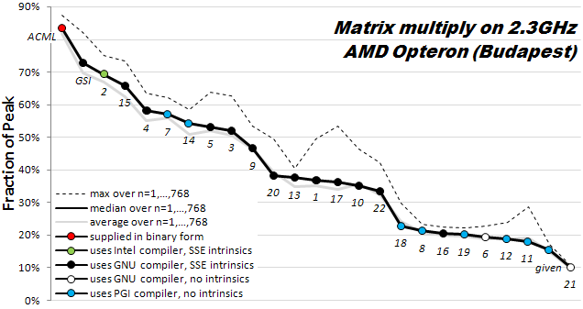
How hard is hand-tuning matmul, anyway?
Results of 22 student teams trying to tune matrix-multiply, in CS267 Spr09
Students given “blocked” code to start with (7x faster than naïve)
Still hard to get close to vendor tuned performance (ACML) (another 6x)
For more discussion, see www.cs.berkeley.edu/~volkov/cs267.sp09/hw1/results/

Slide 19
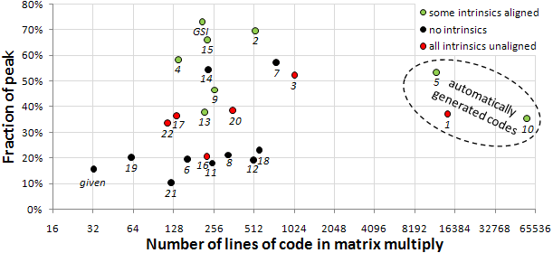
How hard is hand-tuning matmul, anyway?

Slide 20
Parallel MatMul with 2D Processor Layout
P processors in P^{1/2} x P^{1/2} grid
Processors communicate along rows, columns
Each processor owns n/P^{1/2} x n/P^{1/2} submatrices of A,B,C
Example: P=16, processors numbered from P₀₀ to P₃₃
Processor P_{ij} owns submatrices A_{ij}, B_{ij} and C_{ij}
C = A * B
P₀₀ P₀₁ P₀₂ P₀₃
P₀₀ P₀₁ P₀₂ P₀₃
P₀₀ P₀₁ P₀₂ P₀₃
P₁₀ P₁₁ P₁₂ P₁₃
P₁₀ P₁₁ P₁₂ P₁₃
P₁₀ P₁₁ P₁₂ P₁₃
P₂₀ P₂₁ P₂₂ P₂₃
P₂₀ P₂₁ P₂₂ P₂₃
P₂₀ P₂₁ P₂₂ P₂₃
P₃₀ P₃₁ P₃₂ P₃₃
P₃₀ P₃₁ P₃₂ P₃₃
P₃₀ P₃₁ P₃₂ P₃₃

Slide 21
SUMMA Algorithm
SUMMA = Scalable Universal Matrix Multiply
Comes within factor of log P of lower bounds:
Assume fast memory size M = O(n²/P) per processor – 1 copy of data
#words_moved = Ω( #flops / M^{1/2} ) = Ω( (n³/P) / (n²/P)^{1/2} ) = Ω( n² / P^{1/2} )
#messages = Ω( #flops / M^{3/2} ) = Ω( (n³/P) / (n²/P)^{3/2} ) = Ω( P^{1/2} )
Can accommodate any processor grid, matrix dimensions & layout
Used in practice in PBLAS = Parallel BLAS
www.netlib.org/lapack/lawns/lawn{96,100}.ps
Comparison to Cannon’s Algorithm
Cannon attains lower bound
But Cannon harder to generalize to other grids, dimensions, layouts, and Cannon may use more memory
Notes:
SUMMA with more complicated implementation can attain bandwidth lower bound

Slide 22
SUMMA – n x n matmul on P^{1/2} x P^{1/2} grid
k
j
B(k,j)
k
*
=
i
C(i,j)
A(i,k)
C(i, j) is n/P^{1/2} x n/P^{1/2} submatrix of C on processor P_{ij}
A(i,k) is n/P^{1/2} x b submatrix of A
B(k,j) is b x n/P^{1/2} submatrix of B
C(i,j) = C(i,j) + Σ_{k} A(i,k)*B(k,j)
summation over submatrices
Need not be square processor grid

Slide 23
SUMMA– n x n matmul on P^{1/2} x P^{1/2} grid
k
j
B(k,j)
k
*
=
Brow
i
C(i,j)
A(i,k)
Acol
For k=0 to n-1 … or n/b-1 where b is the block size
… = # cols in A(i,k) and # rows in B(k,j)
for all i = 1 to p_{r} … in parallel
owner of A(i,k) broadcasts it to whole processor row
for all j = 1 to p_{c} … in parallel
owner of B(k,j) broadcasts it to whole processor column
Receive A(i,k) into Acol
Receive B(k,j) into Brow
C_myproc = C_myproc + Acol * Brow
For k=0 to n/b-1
for all i = 1 to P^{1/2}
owner of A(i,k) broadcasts it to whole processor row (using binary tree)
for all j = 1 to P^{1/2}
owner of B(k,j) broadcasts it to whole processor column (using bin. tree)
Receive A(i,k) into Acol
Receive B(k,j) into Brow
C_myproc = C_myproc + Acol * Brow

Slide 24
SUMMA Communication Costs
For k=0 to n/b-1
for all i = 1 to P^{1/2}
owner of A(i,k) broadcasts it to whole processor row (using binary tree)
… #words = log P^{1/2} *b*n/P^{1/2} , #messages = log P^{1/2}
for all j = 1 to P^{1/2}
owner of B(k,j) broadcasts it to whole processor column (using bin. tree)
… same #words and #messages
Receive A(i,k) into Acol
Receive B(k,j) into Brow
C_myproc = C_myproc + Acol * Brow
Total #words = log P * n² /P^{1/2}
Within factor of log P of lower bound
(more complicated implementation removes log P factor)
Total #messages = log P * n/b
Choose b close to maximum, n/P^{1/2},
to approach lower bound P^{1/2}

Slide 25
Can we do better?
Lower bound assumed 1 copy of data: M = O(n²/P) per proc.
What if matrix small enough to fit c>1 copies, so M = cn²/P ?
#words_moved = Ω( #flops / M^{1/2} ) = Ω( n² / ( c^{1/2} P^{1/2} ))
#messages = Ω( #flops / M^{3/2} ) = Ω( P^{1/2} /c^{3/2})
Can we attain new lower bound?
Special case: “3D Matmul”: c = P^{1/6}
Bernsten 89, Agarwal, Chandra, Snir 90, Aggarwal 95
Processors arranged in P^{1/3} x P^{1/3} x P^{1/3} grid
Processor (i,j,k) performs C(i,j) = C(i,j) + A(i,k)*B(k,j), where each submatrix is n/P^{1/3} x n/P^{1/3}
Not always that much memory available…

Slide 26
2.5D Matrix Multiplication
Assume can fit cn²/P data per processor, c>1
Processors form (P/c)^{1/2} x (P/c)^{1/2} x c grid
(P/c)^{1/2}
(P/c)^{1/2}
Example: P = 32, c = 2
c

Slide 27
2.5D Matrix Multiplication
Assume can fit cn²/P data per processor, c > 1
Processors form (P/c)^{1/2} x (P/c)^{1/2} x c grid
j
i
Initially P(i,j,0) owns A(i,j) and B(i,j)
each of size n(c/P)^{1/2} x n(c/P)^{1/2}
k
(1) P(i,j,0) broadcasts A(i,j) and B(i,j) to P(i,j,k)
(2) Processors at level k perform 1/c-th of SUMMA, i.e. 1/c-th of Σ_{m} A(i,m)*B(m,j)
(3) Sum-reduce partial sums Σ_{m} A(i,m)*B(m,j) along k-axis so P(i,j,0) owns C(i,j)

Slide 28
2.5D Matmul on BG/P, n=64K
As P increases, available memory grows ➔ c increases proportionally to P
#flops, #words_moved, #messages per proc all decrease proportionally to P
Perfect strong scaling!

Slide 29
2.5D Matmul on BG/P, 16K nodes / 64K cores

Slide 30
2.5D Matmul on BG/P, 16K nodes / 64K cores
c = 16 copies
Distinguished Paper Award, EuroPar’11
SC’11 paper by Solomonik, Bhatele, D.
Notes:
SC’11 paper about need to fully utilize 3D torus network on BG/P to get this to work

Slide 31
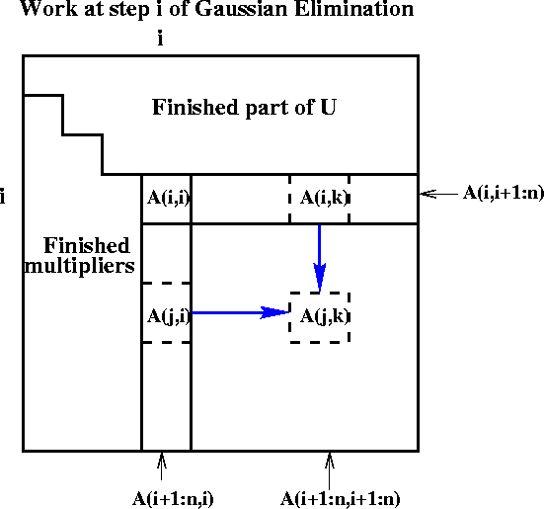
Extending to rest of Direct Linear Algebra Naïve Gaussian Elimination: A =LU
Last version
Express using matrix operations (BLAS)
for i = 1 to n-1
A(i+1:n,i) = A(i+1:n,i) * ( 1 / A(i,i) )
… scale a vector
A(i+1:n,i+1:n) = A(i+1:n , i+1:n )
- A(i+1:n , i) * A(i , i+1:n)
… rank-1 update
for i=1 to n-1
update column i
update trailing matrix
➔
for i = 1 to n-1
for j = i+1 to n
A(j,i) = A(j,i)/A(i,i)
for j = i+1 to n
for k = i+1 to n
A(j,k) = A(j,k) - A(j,i) * A(i,k)

Slide 32
Communication in sequential One-sided Factorizations (LU, QR, …)
Naive Approach
for i=1 to n-1
update column i
update trailing matrix
#words_moved = O(n³)
Blocked Approach (LAPACK)
for i=1 to n/b - 1
update block i of b columns
update trailing matrix
#words moved = O(n³/M^{1/3})
Recursive Approach
func factor(A)
if A has 1 column, update it else
factor(left half of A)
update right half of A
factor(right half of A)
#words moved = O(n³/M^{1/2})
None of these approaches
minimizes #messages
handles eig() or svd()
works in parallel
Need more ideas
Notes:
Recursive approach”
QR: Elmroth, Gustavson
LU: Toledo

Slide 33
TSQR: QR of a Tall, Skinny matrix
W₀
W₁
W₂
W₃
Q₀₀ R₀₀
Q₁₀ R₁₀
Q₂₀ R₂₀
Q₃₀ R₃₀
Q₀₀
Q₁₀
Q₂₀
Q₃₀
R₀₀
R₁₀
R₂₀
R₃₀
W =
=
=
.
R₀₀
R₁₀
R₂₀
R₃₀
Q₀₁ R₀₁
Q₁₁ R₁₁
Q₀₁
Q₁₁
R₀₁
R₁₁
=
=
.
R₀₁
R₁₁
=
Q₀₂ R₀₂

Slide 34
TSQR: QR of a Tall, Skinny matrix
W₀
W₁
W₂
W₃
Q₀₀ R₀₀
Q₁₀ R₁₀
Q₂₀ R₂₀
Q₃₀ R₃₀
Q₀₀
Q₁₀
Q₂₀
Q₃₀
R₀₀
R₁₀
R₂₀
R₃₀
W =
=
=
.
R₀₀
R₁₀
R₂₀
R₃₀
Q₀₁ R₀₁
Q₁₁ R₁₁
Q₀₁
Q₁₁
R₀₁
R₁₁
=
=
.
R₀₁
R₁₁
=
Q₀₂ R₀₂
Output = { Q₀₀, Q₁₀, Q₂₀, Q₃₀, Q₀₁, Q₁₁, Q₀₂, R₀₂ }

Slide 35
TSQR: An Architecture-Dependent Algorithm
W₀
W₁
W₂
W₃
R₀₀
R₁₀
R₂₀
R₃₀
R₀₁
Parallel:
W =
R₀₂
R₁₁
W₀
W₁
W₂
W₃
R₀₀
Sequential:
R₀₁
W =
R₀₂
R₀₃
W₀
W₁
W₂
W₃
R₀₀
R₀₁
Dual Core:
R₀₁
W =
R₀₂
R₁₁
R₀₃
R₁₁
Multicore / Multisocket / Multirack / Multisite / Out-of-core: ?
Can choose reduction tree dynamically
Notes:
Oldest reference for idea of tree: Golub/Plemmons/Sameh 1988,
But didn’t avoid communication

Slide 36
TSQR Performance Results
Parallel
Intel Clovertown
Up to 8x speedup (8 core, dual socket, 10M x 10)
Pentium III cluster, Dolphin Interconnect, MPICH
Up to 6.7x speedup (16 procs, 100K x 200)
BlueGene/L
Up to 4x speedup (32 procs, 1M x 50)
Tesla C 2050 / Fermi
Up to 13x (110,592 x 100)
Grid – 4x on 4 cities (Dongarra et al)
Cloud – early result – up and running
Sequential
“Infinite speedup” for out-of-Core on PowerPC laptop
As little as 2x slowdown vs (predicted) infinite DRAM
LAPACK with virtual memory never finished
Data from Grey Ballard, Mark Hoemmen, Laura Grigori, Julien Langou, Jack Dongarra, Michael Anderson
Notes:
Transition: TSQR -> CAQR

Slide 37
Back to LU: Using similar idea for TSLU as TSQR: Use reduction tree, to do “Tournament Pivoting”
W₁
W₂
W₃
W₄
P₁·L₁·U₁
P₂·L₂·U₂
P₃·L₃·U₃
P₄·L₄·U₄
Choose b pivot rows of W₁, call them W₁’
Choose b pivot rows of W₂, call them W₂’
Choose b pivot rows of W₃, call them W₃’
Choose b pivot rows of W₄, call them W₄’
W^{nxb} =
=
W₁’
W₂’
W₃’
W₄’
P₁₂·L₁₂·U₁₂
P₃₄·L₃₄·U₃₄
Choose b pivot rows, call them W₁₂’
Choose b pivot rows, call them W₃₄’
=
W₁₂’
W₃₄’
= P₁₂₃₄·L₁₂₃₄·U₁₂₃₄
Choose b pivot rows
Go back to W and use these b pivot rows
Move them to top, do LU without pivoting
Extra work, but lower order term
Thm: As numerically stable as Partial Pivoting on a larger matrix

Slide 38
Exascale Machine Parameters Source: DOE Exascale Workshop
2^20 ≈ 1,000,000 nodes
1024 cores/node (a billion cores!)
100 GB/sec interconnect bandwidth
400 GB/sec DRAM bandwidth
1 microsec interconnect latency
50 nanosec memory latency
32 Petabytes of memory
1/2 GB total L1 on a node

Slide 39
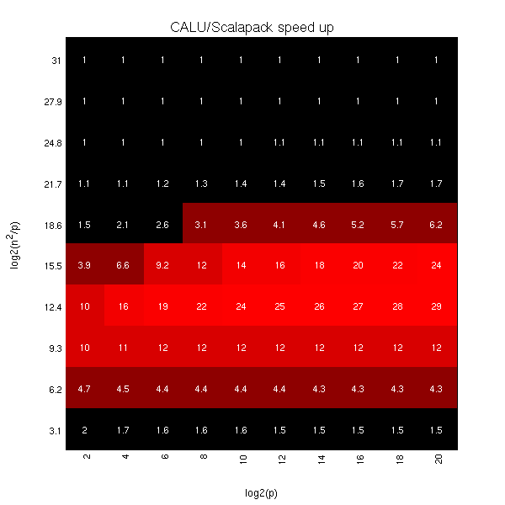
Exascale predicted speedups for Gaussian Elimination: 2D CA-LU vs ScaLAPACK-LU
log₂ (n²/p) =
log₂ (memory_per_proc)
log₂ (p)
Notes:
Vertical axis log2(n^2/p) is memory per processor
Horizontal axis log2(p) is processor count

Slide 40
2.5D vs 2D LU With and Without Pivoting

Slide 41
Summary of dense sequential algorithms attaining communication lower bounds
Algorithms shown minimizing # Messages use (recursive) block layout
Not possible with columnwise or rowwise layouts
Many references (see reports), only some shown, plus ours
Cache-oblivious are underlined, Green are ours, ? is unknown/future work
Algorithm | 2 Levels of Memory |  | Multiple Levels of Memory
 | #Words Moved | and # Messages | #Words Moved | and #Messages
BLAS-3 | Usual blocked or recursive algorithms |  | Usual blocked algorithms (nested), or recursive [Gustavson,97]
Cholesky | LAPACK (with b = M^{1/2}) [Gustavson 97] [BDHS09] | [Gustavson,97] [Ahmed,Pingali,00] [BDHS09] | (←same) | (←same)
LU with pivoting | LAPACK (sometimes) [Toledo,97] , [GDX 08] | [GDX 08] not partial pivoting | [Toledo, 97] [GDX 08]? | [GDX 08]?
QR Rank-revealing | LAPACK (sometimes) [Elmroth,Gustavson,98] [DGHL08] | [Frens,Wise,03] but 3x flops? [DGHL08] | [Elmroth, Gustavson,98] [DGHL08] ? | [Frens,Wise,03] [DGHL08] ?
Eig, SVD | Not LAPACK [BDD11] randomized, but more flops; [BDK11] |  | [BDD11, BDK11?] | [BDD11, BDK11?]
Notes:
Questions:
Was [Gustavson,97] not cache oblivious?
[Frigo, Leiserson, Prokop, Ramachandran,99]

Slide 42
Summary of dense parallel algorithms attaining communication lower bounds
Assume nxn matrices on P processors
Minimum Memory per processor = M = O(n² / P)
Recall lower bounds:
#words_moved = Ω( (n³/ P) / M^{1/2} ) = Ω( n² / P^{1/2} )
#messages = Ω( (n³/ P) / M^{3/2} ) = Ω( P^{1/2} )
Algorithm | Reference | Factor exceeding lower bound for #words_moved | Factor exceeding lower bound for #messages
Matrix Multiply
Cholesky
LU
QR
Sym Eig, SVD
Nonsym Eig
Notes:
ScaLAPACK assumes best block size chosen
Many references, green are ours

Slide 43
Summary of dense parallel algorithms attaining communication lower bounds
Assume nxn matrices on P processors (conventional approach)
Minimum Memory per processor = M = O(n² / P)
Recall lower bounds:
#words_moved = Ω( (n³/ P) / M^{1/2} ) = Ω( n² / P^{1/2} )
#messages = Ω( (n³/ P) / M^{3/2} ) = Ω( P^{1/2} )
Algorithm | Reference | Factor exceeding lower bound for #words_moved | Factor exceeding lower bound for #messages
Matrix Multiply | [Cannon, 69] | 1
Cholesky | ScaLAPACK | log P
LU | ScaLAPACK | log P
QR | ScaLAPACK | log P
Sym Eig, SVD | ScaLAPACK | log P
Nonsym Eig | ScaLAPACK | P^{1/2} log P
Notes:
ScaLAPACK assumes best block size chosen
Many references, green are ours

Slide 44
Summary of dense parallel algorithms attaining communication lower bounds
Assume nxn matrices on P processors (conventional approach)
Minimum Memory per processor = M = O(n² / P)
Recall lower bounds:
#words_moved = Ω( (n³/ P) / M^{1/2} ) = Ω( n² / P^{1/2} )
#messages = Ω( (n³/ P) / M^{3/2} ) = Ω( P^{1/2} )
Algorithm | Reference | Factor exceeding lower bound for #words_moved | Factor exceeding lower bound for #messages
Matrix Multiply | [Cannon, 69] | 1 | 1
Cholesky | ScaLAPACK | log P | log P
LU | ScaLAPACK | log P | n log P / P^{1/2}
QR | ScaLAPACK | log P | n log P / P^{1/2}
Sym Eig, SVD | ScaLAPACK | log P | n / P^{1/2}
Nonsym Eig | ScaLAPACK | P^{1/2} log P | n log P
Notes:
ScaLAPACK assumes best block size chosen
Many references, green are ours

Slide 45
Summary of dense parallel algorithms attaining communication lower bounds
Assume nxn matrices on P processors (better)
Minimum Memory per processor = M = O(n² / P)
Recall lower bounds:
#words_moved = Ω( (n³/ P) / M^{1/2} ) = Ω( n² / P^{1/2} )
#messages = Ω( (n³/ P) / M^{3/2} ) = Ω( P^{1/2} )
Algorithm | Reference | Factor exceeding lower bound for #words_moved | Factor exceeding lower bound for #messages
Matrix Multiply | [Cannon, 69] | 1 | 1
Cholesky | ScaLAPACK | log P | log P
LU | [GDX10] | log P | log P
QR | [DGHL08] | log P | log³ P
Sym Eig, SVD | [BDD11] | log P | log³ P
Nonsym Eig | [BDD11] | log P | log³ P
Notes:
ScaLAPACK assumes best block size chosen
Many references, green are ours

Slide 46
Can we do even better?
Assume nxn matrices on P processors
Use c copies of data: M = O(cn² / P) per processor
Increasing M reduces lower bounds:
#words_moved = Ω( (n³/ P) / M^{1/2} ) = Ω( n² / (c^{1/2} P^{1/2} ) )
#messages = Ω( (n³/ P) / M^{3/2} ) = Ω( P^{1/2} / c^{3/2} )
Algorithm | Reference | Factor exceeding lower bound for #words_moved | Factor exceeding lower bound for #messages
Matrix Multiply | [DS11,SBD11] | polylog P | polylog P
Cholesky | [SD11, in prog.] | polylog P | c² polylog P – optimal!
LU | [DS11,SBD11] | polylog P | c² polylog P – optimal!
QR | Via Cholesky QR | polylog P | c² polylog P – optimal!
Sym Eig, SVD | ?
Nonsym Eig | ?
Notes:
LU with or without pivoting
With pivoting requires a probabilistic analysis regarding which
processors own pivot rows; assume reasonably evenly distributed to attain lower bound.
ScaLAPACK assumes best block size chosen
Many references, green are ours

Slide 47
Symmetric Band Reduction
Grey Ballard and Nick Knight
A ⇒ QAQ^{T} = T, where
A=A^{T} is banded
T tridiagonal
Similar idea for SVD of a band matrix
Use alone, or as second phase when A is dense:
Dense ⇒ Banded ⇒ Tridiagonal
Implemented in LAPACK’s sytrd
Algorithm does not satisfy communication lower bound theorem for applying orthogonal transformations
It can communicate even less!

Slide 48
Successive Band Reduction
b+1
b+1
Notes:
Does not minimize communication by itself, but does no more communication
Than reduction to band form, so overall ok.

Slide 49
Successive Band Reduction
b+1
b+1
d+1
1
c
b = bandwidth
c = #columns
d = #diagonals
Constraint: c+d ≤ b
Notes:
Does not minimize communication by itself, but does no more communication
Than reduction to band form, so overall ok.

Slide 50
Successive Band Reduction
b+1
b+1
d+1
Q₁
1
c
b = bandwidth
c = #columns
d = #diagonals
Constraint: c+d ≤ b
Notes:
Does not minimize communication by itself, but does no more communication
Than reduction to band form, so overall ok.

Slide 51
Successive Band Reduction
b+1
d+c
b+1
d+1
Q₁
2
d+c
1
c
b = bandwidth
c = #columns
d = #diagonals
Constraint: c+d ≤ b
Notes:
Does not minimize communication by itself, but does no more communication
Than reduction to band form, so overall ok.

Slide 52
Successive Band Reduction
b+1
d+1
Q₁^{T}
1
c
d+c
b+1
d+1
Q₁
2
d+c
1
c
b = bandwidth
c = #columns
d = #diagonals
Constraint: c+d ≤ b
Notes:
Does not minimize communication by itself, but does no more communication
Than reduction to band form, so overall ok.

Slide 53
Successive Band Reduction
b+1
d+1
Q₁^{T}
1
c
d+c
b+1
d+1
Q₁
2
d+c
1
c
d+c
2
d+c
b = bandwidth
c = #columns
d = #diagonals
Constraint: c+d ≤ b
Notes:
Does not minimize communication by itself, but does no more communication
Than reduction to band form, so overall ok.

Slide 54
Successive Band Reduction
b+1
d+1
Q₁^{T}
1
c
d+c
b+1
Q₂^{T}
d+1
Q₁
2
d+c
1
c
d+c
Q₂
2
3
d+c
3
b = bandwidth
c = #columns
d = #diagonals
Constraint: c+d ≤ b
Notes:
Does not minimize communication by itself, but does no more communication
Than reduction to band form, so overall ok.

Slide 55
Successive Band Reduction
b+1
d+1
Q₁^{T}
1
c
d+c
b+1
Q₂^{T}
d+1
Q₁
2
d+c
1
c
Q₃^{T}
d+c
Q₂
2
3
d+c
Q₃
4
3
b = bandwidth
c = #columns
d = #diagonals
Constraint: c+d ≤ b
4
Notes:
Does not minimize communication by itself, but does no more communication
Than reduction to band form, so overall ok.

Slide 56
Successive Band Reduction
b+1
d+1
Q₁^{T}
1
c
d+c
b+1
Q₂^{T}
d+1
Q₁
2
d+c
1
c
Q₃^{T}
d+c
Q₂
2
3
d+c
Q₄^{T}
Q₃
4
3
5
b = bandwidth
c = #columns
d = #diagonals
Constraint: c+d ≤ b
Q₄
4
5
Notes:
Does not minimize communication by itself, but does no more communication
Than reduction to band form, so overall ok.

Slide 57
Successive Band Reduction
b+1
d+1
Q₁^{T}
1
c
d+c
b+1
Q₂^{T}
d+1
Q₁
2
d+c
1
c
Q₃^{T}
d+c
Q₂
2
3
d+c
Q₄^{T}
Q₃
4
3
Q₅^{T}
5
b = bandwidth
c = #columns
d = #diagonals
Constraint: c+d ≤ b
Q₄
4
Q₅
5
Notes:
Does not minimize communication by itself, but does no more communication
Than reduction to band form, so overall ok.

Slide 58
Successive Band Reduction
To minimize #words moved (when n > M^{1/2} )
after reducing to bandwidth b = M^{1/2} :
if n > M
Use d=b-1 and c=1
else if M^{1/2} < n ≤ M
Pass 1: Use d=b – M/(4n) and c=M/(4n)
Pass 2: Use d=M/(4n)-1 and c=1
b+1
d+1
Q₁^{T}
1
c
Only need to zero out leading
parallelogram of each trapezoid:
6
d+c
b+1
Q₂^{T}
d+1
Q₁
2
d+c
1
6
c
Q₃^{T}
2
d+c
Q₂
2
3
d+c
Q₄^{T}
Q₃
4
3
Q₅^{T}
5
b = bandwidth
c = #columns
d = #diagonals
Constraint: c+d ≤ b
Q₄
4
Q₅
5
Notes:
Does not minimize communication by itself, but does no more communication
Than reduction to band form, so overall ok.

Slide 59
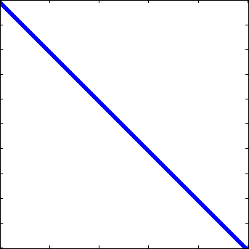
Conventional vs CA - SBR
Touch all data 4 times
Touch all data once
Conventional
Communication-Avoiding
Many tuning parameters:
Number of “sweeps”, #diagonals cleared per sweep, sizes of parallelograms
#bulges chased at one time, how far to chase each bulge
Right choices reduce #words_moved by factor M/bw, not just M^{1/2}

Slide 60
Speedups of Sym. Band Reduction vs DSBTRD
Up to 17x on Intel Gainestown, vs MKL 10.0
n=12000, b=500, 8 threads
Up to 12x on Intel Westmere, vs MKL 10.3
n=12000, b=200, 10 threads
Up to 25x on AMD Budapest, vs ACML 4.4
n=9000, b=500, 4 threads
Up to 30x on AMD Magny-Cours, vs ACML 4.4
n=12000, b=500, 6 threads
Neither MKL nor ACML benefits from multithreading in DSBTRD
Best sequential speedup vs MKL: 1.9x
Best sequential speedup vs ACML: 8.5x

Slide 61
New lower bound for Strassen’s fast matrix multiplication
The communication bandwidth lower bound is
(M = size of fast / local memory)
For Strassen:
For Strassen-like:
For O(n³) algorithm:
log₂ 7
ω₀
log₂ 8
Sequential:
Parallel:
The parallel lower bounds applies to algorithms using:
Minimal required memory: M = Θ(n²/P) Extra available memory: M = Θ(c∙n²/P)
Best Paper Award, SPAA’11

Slide 62
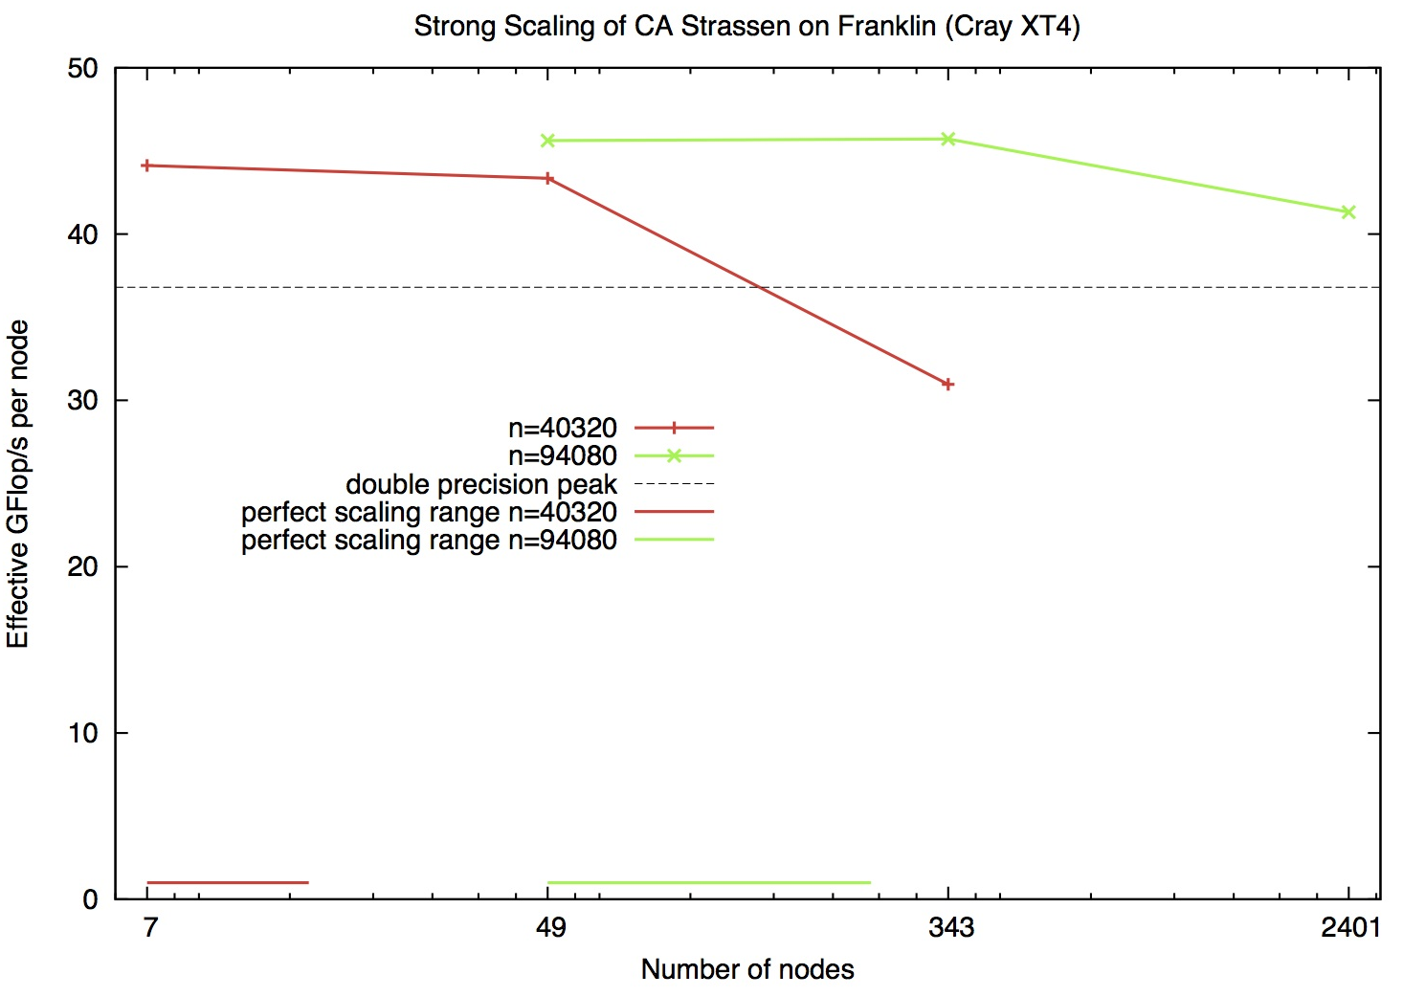
Performance on 7^{k} Processes

Slide 63
Summary of Direct Linear Algebra
New lower bounds, optimal algorithms, big speedups in theory and practice
Lots of other topics, open problems
Heterogeneous architectures
Extends to case where each processor and link has a different speed (SPAA’11)
Lots more dense and sparse algorithms
Some designed, a few implemented, rest to be invented
Need autotuning, synthesis

Slide 64
Avoiding Communication in Iterative Linear Algebra
k-steps of iterative solver for sparse Ax=b or Ax=λx
Does k SpMVs with A and starting vector
Many such “Krylov Subspace Methods”
Goal: minimize communication
Assume matrix “well-partitioned”
Serial implementation
Conventional: O(k) moves of data from slow to fast memory
New: O(1) moves of data – optimal
Parallel implementation on p processors
Conventional: O(k log p) messages (k SpMV calls, dot prods)
New: O(log p) messages - optimal
Lots of speed up possible (modeled and measured)
Price: some redundant computation
64
Notes:
Well – partitioned = modest surface-to-volume ratio
See bebop.cs.berkeley.edu
CG: [van Rosendale, 83], [Chronopoulos and Gear, 89]
GMRES: [Walker, 88], [Joubert and Carey, 92], [Bai et al., 94]

Slide 65
Communication Avoiding Kernels: The Matrix Powers Kernel : [Ax, A²x, …, A^{k}x]
Replace k iterations of y = A⋅x with [Ax, A²x, …, A^{k}x]
Example: A tridiagonal, n=32, k=3
Works for any “well-partitioned” A
A³·x
A²·x
A·x
x
1 2 3 4 …
… 32
Notes:
C. J. Pfeifer, Data flow and storage allocation for the PDQ-5 program on the Philco-2000, Comm. ACM 6, No. 7 (1963), 365366.
Referred to in paper by Leiserson/Rao/Toledo/ in 1993 paper on blocking covers

Slide 66
Communication Avoiding Kernels: The Matrix Powers Kernel : [Ax, A²x, …, A^{k}x]
Replace k iterations of y = A⋅x with [Ax, A²x, …, A^{k}x]
Example: A tridiagonal, n=32, k=3
A³·x
A²·x
A·x
x
1 2 3 4 …
… 32

Slide 67
Communication Avoiding Kernels: The Matrix Powers Kernel : [Ax, A²x, …, A^{k}x]
Replace k iterations of y = A⋅x with [Ax, A²x, …, A^{k}x]
Example: A tridiagonal, n=32, k=3
A³·x
A²·x
A·x
x
1 2 3 4 …
… 32

Slide 68
Communication Avoiding Kernels: The Matrix Powers Kernel : [Ax, A²x, …, A^{k}x]
Replace k iterations of y = A⋅x with [Ax, A²x, …, A^{k}x]
Example: A tridiagonal, n=32, k=3
A³·x
A²·x
A·x
x
1 2 3 4 …
… 32

Slide 69
Communication Avoiding Kernels: The Matrix Powers Kernel : [Ax, A²x, …, A^{k}x]
Replace k iterations of y = A⋅x with [Ax, A²x, …, A^{k}x]
Example: A tridiagonal, n=32, k=3
A³·x
A²·x
A·x
x
1 2 3 4 …
… 32

Slide 70
Communication Avoiding Kernels: The Matrix Powers Kernel : [Ax, A²x, …, A^{k}x]
Replace k iterations of y = A⋅x with [Ax, A²x, …, A^{k}x]
Example: A tridiagonal, n=32, k=3
A³·x
A²·x
A·x
x
1 2 3 4 …
… 32

Slide 71
Communication Avoiding Kernels: The Matrix Powers Kernel : [Ax, A²x, …, A^{k}x]
Replace k iterations of y = A⋅x with [Ax, A²x, …, A^{k}x]
Sequential Algorithm
Example: A tridiagonal, n=32, k=3
Step 1
A³·x
A²·x
A·x
x
1 2 3 4 …
… 32

Slide 72
Communication Avoiding Kernels: The Matrix Powers Kernel : [Ax, A²x, …, A^{k}x]
Replace k iterations of y = A⋅x with [Ax, A²x, …, A^{k}x]
Sequential Algorithm
Example: A tridiagonal, n=32, k=3
Step 1
Step 2
A³·x
A²·x
A·x
x
1 2 3 4 …
… 32

Slide 73
Communication Avoiding Kernels: The Matrix Powers Kernel : [Ax, A²x, …, A^{k}x]
Replace k iterations of y = A⋅x with [Ax, A²x, …, A^{k}x]
Sequential Algorithm
Example: A tridiagonal, n=32, k=3
Step 1
Step 2
Step 3
A³·x
A²·x
A·x
x
1 2 3 4 …
… 32

Slide 74
Communication Avoiding Kernels: The Matrix Powers Kernel : [Ax, A²x, …, A^{k}x]
Replace k iterations of y = A⋅x with [Ax, A²x, …, A^{k}x]
Sequential Algorithm
Example: A tridiagonal, n=32, k=3
Step 1
Step 2
Step 3
Step 4
A³·x
A²·x
A·x
x
1 2 3 4 …
… 32

Slide 75
Communication Avoiding Kernels: The Matrix Powers Kernel : [Ax, A²x, …, A^{k}x]
Replace k iterations of y = A⋅x with [Ax, A²x, …, A^{k}x]
Parallel Algorithm
Example: A tridiagonal, n=32, k=3
Each processor communicates once with neighbors
Proc 1
Proc 2
Proc 3
Proc 4
A³·x
A²·x
A·x
x
1 2 3 4 …
… 32

Slide 76
Communication Avoiding Kernels: The Matrix Powers Kernel : [Ax, A²x, …, A^{k}x]
Replace k iterations of y = A⋅x with [Ax, A²x, …, A^{k}x]
Parallel Algorithm
Example: A tridiagonal, n=32, k=3
Each processor works on (overlapping) trapezoid
Proc 1
Proc 2
Proc 3
Proc 4
A³·x
A²·x
A·x
x
1 2 3 4 …
… 32

Slide 77
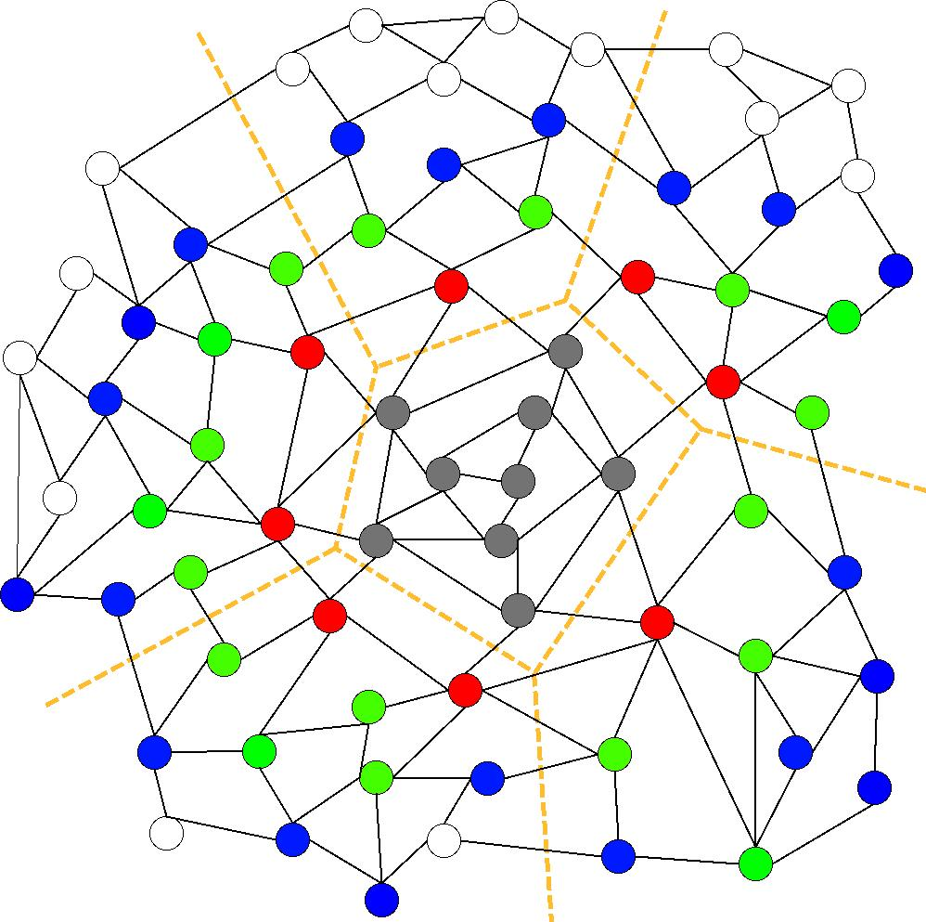
Communication Avoiding Kernels: The Matrix Powers Kernel : [Ax, A²x, …, A^{k}x]
Same idea works for general sparse matrices
Simple block-row partitioning ➔
(hyper)graph partitioning
Top-to-bottom processing ➔
Traveling Salesman Problem
Notes:
Red needed for k=1
Green also needed for k=2
Blue also needed for k=3

Slide 78
Minimizing Communication of GMRES to solve Ax=b
GMRES: find x in span{b,Ab,…,A^{k}b} minimizing || Ax-b ||₂
Standard GMRES
for i=1 to k
w = A · v(i-1) … SpMV
MGS(w, v(0),…,v(i-1))
update v(i), H
endfor
solve LSQ problem with H
Communication-avoiding GMRES
W = [ v, Av, A²v, … , A^{k}v ]
[Q,R] = TSQR(W)
… “Tall Skinny QR”
build H from R
solve LSQ problem with H
Sequential case: #words moved decreases by a factor of k
Parallel case: #messages decreases by a factor of k
Oops – W from power method, precision lost!
78

Slide 79
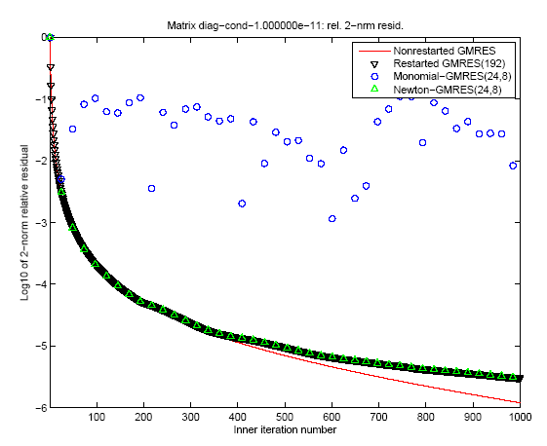
“Monomial” basis [Ax,…,A^{k}x]
fails to converge
Different polynomial basis [p₁(A)x,…,p_{k}(A)x]
does converge
79

Slide 80
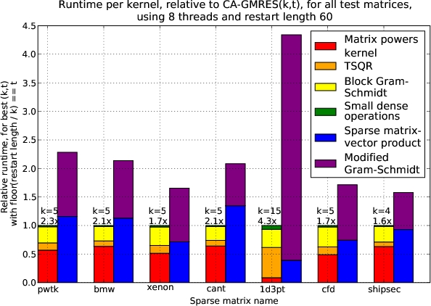
Speed ups of GMRES on 8-core Intel Clovertown
Requires Co-tuning Kernels
[MHDY09]
80

Slide 81
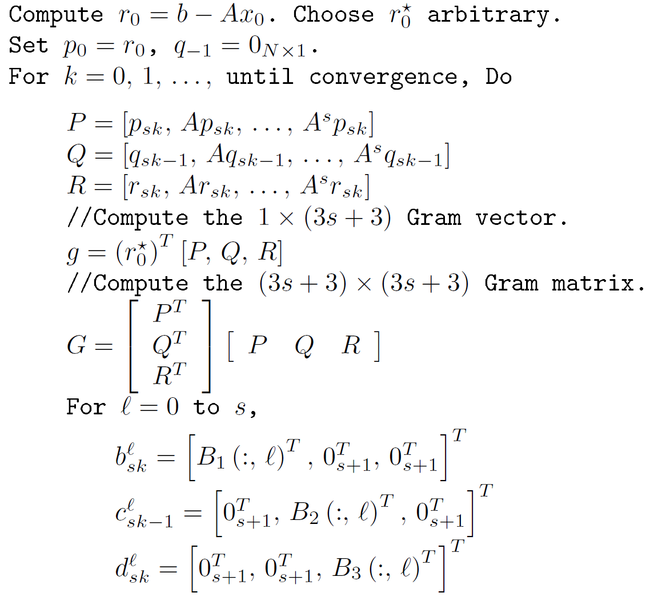
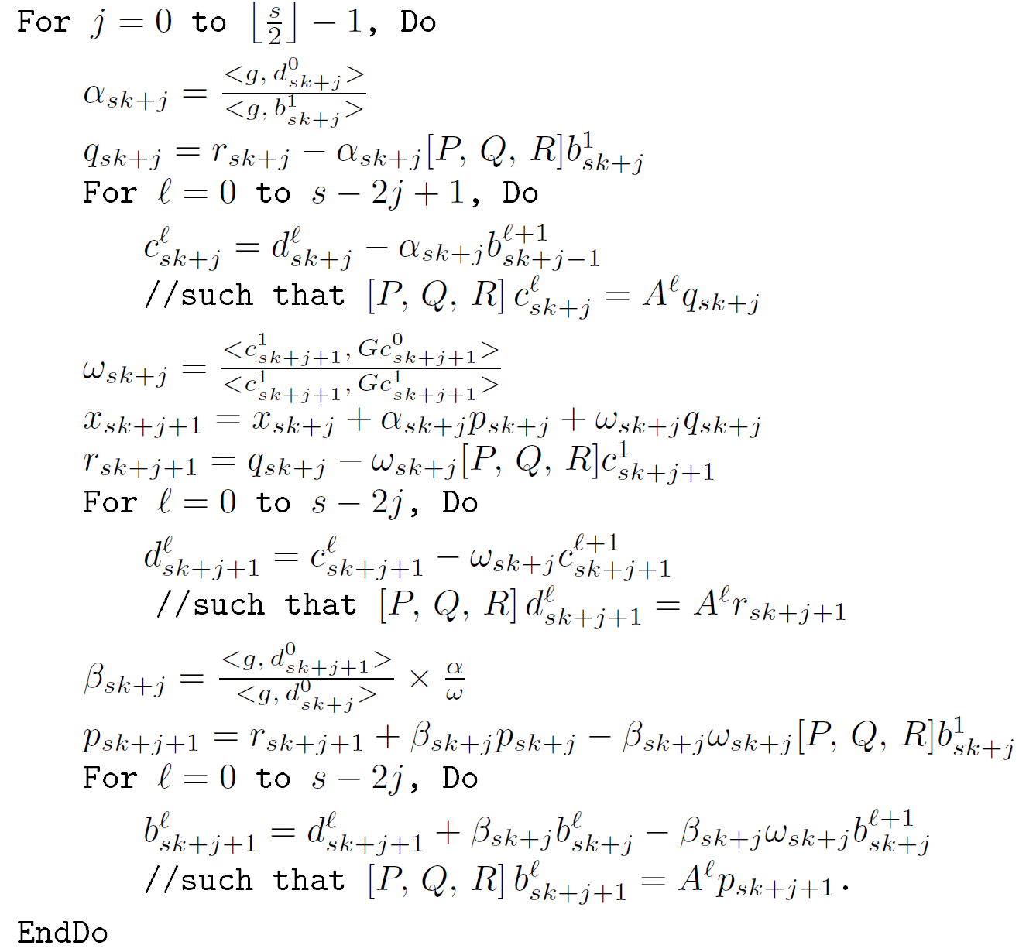
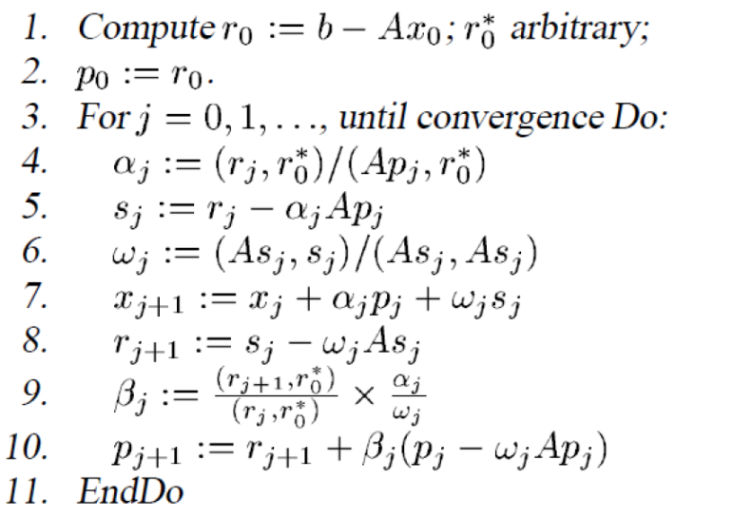

CA-BiCGStab

Slide 82
Tuning space for Krylov Methods
Classifications of sparse operators for avoiding communication
Explicit indices or nonzero entries cause most communication, along with vectors
Ex: With stencils (all implicit) all communication for vectors
Indices
 | Explicit (O(nnz)) | Implicit (o(nnz))
Explicit (O(nnz)) | CSR and variations | Vision, climate, AMR,…
Implicit (o(nnz)) | Graph Laplacian | Stencils
Nonzero
entries
Operations
[x, Ax, A²x,…, A^{k}x ] or [x, p₁(A)x, p₂(A)x, …, p_{k}(A)x ]
Number of columns in x
[x, Ax, A²x,…, A^{k}x ] and [y, A^{T}y, (A^{T})²y,…, (A^{T})^{k}y ], or [y, A^{T}Ay, (A^{T}A)²y,…, (A^{T}A)^{k}y ],
return all vectors or just last one
Cotuning and/or interleaving
W = [x, Ax, A²x,…, A^{k}x ] and {TSQR(W) or W^{T}W or … }
Ditto, but throw away W
Preconditioned versions

Slide 83
Summary of Iterative Linear Algebra
New Lower bounds, optimal algorithms, big speedups in theory and practice
Lots of other progress, open problems
Many different algorithms reorganized
More underway, more to be done
Need to recognize stable variants more easily
Preconditioning
Hierarchically Semiseparable Matrices
Autotuning and synthesis
Different kinds of “sparse matrices”

Slide 84
For further information
www.cs.berkeley.edu/~demmel
Papers
bebop.cs.berkeley.edu
www.netlib.org/lapack/lawns
1-week-short course – slides and video
www.ba.cnr.it/ISSNLA2010
Google “parallel computing course”
Course on parallel computing to be offered by NSF XSEDE next semester

Slide 85
Collaborators and Supporters
Collaborators
Katherine Yelick (UCB & LBNL), Michael Anderson (UCB), Grey Ballard (UCB), Erin Carson (UCB), Jack Dongarra (UTK), Ioana Dumitriu (U. Wash), Laura Grigori (INRIA), Ming Gu (UCB), Mike Heroux (SNL), Mark Hoemmen (Sandia NL), Olga Holtz (UCB & TU Berlin), Kurt Keutzer (UCB), Nick Knight (UCB), Jakub Kurzak (UTK), Julien Langou (U Colo. Denver), Xiaoye Li (LBNL), Ben Lipshitz (UCB), Marghoob Mohiyuddin (UCB), Oded Schwartz (UCB), Edgar Solomonik (UCB), Michelle Strout (Colo. SU), Vasily Volkov (UCB), Sam Williams (LBNL), Hua Xiang (INRIA)
Other members of the ParLab, BEBOP, CACHE, EASI, MAGMA, PLASMA, FASTMath projects
Supporters
DOE, NSF, UC Discovery
Intel, Microsoft, Mathworks, National Instruments, NEC, Nokia, NVIDIA, Samsung, Sun

Slide 86
Summary
Time to redesign all linear algebra
algorithms and software
And eventually the rest of the 13 motifs
Don’t Communic…

Slide 87
Extra Slides

Slide 88
Exascale Machine Parameters
2^30 ≈ 1,000,000 nodes
1024 cores/node (a billion cores!)
100 GB/sec interconnect bandwidth
400 GB/sec DRAM bandwidth
1 microsec interconnect latency
50 nanosec memory latency
32 Petabytes of memory
1/2 GB total L1 on a node
20 Megawatts !?

Slide 89
Direct linear algebra: Prior Work on Matmul
Assume n³ algorithm for C=A*B (i.e. not Strassen-like)
Sequential case, with fast memory of size M
Lower bound on #words moved to/from slow memory = Ω (n³ / M^{1/2} ) [Hong, Kung, 81]
Attained using “blocked” or cache-oblivious algorithms
Parallel case on P processors:
Assume load balanced, one copy each of A, B, C
Lower bound on #words communicated = Ω (n² / P^{1/2} ) [Irony, Tiskin, Toledo, 04]
Attained by Cannon’s Algorithm
NNZ | Lower bound on #words | Attained by
3n² (“2D alg”) | Ω (n² / P^{1/2} ) | [Cannon, 69]
3n² P^{1/3} (“3D alg”) | Ω (n² / P^{2/3} ) | [Johnson,93]
Notes:
All true for dense or sparse, LU, Cholesky (complete or incomplete),
And we also believe QR

Slide 90
Eigenvalue Algorithms
Symmetric eigenproblem and SVD
Variations on Successive Band Reduction can minimize communication
Up to 17x speedups over dsbtrd in Intel MKL
Talk by Grey Ballard, Thursday , 4:30pm
Nonsymmetric eigenproblem
Used divide-and-conquer [JD, Dumitriu, Holtz, 07]
Need randomized rank-revealing decomposition
Correctness guaranteed, progress probabilistic
Talk by Ioana Dumitriu, Thursday, 5:10pm

Slide 91
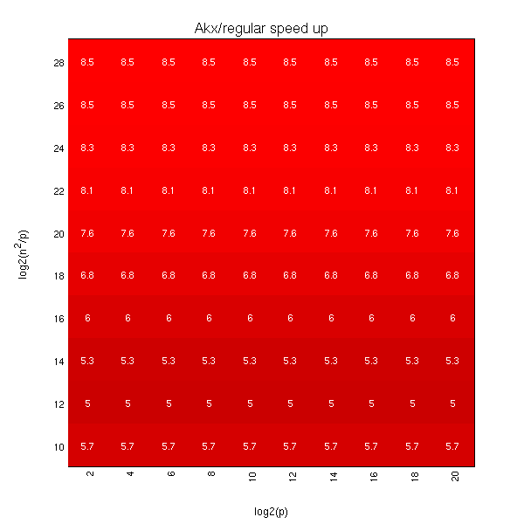
Exascale predicted speedups for Matrix Powers Kernel over SpMV for 2D Poisson (5 point stencil)
log₂ (n²/p) =
log₂ (memory_per_proc)
log₂ (p)

Slide 92
Communication-Avoiding LU: Use reduction tree, to do “Tournament Pivoting”
W₁
W₂
W₃
W₄
P₁·L₁·U₁
P₂·L₂·U₂
P₃·L₃·U₃
P₄·L₄·U₄
Choose b pivot rows of W₁, call them W₁’
Ditto for W₂, yielding W₂’
Ditto for W₃, yielding W₃’
Ditto for W₄, yielding W₄’
W^{nxb} =
=
W₁’
W₂’
W₃’
W₄’
P₁₂·L₁₂·U₁₂
P₃₄·L₃₄·U₃₄
Choose b pivot rows, call them W₁₂’
Ditto, yielding W₃₄’
=
W₁₂’
W₃₄’
= P₁₂₃₄·L₁₂₃₄·U₁₂₃₄
Choose b pivot rows
Go back to W and use these b pivot rows
(move them to top, do LU without pivoting)

Slide 93
Collaborators
Katherine Yelick, Michael Anderson, Grey Ballard, Erin Carson, Ioana Dumitriu, Laura Grigori, Mark Hoemmen, Olga Holtz, Kurt Keutzer, Nicholas Knight, Julien Langou, Marghoob Mohiyuddin, Oded Schwartz, Edgar Solomonik, Vasily Volkok, Sam Williams, Hua Xiang

Slide 94
Summary of dense parallel algorithms attaining communication lower bounds
Assume nxn matrices on P processors
Memory per processor = M = O(n² / P)
Recall lower bounds:
#words_moved = Ω( (n³/ P) / M^{1/2} ) = Ω( n² / P^{1/2} )
#messages = Ω( (n³/ P) / M^{3/2} ) = Ω( P^{1/2} )
Algorithm | Reference | Factor exceeding lower bound for #words_moved | Factor exceeding lower bound for #messages
Matrix Multiply
Cholesky
LU
QR
Sym Eig, SVD
Nonsym Eig
Notes:
ScaLAPACK assumes best block size chosen
Many references, green are ours

Slide 95
Summary of dense parallel algorithms attaining communication lower bounds
Assume nxn matrices on P processors (conventional approach)
Memory per processor = M = O(n² / P)
Recall lower bounds:
#words_moved = Ω( (n³/ P) / M^{1/2} ) = Ω( n² / P^{1/2} )
#messages = Ω( (n³/ P) / M^{3/2} ) = Ω( P^{1/2} )
Algorithm | Reference | Factor exceeding lower bound for #words_moved | Factor exceeding lower bound for #messages
Matrix Multiply | [Cannon, 69] | 1
Cholesky | ScaLAPACK | log P
LU | ScaLAPACK | log P
QR | ScaLAPACK | log P
Sym Eig, SVD | ScaLAPACK | log P
Nonsym Eig | ScaLAPACK | P^{1/2} log P
Notes:
ScaLAPACK assumes best block size chosen
Many references, green are ours

Slide 96
Summary of dense parallel algorithms attaining communication lower bounds
Assume nxn matrices on P processors (conventional approach)
Memory per processor = M = O(n² / P)
Recall lower bounds:
#words_moved = Ω( (n³/ P) / M^{1/2} ) = Ω( n² / P^{1/2} )
#messages = Ω( (n³/ P) / M^{3/2} ) = Ω( P^{1/2} )
Algorithm | Reference | Factor exceeding lower bound for #words_moved | Factor exceeding lower bound for #messages
Matrix Multiply | [Cannon, 69] | 1 | 1
Cholesky | ScaLAPACK | log P | log P
LU | ScaLAPACK | log P | n log P / P^{1/2}
QR | ScaLAPACK | log P | n log P / P^{1/2}
Sym Eig, SVD | ScaLAPACK | log P | n / P^{1/2}
Nonsym Eig | ScaLAPACK | P^{1/2} log P | n log P
Notes:
ScaLAPACK assumes best block size chosen
Many references, green are ours

Slide 97
Summary of dense parallel algorithms attaining communication lower bounds
Assume nxn matrices on P processors (better)
Memory per processor = M = O(n² / P)
Recall lower bounds:
#words_moved = Ω( (n³/ P) / M^{1/2} ) = Ω( n² / P^{1/2} )
#messages = Ω( (n³/ P) / M^{3/2} ) = Ω( P^{1/2} )
Algorithm | Reference | Factor exceeding lower bound for #words_moved | Factor exceeding lower bound for #messages
Matrix Multiply | [Cannon, 69] | 1 | 1
Cholesky | ScaLAPACK | log P | log P
LU | [GDX10] | log P | log P
QR | [DGHL08] | log P | log³ P
Sym Eig, SVD | [BDD11] | log P | log³ P
Nonsym Eig | [BDD11] | log P | log³ P
Notes:
ScaLAPACK assumes best block size chosen
Many references, green are ours

Slide 98
Can we do even better?
Assume nxn matrices on P processors
Why just one copy of data: M = O(n² / P) per processor?
Recall lower bounds:
#words_moved = Ω( (n³/ P) / M^{1/2} ) = Ω( n² / P^{1/2} )
#messages = Ω( (n³/ P) / M^{3/2} ) = Ω( P^{1/2} )
Algorithm | Reference | Factor exceeding lower bound for #words_moved | Factor exceeding lower bound for #messages
Matrix Multiply | [Cannon, 69] | 1 | 1
Cholesky | ScaLAPACK | log P | log P
LU | [GDX10] | log P | log P
QR | [DGHL08] | log P | log³ P
Sym Eig, SVD | [BDD11] | log P | log³ P
Nonsym Eig | [BDD11] | log P | log³ P
Notes:
ScaLAPACK assumes best block size chosen
Many references, green are ours

Slide 99
Can we do even better?
Assume nxn matrices on P processors
Why just one copy of data: M = O(n² / P) per processor?
Increase M to reduce lower bounds:
#words_moved = Ω( (n³/ P) / M^{1/2} ) = Ω( n² / P^{1/2} )
#messages = Ω( (n³/ P) / M^{3/2} ) = Ω( P^{1/2} )
Algorithm | Reference | Factor exceeding lower bound for #words_moved | Factor exceeding lower bound for #messages
Matrix Multiply | [Cannon, 69] | 1 | 1
Cholesky | ScaLAPACK | log P | log P
LU | [GDX10] | log P | log P
QR | [DGHL08] | log P | log³ P
Sym Eig, SVD | [BDD11] | log P | log³ P
Nonsym Eig | [BDD11] | log P | log³ P
Notes:
ScaLAPACK assumes best block size chosen
Many references, green are ours

Slide 100
Beating #words_moved = Ω(n²/P^{1/2})
#words_moved = Ω((n³/P)/M^{1/2})
If c copies of data, M = c·n²/P, bound decreases by factor c^{1/2}
Can we attain it?
“3D” Matmul Algorithm on P^{1/3} x P^{1/3} x P^{1/3} processor grid
P^{1/3} redundant copies of A and B
Reduces communication volume to O( (n²/P^{2/3}) log(P) )
optimal for P^{1/3} copies (more memory can’t help)
Reduces number of messages to O(log(P)) – also optimal
“2.5D” Algorithms
Extends to 1 ≤ c ≤ P^{1/3} copies on (P/c)^{1/2} x (P/c)^{1/2} x c grid
Reduces communication volume of Matmul and LU by c^{1/2}
Reduces comm 83% on 64K proc BG-P, LU&MM speedup 2.6x
Distinguished Paper Prize, Euro-Par’11 (E. Solomonik, JD)
k
“C face”
Cube representing
C(1,1) += A(1,3)*B(3,1)
C(2,3)
C(1,1)
A(1,3)
B(3,1)
j
B(1,3)
A(2,1)
“B face”
i
“A face”
Notes:
Extension to c by McColl and Tiskin in CRCW PRAM model in 1999
Ashcraft, Toledo tried LU, failed but we can!
Aggarwal, Chandra, Snir 1988
Bernsten, 1988
Gupta, Kumar 1993
Johnson, 1993
Distinguished paper award, EuroPar’11

Slide 101
Lower bound for Strassen’s fast matrix multiplication
Recall O(n³) case:
For Strassen’s:
For Strassen-like:
log₂ 8
log₂ 7
ω₀
Sequential:
Parallel:
Parallel lower bounds apply to 2D (1 copy of data) and 2.5D (c copies)
Attainable
Sequential: usual recursive algorithms, also for LU, QR, eig, SVD,…
Parallel: just matmul so far …
Talk by Oded Schwartz, Thursday, 5:30pm
Best Paper Award, SPAA’11 (Ballard, JD, Holtz, Schwartz)
Notes:
BW recursion: contract sub-trees corresponding to matrices of M/3 elements to leaves, of cost M
Best Paper Prize, SPAA’11

Slide 102



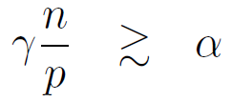
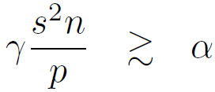
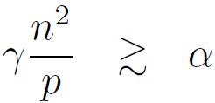
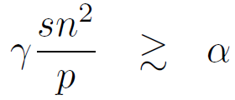
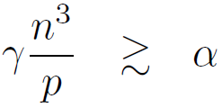
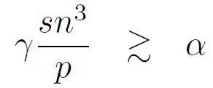
Sequential Strong Scaling
 | Standard Alg. | CA-CG with SA1 | CA-CG with SA2
1D 3-pt stencil
2D 5-pt stencil
3D 7-pt stencil

Slide 103
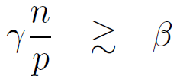
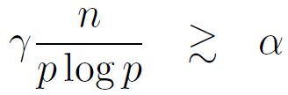
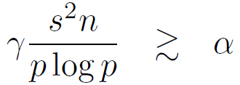
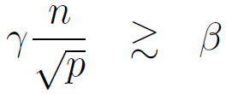
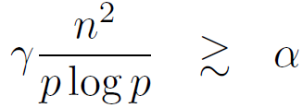
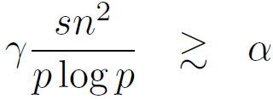
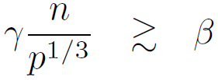
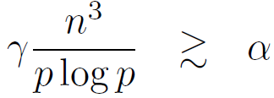
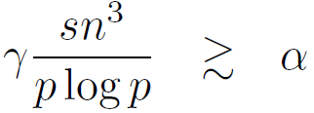
Parallel Strong Scaling
 | Standard Alg. | CA-CG with PA1
1D 3-pt stencil
2D 5-pt stencil
3D 7-pt stencil

Slide 104
Weak Scaling
Change p to x*p, n to x^(1/d)*n
d = {1, 2, 3} for 1D, 2D, and 3D mesh
Bandwidth
Perfect weak scaling for 1D, 2D, and 3D
Latency
Perfect weak scaling for 1D, 2D, and 3D if you ignore the log(xp) factor in the denominator
Makes constraint on alpha harder to satisfy

Slide 105
Performance Model Assumptions
Plot for Parallel Algorithm for 1D 3-pt stencil
Exascale machine parameters:
100 GB/sec interconnect BW
1 microsecond network latency
2^28 cores
.1 ns per flop (per core)

Slide 106
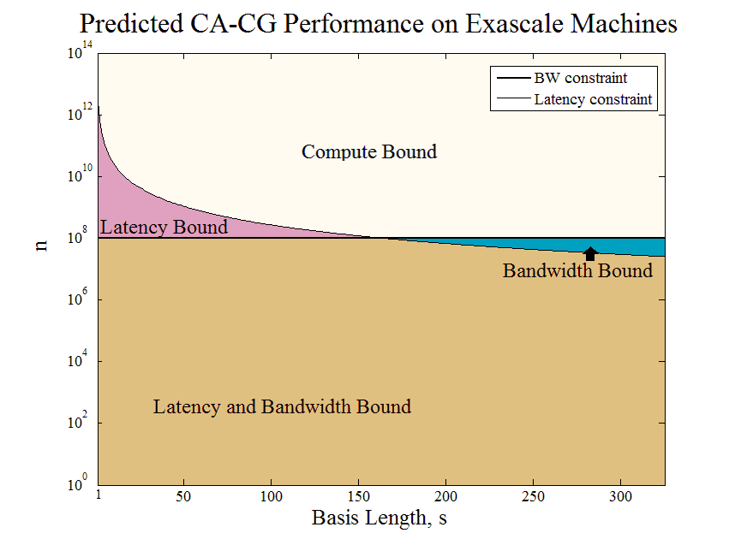

Slide 107
Observations
s =1 are the constraints for the standard algorithm
Standard algorithm is communication bound if n <~ 10¹²
For 10⁸ <~ n <~ 10¹², we can theoretically increase s such that the algorithm is no longer communication bound
In practice, high s values have some complications due to stability, but even s ~ 10 can remove communication bottleneck for matrix sizes ~10¹⁰

Slide 108
Collaborators and Supporters
Collaborators
Katherine Yelick (UCB & LBNL) Michael Anderson (UCB), Grey Ballard (UCB), Jong-Ho Byun (UCB), Erin Carson (UCB), Jack Dongarra (UTK), Ioana Dumitriu (U. Wash), Laura Grigori (INRIA), Ming Gu (UCB), Mark Hoemmen (Sandia NL), Olga Holtz (UCB & TU Berlin), Kurt Keutzer (UCB), Nick Knight (UCB), Julien Langou, (U Colo. Denver), Marghoob Mohiyuddin (UCB), Hong Diep Nguyen (UCB), Oded Schwartz (TU Berlin), Edgar Solomonik (UCB), Michelle Strout (Colo. SU), Vasily Volkov (UCB), Sam Williams (LBNL), Hua Xiang (INRIA)
Other members of the ParLab, BEBOP, CACHE, EASI, MAGMA, PLASMA, TOPS projects
Supporters
NSF, DOE, UC Discovery
Intel, Microsoft, Mathworks, National Instruments, NEC, Nokia, NVIDIA, Samsung, Sun

Slide 109
Example Place Holder
I would like to insert values into these formulas for current/future architectures, and plot them over time. For example, plotting γ M^{1/2} / β over time, and comparing the ratio to 1, will tell use whether architectures are becoming more or less communication bound.
Does anyone have the data to do this easily for some current/future architectures? Ideally a spread sheet, one row per platform and columns for speeds and sizes of various components for difference levels of memory hierarchy, etc.

Slide 110
Reading List Topics (so far)
Communication lower bounds for linear algebra
Communication avoiding algorithms for linear algebra
Fast Fourier Transform
Graph Algorithms
Sorting
Software Generation
Data Structures
Lower bounds for Searching
Dynamic Programming
Work stealing

Slide 111
Are we using all the hardware resources?
Assume nxn dense matrices on P processors
Usual approach
1 copy of data ⇒ Memory per processor = M ≈ n² / P
Recall lower bounds:
#words_moved = Ω( (n³/ P) / M^{1/2} ) = Ω( n² / P^{1/2} )
#messages = Ω( (n³/ P) / M^{3/2} ) = Ω( P^{1/2} )
Attained by 2D algorithms (many examples)
P processors connected in P^{1/2} x P^{1/2} mesh
Each processor owns, computes on a square submatrix
New approach
Use all available memory
c>1 copies of data ⇒ Memory per processor = M ≈ c n² / P
Lower bounds get smaller
New 2.5D algorithms can attain new lower bounds
P processors in (P/c)^{1/2} x (P/c)^{1/2} x c mesh
Notes:
ScaLAPACK assumes best block size chosen
Many references, green are ours

Slide 112
2.5D Matmul versus ScaLAPACK
2D algorithms use P^{1/2} x P^{1/2} mesh and minimal memory
2.5D algorithms use (P/c)^{1/2} x (P/c)^{1/2} x c^{1/2} mesh and c-fold memory
Matmul sends c^{1/2} times fewer words – lower bound
Matmul sends c^{3/2} times fewer messages – lower bound
Perfect
Strong Scaling
Critical to use all
links of BG/P’s
3D torus
interconnect
Distinguished Paper Award, EuroPar’11

Slide 113
Timing Breakdown for
2D vs 2.5D Gaussian Elimination:
How much communication can we avoid?
Communication
Reduced 86%
Pivoting
No pivoting
Distinguished Paper Award, EuroPar’11

Slide 114
Implications for Architectural Scaling
Machine parameters:
γ = seconds per flop (multiply or add)
β = reciprocal bandwidth (in seconds)
α = latency (in seconds)
M = local (fast) memory size
P = number of processors
Goal: relationships among these parameters that guarantees that communication is not the bottleneck for direct linear algebra
Time = γ * #flops + β * #flops/M^{1/2} + α * #flops/M^{3/2}

Slide 115
Implications for Architectural Scaling Sequential Case:
Requirements so that “most” time is spent doing arithmetic on n x n dense matrices, n² > M
γ M^{1/2} > ≈ β
In other words, time to add two rows of largest locally storable square matrix exceeds reciprocal bandwidth
γ M^{3/2} > ≈ α
In other words, time to multiply 2 largest locally storable square matrices exceeds latency
Applies to every level of memory hierarchy
γ M^{1/3} > ≈ β for old algorithms
γ M > ≈ α for old algorithms
Stricter requirements on architecture for old algorithms

Slide 116
Implications for Architectural Scaling Parallel Case:
Requirements so that “most” time is spent doing arithmetic on n x n dense matrices
γ (n/p^{1/2}) > ≈ β
In other words, time to add two rows of locally stored square matrix exceeds reciprocal bandwidth
γ (n/p^{1/2})³ > ≈ α
In other words, time to multiply 2 locally stored square matrices exceeds latency
γ M^{1/2} > ≈ β
γ (n/p^{1/2})² > ≈ α
γ M^{3/2} > ≈ α
Stricter requirements on architecture for old algorithms
Looser requirements on architecture for 2.5D algorithms

Slide 117
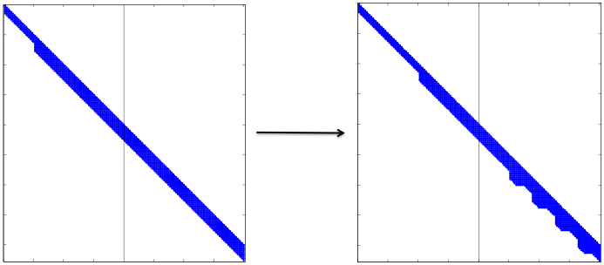
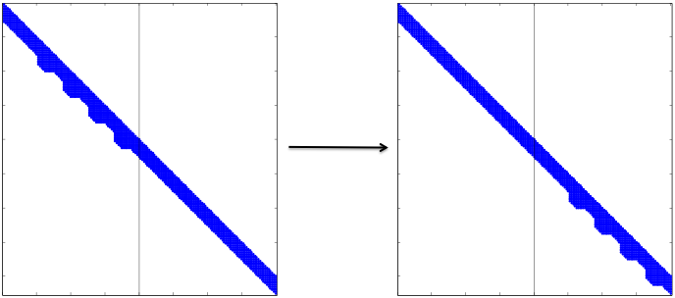
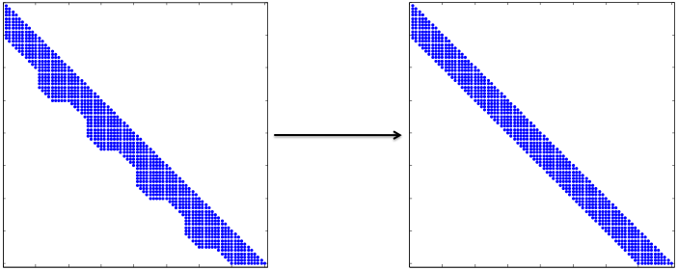
Illustration of
Parallel SBR
Pipeline multiple bulge chases from one processor to next
Notes:
These are the three local kernels for the parallel SBR algorithm. The first (top) picture is where parallelograms are annihilated (it’s hard to tell from the picture, but ¼ of the parallelograms are zeroed out from the left set of columns) and their bulges are all packed in the right set. In the second picture, the bulges are passed from the left set of columns to the right set. In the last picture, a set of bulges are chased off the end of the band. Most of the processors will spend their time in the second picture (passing bulges along). The messages between processors will be the size of a set of columns (either passing a clean set of columns left or passing a bulge-y set of columns right). Our algorithm will achieve O( \sqrt P \log (n / \sqrt P) messages, whereas Lang’s algorithm sends O(n) messages.

Slide 118
Autotuning search space for SBR
Number of sweeps and diagonals per sweep: {d_{i}}
Satisfying Σ d_{i} = b
Parameters for i^{th} sweep
Number of columns in each parallelogram: c_{i}
Satisfying c_{i} + d_{i} ≤ b_{i} = bandwidth after first i-1 sweeps
Number of bulges chased at a time: mult_{i}
Number of times bulge is chased in a row: hops_{i}
Parameters for individual bulge chases
Algorithm choice (BLAS1, BLAS2, BLAS3 varieties)
Inner blocking size for BLAS3

Slide 119
Communication-Avoiding SBR: Theory
Goal: choose tuning parameters to minimize communication (as opposed to run time...)
Reduce bandwidth by half at each sweep
Start with big c, then halve; small mult, then double
Algorithm | #Flops | #Words_moved | Data reuse
Schwarz | 4n²b | O(n²b) | O(1)
M-H | 6n²b | O(n²b) | O(1)
SBR (best params) | 5n²b | O(n² log b) | O(b / log b)
CA-SBR (1≤b≤M ^{1/2}/3) | 5n²b | O(n²b²/ M) | O(M/b)
Beats O(M^{1/2}) reuse for 3-nested-loop-like algorithms
Similar theoretical improvements for dist. mem.

Slide 120
Band Reduction – prior work
1963 – Rutishauser: Givens down diagonals and Householder
1968 – Schwartz: Givens up columns
1975 – Muraka/Horikoshi: improved R’s Householder alg.
1984 – Kaufman: vectorized S’s alg. (LAPACK’s xsbtrd)
1993 – Lang: parallelized M/H’s alg. (dist. mem.)
2000 – Bischof/Lang/Sun: generalized all but S’s alg.
2009 – Davis/Rajamanickam: Givens in blocks
2011 – Luszczek/Ltaief/Dongarra: parallelized M/H’s alg (shared mem.)

Slide 121
Can we do even better?
Assume nxn matrices on P processors
Why just one copy of data: M = O(n² / P) per processor?
Increase M to reduce lower bounds:
#words_moved = Ω( (n³/ P) / M^{1/2} ) = Ω( n² / P^{1/2} )
#messages = Ω( (n³/ P) / M^{3/2} ) = Ω( P^{1/2} )
Algorithm | Reference | Factor exceeding lower bound for #words_moved | Factor exceeding lower bound for #messages
Matrix Multiply | [Cannon, 69] | 1 | 1
Cholesky | ScaLAPACK | log P | log P
LU | [GDX10] | log P | log P
QR | [DGHL08] | log P | log³ P
Sym Eig, SVD | [BDD11] | log P | log³ P
Nonsym Eig | [BDD11] | log P | log³ P
Notes:
ScaLAPACK assumes best block size chosen
Many references, green are ours

