Slide 1
Retroactive Auditing
Xi Wang Nickolai Zeldovich Frans Kaashoek
MIT CSAIL

Slide 2
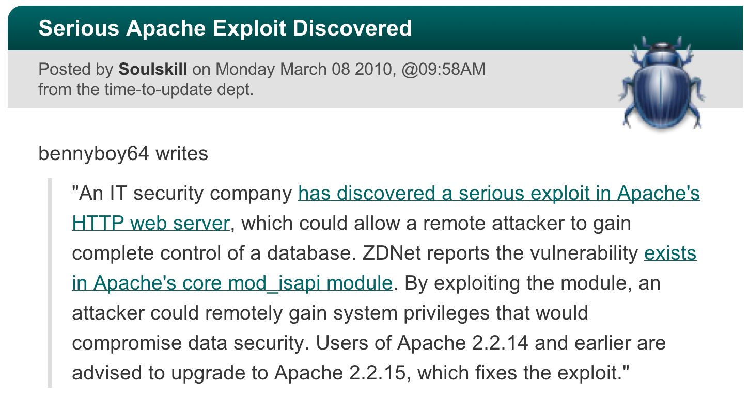

Admin Reading Vulnerability Exploits
Are my servers
compromised?

Slide 3
Goal & Challenge
Admin must detect attacks and do recovery
How can admin tell if server is comprised?
Hard to catch anomalies
Server may work “well” with backdoor installed
Auditing tool
Report alarms after compromise happened

Slide 4
Existing Approaches
Tripwire
Monitor suspicious filesystem changes
Not work for general vulnerability exploits
IntroVirt
Replay past execution with predicates
Human effort: hand-written predicates required for every vulnerability
Disadvantages: generality & human effort

Slide 5
Idea: Auditing using Patches
Advantages
General
Little human effort required
What the system would’ve been like w/ patch
Run original code
Rollback
Replay
Diff
Run patched code

Slide 6
What Can Admin Conclude
N
Vulnerability not exploited
Diff
False alarms
Y
Attacks
Assumptions
Patch correctly fixes vulnerability
Replay is faithful
Auditing tool is not subverted

Slide 7
Challenges
False alarms
Replay is expensive
Replay must be secured
Recovery from compromise

Slide 8
Case Study: Apache 2.2
36 vulnerabilities from 2005 to 2010
Non-deterministic
Timestamps
Multiple processes/threads

Slide 9
Strawman Design
Whole-process auditing: Apache httpd
Time-consuming
False alarms for all patches
Non-determinism
Run original httpd
Rollback
Replay requests
Diff responses & files
Run patched httpd

Slide 10
Idea: Fine-Grained Auditing
Restrict auditing scope to single function
Assume the function is deterministic
Run original func.
Rollback
Replay single process
Fork before invoking func.
Diff (memdiff)
Run patched func.

Slide 11
Example: CVE-2009-0023
Apache API apr_strmatch_precompile
Buffer overflow with input string s[i]>127
// const char *s;
// apr_size_t *shift;
for (i = 0; i < pattern->length-1; i++) {
- shift[(int)s[i]] = pattern->length-i-1;
+ shift[(unsigned char)s[i]] = pattern->length-i-1;
A function stub is injected via LD_PRELOAD

Slide 12
Stub
stub_apr_strmatch_compile(…):
if fork() == 0:
start_memlog
call patched_apr_strmatch_compile(…)
end_memlog
else:
start_memlog
call original_apr_strmatch_compile(…)
end_memlog
join
diff

Slide 13
Apache 2.2 Vulnerabilities (36)
Simple DoS attacks, e.g.,
null pointer dereference

Slide 14
Case Study: CVE-2009-0023
// Init: shift[240] = 4
// shift[s[i]] = 2, given index s[i] = 0xf0 (-16 / 240)
for (i = 0; i < pattern->length-1; i++) {
- shift[(int)s[i]] = pattern->length-i-1;
+ shift[(unsigned char)s[i]] = pattern->length-i-1;
shift[-16]
Shift[240]
…
original
02
00
00
00
00
00
00
00
04
00
00
00
00
00
00
00
…
patched
02
00
00
00
00
00
00
00

Slide 15
Case Study: CVE-2005-3352
if (!strcasecmp(value, "referer")) {
referer = apr_table_get(r->headers_in, "Referer");
if (referer && *referer) {
- return apr_pstrdup(r->pool, referer);
+ return apr_escape_html(r->pool, referer);
}
…
…
original
>
<
s
c
r
i
p
t
…
…
patched
&
g
t
;
&
l
t
;

Slide 16
False Alarm Example: Charset
Charset
HTTP response doesn’t enforce charset
Client browser may be tricked into using UTF-7
Cross-site scripting
Patch: add charset to HTTP response
Different output
false alarm for every input
New diff: DOM tree

Slide 17
More Challenges
False alarms
Non-determinism
Fine-grained auditing
More diff: DOM, syscall
Major code change
2/36 vulnerabilities in Apache 2.2
Replay is expensive: log slicing?
Replay must be secured: kernel module, VM?
Recovery: using Retro?

Slide 18
Conclusion
Detect past vulnerability exploits
Retroactive auditing
Use security patches
A proof-of-concept prototype
Fine-grained auditing & memdiff
Applied to two cases in Apache 2.2

