Slide 1
Program Representations

Slide 2
Representing programs
Goals

Slide 3
Representing programs
Primary goals
analysis is easy and effective
just a few cases to handle
directly link related things
transformations are easy to perform
general, across input languages and target machines
Additional goals
compact in memory
easy to translate to and from
tracks info from source through to binary, for source-level debugging, profilling, typed binaries
extensible (new opts, targets, language features)
displayable

Slide 4
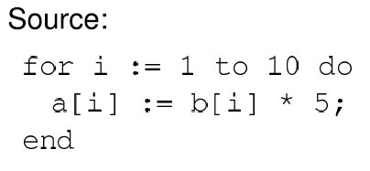
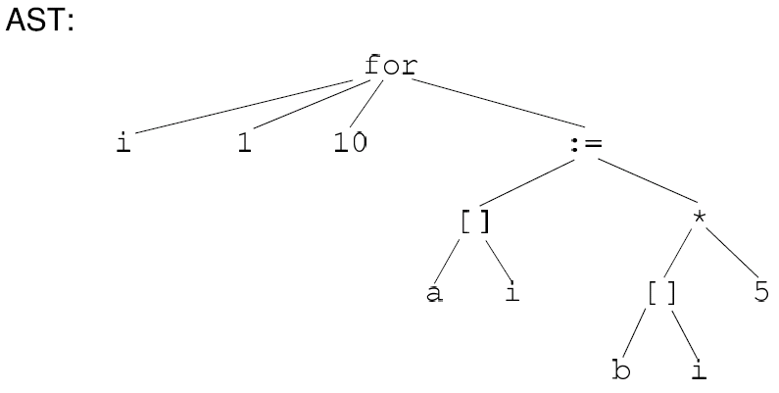
Option 1: high-level syntax based IR
Represent source-level structures and expressions directly
Example: Abstract Syntax Tree

Slide 5
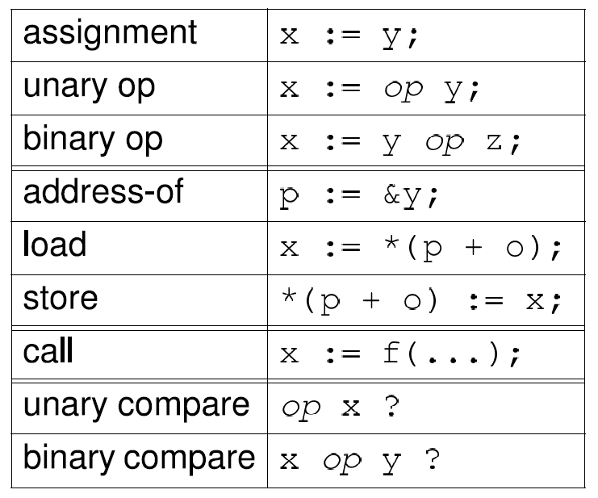
Option 2: low-level IR
Translate input programs into low-level primitive chunks, often close to the target machine
Examples: assembly code, virtual machine code (e.g. stack machines), three-address code, register-transfer language (RTL)
Standard RTL instrs:

Slide 6
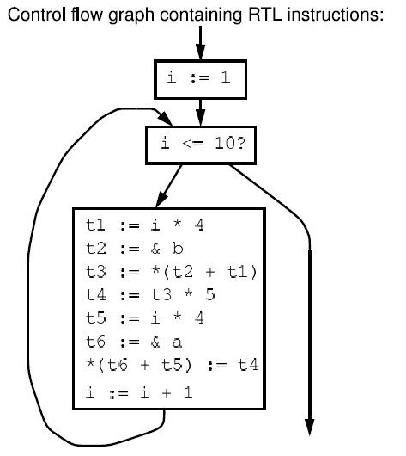
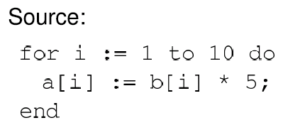
Option 2: low-level IR

Slide 7
Comparison

Slide 8
Comparison
Advantages of high-level rep
analysis can exploit high-level knowledge of constructs
easy to map to source code (debugging, profiling)
Advantages of low-level rep
can do low-level, machine specific reasoning
can be language-independent
Can mix multiple reps in the same compiler

Slide 9
Components of representation
Control dependencies: sequencing of operations
evaluation of if & then
side-effects of statements occur in right order
Data dependencies: flow of definitions from defs to uses
operands computed before operations
Ideal: represent just those dependencies that matter
dependencies constrain transformations
fewest dependences ) flexibility in implementation

Slide 10
Control dependencies
Option 1: high-level representation
control implicit in semantics of AST nodes
Option 2: control flow graph (CFG)
nodes are individual instructions
edges represent control flow between instructions
Options 2b: CFG with basic blocks
basic block: sequence of instructions that don’t have any branches, and that have a single entry point
BB can make analysis more efficient: compute flow functions for an entire BB before start of analysis

Slide 11
Control dependencies
CFG does not capture loops very well
Some fancier options include:
the Control Dependence Graph
the Program Dependence Graph
More on this later. Let’s first look at data dependencies

Slide 12
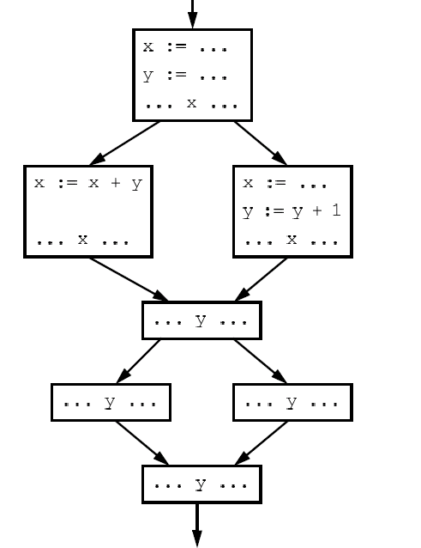
Data dependencies
Simplest way to represent data dependencies: def/use chains

Slide 13
Def/use chains
Directly captures dataflow
works well for things like constant prop
But...
Ignores control flow
misses some opt opportunities since conservatively considers all paths
not executable by itself (for example, need to keep CFG around)
not appropriate for code motion transformations
Must update after each transformation
Space consuming

Slide 14
SSA
Static Single Assignment
invariant: each use of a variable has only one def

Slide 15
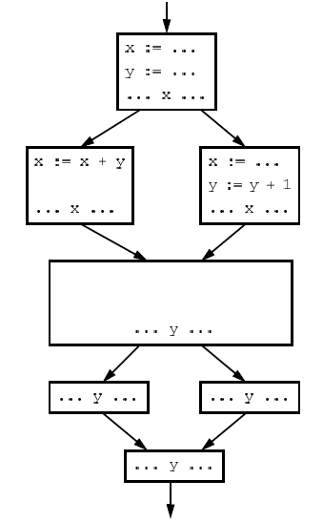

Slide 16
SSA
Create a new variable for each def
Insert φ pseudo-assignments at merge points
Adjust uses to refer to appropriate new names
Question: how can one figure out where to insert φ nodes using a liveness analysis and a reaching defns analysis.

Slide 17
Converting back from SSA
Semantics of x₃ := φ(x₁, x₂)
set x₃ to x_{i} if execution came from ith predecessor
How to implement φ nodes?

Slide 18
Converting back from SSA
Semantics of x₃ := φ(x₁, x₂)
set x₃ to x_{i} if execution came from ith predecessor
How to implement φ nodes?
Insert assignment x₃ := x₁ along 1st predecessor
Insert assignment x₃ := x₂ along 2nd predecessor
If register allocator assigns x₁, x₂ and x₃ to the same register, these moves can be removed
x₁ .. x_{n} usually have non-overlapping lifetimes, so this kind of register assignment is legal

Slide 19
Common Sub-expression Elim
Want to compute when an expression is available in a var
Domain:

Slide 20
Flow functions
in
F_{X := Y op Z}(in) =
X := Y op Z
out
in
F_{X := Y}(in) =
X := Y
out

Slide 21
Flow functions
in
F_{X := Y op Z}(in) = in – { X ! * }
– { * ! ... X ... } [
{ X ! Y op Z | X ≠ Y Æ X ≠ Z}
X := Y op Z
out
in
F_{X := Y}(in) = in – { X ! * }
– { * ! ... X ... } [
{ X ! E | Y ! E 2 in }
X := Y
out

Slide 22
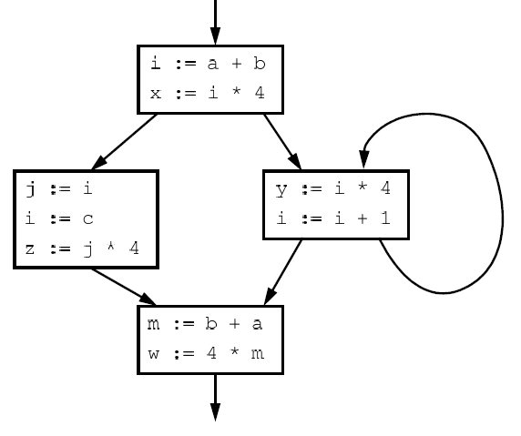
Example

Slide 23
Example

Slide 24
Problems
z := j * 4 is not optimized to z := x, even though x contains the value j * 4
m := b + a is not optimized, even though a + b was already computed
w := 4 * m it not optimized to w := x, even though x contains the value 4 *m

Slide 25
Problems: more abstractly
Available expressions overly sensitive to name choices, operand orderings, renamings, assignments
Use SSA: distinct values have distinct names
Do copy prop before running available exprs
Adopt canonical form for commutative ops

Slide 26
Example in SSA
in
X := Y op Z
F_{X := Y op Z}(in) =
out
in₀
in₁
F_{X := Y}(in₀, in₁) =
X := φ(Y,Z)
out

Slide 27
Example in SSA
in
X := Y op Z
F_{X := Y op Z}(in) = in [ { X ! Y op Z }
out
in₀
in₁
F_{X := Y}(in₀, in₁) = (in₀ Å in₁ ) [
{ X ! E | Y ! E 2 in₀ Æ Z ! E 2 in₁ }
X := φ(Y,Z)
out

Slide 28
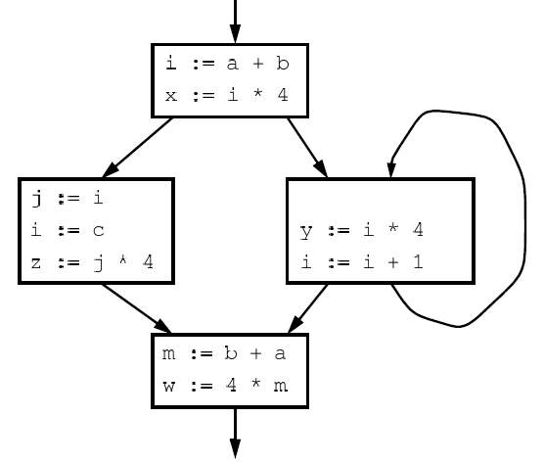
Example in SSA

Slide 29
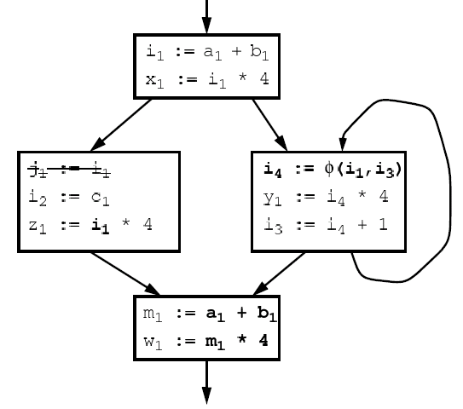
Example in SSA

Slide 30
What about pointers?
Pointers complicate SSA. Several options.
Option 1: don’t use SSA for pointed to variables
Option 2: adapt SSA to account for pointers
Option 3: define src language so that variables cannot be pointed to (eg: Java)

Slide 31
SSA helps us with CSE
Let’s see what else SSA can help us with
Loop-invariant code motion

Slide 32
Loop-invariant code motion
Two steps: analysis and transformations
Step1: find invariant computations in loop
invariant: computes same result each time evaluated
Step 2: move them outside loop
to top if used within loop: code hoisting
to bottom if used after loop: code sinking

