Slide 1




Supercomputing in Plain English Overview: What the Heck is Supercomputing?
Henry Neeman, Director
OU Supercomputing Center for Education & Research (OSCER)
University of Oklahoma
Tuesday January 22 2013

Slide 2
This is an experiment!
It’s the nature of these kinds of videoconferences that FAILURES ARE GUARANTEED TO HAPPEN! NO PROMISES!
So, please bear with us. Hopefully everything will work out well enough.
If you lose your connection, you can retry the same kind of connection, or try connecting another way.
Remember, if all else fails, you always have the toll free phone bridge to fall back on.

Slide 3
H.323 (Polycom etc) #1
If you want to use H.323 videoconferencing – for example, Polycom – then:
If you AREN’T registered with the OneNet gatekeeper (which is probably the case), then:
Dial 164.58.250.47
Bring up the virtual keypad. On some H.323 devices, you can bring up the virtual keypad by typing: # (You may want to try without first, then with; some devices won't work with the #, but give cryptic error messages about it.)
When asked for the conference ID, or if there's no response, enter: 0409
On most but not all H.323 devices, you indicate the end of the ID with: #

Slide 4
H.323 (Polycom etc) #2
If you want to use H.323 videoconferencing – for example, Polycom – then:
If you ARE already registered with the OneNet gatekeeper (most institutions aren’t), dial:
2500409
Many thanks to Skyler Donahue and Steven Haldeman of OneNet for providing this.

Slide 5
Wowza #1
You can watch from a Windows, MacOS or Linux laptop using Wowza from either of the following URLs:
http://www.onenet.net/technical-resources/video/sipe-stream/
OR
https://vcenter.njvid.net/videos/livestreams/page1/
Wowza behaves a lot like YouTube, except live.
Many thanks to Skyler Donahue and Steven Haldeman of OneNet and Bob Gerdes of Rutgers U for providing this.

Slide 6
Wowza #2
Wowza has been tested on multiple browsers on each of:
Windows (7 and 8): IE, Firefox, Chrome, Opera, Safari
MacOS X: Safari, Firefox
Linux: Firefox, Opera
We’ve also successfully tested it on devices with:
Android
iOS
However, we make no representations on the likelihood of it working on your device, because we don’t know which versions of Android or iOS it might or might not work with.

Slide 7
Wowza #3
If one of the Wowza URLs fails, try switching over to the other one.
If we lose our network connection between OU and OneNet, then there may be a slight delay while we set up a direct connection to Rutgers.

Slide 8
Toll Free Phone Bridge
IF ALL ELSE FAILS, you can use our toll free phone bridge:
800-832-0736
* 623 2847 #
Please mute yourself and use the phone to listen.
Don’t worry, we’ll call out slide numbers as we go.
Please use the phone bridge ONLY if you cannot connect any other way: the phone bridge can handle only 100 simultaneous connections, and we have over 350 participants.
Many thanks to OU CIO Loretta Early for providing the toll free phone bridge.

Slide 9
Please Mute Yourself
No matter how you connect, please mute yourself, so that we cannot hear you.
(For Wowza, you don’t need to do that, because the information only goes from us to you, not from you to us.)
At OU, we will turn off the sound on all conferencing technologies.
That way, we won’t have problems with echo cancellation.
Of course, that means we cannot hear questions.
So for questions, you’ll need to send e-mail.

Slide 10
Questions via E-mail Only
Ask questions by sending e-mail to:
sipe2013@gmail.com
All questions will be read out loud and then answered out loud.

Slide 11
TENTATIVE Schedule
Tue Jan 22: Overview: What the Heck is Supercomputing?
Tue Jan 29: The Tyranny of the Storage Hierarchy
Tue Feb 5: Instruction Level Parallelism
Tue Feb 12: Stupid Compiler Tricks
Tue Feb 19: Shared Memory Multithreading
Tue Feb 26: Distributed Multiprocessing
Tue March 5: Applications and Types of Parallelism
Tue March 12: Multicore Madness
Tue March 19: NO SESSION (OU's Spring Break)
Tue March 26: High Throughput Computing
Tue Apr 2: GPGPU: Number Crunching in Your Graphics Card
Tue Apr 9: Grab Bag: Scientific Libraries, I/O Libraries, Visualization

Slide 12
Supercomputing Exercises #1
Want to do the “Supercomputing in Plain English” exercises?
The first exercise is already posted at:
http://www.oscer.ou.edu/education/
If you don’t yet have a supercomputer account, you can get a temporary account, just for the “Supercomputing in Plain English” exercises, by sending e-mail to:
hneeman@ou.edu
Please note that this account is for doing the exercises only, and will be shut down at the end of the series. It’s also available only to those at institutions in the USA.
This week’s Introductory exercise will teach you how to compile and run jobs on OU’s big Linux cluster supercomputer, which is named Boomer.

Slide 13
Supercomputing Exercises #2
You’ll be doing the exercises on your own (or you can work with others at your local institution if you like).
These aren’t graded, but we’re available for questions:
hneeman@ou.edu

Slide 14
Thanks for helping!
OU IT
OSCER operations staff (Brandon George, Dave Akin, Brett Zimmerman, Josh Alexander, Patrick Calhoun)
Horst Severini, OSCER Associate Director for Remote & Heterogeneous Computing
Debi Gentis, OU Research IT coordinator
Kevin Blake, OU IT (videographer)
Chris Kobza, OU IT (learning technologies)
Mark McAvoy
Kyle Keys, OU National Weather Center
James Deaton, Skyler Donahue and Steven Haldeman, OneNet
Bob Gerdes, Rutgers U
Lisa Ison, U Kentucky
Paul Dave, U Chicago

Slide 15
This is an experiment!
It’s the nature of these kinds of videoconferences that FAILURES ARE GUARANTEED TO HAPPEN! NO PROMISES!
So, please bear with us. Hopefully everything will work out well enough.
If you lose your connection, you can retry the same kind of connection, or try connecting another way.
Remember, if all else fails, you always have the toll free phone bridge to fall back on.

Slide 16
Coming in 2013!
From Computational Biophysics to Systems Biology, May 19-21, Norman OK
Great Plains Network Annual Meeting, May 29-31, Kansas City
XSEDE2013, July 22-25, San Diego CA
IEEE Cluster 2013, Sep 23-27, Indianapolis IN
OKLAHOMA SUPERCOMPUTING SYMPOSIUM 2013, Oct 1-2, Norman OK
SC13, Nov 17-22, Denver CO

Slide 17
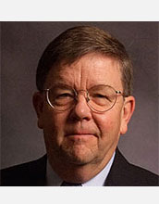

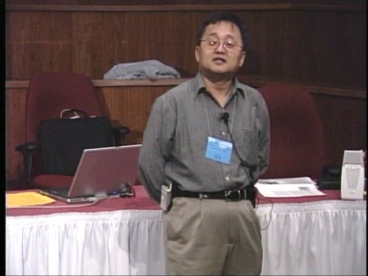
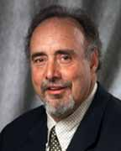
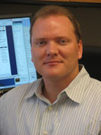
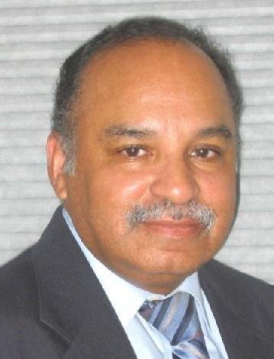
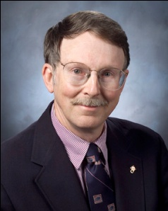
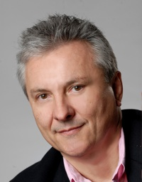
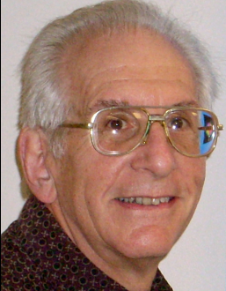
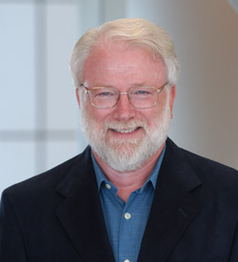
OK Supercomputing Symposium 2013
2003 Keynote:
Peter Freeman
NSF
Computer & Information
Science & Engineering
Assistant Director
2004 Keynote:
Sangtae Kim
NSF Shared
Cyberinfrastructure
Division Director
2005 Keynote:
Walt Brooks
NASA Advanced
Supercomputing
Division Director
2006 Keynote:
Dan Atkins
Head of NSF’s
Office of
Cyberinfrastructure
2007 Keynote:
Jay Boisseau
Director
Texas Advanced
Computing Center
U. Texas Austin
2008 Keynote: José Munoz Deputy Office Director/ Senior Scientific Advisor NSF Office of Cyberinfrastructure
2013 Keynote to be announced!
2009 Keynote: Douglass Post Chief Scientist US Dept of Defense HPC Modernization Program
2010 Keynote: Horst Simon Deputy Director Lawrence Berkeley National Laboratory
FREE! Wed Oct 2 2013 @ OU
Over 235 registra2ons already!
Over 150 in the first day, over 200 in the first week, over 225 in the first month.
2011 Keynote: Barry Schneider Program Manager National Science Foundation
2012 Keynote: Thom Dunning Director National Center for Supercomputing Applications
http://symposium2013.oscer.ou.edu/
Reception/Poster Session
Tue Oct 1 2013 @ OU
Symposium Wed Oct 2 2013 @ OU

Slide 18
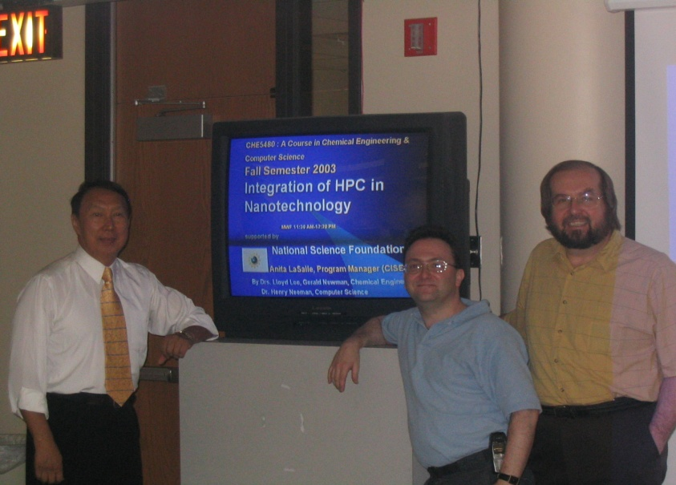
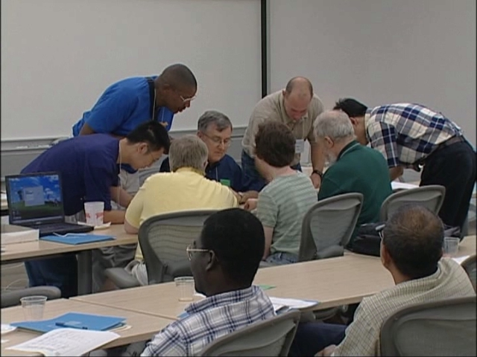
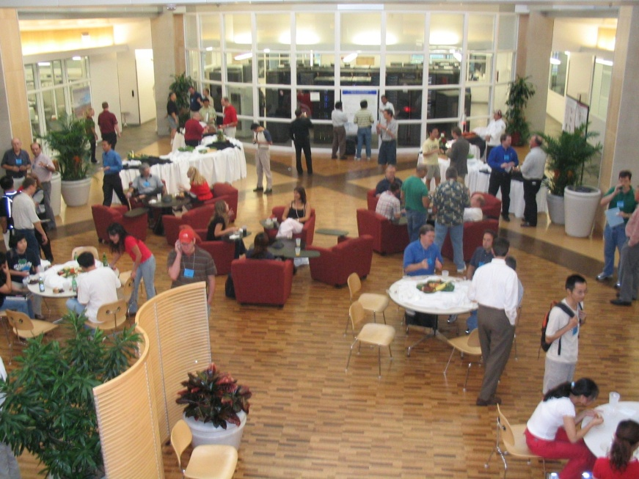
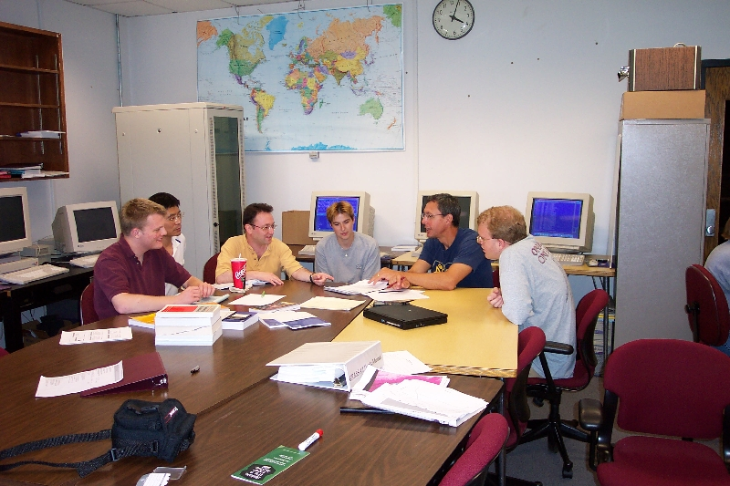
People

Slide 19
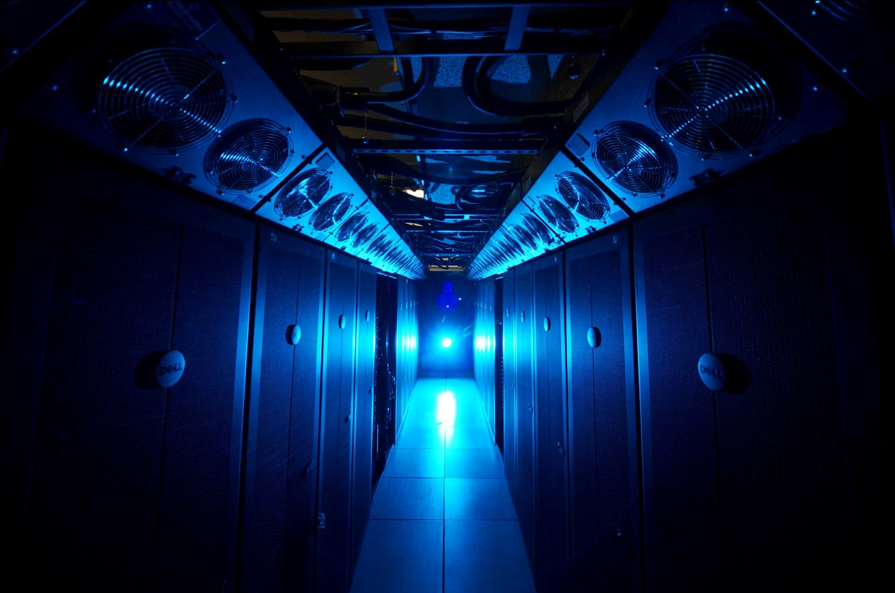
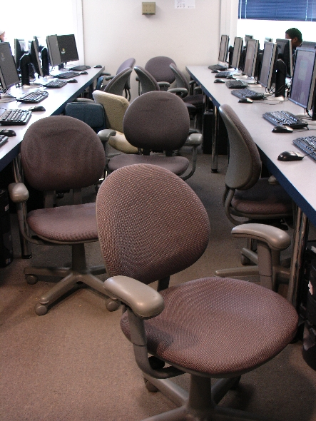
Things

Slide 20
Thanks for your attention! Questions? www.oscer.ou.edu

Slide 21
What is Supercomputing?
Supercomputing is the biggest, fastest computing right this minute.
Likewise, a supercomputer is one of the biggest, fastest computers right this minute.
So, the definition of supercomputing is constantly changing.
Rule of Thumb: A supercomputer is typically at least 100 times as powerful as a PC.
Jargon: Supercomputing is also known as High Performance Computing (HPC) or High End Computing (HEC) or Cyberinfrastructure (CI).

Slide 22
Fastest Supercomputer vs. Moore
Speed in GFLOPs
GFLOPs:
billions of calculations per second
1993: 1024 CPU cores
www.top500.org
Year

Slide 23
What is Supercomputing About?
Size
Speed
Laptop

Slide 24
What is Supercomputing About?
Size: Many problems that are interesting to scientists and engineers can’t fit on a PC – usually because they need more than a few GB of RAM, or more than a few 100 GB of disk.
Speed: Many problems that are interesting to scientists and engineers would take a very very long time to run on a PC: months or even years. But a problem that would take a month on a PC might take only an hour on a supercomputer.

Slide 25
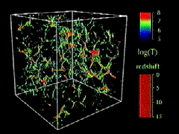
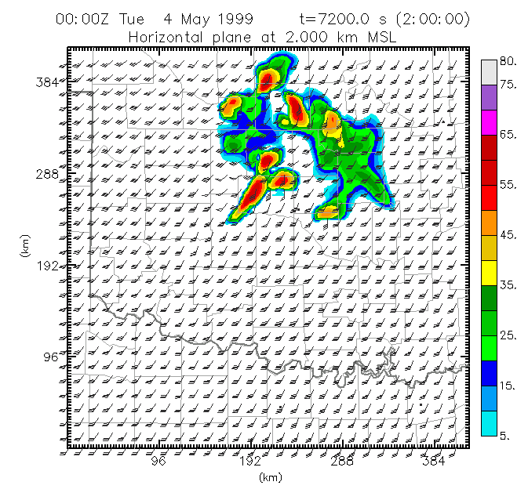
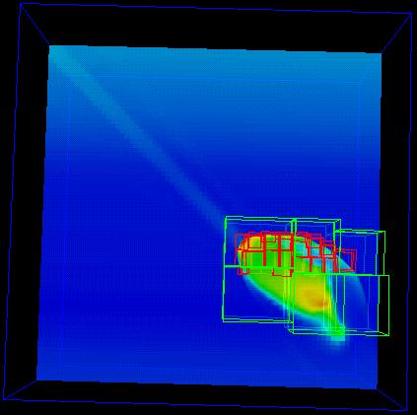
What Is HPC Used For?
Simulation of physical phenomena, such as
Weather forecasting
Galaxy formation
Oil reservoir management
Data mining: finding needles of information in a haystack of data,
such as
Gene sequencing
Signal processing
Detecting storms that might produce tornados
Visualization: turning a vast sea of data into pictures that a scientist can understand
^{[1]}
Moore, OK
Tornadic
Storm
May 3 1999^{[2]}
^{[3]}

Slide 26
Supercomputing Issues
The tyranny of the storage hierarchy
Parallelism: doing multiple things at the same time

Slide 27
OSCER

Slide 28

What is OSCER?
Multidisciplinary center
Division of OU Information Technology
Provides:
Supercomputing education
Supercomputing expertise
Supercomputing resources: hardware, storage, software
For:
Undergrad students
Grad students
Staff
Faculty
Their collaborators (including off campus)

Slide 29
Who is OSCER? Academic Depts
Aerospace & Mechanical Engr
Anthropology
Biochemistry & Molecular Biology
Biological Survey
Botany & Microbiology
Chemical, Biological & Materials Engr
Chemistry & Biochemistry
Civil Engr & Environmental Science
Computer Science
Economics
Electrical & Computer Engr
Finance
Health & Sport Sciences
History of Science
Industrial Engr
Geography
Geology & Geophysics
Library & Information Studies
Mathematics
Meteorology
Petroleum & Geological Engr
Physics & Astronomy
Psychology
Radiological Sciences
Surgery
Zoology
E
E
E
E
More than 150 faculty & staff in 26 depts in Colleges of Arts & Sciences, Atmospheric & Geographic Sciences, Business, Earth & Energy, Engineering, and Medicine – with more to come!

Slide 30
Who is OSCER? Groups
Advanced Center for Genome Technology
Center for Analysis & Prediction of Storms
Center for Aircraft & Systems/Support Infrastructure
Cooperative Institute for Mesoscale Meteorological Studies
Center for Engineering Optimization
Fears Structural Engineering Laboratory
Human Technology Interaction Center
Institute of Exploration & Development Geosciences
Instructional Development Program
Interaction, Discovery, Exploration, Adaptation Laboratory
Microarray Core Facility
OU Information Technology
OU Office of the VP for Research
Oklahoma Center for High Energy Physics
Robotics, Evolution, Adaptation, and Learning Laboratory
Sasaki Applied Meteorology Research Institute
Symbiotic Computing Laboratory
E
E
E
E

Slide 31
Who? Oklahoma Collaborators
Cameron University
East Central University
Langston University
Northeastern State University
Northwestern Oklahoma State University
Oklahoma Baptist University
Oklahoma City University
Oklahoma Panhandle State University
Oklahoma School of Science & Mathematics
Oklahoma State University
Rogers State University
St. Gregory’s University
Southeastern Oklahoma State University
Southwestern Oklahoma State University
University of Central Oklahoma
University of Oklahoma (Norman, HSC, Tulsa)
University of Science & Arts of Oklahoma
University of Tulsa
NOAA National Severe Storms Laboratory
NOAA Storm Prediction Center
Oklahoma Climatological Survey
Oklahoma Medical Research Foundation
OneNet
Samuel Roberts Noble Foundation
Tinker Air Force Base
OSCER has supercomputer users at every public university in Oklahoma, plus at many private universities and one high school.
E
E
E
E

Slide 32
Who Are the Users?
Over 800 users so far, including:
Roughly equal split between students vs faculty/staff (students are the bulk of the active users);
many off campus users (roughly 20%);
… more being added every month.
Comparison: XSEDE, consisting of 7 resource provide sites across the US, has ~7500 unique users.

Slide 33
User Growth Profile
2012 = 18 x 2002
But each user has exponentially growing needs!
Growth per user has been 1/6 of Moore’s Law.

Slide 34


Biggest Consumers
Center for Analysis & Prediction of Storms: daily real time weather forecasting
Oklahoma Center for High Energy Physics: simulation and data analysis of banging tiny particles together at unbelievably high speeds
Chemical Engineering: lots and lots of molecular dynamics

Slide 35
Why OSCER?
Computational Science & Engineering has become sophisticated enough to take its place alongside experimentation and theory.
Most students – and most faculty and staff – don’t learn much CSE, because CSE is seen as needing too much computing background, and as needing HPC, which is seen as very hard to learn.
HPC can be hard to learn: few materials for novices; most documents written for experts as reference guides.
We need a new approach: HPC and CSE for computing novices – OSCER’s mandate!

Slide 36
Why Bother Teaching Novices?
Application scientists & engineers typically know their applications very well, much better than a collaborating computer scientist ever would.
Commercial software lags far behind the research community.
Many potential CSE users don’t need full time CSE and HPC staff, just some help.
One HPC expert can help dozens of research groups.
Today’s novices are tomorrow’s top researchers, especially because today’s top researchers will eventually retire.

Slide 37
What Does OSCER Do? Teaching
Science and engineering faculty from all over America learn
supercomputing at OU by playing with a jigsaw puzzle (NCSI @ OU 2004).

Slide 38
What Does OSCER Do? Rounds
OU undergrads, grad students, staff and faculty learn
how to use supercomputing in their specific research.

Slide 39
OSCER Resources

Slide 40
NEW SUPERCOMPUTER!
874 Intel Xeon CPU chips/6992 cores
412 dual socket/oct core Sandy Bridge 2.0 GHz, 32 GB
23 dual socket/oct core Sandy Bridge 2.0 GHz, 64 GB
1 quad socket/oct core Westmere, 2.13 GHz, 1 TB
15,680 GB RAM
~250 TB global disk
QLogic Infiniband
(16.67 Gbps, ~1 microsec latency)
Dell Force10 Gigabit/10G Ethernet
Red Hat Enterprise Linux 6
Peak speed: 111.6 TFLOPs*
*TFLOPs: trillion calculations per second
Just over 3x (300%) as fast as our 2008-12 supercomputer.
Just over 100x (10,000%) as fast as our first cluster supercomputer in 2002.
boomer.oscer.ou.edu
Just moved to new building!

Slide 41

What is a Cluster Supercomputer?
“… [W]hat a ship is … It's not just a keel and hull and a deck and sails. That's what a ship needs. But what a ship is ... is freedom.”
– Captain Jack Sparrow
“Pirates of the Caribbean”

Slide 42
What a Cluster is ….
A cluster needs of a collection of small computers, called nodes, hooked together by an interconnection network (or interconnect for short).
It also needs software that allows the nodes to communicate over the interconnect.
But what a cluster is … is all of these components working together as if they’re one big computer ... a super computer.

Slide 43
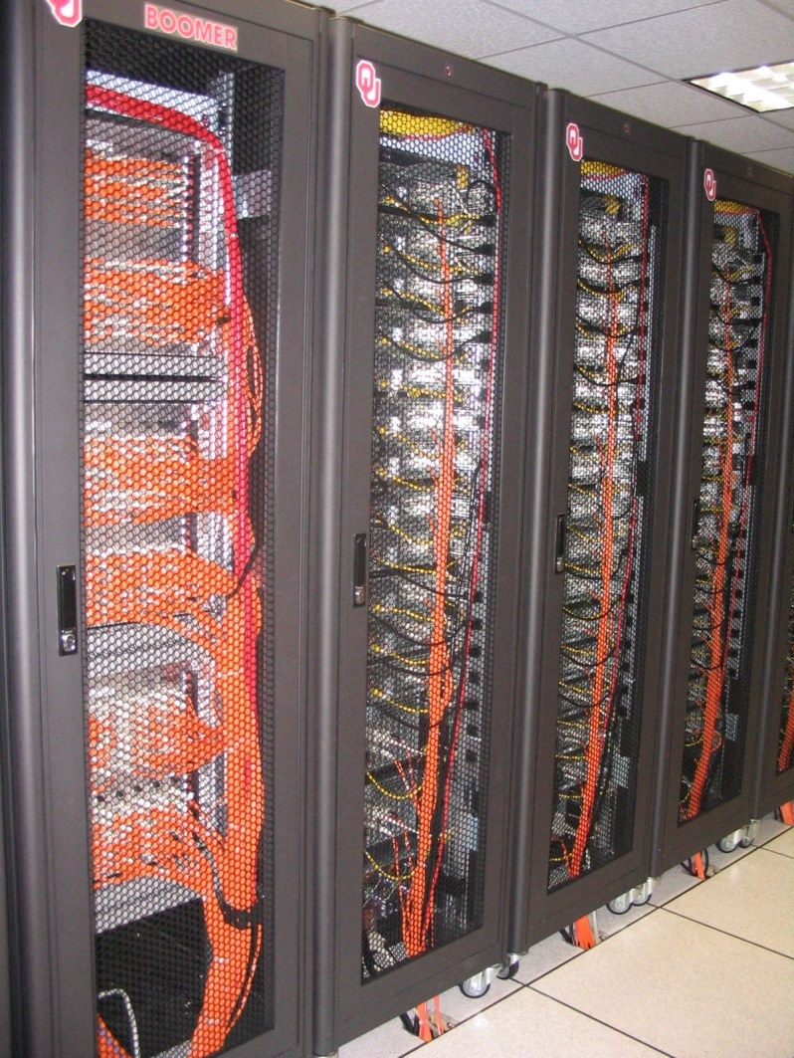
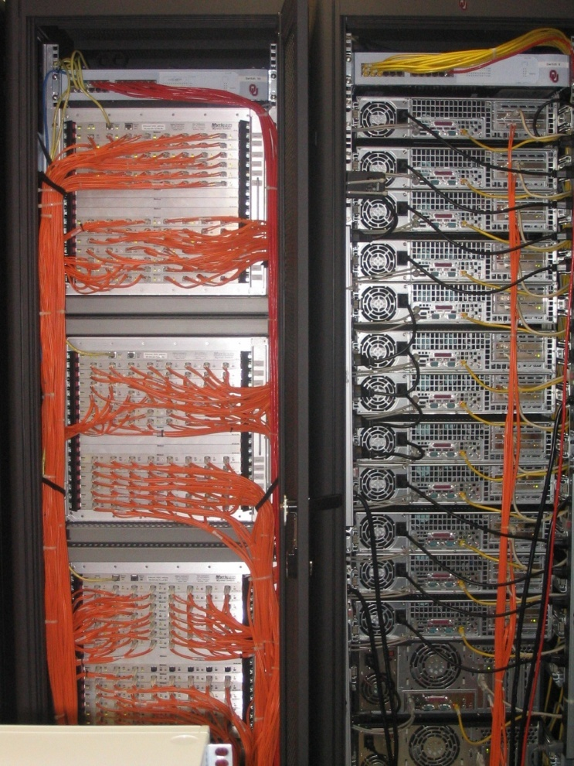
An Actual Cluster
Interconnect
Also named Boomer, in service 2002-5.
Nodes

Slide 44
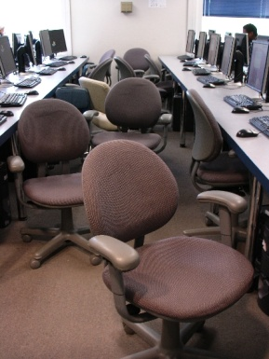
Condor Pool
Condor is a software technology that allows idle desktop PCs to be used for number crunching.
OU IT has deployed a large Condor pool (795 desktop PCs in IT student labs all over campus).
It provides a huge amount of additional computing power – more than was available in all of OSCER in 2005.
20+ TFLOPs peak compute speed.
And, the cost is very very low – almost literally free.
Also, we’ve been seeing empirically that Condor gets about 80% of each PC’s time.

Slide 45
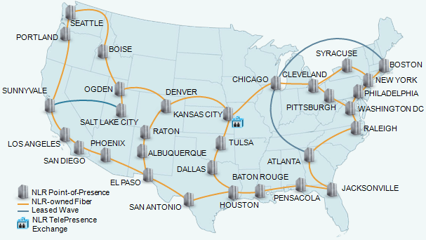
National Lambda Rail

Slide 46
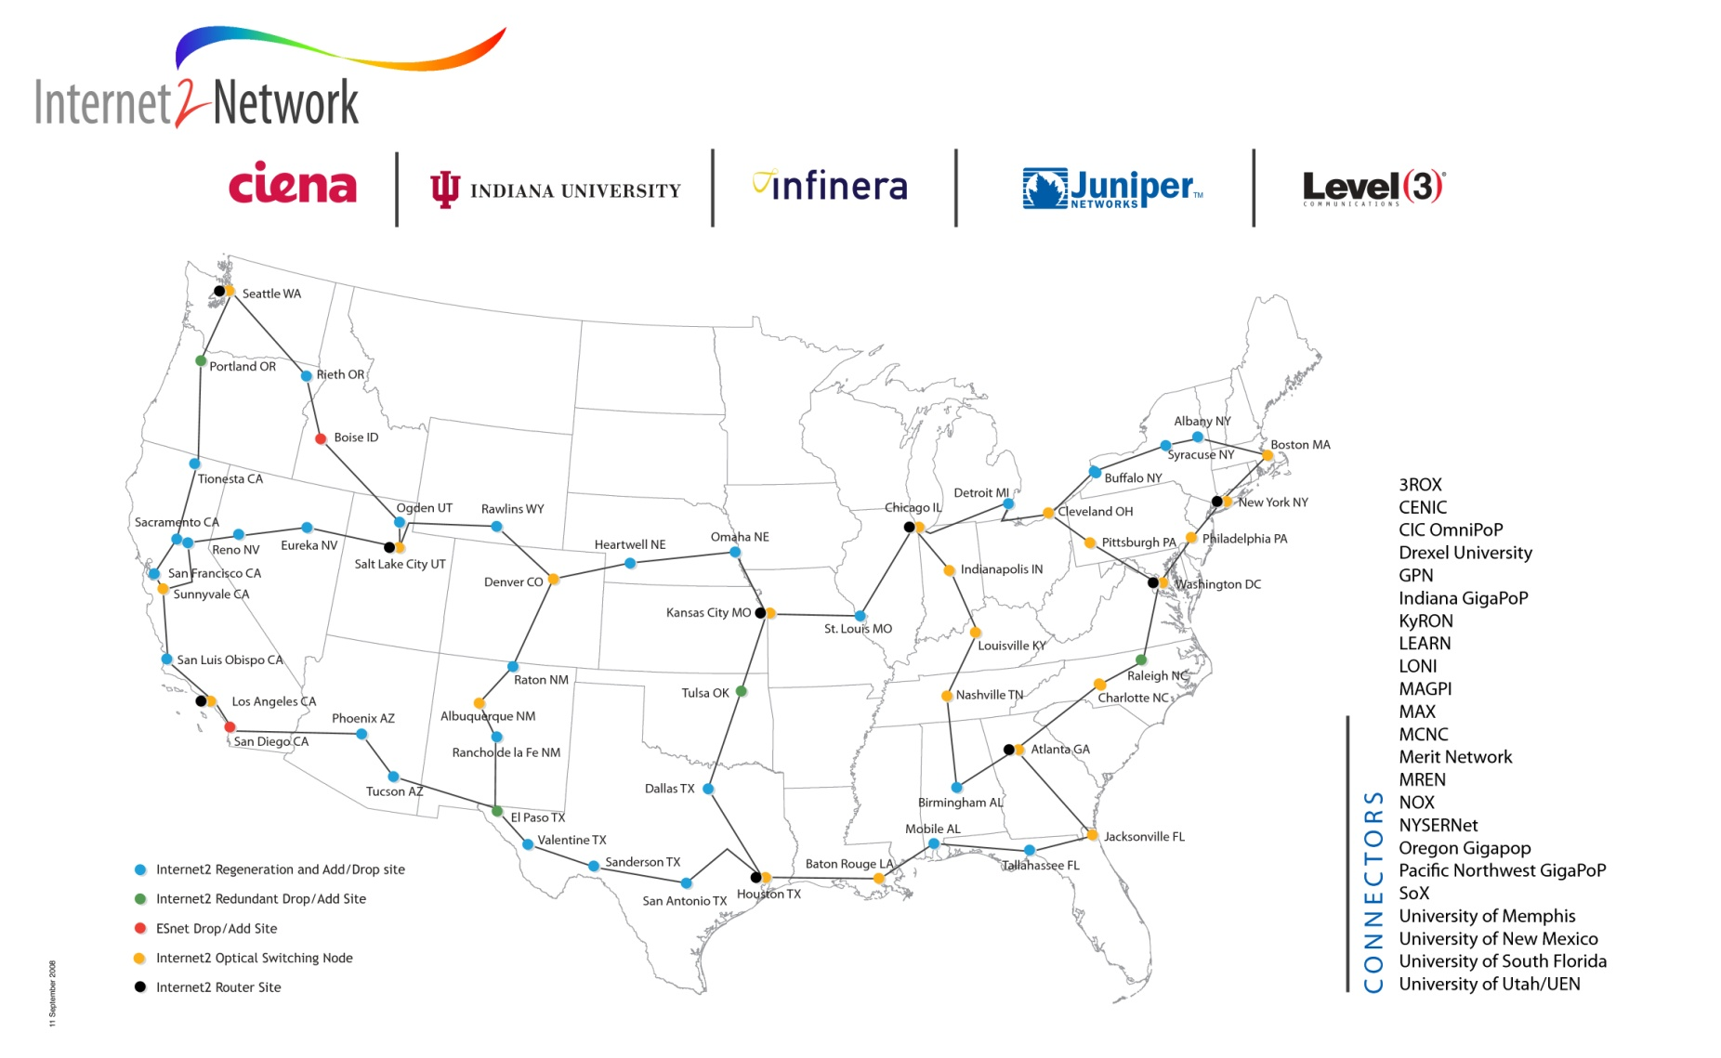
Internet2
www.internet2.edu

Slide 47
NSF EPSCoR C2 Grant
Oklahoma has been awarded a National Science Foundation EPSCoR RII Intra- campus and Inter-campus Cyber Connectivity (C2) grant (PI Neeman), a collaboration among OU, OneNet and several other academic and nonprofit institutions, which is:
upgrading the statewide ring from routed components to optical components, making it straightforward and affordable to provision dedicated “lambda” circuits within the state;
upgrading several institutions’ connections;
providing telepresence capability to institutions statewide;
providing IT professionals to speak to IT and CS courses about what it’s like to do IT for a living.

Slide 48
NSF MRI Grant: Petascale Storage
OU has been awarded an National Science Foundation Major Research Instrumentation (MRI) grant (PI Neeman).
We’ll purchase and deploy a combined disk/tape bulk storage archive:
the NSF budget pays for the hardware, software and warranties/maintenance for 3 years;
OU cost share and institutional commitment pay for space, power, cooling and labor, as well as maintenance after the 3 year project period;
individual users (e.g., faculty across Oklahoma) pay for the media (disk drives and tape cartridges).

Slide 49

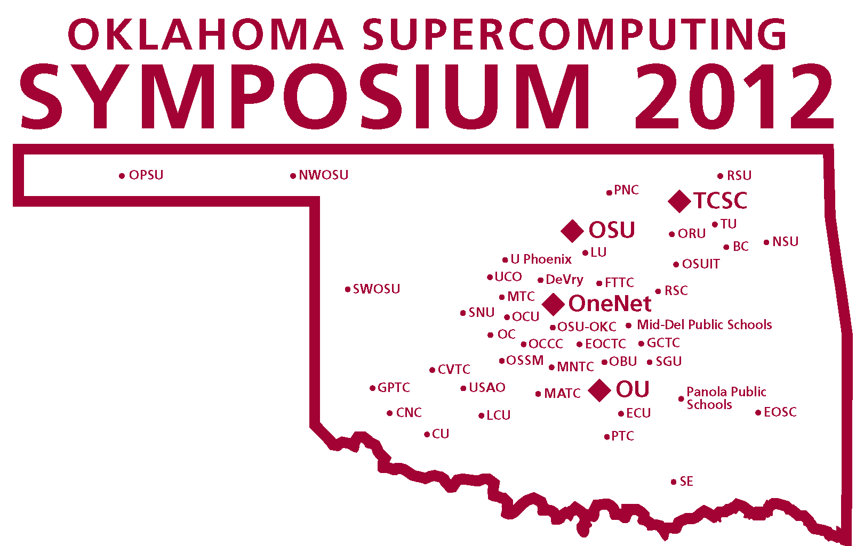
OK Cyberinfrastructure Initiative
All academic institutions in Oklahoma are eligible to sign up for free use of OU’s and OSU’s centrally-owned CI resources.
Other kinds of institutions (government, non-governmental) are eligible to use, though not necessarily for free.
Everyone can participate in our CI education initiative.
The Oklahoma Supercomputing Symposium, our annual conference, continues to be offered to all.

Slide 50
OCII Goals
Reach institutions outside the mainstream of advanced computing.
Serve every higher education institution in Oklahoma that has relevant curricula.
Educate Oklahomans about advanced computing.
Attract underrepresented populations and institution types into advanced computing.

Slide 51
OCII Service Methodologies Part 1
Access (A): to supercomputers and related technologies (20 OK academic institutions to date).
Dissemination (D): Oklahoma Supercomputing Symposium – annual advanced computing conference (25 OK academic institutions to date).
Education (E): “Supercomputing in Plain English” (SiPE) workshop series: 11 talks about advanced computing, taught with stories, analogies and play rather than deep technical jargon. Have reached 166 institutions (academic, government, industry, nonprofit) in 42 US states and territories and 5 other countries (14 OK academic institutions to date) – coming again in Spring 2013!

Slide 52
OCII Service Methodologies Part 2
Faculty Development (F): Workshops held at OU and OSU on advanced computing and computational science topics, sponsored by the National Computational Science Institute, the SC supercomputing conference series, the Linux Clusters Institute, the Virtual School for Computational Science & Engineering. Oklahoma is the only state to have hosted multiple events sponsored by each of these (18 OK academic).
Outreach (O): “Supercomputing in Plain English” (SiPE) overview talk (24 OK academic).
Proposal Support (P): Letters of commitment for access to OCII resources; collaborations with OCII lead institutions (4 OK academic, 1 nongovernmental).

Slide 53
OCII Service Methodologies Part 3
Technology (T): Got or helped get technology (e.g., network upgrade, mini-supercomputer, hi def video camera for telepresence) for that institution (14 OK academic).
Workforce Development (W) – (35 OK academic)
Oklahoma Information Technology Mentorship Program (OITMP)
“A Day in the Life of an IT Professional” presentations to courses across the full spectrum of higher education.
Job shadowing opportunities and direct mentoring of individual students.
Institution Types: high schools, career techs, community colleges, regional universities, PhD-granting universities.
Special effort to reach underrepresented populations:
underrepresented minorities, non-PhD-granting, rural

Slide 54
OCII Institution Profile
To date, OCII has served 96 Oklahoma institutions, agencies and organizations:
49 OK academic
47 OK non-academic

Slide 55
OCII Institution Profile
To date, OCII has served 96 Oklahoma institutions, agencies and organizations:
49 OK academic
Universities & Colleges
3 comprehensive PhD-granting
21 regional non-PhD-granting
Community Colleges: 10
Career techs: 11
High schools: 2
Public school systems: 2
47 OK non-academic

Slide 56
OCII Institution Profile
To date, OCII has served:
49 OK academic
8 Minority Serving Institutions:
Oklahoma’s only Historically Black University: Langston U
Native American Serving Non-tribal Institutions
East Central U (Ada)
Northeastern Oklahoma A&M College (Miami)
Northeastern State U (Tahlequah)
Southeastern Oklahoma State U (Durant)
Tribal Colleges
College of the Muscogee Nation (Okmulgee)
Comanche Nation College (Lawton)
Pawnee Nation College (Pawnee)
Other Minority Serving Insitution
Bacone College (Muskogee)
47 OK non-academic

Slide 57
OCII Institution Profile
To date, OCII has served 96 Oklahoma institutions, agencies and organizations:
49 OK academic
8 Minority Serving Institutions
15 other institutions with above state and national average for one or more underrepresented minorities
47 OK non-academic

Slide 58
OCII Institution Profile
To date, OCII has served 96 Oklahoma institutions, agencies and organizations:
49 OK academic institutions
47 OK non-academic organizations
16 commercial
18 government
2 military
11 non-governmental

Slide 59
OCII Academic Institutions
Bacone College (MSI, 30.9% AI, 24.0% AA): T
Cameron U (8.1% AI, 15.4% AA): A, D, E, F, O, T, W
Teaching advanced computing course using OSCER’s supercomputer.
Canadian Valley Tech Center: W
College of the Muscogee Nation (Tribal): O, T
Comanche Nation College (Tribal): D, O, T
DeVry U Oklahoma City: D, F, O
East Central U (NASNI, 20.4% AI, rural): A, D, E, F, O, P, T, W
Taught advanced computing course using OSCER’s supercomputer.
Eastern Oklahoma State College (24.5% AI): W
Average: ~3 (mean 3.4, median 3, mode 1)
Eastern Oklahoma County Tech Center (10.4% AI): W
Francis Tuttle Tech Center: D, W
Gordon Cooper Tech Center (18.5% AI, nonmetro): D, O, W
Great Plains Tech Center (11.7% AI): T, W
Kiamichi Tech Center (18.6% AI): W
Langston U (HBCU, 82.8% AA): A, D, E, F, O, P, T, W
NSF Major Research Instrumentation grant for supercomputer awarded in 2012.
Note: Langston U (HBCU) and East Central U (NASNI) are the only two non-PhD-granting institutions to have benefited from every category of service that OCII provides.
AA = African American (7.4% OK population, 12.6% US population)
AI = American Indian (8.6% OK, 0.9% US)
H = Hispanic (8.9% OK, 16.3% US)
ALL = 24.9% OK, 29.8% US
HBCU: Historically Black College or University
NASNI = Native American Serving Non-Tribal Institution
MSI = Minority Serving Institution

Slide 60
OCII Academic (cont’d)
Lawton Christian School (high school): W
Metro Tech Centers (30.6% AA): D
Mid-America Tech Center (23.5% AI): D, T, W
Mid-Del Public Schools: D
Moore Norman Tech Center: D
Northeast Tech Center (20.9% AI): W
Northeastern Oklahoma A&M College (NASNI, 20.1% AI): W
Northeastern State U (NASNI, 28.3% AI, nonmetro): A, D, E, F, O, T, W
Taught computational chemistry course using OSCER’s supercomputer.
Northwestern Oklahoma State U: A, F, O
Oklahoma Baptist U (nonmetro): A, D, E, F, O, W
Oklahoma Christian U: W
Oklahoma City U: A, D, E, F, O, T, W
Educational Alliance for a Parallel Future mini-supercomputer proposal funded in 2011.
Teaching advanced computing course using OSCER’s supercomputer (several times).
Oklahoma City Community College: W
Oklahoma Panhandle State U (rural, 15.4% H): A, D, O, W
Oklahoma School of Science & Mathematics (high school): A, D, E, O, W
Oklahoma State U (PhD, 8.3% AI): A, D, E, F, O, T, W
NSF Major Research Instrumentation proposal for supercomputer funded in 2011.
Oklahoma State U Institute of Technology (Comm College, 24.2% AI): W
Average: ~3 (mean 3.4, median 3, mode 1)
AA = African American (7.4% OK population, 12.6% US population)
AI = American Indian (8.6% OK, 0.9% US)
H = Hispanic (8.9% OK, 16.3% US)
ALL = 24.9% OK, 29.8% US
HBCU: Historically Black College or University
NASNI = Native American Serving Non-Tribal Institution
MSI = Minority Serving Institution

Slide 61
OCII Academic (cont’d)
Oklahoma State U OKC (Comm College): O, W
Oral Roberts U: A, F, O, W
Panola Public Schools: D
Pawnee Nation College (Tribal): T
Pontotoc Tech Center (30.4% AI): W
Rogers State U (13.9% AI): A, D, F, O
Rose State College (17.4% AA): W
St. Gregory’s U (nonmetro): A, D, E, F, O
Southeastern Oklahoma State U (NASNI, 29.6% AI, nonmetro): A, D, E, F, O, T, W
Educational Alliance for a Parallel Future mini-supercomputer grant funded in 2011.
Southern Nazarene U: A, D, F, O, P, T, W
Teaching computational chemistry course using OSCER’s supercomputer.
Southern Tech Center (9.1% AI): W
Southwestern Oklahoma State U (rural): A, D, E, F, O
Tulsa Community College: W
U Central Oklahoma: A, D, E, F, O, W
NSF Major Research Instrumentation proposal for supercomputer submitted in 2011-12.
U Oklahoma (PhD): A, D, E, F, O, P, T, W
NSF Major Research Instrumentation proposal for large scale storage funded in 2010.
U Phoenix: D
U of Science & Arts of Oklahoma (14.1% AI): A, O
U Tulsa (PhD): A, D, E, F, O
Taught bioinformatics course using OSCER’s supercomputer.
Average: ~3 (mean 3.4, median 3, mode 1)
AA = African American (7.4% OK population, 12.6% US population)
AI = American Indian (8.6% OK, 0.9% US)
H = Hispanic (8.9% OK, 16.3% US)
ALL = 24.9% OK, 29.8% US
HBCU: Historically Black College or University
NASNI = Native American Serving Non-Tribal Institution
MSI = Minority Serving Institution

Slide 62
OCII Non-academic
Commercial (16)
Andon Corp : D, F
Chesapeake Energy Corp : D
Creative Consultants : D
Fusion Geophysical: D
Indus Corp: D, E
Information Techknologic: D
KANresearch: D
KeyBridge Technologies: D
Lumenate: D
OGE Energy Corp: D
Perfect Order (now defunct): D
PowerJam Production Inc: D
Versatile: D
Visage Production Inc: D, E
Weather Decision Technologies Inc : A
Weathernews Americas Inc.: A, D
Government (18)
City of Duncan: D
City of Edmond: D
City of Nichols Hills: D
NOAA National Severe Storms Laboratory: A, D, E, F
NOAA Storm Prediction Center: D
NOAA National Weather Service: D
NOAA Radar Operations Center: D
OK Climatological Survey: D
OK Department of Health: D, E
OK Department of Human Services: D, E
OK Department of Libraries: D
OK Department of Mental Health and Substance Abuse Services: D
OK Office of State Finance: D
Oklahoma State Chamber of Commerce: D
OK State Regents for Higher Education: A, D
OK State Supreme Court: D
OK Tax Commission: D
Tulsa County Court Services: D

Slide 63
OCII Non-academic (cont’d)
Military (2)
Fort Sill Army Base: E
Tinker Air Force Base: A, D, E, F, O
Non-governmental/non-profit (11)
American Society of Mechanical Engineers, Oklahoma City chapter: O
Engineering Club of Oklahoma City: O
Lions Club of Norman OK: O
Lions Club of Shawnee OK: O
Norman Science Café: O
Oklahoma EPSCoR: D
Oklahoma Historical Society: D
Oklahoma Innovation Institute: D
Oklahoma Medical Research Foundation: A, D, P
Oklahoma Nanotechnology Initiative: D
Samuel Noble Roberts Foundation (rural): A, D, E, F, T

Slide 64
OCII Goal for 2013
GOAL: Over 100 total institutions and organizations served by OCII (at 96)
GOAL: Over 50 academic institutions served by OCII (at 49)
GOAL: Over 35 academic institutions served by OITMP (at 35)

Slide 65
OCII Outcomes: Research
External research funding to OK institutions facilitated by OCII lead institutions (Fall 2001- Fall 2012): over $125M
Funded projects facilitated: over 200
OK faculty and staff: over 100 in ~20 academic disciplines
Specifically needed OCII just to be funded: over $21M
(necessary but far from sufficient)
NSF EPSCoR RII Track-1: $15M to OK
NSF EPSCoR RII Track-2: $3M to OK
NSF EPSCoR RII C2: $1.17M to OK
NSF MRI (OU): $793K
NSF MRI (OSU): $908K
NSF MRI (Langston U): $250K
SUBMITTED: NSF EPSCoR RII Track-1: $20M + $4M Regents
Publications facilitated: roughly 900

Slide 66
OCII Outcomes: Teaching
Teaching: 7 + 1 institutions including 2 MSIs
Teaching/taught parallel computing using OSCER resources:
Cameron U
East Central U (NASNI)
Oklahoma City U
Taught parallel computing via LittleFe baby supercomputer:
Southeastern Oklahoma State U (NASNI)
Taught computational chemistry using OSCER resources:
Northeastern State U (NASNI)
Southern Nazarene U
Rogers State U

Slide 67
OCII Outcomes: Resources
6 institutions including 2 MSIs, plus C2 institutions
NSF Major Research Instrumentation grants: $1.95M
OU: Oklahoma PetaStore, $793K (in production)
Oklahoma State U: Cowboy cluster, $909K (in production)
Langston U: cluster, $250K (to be acquired)
LittleFe baby supercomputer grants ($2500 each)
OU: Ron Barnes
Oklahoma City U: Larry Sells & John Goulden
Southeastern Oklahoma State U: Mike Morris & Karl Frinkle
Networking: C2 grant: $1.17M

Slide 68
OCII Outcomes: C2 Grant
NSF EPSCoR RII C2 networking grant: $1.17M
Major upgrades to:
Statewide ring
OU, OSU, TU, Langston U, Noble Foundation
Smaller upgrades to:
College of the Muscogee Nation
Bacone College
Pawnee Nation College
Comanche Nation College
Oklahoma IT Mentorship Program: 35 institutions served
3 PhD-granting, 13 regional colleges/universities
7 community colleges, 10 career techs, 2 high schools

Slide 69
A Quick Primer on Hardware

Slide 70
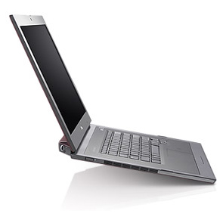
Henry’s Laptop
Dell Latitude Z600^{[4]}
Intel Core2 Duo SU9600 1.6 GHz w/3 MB L2 Cache
4 GB 1066 MHz DDR3 SDRAM
256 GB SSD Hard Drive
DVD+RW/CD-RW Drive (8x)
1 Gbps Ethernet Adapter

Slide 71
Typical Computer Hardware
Central Processing Unit
Primary storage
Secondary storage
Input devices
Output devices

Slide 72
Central Processing Unit
Also called CPU or processor: the “brain”
Components
Control Unit: figures out what to do next – for example, whether to load data from memory, or to add two values together, or to store data into memory, or to decide which of two possible actions to perform (branching)
Arithmetic/Logic Unit: performs calculations – for example, adding, multiplying, checking whether two values are equal
Registers: where data reside that are being used right now

Slide 73
Primary Storage
Main Memory
Also called RAM (“Random Access Memory”)
Where data reside when they’re being used by a program that’s currently running
Cache
Small area of much faster memory
Where data reside when they’re about to be used and/or have been used recently
Primary storage is volatile: values in primary storage disappear when the power is turned off.

Slide 74
Secondary Storage
Where data and programs reside that are going to be used in the future
Secondary storage is non-volatile: values don’t disappear when power is turned off.
Examples: hard disk, CD, DVD, Blu-ray, magnetic tape, floppy disk
Many are portable: can pop out the CD/DVD/tape/floppy and take it with you

Slide 75
Input/Output
Input devices – for example, keyboard, mouse, touchpad, joystick, scanner
Output devices – for example, monitor, printer, speakers

Slide 76
The Tyranny of the Storage Hierarchy

Slide 77
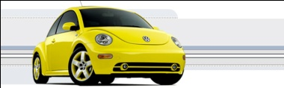
The Storage Hierarchy
Fast, expensive, few
Registers
Cache memory
Main memory (RAM)
Hard disk
Removable media (CD, DVD etc)
Internet
Slow, cheap, a lot
[5]

Slide 78
RAM is Slow
CPU
384 GB/sec
The speed of data transfer
between Main Memory and the
CPU is much slower than the
speed of calculating, so the CPU
spends most of its time waiting
for data to come in or go out.
Bottleneck
17 GB/sec (4.4%)

Slide 79
Why Have Cache?
CPU
Cache is much closer to the speed
of the CPU, so the CPU doesn’t
have to wait nearly as long for
stuff that’s already in cache:
it can do more
operations per second!
30 GB/sec (8%)
17 GB/sec(1%)

Slide 80
Henry’s Laptop
Dell Latitude Z600^{[4]}
Intel Core2 Duo SU9600 1.6 GHz w/3 MB L2 Cache
4 GB 1066 MHz DDR3 SDRAM
256 GB SSD Hard Drive
DVD+RW/CD-RW Drive (8x)
1 Gbps Ethernet Adapter

Slide 81
Storage Speed, Size, Cost
Henry’s Laptop | Registers (Intel Core2 Duo 1.6 GHz) | Cache Memory (L2) | Main Memory (1333MHz DDR3 SDRAM) | Hard Drive | Ethernet (1000 Mbps) | DVD+R (16x) | Phone Modem (56 Kbps)
Speed (MB/sec) [peak] | 314,573^{[6]} (12,800 MFLOP/s*) | 30,720 | 17,400 ^{[7]} | 25^{[9]} | 125 | 22 ^{[10]} | 0.007
Size (MB) | 464 bytes** ^{[11]} | 3 | 4096 | 500,000 | unlimited | unlimited | unlimited
Cost ($/MB) | – | $32 ^{[12]} | $0.004 ^{[12]} | $0.00005 ^{[12]} | charged per month (typically) | $0.0002 ^{[12]} | charged per month (typically)
* MFLOP/s: millions of floating point operations per second
** 16 64-bit general purpose registers, 8 80-bit floating point registers,
16 128-bit floating point vector registers

Slide 82
Why the Storage Hierarchy?
Why does the Storage Hierarchy always work? Why are faster forms of storage more expensive and slower forms cheaper?
Proof by contradiction:
Suppose there were a storage technology that was slow and expensive.
How much of it would you buy?
Comparison
Zip: Cartridge $7.15 (2.9 cents per MB), speed 2.4 MB/sec
Blu-Ray: Disk $4 ($0.00015 per MB), speed 19 MB/sec
Not surprisingly, no one buys Zip drives any more.

Slide 83
Parallelism

Slide 84
Parallelism
Parallelism means doing multiple things at the same time: you can get more work done in the same time.
Less fish …
More fish!

Slide 85
The Jigsaw Puzzle Analogy

Slide 86
Serial Computing
Suppose you want to do a jigsaw puzzle
that has, say, a thousand pieces.
We can imagine that it’ll take you a
certain amount of time. Let’s say
that you can put the puzzle together in
an hour.

Slide 87
Shared Memory Parallelism
If Scott sits across the table from you, then he can work on his half of the puzzle and you can work on yours. Once in a while, you’ll both reach into the pile of pieces at the same time (you’ll contend for the same resource), which will cause a little bit of slowdown. And from time to time you’ll have to work together (communicate) at the interface between his half and yours. The speedup will be nearly 2-to-1: y’all might take 35 minutes instead of 30.

Slide 88
The More the Merrier?
Now let’s put Paul and Charlie on the other two sides of the table. Each of you can work on a part of the puzzle, but there’ll be a lot more contention for the shared resource (the pile of puzzle pieces) and a lot more communication at the interfaces. So y’all will get noticeably less than a 4-to-1 speedup, but you’ll still have an improvement, maybe something like 3-to-1: the four of you can get it done in 20 minutes instead of an hour.

Slide 89
Diminishing Returns
If we now put Dave and Tom and Horst and Brandon on the corners of the table, there’s going to be a whole lot of contention for the shared resource, and a lot of communication at the many interfaces. So the speedup y’all get will be much less than we’d like; you’ll be lucky to get 5-to-1.
So we can see that adding more and more workers onto a shared resource is eventually going to have a diminishing return.

Slide 90
Distributed Parallelism
Now let’s try something a little different. Let’s set up two tables, and let’s put you at one of them and Scott at the other. Let’s put half of the puzzle pieces on your table and the other half of the pieces on Scott’s. Now y’all can work completely independently, without any contention for a shared resource. BUT, the cost per communication is MUCH higher (you have to scootch your tables together), and you need the ability to split up (decompose) the puzzle pieces reasonably evenly, which may be tricky to do for some puzzles.

Slide 91
More Distributed Processors
It’s a lot easier to add more processors in distributed parallelism. But, you always have to be aware of the need to decompose the problem and to communicate among the processors. Also, as you add more processors, it may be harder to load balance the amount of work that each processor gets.

Slide 92
Load Balancing
Load balancing means ensuring that everyone completes their workload at roughly the same time.
For example, if the jigsaw puzzle is half grass and half sky, then you can do the grass and Scott can do the sky, and then y’all only have to communicate at the horizon – and the amount of work that each of you does on your own is roughly equal. So you’ll get pretty good speedup.

Slide 93
Load Balancing
Load balancing can be easy, if the problem splits up into chunks of roughly equal size, with one chunk per processor. Or load balancing can be very hard.

Slide 94
Load Balancing
EASY
Load balancing can be easy, if the problem splits up into chunks of roughly equal size, with one chunk per processor. Or load balancing can be very hard.

Slide 95
Load Balancing
EASY
HARD
Load balancing can be easy, if the problem splits up into chunks of roughly equal size, with one chunk per processor. Or load balancing can be very hard.

Slide 96
Moore’s Law

Slide 97
Moore’s Law
In 1965, Gordon Moore was an engineer at Fairchild Semiconductor.
He noticed that the number of transistors that could be squeezed onto a chip was doubling about every 2 years.
It turns out that computer speed is roughly proportional to the number of transistors per unit area.
Moore wrote a paper about this concept, which became known as “Moore’s Law.”

Slide 98
Fastest Supercomputer vs. Moore
Speed in GFLOPs
GFLOPs:
billions of calculations per second
1993: 1024 CPU cores
www.top500.org
Year

Slide 99
Fastest Supercomputer vs. Moore
2012: 1,572,864 CPU cores,
16,324,750 GFLOPs
(HPL benchmark)
Speed in GFLOPs
GFLOPs:
billions of calculations per second
1993: 1024 CPU cores
1993: 1024 CPU cores, 59.7 GFLOPs
Gap: Supercomputers were 35x higher than Moore in 2011.
www.top500.org
Year

Slide 100
Moore: Uncanny!
Nov 1971: Intel 4004 – 2300 transistors
March 2010: Intel Nehalem Beckton – 2.3 billion transistors
Factor of 1M improvement in 38 1/3 years
2^{(38.33 years / 1.9232455)} = 1,000,000
So, transistor density has doubled every 23 months:
UNCANNILY ACCURATE PREDICTION!

Slide 101
Moore’s Law in Practice
CPU
log(Speed)
Year

Slide 102
Moore’s Law in Practice
Network Bandwidth
CPU
log(Speed)
Year

Slide 103
Moore’s Law in Practice
Network Bandwidth
CPU
log(Speed)
RAM
Year

Slide 104
Moore’s Law in Practice
Network Bandwidth
log(Speed)
CPU
RAM
1/Network Latency
Year

Slide 105
Moore’s Law in Practice
Network Bandwidth
CPU
log(Speed)
RAM
1/Network Latency
Software
Year

Slide 106
Moore’s Law on Gene Sequencers
Increases 10x every 16 months, compared to 2x every 23 months for CPUs.
Gene Sequencing
Network Bandwidth
CPU
log(Speed)
RAM
1/Network Latency
Software
Year

Slide 107
Why Bother?

Slide 108
Why Bother with HPC at All?
It’s clear that making effective use of HPC takes quite a bit of effort, both learning how and developing software.
That seems like a lot of trouble to go to just to get your code to run faster.
It’s nice to have a code that used to take a day, now run in an hour. But if you can afford to wait a day, what’s the point of HPC?
Why go to all that trouble just to get your code to run faster?

Slide 109
Why HPC is Worth the Bother
What HPC gives you that you won’t get elsewhere is the ability to do bigger, better, more exciting science. If your code can run faster, that means that you can tackle much bigger problems in the same amount of time that you used to need for smaller problems.
HPC is important not only for its own sake, but also because what happens in HPC today will be on your desktop in about 10 to 15 years and on your cell phone in 25 years: it puts you ahead of the curve.

Slide 110
The Future is Now
Historically, this has always been true:
Whatever happens in supercomputing today will be on your desktop in 10 – 15 years.
So, if you have experience with supercomputing, you’ll be ahead of the curve when things get to the desktop.

Slide 111
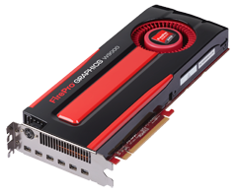
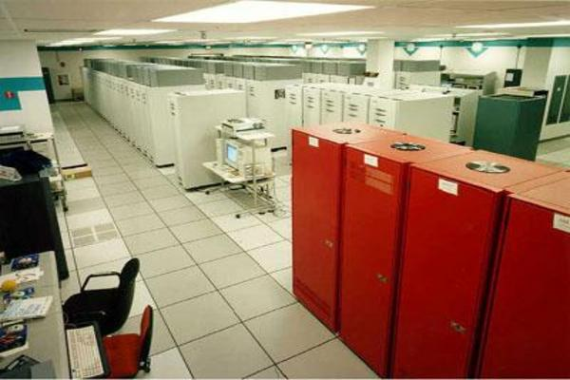
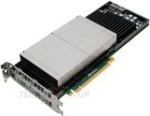
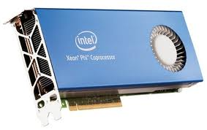
What does 1 TFLOPs Look Like?
2002: Row
2012: Card
1997: Room
AMD FirePro W9000^{[14]}
ASCI RED^{[13]}
Sandia National Lab
NVIDIA Kepler K20^{[15]}
boomer.oscer.ou.edu
In service 2002-5: 11 racks
Intel MIC Xeon PHI^{[16]}

Slide 112
Coming in 2013!
From Computational Biophysics to Systems Biology, May 19-21, Norman OK
Great Plains Network Annual Meeting, May 29-31, Kansas City
XSEDE2013, July 22-25, San Diego CA
IEEE Cluster 2013, Sep 23-27, Indianapolis IN
OKLAHOMA SUPERCOMPUTING SYMPOSIUM 2013, Oct 1-2, Norman OK
SC13, Nov 17-22, Denver CO

Slide 113
OK Supercomputing Symposium 2013
2003 Keynote:
Peter Freeman
NSF
Computer & Information
Science & Engineering
Assistant Director
2004 Keynote:
Sangtae Kim
NSF Shared
Cyberinfrastructure
Division Director
2005 Keynote:
Walt Brooks
NASA Advanced
Supercomputing
Division Director
2006 Keynote:
Dan Atkins
Head of NSF’s
Office of
Cyberinfrastructure
2007 Keynote:
Jay Boisseau
Director
Texas Advanced
Computing Center
U. Texas Austin
2008 Keynote: José Munoz Deputy Office Director/ Senior Scientific Advisor NSF Office of Cyberinfrastructure
2013 Keynote to be announced!
2009 Keynote: Douglass Post Chief Scientist US Dept of Defense HPC Modernization Program
2010 Keynote: Horst Simon Deputy Director Lawrence Berkeley National Laboratory
FREE! Wed Oct 2 2013 @ OU
Over 235 registra2ons already!
Over 150 in the first day, over 200 in the first week, over 225 in the first month.
2011 Keynote: Barry Schneider Program Manager National Science Foundation
2012 Keynote: Thom Dunning Director National Center for Supercomputing Applications
http://symposium2013.oscer.ou.edu/
Reception/Poster Session
Tue Oct 1 2013 @ OU
Symposium Wed Oct 2 2013 @ OU

Slide 114
Thanks for your attention! Questions? www.oscer.ou.edu

Slide 115
References
[1] Image by Greg Bryan, Columbia U.
[2] “Update on the Collaborative Radar Acquisition Field Test (CRAFT): Planning for the Next Steps.”
Presented to NWS Headquarters August 30 2001.
[3] See http://hneeman.oscer.ou.edu/hamr.html for details.
[4] http://www.dell.com/
[5] http://www.vw.com/newbeetle/
[6] Richard Gerber, The Software Optimization Cookbook: High-performance Recipes for the Intel Architecture. Intel Press, 2002, pp. 161-168.
[7] RightMark Memory Analyzer. http://cpu.rightmark.org/
[8] ftp://download.intel.com/design/Pentium4/papers/24943801.pdf
[9] http://www.samsungssd.com/meetssd/techspecs
[10] http://www.samsung.com/Products/OpticalDiscDrive/SlimDrive/OpticalDiscDrive_SlimDrive_SN_S082D.asp?page=Specifications
[11] ftp://download.intel.com/design/Pentium4/manuals/24896606.pdf
[12] http://www.pricewatch.com/

