Slide 1
Inference of Allele Specific Isoform Expression (ASIE) Levels from RNA-Seq Data
Sahar Al Seesi and Ion Măndoiu
Computer Science and Engineering
CANGS 2012

Slide 2
Outline
Problem definition
Challenges and limitations of current approaches
ASIE pipeline
SNVQ
RefHap
Diploid IsoEM
Results

Slide 3
Gene/Isoform Expression Estimation
Make cDNA & shatter into fragments
Sequence fragment ends
Map reads
A
B
C
D
E
A
B
C
Gene Expression (GE)
Isoform Expression (IE)
A
C
D
E

Slide 4
Allele Specific Gene/Isoform Expression Estimation
H0
H1
Make cDNA &
shatter into fragments
Sequence fragment ends
H0
H1
Map reads
A
B
C
D
E
A
B
C
D
E
Allele Specific Gene Expression (GE)
Allele Specific Isoform Expression (IE)

Slide 5
Challenges and limitations of current approaches
Need for diploid transcriptome
Existing studies rely on simple alleles coverage analysis for heterozygous SNP sites
Not isoform specific
Read mapping bias towards the reference allele
Use less information → less robust estimates

Slide 6
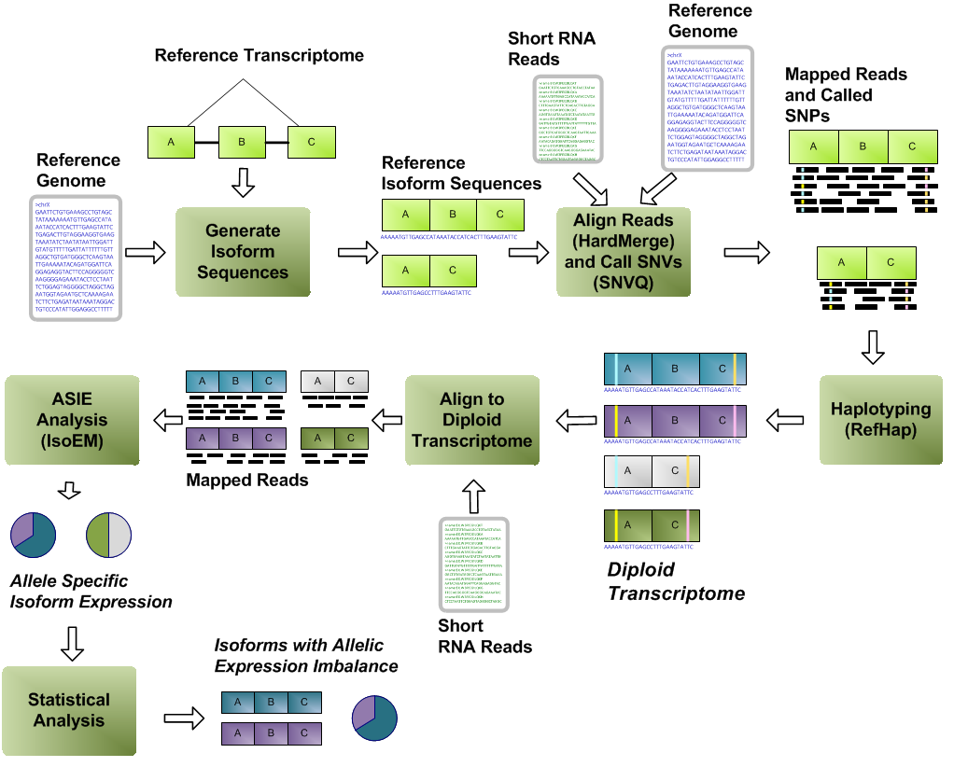

Pipeline for ASIE from RNA-Seq Reads

Slide 7
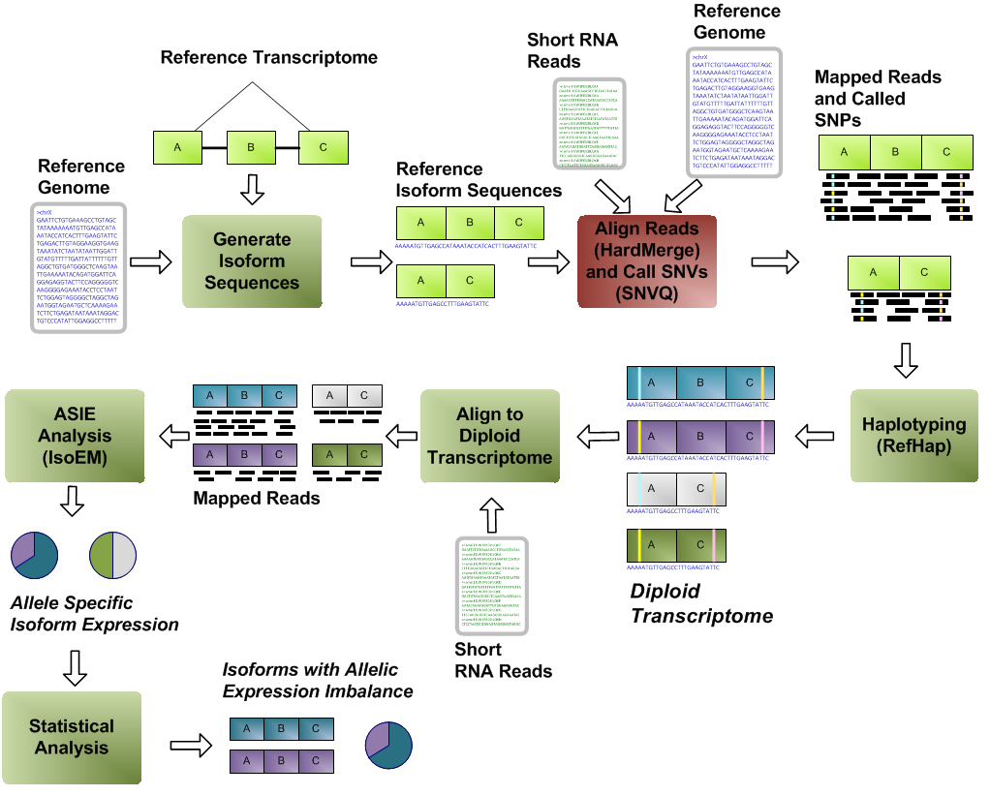
Pipeline for ASIE from RNA-Seq Reads

Slide 8
Hybrid Approach Based on Merging Alignments
Transcript Library
Mapping
Transcript mapped reads
mRNA reads
Read Merging
Mapped reads
Genome Mapping
Genome mapped reads

Slide 9
Merging Rules for Short Reads
Genome | Transcripts | Agree? | Hard Merge
Unique | Unique | Yes | Keep
Unique | Unique | No | Throw
Unique | Multiple | No | Throw
Unique | Not Mapped | No | Keep
Multiple | Unique | No | Throw
Multiple | Multiple | No | Throw
Multiple | Not Mapped | No | Throw
Not mapped | Unique | No | Keep
Not mapped | Multiple | No | Throw
Not mapped | Not Mapped | Yes | Throw

Slide 10
Merging Local Alignments of ION Reads: HardMerge at Base-Level
Input: SAM files with alignments from genome and transcriptome mapping
The following alignments are filtered out
Any local alignments of length <= 15 bases
All alignments of read that has alignments on different chromosomes or different strands
Key idea: a read base mapped to multiple locations is discarded
Output alignments are generated from contiguous stretches of non-ambiguously mapped bases, based on the unique genomic location of these bases
Subject to the above filtering criteria

Slide 11
HardMerge Example
Input alignments in genome coordinates:
Filter multiple local alignments/sub-alignments
Output alignment:

Slide 12
SNV Detection and Genotyping
J. Duitama and P.K. Srivastava and I.I. Mandoiu, Towards Accurate Detection and Genotyping of Expressed Variants from Whole Transcriptome Sequencing Data, BMC Genomics 13(Suppl 2):S6, 2012
A reliable hybrid mapping strategy
Bayesian model for SNV detection based on quality scores

Slide 13
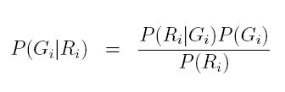

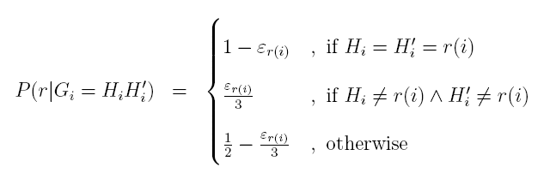
SNVQ Model
Calculate conditional probabilities by multiplying contributions of individual reads

Slide 14
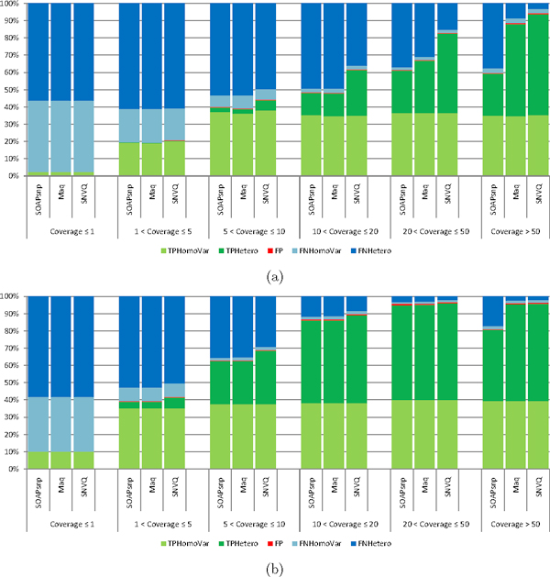
Accuracy per Coverage Bins

Slide 15
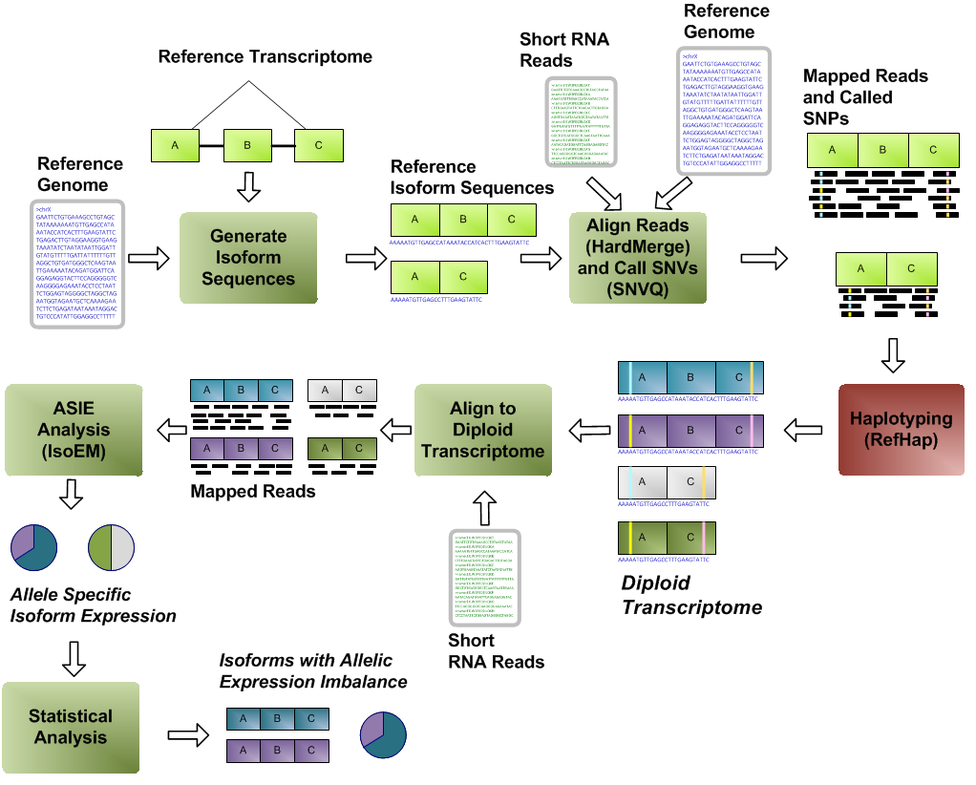
Pipeline for ASIE from RNA-Seq Reads

Slide 16
ReFHap
J. Duitama and T. Huebsch and G. McEwen and E. Suk and M.R. Hoehe, ReFHap: A Reliable and Fast Algorithm for Single Individual Haplotyping, Proc. 1st ACM Intl. Conf. on Bioinformatics and Computational Biology, pp. 160-169, 2010
Problem Formulation
Alleles for each locus are encoded with 0 and 1
Fragment: Aligned read showing coocurrance of two or more alleles in the same chromosome copy
Locus | 1 | 2 | 3 | 4 | 5 | 6 | 7 | 8 | 9 | ...
f | - | 0 | 1 | 1 | - | 1 | - | 0 | 0 | ...

Slide 17
Problem Formulation
Input: Matrix M of m fragments covering n loci
Locus | 1 | 2 | 3 | 4 | 5 | ... | n
f₁ | 1 | 1 | 0 | - | 1 |  | -
f₂ | - | 0 | 1 | 0 | 0 |  | 1
f₃ | - | 0 | 0 | 0 | 1 |  | -
...
f_{m} | - | - | - | - | 1 |  | 0

Slide 18
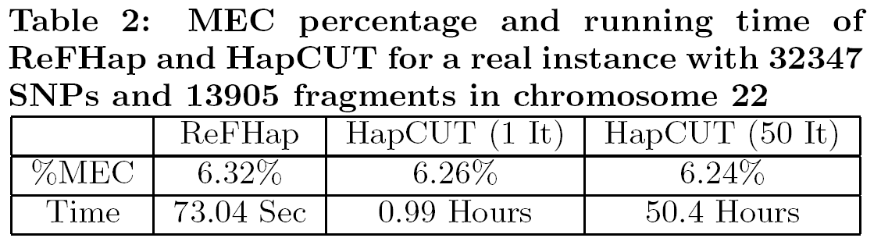
ReFHap vs HapCUT

Slide 19
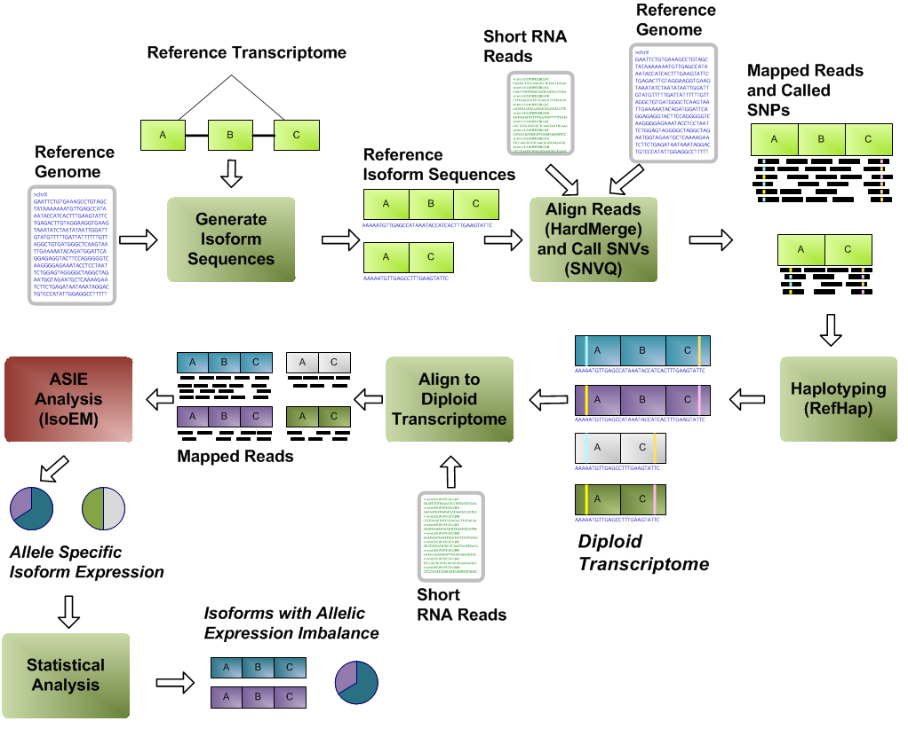
Pipeline for ASIE from RNA-Seq Reads

Slide 20

IsoEM: Isoform Expression Level Estimation
Expectation-Maximization algorithm
Unified probabilistic model incorporating
Single and/or paired reads
Fragment length distribution
Strand information
Base quality scores
Repeat and hexamer bias correction

Slide 21
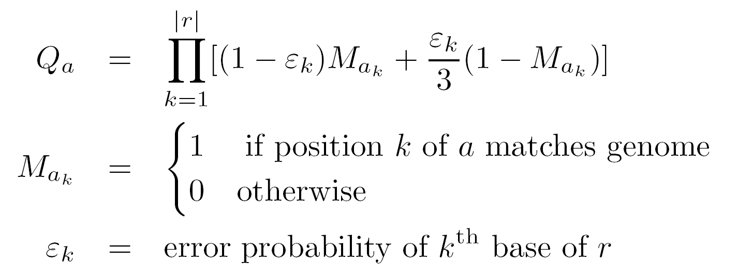
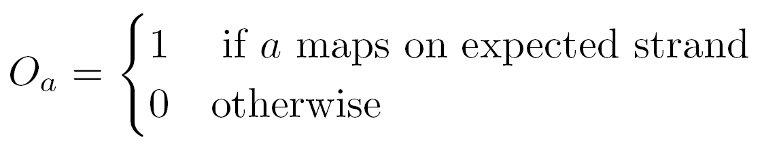
Read-isoform compatibility

Slide 22
Fragment length distribution
Paired reads
F_{a}(i)
i
A
A
A
B
B
B
C
C
C
j
A
A
A
C
C
C
F_{a} (j)

Slide 23
IsoEM vs. Cufflinks 1.0.3 on ION reads

Slide 24
Simplified Pipeline for ASIE in F1 Hybrids

Slide 25
Whole Brain RNA-Seq Data - Sanger Institute Mouse Genomes Project

Slide 26
Hybrid | C57BL IE | Strain IE | C57BL GE | Strain GE
C57BLxStrain | Pearson | Pearson | Pearson | Pearson
C57BLxSPRET | 0.952 | 0.726 | 0.951 | 0.725
C57BLxBALBc | 0.705 | 0.675 | 0.706 | 0.675
C57BLxAJ | 0.855 | 0.902 | 0.856 | 0.903
C57BLxCAST | 0.872 | 0.824 | 0.924 | 0.882
C57BLxSPRET | 0.952 | 0.726 | 0.951 | 0.725
Correlation between FPKM values, for each strain, inferred from the separate strain RNA-Seq Read vs. the pooled read of the two strains (synthetic hybrid)

Slide 27
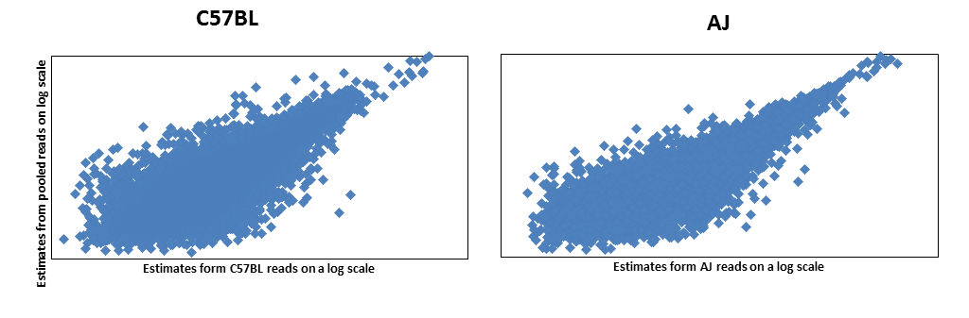
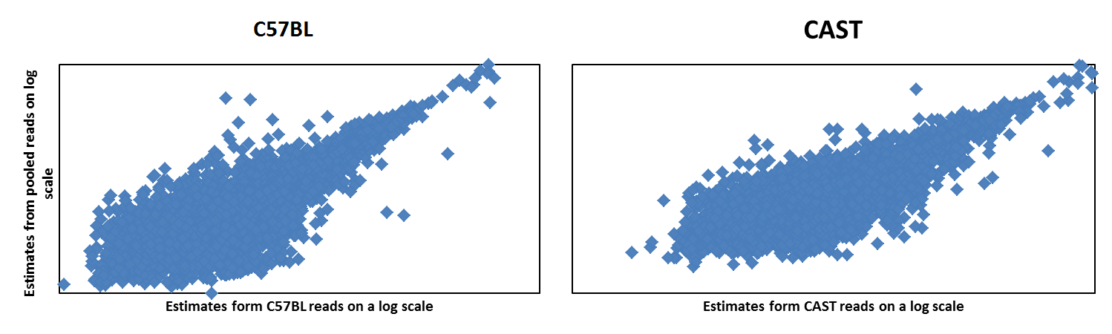
Allele Specific Isoform Expression for Synthetic Hybrid C57BLxAJ
R² = 0.73
R² = 0.81
Correlation between FPKM values, for each strain, inferred from the separate
strain RNA-Seq Read vs. the pooled read of the two strains (synthetic hybrid)

Slide 28
Allele Specific Isoform Expression for Synthetic Hybrid C57BLxCAST
R² = 0.76
R² = 0.68
Correlation between FPKM values, for each strain, inferred from the separate
strain RNA-Seq Read vs. the pooled read of the two strains (synthetic hybrid)

Slide 29
Allele Specific Expression on Drosophila RNA-Seq data from [McManus et al. 10]

Slide 30
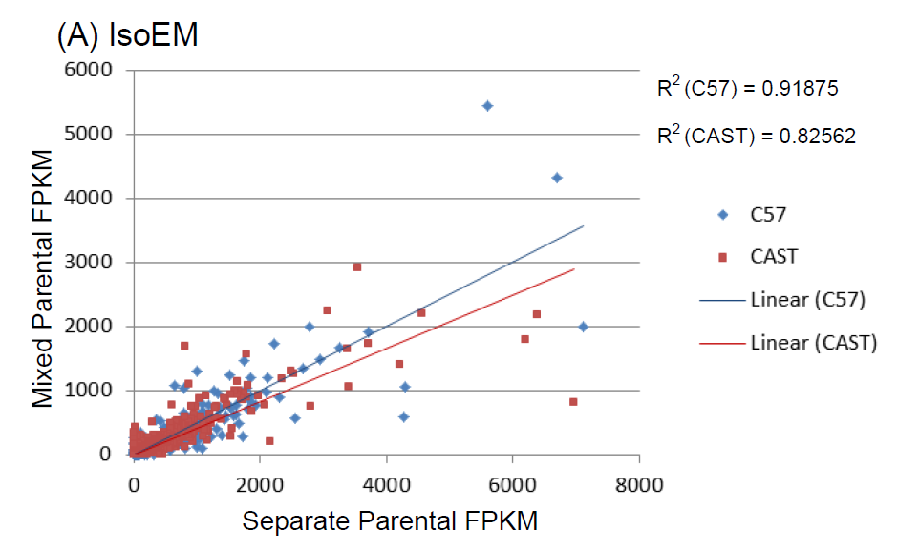
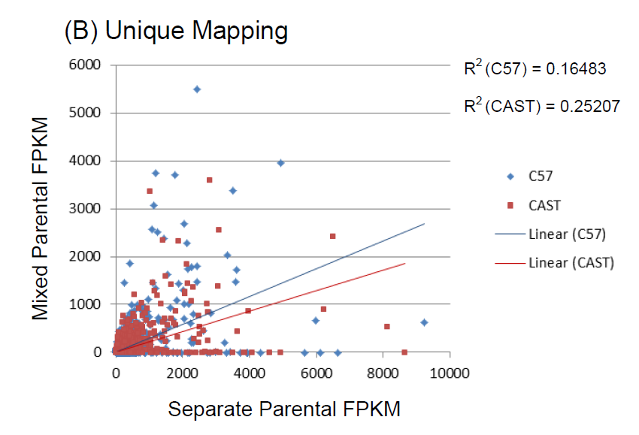
Allele Specific Expression for Mouse RNA-Seq Data from [Gregg et al. 2010]

Slide 31
Conclusion
Proposed novel RNA-Seq analysis pipeline
Reconstructs diploid transcriptome
Not affected by mapping bias towards reference allele
Estimation of allele specific expression levels of isoforms
Robust estimation based on all reads

Slide 32
What’s Next?
Test whole pipeline
Use read coverage information SNVs along with max cut sizes in RefHap to phase isolated SNPs
Incorporate flowgram data, when available, in SNV detection
Deploy on Galaxy
Develop ASIE plugin for ION Torrent

Slide 33


Acknowledgments
Ion Mandoiu (Uconn)
Jorge Duitama (KU Leuven)
Marius Nicolae (Uconn)
Alex Zelikovsky (GSU)
Serghei Mangul (GSU)
Adrian Caciula (GSU)
Dumitru Brinza (Life Tech)
Pramod Srivastava (UCHC)

