Slide 1



Supercomputing in Plain English Instruction Level Parallelism
Henry Neeman, Director
OU Supercomputing Center for Education & Research
University of Oklahoma Information Technology
Tuesday February 22 2011

Slide 2
This is an experiment!
It’s the nature of these kinds of videoconferences that FAILURES ARE GUARANTEED TO HAPPEN! NO PROMISES!
So, please bear with us. Hopefully everything will work out well enough.
If you lose your connection, you can retry the same kind of connection, or try connecting another way.
Remember, if all else fails, you always have the toll free phone bridge to fall back on.

Slide 3
Access Grid
If you aren’t sure whether you have AG, you probably don’t.
Tue Feb 22 | Optiverse
Tue March 1 | Walkabout
Tue March 8 | NO WORKSHOP
Tue March 15 | NO WORKSHOP
Tue March 22 | Axon
Tue March 29 | NO WORKSHOP
Tue Apr 5 | Axon
Tue Apr 12 | Platinum
Tue Apr 19 | Mosaic
Tue Apr 26 | Monte Carlo
Tue May 3 | Helium
Many thanks to Patrick Calhoun of OU for setting these up for us.

Slide 4
H.323 (Polycom etc)
From an H.323 device (e.g., Polycom, Tandberg, Lifesize, etc):
If you ARE already registered with the OneNet gatekeeper: Dial 2500409
If you AREN'T registered with the OneNet gatekeeper (probably the case):
Dial: 164.58.250.47
Bring up the virtual keypad. On some H.323 devices, you can bring up the virtual keypad by typing: #
When asked for the conference ID, enter: 0409
On some H.323 devices, you indicate the end of conference ID with: #
Many thanks to Roger Holder and OneNet for providing this.

Slide 5
H.323 from Internet Explorer
From a Windows PC running Internet Explorer:
You MUST have the ability to install software on the PC (or have someone install it for you).
Download and install the latest Java Runtime Environment (JRE) from here: http://www.oracle.com/technetwork/java/javase/downloads/ (Click on the Java Download icon, because that install package includes both the JRE and other components.)
Download and install this video decoder: http://164.58.250.47/codian_video_decoder.msi
Start Internet Explorer.
Copy-and-paste this URL into your IE window: http://164.58.250.47/
When that webpage loads, in the upper left, click on “Streaming.”
In the textbox labeled Sign-in Name, type your name.
In the textbox labeled Conference ID, type this: 0409
Click on “Stream this conference.”
When that webpage loads, you may see, at the very top, a bar offering you options. If so, click on it and choose “Install this add-on.”

Slide 6
H.323 from XMeeting (MacOS)
From a Mac running MacOS X:
Download XMeeting from http://xmeeting.sourceforge.net/
Install XMeeting as follows:
Open the .dmg file.
Drag XMeeting into the Applications folder.
Open XMeeting from Applications.
Skip the setup wizard.
In the call box, type 164.58.250.47
Click the Call button.
From the Remote Control window, when prompted to join the conference, enter : 0409#

Slide 7
EVO
There’s a quick tutorial on the OSCER education webpage.

Slide 8
QuickTime Broadcaster
If you cannot connect via the Access Grid, H.323 or iLinc, then you can connect via QuickTime:
rtsp://129.15.254.141/test_hpc09.sdp
We recommend using QuickTime Player for this, because we’ve tested it successfully.
We recommend upgrading to the latest version at:
http://www.apple.com/quicktime/
When you run QuickTime Player, traverse the menus
File -> Open URL
Then paste in the rstp URL into the textbox, and click OK.
Many thanks to Kevin Blake of OU for setting up QuickTime Broadcaster for us.

Slide 9
WebEx
We have only a limited number of WebEx connections, so please avoid WebEx unless you have NO OTHER WAY TO CONNECT.
Instructions are available on the OSCER education webpage.
Thanks to Tim Miller of Wake Forest U.

Slide 10
Phone Bridge
If all else fails, you can call into our toll free phone bridge:
1-866-285-7778, access code 6483137#
Please mute yourself and use the phone to listen.
Don’t worry, we’ll call out slide numbers as we go.
Please use the phone bridge ONLY if you cannot connect any other way: the phone bridge is charged per connection per minute, so our preference is to minimize the number of connections.
Many thanks to Amy Apon and U Arkansas for providing the toll free phone bridge.

Slide 11
Please Mute Yourself
No matter how you connect, please mute yourself, so that we cannot hear you.
At OU, we will turn off the sound on all conferencing technologies.
That way, we won’t have problems with echo cancellation.
Of course, that means we cannot hear questions.
So for questions, you’ll need to send some kind of text.

Slide 12
Questions via Text: iLinc or E-mail
Ask questions via e-mail to sipe2011@yahoo.com.
All questions will be read out loud and then answered out loud.

Slide 13
Thanks for helping!
OSCER operations staff (Brandon George, Dave Akin, Brett Zimmerman, Josh Alexander)
Horst Severini, OSCER Associate Director for Remote & Heterogeneous Computing
OU Research Campus staff (Patrick Calhoun, Mark McAvoy)
Kevin Blake, OU IT (videographer)
John Chapman, Jeff Pummill and Amy Apon, U Arkansas
James Deaton and Roger Holder, OneNet
Tim Miller, Wake Forest U
Jamie Hegarty Schwettmann, i11 Industries

Slide 14
This is an experiment!
It’s the nature of these kinds of videoconferences that FAILURES ARE GUARANTEED TO HAPPEN! NO PROMISES!
So, please bear with us. Hopefully everything will work out well enough.
If you lose your connection, you can retry the same kind of connection, or try connecting another way.
Remember, if all else fails, you always have the toll free phone bridge to fall back on.

Slide 15
Supercomputing Exercises
Want to do the “Supercomputing in Plain English” exercises?
The first exercise is already posted at:
http://www.oscer.ou.edu/education.php
If you don’t yet have a supercomputer account, you can get a temporary account, just for the “Supercomputing in Plain English” exercises, by sending e-mail to:
hneeman@ou.edu
Please note that this account is for doing the exercises only, and will be shut down at the end of the series.
This week’s Tiling exercise will give you experience optimizing performance by finding the best tile size.

Slide 16
Outline
What is Instruction-Level Parallelism?
Scalar Operation
Loops
Pipelining
Loop Performance
Superpipelining
Vectors
A Real Example

Slide 17
Parallelism
Parallelism means doing multiple things at the same time: You can get more work done in the same time.
Less fish …
More fish!

Slide 18
What Is ILP?
Instruction-Level Parallelism (ILP) is a set of techniques for executing multiple instructions at the same time within the same CPU core.
(Note that ILP has nothing to do with multicore.)
The problem: A CPU core has lots of circuitry, and at any given time, most of it is idle, which is wasteful.
The solution: Have different parts of the CPU core work on different operations at the same time: If the CPU core has the ability to work on 10 operations at a time, then the program can, in principle, run as much as 10 times as fast (although in practice, not quite so much).

Slide 19
DON’T
PANIC!

Slide 20
Why You Shouldn’t Panic
In general, the compiler and the CPU will do most of the heavy lifting for instruction-level parallelism.
BUT:
You need to be aware of ILP, because
how your code is structured affects
how much ILP the compiler and the
CPU can give you.

Slide 21
Kinds of ILP
Superscalar: Perform multiple operations at the same time (for example, simultaneously perform an add, a multiply and a load).
Pipeline: Start performing an operation on one piece of data while finishing the same operation on another piece of data – perform different stages of the same operation on different sets of operands at the same time (like an assembly line).
Superpipeline: A combination of superscalar and pipelining – perform multiple pipelined operations at the same time.
Vector: Load multiple pieces of data into special registers and perform the same operation on all of them at the same time.

Slide 22
What’s an Instruction?
Memory: For example, load a value from a specific address in main memory into a specific register, or store a value from a specific register into a specific address in main memory.
Arithmetic: For example, add two specific registers together and put their sum in a specific register – or subtract, multiply, divide, square root, etc.
Logical: For example, determine whether two registers both contain nonzero values (“AND”).
Branch: Jump from one sequence of instructions to another (for example, function call).
… and so on ….

Slide 23

What’s a Cycle?
You’ve heard people talk about having a 2 GHz processor or a 3 GHz processor or whatever. (For example, consider a laptop with a 1.6 GHz Core 2 Duo.)
Inside every CPU is a little clock that ticks with a fixed frequency.
We call each tick of the CPU clock a clock cycle or a cycle.
So a 2 GHz processor has 2 billion clock cycles per second.
Typically, a primitive operation (for example, add, multiply, divide) takes a fixed number of cycles to execute (assuming no pipelining).

Slide 24
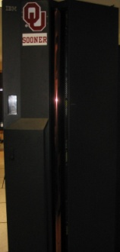
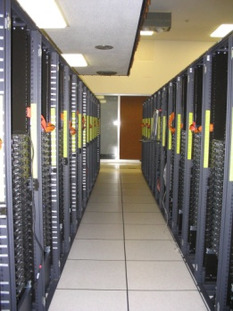
What’s the Relevance of Cycles?
Typically, a primitive operation (for example, add, multiply, divide) takes a fixed number of cycles to execute (assuming no pipelining).
IBM POWER4 ^{[1]}
Multiply or add: 6 cycles (64 bit floating point)
Load: 4 cycles from L1 cache
14 cycles from L2 cache
Intel Pentium4 EM64T (Core) ^{[2]}
Multiply: 7 cycles (64 bit floating point)
Add, subtract: 5 cycles (64 bit floating point)
Divide: 38 cycles (64 bit floating point)
Square root: 39 cycles (64 bit floating point)
Tangent: 240-300 cycles (64 bit floating point)

Slide 25
Scalar Operation

Slide 26
DON’T
PANIC!

Slide 27
Scalar Operation
z = a * b + c * d;
How would this statement be executed?
Load a into register R0
Load b into R1
Multiply R2 = R0 * R1
Load c into R3
Load d into R4
Multiply R5 = R3 * R4
Add R6 = R2 + R5
Store R6 into z

Slide 28
Does Order Matter?
z = a * b + c * d;
Load a into R0
Load b into R1
Multiply R2 = R0 * R1
Load c into R3
Load d into R4
Multiply R5 = R3 * R4
Add R6 = R2 + R5
Store R6 into z
Load d into R0
Load c into R1
Multiply R2 = R0 * R1
Load b into R3
Load a into R4
Multiply R5 = R3 * R4
Add R6 = R2 + R5
Store R6 into z
In the cases where order doesn’t matter, we say that
the operations are independent of one another.

Slide 29
Superscalar Operation
z = a * b + c * d;
Load a into R0 AND
load b into R1
Multiply R2 = R0 * R1 AND
load c into R3 AND
load d into R4
Multiply R5 = R3 * R4
Add R6 = R2 + R5
Store R6 into z
If order doesn’t matter,
then things can happen simultaneously.
So, we go from 8 operations down to 5.
(Note: there are lots of simplifying assumptions here.)

Slide 30
Loops

Slide 31
Loops Are Good
Most compilers are very good at optimizing loops, and not very good at optimizing other constructs.
Why?
DO index = 1, length
dst(index) = src1(index) + src2(index)
END DO
for (index = 0; index < length; index++) {
dst[index] = src1[index] + src2[index];
}

Slide 32
Why Loops Are Good
Loops are very common in many programs.
Also, it’s easier to optimize loops than more arbitrary sequences of instructions: when a program does the same thing over and over, it’s easier to predict what’s likely to happen next.
So, hardware vendors have designed their products to be able to execute loops quickly.

Slide 33
DON’T
PANIC!

Slide 34
Superscalar Loops (C)
for (i = 0; i < length; i++) {
z[i] = a[i] * b[i] + c[i] * d[i];
}
Each of the iterations is completely independent of all of the other iterations; for example,
z[0] = a[0] * b[0] + c[0] * d[0]
has nothing to do with
z[1] = a[1] * b[1] + c[1] * d[1]
Operations that are independent of each other can be performed in parallel.

Slide 35
Superscalar Loops (F90)
DO i = 1, length
z(i) = a(i) * b(i) + c(i) * d(i)
END DO
Each of the iterations is completely independent of all of the other iterations; for example,
z(1) = a(1) * b(1) + c(1) * d(1)
has nothing to do with
z(2) = a(2) * b(2) + c(2) * d(2)
Operations that are independent of each other can be performed in parallel.

Slide 36
Superscalar Loops
for (i = 0; i < length; i++) {
z[i] = a[i] * b[i] + c[i] * d[i];
}
Load a[i] into R0 AND load b[i] into R1
Multiply R2 = R0 * R1 AND load c[i] into R3 AND load d[i] into R4
Multiply R5 = R3 * R4 AND load a[i+1] into R0 AND load b[i+1] into R1
Add R6 = R2 + R5 AND load c[i+1] into R3 AND load d[i+1] into R4
Store R6 into z[i] AND multiply R2 = R0 * R1
etc etc etc
Once this loop is “in flight,” each iteration adds only 2 operations to the total, not 8.

Slide 37
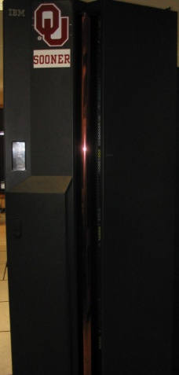
Example: IBM POWER4
8-way Superscalar: can execute up to 8 operations at the same time^{[1]}
2 integer arithmetic or logical operations, and
2 floating point arithmetic operations, and
2 memory access (load or store) operations, and
1 branch operation, and
1 conditional operation

Slide 38
Pipelining

Slide 39
Pipelining
Pipelining is like an assembly line or a bucket brigade.
An operation consists of multiple stages.
After a particular set of operands
z(i) = a(i) * b(i) + c(i) * d(i)
completes a particular stage, they move into the next stage.
Then, another set of operands
z(i+1) = a(i+1) * b(i+1) + c(i+1) * d(i+1)
can move into the stage that was just abandoned by the previous set.

Slide 40
DON’T
PANIC!

Slide 41
Pipelining Example
t = 0
t = 1
t = 2
t = 3
t = 4
t = 5
t = 6
t = 7
Instruction
Fetch
Instruction
Decode
Operand
Fetch
Instruction
Execution
Result
Writeback
i = 1
DON’T PANIC!
Instruction
Fetch
Instruction
Decode
Operand
Fetch
Instruction
Execution
Result
Writeback
i = 2
i = 3
Instruction
Fetch
Instruction
Decode
Operand
Fetch
Instruction
Execution
Result
Writeback
DON’T PANIC!
i = 4
Instruction
Fetch
Instruction
Decode
Operand
Fetch
Instruction
Execution
Result
Writeback
Computation time
If each stage takes, say, one CPU cycle, then once the loop gets going, each iteration of the loop increases the total time by only one cycle. So a loop of length 1000 takes only 1004 cycles. ^{[3]}

Slide 42
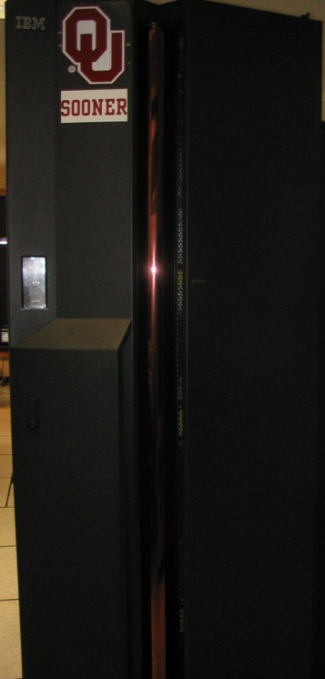
Pipelines: Example
IBM POWER4: pipeline length ≅ 15 stages ^{[1]}

Slide 43
Some Simple Loops (F90)
DO index = 1, length
dst(index) = src1(index) + src2(index)
END DO
DO index = 1, length
dst(index) = src1(index) - src2(index)
END DO
DO index = 1, length
dst(index) = src1(index) * src2(index)
END DO
DO index = 1, length
dst(index) = src1(index) / src2(index)
END DO
DO index = 1, length
sum = sum + src(index)
END DO
Reduction: convert
array to scalar

Slide 44
Some Simple Loops (C)
for (index = 0; index < length; index++) {
dst[index] = src1[index] + src2[index];
}
for (index = 0; index < length; index++) {
dst[index] = src1[index] - src2[index];
}
for (index = 0; index < length; index++) {
dst[index] = src1[index] * src2[index];
}
for (index = 0; index < length; index++) {
dst[index] = src1[index] / src2[index];
}
for (index = 0; index < length; index++) {
sum = sum + src[index];
}

Slide 45
Slightly Less Simple Loops (F90)
DO index = 1, length
dst(index) = src1(index) ** src2(index) !! src1 ^ src2
END DO
DO index = 1, length
dst(index) = MOD(src1(index), src2(index))
END DO
DO index = 1, length
dst(index) = SQRT(src(index))
END DO
DO index = 1, length
dst(index) = COS(src(index))
END DO
DO index = 1, length
dst(index) = EXP(src(index))
END DO
DO index = 1, length
dst(index) = LOG(src(index))
END DO

Slide 46
Slightly Less Simple Loops (C)
for (index = 0; index < length; index++) {
dst[index] = pow(src1[index], src2[index]);
}
for (index = 0; index < length; index++) {
dst[index] = src1[index] % src2[index];
}
for (index = 0; index < length; index++) {
dst[index] = sqrt(src[index]);
}
for (index = 0; index < length; index++) {
dst[index] = cos(src[index]);
}
for (index = 0; index < length; index++) {
dst[index] = exp(src[index]);
}
for (index = 0; index < length; index++) {
dst[index] = log(src[index]);
}

Slide 47
Loop Performance

Slide 48
Performance Characteristics
Different operations take different amounts of time.
Different processor types have different performance characteristics, but there are some characteristics that many platforms have in common.
Different compilers, even on the same hardware, perform differently.
On some processors, floating point and integer speeds are similar, while on others they differ.

Slide 49
Arithmetic Operation Speeds
Better

Slide 50
Fast and Slow Operations
Fast: sum, add, subtract, multiply
Medium: divide, mod (that is, remainder)
Slow: transcendental functions (sqrt, sin, exp)
Incredibly slow: power x^{y} for real x and y
On most platforms, divide, mod and transcendental functions are not pipelined, so a code will run faster if most of it is just adds, subtracts and multiplies.
For example, solving an N x N system of linear equations by LU decomposition uses on the order of N³ additions and multiplications, but only on the order of N divisions.

Slide 51
What Can Prevent Pipelining?
Certain events make it very hard (maybe even impossible) for compilers to pipeline a loop, such as:
array elements accessed in random order
loop body too complicated
if statements inside the loop (on some platforms)
premature loop exits
function/subroutine calls
I/O

Slide 52
How Do They Kill Pipelining?
Random access order: Ordered array access is common, so pipelining hardware and compilers tend to be designed under the assumption that most loops will be ordered. Also, the pipeline will constantly stall because data will come from main memory, not cache.
Complicated loop body: The compiler gets too overwhelmed and can’t figure out how to schedule the instructions.

Slide 53
How Do They Kill Pipelining?
if statements in the loop: On some platforms (but not all), the pipelines need to perform exactly the same operations over and over; if statements make that impossible.
However, many CPUs can now perform speculative execution: both branches of the if statement are executed while the condition is being evaluated, but only one of the results is retained (the one associated with the condition’s value).
Also, many CPUs can now perform branch prediction to head down the most likely compute path.

Slide 54
How Do They Kill Pipelining?
Function/subroutine calls interrupt the flow of the program even more than if statements. They can take execution to a completely different part of the program, and pipelines aren’t set up to handle that.
Loop exits are similar. Most compilers can’t pipeline loops with premature or unpredictable exits.
I/O: Typically, I/O is handled in subroutines (above). Also, I/O instructions can take control of the program away from the CPU (they can give control to I/O devices).

Slide 55
What If No Pipelining?
SLOW!
(on most platforms)

Slide 56
Randomly Permuted Loops
Better

Slide 57
Superpipelining

Slide 58
Superpipelining
Superpipelining is a combination of superscalar and pipelining.
So, a superpipeline is a collection of multiple pipelines that can operate simultaneously.
In other words, several different operations can execute simultaneously, and each of these operations can be broken into stages, each of which is filled all the time.
So you can get multiple operations per CPU cycle.
For example, a IBM Power4 can have over 200 different operations “in flight” at the same time.^{[1]}

Slide 59
More Operations At a Time
If you put more operations into the code for a loop, you can get better performance:
more operations can execute at a time (use more pipelines), and
you get better register/cache reuse.
On most platforms, there’s a limit to how many operations you can put in a loop to increase performance, but that limit varies among platforms, and can be quite large.

Slide 60
Some Complicated Loops
DO index = 1, length
dst(index) = src1(index) + 5.0 * src2(index)
END DO
dot = 0
DO index = 1, length
dot = dot + src1(index) * src2(index)
END DO
DO index = 1, length
dst(index) = src1(index) * src2(index) + &
& src3(index) * src4(index)
END DO
DO index = 1, length
diff12 = src1(index) - src2(index)
diff34 = src3(index) - src4(index)
dst(index) = SQRT(diff12 * diff12 + diff34 * diff34)
END DO
madd (or FMA):
mult then add
(2 ops)
dot product
(2 ops)
from our
example
(3 ops)
Euclidean distance
(6 ops)

Slide 61
A Very Complicated Loop
lot = 0.0
DO index = 1, length
lot = lot + &
& src1(index) * src2(index) + &
& src3(index) * src4(index) + &
& (src1(index) + src2(index)) * &
& (src3(index) + src4(index)) * &
& (src1(index) - src2(index)) * &
& (src3(index) - src4(index)) * &
& (src1(index) - src3(index) + &
& src2(index) - src4(index)) * &
& (src1(index) + src3(index) - &
& src2(index) + src4(index)) + &
& (src1(index) * src3(index)) + &
& (src2(index) * src4(index))
END DO
24 arithmetic ops per iteration
4 memory/cache loads per iteration

Slide 62
Multiple Ops Per Iteration
Better

Slide 63
Vectors

Slide 64
What Is a Vector?
A vector is a giant register that behaves like a collection of regular registers, except these registers all simultaneously perform the same operation on multiple sets of operands, producing multiple results.
In a sense, vectors are like operation-specific cache.
A vector register is a register that’s actually made up of many individual registers.
A vector instruction is an instruction that performs the same operation simultaneously on all of the individual registers of a vector register.

Slide 65
Vector Register
v0
v1
v2
<-
+
<-
+
<-
+
<-
+
<-
+
<-
+
<-
+
<-
+
v0 <- v1 + v2

Slide 66

Vectors Are Expensive
Vectors were very popular in the 1980s, because they’re very fast, often faster than pipelines.
In the 1990s, though, they weren’t very popular. Why?
Well, vectors aren’t used by many commercial codes (for example, MS Word). So most chip makers didn’t bother with vectors.
So, if you wanted vectors, you had to pay a lot of extra money for them.
The Pentium III Intel reintroduced very small integer vectors (2 operations at a time),. The Pentium4 added floating point vector operations, also of size 2. The Core family has doubled the vector size to 4, and Sandy Bridge (2011) to 8.

Slide 67
A Real Example

Slide 68
A Real Example^{[4]}
DO k=2,nz-1
DO j=2,ny-1
DO i=2,nx-1
tem1(i,j,k) = u(i,j,k,2)*(u(i+1,j,k,2)-u(i-1,j,k,2))*dxinv2
tem2(i,j,k) = v(i,j,k,2)*(u(i,j+1,k,2)-u(i,j-1,k,2))*dyinv2
tem3(i,j,k) = w(i,j,k,2)*(u(i,j,k+1,2)-u(i,j,k-1,2))*dzinv2
END DO
END DO
END DO
DO k=2,nz-1
DO j=2,ny-1
DO i=2,nx-1
u(i,j,k,3) = u(i,j,k,1) - &
& dtbig2*(tem1(i,j,k)+tem2(i,j,k)+tem3(i,j,k))
END DO
END DO
END DO
. . .

Slide 69
Real Example Performance
Better

Slide 70
DON’T
PANIC!

Slide 71
Why You Shouldn’t Panic
In general, the compiler and the CPU will do most of the heavy lifting for instruction-level parallelism.
BUT:
You need to be aware of ILP, because
how your code is structured affects
how much ILP the compiler and the
CPU can give you.

Slide 72
Summer Workshops 2011
In Summer 2011, there will be several workshops on HPC and Computational and Data Enabled Science and Engineering (CDESE) across the US.
These will be weeklong intensives, running from Sunday evening through Saturday morning.
We’re currently working on where and when those workshops will be held.
Once we’ve got that worked out, we’ll announce them and open up the registration website.
One of them will be held at OU.

Slide 73
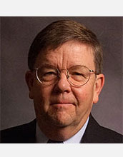

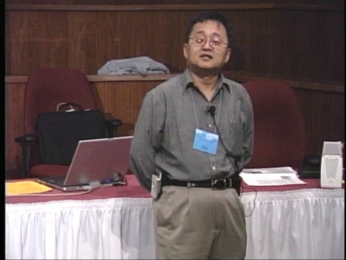
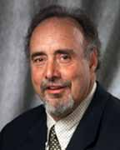

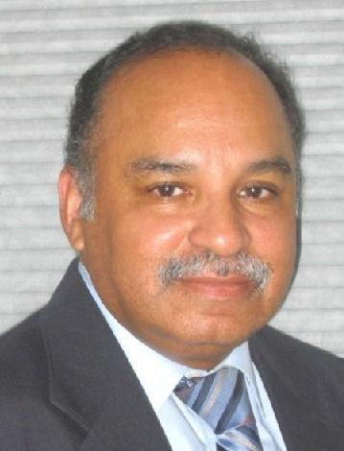
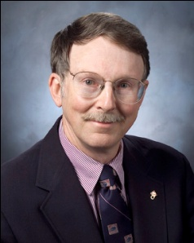
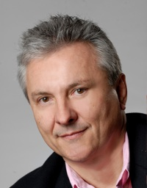
OK Supercomputing Symposium 2011
2003 Keynote:
Peter Freeman
NSF
Computer & Information
Science & Engineering
Assistant Director
2004 Keynote:
Sangtae Kim
NSF Shared
Cyberinfrastructure
Division Director
2005 Keynote:
Walt Brooks
NASA Advanced
Supercomputing
Division Director
2006 Keynote:
Dan Atkins
Head of NSF’s
Office of
Cyberinfrastructure
2007 Keynote:
Jay Boisseau
Director
Texas Advanced
Computing Center
U. Texas Austin
2008 Keynote: José Munoz Deputy Office Director/ Senior Scientific Advisor NSF Office of Cyberinfrastructure
?
FREE! Wed Oct 12 2011 @ OU
Over 235 registratons already!
Over 150 in the first day, over 200 in the first week, over 225 in the first month.
http://symposium2011.oscer.ou.edu/
Parallel Programming Workshop FREE! Tue Oct 11 2011 @ OU
FREE! Symposium Wed Oct 12 2011 @ OU
2009 Keynote: Douglass Post Chief Scientist US Dept of Defense HPC Modernization Program
2010 Keynote: Horst Simon Deputy Director Lawrence Berkeley National Laboratory
2011 Keynote to be announced

Slide 74
SC11 Education Program
At the SC11 supercomputing conference, we’ll hold our annual Education Program, Sat Nov 12 – Tue Nov 15.
You can apply to attend, either fully funded by SC11 or self-funded.
Henry is the SC11 Education Chair.
We’ll alert everyone once the registration website opens.

Slide 75
Thanks for your attention! Questions? www.oscer.ou.edu

Slide 76
References
[1] Steve Behling et al, The POWER4 Processor Introduction and Tuning Guide, IBM, 2001.
[2] Intel® 64 and IA-32 Architectures Optimization Reference Manual, Order Number: 248966-015, May 2007.
http://www.intel.com/design/processor/manuals/248966.pdf
[3] Kevin Dowd and Charles Severance, High Performance Computing,
2nd ed. O’Reilly, 1998.
[4] Code courtesy of Dan Weber, 2001.

