Slide 1

Computer Aided Programming
the Next Frontier

Slide 2
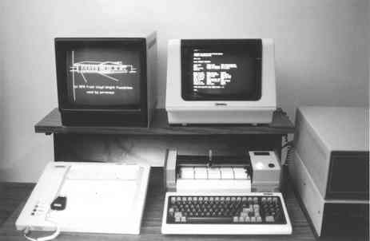
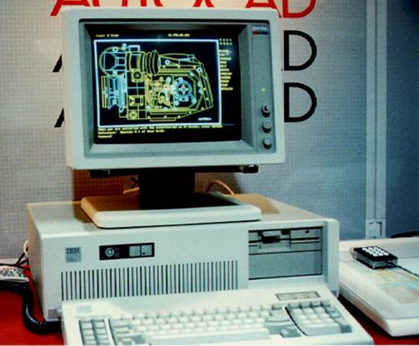
A Brief History of CAD
1960-1980s
Design organization and management
Modularity and Reusability
“Compilation”
Interface Checking
1990s
Push-Button Design Validation
2000s
Design Synthesis and Optimization

Slide 3
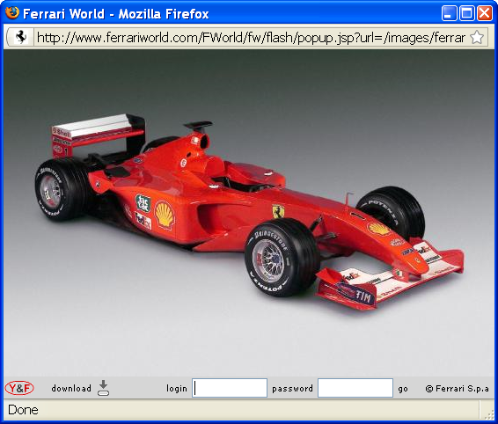
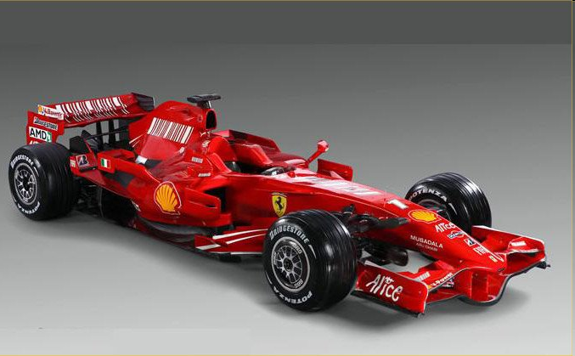
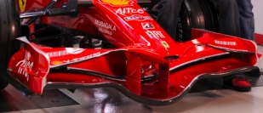
Synthesis in CAD
2000
2008

Slide 4

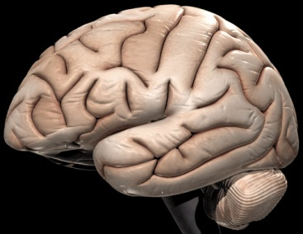
Human / Machine Collaboration
Computer Aided Engineering is a combination of techniques in which man and machine are blended into a problem solving team, intimately coupling the best characteristics of each.
S.A. Meguid 1986
Integrated Computer-aided Design of Mechanical Systems

Slide 5
Computer Aided Programming
Make programming easier
by leveraging programmer insight
and combining it with large amounts of computing power
Going beyond validation
The next frontier is software synthesis

Slide 6
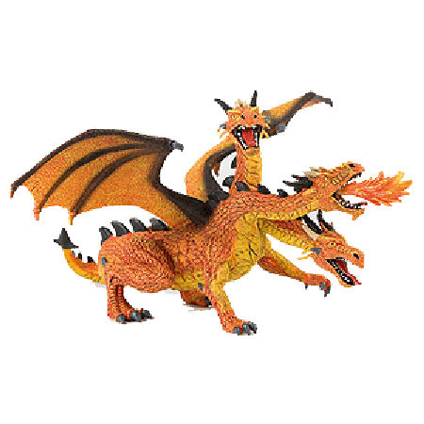
CAP In Action
Conquering the challenges that make programming difficult
Complex Algorithms
Massive Code Bases
Unpredictable Environments

Slide 7
CAP In Action
Storyboard Programming
turning graphical insights into code
with Rishabh Singh
MatchMaker
a case study in data driven synthesis
with Zhilei Xu and Kuat Yassenov
Specification-based Hardening
using symbolic reasoning to make programs more robust
with Jean Yang

Slide 8
Storyboard Programming

Slide 9
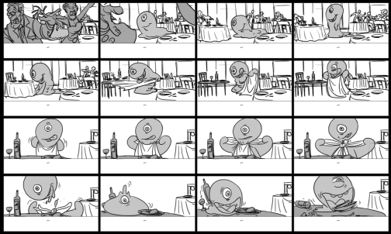
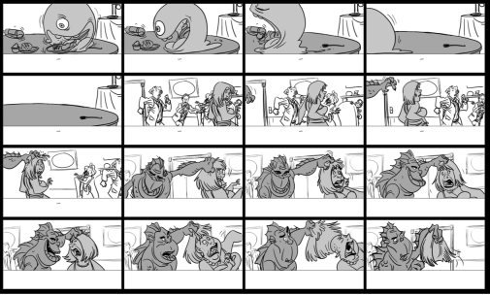
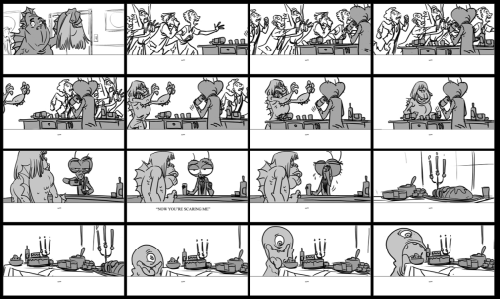
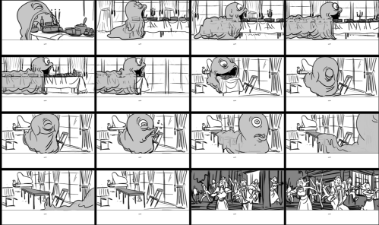
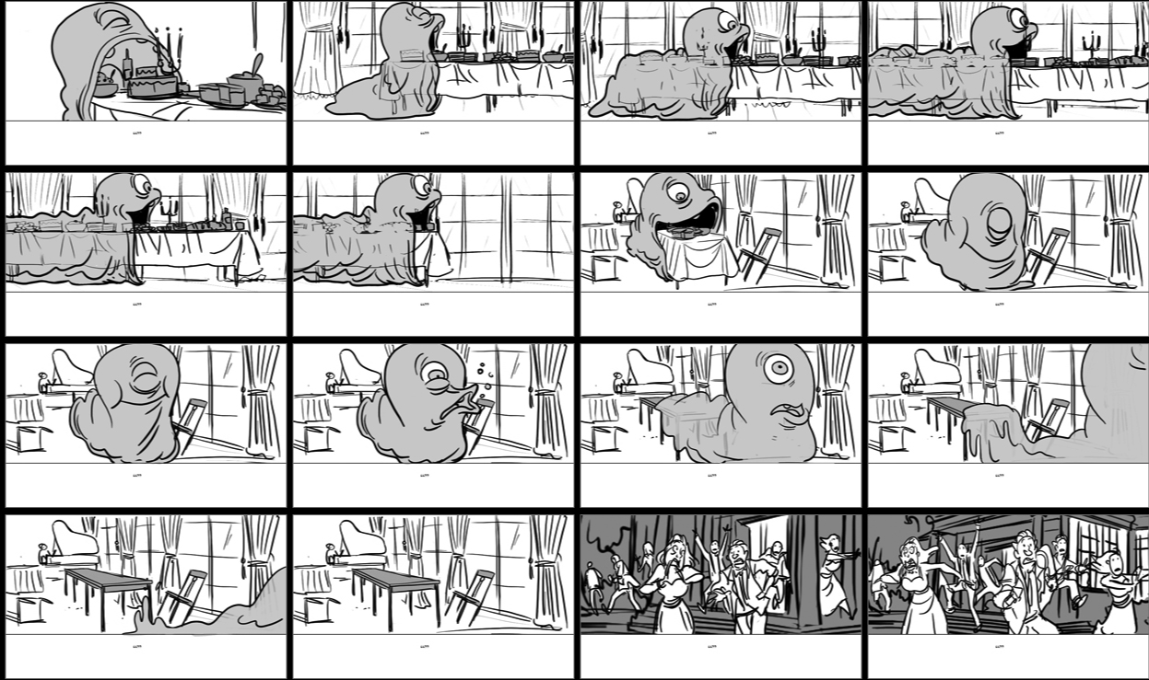

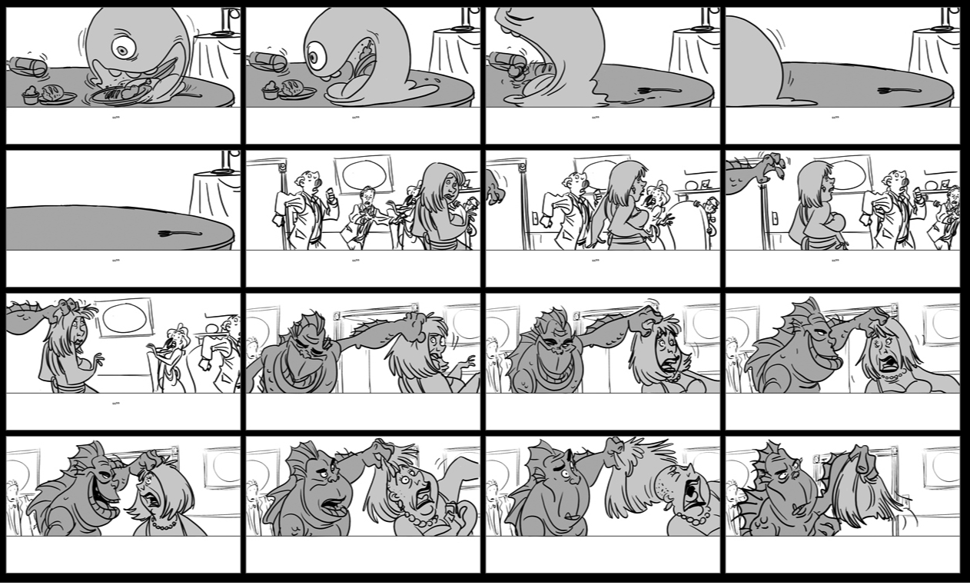

Storyboard Programming
© Nassos Vakalis

Slide 10
Storyboard Programming
head
x
head
x
head
x
head
x
front
a
b
back
front
a
b
back
head
head
head
head
front
a
x
b
back
front
a
x
x
b
back
x
void insert(List l, Node x){
Node head = l.head;
Node cur = head, prev = null;
while(cur != null && cur.val < x){
prev = cur;
cur = cur.next;
}
if(head == null) head = x;
if(prev != null) prev.next = x;
x.next = cur;
}
x
void insert(List l, Node x){
Node head = l.head;
Node cur, prev;
...
while(...){
...
}
...
}
head
head
head
head
x
x
x
front
front
a
b
a
b
back
back
head
head
head
head
front
front
a
x
x
a
b
x
x
back
b
back

Slide 11
How do we make this real
Give semantic meaning to the storyboard
storyboard is the link between synthesizer and user
storyboard is a specification
storyboard focuses on what is important
Algorithm must exploit storyboard insight
turn the insights of the storyboard into an abstract domain
synthesis algorithm must be able to exploit abstraction
Saurabh and Sumit have showed us how to do this!
Expand expressiveness and scalability
some problems are too hard to solve in one shot
even with abstraction
how do we express inductive insight?

Slide 12
Anatomy of a Storyboard
Environment
Env{
Node head, prev, curr;
[Node] a, b, x;
[[Node]] front, back ;
front.next = { front, a};
back.next = {back, null};
assert front < a < x < b < back;
}
head
x
head
front
a
b
back
head
head
front
a
x
b
back

Slide 13
Anatomy of a Storyboard
Scenario
Start {
head = front;
a.next = b;
b.next = back;
}
End{
head = front;
a.next = x;
x.next = b;
b.next = back;
}
head
x
front
a
b
back
head
front
a
x
b
back

Slide 14
Storyboard ➔ Abstract Domain
Scenario
Start {
head = front;
a.next = b;
b.next = back;
}
End{
head = front;
a.next = x;
x.next = b;
b.next = back;
}
Predicate Abstraction
head = { , }
a.next = { , , }
b.next = { , }
x.next = { , }
cur = { }
prev = { }
front
b
x
back
b
front
a
x
b
back
front
a
x
b
back

Slide 15
Synthesis with Abstract Interpretation
t_{in}
void insert(List l, Node x){
Node head = l.head;
Node cur, prev;
f₁
while(f_{p}){
f₂
}
f₃
}
f₁
t₁
f₂
false
f_{p}
true
t₃
t₂
f₃
t_{out}

Slide 16





Synthesis with Abstract Interpretation
t_{in}
f₁
t₁
f₂
false
f_{p}
true
t₃
t₂
f₃
t_{out}
Basic Satisfiability Query
We don’t care for the least fixed point

Slide 17
Does this work?
Benchmark | | Program Space| | Abstract States | Synthesis Time
Linked List insertion | 5 * 10¹⁵ | 249 | 6m08s
Linked List deletion | 5 * 10¹⁵ | 249 | 5m46s
Binary Search Tree insertion | 9*10²⁵ | 211 | 2m32s
Great for “Scan & Modify” manipulations
More complex operations require additional machinery

Slide 18
Adding Inductive Invariants
head
List reverse(List l){
Node head = l.head;
Node t1, t2, t3;
...
while(...){
...
}
...
return l;
}
Start:
a
mid
z
head
End:
a
mid
z
a
mid
=
Unfold( )
mid
Fold( ) =
Fold( ) =
a
mid
mid
a
a
mid

Slide 19
Challenge
Set of abstract states can get really big
synthesis in “one shot” no longer an option
Counterexample Guided Inductive Synthesis
candidate implementation
succeed
Inductive Synthesizer
Automated Validation
Derive candidate implementation from concrete inputs.
fail
ok
buggy
Your verifier/checker goes here
fail
counterexample input
observation set E
Validation is now abstract interpretation

Slide 20
CEGIS + Abstraction
t_{in}
Inductive synthesis over traces
f₁
t₁
f₂
false
f_{p}
true
t₃
t₂
f₃
t_{out}

Slide 21
Take home points
Need intuitive mechanisms for providing insight
storyboards are a great mechanism for this
Easier to write abstractions than programs
provided you have the right tools

Slide 22
Matchmaker
A data driven approach to Synthesis

Slide 23
The problem with scale
OO Frameworks revolutionized programming
designed around flexibility and extensibility
Overall this was a good thing
facilitates reuse
new applications deliver rich functionality with little new code
But, there were unintended consequences
functionality is atomized into very small methods
proliferation of classes and interfaces
“Ravioli” code

Slide 24
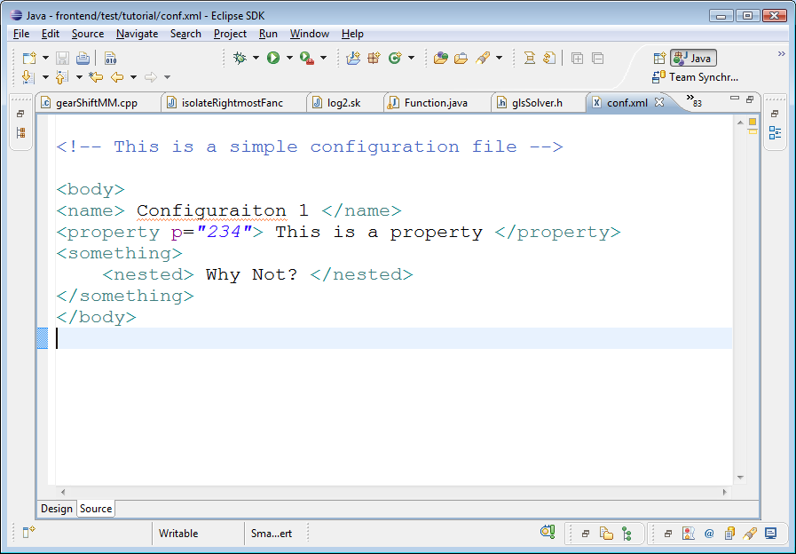
Example: Eclipse Syntax Highlighting
Different lexical elements highlighted in different colors
comment
tag
string
If we create an editor for our own language
How do we get it to do this?

Slide 25
What we know
TextEditor
ITokenScanner
SkEditor
SkScanner
TextEditor.setTokenScanner( );

Slide 26
How do editors and Scanners Meet?
DefaultDamagerRepairer dr =new DefaultDamagerRepairer(new SkScanner());
PresentationReconciler rcr = new PresentationReconciler();
rcr.setDamager(dr, …); rcr.setRepairer(dr, …);
SkEditor
SkScanner
(1)
DamageRepairer
(3)
PresentationReconciler
(2)

Slide 27
How do editors and Scanners Meet?
class SkConfig extends SourceViewerConfiguration {
(4) public IPresentationReconciler getPresentationReconciler(…) {
(1) DefaultDamagerRepairer dr =new DefaultDamagerRepairer(new SkScanner());
(2) PresentationReconciler rcr = new PresentationReconciler();
(1) rcr.setDamager(dr, …); rcr.setRepairer(dr, …);
return rcr;
}
}
class SkConfig extends SourceViewerConfiguration { … }
(5) Constructor of SkEditor must set FooConfig as SourceViewerConfiguration.
SkEditor() { setSourceViewerConfiguration(new SkConfig()); }
DefaultDamagerRepairer dr =new DefaultDamagerRepairer(new SkScanner());
PresentationReconciler rcr = new PresentationReconciler();
rcr.setDamager(dr, …); rcr.setRepairer(dr, …);
SkEditor
SkScanner
(1)
DamageRepairer
SourceViewer
(3)
.config.getPR() (4)
PresentationReconciler
(2)

Slide 28
How do editors and Scanners Meet?
Very complicated!
class SkConfig extends SourceViewerConfiguration { (4)
public getPresentationReconciler(…) {
DefaultDamagerRepairer dr = new DefaultDamagerRepairer(new SkScanner()); (1)
PresentationReconciler rcr = new PresentationReconciler (); (2)
rcr.setDamager(dr, …); rcr.setRepairer(dr, …); (3)
return rcr;
}
}
Class SkEditor extends TextEditor {
SkEditor() {
setSourceViewerConfiguration(new SkConfig()); (5)
}
}
We can synthesize this code!

Slide 29
Standard practice is insufficient
Documentation?
fragmented between descriptions of individual classes.
Tutorial?
good, but there’s few tutorials. Poor coverage
100 classes => 100*100 pairs of classes => 10,000 end-to-end tutorials.
Example code? Test suite code?
good, but not concise
poor understandability.

Slide 30
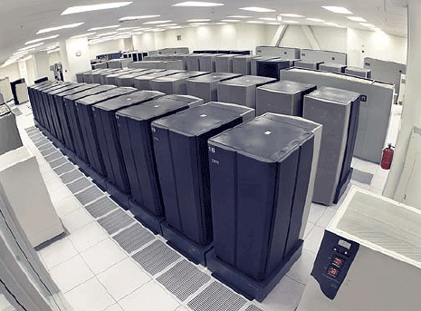
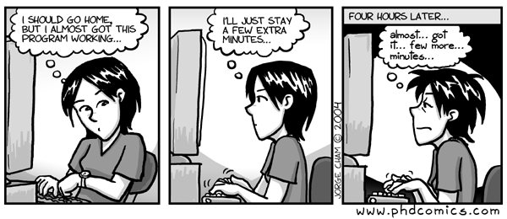
Data Driven Synthesis
Synthesis is a better answer
But how can the synthesizer cope with this complexity
Synthesizer must use data
This is where a lot of the human insight comes from
Program Behavior Database
Interactive Programming Tools

Slide 31
MatchMaker approach
Observation 1:
Interaction between two objects usually requires a chain of references between them.
Critical Chain
SkEditor
SkScanner
Our goal is to find the important code pieces that work together to build the chain

Slide 32
MatchMaker approach
Observation 2:
Often helpful to imitate the behavior of sibling classes.
TextEditor
ITokenScanner
XMLEditor
XMLScanner
SkEditor
SkScanner

Slide 33
MatchMaker approach
Observation 3:
We have data about many runs with many different editors
(A1 ∧ A2) - B
A1 = {Important code for forming critical chain 1}
Trace 1:
XMLEditor
XMLScanner
A2 = {Important code for forming critical chain 2}
Trace 2:
XMLEditor
XMLScanner
B = {All code in this trace, which forms no critical link}
Trace 3:
FooEditor
No Scanner
Notes:
We have multiple traces for the example “XMLEditor” which uses “XMLScanner”. And we have trace in which there’s some “FooEditor”, but without corresponding Scanner.

Slide 34
Database
Currently very rudimentary
Track
method enter/exit,
heap load/store,
class hierarchy.
Many events can be safely ignored
Also contains periodic heap snapshots
Lots of data, but manageable
between 3 and 7 MB per second of real-time execution

Slide 35
How long does this take?
Searching for relevant data could be expensive
but it parallelizes easily
indexing can help a lot
right now our databases are small, so this takes < 30 sec
The rest is easy after the right data is found
finding the critical path takes < 20 sec
building the call tree takes about 30 sec
tree matching takes < 1 sec
Once you have found the relevant block of data in the database

Slide 36
Algorithm
Find critical chain in one trace:
iterate over the snapshots
find the earliest pointer dereference chain from X to Y.
X: object of TextEditor’s subclass
Y: object of ITokenScanner’s subclass
Thin slicing connects critical chain to code
Result is a tree of important calls
Compare trees from many different instances
Search for similarities and differences

Slide 37
Take Home
Modern OOP frameworks are
flexible
extensible
and very very complex.
Hard to match classes so they work together
MatchMaker uses data to synthesize code
Data matters.

Slide 38
Specification-based Hardening

Slide 39
Control vs. ease of specification
Imperative program
void doSomething() {
doThing();
if (cornerCase1) {
handleCC1();
} else if (cornerCase2) {
handleCC2();
} else … {
…
}
}
Declarative program
doSomething :- theRightThing.
Control
Ease of specification

Slide 40
Specification based hardening
Declaratively hardened program
Common case
execution
Common case
execution
Common case
execution
Common case
execution
void doSomething() {
if (commonCase) {
doThing();
}
else {
doDeclarative;
}
}
doDeclarative :- theRightThing.
Corner-
case
oracle

Slide 41
Specification based hardening
Program
Exceptional case
Specification
Result

Slide 42
Example
Name | M | Spouse
0 | N | -1
1 | Y | 3
2 | Y | 10
3 | Y | 1
married = filter census by married;
average = avg(married .age );

Slide 43
Example
Name | M | Spouse
0 | N | -1
1 | ? | ?
2 | Y | 10
3 | Y | 1
original = filter census by married;
unknown = filter census by married=null;
imputed = join unknown.(name, age) by name,
original .( spouse) by spouse;
average = avg( original .age union imputed.age );

Slide 44
Example
Name | Age | M | Spouse | Mother | Father | Children
0 | 10 | N | -1 | 8 | 10 | …
1 | ? | ? | ? | 10 | 5 | …
2 | 60 | Y | 10 | 20 | … | …
3 | 30 | Y | 1 | 2 | … | …
What if the age can be missing?

Slide 45
Missing Age / Married / Spouse
original = filter census by married;
unknown = filter census by married=null;
imputed = join unknown.(name, age, mother, father ) by name
original .( spouse) by spouse;
allmarried = original .( name, age, mother, father ) union
imputed.(name, age, mother, father )
goodAges = filter allmarried .( name, age) by age neq null
noAges = filter allmarried by age = null
children = ( join noAges.(name) by name, census .( father , age) by father )
union
( join noAges.(name) by name, census .( mother, age) by mother)
as (name, name , childage );
parents = ( join noAges.(name, father ) by father , census .( age, name) by name)
union
( join noAges.(name, mother) by mother, census .( age, name) by name)
as (name, parent , parentage , parent );
family = cogroup children .( name, childage ) by name,
parents .( name, parentage ) by name
imputedAges = foreach family generate group, rand(max( children . childage)+12
, min(parents . parentage)-12 ) as (name, age)
average = avg(goodAges.age union imputedAges.age);

Slide 46
Example in LogLog
census = load census . txt as census_data
married = filter census by married;
average = avg(married .age );
type census_rel_impute_ma = census_rel_inpute_m
with ( rel ) {
forall r , r ’ in rel :
(( r .mother == r ’. name) or ( r . father == r ’. name)) implies
r .age < r ’. age - 12
}
type census_rel_impute_m = census_data_imputed relation
with ( rel ) {
forall r , r ’ in rel : ( r .spouse == r ’. name) implies
(( r .name == r ’. spouse) and (r . married == r ’. married ))
}
type census_data_imputed = census_data
with ( r ) { r .spouse >= 0 ==> r.married }

Slide 47
LogLog execution
Name | M | Spouse
0 | N | -1
1 | ? | ?
2 | Y | 10
3 | Y | 1
sum = 0
sum = 0
sum = symvar1
sum = symvar1 + 1
sum = symvar1 + 2
symvar1 = 1
sum = 3

Slide 48
Declarative hardening
This is a case study of a richer paradigm
some aspects are better handled imperatively
some are better handled declaratively
non-deterministic data helps connect the two
We are studying applications to security
security
privacy

Slide 49
Conclusion
It’s time for a revolution in programming tools
Unprecedented ability to reason about programs
Unprecedented access to large-scale computing resources
Unprecedented challenges faced by programmers
Successful tools can’t ignore the programmer
programmers know too much to be replaced by machines
but they sure need our help!

Slide 52
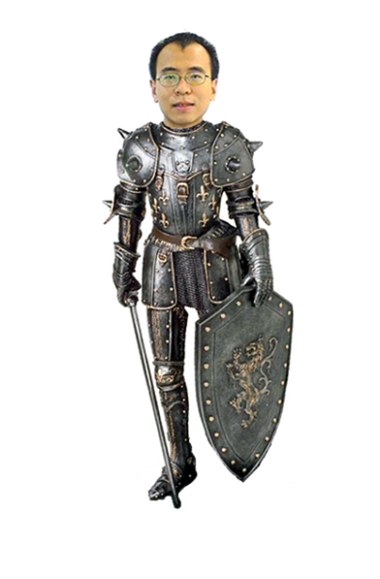

Data Driven Programming Aids
Database serves as an oracle
Support queries that can’t be answered statically
Discover API Usage Rules
How do I register my event listeners?
Complex questions about behavior of the program
Where does this value come from?
How do I get two objects to interact?
Zhilei Xu
Kuat Yessenov
Massive Code Bases

Slide 53
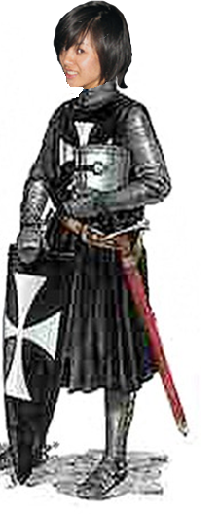
Declarative Program Hardening
Programmers understand the common case
It’s the unexpected corner cases that haunt them
Idea:
Let programmers write code for the common case
Process corner cases using symbolic execution of a declarative specification
Declarative specification hardens the program
Jean Yang
Hostile Environments

Slide 54
Conclusion
It’s time for a revolution in programming tools
Unprecedented ability to reason about programs
Unprecedented access to large-scale computing resources
Unprecedented challenges faced by programmers

Slide 55
Storyboard Programming
head
x
head
x
front
a
b
back
front
a
head
head
front
a
x
b
back
front
a
x
head
x
head
x
b
back
head
head
x
b
back
x

Slide 56
