Slide 1
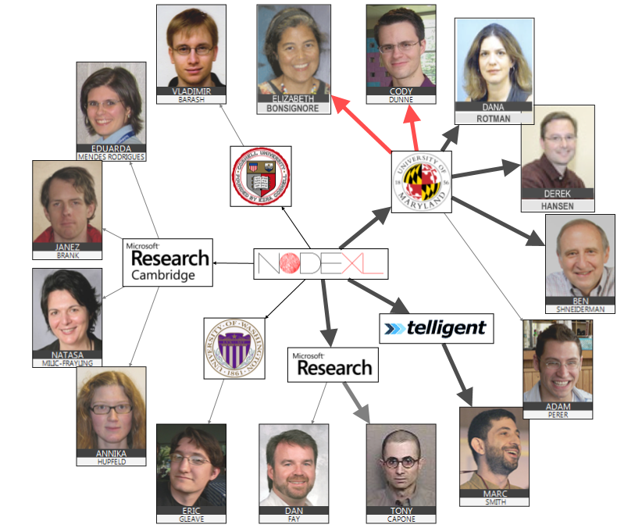


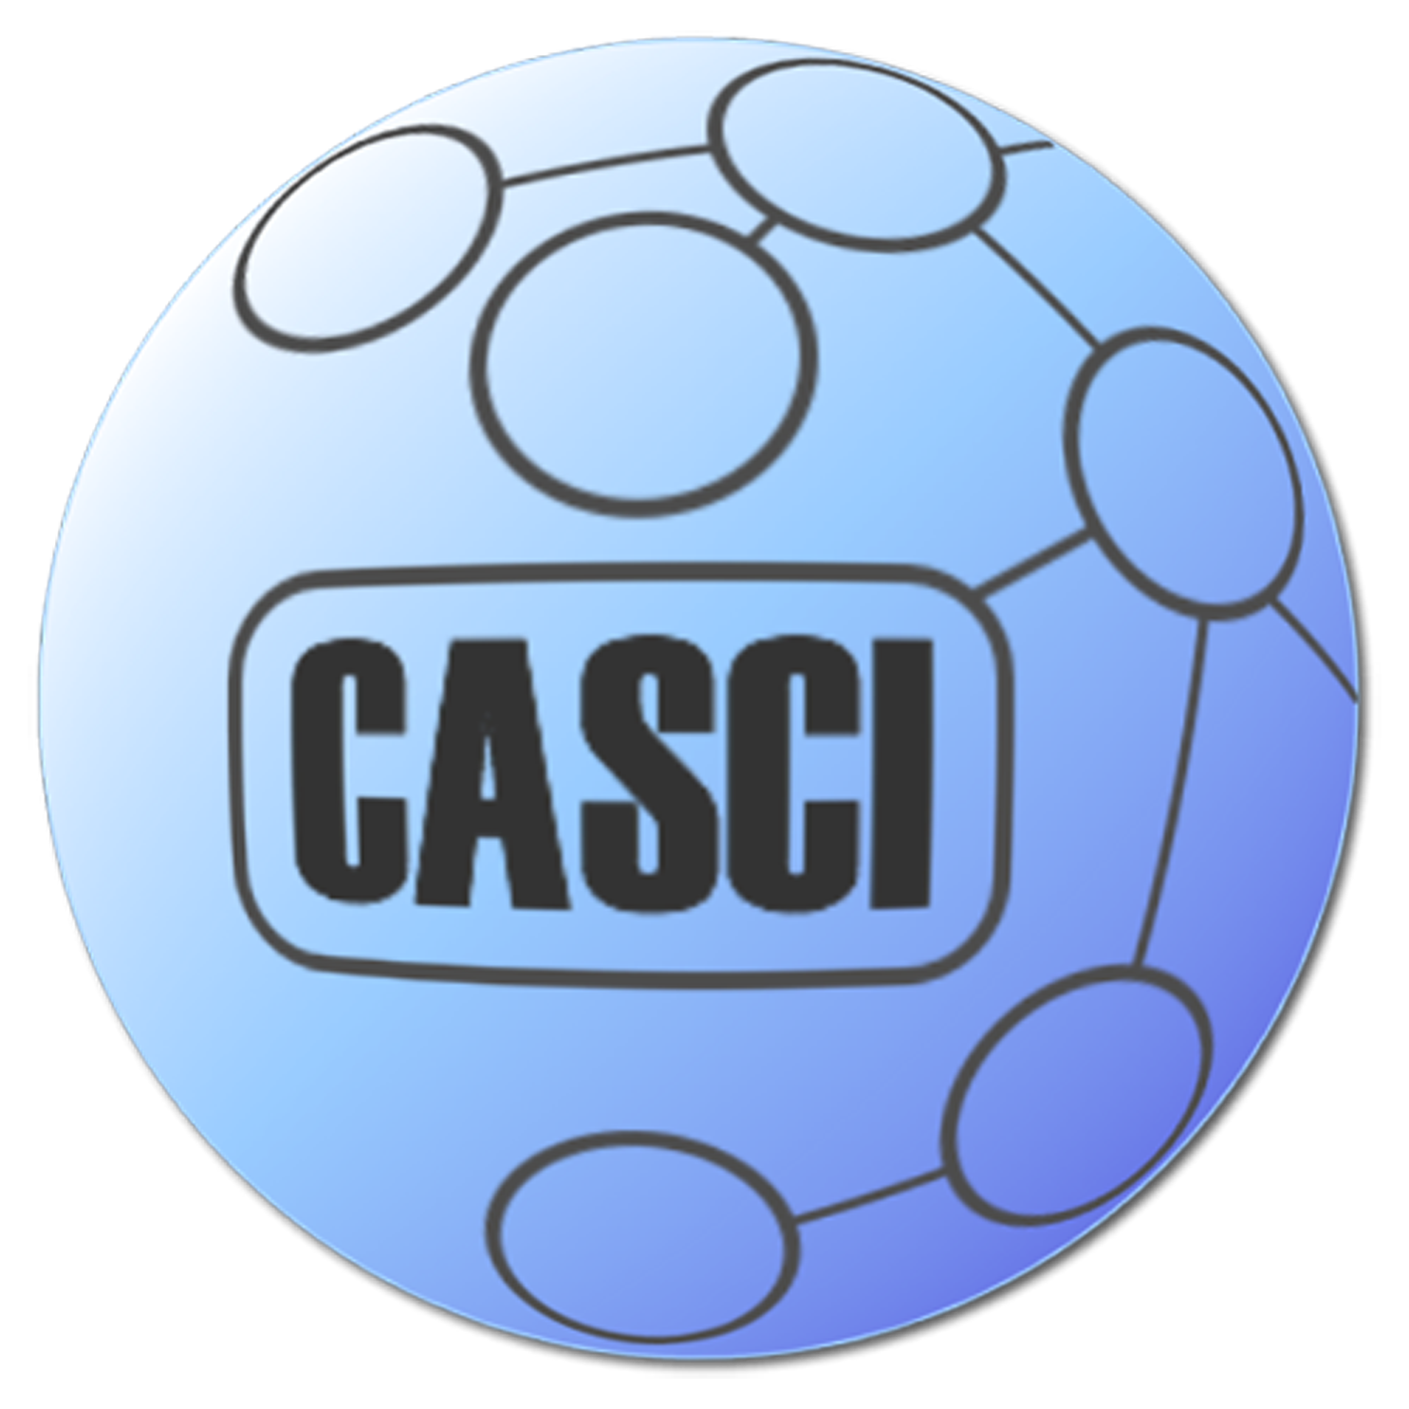
First Steps to NetViz Nirvana: Evaluating Social Network Analysis with NodeXL

Slide 2

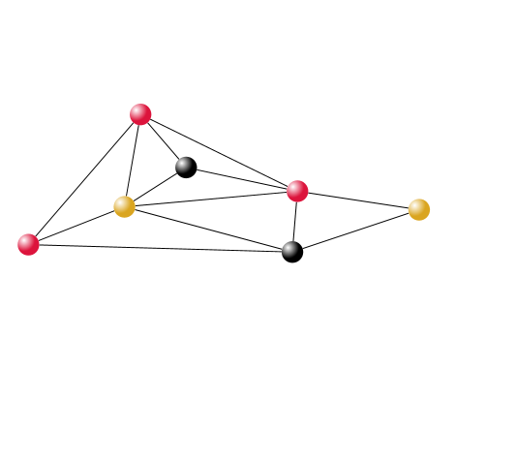
Motivation & Goals for Study
NodeXL evaluation
NetViz Nirvana & Readability Metrics
Research Methods
Samples of Student Work
Lessons Learned
Educators
Designers
Researchers
Notes:
Outline for talk:
Motivation & Research Goals
Social Network Analysis (SNA) for Community Practitioners
NodeXL as SNA Teaching/Learning Tool
Methodology
Qualitative
2 Related but Distinct User Groups
Findings
Learning SNA with NodeXL
Information Science Graduate Students
Usability of NodeXL as an SNA Toolkit
Computer Science Graduate Students
Implications

Slide 3

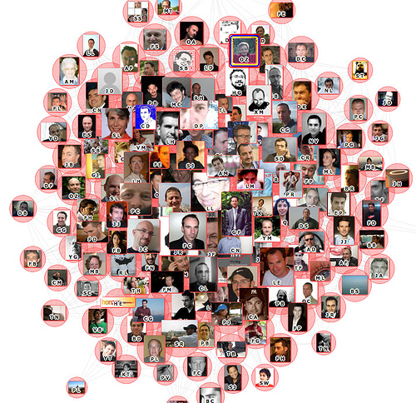
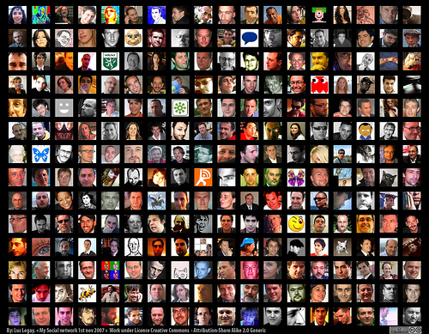
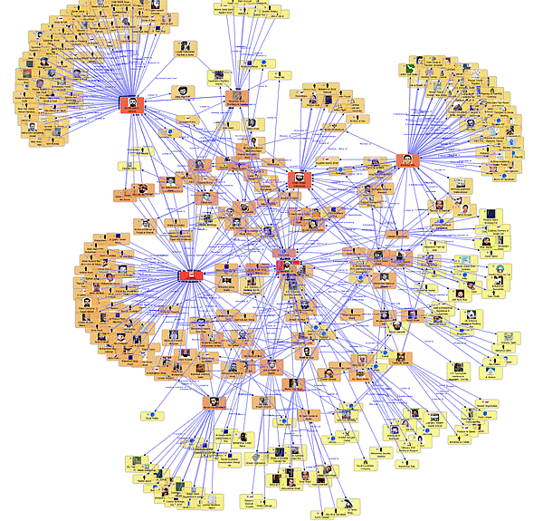

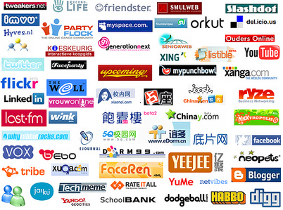
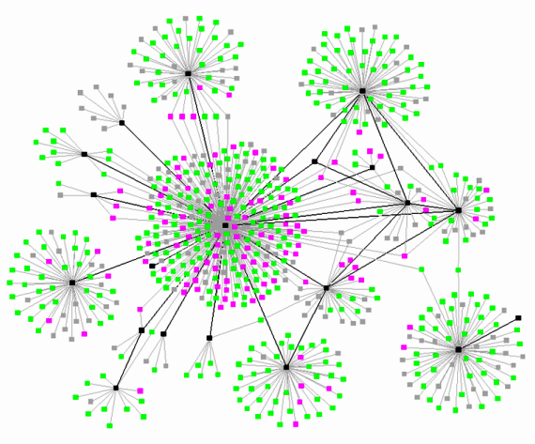
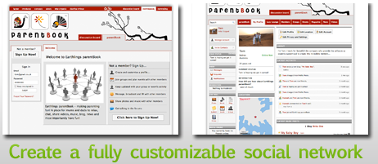
SNA Tools are not just for scientists anymore
Long-term Goal: Accessible Tools and Educational Strategies
How can we support practitioners to cultivate
sustainable online communities?
Create Your Own
Social Network Site
Images courtesy of: Luc Legay’s twitter & facebook network visualizations (http://www.flickr.com/photos/luc/1824234195/in/set-72157605210232207/)
and http://prblog.typepad.com,
Notes:
[3: First, the motivation for our study]
In most cases to date, existing network analysis tools have been relegated to computer scientists who develop algorithms for drawing graphs. Most use command line interfaces, have steep learning curves or require some level of programming expertise. Yet, social network analysis in particular is of interest and importance in academic, commercial and in general social media contexts --
Social Network Analysis need not be just for scientists anymore –
Online community managers have a stake in learning how to use social network analysis to cultivate their communities.
To that end, the long-term goal for the study is to help develop and promote Accessible tools and Educational Strategies for Social Network Analysis geared to community participants, managers, analysts, and designers.

Slide 4
Focus for this talk
Evaluation of NodeXL
For teaching SNA concepts
For diverse user set
NetViz Nirvana principles &
Readability Metrics (RMs)
Notes:
Specific discussion points/"Focus of this talk" -- Evaluation of NodeXL as a tool for teaching SNA concenpts + overall usability (specifically for practitioners)
Also NetVis Nirvana RMs
- What the study/goal is NOT: A comparison of existing and emerging tools -- not a feature by feature usability for a couple of reasons -- tools were/are changing too rapidly during the time of evaluation; not realistic based on the complex, nuanced ways in which these practitioners wanted to explore...blah blah....

Slide 5
Focus for this talk
Evaluation of NodeXL
For teaching SNA concepts
For diverse user set
NetViz Nirvana principles &
Readability Metrics (RMs)
Notes:
Specific discussion points/"Focus of this talk" -- Evaluation of NodeXL as a tool for teaching SNA concenpts + overall usability (specifically for practitioners)
Also NetVis Nirvana RMs
- What the study/goal is NOT: A comparison of existing and emerging tools -- not a feature by feature usability for a couple of reasons -- tools were/are changing too rapidly during the time of evaluation; not realistic based on the complex, nuanced ways in which these practitioners wanted to explore...blah blah....

Slide 6
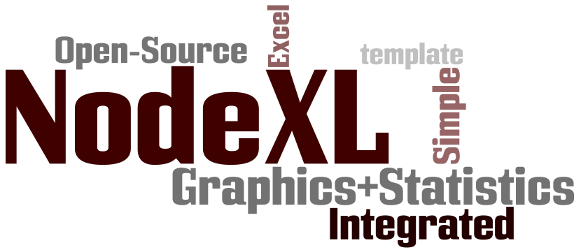
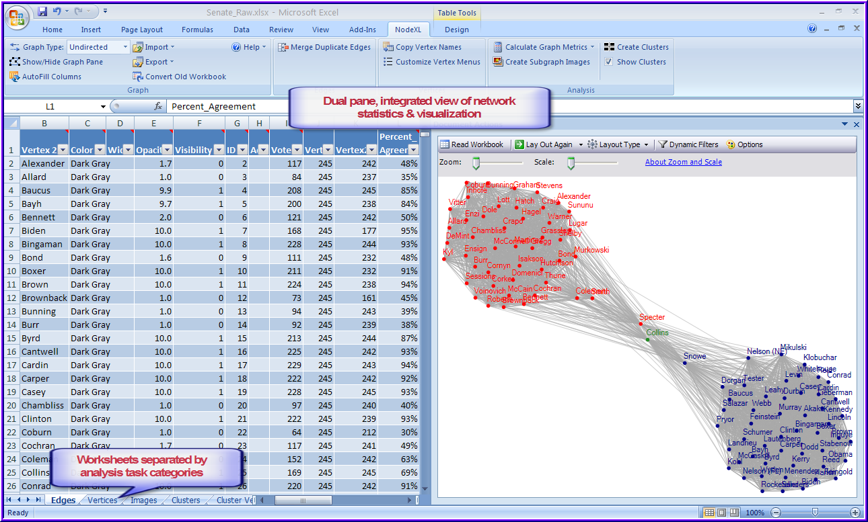
Network Overview, Discovery and Exploration for Excel
Notes:
NodeXL overview
Open-Source Plug-in/template to MS Excel 2007 –
Leverages the Excel spreadsheet application to store network data (i.e., nodes/edges), and
Also takes advantage of common spreadsheet data manipulation tasks such as sorting, filtering, creating formulas.
Provides tightly integrated, coordinated views between the node/edge data, statistical measures, and visualizations or graph diagramming options.
See here the basic layout – spreadsheet on left; graph on right,
Worksheet tabs enable movement between specific views of nodes, edges, clusters, overall metrics;
Clicking on a node or edge in the graph highlights the cell data for that node or edge;

Slide 7
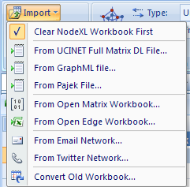
Network Overview, Discovery and Exploration for Excel
Import network data
from existing spreadsheets
…Or, from several common
social network data sources
Notes:
NodeXL provides means to import data from multiple sources,
as well as the standard spreadsheet import -- a format many data sources may already be in!

Slide 8
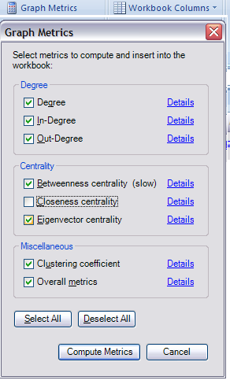
Network Overview, Discovery and Exploration for Excel
Library of basic network metrics
Select as Needed
Notes:
Incorporates a starter library of basic network metrics
Such as Degree, Directional degree attributes, various centrality measures

Slide 9
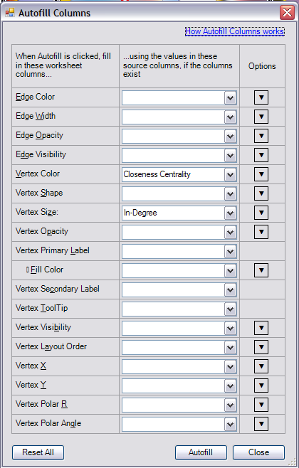


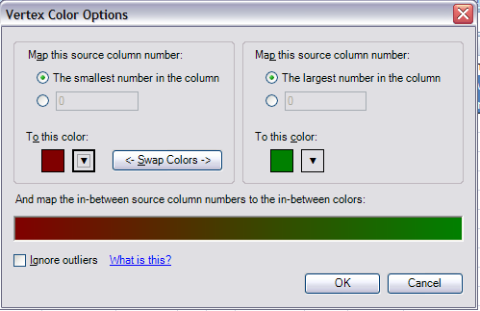
Network Overview, Discovery and Exploration for Excel
Multiple ways to map data
to display properties
Notes:
Multiple means to map data to display
attributes –
Nodes can change properties such as
shape, color, size based on the network
data
Edges can change thickness and color

Slide 10
Focus for this talk
Evaluation of NodeXL
For teaching SNA concepts
For diverse user set
NetViz Nirvana principles &
Readability Metrics (RMs)
Notes:
Specific discussion points/"Focus of this talk" -- Evaluation of NodeXL as a tool for teaching SNA concenpts + overall usability (specifically for practitioners)
Also NetVis Nirvana RMs
- What the study/goal is NOT: A comparison of existing and emerging tools -- not a feature by feature usability for a couple of reasons -- tools were/are changing too rapidly during the time of evaluation; not realistic based on the complex, nuanced ways in which these practitioners wanted to explore...blah blah....

Slide 11
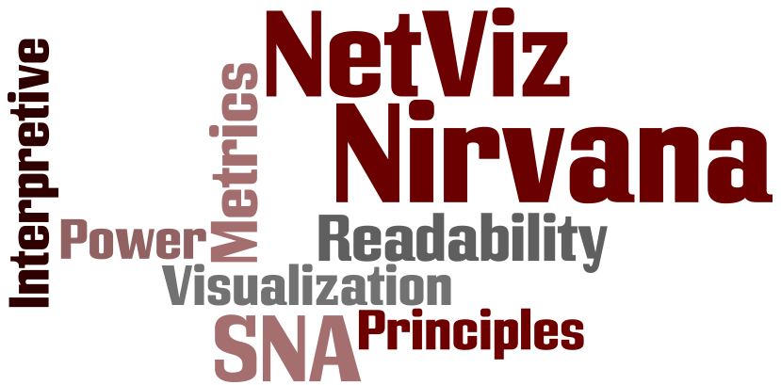
NetViz Nirvana
Every node is visible
Every node’s degree is countable
Every edge can be followed from source to destination
Clusters and outliers are identifiable
Notes:
** Can either do details on this one slide – e.g., Every node is visible == node occlusion

Slide 12
Readability Metrics
How understandable is the network drawing?
Continuous scale [0,1]
Also called aesthetic metrics
Global metrics are not sufficient to guide users
Node and edge readability metrics

Slide 13
Node Occlusion RM
Proportional to the lost node area when ‘flattening’ all overlapping nodes
1: No area is lost
0: All nodes overlap completely (N-1 node areas lost)
C
B
A
D

Slide 14
Edge Crossing RM
A
Number of crossings scaled by approximate upper bound
C
B
D

Slide 15
Edge Tunnel RM
Number of tunnels scaled by approximate upper bound
Local Edge Tunnels
Triggered Edge Tunnels
C
A
B
D

Slide 16
Label Height RMs
Text height should have a visual angle within 20-22 minutes of arc

Slide 17
Label Distinctiveness
Every label should be uniquely identifiable
Prefix trees find all identical labels at any truncation length

Slide 18

Qualitative Theoretical Foundation
Multi-Dimensional In-depth Long-term Case Studies Approach (MILCs)
Ideal for studying how users explore complex data sets
Two-Pronged User Survey
Core Set of Data Collection Methods
Length & Focus tailored to background of each group
Notes:
MILCs definition/intro
Why is it important? – use info from BenS about the number of shallow user studies – and how MILCs are an approach to evaluate learning, too
Ideal for studying how users explore complex data sets and learn structural signatures of SNA metrics
To address “depth” – MILCs
To address “diversity” – two sets of users with different backgrounds, IS (community experts/practitioners with little SNA or InfoVis experience) versus CS (technical experts with background in SNA metrics and InfoVis)

Slide 19
Information Science Graduate Students
Participant Pool | N=15 Studying online community of their choice
Timeframe | ~ 5 weeks
Data Collection | Class/Lab/online discussions Individual observation Student coursework, diaries Pre/Post course surveys In-depth Interviews
Data Analysis | Grounded Theory approach
Notes:
15 graduate students, a mixture of library science and information management
Each student studying an online community that they had a particular interest or investment in
-- ranging from Serious Eats to Soccer fans to Depression support groups to Arts/Crafts Support Group to
Lostpedia community to Weight loss group to Wedding Planning Group….
IS Students Timeframe: 3 weeks dedicated lab/lecture time, but overall collection and level of effort =5 weeks

Slide 20
Computer Science Graduate Students
Participant Pool | N=6 Experienced in Graph Theory, SNA, InfoViz techniques
Timeframe | ~ 1:45 hours/participant
Data Collection | Individual observation Pre/Post surveys In-depth interviews
Data Analysis | Grounded Theory approach Quantitative analysis of surveys

Slide 21
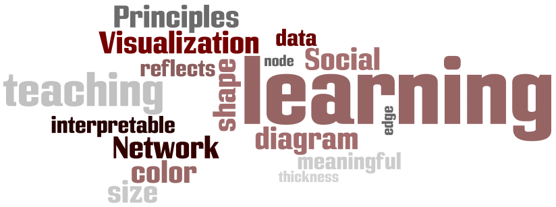
Salient issues: Learning & Teaching SNA
Students enjoy mapping display properties for nodes & edges that reflect the actors & relations they represent
NodeXL effectively supports this integration of data & visualization
Students strove to achieve NetViz Nirvana
Notes:
A significant requirement regarding the development of tools for social network analysis – one that distinguishes it from classic graph theory and graph drawing – is that the nodes and edges of social network diagrams should convey attributes that are similar to the characteristics of the actors and relations they represent.
For example, if a particular member of a community forum submits comments more than any other member in a forum, then the edges connecting her node to that forum might be thicker than the edges for other members. OR, if a person has more friends or connections than other members of a particular community, the node representing him might be larger than other nodes in that community network.
Some of the key aspects revealed about learning and teaching SNA with NodeXL
Key influencers for the IS students regarding their use of NodeXL and what they learned about SNA and its applicability to creating, maintaining, nurturing, learning about the online communities they were studying
Meaningful visualizations of social networks demand that nodes and edges in social network diagrams convey the same attributes as the people and relations they represent
-- Students applied this concept by taking advantage of the variety of visual features that can be changed based on individual and community metrics – changed size and shape of nodes based on numbers of friends, levels of participation, levels of experience, etc.
Pedagogical influence of NetViz Nirvana – Principles and applicable metrics to enhance “Readability”

Slide 22
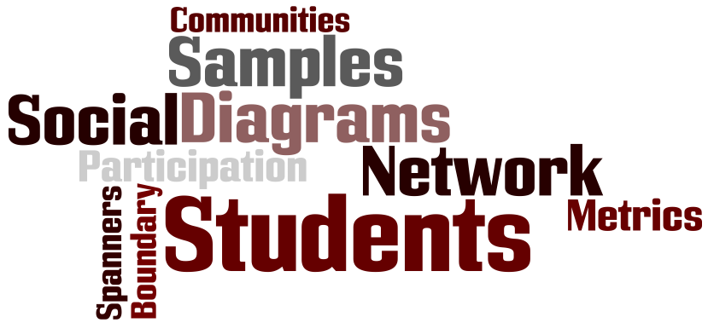
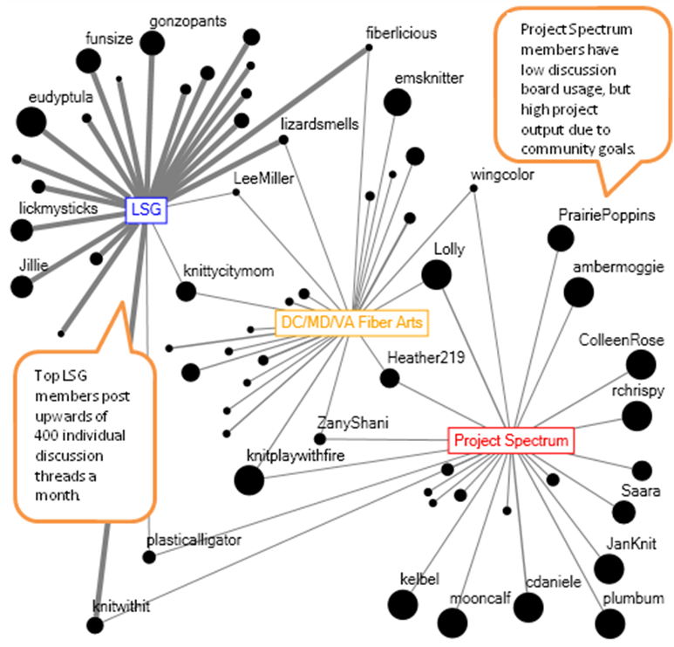
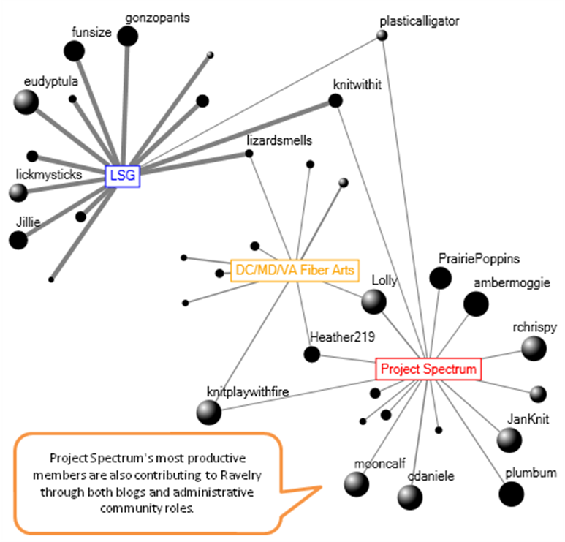
Use of NodeXL to
Identify Boundary Spanners across sub-groups of Ravelry community
Gain insight on factors leading to high # of completed projects
Notes:
She studied the Ravelry community – an online community of > 250,000 knitters/crocheters.
She focused on 3 sub-groups based on their profile entries (how many meet-ups or “Knit-alongs” they shared,
As well as common interests shared)
She filtered out the top 20 posters in each sub-group, with node size reflecting the number of completed projects, and
tie-strength representing levels of participation.
From the graph on the left, you can see that boundary spanners are rare – the sub-groups are pretty tight among themselves.
No member belongs to more than 2 of the sub-groups that she isolated.
These posters also have a relatively high level of completed projects.
Interestingly each subgroup also reflects different traits – Lazy/Stupid/Godless (LSG) are very social/high posters to the forum;
Project Spectrum may not post as much, but complete many more projects – perhaps through meet ups, but this might
be worth exploring further.
In the graph on the right, she used NodeXL to filter out members who did not have a blog, too.
Here, the spheres indicate Ravelers who are also community moderators or volunteer editors – and shows that
Members with high community involvement in multiple areas have higher project outputs.

Slide 23
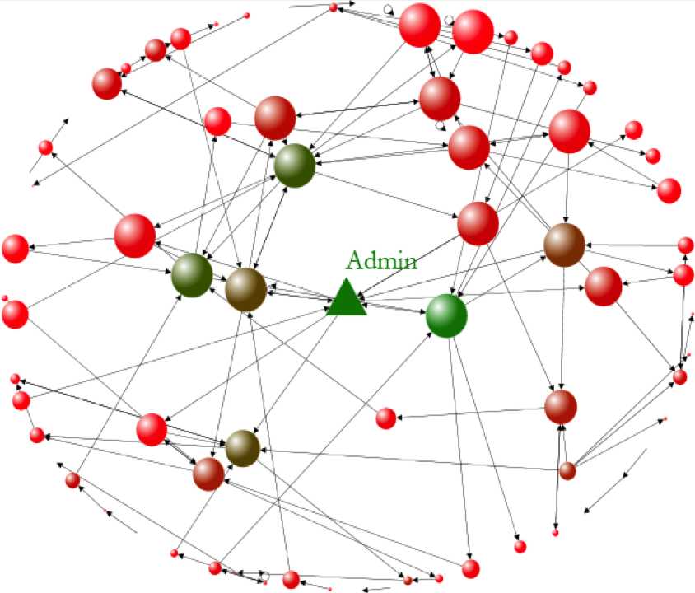
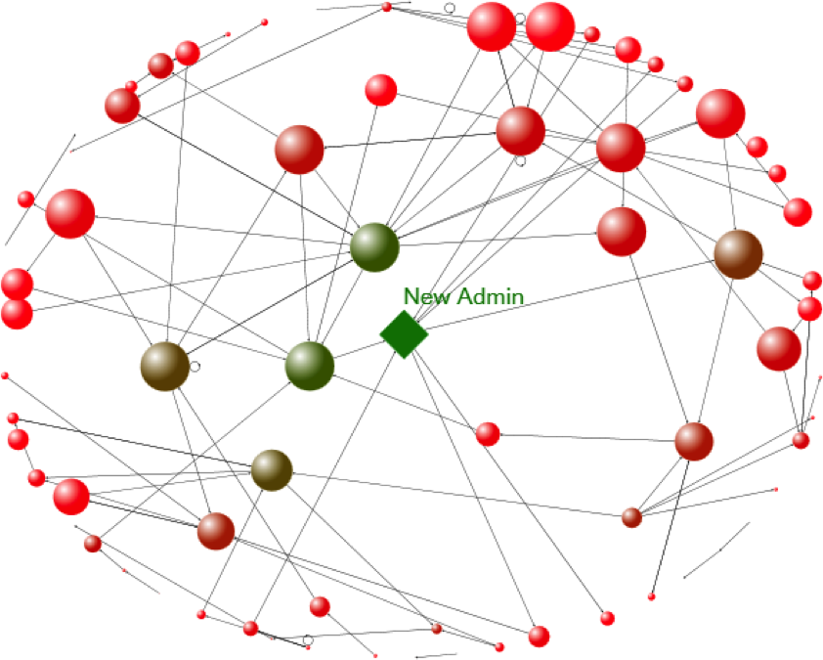
Node Color == Betweenness Centrality
Node Size == Eigenvector Centrality
Use of NodeXL to
Confirm hypotheses about key characteristics for listserv admin
Model a potential management problem with ease
Notes:
While not the greatest example for displaying NetViz Nirvana (i.e., there are many edge crossings) – an relatively sophisticated and insightful use of network metrics to reveal social or community roles and structure
Vertex Color = Betweenness Centrality ➔ high values indicate a bridge – one without whom the graph would disconnect
Most experienced are bright green; least experienced/time in community members are a few differing hues; medium experienced are olive drab/brownish….
Vertex Size = Eigenvector Centrality ➔ Higher if you are connected to highly connected people
LEFT figure: Student confirms a hypothesis that the community administrator and more experienced members have high eigenvector centrality (connectedness, represented by node radius) and betweenness centrality (bridging, represented by node color).
RIGHT figure: Student models which community member (node) would be the next best candidate to serve as community administrator (based on hypothesis that leaders are bridges across sub-groups among the network and they are also highly connected to other highly connected people)
To simulate the management dilemma, he filtered all the stats data about the current admin by applying the “skip filter” available in NodeXL – the next best admin that meets his high eigenvalue/high bridging abilities pops up

Slide 24

Lessons Learned for Educators
Promote awareness of layout considerations (NetViz Nirvana)
Scaffold learning with interaction history & “undo” actions
Pacing issues
Higher level of Excel experience desirable
Notes:
LLs
- Educators

Slide 25
Lessons Learned for Researchers
MILCs more representative of exploratory analysis than traditional usability tests
MILCs also more representative of the learning process
MILCs require more intensive data collection & analysis
Notes:
LLs
MILCs are more effective than traditional, lab-controlled usability tests => because they are more faithful and representative of the way users explore complex data sets like social networks and structures
Relatively obvious point but one that deserves mention – MILCs require more intensive data collection & analysis
-- more ethnographic in nature, for ex – generated and transcribed about 10 hours of audio/video interview data and
12 hours of lab/class video, in addition to the pre-survey questions,
about 40 student diary entries,
assignment data,
post-survey focus group
Online course discussion threads

Slide 26
Lessons Learned for Designers
Multiple coordinated views (data, visualization, statistics)
Encode visual elements with individual & community attributes
Add RM interactions (based on NetViz Nirvana)
Extensible data manipulation
Track interaction history & “undo” actions
Improved edge & node aggregation
Notes:
LLs
- Designers
Users enjoyed -- tight
Acclamations
Interaction between workbook and graph
Separate data & visualization, connected with brushing and linking
Cell referencing for tunable formula constants
Criticisms
Lack of responsive controls at all times
Optionally disable real-time updating
Better UI design – simpler, larger icons and groupings
Improved edge & node aggregation
Vector graphic export

Slide 27

Research Methods
User pool represented diversity & depth
SNA Education
IS user results showcased NodeXL’s power as a learning & teaching tool for SNA
NodeXL Usability and Design
CS user feedback enabled rapid implementation of requested features & fixes during the study & beyond
Notes:
Diversity → two well-represented user groups
Depth → timeframe for users to explore, experiment with their own data sets, learn by trial and error, etc.

Slide 28
Questions?
http://casci.umd.edu/NodeXL_Teaching
http://www.codeplex.com/NodeXL
http://www.cs.umd.edu/hcil/research/visualization.shtml
Thank you!
Elizabeth Bonsignore ebonsign@umd.edu
Cody Dunne cdunne@cs.umd.edu
Notes:
NODEXL DIAGRAM OF NODEXL – demonstrating how the toolkit is:
- CONNECTED TO STATISTICAL MEASURES AVAILABLE
- CONNECTED TO VARIOUS VISUALIZATION FEATURES
(EXISTING AND PLANNED)
ALSO: INTERFACE ITSELF IS PART OF A PROGRAM THAT IS FAMILIAR (EXCEL) AND
MANY SNA DATA SOURCES ALREADY IN A SPREADSHEET LIKE FORMAT

Slide 29
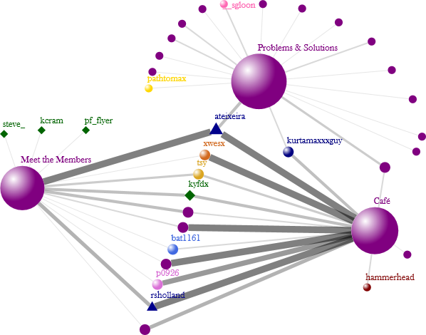


KEY
Sub-Groups
Community Leaders
Hosts
Use of NodeXL to
Identify Boundary Spanners in the
Subaru Owners’ sub-group
Show levels of participation in different forums (edge width)
Carspace community logo courtesy of Edmund’s CarSpace: http://www.carspace.com/
Notes:
GOAL: To identify the bridge spanners in three subgroups. Metrics like degree and tie strength used to guage the membership and the level of participation in these subgroups.
The edges represent the tie strength which is the number of posts a person contributes in a particular discussion forum.This gives us a sense of member’s participation within subgroups. The “café” subgroup and the “meet the members” subgroups have more cross over than the “problems & solutions” subgroup. One reason could be the nature of discussion that is carried out within the subgroup. The“café” subgroup was created for members to give them freedom to exchange ideas which are considered suitable for discussion in the community (i.e., car-talk) and to avoid threads being deleted as “Off topic” threads.
“Meet the members” subgroup provides an additional personal space in form of a discussion forum for members to know each other at a more personal level and build friendship ties. These two subgroups enjoy shared membership and the two groups are well connected with each other. Intersestingly, the two community leaders (blue triangles) and the host (kyfdx) make almost equal amount of contribution in both the subgroups.
Another interesting observation: the community leaders (blue triangles) are actively involved in the community and are heavily participating in the discussions as compared to the hosts (green diamonds) of the community.
** Reason for various colors of the other nodes is that student used these in secondary graphs about friendship ties among members **
The radius of the nodes is set on degree to guage the number of connections a node has and also to understand how the information flows within the community. Since I am looking for members contributions in these three subgroups the variation in the size of the nodes is not very distinguishable for the members. However, degree is a useful measure for the subgroups since it represents how many people are connected or associated with the subgroup. In the visualization, by looking at the size of the spheres and one can see that the problems and solutions subgroup enjoys rich membership then the other subgroups.

Slide 30
First Steps to NetViz Nirvana: Evaluating Social Network Analysis with NodeXL
Elizabeth Bonsignore, Cody Dunne
Dana Rotman, Marc Smith, Tony Capone, Derek L. Hansen, Ben Shneiderman

