Slide 1
America’s Most Wanted
Top US Government Data Resources
Lynda Kellam
Data Services & Government Information Librarian
The University of North Carolina at Greensboro

Slide 2
Overview of session
Questions to consider:
What is it and why is it a top source?
What are the newest features (if any)?
What are areas for improvement?
Sources: data.gov, geodata.gov, American FactFinder, Bureau of Labor Statistics, National Center for Education Statistics, Data Ferrett

Slide 3
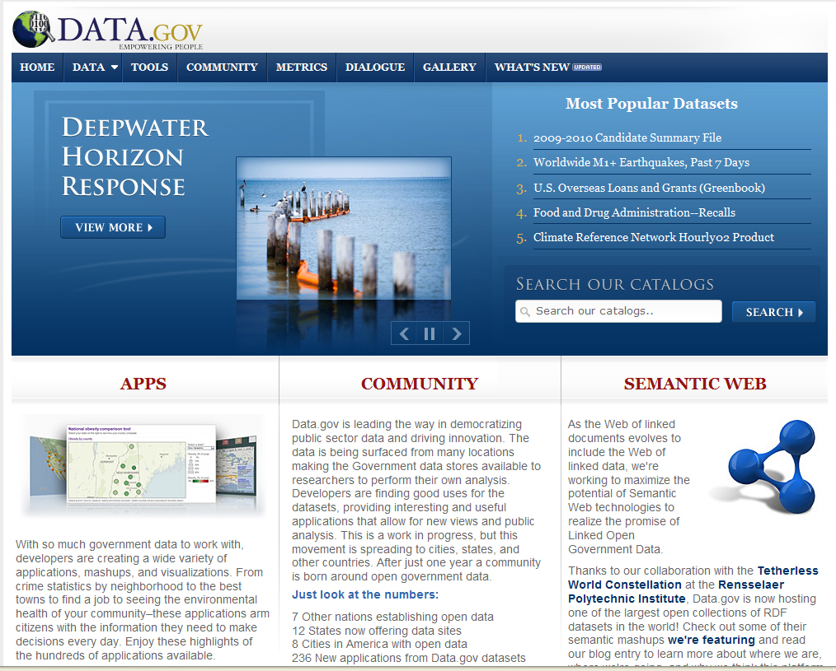
Newest kid on the block
data.gov

Slide 5
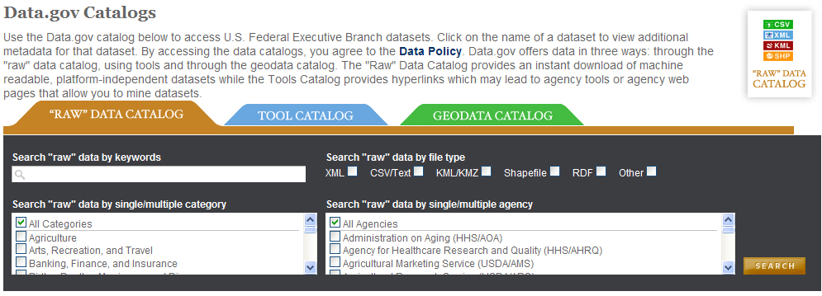
What are some major features?
Three catalogs (raw data, tools, geodata)
Variety of data formats (xls, xml, csv, kml, etc.)
Notes:
Three catalogs for searching
Raw data catalog for searching “raw” data (xml, csv, etc) = download data
Tool catalog = links to a mixed bag (rss feeds, reports, widgets, databases for extracting data)
Geodata catalog = geocoded data and shapefiles for GIS; Preview is new feature that allows you to preview data before downloading a shapefile

Slide 6
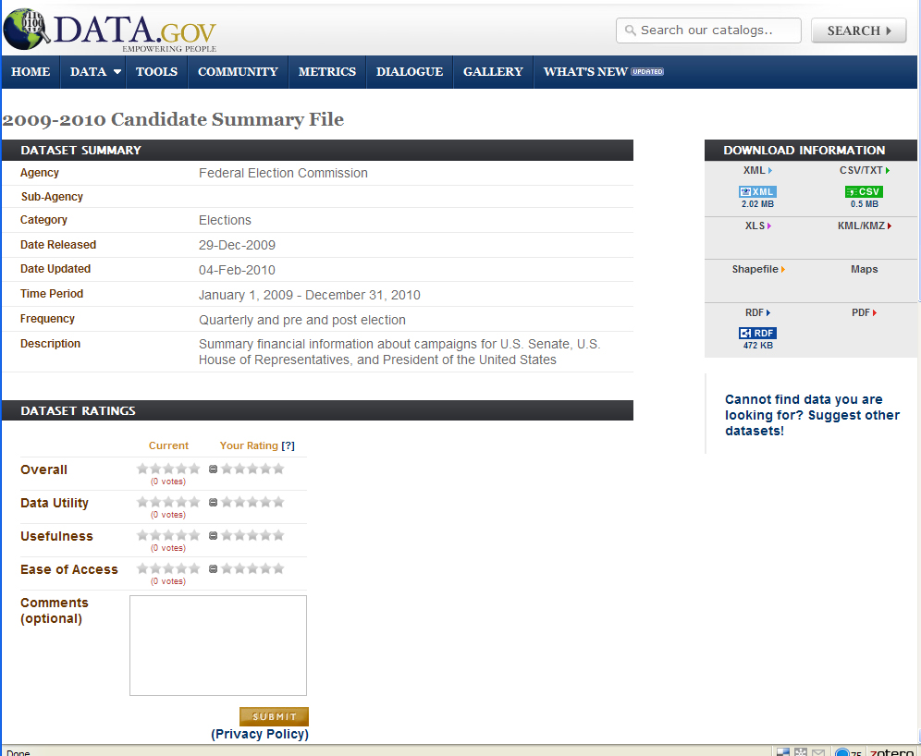
Types of files available
Raw Data Catalog Entry

Slide 7
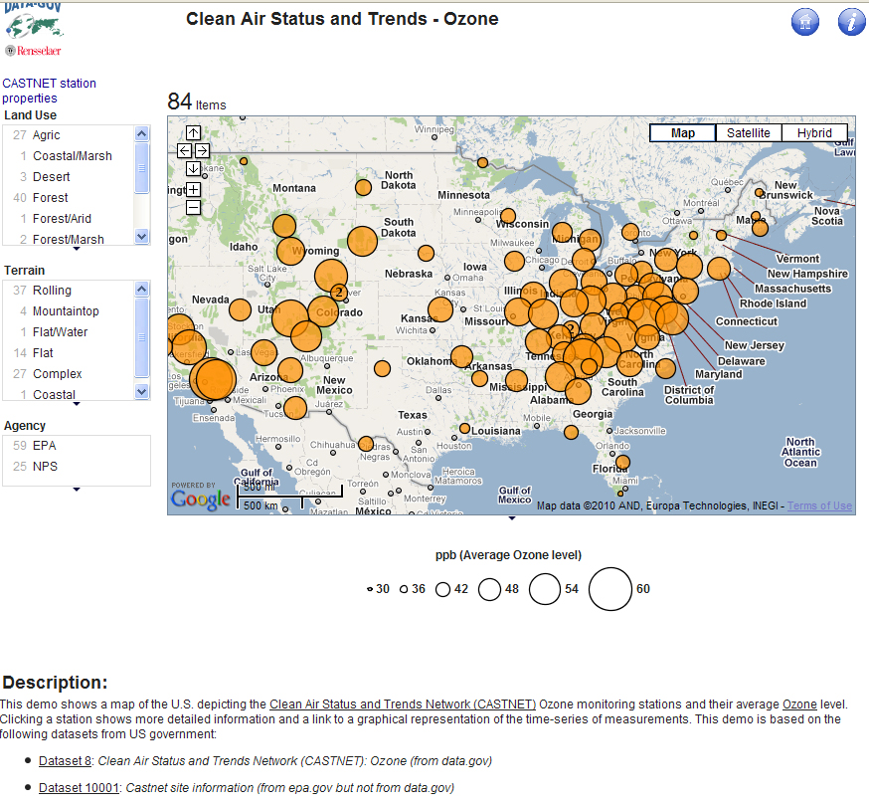
New features
Integrated search with search.usa.gov
Site for mash ups
Mash up using ozone and visibility readings with geographic information about sites of those readings.
More info: http://data-gov.tw.rpi.edu/wiki/Demo:_Clean_Air_Status_and_Trends_-_Ozone

Slide 8
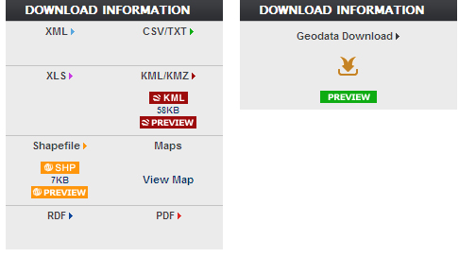
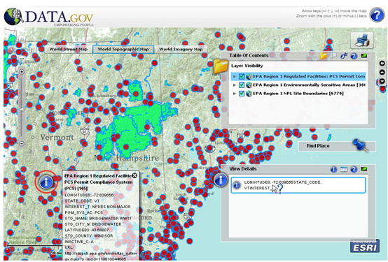
GEO Viewer

Slide 9
Uses and Areas for Improvement
Uses:
Great focus on environmental data
Good free portal for finding data sources
Improvement:
Needs more data downloads and fewer links out
Go beyond executive branch data
More variety of subjects
Glitches need to be fixed

Slide 10
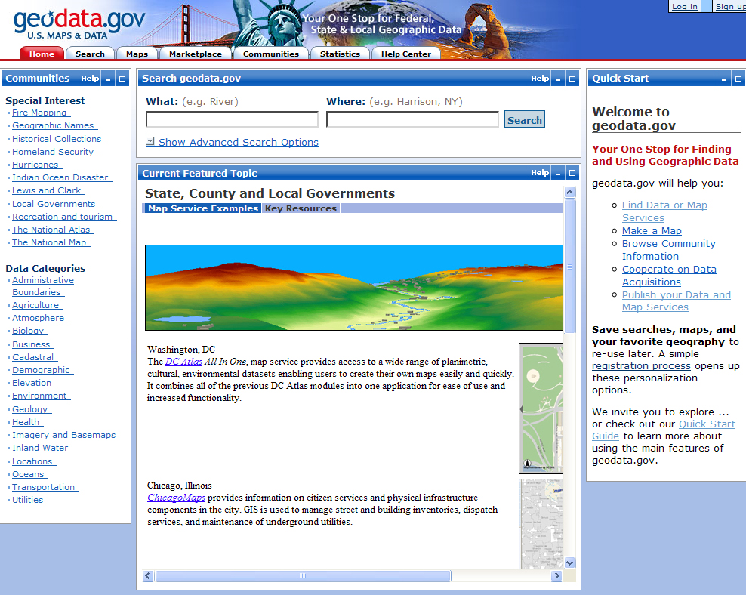
Trendsetter
Geodata.gov

Slide 12
What are the major features?
User account allows saving search criteria and maps
Email alerts for saved search criteria
Content is from variety of producers
Focus is on metadata records
Possible to search for data by geography

Slide 13
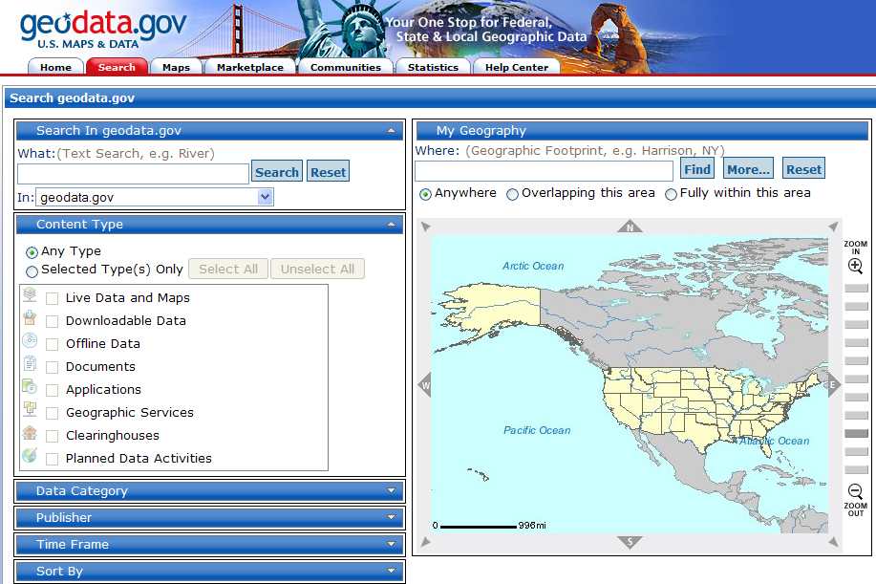
geodata.gov search screen

Slide 14
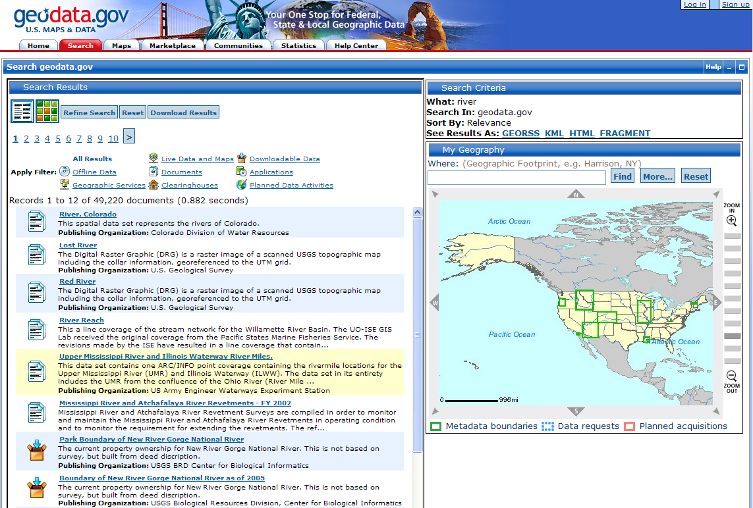
Search results

Slide 15
Uses and Areas for Improvement
Uses:
Another free portal for tracking down sources
Great focus on geographic searching
Improvement:
Needs clarification on how will work with data.gov
Integrate map searching into data.gov?

Slide 16
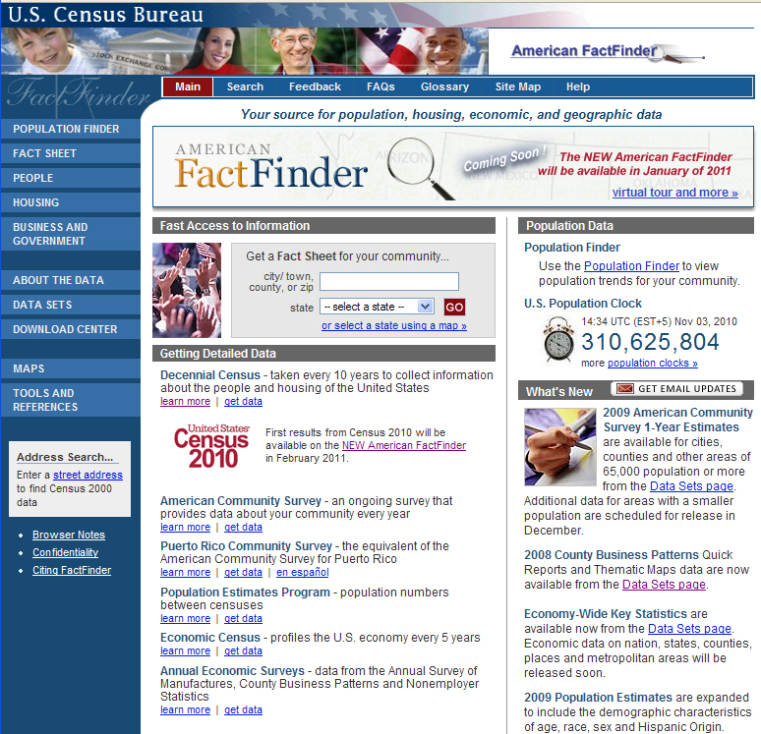
Most in need of an extreme makeover
American FactFinder

Slide 17
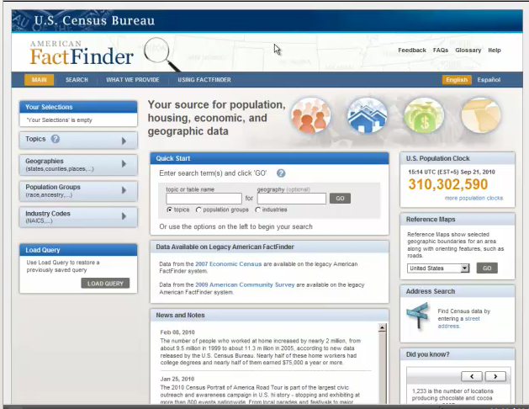

Slide 18
Features to come!
Search by topic, geography, population group, or industry code
Enhanced table features
Rearrange rows and columns
Sort data in a column
Bookmarking tables
New mapping feature available
Check http://factfinder2.census.gov

Slide 19
Data to come!
American Community Survey data releases
2005-2009 ACS 5 year estimates released in early December
State population counts released on December 31, 2010
The Director’s Blog: http://blogs.census.gov/2010census/

Slide 20
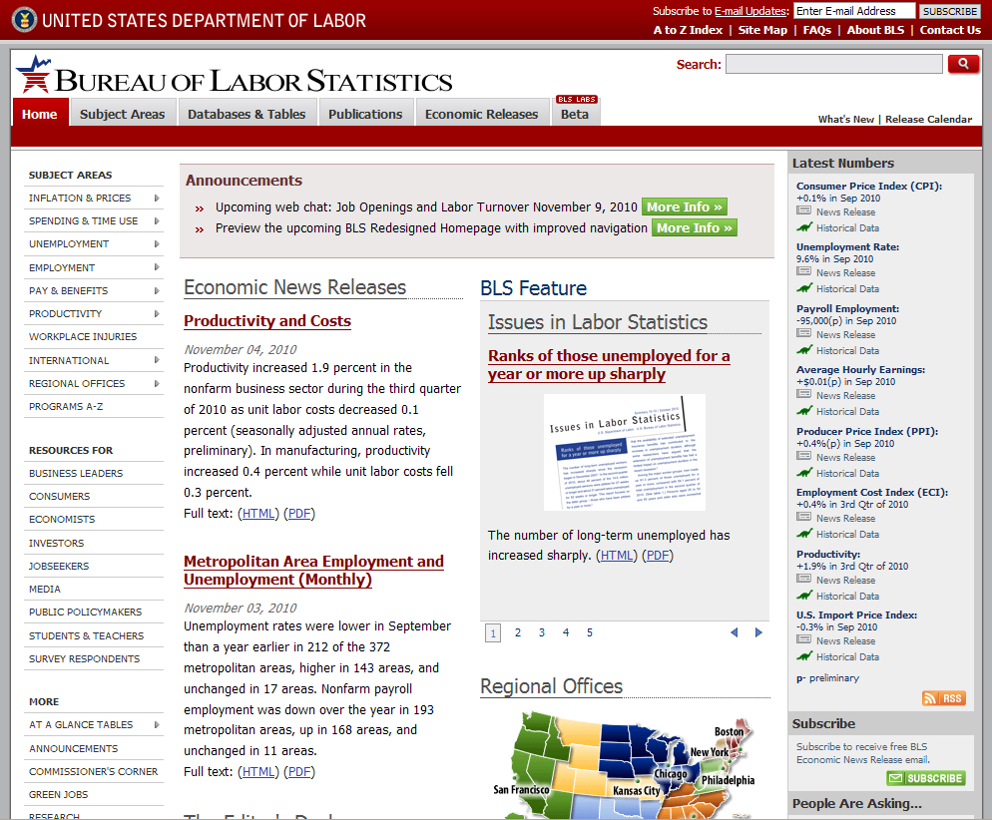
Most improved
Bureau of Labor Statistics

Slide 21
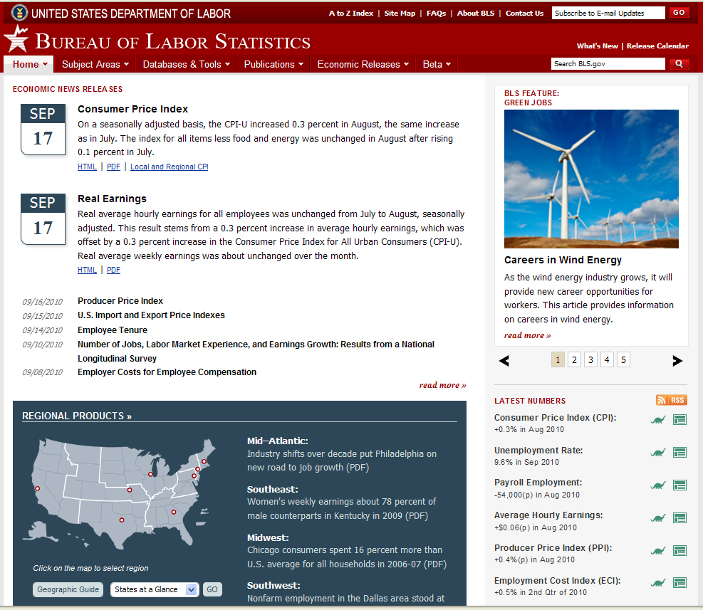
Economic
Releases
Regional Products

Slide 22
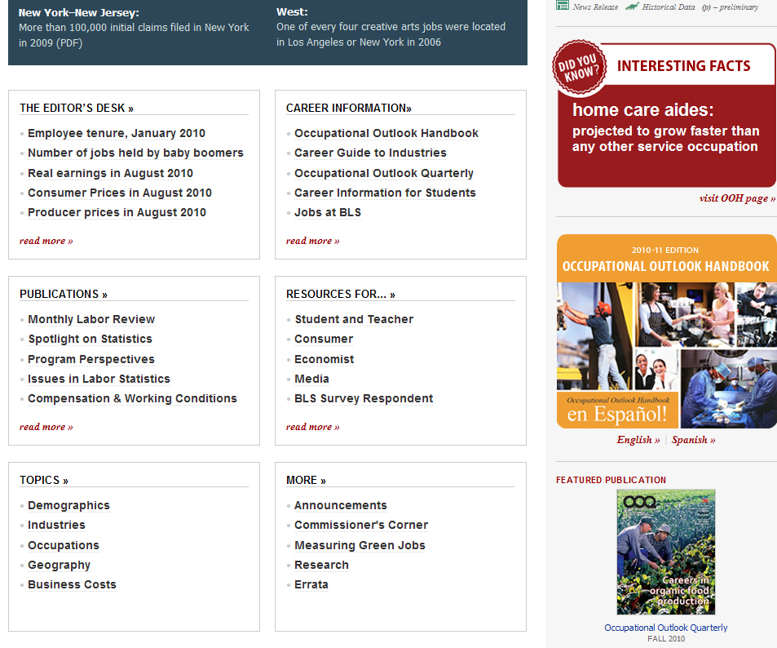
Did you know section
OOH featured

Slide 23
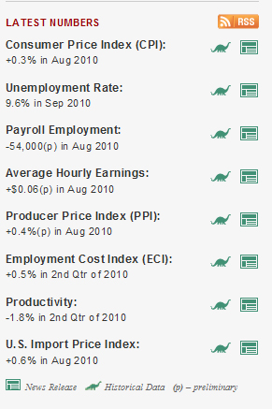
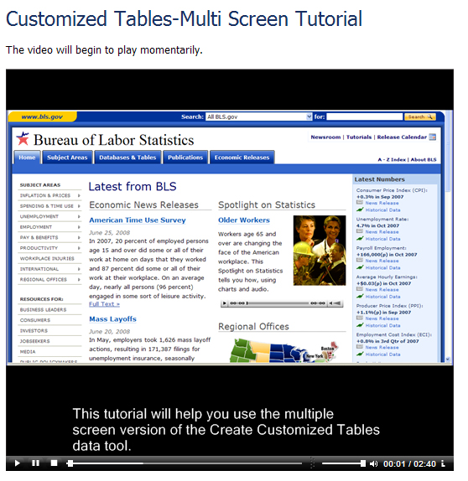
Other features
RSS feed for major numbers
Flash and html tutorials
http://www.bls.gov/tutorial/home.htm

Slide 24
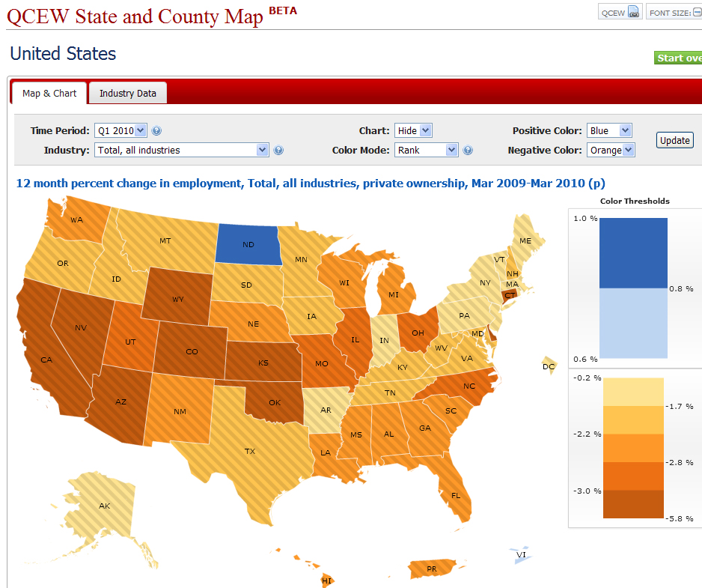
BLS Labs
Revamped search engine
State & county mapping tool

Slide 25
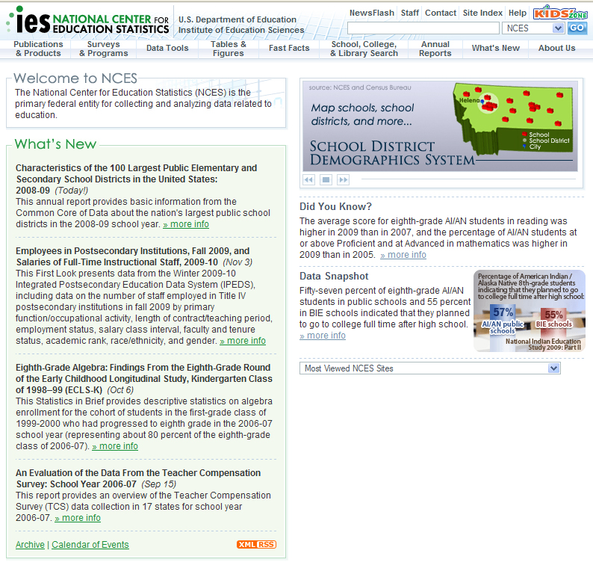
Old Standby
National Center for Education Statistics

Slide 27
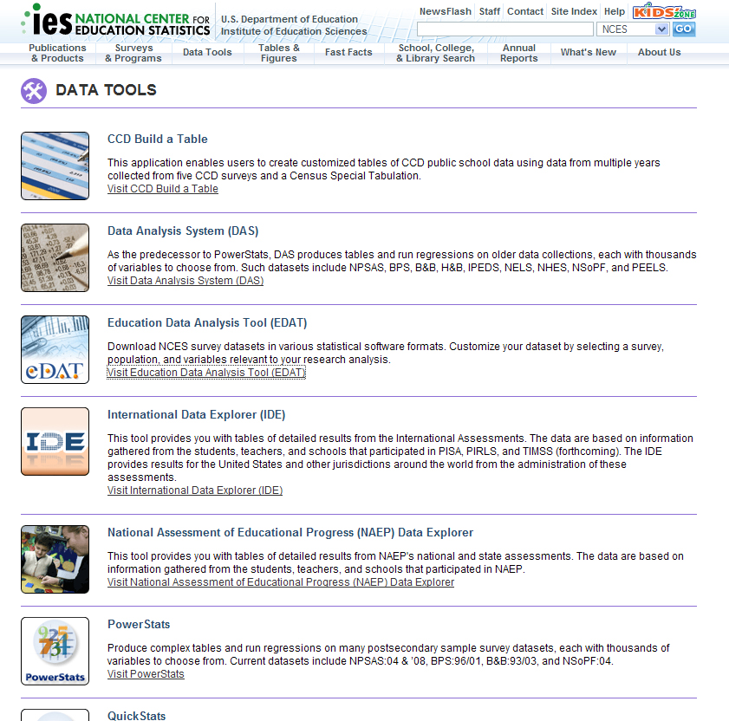
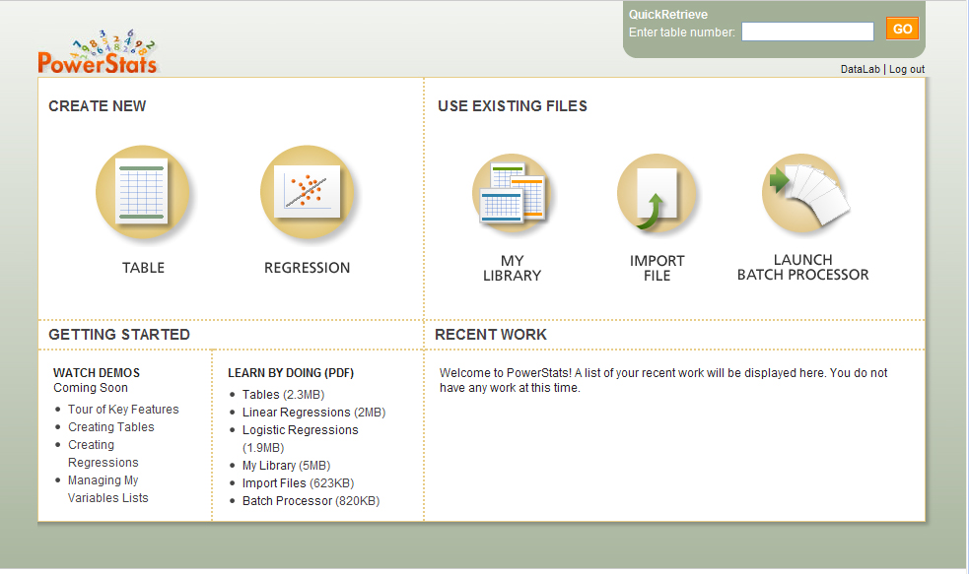
Features
RSS for announcements
Data Tools page

Slide 28
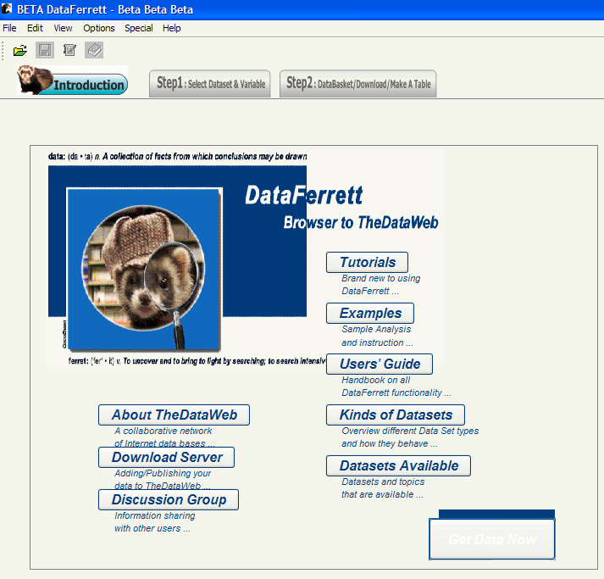
Least appreciated
Data Ferrett

Slide 30
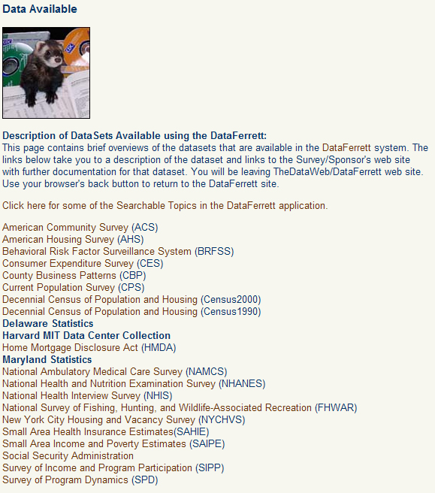
Features
Relatively easy to use interface for complex data
Options for mapping, graphing and downloading
Good variety of data files
Support for beta is unclear

Slide 31
Comments or Questions?
Lynda Kellam
Email: lmkellam@uncg.edu
Twitter: @lyndamk
Gtalk: lyndamk@gmail.com

