Slide 1
SPoRT Update GOES-R Proving Ground
November 23, 2010

Slide 2
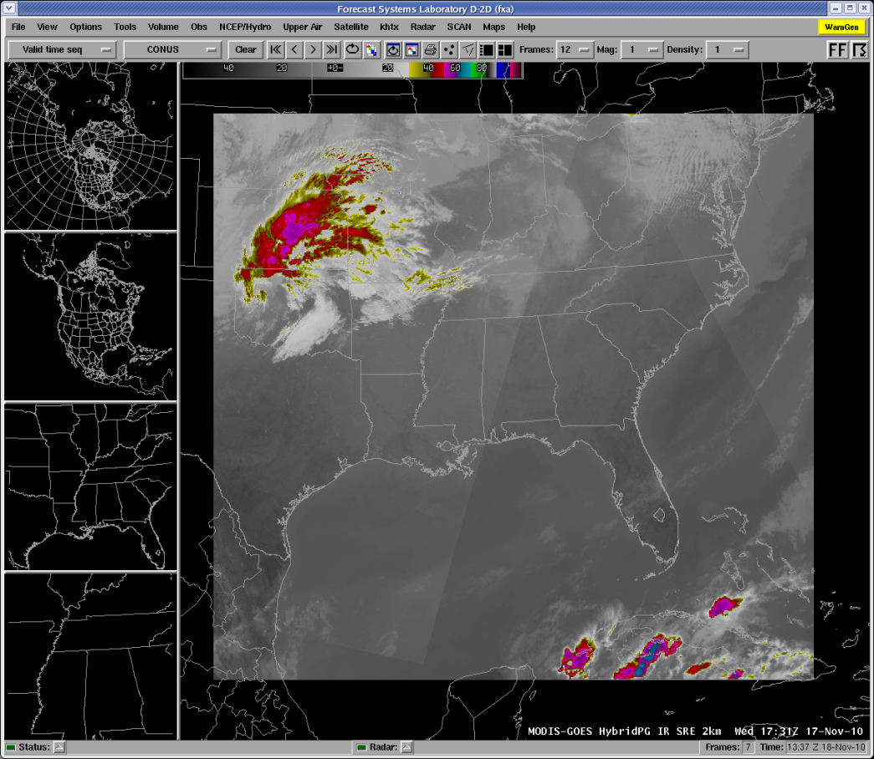
SPoRT Developed PG Products Hybrid MODIS Imagery
Hybrid – GOES/MODIS Imagery as NRT proxy to ABI
Match spatial res. 2 km for IR 500 m for vis.
Temporal res. 15 minutes vs 5 minute
Insert MODIS into a GOES image for continuity to loop.
Bowtie corrected.

Slide 3
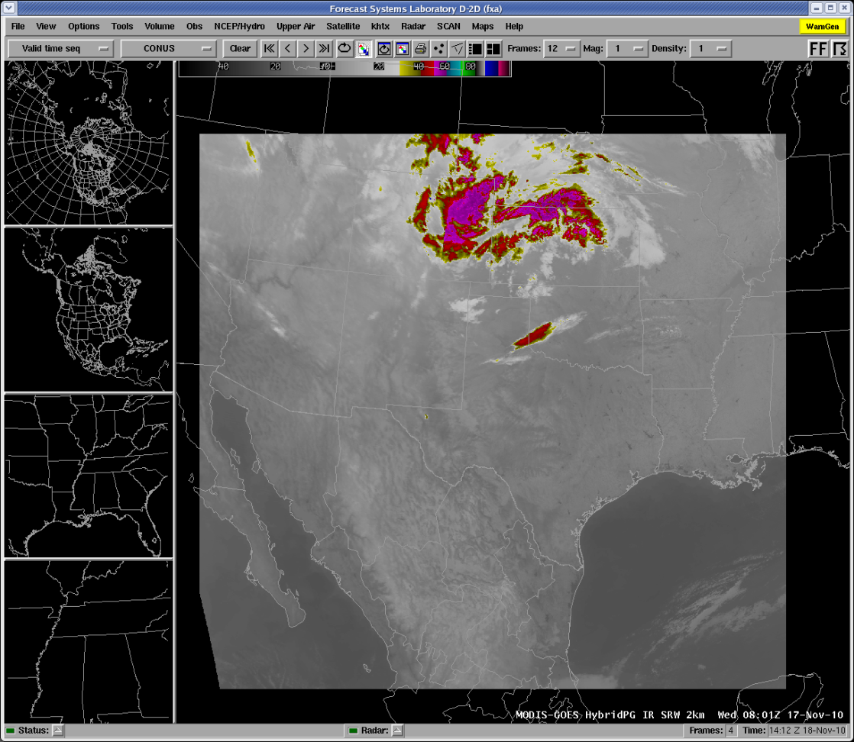

Hybrid Domains – SRW, SRE

Slide 4
Hybrid Products
2 km Regional Products
500 m State Scale
11um
3.9um
Water Vapor
Visible
Huntsville
Nashville
Morristown/Knoxville
Melbourne
Jackson
Corpus Christi
Houston/Galveston
Albuquerque
SPoRT has demonstrated these products to its intended users of active collaborators. Each of the WFOs to the right has been contacted to formally evaluate these PG products along with Pseudo-GLM products from SPoRT. Their “official” response is pending, along with their feedback as to which products they want to concentrate their evaluation efforts.

Slide 5
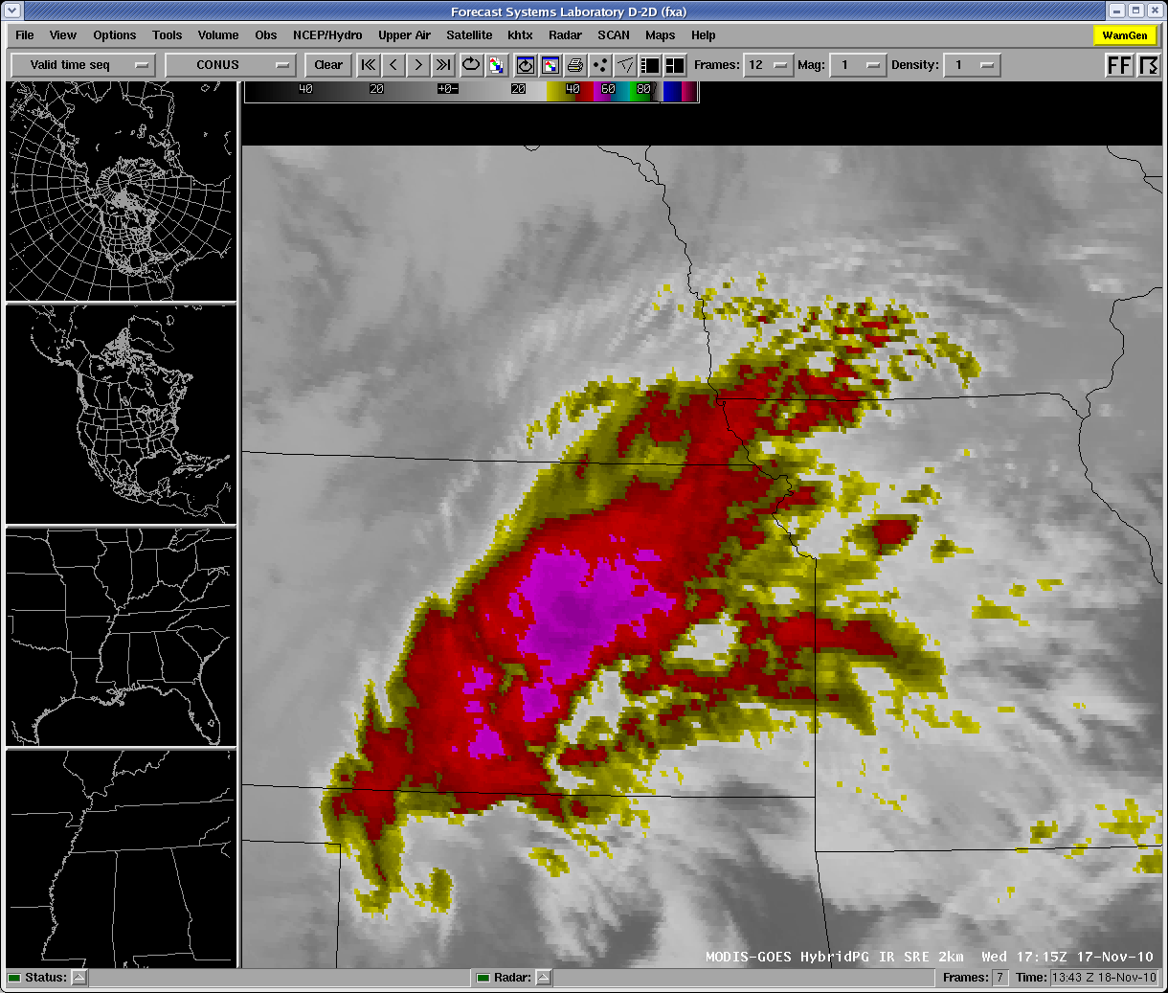
PG Hybrid SRE 11um MW example
Notes:
Both remapped to the 2 km resolution.

Slide 6
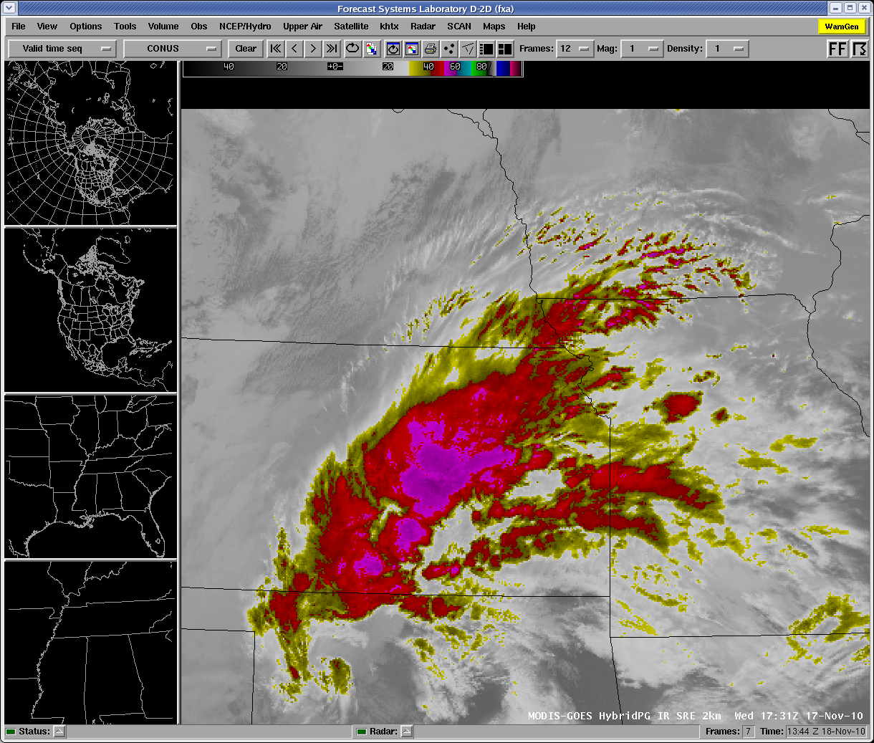
PG Hybrid SRE 11um MW example

Slide 7
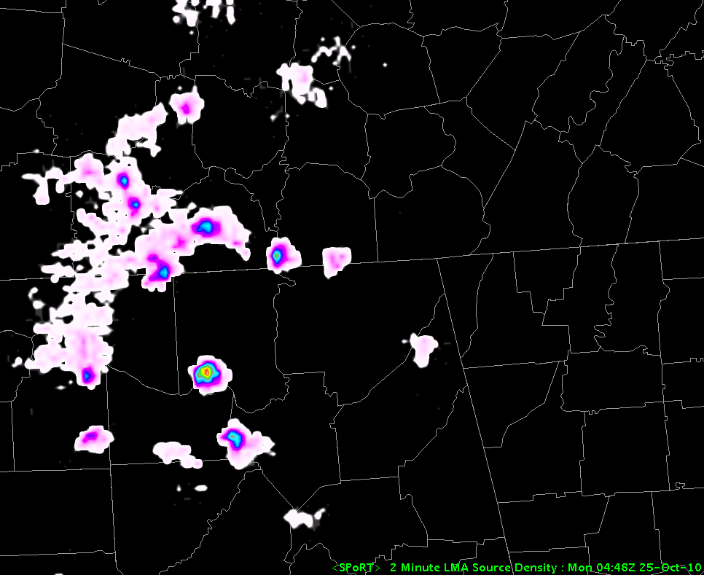
Total Lightning in AWIPS II
AWIPS I “style” interpolation in AWIPS II

Slide 8
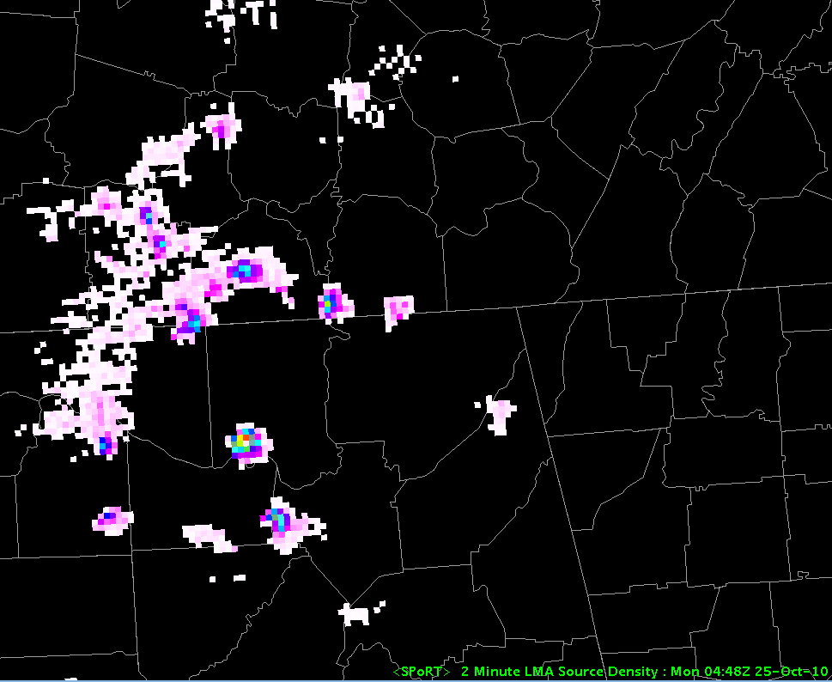
Total Lightning in AWIPS II
AWIPS II “raw data” display
Notes:
We are putting data into the HDF5 versus the meta database. Matt has new version to install. What is the next step? Where is McIDAS?

Slide 9
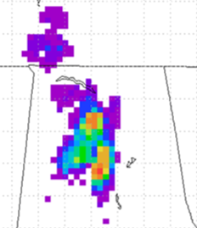
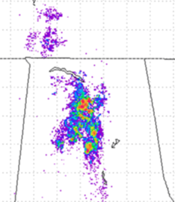
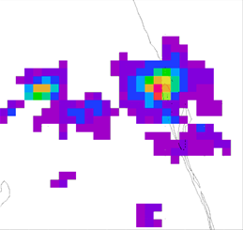
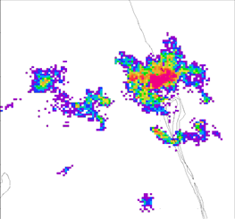
What is the Pseudo-GLM?
North Alabama Data
Uses ground-based LMA
Use any available network
Different from current displays
Uses flash density
10 km resolution
Same temporal resolution
Pseudo-GLM
Source Density
Kennedy Space Center

Slide 10
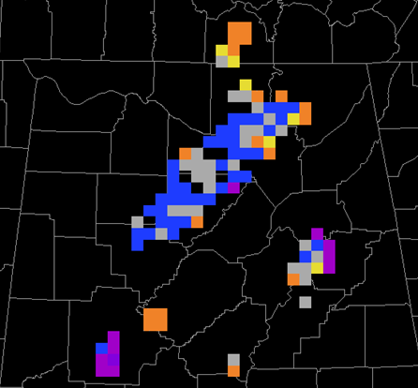
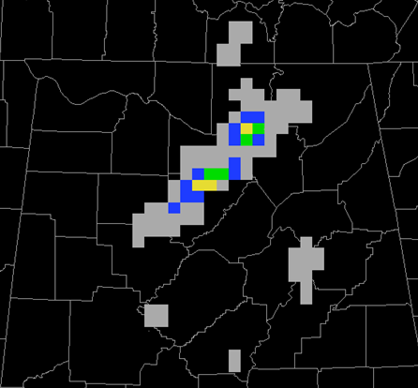
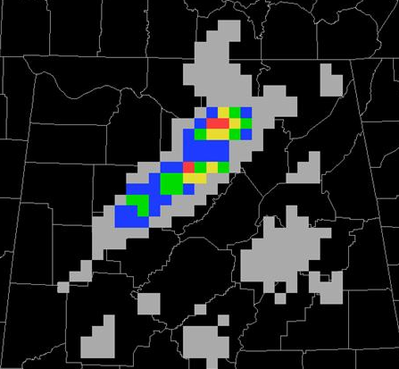
Other Pseudo-GLM Products
Rate of Change
2-min PGLM
30 min Maximum Density

Slide 11
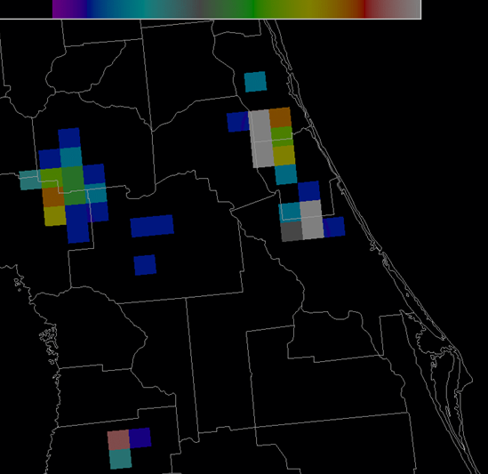
SPoRT Partner Collaborations
Will not replace existing total lightning data
Recommend WES case
PGLM not likely to be used in real-time
Allows more vigorous analysis
Same temporal resolution
Pseudo-GLM from KSC LDAR II
Notes:
List likely candidates from Kevin’s slide

Slide 12
Evaluation Plans
Test-bed: Huntsville WFO has been ingesting and displaying initial version of hybrid product for several months. Ready to widen user group.
Provide instructions to update D-2d with PG hybrid products to willing participants (~8) and evaluate this Winter.
Prepare AWG Convective Initiation product for use within D-2d and assist AWG with training development.
Look to provide other AWG products (e.g. fog), if possible.
Prepare users for second evaluation period that include CI and other products in Spring (near HWT SE time period).

Slide 13
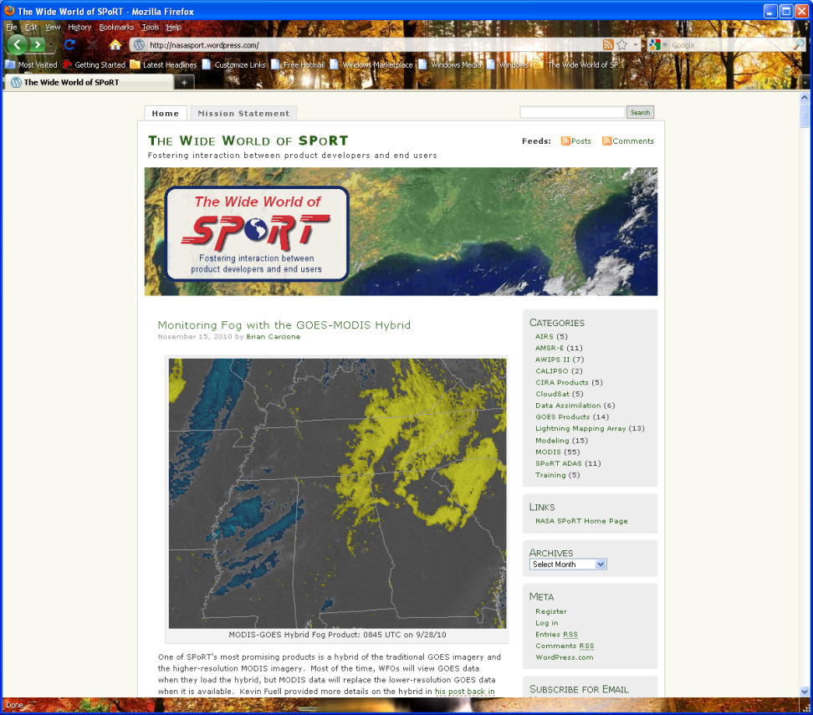
Evaluation Strategy
Wide World of SPoRT Blog
Sign up for individual accounts and alerts
Web survey to rate value of products and indicate primary application
What is current forecast application?
How does this change?
Blog post to share with GOES-R PG community your use of the data
Evaluate for 3-4 weeks and then can provide results and adjust product/display /training as needed.

