Slide 1

Computing Cooperatively with People You Don't Trust
University of Richmond
30 January 2012
David Evans
University of Virginia
http://www.cs.virginia.edu/evans
http://MightBeEvil.com

Slide 2
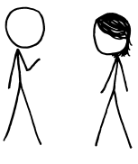
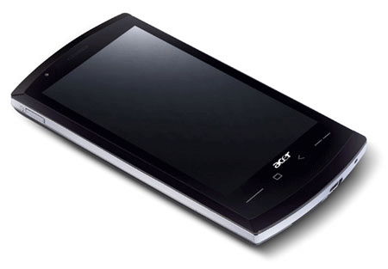

“Genetic Dating”
Bob
Alice
Genome Compatibility Protocol
Your offspring will have good immune systems!
Your offspring will have good immune systems!
WARNING!
Don’t Reproduce
WARNING!
Don’t Reproduce

Slide 3


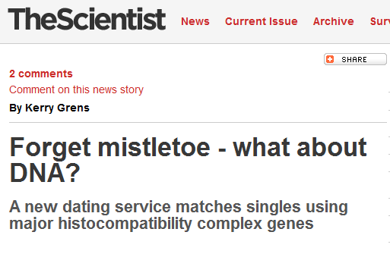


Slide 4
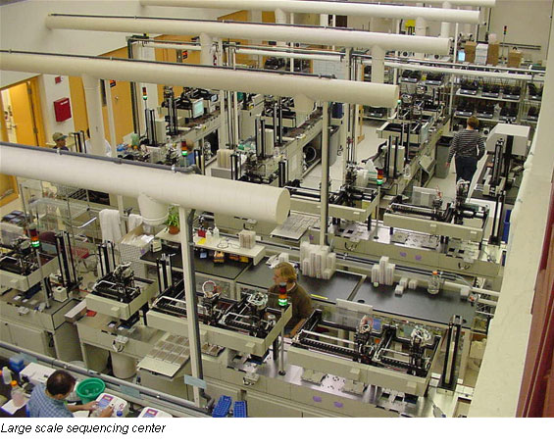
Genome Sequencing
1990: Human Genome Project starts, estimate $3B to sequence one genome ($0.50/base)
2000: Human Genome Project declared complete, cost ~$300M
Whitehead Institute, MIT

Slide 5
Cost to sequence human genome
Moore’s Law prediction
(halve every 18 months)
Data from National Human Genome Research Institute: http://www.genome.gov/sequencingcosts

Slide 6
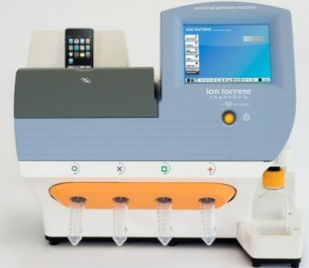
Cost to sequence human genome
Moore’s Law prediction
(halve every 18 months)
Ion torrent Personal Genome Machine
Data from National Human Genome Research Institute: http://www.genome.gov/sequencingcosts

Slide 7
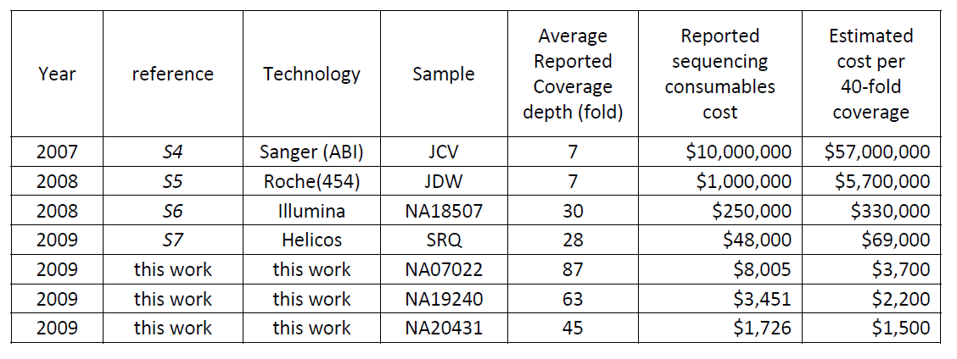
Human Genome Sequencing Using Unchained Base Reads on Self-Assembling DNA Nanoarrays. Radoje Drmanac, Andrew B. Sparks, Matthew J. Callow, Aaron L. Halpern, Norman L. Burns, Bahram G. Kermani, Paolo Carnevali, Igor Nazarenko, Geoffrey B. Nilsen, George Yeung, Fredrik Dahl, Andres Fernandez, Bryan Staker, Krishna P. Pant, Jonathan Baccash, Adam P. Borcherding, Anushka Brownley, Ryan Cedeno, Linsu Chen, Dan Chernikoff, Alex Cheung, Razvan Chirita, Benjamin Curson, Jessica C. Ebert, Coleen R. Hacker, Robert Hartlage, Brian Hauser, Steve Huang, Yuan Jiang, Vitali Karpinchyk, Mark Koenig, Calvin Kong, Tom Landers, Catherine Le, Jia Liu, Celeste E. McBride, Matt Morenzoni, Robert E. Morey, Karl Mutch, Helena Perazich, Kimberly Perry, Brock A. Peters, Joe Peterson, Charit L. Pethiyagoda, Kaliprasad Pothuraju, Claudia Richter, Abraham M. Rosenbaum, Shaunak Roy, Jay Shafto, Uladzislau Sharanhovich, Karen W. Shannon, Conrad G. Sheppy, Michel Sun, Joseph V. Thakuria, Anne Tran, Dylan Vu, Alexander Wait Zaranek, Xiaodi Wu, Snezana Drmanac, Arnold R. Oliphant, William C. Banyai, Bruce Martin, Dennis G. Ballinger, George M. Church, Clifford A. Reid. Science, January 2010.

Slide 8




Dystopia
Personalized Medicine

Slide 9
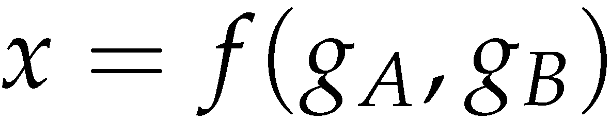
Secure Two-Party Computation
Bob’s Genome: ACTG…
Markers (~1000): [0,1, …, 0]
Alice’s Genome: ACTG…
Markers (~1000): [0, 0, …, 1]
Bob
Alice
Can Alice and Bob compute a function of their private data, without exposing anything about their data besides the result?

Slide 10
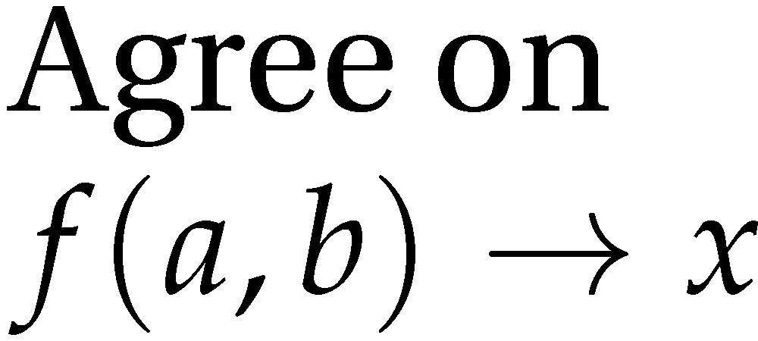


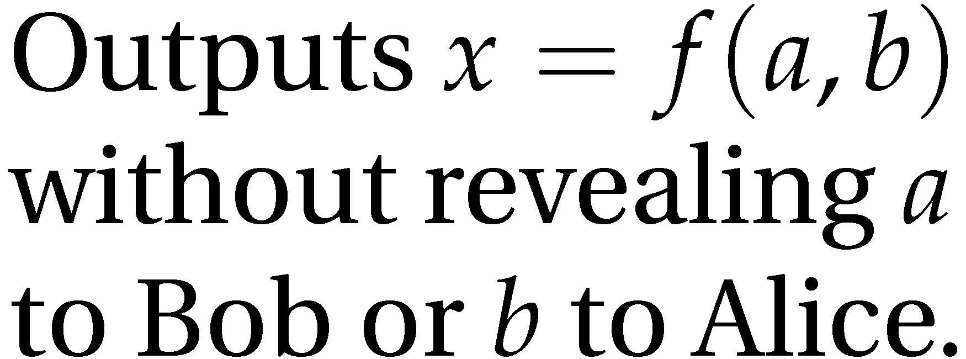
Secure Function Evaluation
Alice (circuit generator)
Bob (circuit evaluator)
Garbled Circuit Protocol
Andrew Yao, 1982/1986

Slide 11
Regular Logic
Inputs |  | Output
a | b | x
0 | 0 | 0
0 | 1 | 0
1 | 0 | 0
1 | 1 | 1
a
b
AND
x

Slide 12
Computing with Meaningless Values?
Inputs |  | Output
a | b | x
a₀ | b₀ | x₀
a₀ | b₁ | x₀
a₁ | b₀ | x₀
a₁ | b₁ | x₁
a₀ or a₁
b₀ or b₁
a_{i}, b_{i}, x_{i} are random values, chosen by the circuit generator but meaningless to the circuit evaluator.
AND
x₀ or x₁

Slide 13
Encryption
Encrypt

Slide 14
Logic with Privacy
Inputs |  | Output
a | b | x
a₀ | b₀
a₀ | b₁
a₁ | b₀
a₁ | b₁

Slide 15
Computing with Garbled Tables
Inputs |  | Output
a | b | x
a₀ | b₀ | Enc_{a0,b0}(x₀)
a₀ | b₁ | Enc_{a0,b1}(x₀)
a₁ | b₀ | Enc_{a1,b0}(x₀)
a₁ | b₁ | Enc_{a1,b1}(x₁)
Bob can only decrypt one of these!
a₀ or a₁
b₀ or b₁
Garbled And Gate
Enc_{a0, b1}(x₀)
Enc_{a1,b1}(x₁)
Enc_{a1,b0}(x₀)
Enc_{a0,b0}(x₀)
Random Permutation
AND
x₀ or x₁

Slide 16
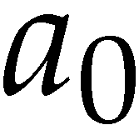
Garbled Circuit Protocol
Alice (circuit generator)
Bob (circuit evaluator)
Garbled Gate
Enc_{a0, b1}(x₀)
Enc_{a1,b1}(x₁)
Enc_{a1,b0}(x₀)
Enc_{a0,b0}(x₀)
Sends a_{i} to Bob based on her input value
How does the Bob learn his own input wires?

Slide 17




Primitive: Oblivious Transfer
Alice
Bob
Oblivious Transfer Protocol
Oblivious: Alice doesn’t learn which secret Bob obtains
Transfer: Bob learns one of Alice’s secrets
Rabin, 1981; Even, Goldreich, and Lempel, 1985; many subsequent papers

Slide 18
Chaining Garbled Circuits
And Gate 1
Enc_{a10, b11}(x1₀)
Enc_{a11,b11}(x1₁)
Enc_{a11,b10}(x1₀)
Enc_{a10,b10}(x1₀)
a0
b0
a1
b1
AND
AND
x0
x1
Or Gate 2
Enc_{x00, x11}(x2₁)
Enc_{x01,x11}(x2₁)
Enc_{x01,x10}(x2₁)
Enc_{x00,x10}(x2₀)
OR
x₂
…
We can do any computation privately this way!

Slide 19
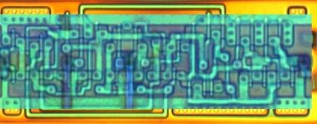
Building Computing Systems
Enc_{x00, x11}(x2₁)
Enc_{x01,x11}(x2₁)
Enc_{x01,x10}(x2₁)
Enc_{x00,x10}(x2₀)
Digital Electronic Circuits | Garbled Circuits
Operate on known data | Operate on encrypted wire labels
One-bit logical operation requires moving a few electrons a few nanometers (hundreds of Billions per second) | One-bit logical operation requires performing (up to) 4 encryption operations: very slow execution
Reuse is great! | Reuse is not allowed for privacy: huge circuits needed

Slide 20
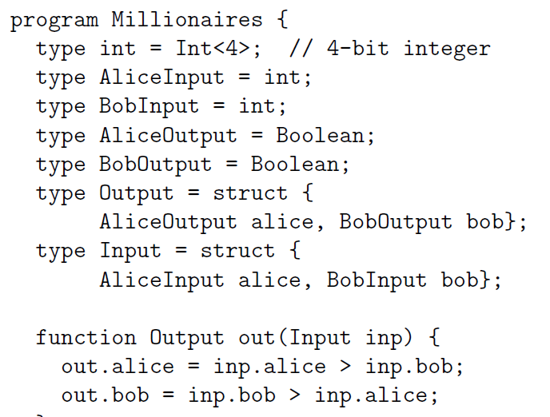
Fairplay
Bob
Alice
SFDL Compiler
SFDL Compiler
Circuit
(SHDL)
SFDL Program
Garbled Tables Generator
Dahlia Malkhi, Noam Nisan, Benny Pinkas and Yaron Sella [USENIX Sec 2004]
Garbled Tables Evaluator

Slide 21
Faster Garbled Circuits
Circuit-Level Application
Circuit Structure
Circuit Structure
GC Framework (Generator)
GC Framework
(Evaluator)
Enc_{x00, x11}(x2₁)
Enc_{x01,x11}(x2₁)
Enc_{x01,x10}(x2₁)
Enc_{x20, x21}(x3₀)
Enc_{x21,x21}(x3₀)
Enc_{x21,x20}(x3₁)
x2₁
Enc_{x20, x31}(x4₁)
Enc_{x21,x31}(x4₁)
Enc_{x21,x30}(x4₀)
x3₁
Enc_{x40, x31}(x5₁)
Enc_{x41,x31}(x5₀)
Enc_{x41,x30}(x5₀)
Enc_{x40, x51}(x6₁)
Enc_{x41,x51}(x6₀)
Enc_{x41,x50}(x6₀)
x4₁
Enc_{x30, x61}(x7₁)
Enc_{x31,x61}(x7₀)
Enc_{x31,x60}(x7₁)
x5₁
x6₀
x7₁
Gates can be evaluated as they are generated: pipelining
Gates can be evaluated in any topological sort order: parallelizing
Garbled evaluation can be combined with normal execution

Slide 22
Results: Performance
Binary gates per millisecond
100,000 gates per second

Slide 23
Results: Scalability
Largest circuit executed
(non-free gates)

Slide 24

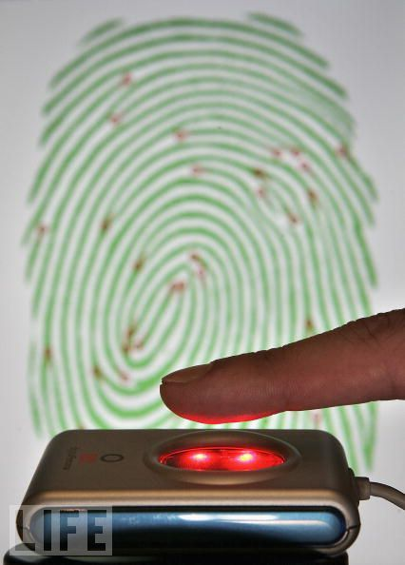
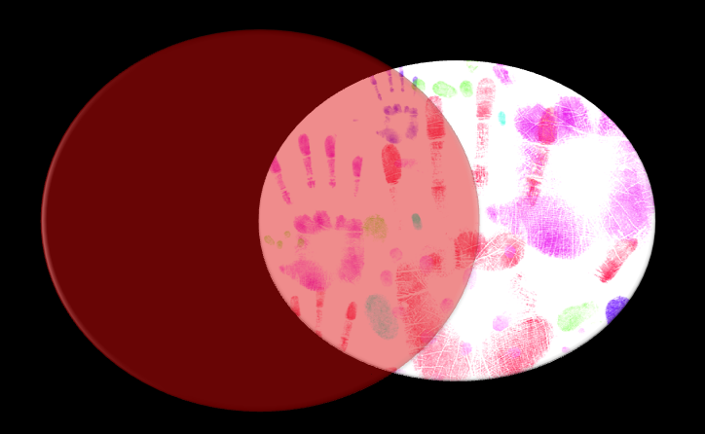

Applications
Private Personal Genomics
Privacy-Preserving Biometric Matching
Private AES Encryption
Private Set Intersection

Slide 25
Heterozygous Recessive Risk
Alice
 | A | a
A | AA | Aa
a | aA | aa
carrier
Bob
cystic fibrosis
Alice’s Heterozygous Recessive genes: { 5283423, 1425236, 839523, … }
Bob’s Heterozygous Recessive genes: { 5823527, 839523, 169325, … }
Goal: find the intersection of A and B

Slide 26
Bit Vector Intersection
Alice’s Recessive genes:
{ 5283423, 1425236, 839523, … }
Bob’s Recessive genes:
{ 5823527, 839523, 169325, … }
[ PAH, PKU, CF, … ]
[ 0, 0, 1, 0, 0, 0, 1, 0, 1, 1, 0]
[ 0, 0, 1, 0, 0, 0, 0, 0, 1, 0, 0]
. . .
AND
AND
AND
. . .
Bitwise AND

Slide 27



Common Contacts
Notes:
.

Slide 28
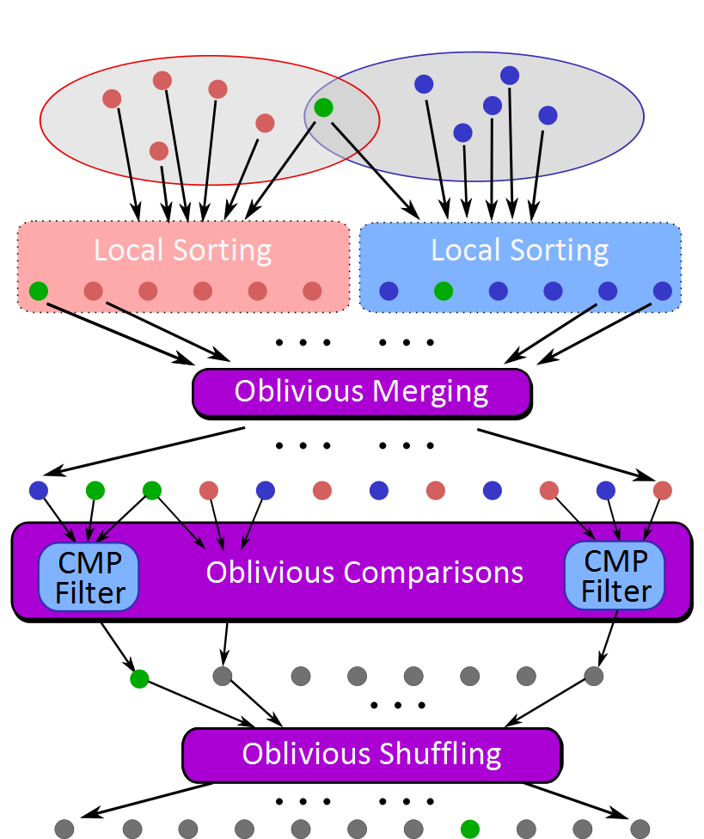
Sort-Compare-Shuffle
Sort: Take advantage of total order of elements
Compare adjacent elements
Shuffle to hide positions

Slide 29
SCS-WN Protocol Results
32-bit values

Slide 30
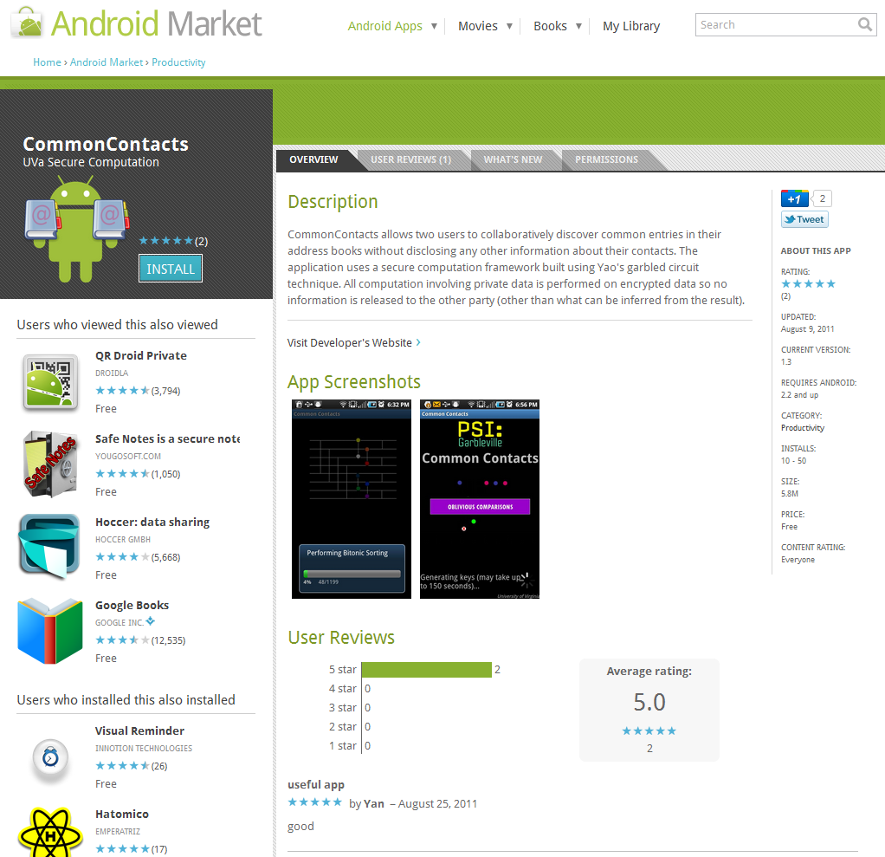

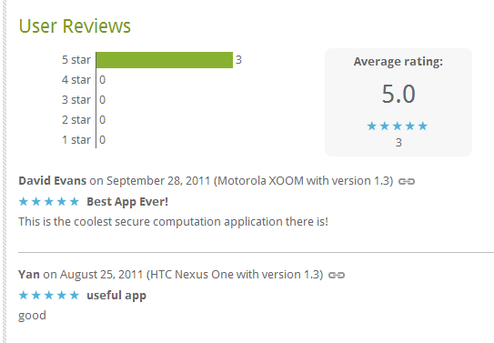

Slide 31
Problem | Best Previous Result | Our Result | Speedup
Private Set Intersection (contact matching, common disease carrier) | Competitive with best custom protocols, scales to millions of 32-bit elements
Hamming Distance (Face Recognition) | 213s [SCiFI, 2010] | 0.051s | 4176
Levenshtein Distance (genome, text comparison) – two 200-character inputs | 534s [Jha+, 2008] | 18.4s | 29
Smith-Waterman (genome alignment) – two 60-nucleotide sequences | [Not Implementable] | 447s | -
AES Encryption | 3.3s [Henecka, 2010] | 0.2s | 16.5
Fingerprint Matching (1024-entry database, 640x8bit vectors) | ~83s [Barni, 2010] | 18s | 4.6
NDSS 2012
USENIX Security 2011
NDSS 2011

Slide 32
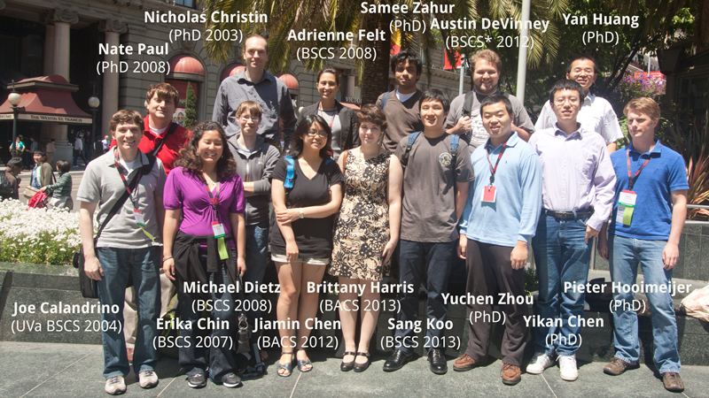
Research Group and Alumni

Slide 33
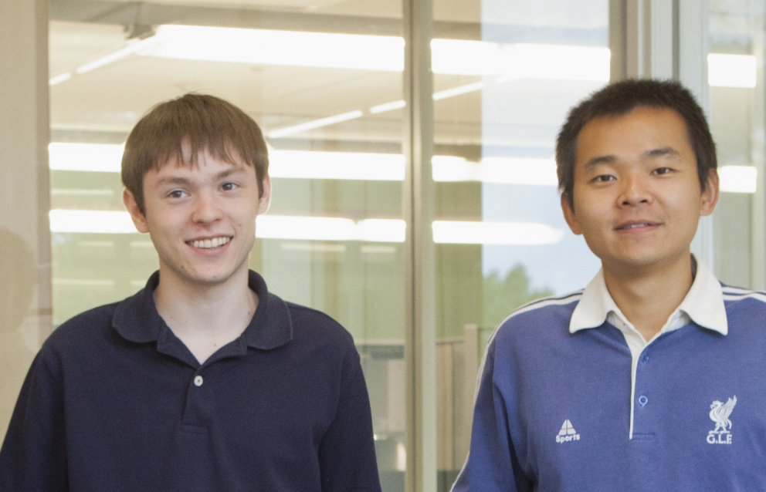
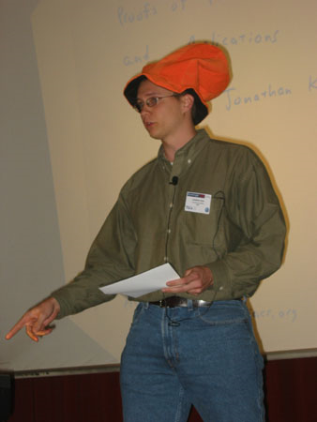
Peter Chapman
(UVa BACS 2012)
Yan Huang
(UVa Computer Science
PhD Student)
Funding:
NSF, MURI (AFOSR), Google
Jonathan Katz
(University of Maryland)

Slide 34
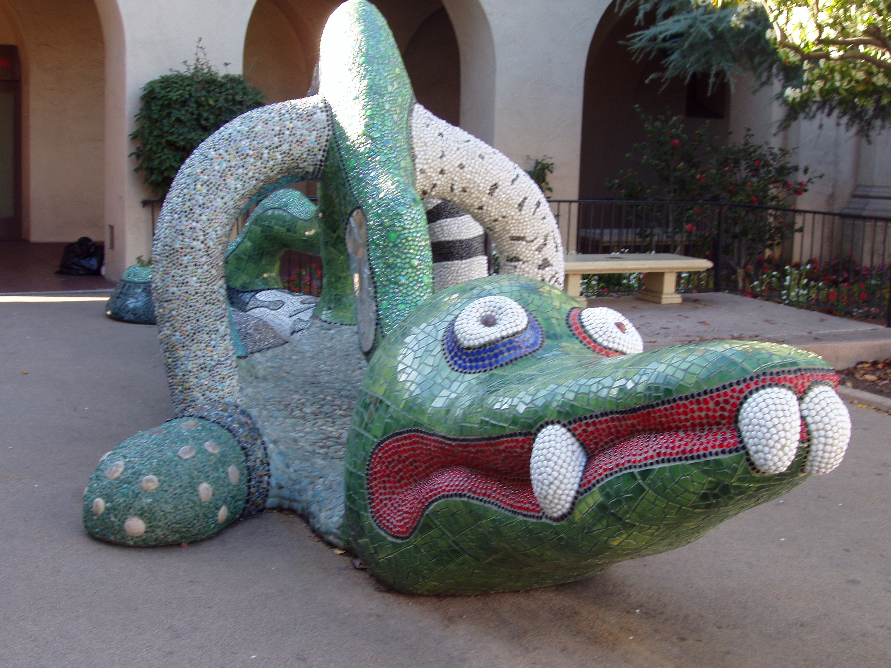
MightBeEvil.com

