Slide 1

Bioinformatics Methods for Reconstruction of Infectious Bronchitis Virus Quasispecies from Next Generation Sequencing Data
Bassam Tork
Georgia State University
Atlanta, GA 30303, USA

Slide 2
Outline
Introduction
Reconstruction of Quasispecies from Shotgun Reads.
Experiment Results
Future Work.

Slide 3
Infectious Bronchitis Virus (IBV)
Group 3 coronavirus
Economic loss in US poultry farms
Young chickens
Broiler chickens
Layers
Worldwide distribution, with dozens of serotypes in circulation
Co-infection with multiple serotypes is not uncommon, creating conditions for recombination

Slide 4
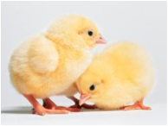
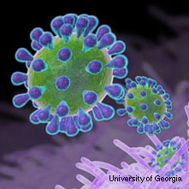
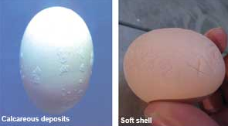
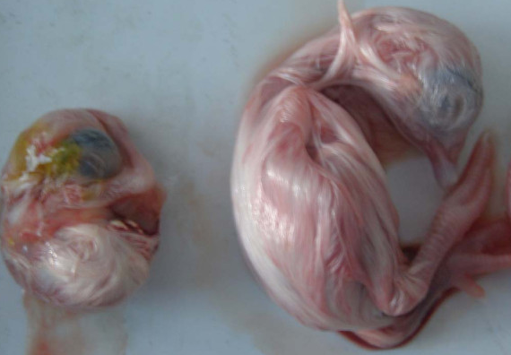
Infectious Bronchitis Virus (IBV)
Main cause of economic loss in US poultry farms
healthy chicks
IBV-infected
egg defect
IBV-infected
embryo
normal
embryo

Slide 5
IBV Vaccination
Broadly used; attenuated live vaccine
Short lived protection
Layers need to be re-vaccinated multiple times during their lifespan
Vaccines might undergo selection in vivo and regain virulence [Hilt, Jackwood, and McKinley 2008]

Slide 6
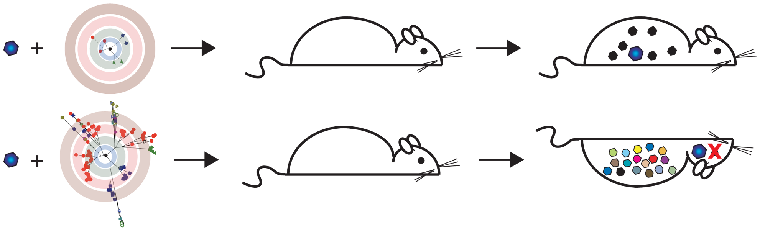
How Are Quasispecies Contributing to Virus Persistence and Evolution?
Variants differ in
Virulence
escape immune response
Resistance to antiviral therapies
Lauring & Andino, PLoS Pathogens 2011

Slide 7
Next Generation Sequencing and IBV
Develop computational methods to study quasispecies evolution pre and post vaccination
Optimize vaccination Strategies

Slide 8
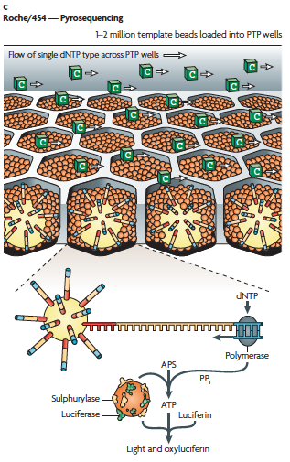
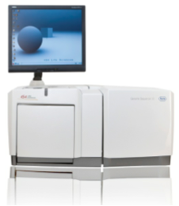
+ Ion Torrent
Ion Proton

Slide 9
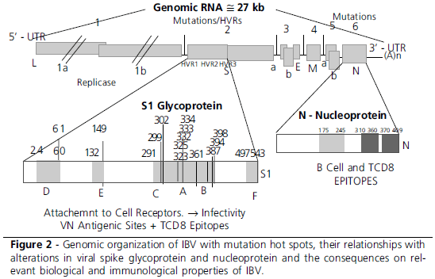
Evolution of IBV
Taken from Rev. Bras. Cienc. Avic. vol.12 no.2 Campinas Apr./June 2010

Slide 10
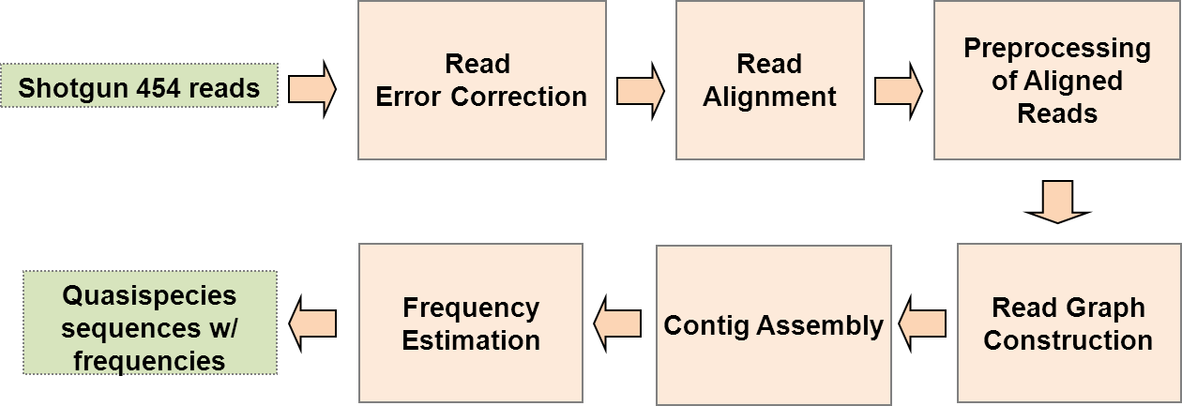
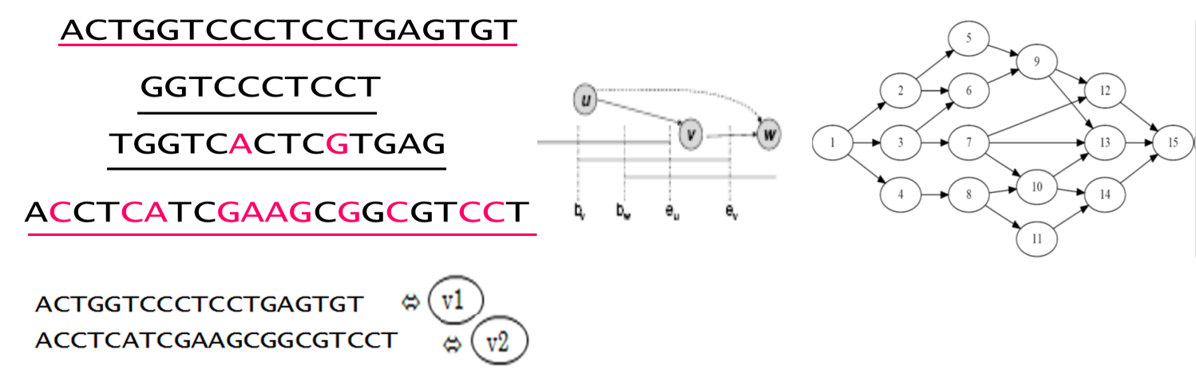
ViSpA:Viral Spectrum Assembler
User Specified Parameters: (A) Number of mismatches (B) Mutation rate

Slide 11
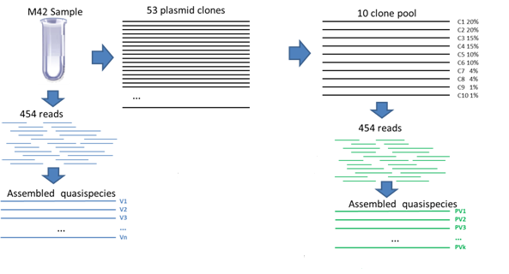
Experiment1
A
B

Slide 12


Reads Statistics & Coverage
Sample | Number of Reads
 | Uncorrected | SAET Corrected | Shorah Corrected | KEC Corrected
M42 isolate | 53062 | 53062 | 50858 | 48945
M42 clone pool | 21040 | 21040 | 19439 | 17122

Slide 13
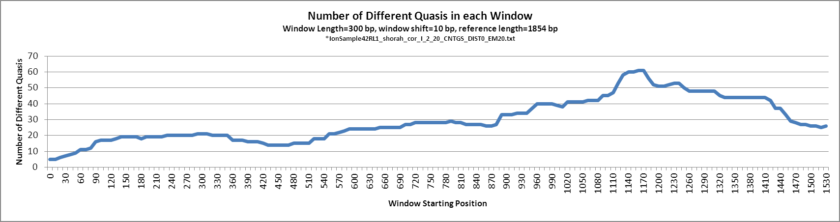
Reconstructed Quasispecies Variability
*IonSample42RL1.fas_KEC_corrected_I_2_20_CNTGS_DIST0_EM20.txt
Sequencing primer ATGGTTTGTGGTTTAATTCACTTTC

Slide 14
Pairwise Edit Distance between 10 Clone Pool
C1 | C2 | C3 | C4 | C5 | C6 | C7 | C8 | C9 | C10
0 | 0 | 2 | 2 | 1 | 3 | 4 | 42 | 7 | 3 | C1
 | 0 | 2 | 2 | 1 | 2 | 3 | 41 | 6 | 2 | C2
 |  | 0 | 4 | 3 | 5 | 6 | 44 | 9 | 5 | C3
 |  |  | 0 | 1 | 5 | 4 | 42 | 9 | 3 | C4
 |  |  |  | 0 | 4 | 3 | 41 | 8 | 2 | C5
 |  |  |  |  | 0 | 6 | 40 | 6 | 4 | C6
 |  |  |  |  |  | 0 | 45 | 11 | 4 | C7
 |  |  |  |  |  |  | 0 | 41 | 41 | C8
 |  |  |  |  |  |  |  | 0 | 8 | C9

Slide 15
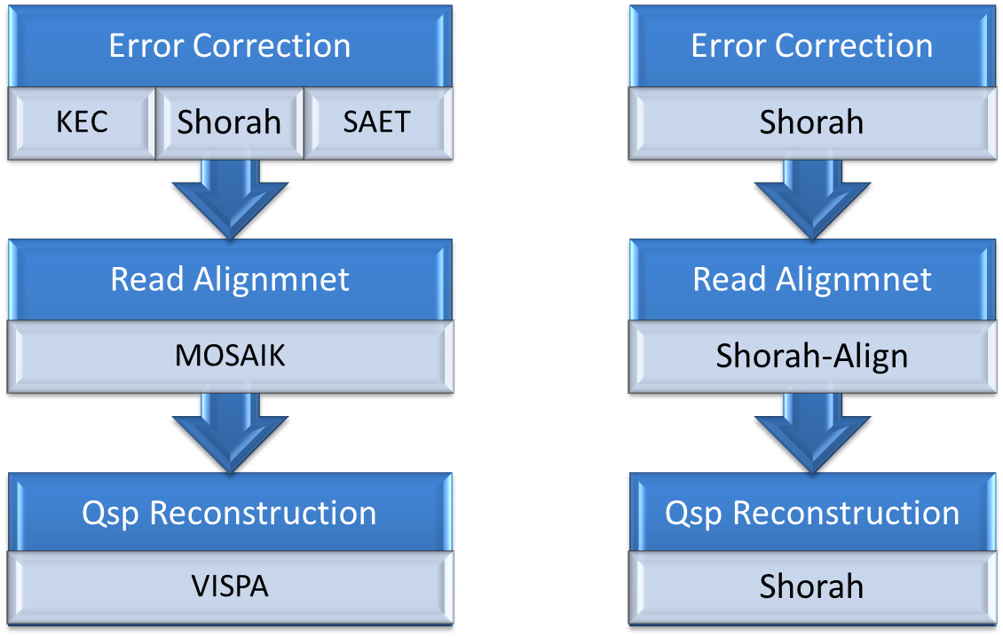
Quasispecies Reconstruction Flows

Slide 16
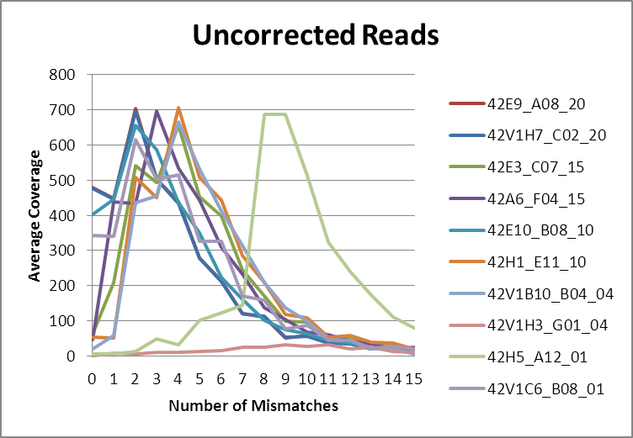
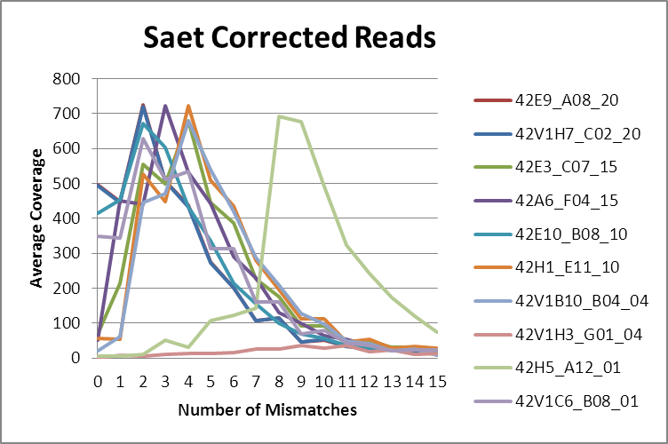
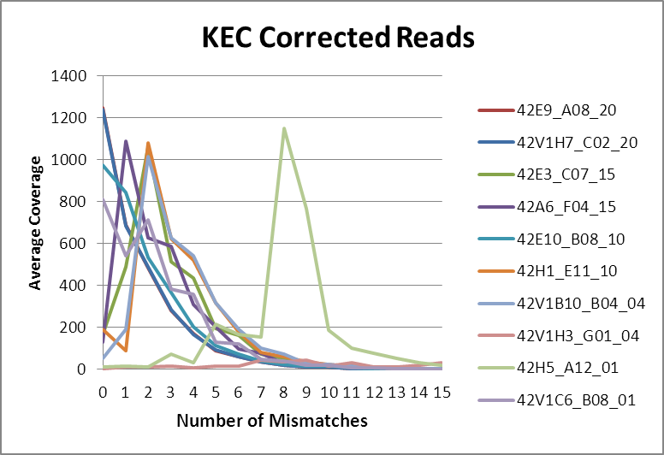
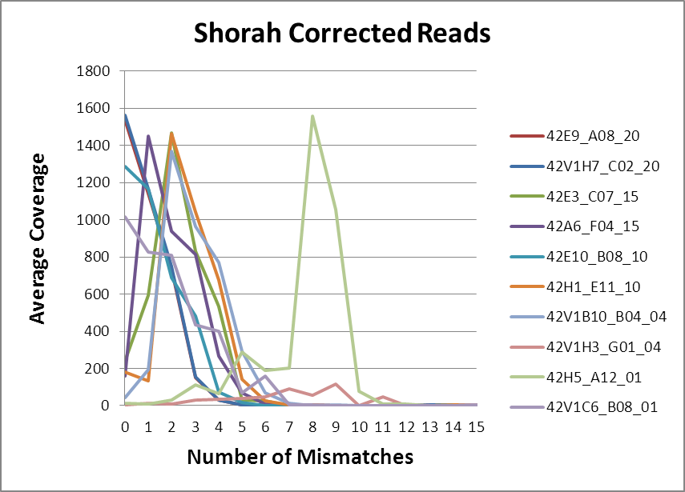
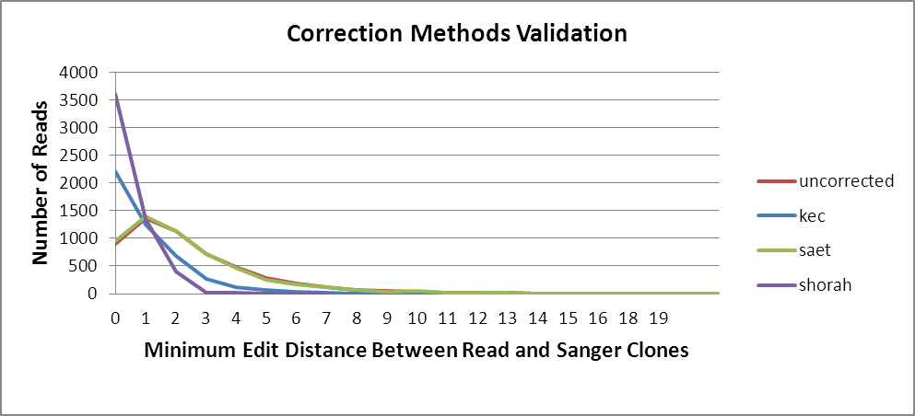
Reads Validation

Slide 17
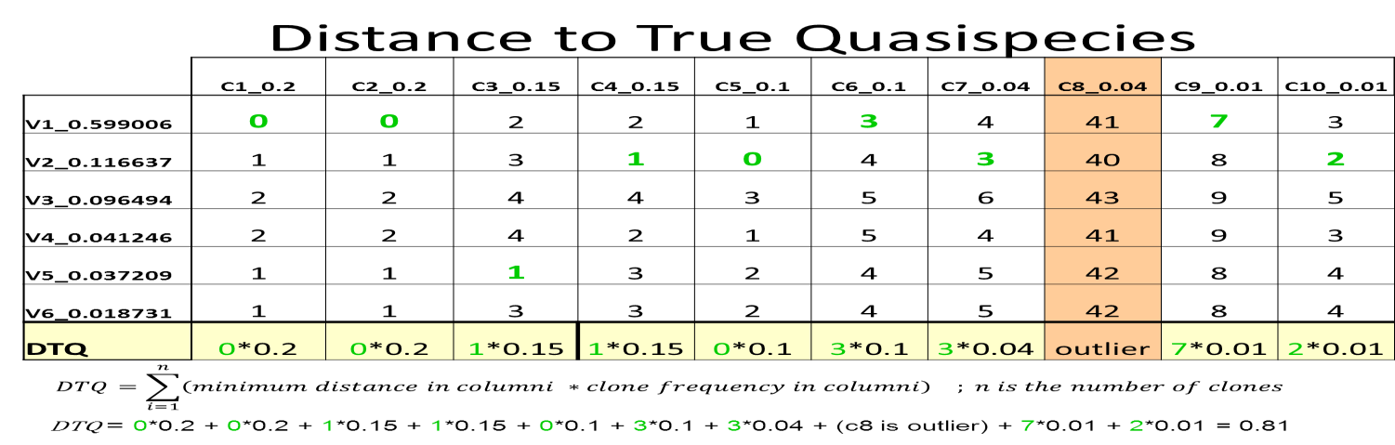
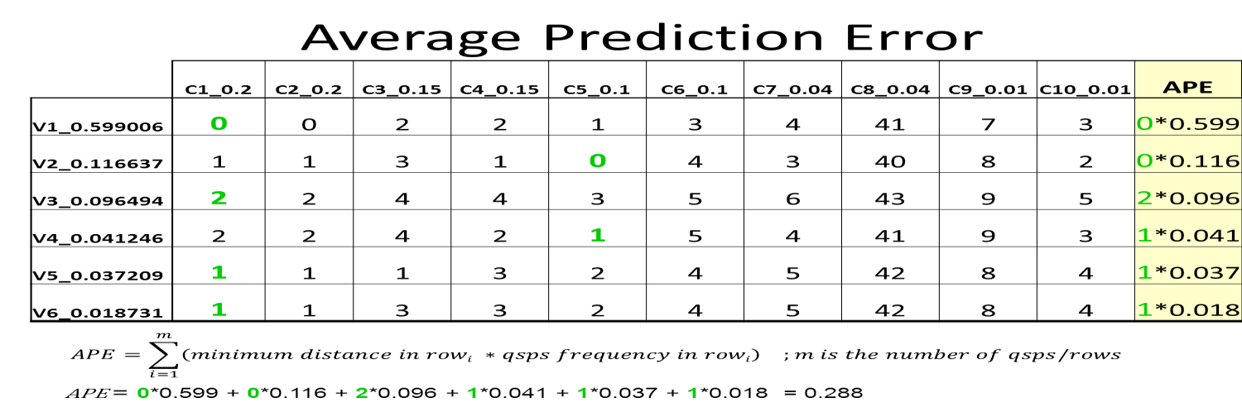
How well we predicted sanger clones
How well our
prediction is

Slide 18
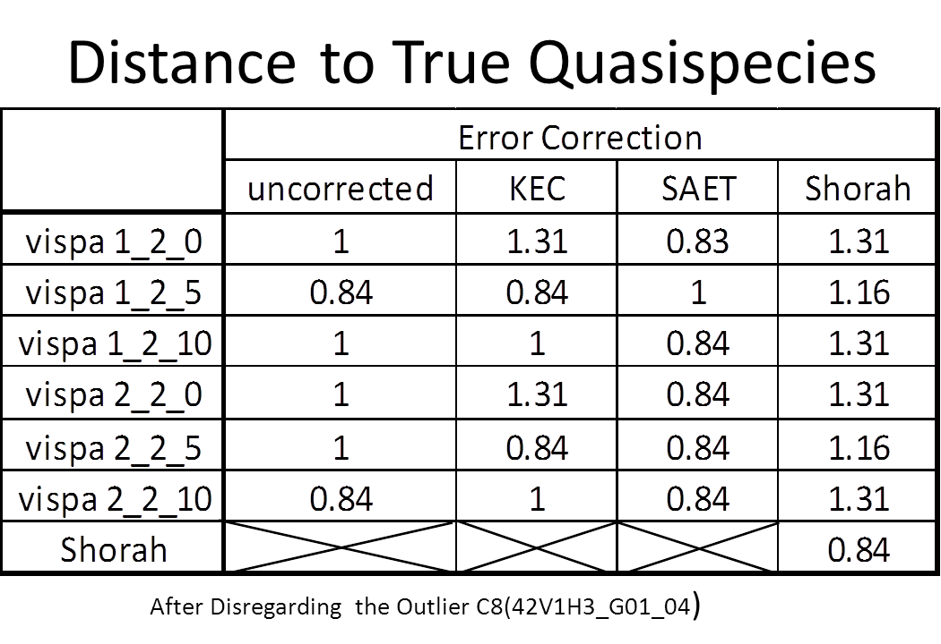
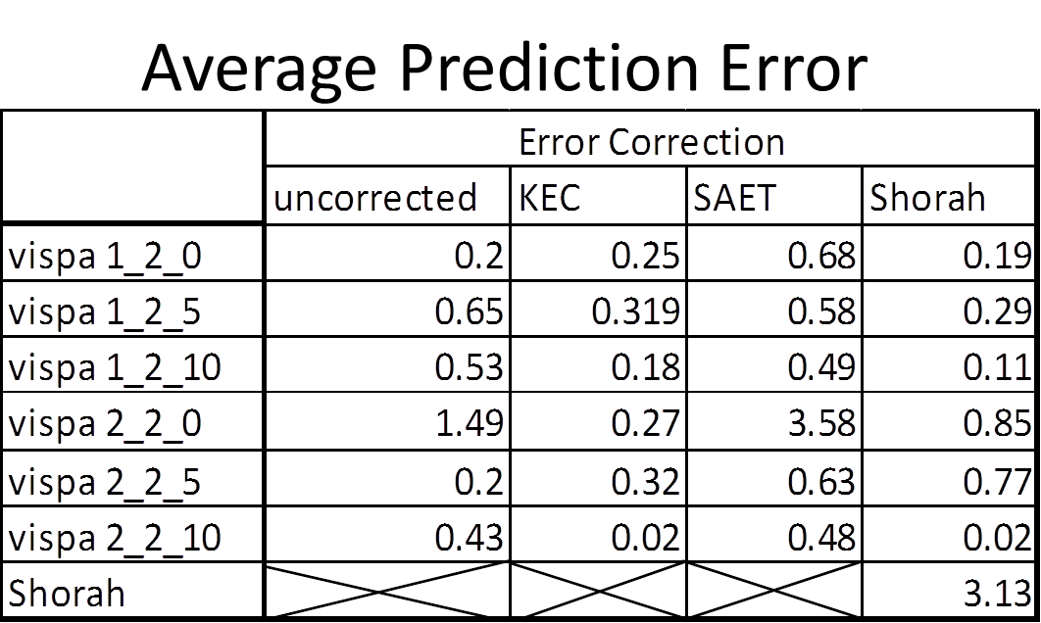
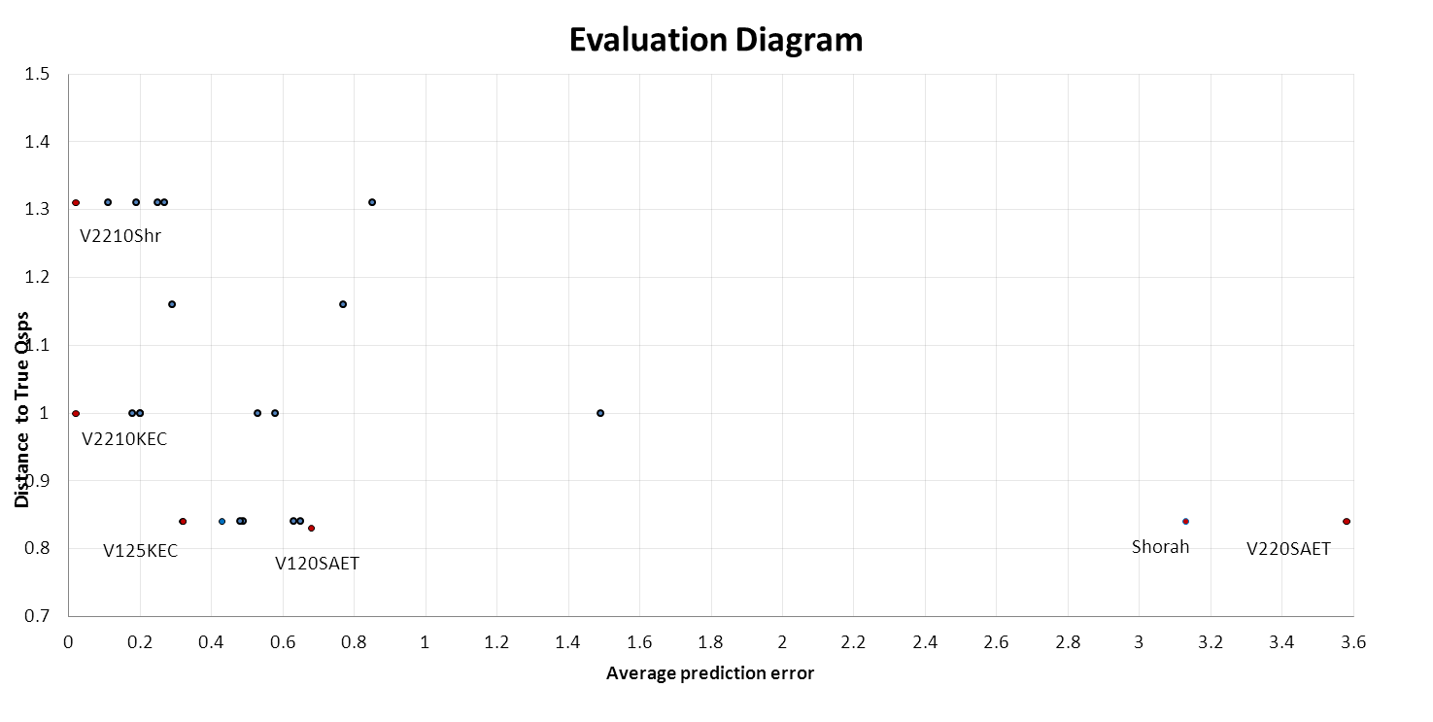
Average Prediction Error

Slide 19
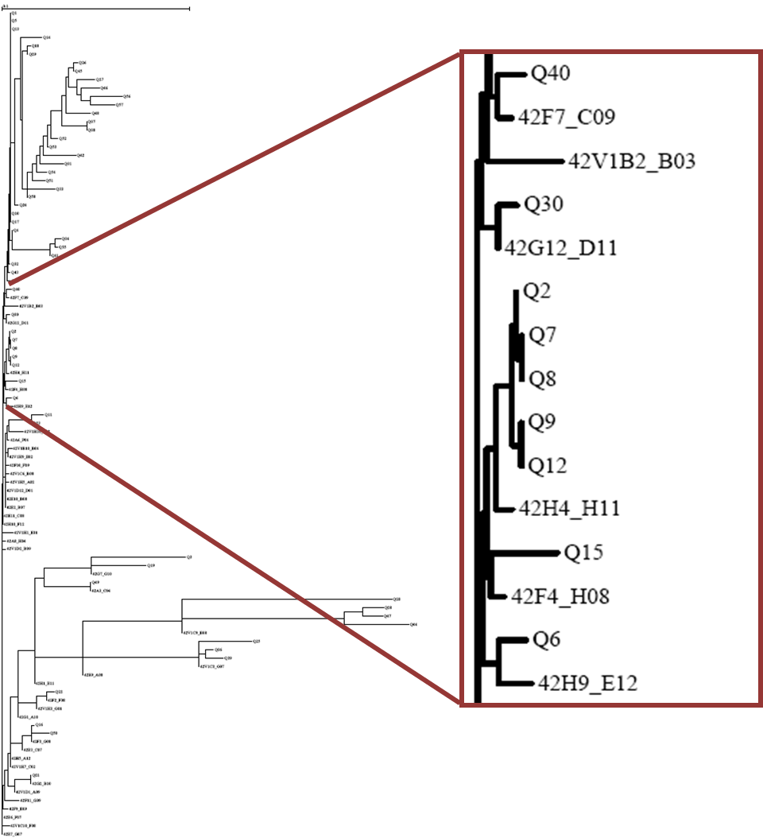
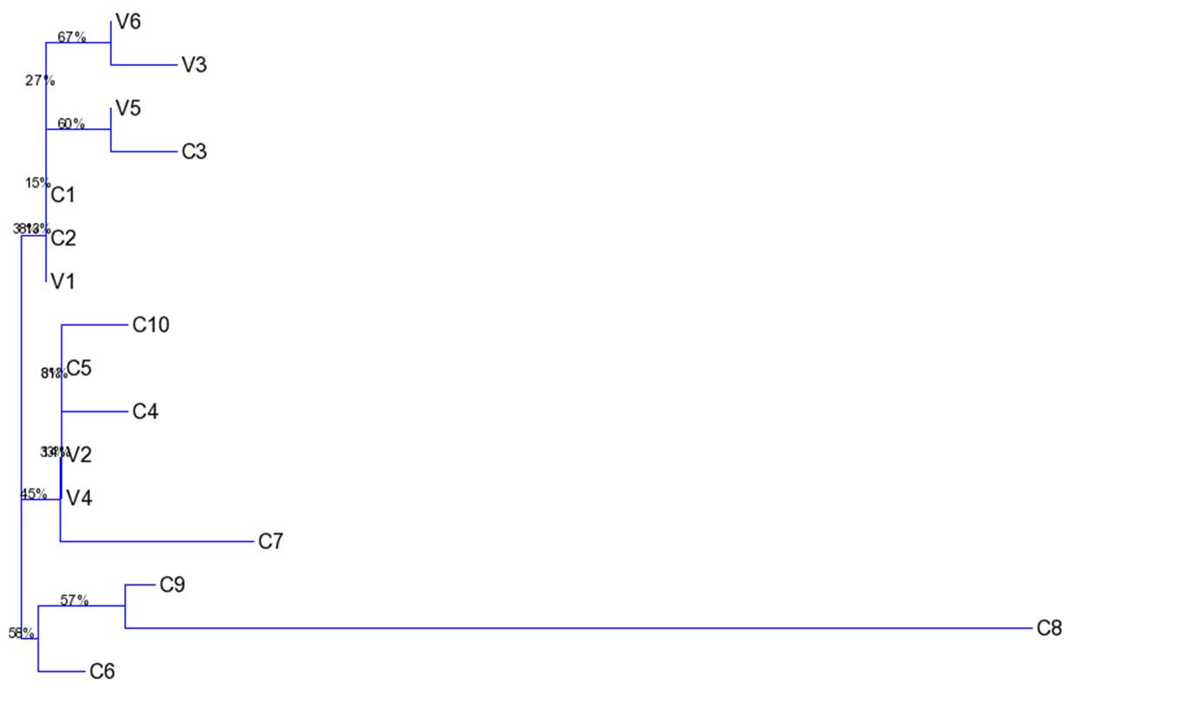
A: M42 Sanger
& ViSpA NJ Tree
B: M42 10 Clone Sangers
& ViSpA NJ Tree

Slide 20
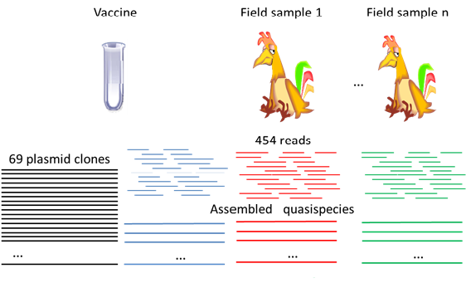
Experiment2

Slide 21
Reads Statistics & Coverage
Sample | Number of Reads
 | Uncorrected | SAET corrected | Shorah corrected | KEC corrected
M41 Vaccine | 92113 | 92113 | 87883 | 85311
Field #1 | 38502 | 38502 | 33685 | 32521
Field #2 | 132513 | 132513 | 123370 | 111686
Field #3 | 76906 | 76906 | 71408 | 64507
Field #4 | 44467 | 44467 | 41653 | 37295

Slide 22
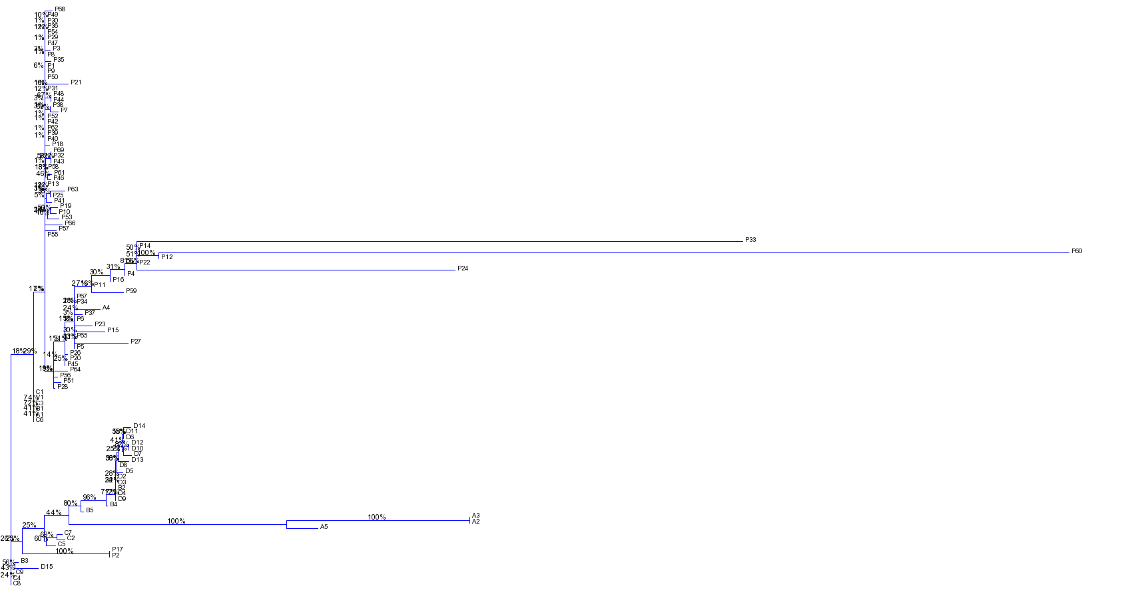
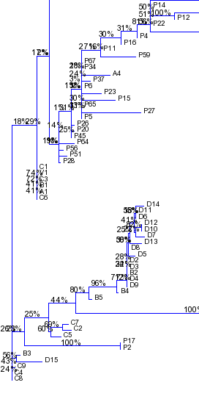

Vaccine Sanger & ViSpA NJ Tree

Slide 23
Future Work
Comparison of shotgun and amplicon based reconstruction methods
Quasispecies reconstruction from Ion Torrent reads
Combining long and short read technologies
Optimization of vaccination strategies

Slide 24




Contributors
Bassam Tork
Ekaterina Nenastyeva
Alex Artyomenko
Serghei Mangul
Nicholas Mancuso
Alexander Zelikovsky
University of Connecticut:
Rachel O’Neal, PhD.
Ion Mandiou, PhD.
Mazhar Kahn, Ph.D.
Hongjun Wang, Ph.D.
Craig Obergfell
Andrew Bligh
University of Maryland
Irina Astrovskaya, Ph.D.

Slide 25

Fundings
University of Connecticut:
Georgia State University:
Molecular Basis of Disease Program

Slide 26
Thanks

