Slide 1


Using Simple Abstraction to Guide the Reinvention of Computing for Parallelism
Uzi Vishkin
Same title, http://www.umiacs.umd.edu/users/vishkin/XMT/cacm2010.pdf, CACM, January 2011, to appear
Notes:
If the problem is navigating in space, a telescope may do a better job than a microscope

Slide 2
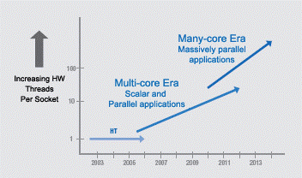
Commodity computer systems
1946➔2003 General-purpose computing: Serial. 5KHz➔4GHz.
2004 General-purpose computing goes parallel.
Clock frequency growth flat. #Transistors/chip 1980➔2011: 29K➔30B!
#”cores”: ~d^{y-2003}
If you want your program to
run significantly faster …
you’re going to have to
parallelize it
➔ Parallelism: only game in town
But, what about the programmer? “The Trouble with Multicore: Chipmakers are busy designing microprocessors that most programmers can't handle”—D. Patterson, IEEE Spectrum, 2010
Intel Platform 2015, March05:

Slide 3
Conclusion of Coming Intro Slide(s)
Productivity: code development time + runtime
Vendors’ many-cores are Productivity limited
Vendors: monolithic
Concerns 1. CS in awe of vendors’ HW: “face of practice”; Justified only if accepted/adopted
2. Debate: cluttered and off-point
3. May lead to misplaced despair
Need HW diversity of high productivity solutions. Then “natural selection”.
Will explain why US interests mandate greater role to academia

Slide 4

An “application dreamer”: between a rock and a hard place
Is CS destined for low productivity?
Programmer’s productivity busters Many-core HW
Decomposition-inventive design
☹ Reason about concurrency in threads
For the more parallel HW: issues if whole program is not highly parallel
Optimized for things you can “truly measure”: (old) benchmarks & power. What about productivity?
[Credit: wordpress.com]
Casualties of too-costly SW development
- Cost and time-to-market of applications
- Business model for innovation (& American ingenuity)
- Advantage to lower wage CS job markets. Next slide US: 15%
NSF HS plan: attract best US minds with less programming, 10K CS teachers
Vendors/VCs $3.5B Invest in America Alliance: Start-ups,10.5K CS grad jobs
.. Only future of the field & U.S. (and ‘US-like’) competitiveness
Notes:
Can I change this HW (the rock)?
No, you can develop a decomposition-first multi-threaded program

Slide 5
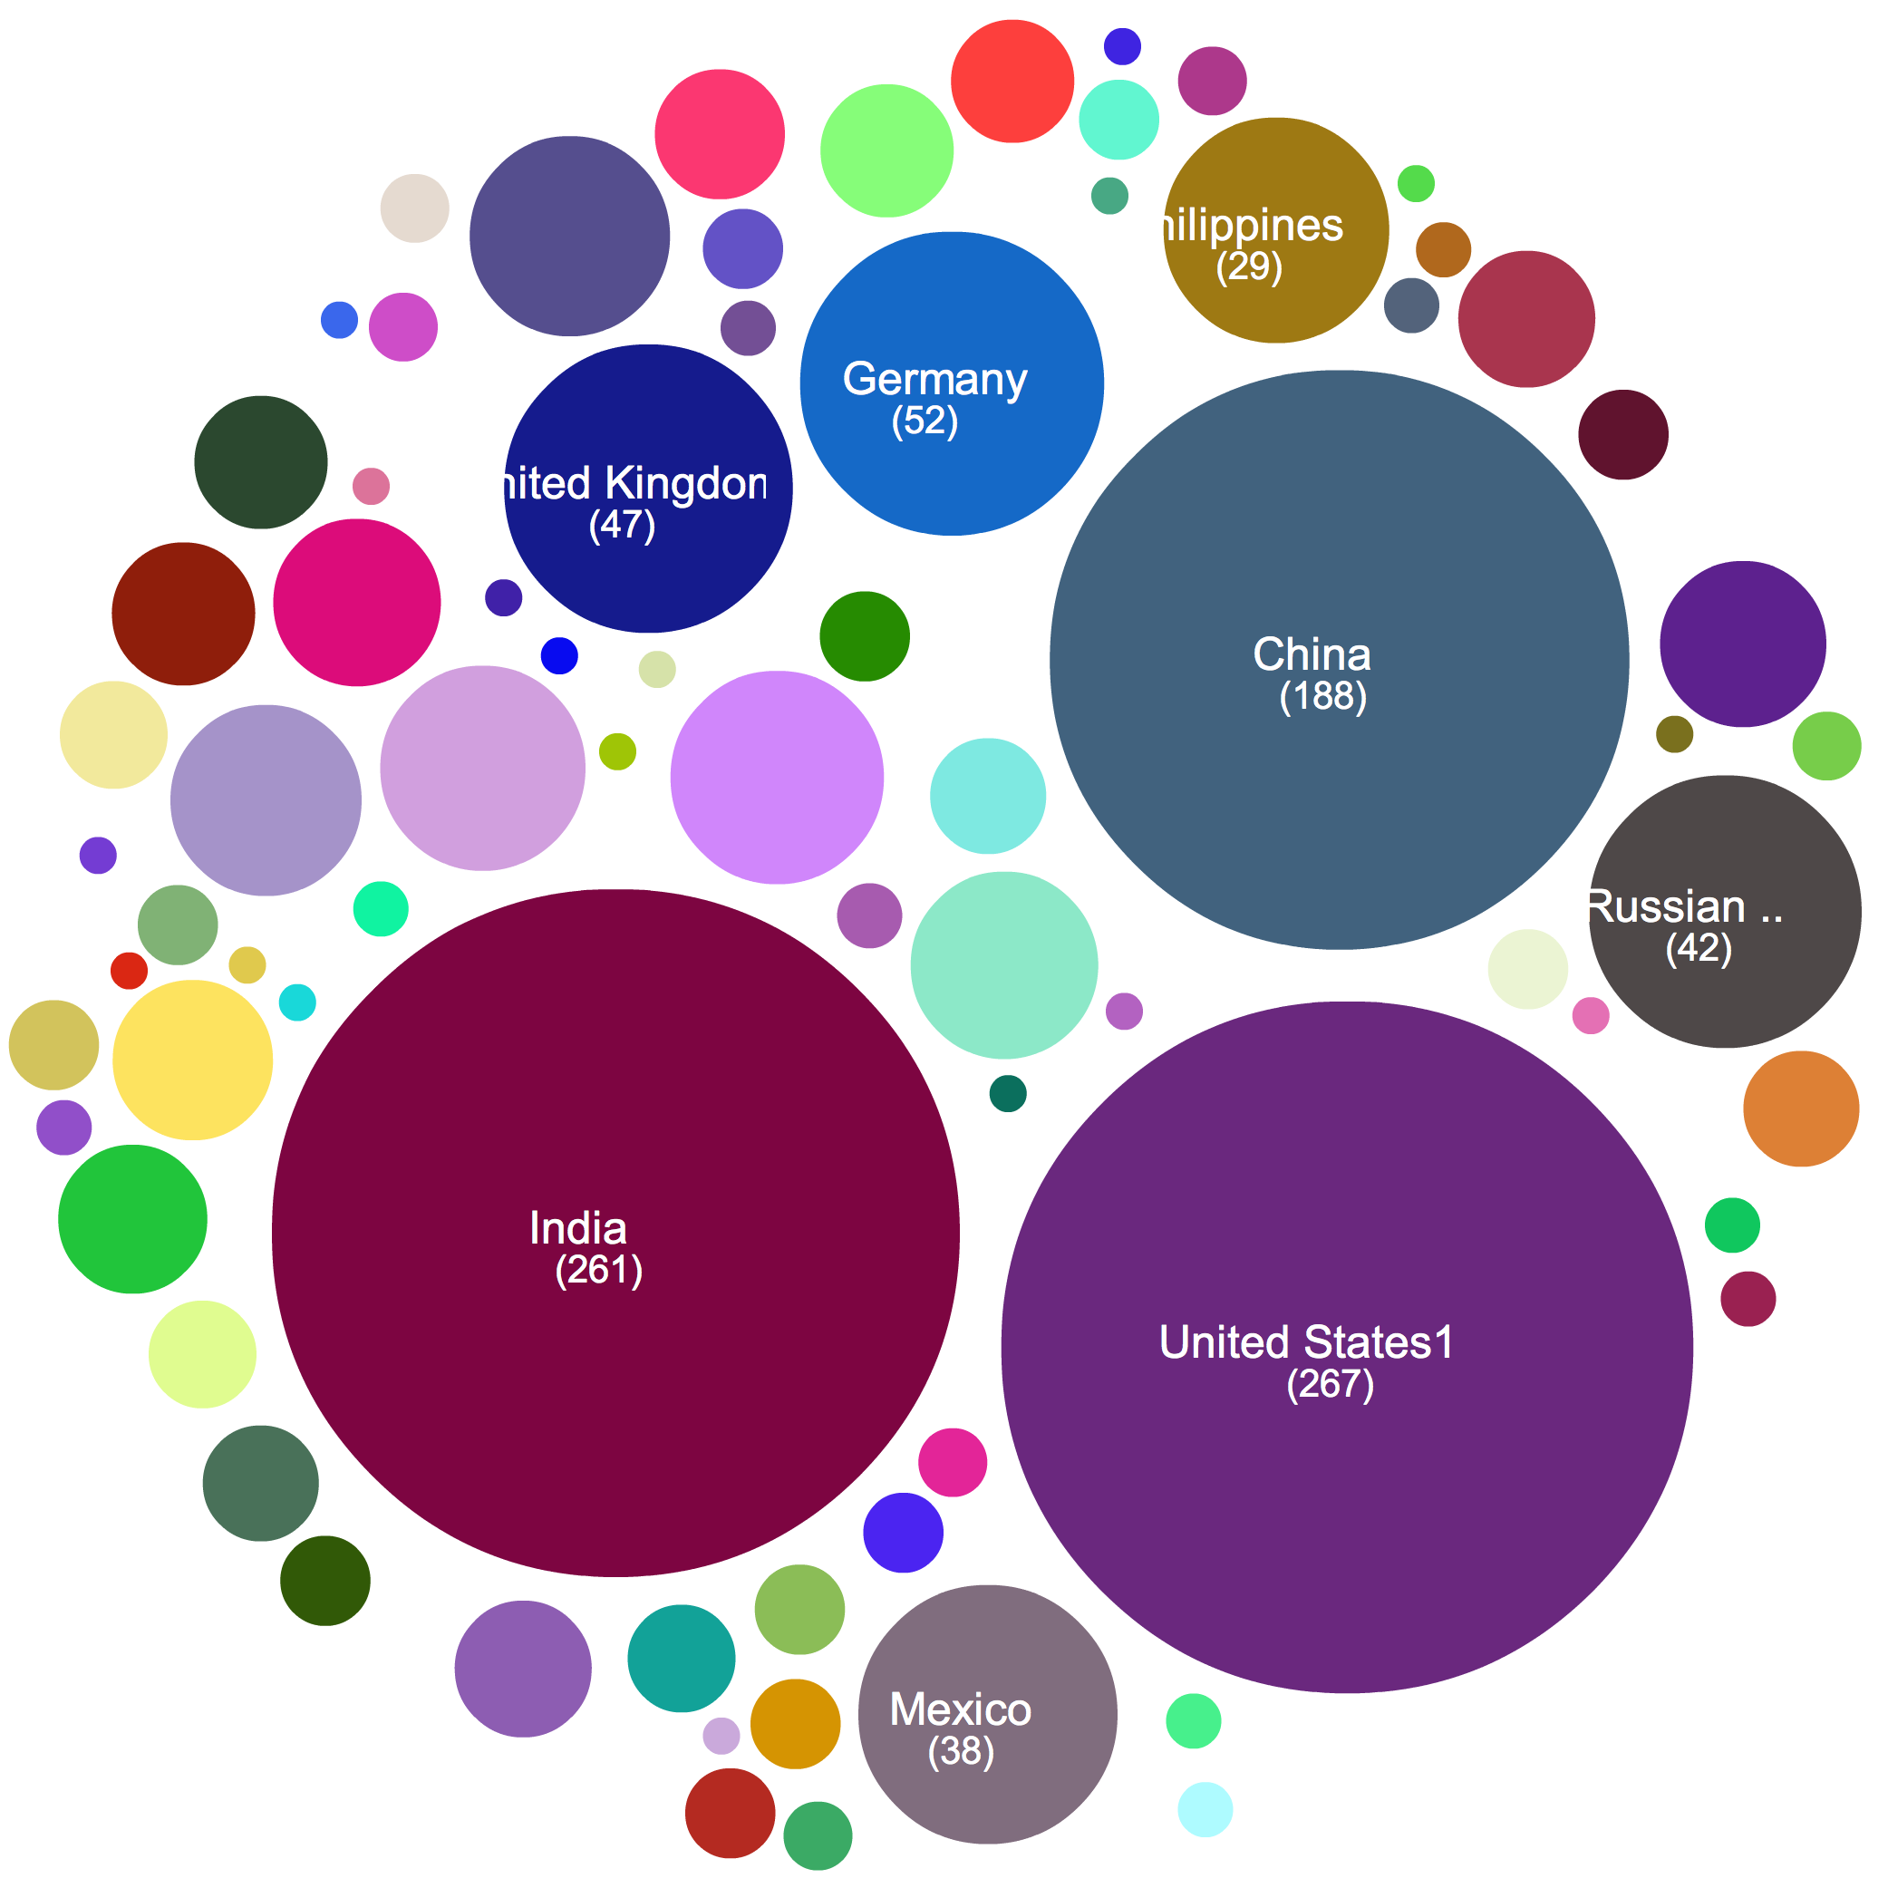
Membership in Intel Academic Community
Implementing parallel computing into CS curriculum
85% outside USA
Source: M. Wrinn, Intel
At SIGCSE’10
Notes:
Slide 8

Slide 6
Lessons from Invention of Computing
H. Goldstine, J. von Neumann. Planning and coding problems for an electronic computing instrument, 1947: “.. in comparing codes 4 viewpoints must be kept in mind, all of them of comparable importance:
Simplicity and reliability of the engineering solutions required by the code;
Simplicity, compactness and completeness of the code;
Ease and speed of the human procedure of translating mathematical conceived methods into the code, and also of finding and correcting errors in coding or of applying to it changes that have been decided upon at a later stage;
Efficiency of the code in operating the machine near it full intrinsic speed.
Take home
Legend features that fail the “truly measure” test
In today’s language programmer’s productivity
Birth (?) of CS: Translation into code of non-specific methods
Next: what worked .. how to match that for parallelism

Slide 7

How was the “non-specificity” addressed?
Answer: GvN47 based coding for whatever future application on math. induction coupled with a simple abstraction
Then came: HW, Algorithms+SW
[Engineering problem. So, why mathematician? Hunch: hard for engineers to relate to .. then and now. A. Ghuloum (Intel), CACM 9/09: “..hardware vendors tend to understand the requirements from the examples that software developers provide… ]
Met desiderata for code and coding. See, e.g.:
- Knuth67, The art of Computer Programming. Vol. 1: Fundamental Algorithms. Chapter 1: Basic concepts 1.1 Algorithms 1.2 Math Prelims 1.2.1 Math Induction
Algorithms: 1. Finiteness 2. Definiteness 3. Input & Output 4. Effectiveness
Gold standards
Definiteness: Helped by Induction
Effectiveness: Helped by “Uniform cost criterion" [AHU74] abstraction
2 comments on induction: 1. 2nd nature for math: proofs & axiom of the natural numbers. 2. need to read into GvN47: “..to make the induction complete..”
Notes:
HW vendors have a hummer for optimizing incremental changes. However, they now need to deal with a paradigm shift, but having a hummer tends to make everything look to us like a nail.

Slide 8
Serial Abstraction & A Parallel Counterpart
Rudimentary abstraction that made serial computing simple: that any single instruction available for execution in a serial program executes immediately – ”Immediate Serial Execution (ISE)”
Abstracts away different execution time for different operations (e.g., memory hierarchy) . Used by programmers to conceptualize serial computing and supported by hardware and compilers. The program provides the instruction to be executed next (inductively)
Rudimentary abstraction for making parallel computing simple: that indefinitely many instructions, which are available for concurrent execution, execute immediately, dubbed Immediate Concurrent Execution (ICE)
➔Step-by-step (inductive) explication of the instructions available next for concurrent execution. # processors not even mentioned. Falls back on the serial abstraction if 1 instruction/step.
Serial Execution, Based on Serial Abstraction
What could I do in parallel at each step assuming unlimited hardware
➔
Parallel Execution, Based on Parallel Abstraction
#
ops
.
.
#
ops
.
.
.
.
..
..
..
..
time
time
Time = Work
Work = total #ops
Time << Work

Slide 9
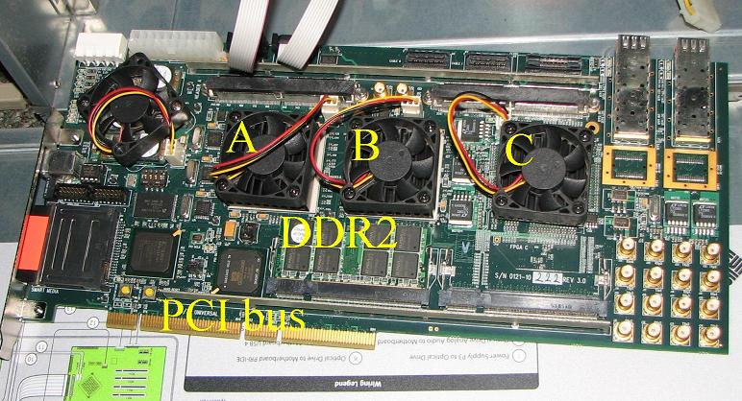
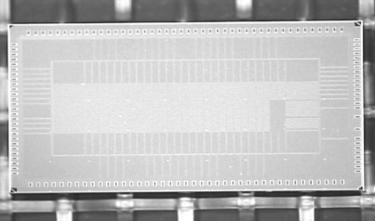
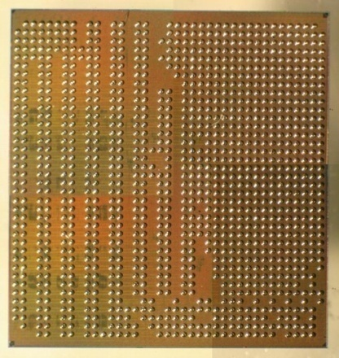
Not behind GvN47 in 1947
Algorithms
PRAM-On-Chip HW Prototypes
PRAM parallel algorithmic theory. “Natural selection”. Latent, though not widespread, knowledgebase
“Work-depth”. SV82 conjectured: The rest (full PRAM algorithm) just a matter of skill.
Lots of evidence that “work-depth” works. Used as framework in main PRAM algorithms texts: JaJa92, KKT01
Later: programming & workflow
64-core, 75MHz FPGA of XMT
(Explicit Multi-Threaded) architecture
SPAA98..CF08
128-core intercon. network IBM 90nm: 9mmX5mm, 400 MHz [HotI07]➔Fund
work on asynch NOCS’10
FPGA design➔ASIC
IBM 90nm: 10mmX10mm
150 MHz
Rudimentary yet stable compiler. Architecture scales to 1000+ cores on-chip

Slide 10
Key for GvN47 Engineering solution (1st visit of slide)
Program-counter & stored program
Later: Seek upgrade for parallel abstraction
Virtual over physical:
distributed solution

Slide 11
Talk from 30K feet
* Past Math induction plus ISE
Foundation for first 6 decades of CS
Proposed Math induction plus ICE
Foundation for future of CS
* (Great) Parallel system theory work/modeling
Descriptive: How to get the most from what vendors are giving us
This talk Prescriptive

Slide 12
Versus Serial & Other Parallel 1st Example: Exchange Problem
2 Bins A and B. Exchange contents of A and B. Ex. A=2,B=5➔A=5,B=2.
Algorithm (serial or parallel): X:=A;A:=B;B:=X. 3 Ops. 3 Steps. Space 1.
Array Exchange Problem
2n bins A[1..n], B[1..n]. Replace A(i) and B(i), i=1..n.
Serial Alg: For i=1 to n do /*serial exchange through eye-of-a-needle
X:=A(i);A(i):=B(i);B(i):=X
3n Ops. 3n Steps. Space 1
Parallel Alg: For i=1 to n pardo /*2-bin exchange in parallel
X(i):=A(i);A(i):=B(i);B(i):=X(i)
3n Ops. 3 Steps. Space n
Discussion
Parallelism tends to require some extra space
Par Alg clearly faster than Serial Alg.
What is “simpler” and “more natural”: serial or parallel?
Small sample of people: serial, but only if you .. majored in CS
Eye-of-a-needle: metaphor for the von-Neumann mental & operational bottleneck
Reflects extreme scarcity of HW. Less acute now
Notes:
12

Slide 13
2nd Example of PRAM-like Algorithm
Parallel: parallel data-structures.
Inherent serialization: S.
Gain relative to serial: (first cut) ~T/S!
Decisive also relative to coarse-grained parallelism.
Note: (i) “Concurrently” as in natural BFS: only change to serial algorithm
(ii) No “decomposition”/”partition”
➔ Speed-up wrt GPU: same-silicon area for highly parallel input 5.4X!
(iii) But, SMALL CONFIG on 20-way parallel input: 109X wrt same GPU
Mental effort of PRAM-like programming
1. sometimes easier than serial
2. considerably easier than for any parallel computer currently sold. Understanding falls within the common denominator of other approaches.
Input: (i) All world airports.
(ii) For each, all its non-stop flights.
Find: smallest number of flights from DCA to every other airport.
Basic (actually parallel) algorithm
Step i:
For all airports requiring i-1flights
For all its outgoing flights
Mark (concurrently!) all “yet unvisited” airports as requiring i flights (note nesting)
Serial: forces eye-of-a-needle queue; need to prove that still the same as the parallel version.
O(T) time; T – total # of flights
Notes:
13

Slide 18
In CS, we single-mindedly serialize -- needed or not
Recall the story about a boy/girl-scout helping an old lady cross the street, even if .. she does not want to cross it
All the machinery (think about compilers) that we try later to get the old lady to the right side of the street, where she originally was and wanted to remain, may not rise to challenge
Conclusion: Got to talk to the boy/girl-scout
To clarify:
The business case for supporting in the best possible way existing serial code is clear
The question is how to write programs in the future

Slide 19
Programmer’s Model as Workflow
Arbitrary CRCW Work-depth algorithm.
- Reason about correctness & complexity in synchronous model
SPMD reduced synchrony
Main construct: spawn-join block. Can start any number of processes at once. Threads advance at own speed, not lockstep
Prefix-sum (ps). Independence of order semantics (IOS) – matches Arbitrary CW. For locality: assembly language threads are not-too-short
Establish correctness & complexity by relating to WD analyses
spawn
join
spawn
join
Circumvents: (i) decomposition-inventive; (ii) “the problem with threads”, e.g., [Lee]
Issue: nesting of spawns.
Tune (compiler or expert programmer): (i) Length of sequence of round trips to memory, (ii) QRQW, (iii) WD. [VCL07]
- Correctness & complexity by relating to prior analyses

Slide 20
Snapshot: XMT High-level language
A
D
Cartoon Spawn creates threads; a
thread progresses at its own speed
and expires at its Join.
Synchronization: only at the Joins. So,
virtual threads avoid busy-waits by
expiring. New: Independence of order
semantics (IOS)
The array compaction (artificial) problem
Input: Array A[1..n] of elements.
Map in some order all A(i) not equal 0 to array D.
1
0
5
0
0
0
4
0
0
e0
1
4
5
e2
e6
For program below:
e$ local to thread $;
x is 3

Slide 21
XMT-C
Single-program multiple-data (SPMD) extension of standard C.
Includes Spawn and PS - a multi-operand instruction.
Essence of an XMT-C program
int x = 0;
Spawn(0, n-1) /* Spawn n threads; $ ranges 0 to n − 1 */
{ int e = 1;
if (A[$] not-equal 0)
{ PS(x,e);
D[e] = A[$] }
}
n = x;
Notes: (i) PS is defined next (think F&A). See results for
e0,e2, e6 and x. (ii) Join instructions are implicit.

Slide 22
XMT Assembly Language
Standard assembly language, plus 3 new instructions: Spawn, Join, and PS.
The PS multi-operand instruction
New kind of instruction: Prefix-sum (PS).
Individual PS, PS Ri Rj, has an inseparable (“atomic”) outcome:
Store Ri + Rj in Ri, and
(ii) Store original value of Ri in Rj.
Several successive PS instructions define a multiple-PS instruction. E.g., the
sequence of k instructions:
PS R1 R2; PS R1 R3; ...; PS R1 R(k + 1)
performs the prefix-sum of base R1 elements R2,R3, ...,R(k + 1) to get:
R2 = R1; R3 = R1 + R2; ...; R(k + 1) = R1 + ... + Rk; R1 = R1 + ... + R(k + 1).
Idea: (i) Several ind. PS’s can be combined into one multi-operand instruction.
(ii) Executed by a new multi-operand PS functional unit. Enhanced Fetch&Add.
Story: 1500 cars enter a gas station with 1000 pumps. Main XMT patent: Direct in unit time a car to a EVERY pump; PS patent: Then, direct in unit time a car to EVERY pump becoming available

Slide 23
Workflow from parallel algorithms to programming versus trial-and-error
Option 1
Option 2
Domain decomposition,
or task decomposition
PAT
Parallel algorithmic thinking (say PRAM)
PAT
Prove
correctness
Program
Program
Insufficient inter-thread bandwidth?
Still correct
Rethink algorithm: Take better advantage of cache
Tune
Compiler
Still correct
Hardware
Hardware
Is Option 1 good enough for the parallel programmer’s model?
Options 1B and 2 start with a PRAM algorithm, but not option 1A.
Options 1A and 2 represent workflow, but not option 1B.
Not possible in the 1990s.
Possible now.
Why settle for less?

Slide 24
What difference do we hope to make? Productivity in Parallel Computing
The large parallel machines story
Funding of productivity: $M650 HProductivityCS, ~2002
Met # Gflops goals: up by 1000X since mid-90’s
Met power goals. Also: groomed eloquent spokespeople
Progress on productivity: No agreed benchmarks. No spokesperson. Elusive! In fact, not much has changed since: “as intimidating and time consuming as programming in assembly language”--NSF Blue Ribbon Committee, 2003 or even “parallel software crisis”, CACM 1991.
Common sense engineering: Untreated bottleneck ➔ diminished returns on improvements➔ bottleneck becomes more critical
Next 10 years: New specific programs on flops and power. What about productivity?!
Reality: economic island. Cleared by marketing: DOE applications
Enter: mainstream many-cores
Every CS major should be able to program many-cores

Slide 25
Many-Cores are Productivity Limited
~2003 Wall Street traded companies gave up the safety of the only paradigm that worked for them for parallel computing ➔ The “software spiral” (the cyclic process of HW improvement leading to SW improvement) is broken
Reality: Never easy-to-program, fast general-purpose parallel computer for single task completion time. Current parallel architectures: never really worked for productivity. Uninviting programmers' models simply turn programmers away
Why drag the whole field to a recognized disaster area?
Keynote, ISCA09: 10 ways to waste a parallel computer. We can do better: repel the programmer; don’t worry about the rest ☺
New ideas needed to reproduce the success of the serial paradigm for many-core computing, where obtaining strong, but not absolutely the best performance is relatively easy.
➔ Must start to benchmark HW+SW for productivity. See CFP for PPoPP2011. Joint video-conferencing course with UIUC.

Slide 26
XMT (Explicit Multi-Threading): A PRAM-On-Chip Vision
IF you could program a current manycore ➔ great speedups. XMT: Fix the IF
XMT was designed from the ground up with the following features:
Allows a programmer’s workflow, whose first step is algorithm design for work-depth. Thereby, harness the whole PRAM theory
No need to program for locality beyond use of local thread variables, post work-depth
Hardware-supported dynamic allocation of “virtual threads” to processors.
Sufficient interconnection network bandwidth
Gracefully moving between serial & parallel execution (no off-loading)
Backwards compatibility on serial code
Support irregular, fine-grained algorithms (unique). Some role for hashing.
Tested HW & SW prototypes
Software release of full XMT environment
SPAA’09: ~10X relative to Intel Core 2 Duo

Slide 27
Key for GvN47 Engineering solution (2nd visit of slide)
Program-counter & stored program
Later: Seek upgrade for parallel abstraction
Virtual over physical:
distributed solution

Slide 28
XMT Architecture Overview
One serial core – master thread control unit (MTCU)
Parallel cores (TCUs) grouped in clusters
Global memory space evenly partitioned in cache banks using hashing
No local caches at TCU. Avoids expensive cache coherence hardware
HW-supported run-time load-balancing of concurrent threads over processors. Low thread creation overhead. (Extend classic stored-program+program counter; cited by 30+ patents; Prefix-sum to registers & to memory. )
MTCU
Hardware Scheduler/Prefix-Sum Unit
Cluster 1
Cluster 2
Cluster C
Parallel Interconnection Network
…
Memory Bank 1
Memory Bank 2
Shared Memory
(L1 Cache)
Memory Bank M
DRAM Channel 1
DRAM Channel D
- Enough interconnection network
bandwidth

Slide 29
Ease of Programming
Benchmark Can any CS major program your manycore?
Cannot really avoid it!
Teachability demonstrated so far for XMT [SIGCSE’10]
- To freshman class with 11 non-CS students. Some prog. assignments: merge-sort*, integer-sort* & sample-sort.
Other teachers:
- Magnet HS teacher. Downloaded simulator, assignments, class notes, from XMT page. Self-taught. Recommends: Teach XMT first. Easiest to set up (simulator), program, analyze: ability to anticipate performance (as in serial). Can do not just for embarrassingly parallel. Teaches also OpenMP, MPI, CUDA. See also, keynote at CS4HS’09@CMU + interview with teacher.
- High school & Middle School (some 10 year olds) students from underrepresented groups by HS Math teacher.
*Also in Nvidia’s Satish, Harris & Garland IPDPS09

Slide 30

Middle School Summer Camp Class Picture, July’09 (20 of 22 students)

Slide 31
Software release
Allows to use your own computer for programming on an XMT environment & experimenting with it, including:
a) Cycle-accurate simulator of the XMT machine
b) Compiler from XMTC to that machine
Also provided, extensive material for teaching or self-studying parallelism, including
Tutorial + manual for XMTC (150 pages)
Class notes on parallel algorithms (100 pages)
Video recording of 9/15/07 HS tutorial (300 minutes)
Video recording of Spring’09 grad Parallel Algorithms lectures (30+hours)
www.umiacs.umd.edu/users/vishkin/XMT/sw-release.html,
Or just Google “XMT”
Notes:
31

Slide 32
But, what is the performance penalty for easy programming? Surprise benefit! vs. GPU [HotPar10]
1024-TCU XMT simulations vs. code by others for GTX280. < 1 is slowdown. Sought: similar silicon area & same clock.
Postscript regarding BFS
59X if average parallelism is 20
111X if XMT is … downscaled to 64 TCUs

Slide 33
Problem acronyms
BFS: Breadth-first search on graphs
Bprop: Back propagation machine learning alg.
Conv: Image convolution kernel with separable filter
Msort: Merge-sort algorith
NW: Needleman-Wunsch sequence alignment
Reduct: Parallel reduction (sum)
Spmv: Sparse matrix-vector multiplication

Slide 34
Few more experimental results
AMD Opteron 2.6 GHz, RedHat Linux Enterprise 3, 64KB+64KB L1 Cache, 1MB L2 Cache (none in XMT), memory bandwidth 6.4 GB/s (X2.67 of XMT)
M_Mult was 2000X2000 QSort was 20M
XMT enhancements: Broadcast, prefetch + buffer, non-blocking store, non-blocking caches.
XMT Wall clock time (in seconds)
App. XMT Basic XMT Opteron
M-Mult 179.14 63.7 113.83
QSort 16.71 6.59 2.61
Assume (arbitrary yet conservative)
ASIC XMT: 800MHz and 6.4GHz/s
Reduced bandwidth to .6GB/s and projected back by 800X/75
XMT Projected time (in seconds)
App. XMT Basic XMT Opteron
M-Mult 23.53 12.46 113.83
QSort 1.97 1.42 2.61
Simulation of 1024 processors: 100X on standard benchmark suite for VHDL gate-level simulation. for 1024 processors [Gu-V06]
Silicon area of 64-processor XMT, same as 1 commodity processor (core) (already noted: ~10X relative to Intel Core 2 Duo)

Slide 35
Q&A
Question: Why PRAM-type parallel algorithms matter, when we can get by with existing serial algorithms, and parallel programming methods like OpenMP on top of it?
Answer: With the latter you need a strong-willed Comp. Sci. PhD in order to come up with an efficient parallel program at the end. With the former (study of parallel algorithmic thinking and PRAM algorithms) high school kids can write efficient (more efficient if fine-grained & irregular!) parallel programs.

Slide 36
Conclusion
XMT provides viable answer to biggest challenges for the field
Ease of programming
Scalability (up&down)
Facilitates code portability
SPAA’09 good results: XMT vs. state-of-the art Intel Core 2
HotPar’10/ICPP’08 compare with GPUs ➔ XMT+GPU beats all-in-one
Fund impact productivity, prog, SW/HW sys arch, asynch/GALS
Easy to build. 1 student in 2+ yrs: hardware design + FPGA-based XMT computer in slightly more than two years ➔ time to market; implementation cost.
Central issue: how to write code for the future? answer must provide compatibility on current code, competitive performance on any amount of parallelism coming from an application, and allow improvement on revised code ➔ time for agnostic (rather than product-centered) academic research

Slide 37
Current Participants
Grad students:, George Caragea, James Edwards, David Ellison, Fuat Keceli, Beliz Saybasili, Alex Tzannes. Recent grads: Aydin Balkan, Mike Horak, Xingzhi Wen
Industry design experts (pro-bono).
Rajeev Barua, Compiler. Co-advisor of 2 CS grad students. 2008 NSF grant.
Gang Qu, VLSI and Power. Co-advisor.
Steve Nowick, Columbia U., Asynch computing. Co-advisor. 2008 NSF team grant.
Ron Tzur, U. Colorado, K12 Education. Co-advisor. 2008 NSF seed funding
K12: Montgomery Blair Magnet HS, MD, Thomas Jefferson HS, VA, Baltimore (inner city) Ingenuity Project Middle School 2009 Summer Camp, Montgomery County Public Schools
Marc Olano, UMBC, Computer graphics. Co-advisor.
Tali Moreshet, Swarthmore College, Power. Co-advisor.
Bernie Brooks, NIH. Co-Advisor.
Marty Peckerar, Microelectronics
Igor Smolyaninov, Electro-optics
Funding: NSF, NSA 2008 deployed XMT computer, NIH
Industry partner: Intel
Reinvention of Computing for Parallelism. Selected for Maryland Research Center of Excellence (MRCE) by USM. Not yet funded. 17 members, including UMBC, UMBI, UMSOM. Mostly applications.

Slide 38
Backup slides
Many forget that the only reason that PRAM algorithms did not become standard CS knowledge is that there was no demonstration of an implementable computer architecture that allowed programmers to look at a computer like a PRAM. XMT changed that, and now we should let Mark Twain complete the job.
We should be careful to get out of an experience only the wisdom that is in it— and stop there; lest we be like the cat that sits down on a hot stove-lid. She will never sit down on a hot stove-lid again— and that is well; but also she will never sit down on a cold one anymore.— Mark Twain

Slide 39
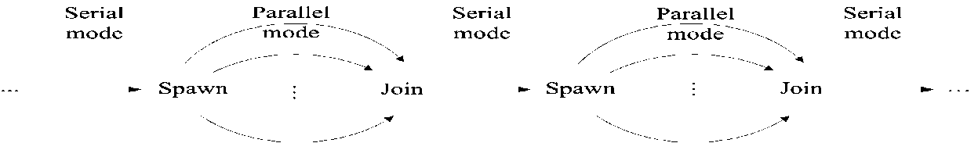
How does it work and what should people know to participate
“Work-depth” Alg Methodology (SV82) State all ops you can do in parallel. Repeat. Minimize: Total #operations, #rounds. Note: 1 The rest is skill. 2. Sets the algorithm
Program single-program multiple-data (SPMD). Short (not OS) threads. Independence of order semantics (IOS). XMTC: C plus 3 commands: Spawn+Join, Prefix-Sum (PS) Unique 1st parallelism then decomposition
Legend: Level of abstraction
Means
Means: Programming methodology Algorithms → effective programs.
Extend the SV82 Work-Depth framework from PRAM-like to XMTC
[Alternative Established APIs (VHDL/Verilog,OpenGL,MATLAB) “win-win proposition”]
Performance-Tuned Program minimize length of sequence of round-trips to memory + QRQW + Depth; take advantage of arch enhancements (e.g., prefetch)
Means: Compiler: [ideally: given XMTC program, compiler provides decomposition: tune-up manually ➔ “teach the compiler”]
Architecture HW-supported run-time load-balancing of concurrent threads over processors. Low thread creation overhead. (Extend classic stored-program program counter; cited by 15 Intel patents; Prefix-sum to registers & to memory. )
All Computer Scientists will need to know >1 levels of abstraction (LoA)
CS programmer’s model: WD+P. CS expert : WD+P+PTP. Systems: +A.

Slide 40
PERFORMANCE PROGRAMMING & ITS PRODUCTIVITY
Basic Algorithm (sometimes informal)
Add data-structures (for serial algorithm)
Add parallel data-structures
(for PRAM-like algorithm)
Serial program (C)
3
Parallel program (XMT-C)
1
Low overheads!
4
Standard Computer
Decomposition
XMT Computer
(or Simulator)
Parallel
Programming
(Culler-Singh)
Assignment
Orchestration
4 easier than 2
Problems with 3
4 competitive with 1: cost-effectiveness; natural
Mapping
2
Parallel computer

Slide 41
APPLICATION PROGRAMMING & ITS PRODUCTIVITY
Application programmer’s interfaces (APIs)
(OpenGL, VHDL/Verilog, Matlab)
compiler
Serial program (C)
Parallel program (XMT-C)
Automatic?
Yes
Maybe
Yes
Standard Computer
Decomposition
XMT architecture
(Simulator)
Parallel
Programming
(Culler-Singh)
Assignment
Orchestration
Mapping
Parallel computer

Slide 42
XMT Block Diagram – Back-up slide

Slide 43
ISA
Any serial (MIPS, X86). MIPS R3000.
Spawn (cannot be nested)
Join
SSpawn (can be nested)
PS
PSM
Instructions for (compiler) optimizations

Slide 44
The Memory Wall
Concerns: 1) latency to main memory, 2) bandwidth to main memory.
Position papers: “the memory wall” (Wulf), “its the memory, stupid!” (Sites)
Note: (i) Larger on chip caches are possible; for serial computing, return on using them: diminishing. (ii) Few cache misses can overlap (in time) in serial computing; so: even the limited bandwidth to memory is underused.
XMT does better on both accounts:
• uses more the high bandwidth to cache.
• hides latency, by overlapping cache misses; uses more bandwidth to main memory, by generating concurrent memory requests; however, use of the cache alleviates penalty from overuse.
Conclusion: using PRAM parallelism coupled with IOS, XMT reduces the effect of cache stalls.

Slide 45
Some supporting evidence (12/2007)
Large on-chip caches in shared memory. 8-cluster (128 TCU!) XMT has only 8 load/store units, one per cluster. [IBM CELL: bandwidth 25.6GB/s from 2 channels of XDR. Niagara 2: bandwidth 42.7GB/s from 4 FB-DRAM channels. With reasonable (even relatively high rate of) cache misses, it is really not difficult to see that off-chip bandwidth is not likely to be a show-stopper for say 1GHz 32-bit XMT.

Slide 46
Memory architecture, interconnects
• High bandwidth memory architecture.
- Use hashing to partition the memory and avoid hot spots.
Understood, BUT (needed) departure from mainstream practice.
• High bandwidth on-chip interconnects
• Allow infrequent global synchronization (with IOS).
Attractive: lower power.
• Couple with strong MTCU for serial code.

Slide 47
Naming Contest for New Computer
Paraleap
chosen out of ~6000 submissions
Single (hard working) person (X. Wen) completed synthesizable Verilog description AND the new FPGA-based XMT computer in slightly more than two years. No prior design experience. Attests to: basic simplicity of the XMT architecture ➔ faster time to market, lower implementation cost.

Slide 48


XMT Development – HW Track
Interconnection network. Led so far to:
ASAP’06 Best paper award for mesh of trees (MoT) study
Using IBM+Artisan tech files: 4.6 Tbps average output at max frequency (1.3 - 2.1 Tbps for alt networks)! No way to get such results without such access
90nm ASIC tapeout
Bare die photo of 8-terminal interconnection
network chip IBM 90nm process, 9mm x 5mm
fabricated (August 2007)
Synthesizable Verilog of the whole architecture. Led so far to:
Cycle accurate simulator. Slow. For 11-12K X faster:
1st commitment to silicon—64-processor, 75MHz computer; uses FPGA: Industry standard for pre-ASIC prototype
1st ASIC prototype–90nm 10mm x 10mm
64-processor tapeout 2008: 4 grad students

Slide 49
Bottom Line
Cures a potentially fatal problem for growth of general-purpose processors: How to program them for single task completion time?

Slide 50
Positive record
Proposal Over-Delivering
NSF ‘97-’02 experimental algs. architecture
NSF 2003-8 arch. simulator silicon (FPGA)
DoD 2005-7 FPGA FPGA+2 ASICs

Slide 51
Final thought: Created our own coherent planet
When was the last time that a university project offered a (separate) algorithms class on own language, using own compiler and own computer?
Colleagues could not provide an example since at least the 1950s. Have we missed anything?
For more info:
http://www.umiacs.umd.edu/users/vishkin/XMT/

Slide 52
Merging: Example for Algorithm & Program
Input: Two arrays A[1. . n], B[1. . n]; elements from a totally ordered domain S. Each array is monotonically non-decreasing.
Merging: map each of these elements into a monotonically non-decreasing array C[1..2n]
Serial Merging algorithm
SERIAL − RANK(A[1 . . ];B[1. .])
Starting from A(1) and B(1), in each round:
compare an element from A with an element of B
determine the rank of the smaller among them
Complexity: O(n) time (and O(n) work...)
PRAM Challenge: O(n) work, least time
Also (new): fewest spawn-joins

Slide 53
Merging algorithm (cont’d)
“Surplus-log” parallel algorithm for Merging/Ranking
for 1 ≤ i ≤ n pardo
Compute RANK(i,B) using standard binary search
Compute RANK(i,A) using binary search
Complexity: W=(O(n log n), T=O(log n)
The partitioning paradigm
n: input size for a problem. Design a 2-stage parallel algorithm:
Partition the input into a large number, say p, of independent small jobs AND size of the largest small job is roughly n/p.
Actual work - do the small jobs concurrently, using a separate (possibly serial) algorithm for each.

Slide 54
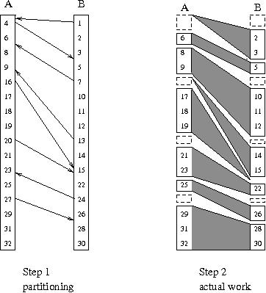
Linear work parallel merging: using a single spawn
Stage 1 of algorithm: Partitioning for 1 ≤ i ≤ n/p pardo [p <= n/log and p | n]
b(i):=RANK(p(i-1) + 1),B) using binary search
a(i):=RANK(p(i-1) + 1),A) using binary search
Stage 2 of algorithm: Actual work
Observe Overall ranking task broken into 2p independent “slices”.
Example of a slice
Start at A(p(i-1) +1) and B(b(i)).
Using serial ranking advance till:
Termination condition
Either some A(pi+1) or some B(jp+1) loses
Parallel program 2p concurrent threads
using a single spawn-join for the whole
algorithm
Example Thread of 20: Binary search B.
Rank as 11 (index of 15 in B) + 9 (index of
20 in A). Then: compare 21 to 22 and rank
21; compare 23 to 22 to rank 22; compare 23
to 24 to rank 23; compare 24 to 25, but terminate
since the Thread of 24 will rank 24.

Slide 55
Linear work parallel merging (cont’d)
Observation 2p slices. None larger than 2n/p.
(not too bad since average is 2n/2p=n/p)
Complexity Partitioning takes W=O(p log n), and T=O(log n) time, or O(n) work and O(log n) time, for p <= n/log n.
Actual work employs 2p serial algorithms, each takes O(n/p) time.
Total W=O(n), and T=O(n/p), for p <= n/log n.
IMPORTANT: Correctness & complexity of parallel program
Same as for algorithm.
This is a big deal. Other parallel programming approaches do not have a simple concurrency model, and need to reason w.r.t. the program.

