Slide 1
THE 2010 CENSUS [United States]
Reynolds Farley
Lisa Neidert
November 10, 2010

Slide 2
Overview
History & Background
Success
User Experience
The Future

Slide 3
It is in the Constitution
The framers of the Constitution mandated a decennial census to:
Ensure that population size - not political influence or economic wealth - determined how many representatives each state had in the lower house of Congress
Ensure that federal taxes would be levied upon states in proportion to their population size

Slide 4

Language from the Constitution
“Representatives and direct Taxes shall be apportioned among the several States which may be included within this Union, according to their respective Numbers, which shall be determined by adding to the whole Number of free Persons, including those bound to Service for a Term of Years, and excluding Indians not taxed, three-fifths of all other Persons. The actual Enumeration shall be made within three Years after the first Meeting of the Congress of the United States, and within every subsequent Term of Ten Years, in such Manner as they shall by Law direct. The Number of Representatives shall not exceed one for every thirty Thousand but each State shall have at Least one Representative”. . . (Article 1, Section 2)
Amendment XIV adopted in 1868 allocated representatives according to the whole number of persons excluding Indians not taxed.
“No Capitation, or other direct Tax shall be laid, unless in Proportion to the Census or Enumeration herein before directed to be taken”
After the War of 1812, the federal government stopped imposing taxes on states on the basis of their population size. Amendment XVI, adopted in 1913, permitted an income tax.

Slide 5
Nineteenth Century Developments
United States settled the Continent and terminated slavery
Decennial censuses became a means for gathering data about manufacturing, literacy, immigration and the mulatto population.
The United States became an urban and industrial nation
Census added many questions about nativity, languages, conditions in cities and some about labor force activities.
Scientific thinking and quantitative literacy
A gradual development of a federal statistical system not tied to the census. It gathered data about employment, immigration, agriculture and manufacturing.

Slide 6
The Depression Era (1930s) and Its Consequences for Federal Statistics
The Depression Years: 1930 to 1940
To address major problems of economic chaos and assess new federal programs, numerous governmental agencies began collecting extensive data about employment, financial activities, agriculture, health and mortality.
The Census of 1940
This was the first modern census and the first census to use sampling. Innovative questions were added about labor market activities, educational attainment, earnings, housing conditions and migration.

Slide 7
Censuses of 1950 - 2000
These were very much similar to the Census of 1940. New questions were added about disabilities.
By 1960 a clear distinction developed between the short form questionnaire and the long form questionnaire.
The short form questionnaire was sent to every household and gathered the basic demographic data needed for Constitutional reasons.
The long-form questionnaire included the short-form questions. It was sent to about one housing unit in six and asked about 60 additional social, economic and demographic questions.

Slide 8
Census 2010: Back to the Future
This was a short-form only questionnaire. The residents of every household answered 10 basic demographic questions.
The American Community Survey now gathers the social, economic and demographic information that used to be obtained with the census long-form questionnaire. It provides annual data based on a sample size of about three million households every year.

Slide 9
Background
2010 Census was a short-form only census
10 questions 10 minutes
Replacement for the long-form is the American Community Survey (ACS)
In full production since 2005
Census & ACS are intertwined
Discussion will go back and forth between Census and ACS

Slide 10

Census 2010 a Success
GAO “Critical List”
March 8, 2008
Participation Rate
Cost
Returned 1.6B

Slide 11
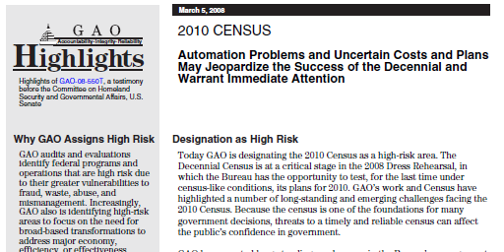
Success: GAO Critical List

Slide 12
Participation Rates: Comparisons

Slide 13
Census 2010 Mail Participation Rates: by County (blue is bad)

Slide 14
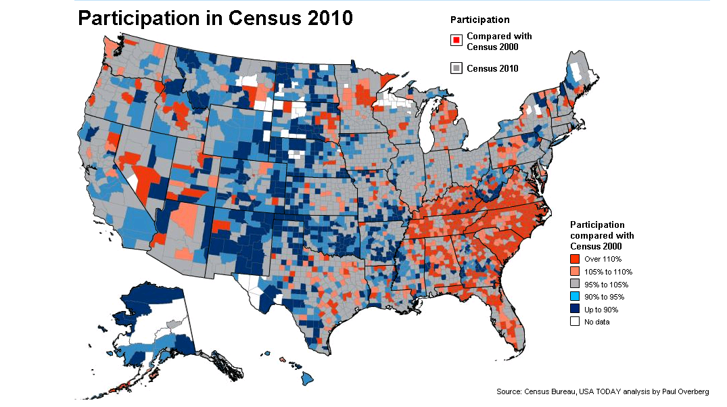
Participation Rates: 2010 vs 2000

Slide 15

Success: Cost, but some beg to differ

Slide 16
Information for Potential Users
US census data are public & free
Quick turn-around between collection & dissemination
American Community Survey data for 2009 released in September 2010
Dissemination Portals
Potential for confusion

Slide 17
Census Data are Public Access & Free
The Census Bureau has a long history of making data publically available, including microdata
Allows for re-distribution by others (including commercial ventures)
ICPSR
Minnesota Population Center
IPUMS (microdata)
NHGIS/Social Explorer (summary)
Exceptions
Special Tabulations ($$$)
Restricted Data Centers

Slide 18
Quick Turnaround Dissemination Schedule - Census
Product | Date
Population Estimates (not 2010 census) | December 2010
Apportionment Counts | December 31, 2010
Redistricting File (P.L. 94-171) | Feb – Mar 2011
“GQ File” | May 2011
Summary File 1 | Jun – Aug 2011
Summary File 2 | Dec – Apr 2012
Public Use Microdata File (short-form only) | TBD
Source: | http://www.census.gov/population/www/cen2010/glance/

Slide 19
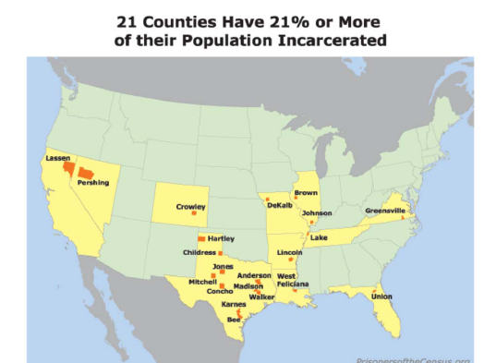
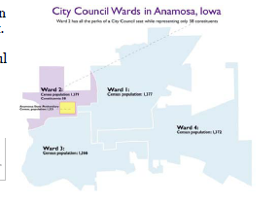

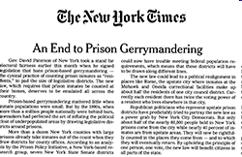
Responsiveness to User Concerns

Slide 20
Quick Turnaround Dissemination Schedule - ACS
Data collection in the field (Jan 1 – Dec 31)
Data released in the following year according to table
http://www.census.gov/acs/www/data_documentation/2009_release_schedule/
Date | Product
September | 1-year summary
November | 1-year microdata
December | 5-year summary
January | 3-year summary
February | 3-year & 5-year microdata

Slide 21
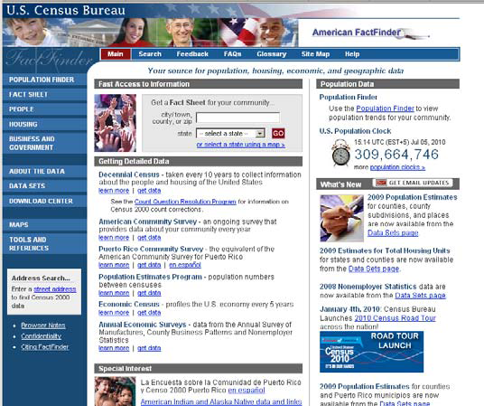
Dissemination Portal: American FactFinder
American FactFinder for summary data

Slide 22
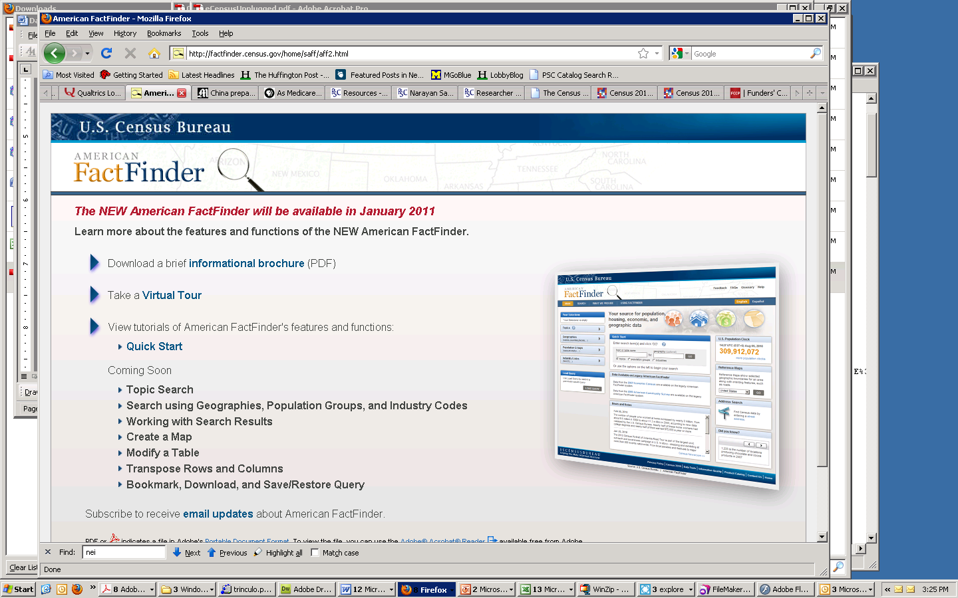
Yikes: New Release of American FactFinder
New version rolling out in Jan/Feb 2011

Slide 23
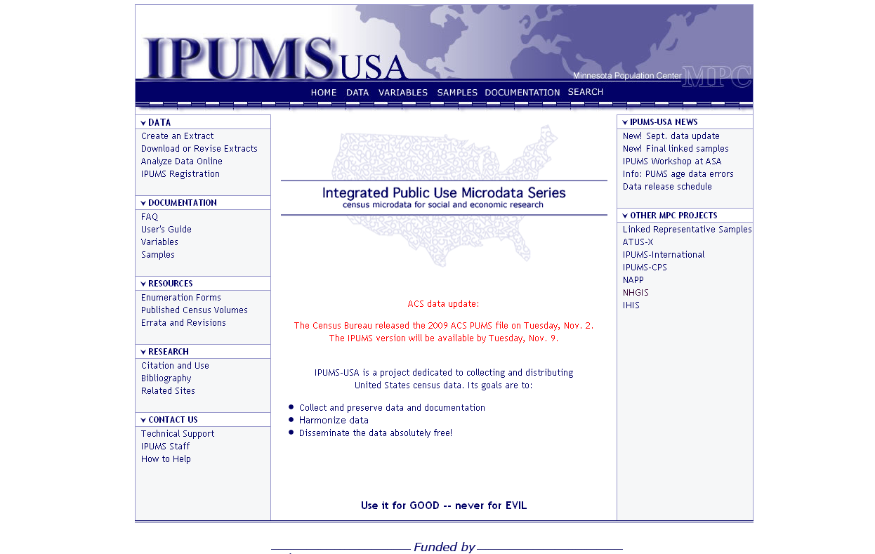
Dissemination Portal: IPUMS for microdata
Do not recommend Census Bureau venues
Use IPUMS

Slide 24
User Confusion
ACS vs Census
5-year vs P.L. 94-171
5-year vs SF1
ACS Comparisons
1-year; 3-year; 5-year
Group Quarters (in sample or not?)
Unemployment/jobs data
ACS vs CPS vs Establishment (Employer) Survey
Poverty/Income
ACS vs CPS

Slide 25
The Future
Costs & Congress
Re-engineered census
Cost Drivers and Solutions
E-census; just-in-time mailing
Use of administrative records
A likely scenario

Slide 26
Increasing cost of census is unsustainable
Cost per household in 2010 $

Slide 27
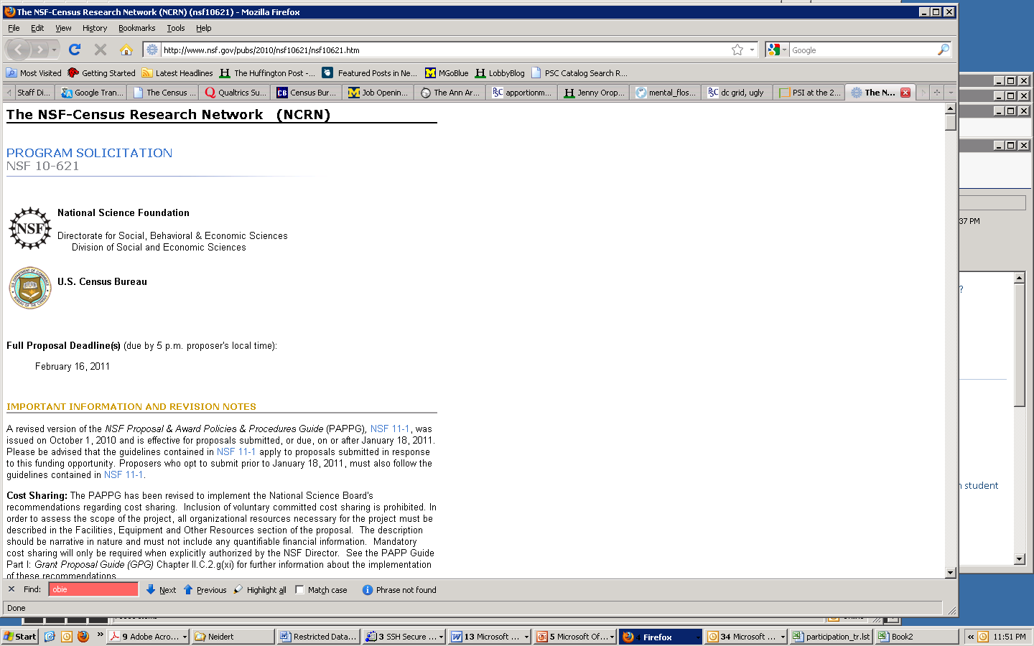
Re-engineering the census

Slide 28
Potential Research: Administrative Records

Slide 29
e-Census as a mode in 2020?

Slide 30
Targeting: Benefits of second mailing

Slide 31
2020 Census: One option

Slide 32
Questions?

