Slide 1

ICPSR Fall Data Fair 2010
Small Data Archives –
Cultural Policy & the Arts National Data Archive (CPANDA)
Bobray Bordelon
Princeton University

Slide 2
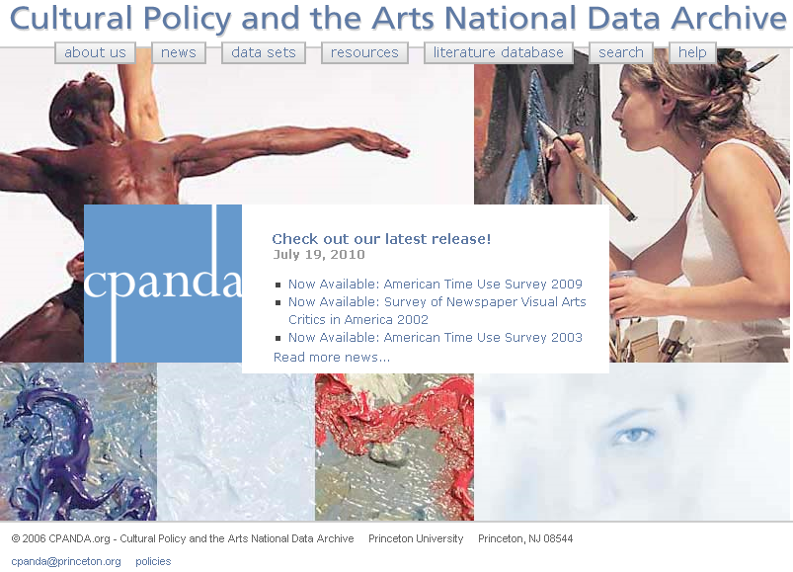

Slide 3

CPANDA - Cultural Policy & the Arts National Data Archive
World's 1st interactive digital archive of policy-relevant data on the arts & cultural policy in the USA.
Collaborative effort of Princeton University Library & the Princeton Center for Arts & Cultural Policy Studies.
The Pew Charitable Trusts underwrote the original development of the archive.

Slide 4
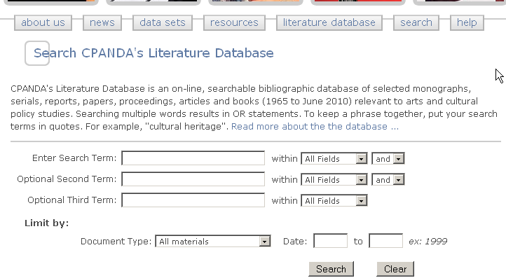

Slide 5
Literature Database:
Searchable by:
Title
Author
Subject
Journal
Publisher
Includes:
Books
Articles
Dissertations
Chapters
Working Papers/Reports

Slide 6
Literature Database:
1960-1969: 5 entries
1970-1979: 29 entries
1980-1989: 173 entries
1990-1999: 259 entries
2000-2005: 216 entries
2006-2007: 189 entries
2008: 142 entries
2009: 184 entries
2010 (1st half): 116 entries

Slide 7
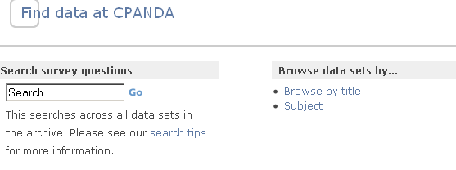

Slide 8
Data:
36 major series consisting of 239 data sets

Slide 9
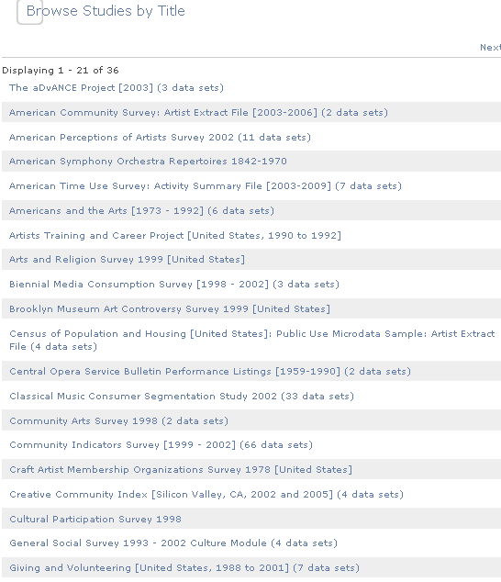

Slide 10
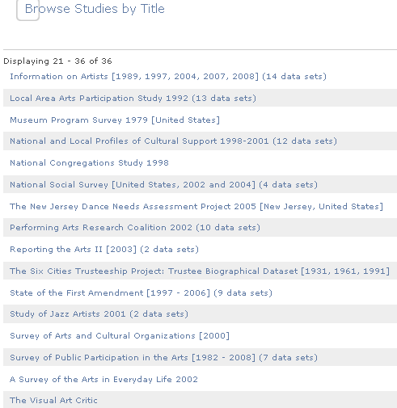

Slide 11
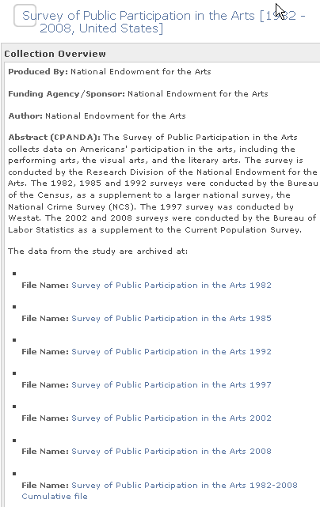

Slide 12
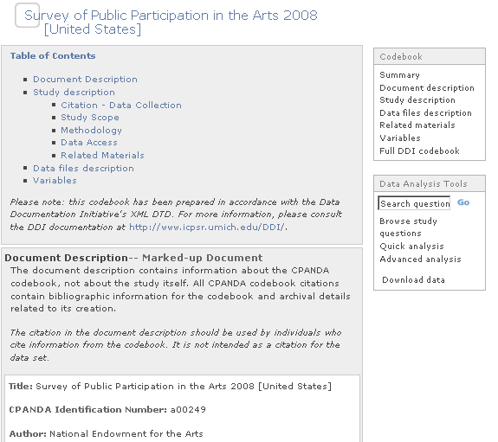

Slide 13
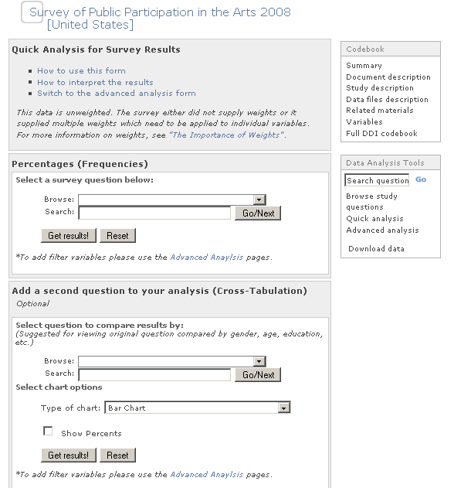

Slide 14
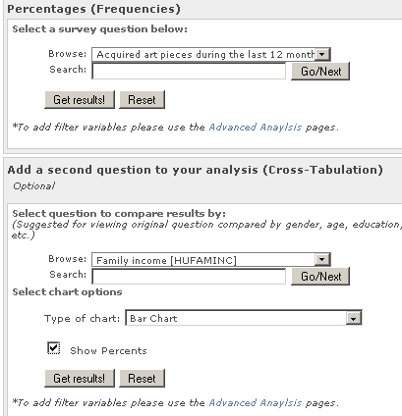

Slide 15
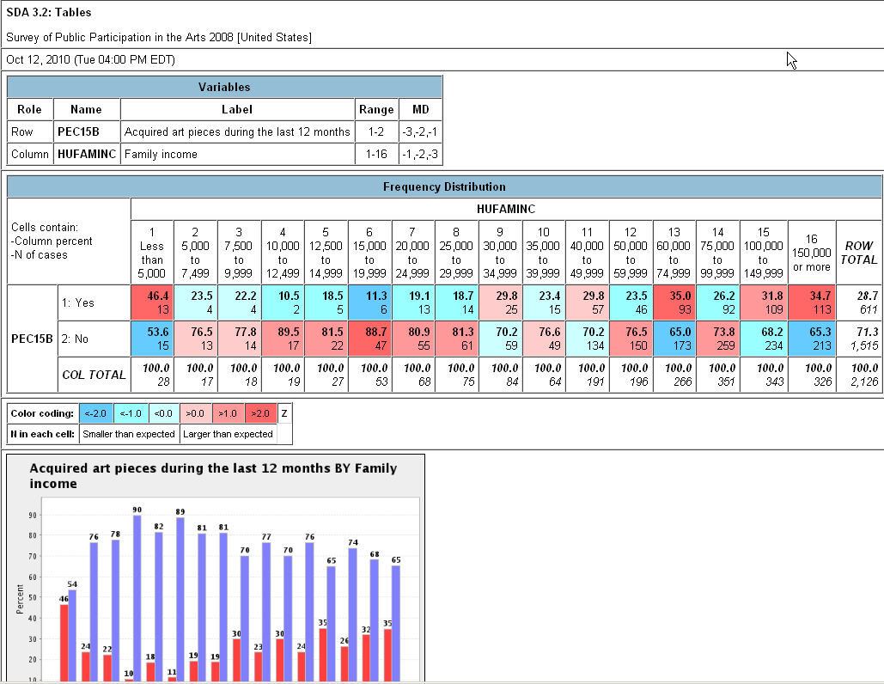

Slide 16
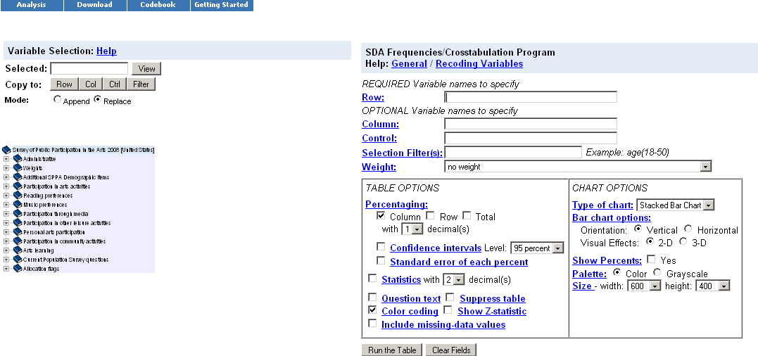

Slide 17
Coming:
Continued expansion of Bibliography
Clean up
More studies by Joan Jeffri
Processing of free datasets involving cultural policy
Give us your data!

Slide 18
CPANDA
Bobray Bordelon
Cpanda@Princeton.org
609-258-3211

