Slide 1
Magnetic reversals and superplumes: is there a connection?
Emily Peterman
Bowdoin College
July 2012

Slide 2
Context of exercise within course
Taught in week 2 or 3 of Plate Tectonics
Course is T-Th, 85 min blocks + 3 hr lab
Exercise developed in response to student curiosity about how/why magnetic field reverses
Students present Glatzmaier & Olson (2005) on magnetic reversals
Provides common starting point for discussion

Slide 3
Computer models suggest that outer core convection likely initiates reversals
Glatzmaier & Olson, 2005

Slide 4
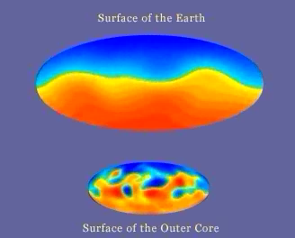

Slide 5
Skill and learning goals of exercise
Identify trends: frequency & duration magnetic reversals
Compare/contrast: superplumes, mantle plumes & MOR
Develop testable hypothesis: relationship between superplumes & magnetic reversals
Synthesize datasets & compose data-supported argument
Evaluate data quality
Contextualize new knowledge
“These are the skills employers (and grad school advisers) look for. We practice them in class to best prepare you for any career you choose”

Slide 6
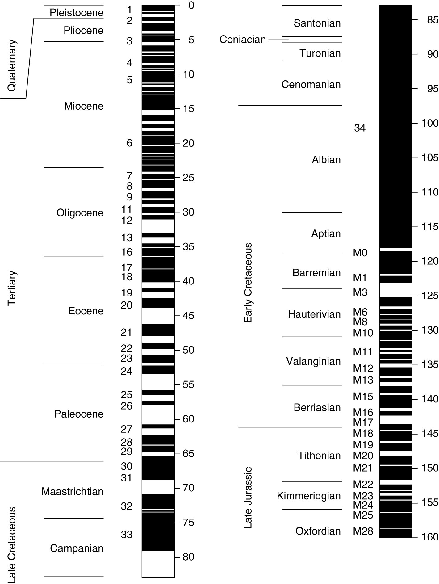
Dataset 1
Start with observation
Identify trends
Duration, frequency
Common “hiccups”:
What do the two sets of numbers mean?
What is “normal” polarity?
Why are there so many names? Do the names matter?
Reading the actual timescale on this figure

Slide 7
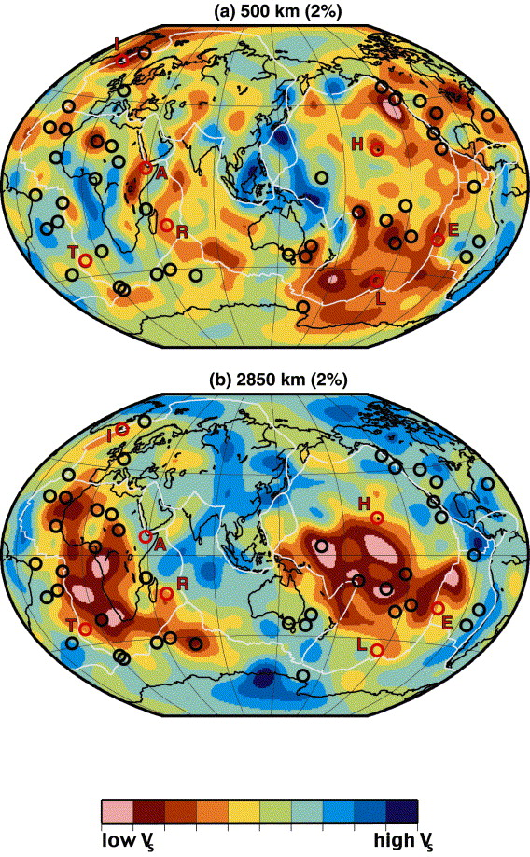
Dataset 2 (identify trends) – 500 km depth
(Courtillot et al., 2003)

Slide 8
Dataset 2 (identify trends) – 2850 km depth
(Courtillot et al., 2003)

Slide 9
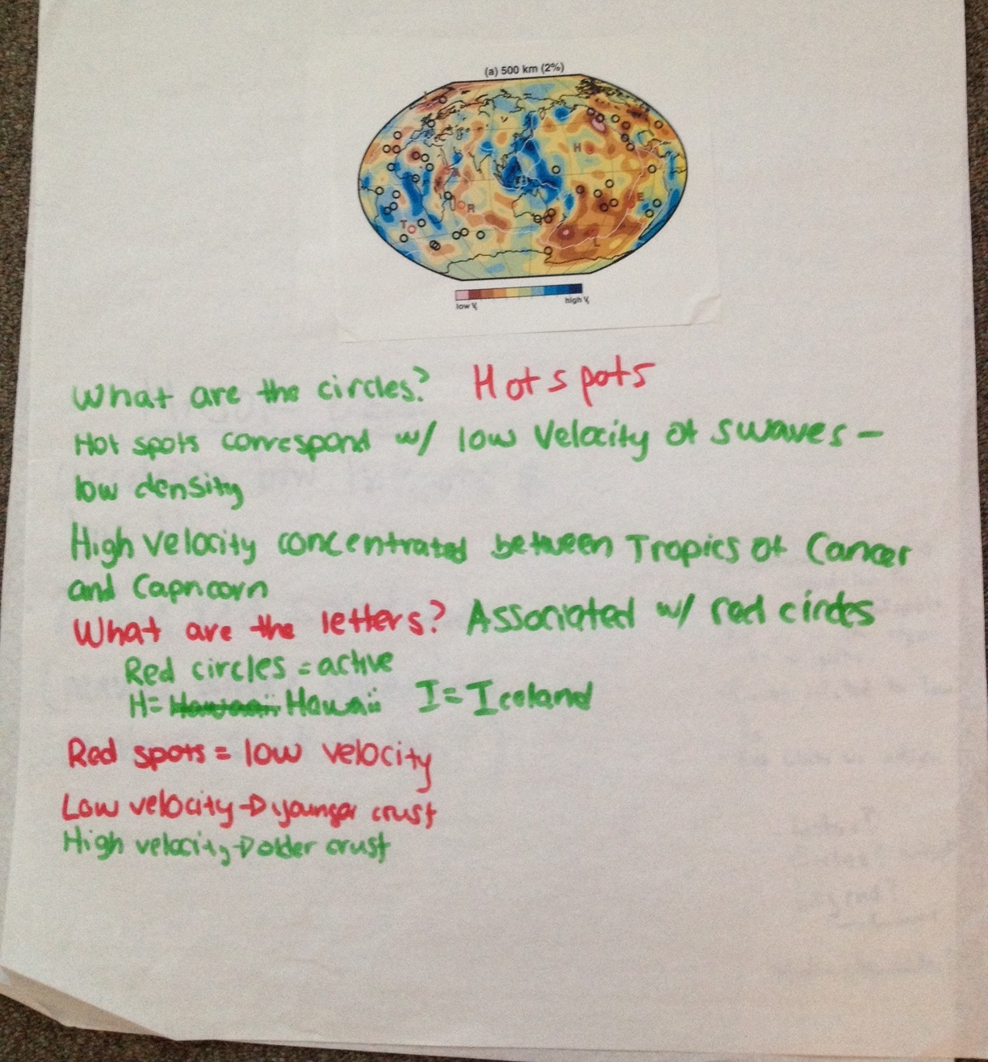
Analyzing figures in groups

Slide 10
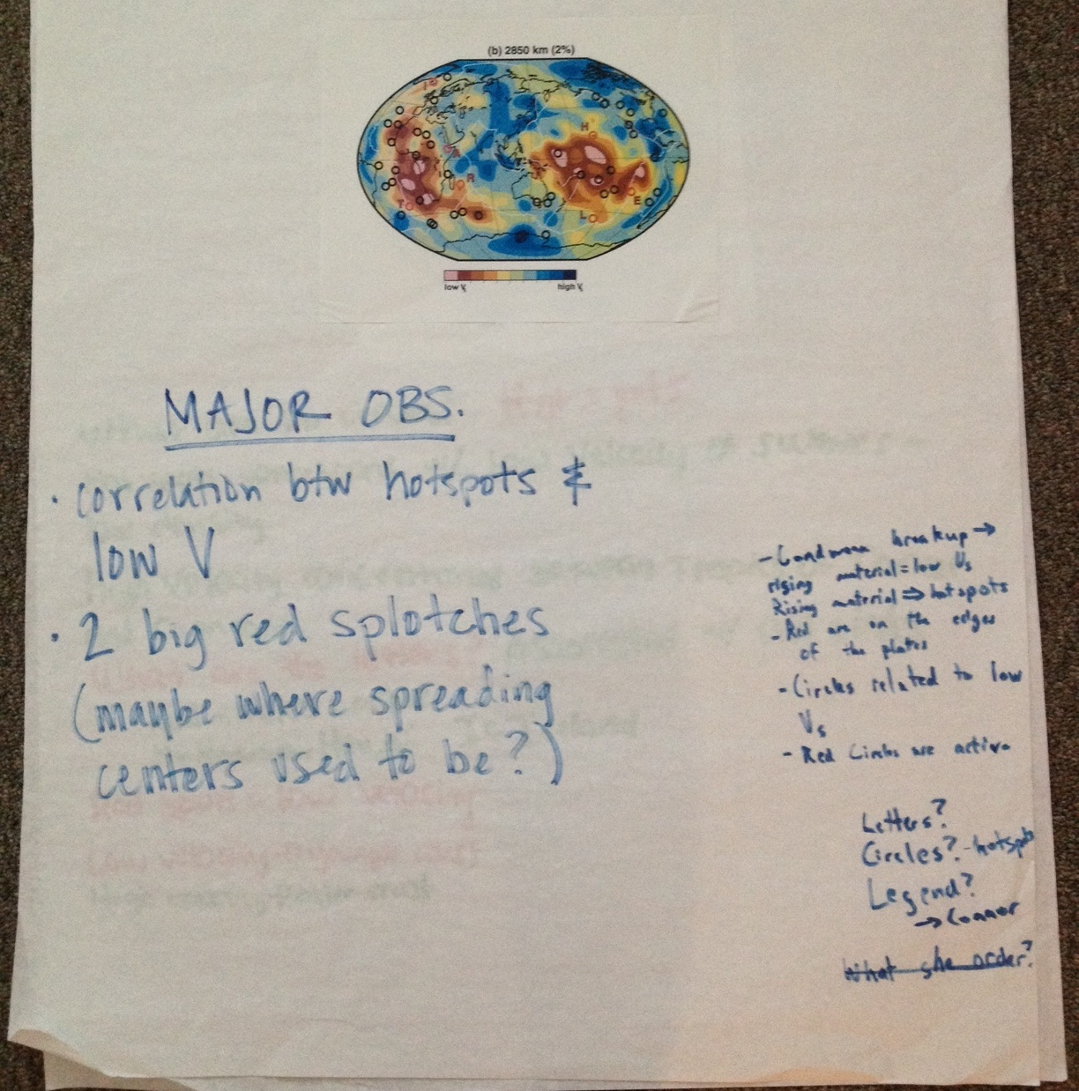
Analyzing figures in groups

Slide 11
1) Students present findings and questions that came up 2) Discuss the relationship between the two figures

Slide 12
Quick draw to assess understanding & synthesis
Given these two figures and what you know about the Earth’s internal layering, draw a schematic cross-section through the Earth from the north to the south poles
Include the major discontinuites
Draw as close to scale as you can
Where appropriate, draw arrows to indicate relative motion

Slide 13
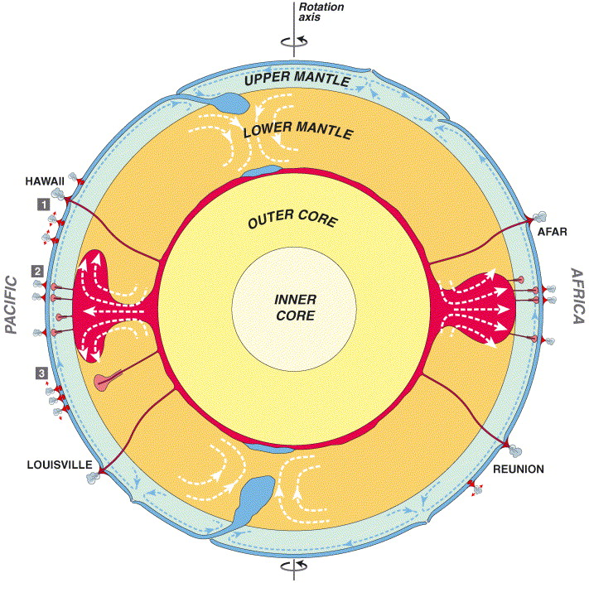
They should get something that approximates this
Sometimes, they need a little help with synthesis…

Slide 14
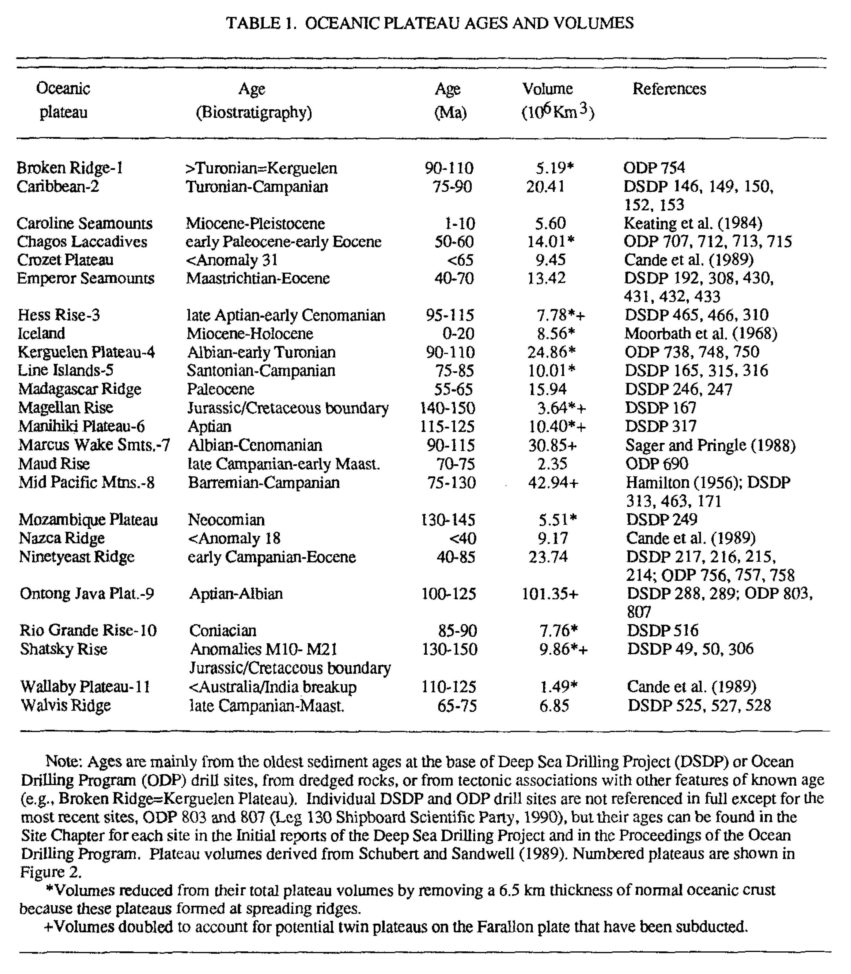
Dataset 3: volume of oceanic plateau (version 1)
Larson, 1991
Notes:
From Larson, 1991 Latest pulse of Earth: Evidence for a mid-Cretaceous superplume

Slide 15
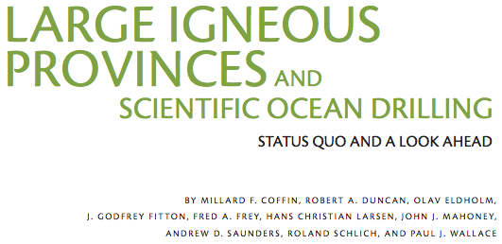
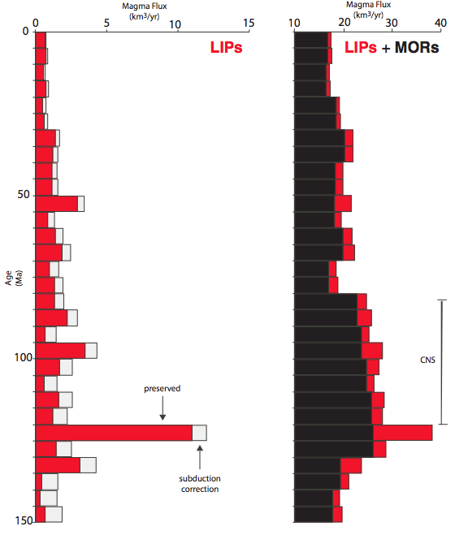
Dataset 3: volume of oceanic plateau (version 2)
Coffin et al., 2006
0
50
Time (Ma)
100
150

Slide 16
Dataset 3: volume of oceanic plateau (version 2)
Coffin et al., 2006
0
50
Time (Ma)
100
150

Slide 17
Dataset 3: volume of oceanic plateau (version 2)
Coffin et al., 2006
0
50
Time (Ma)
100
150

Slide 18
Advantages (and challenges) of different dataset 2 versions
More recent
Corrected for subduction
Includes MOR and LIP
Can lead to a more sophisticated conversation
They plot data
Older & not corrected
Good to show what we knew vs. know now (precision)

Slide 19
Discussion questions that lead to hypothesis development, data evaluation and final wrap-up
What data did you use?
What are the strengths of each dataset?
What are the limitations of each dataset?
Can your hypothesis be tested elsewhere (geographically or in the geologic record)?
What other data would you like to have to evaluate your hypothesis?

Slide 20
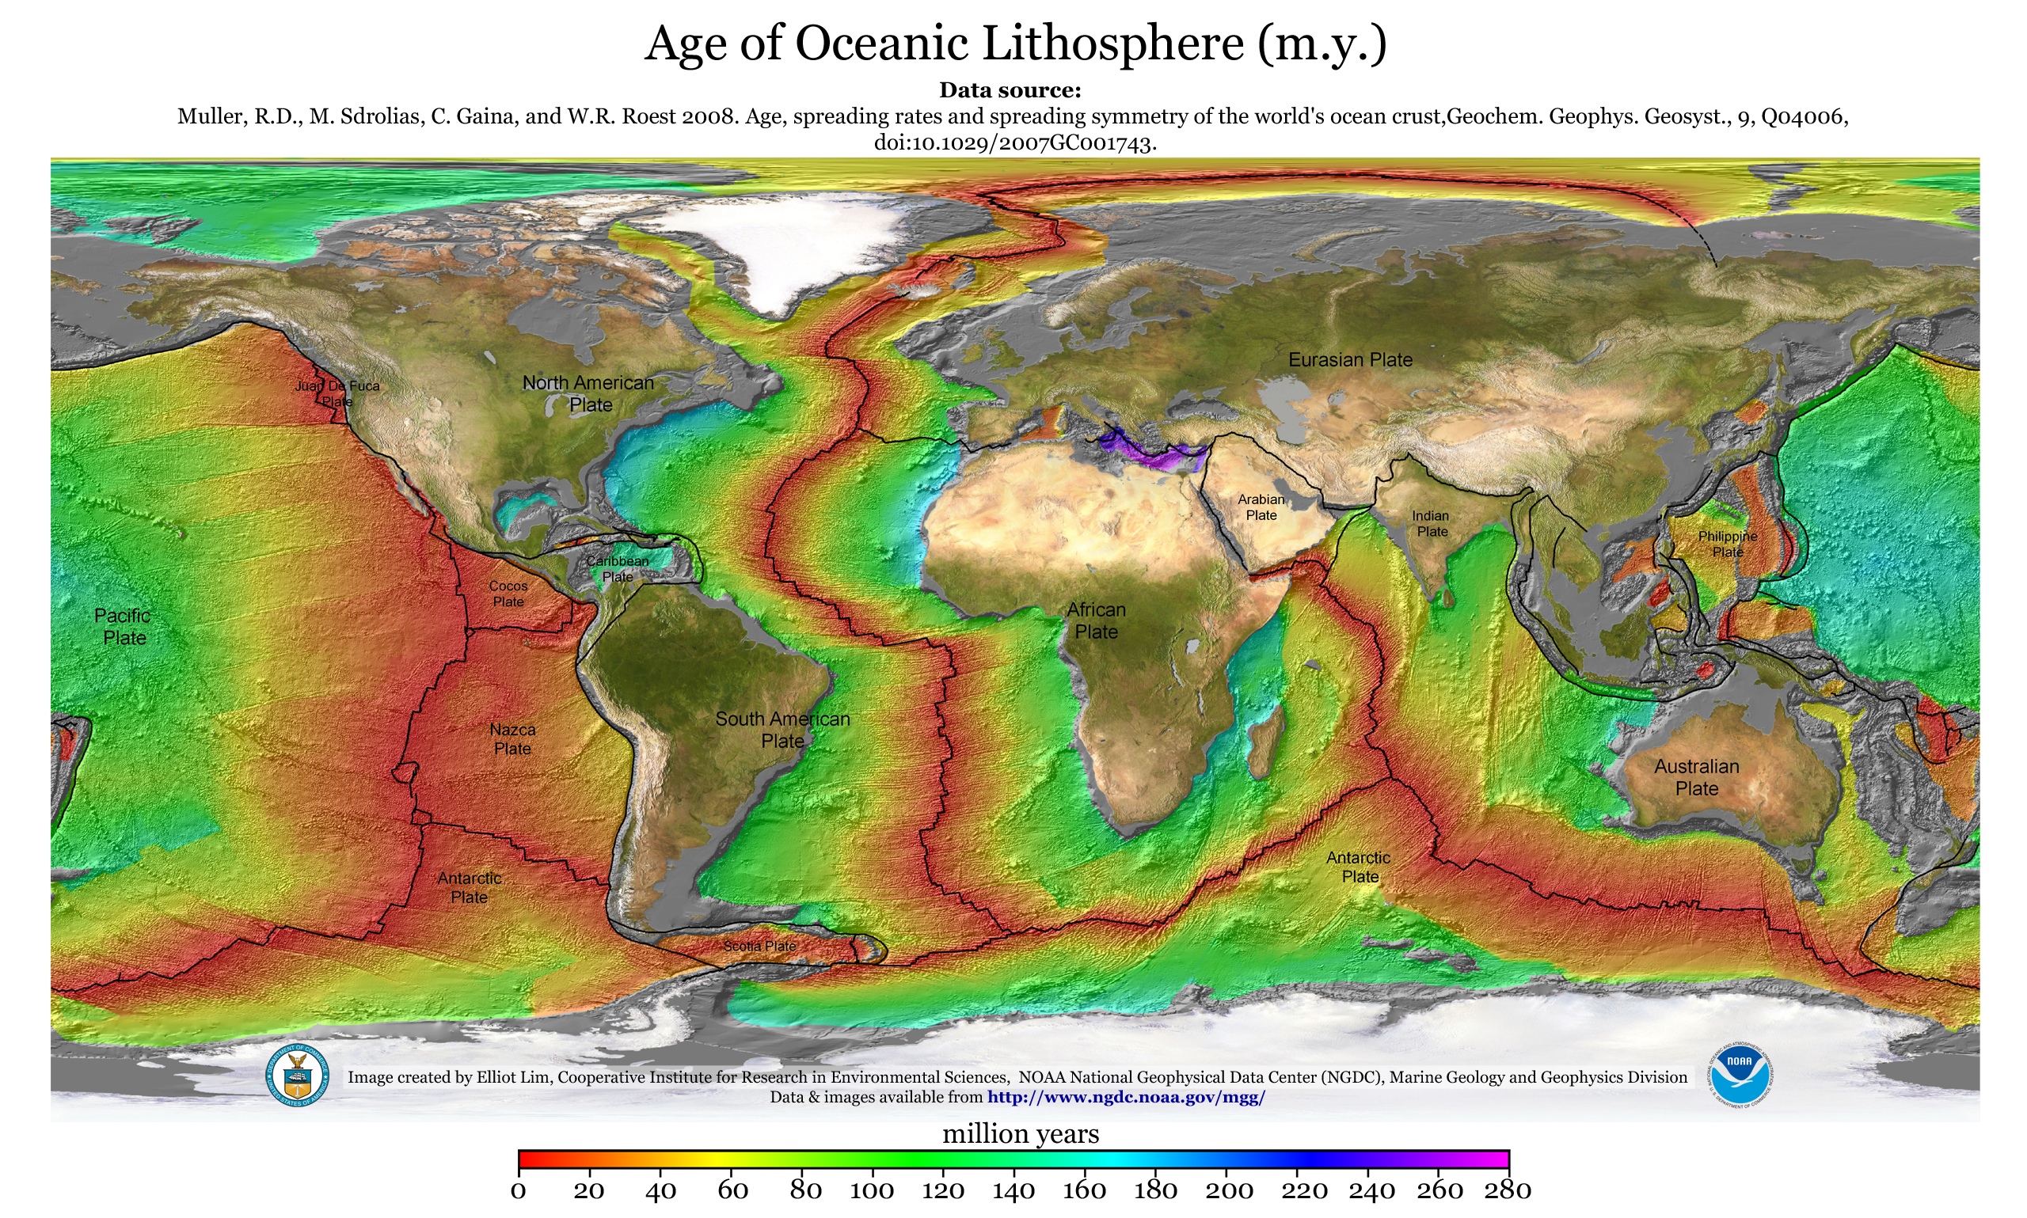
Data evaluation – Why the record is probably not perfect & why we focus on the Cretaceous

Slide 21
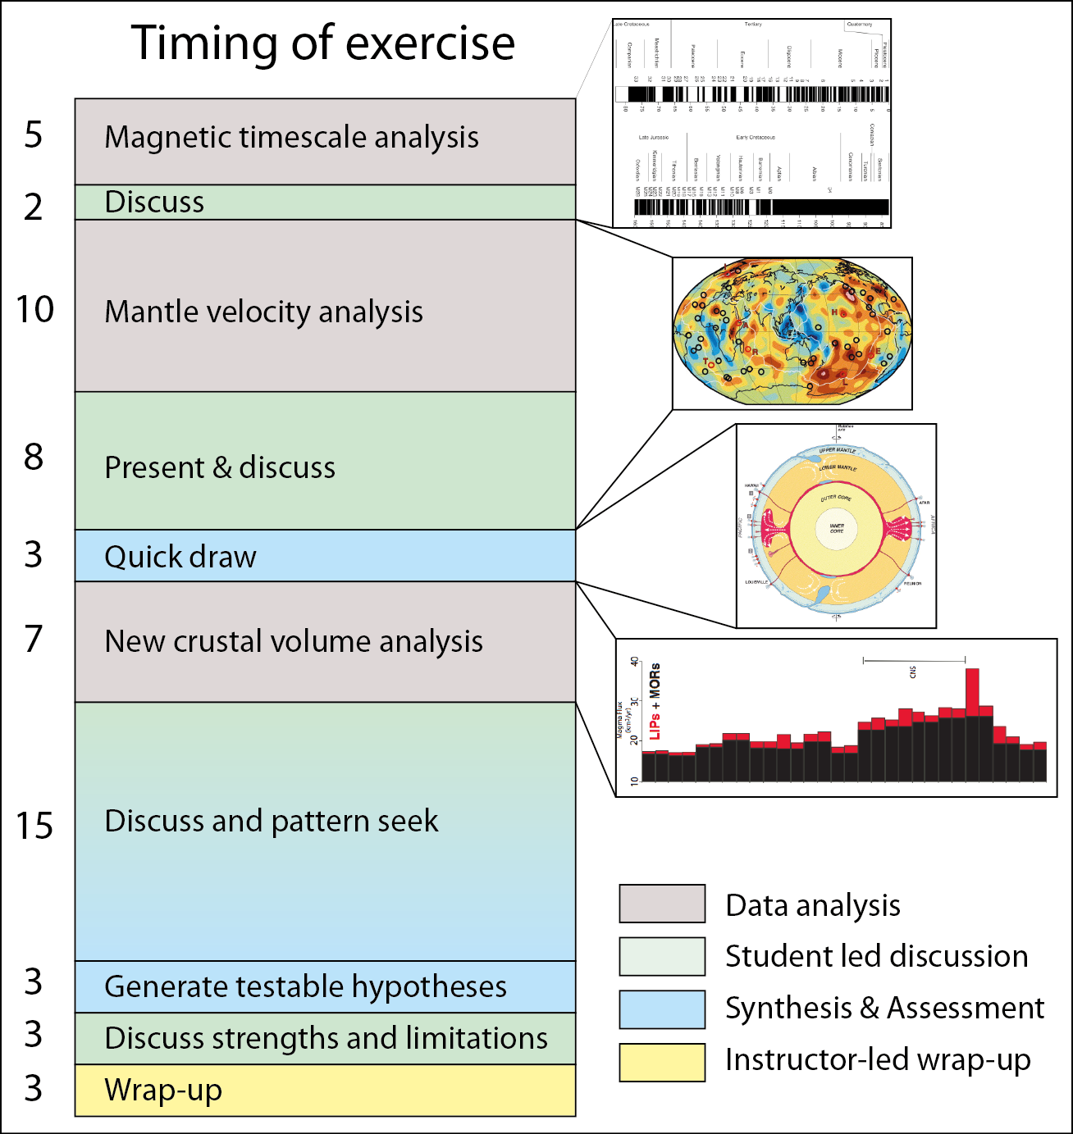

Slide 22
Skill and learning goals of exercise
Identify trends: frequency & duration magnetic reversals
Compare/contrast: superplumes, mantle plumes & MOR
Develop testable hypothesis: relationship between superplumes & magnetic reversals
Synthesize datasets & compose data-supported argument
Evaluate data quality
Contextualize new knowledge
“These are the skills employers (and grad school advisers) look for. We practice them in class to best prepare you for any career you choose”

