Slide 1
Learning to Interpret Natural Language Navigation Instructions from Observations
David L. Chen and Raymond J. Mooney
Department of Computer Science
The University of Texas at Austin
Twenty-Fifth Conference on Artificial Intelligence (AAAI-11)
August 9, 2011

Slide 2
Navigation Task
Learn to interpret and follow free-form navigation instructions
e.g. Go down this hall and make a right when you see an elevator to your left
Assume no prior linguistic knowledge
Learn by observing how humans follow instructions
Use virtual worlds and instructor/follower data from MacMahon et al. (2006)

Slide 3


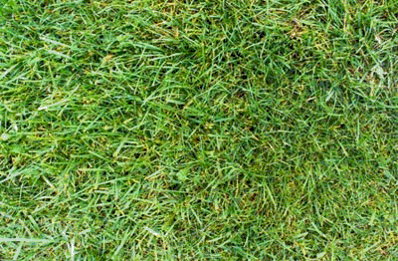

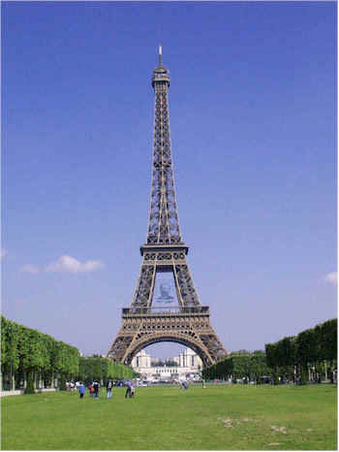
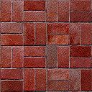
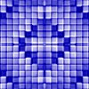



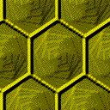
Environment
H
H – Hat Rack
L – Lamp
E – Easel
S – Sofa
B – Barstool
C - Chair
L
E
E
C
S
S
C
B
H
L

Slide 4
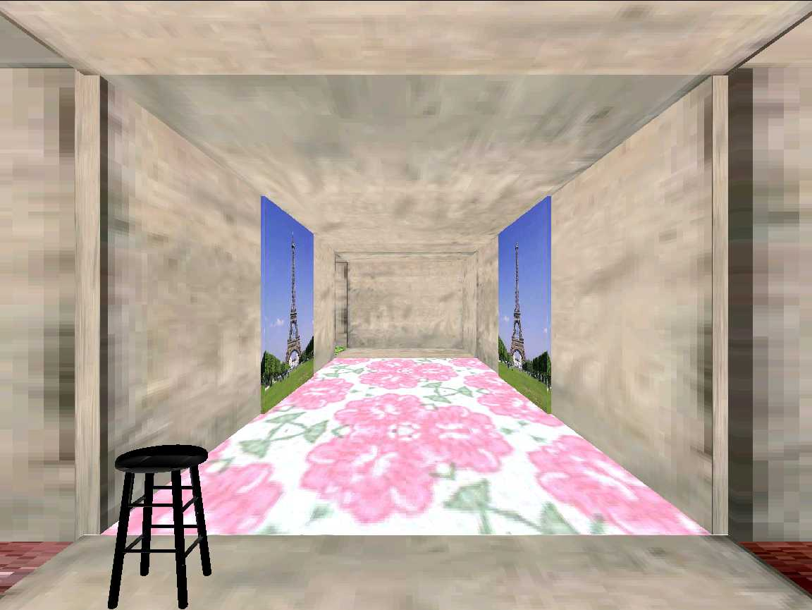
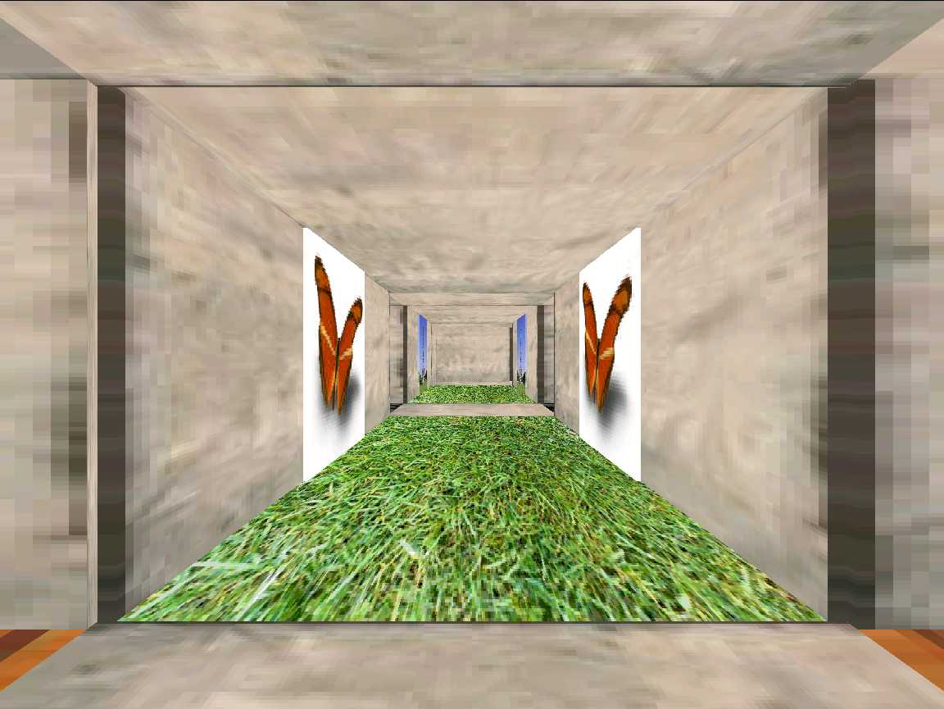
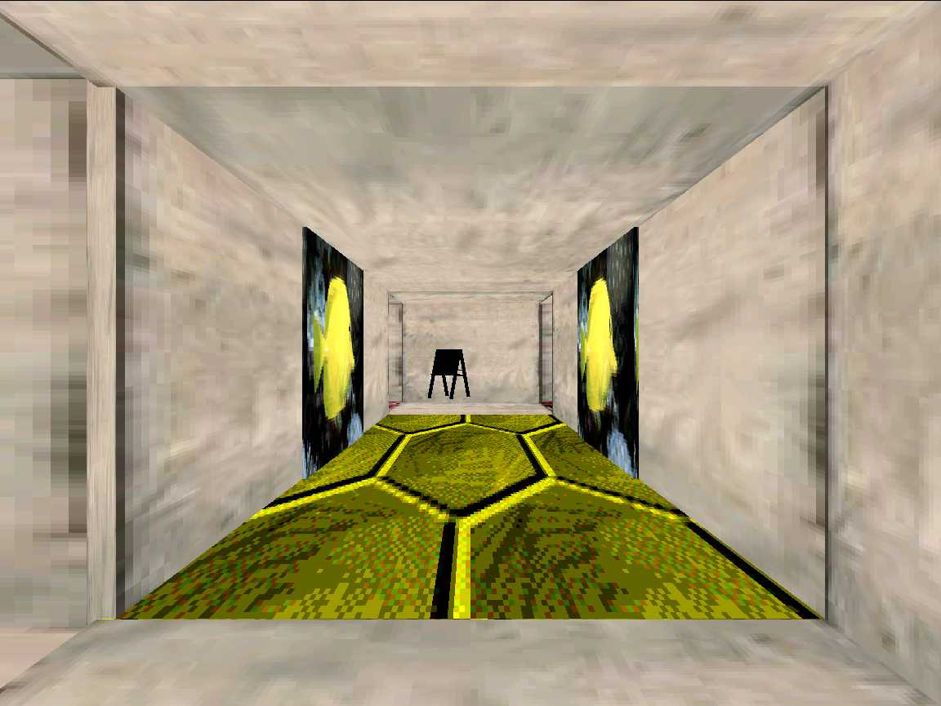
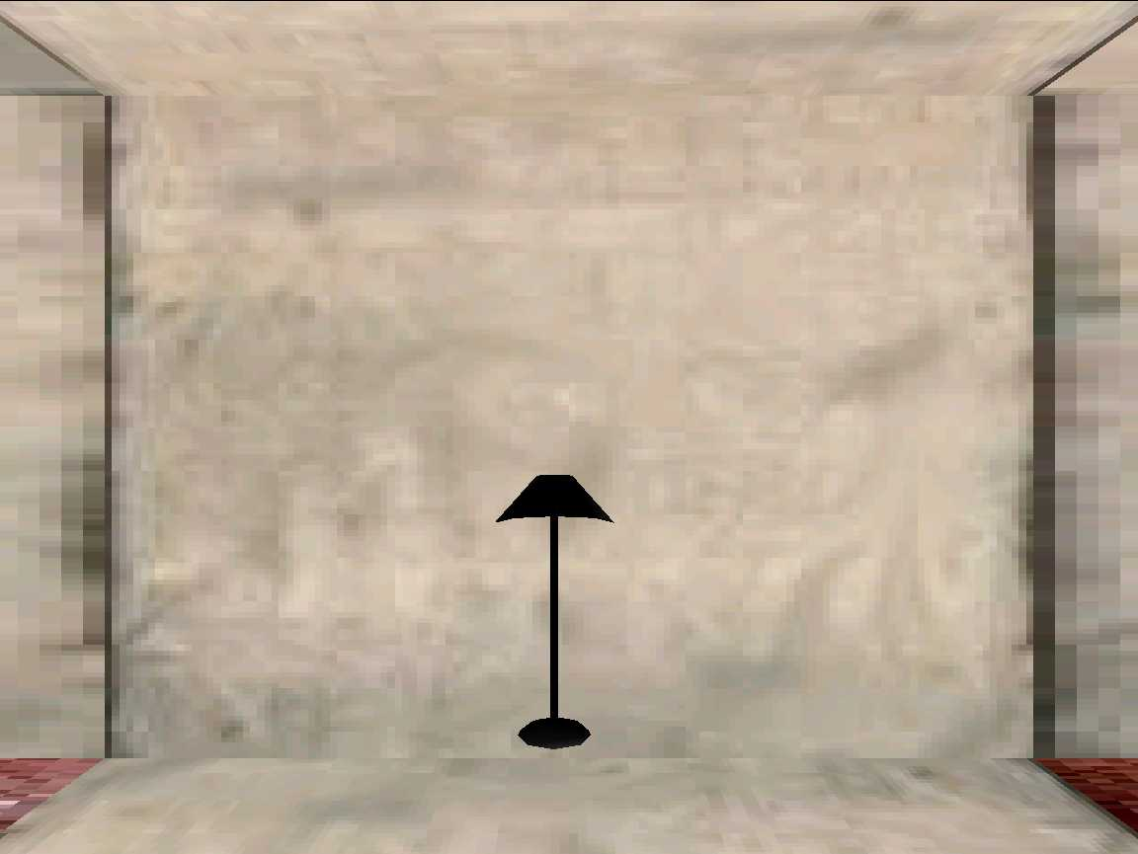
Environment

Slide 5
Example Task
Task: Navigate from location 3 to location 4
3
H
4

Slide 6
Example Task
“Take your first left. Go all the way down until you hit a dead end.”
“Go towards the coat hanger and turn left at it. Go straight down the hallway and the dead end is position 4.”
“Walk to the hat rack. Turn left. The carpet should have green octagons. Go to the end of this alley. This is p-4.”
“Walk forward once. Turn left. Walk forward twice.”

Slide 7
Example Task
Task: Navigate from location 3 to location 4
3
Observed primitive actions:
Forward, Left, Forward, Forward
H
4

Slide 8
Related Work
Simpler worlds, no prior linguistic knowledge
Shimizu and Haas 2009
Matuszek et al. 2010
More complex environments with prior linguistic knowledge
MacMahon et al. 2006
Vogel and Jurafsky 2010
Kollar et al. 2010

Slide 9
Observation
World State
Action Trace
Instruction
Training

Slide 10
Learning system for parsing
navigation instructions
Observation
World State
Navigation Plan Constructor
Action Trace
Instruction
Training

Slide 11
Learning system for parsing
navigation instructions
Observation
World State
Navigation Plan Constructor
Action Trace
Instruction
Semantic Parser Learner
Training

Slide 12
Learning system for parsing
navigation instructions
Observation
World State
Navigation Plan Constructor
Action Trace
Instruction
Plan Refinement
Semantic Parser Learner
Training

Slide 13
Learning system for parsing
navigation instructions
Observation
World State
Navigation Plan Constructor
Action Trace
Instruction
Plan Refinement
Semantic Parser Learner
Training
Testing
Instruction
World State

Slide 14
Learning system for parsing
navigation instructions
Observation
World State
Navigation Plan Constructor
Action Trace
Instruction
Plan Refinement
Semantic Parser Learner
Training
Testing
Instruction
Semantic Parser
World State

Slide 15
Learning system for parsing
navigation instructions
Observation
World State
Navigation Plan Constructor
Action Trace
Instruction
Plan Refinement
Semantic Parser Learner
Training
Testing
Instruction
Semantic Parser
World State
Execution Module (MARCO)
Action Trace

Slide 16
Learning system for parsing
navigation instructions
Observation
World State
Navigation Plan Constructor
Action Trace
Instruction
Plan Refinement
Semantic Parser Learner
Training
Testing
Instruction
Semantic Parser
World State
Execution Module (MARCO)
Action Trace

Slide 17
Constructing Navigation Plans
Instruction: Walk to the couch and turn left
Action Trace: Forward, Left
Basic plan: Directly model the observed actions
Travel
Turn
steps: 1
LEFT

Slide 18
Constructing Navigation Plans
Instruction: Walk to the couch and turn left
Action Trace: Forward, Left
Basic plan: Directly model the observed actions
Travel
Turn
steps: 1
LEFT
Landmarks plan: Add interleaving verification steps
Travel
Verify
Turn
Verify
steps: 1
at: SOFA
LEFT
front: BLUE
HALL

Slide 19
Plan Refinement
Remove extraneous details in the plans
First learn the meaning of words and short phrases
Use the learned lexicon to remove parts of the plans unrelated to the instructions

Slide 20
Lexicon Learning
1. Collect all plans g that co-occur with a word or short phrase w
Turn and walk to the couch
Turn
Verify
Travel
Verify
LEFT
front: BLUE
HALL
front: SOFA
steps: 2
at: SOFA
Walk to the couch and turn left
Travel
Verify
Turn
Verify
steps: 1
at: SOFA
LEFT
front: BLUE
HALL
Walk to the couch and head down the brick hallway
Travel
Verify
Turn
Verify
steps: 5
at: SOFA
RIGHT
front: BRICK HALL
front: CHAIR

Slide 21
Lexicon Learning
1. Collect all plans g that co-occur with a word or short phrase w
Possible meanings of walk to the couch:
Turn
Verify
Travel
Verify
LEFT
front: BLUE
HALL
front: SOFA
steps: 2
at: SOFA
Travel
Verify
Turn
Verify
steps: 1
at: SOFA
LEFT
front: BLUE
HALL
Travel
Verify
Turn
Verify
steps: 5
at: SOFA
RIGHT
front: BRICK HALL
front: CHAIR

Slide 22
Lexicon Learning
2. Take intersections of all possible pairs of meanings
Possible meanings of walk to the couch:
Turn
Verify
Travel
Verify
LEFT
front: BLUE
HALL
front: SOFA
steps: 2
at: SOFA
Travel
Verify
Turn
Verify
steps: 1
at: SOFA
LEFT
front: BLUE
HALL
Travel
Verify
Turn
Verify
steps: 5
at: SOFA
RIGHT
front: BRICK HALL
front: CHAIR

Slide 23
Lexicon Learning
2. Take intersections of all possible pairs of meanings
Possible meanings of walk to the couch:
Turn
Verify
Travel
Verify
LEFT
front: BLUE
HALL
front: SOFA
steps: 2
at: SOFA
Travel
Verify
Turn
Verify
steps: 1
at: SOFA
LEFT
front: BLUE
HALL
Travel
Verify
Turn
Verify
steps: 5
at: SOFA
RIGHT
front: BRICK HALL
front: CHAIR
Turn
LEFT

Slide 24
Lexicon Learning
2. Take intersections of all possible pairs of meanings
Possible meanings of walk to the couch:
Turn
Verify
Travel
Verify
LEFT
front: BLUE
HALL
front: SOFA
steps: 2
at: SOFA
Travel
Verify
Turn
Verify
steps: 1
at: SOFA
LEFT
front: BLUE
HALL
Travel
Verify
Turn
Verify
steps: 5
at: SOFA
RIGHT
front: BRICK HALL
front: CHAIR
Turn
LEFT
Travel
Verify
at: SOFA

Slide 25
Lexicon Learning
2. Take intersections of all possible pairs of meanings
Possible meanings of walk to the couch:
Turn
Verify
Travel
Verify
LEFT
front: BLUE
HALL
front: SOFA
steps: 2
at: SOFA
Travel
Verify
Turn
Verify
steps: 1
at: SOFA
LEFT
front: BLUE
HALL
Travel
Verify
Turn
Verify
steps: 5
at: SOFA
RIGHT
front: BRICK HALL
front: CHAIR
Turn
LEFT
Travel
Verify
at: SOFA
…

Slide 26

Lexicon Learning
3. Rank the entries by the scoring function
Possible meanings of walk to the couch:
Travel
Verify
at: SOFA
Travel
Verify
Turn
Verify
steps: 1
at: SOFA
LEFT
front: BLUE
HALL
Turn
Verify
Travel
Verify
LEFT
front: BLUE
HALL
front: SOFA
steps: 2
at: SOFA
Turn
LEFT
…

Slide 27
Refining Plans Using A Lexicon
Walk to the couch and turn left
Travel
Verify
Turn
Verify
steps: 1
at: SOFA
LEFT
front: BLUE
HALL

Slide 28
Refining Plans Using A Lexicon
Walk to the couch and turn left
Travel
Verify
Turn
Verify
steps: 1
at: SOFA
LEFT
front: BLUE
HALL
Lexicon entry:
Turn
turn left
LEFT

Slide 29
Refining Plans Using A Lexicon
Walk to the couch and
Travel
Verify
Turn
Verify
steps: 1
at: SOFA
LEFT
front: BLUE
HALL
Lexicon entry:
walk to the couch
Travel
Verify
at: SOFA

Slide 30
Refining Plans Using A Lexicon
and
Travel
Verify
Turn
Verify
steps: 1
at: SOFA
LEFT
front: BLUE
HALL
Lexicon exhausted

Slide 31
Refining Plans Using A Lexicon
and
Travel
Verify
Turn
at: SOFA
LEFT
Remove all unmarked nodes

Slide 32
Refining Plans Using A Lexicon
Walk to the couch and turn left
Travel
Verify
Turn
at: SOFA
LEFT

Slide 33
Experiments
Three different virtual worlds
Hand-segmented original data to single sentences
 | Single Sentences | Paragraphs
# Instructions | 3236 | 706
Vocabulary Size | 629 | 660
Avg. # sentences | 1.0 | 5.0
Avg. # words | 7.8 | 37.6
Avg. # actions | 2.1 | 10.4

Slide 34
Plan Construction
Test how well the system infers the correct navigation plans
Gold-standard plans annotated manually
Use partial parse accuracy as metric
Credit for the correct action type (e.g. Turn)
Additional credit for correct arguments (e.g. LEFT)
Lexicon learned and tested on the same data from two maps out of three

Slide 35
Plan Construction
 | Precision | Recall | F1
Basic Plans | 81.46 | 55.88 | 66.27
Landmarks Plans | 45.42 | 85.46 | 59.29
Refined Landmarks Plans | 78.54 | 78.10 | 78.32

Slide 36
End-to-end Execution
Test how well the system can perform the overall navigation task
Leave-one-map-out approach
Strict metric: Only successful if the final position matches exactly

Slide 37
End-to-end Execution
Lower baseline
A simple generative model based on the frequency of actions alone
Upper baselines
Training with human annotated gold plans
Complete MARCO system (MacMahon, 2006)
Humans

Slide 38
End-to-end Execution
 | Single Sentences | Paragraphs
Simple Generative Model | 11.08% | 2.15%
Basic Plans | 56.99% | 13.99%
Landmarks Plans | 21.95% | 2.66%
Refined Landmarks Plans | 54.40% | 16.18%
Human Annotated Plans | 58.29% | 26.15%
MARCO | 77.87% | 55.69%
Human Followers | N/A | 69.64%

Slide 39
End-to-end Execution
 | Single Sentences | Paragraphs
Simple Generative Model | 11.08% | 2.15%
Basic Plans | 56.99% | 13.99%
Landmarks Plans | 21.95% | 2.66%
Refined Landmarks Plans | 54.40% | 16.18%
Human Annotated Plans | 58.29% | 26.15%
MARCO | 77.87% | 55.69%
Human Followers | N/A | 69.64%

Slide 40
End-to-end Execution
 | Single Sentences | Paragraphs
Simple Generative Model | 11.08% | 2.15%
Basic Plans | 56.99% | 13.99%
Landmarks Plans | 21.95% | 2.66%
Refined Landmarks Plans | 54.40% | 16.18%
Human Annotated Plans | 58.29% | 26.15%
MARCO | 77.87% | 55.69%
Human Followers | N/A | 69.64%

Slide 41
End-to-end Execution
 | Single Sentences | Paragraphs
Simple Generative Model | 11.08% | 2.15%
Basic Plans | 56.99% | 13.99%
Landmarks Plans | 21.95% | 2.66%
Refined Landmarks Plans | 54.40% | 16.18%
Human Annotated Plans | 58.29% | 26.15%
MARCO | 77.87% | 55.69%
Human Followers | N/A | 69.64%

Slide 42
Example Parse
Instruction: | “Place your back against the wall of the ‘T’ intersection. Turn left. Go forward along the pink-flowered carpet hall two segments to the intersection with the brick hall. This intersection contains a hatrack. Turn left. Go forward three segments to an intersection with a bare concrete hall, passing a lamp. This is Position 5.”
Parse: | Turn ( ), Verify ( back: WALL ), Turn ( LEFT ), Travel ( ), Verify ( side: BRICK HALLWAY ), Turn ( LEFT ), Travel ( steps: 3 ), Verify ( side: CONCRETE HALLWAY )

Slide 43
Conclusion
Presented an end-to-end system that learns to interpret free-form navigation instructions
Learn by observing how humans follow instructions
No prior linguistic knowledge
More details and data/code at:
http://www.cs.utexas.edu/~ml/clamp/navigation/

