Slide 1

Why broadband matters

Slide 2

BROADBAND DIFFUSION AND ADOPTION
International
National
State
Rural

Slide 3
WE’RE NUMBER 14!
Notes:
Figures from the Organization for Economic Cooperation and Development (OECD) show a sharp decline in U.S. broadband access rank among its 30 member nations. The U.S. was the leader in broadband penetration. In 2001, the U.S. ranked 4th, but by 2010 had fallen to 14’th place.
Source: http://www.oecd.org/document/54/0,3746,en_2649_33703_38690102_1_1_1_1,00.html (Table 1D)
As for speed, Akamai, one of the largest global networks, released its "Q3 2009 State of the Internet" report that shows the U.S. 18th with an average connection speed of 3.9 Mbps. In first place was South Korea, which clocked in at 14.6 Mbps.
It should be noted that all most all of the countries ahead of the US using this measure are much more densely populated than the US with it’s rural areas.

Slide 4
4TH AMONG TOP 7 INDUSTRIALIZED COUNTRIES
Notes:
Canada is very similar to the US relative to it’s large rural areas and it has achieved a much higher broadband penetration that the U.S. (30.1 % with fixed broadband vs. 27.1%)
The Group of Seven (G7), now the G8, is a club of advanced industrialized states that meets annually to discuss important economic, financial, and political issues. Read more: http://www.answers.com/topic/g7-g8#ixzz1HqiTPmPT
Source: http://www.oecd.org/document/54/0,3746,en_2649_33703_38690102_1_1_1_1,00.html (Table 1i)

Slide 5
IT’S ALL ABOUT BANDWIDTH
Notes:
Source: http://www.oecd.org/document/54/0,3746,en_2649_33703_38690102_1_1_1_1,00.html table 5a
It’s more about bandwidth and speed than it is about the presence or absence of broadband. The U.W. ranks 24’th according to the OECD Organization for Economic Cooperation and Development

Slide 6
PRICE
Notes:
Source: http://www.oecd.org/document/54/0,3746,en_2649_33703_38690102_1_1_1_1,00.html (Table 4e)
Not only do we have lower broadband penetration rates and lower broadband speeds, but we also pay more for our broadband connections.

Slide 7
2009 E-READINESS RANKINGS
Denmark 1
Sweden 2
Netherlands 3
Norway 4
United States 5
Australia 6
Singapore 7
Hong Kong 8
Canada 9
Finland 10
Economist Intelligence Unit
www.eic.com
Notes:
Source: http://graphics.eiu.com/pdf/E-readiness%20rankings.pdf
The Economist Intelligence Unit publishes national e-readiness rankings annually. This organization ranked the US 5’th based on a methodology that considers 6 categories:
Category Weight
Connectivity and technology infrastructure 20%
Business environment 15%
Social and cultural environment 15%
Legal environment 10%
Government policy and vision 15%
Consumer and business adoption 25%
Source: Economist Intelligence Unit, 2009

Slide 8
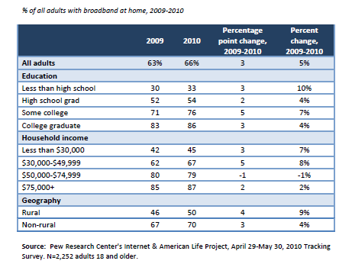
ADOPTION TRENDS WITHIN DEMOGRAPHIC GROUPS, 2009-10
Pew/Internet – August 2010
Notes:
Source: http://www.pewinternet.org/Reports/2010/Home-Broadband-2010.aspx
The Pew Internet and American Life project conducts surveys of US households. This chart from a 2010 report compares home broadband penetration by community type for the US.
Household broadband penetration is growing over the time period, but penetration in rural communities continues to lag urban and communities (50% vs. 70%).

Slide 9
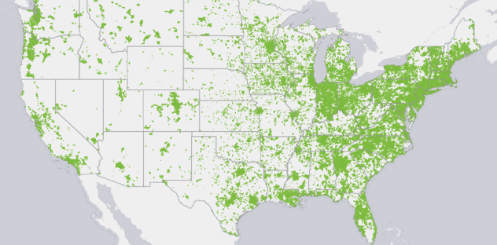
Number of Broadband Providers (National Broadband Map)
Notes:
Source: http://www.broadbandmap.gov/number-of-providers
Availability of broadband service is one reason rural broadband penetration lags behind urban and suburban areas. Studies have also shown that the cost of broadband decreases when there are multiple providers in a community.
This map showing the number of high-speed providers by census block (June 2010). The National Broadband Map (NBM) is a searchable and interactive website that allows users to view broadband availability across every neighborhood in the United States. The NBM was created by the National Telecommunications and Information Administration (NTIA), in collaboration with the Federal Communications Commission (FCC), and in partnership with 50 states, five territories and the District of Columbia. The NBM is a project of NTIA's State Broadband Initiative. The NBM will be updated approximately every six months and was first published on February 17, 2011.

Slide 10

CONSUMER BROADBAND THERE IS A DIVIDE – IT MATTERS
Unavailable in some communities
Bandwidth limits applications
Education/training
Telework
Telemedicine
eCommerce
Entertainment
eGov services
Brain Drain
Economic development
Notes:
Businesses and residents will be less likely to locate in communities with no or limited broadband.
College grads are less likely live in homes without broadband access
Communities with out broadband service are less likely to attract young people or retiring baby boomers.

Slide 11


COMMERCIAL BROADBAND BUSINESS, SCHOOLS, GOVERNMENT, ETC.
Higher service level requirements (99.99999%)
BIG Pipes
Dedicated connections
Higher cost in rural vs. urban/suburban areas
Limited providers in rural areas
Notes:
The previous slides focused on residential broadband service.
Businesses that use broadband often require a higher level of service and dedicated connections with guaranteed bandwidth, synchronous connections (the same up and download speeds). These types of connections are a available in rural areas but they are considerably more expensive than in urban areas.
What organizations in the community use or need this level of broadband service?
Who provides the service to our community?
What does the service cost? How does cost for commercial broadband service compare to the cost in urban areas?

Slide 12
COMMERCIAL BROADBAND MATTERS
Global economy driven by broadband
Businesses less likely to locate or grow without broadband
Geographic penalty
Rural business, governments, schools, hospitals pay more than urban and suburban counterparts
Notes:
Affordable commercial level broadband is important to rural communities. Broadband is a necessary infrastructure that allows businesses to participate in the global economy. Businesses are less likely to locate or grow with out affordable broadband.
Most rural governments, schools and hospitals have to pay more for broadband than their counterparts in urban and suburban communities, making the services and products they provide more expensive to local residents.

Slide 13
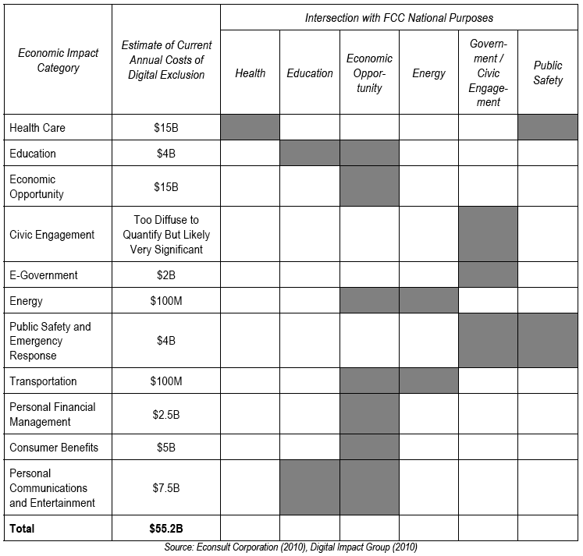
ECONOMIC IMPACT OF DIGITAL EXCLUSION
Notes:
http://www.digitalimpactgroup.org/costofexclusion.pdf
The impact of not having everyone connected is costing this country about $55.2 billion according to a study done by the Digital Impact Group in 2010. Is it reasonable to assume we can connect everyone?
The Brookings Institute reports:
Finland made history this year by declaring that its citizens have a “legal right” to broadband. It passed a law requiring telecommunications providers to “provide all Finnish residents with broadband lines that can run at speeds of at least 1 megabit per second” by July 2010 (Johnson, 2009). With 96 percent of its people already having access to broadband, the legislation affects the four percent who currently are unconnected. The nation’s communications minister announced plans to bring 100 Mbps Internet speed to all residents by 2016.
France has not declared broadband access a legal right, but its courts have said it is a “basic human right”. In a 2009 Constitutional Council action, officials ruled that people need broadband in order to participate in civic affairs and that the country should ensure that all its people had access (Webware, 2009).

Slide 14



FOR MORE INFORMATION:
www.ConnectingCommunities.info
Southern Rural Development Center
Notes:
End slide.

