Slide 1
In Jordan’s Corner @ CIMSS
Mercator CRAS model output for Pacific Region now available on the web and ready for AWIPS
Installed and tested IC4D on portable workstation
Working with Jason Levit to ingest and display convective products at Aviation Weather Center
Need to acquire NCEP/NCO version of N-AWIPS in order to troubleshoot problems with Proving Ground products at National Centers (current policy not to distribute external to organization)

Slide 2
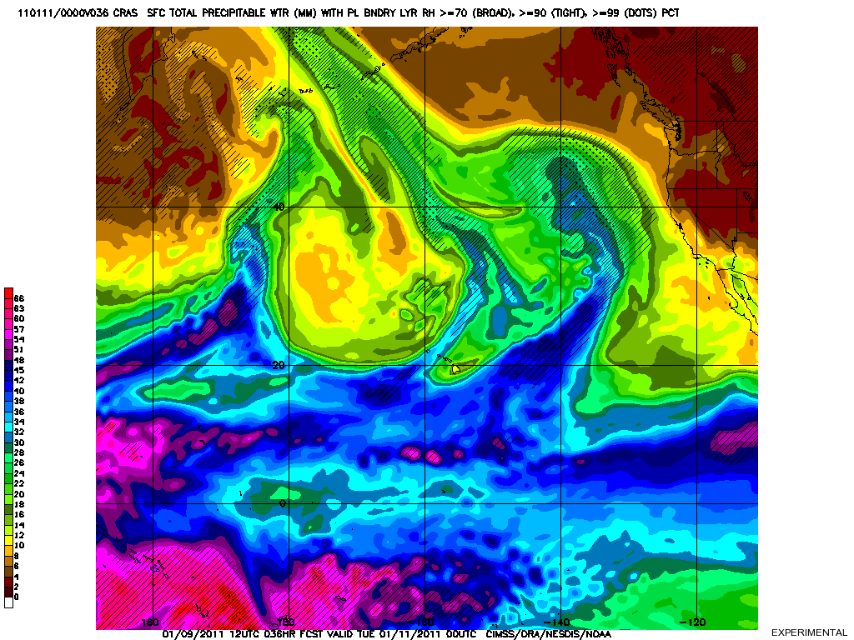
continued
Planned trip to Norman, OK, to prepare for Spring Experiment with Chris Siewert and participate in National Severe Weather Workshop on 3-4 March
On the web
CRAS (CIMSS Regional Assimilation System):
http://cimss.ssec.wisc.edu/cras
Instructions for AWIPS installation of fog and volcanic ash GEOCAT products:
http://cimss.ssec.wisc.edu/~jordang/awips/geocat-ak

