Slide 1

Secure Computation in the
Real World
(ish)
7th International Conference on Information Systems Security
Kolkata, India
17 December 2011
David Evans
University of Virginia
http://www.cs.virginia.edu/evans
http://MightBeEvil.com

Slide 2




“Genetic Dating”
Bob
Alice
Genome Compatibility Protocol
Your offspring will have good immune systems!
Your offspring will have good immune systems!
WARNING!
Don’t Reproduce
WARNING!
Don’t Reproduce

Slide 3





Slide 4
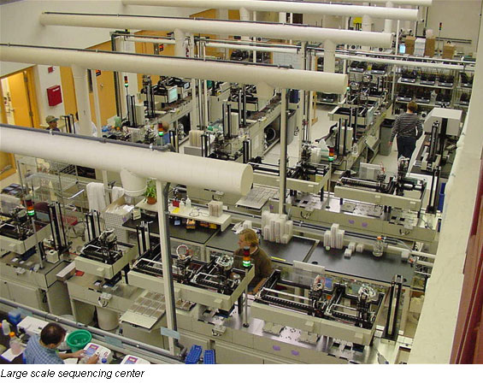
Genome Sequencing
1990: Human Genome Project starts, estimate $3B to sequence one genome ($0.50/base)
2000: Human Genome Project declared complete, cost ~$300M
Whitehead Institute, MIT

Slide 5
Cost to sequence human genome
Moore’s Law prediction
(halve every 18 months)
Data from National Human Genome Research Institute: http://www.genome.gov/sequencingcosts

Slide 6
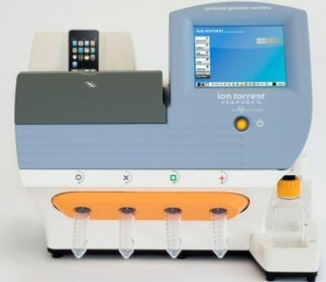
Cost to sequence human genome
Moore’s Law prediction
(halve every 18 months)
Ion torrent Personal Genome Machine
Data from National Human Genome Research Institute: http://www.genome.gov/sequencingcosts

Slide 7




Dystopia
Personalized Medicine

Slide 8
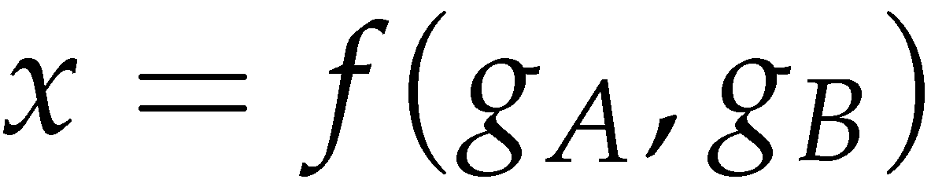
Secure Two-Party Computation
Bob’s Genome: ACTG…
Markers (~1000): [0,1, …, 0]
Alice’s Genome: ACTG…
Markers (~1000): [0, 0, …, 1]
Bob
Alice
Can Alice and Bob compute a function of their private data, without exposing anything about their data besides the result?

Slide 9
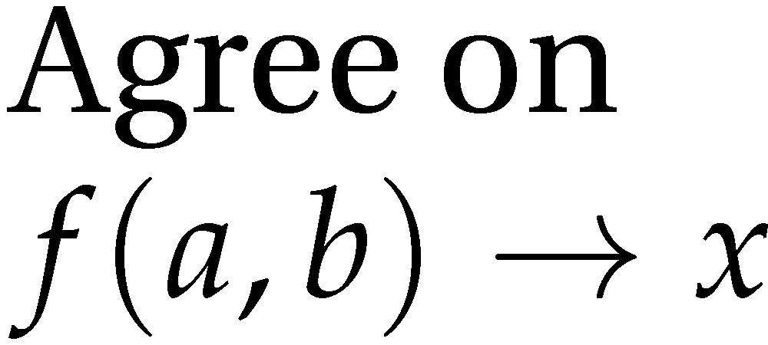


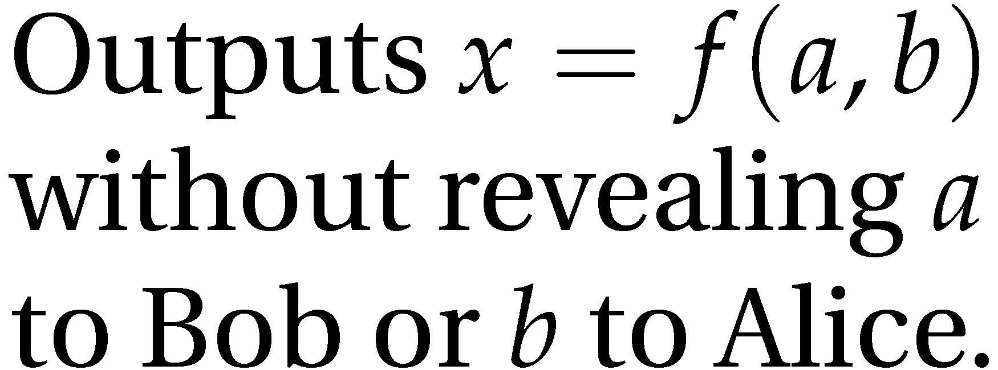
Secure Function Evaluation
Alice (circuit generator)
Bob (circuit evaluator)
Garbled Circuit Protocol
Andrew Yao, 1982/1986

Slide 10
Yao’s Garbled Circuits
Inputs |  | Output
a | b | x
0 | 0 | 0
0 | 1 | 0
1 | 0 | 0
1 | 1 | 1
a
b
AND
x

Slide 11
Computing with Meaningless Values?
Inputs |  | Output
a | b | x
a₀ | b₀ | x₀
a₀ | b₁ | x₀
a₁ | b₀ | x₀
a₁ | b₁ | x₁
a₀ or a₁
b₀ or b₁
a_{i}, b_{i}, x_{i} are random values, chosen by the circuit generator but meaningless to the circuit evaluator.
AND
x₀ or x₁

Slide 12
Computing with Garbled Tables
Inputs |  | Output
a | b | x
a₀ | b₀ | Enc_{a0,b0}(x₀)
a₀ | b₁ | Enc_{a0,b1}(x₀)
a₁ | b₀ | Enc_{a1,b0}(x₀)
a₁ | b₁ | Enc_{a1,b1}(x₁)
Bob can only decrypt one of these!
a₀ or a₁
b₀ or b₁
Garbled And Gate
Enc_{a0, b1}(x₀)
Enc_{a1,b1}(x₁)
Enc_{a1,b0}(x₀)
Enc_{a0,b0}(x₀)
Random Permutation
AND
x₀ or x₁

Slide 13
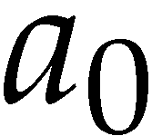
Garbled Circuit Protocol
Alice (circuit generator)
Bob (circuit evaluator)
Garbled Gate
Enc_{a0, b1}(x₀)
Enc_{a1,b1}(x₁)
Enc_{a1,b0}(x₀)
Enc_{a0,b0}(x₀)
Sends a_{i} to Bob based on her input value
How does the Bob learn his own input wires?

Slide 14




Primitive: Oblivious Transfer
Alice
Bob
Oblivious Transfer Protocol
Oblivious: Alice doesn’t learn which secret Bob obtains
Transfer: Bob learns one of Alice’s secrets
Rabin, 1981; Even, Goldreich, and Lempel, 1985; many subsequent papers

Slide 15
Chaining Garbled Circuits
And Gate 1
Enc_{a10, b11}(x1₀)
Enc_{a11,b11}(x1₁)
Enc_{a11,b10}(x1₀)
Enc_{a10,b10}(x1₀)
a0
b0
a1
b1
AND
AND
x0
x1
Or Gate 2
Enc_{x00, x11}(x2₁)
Enc_{x01,x11}(x2₁)
Enc_{x01,x10}(x2₁)
Enc_{x00,x10}(x2₀)
OR
x₂
…
We can do any computation privately this way!

Slide 16
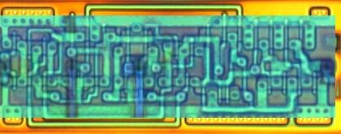
Building Computing Systems
Enc_{x00, x11}(x2₁)
Enc_{x01,x11}(x2₁)
Enc_{x01,x10}(x2₁)
Enc_{x00,x10}(x2₀)
Digital Electronic Circuits | Garbled Circuits
Operate on known data | Operate on encrypted wire labels
One-bit logical operation requires moving a few electrons a few nanometers (hundreds of Billions per second) | One-bit logical operation requires performing (up to) 4 encryption operations: very slow execution
Reuse is great! | Reuse is not allowed for privacy: huge circuits needed

Slide 17
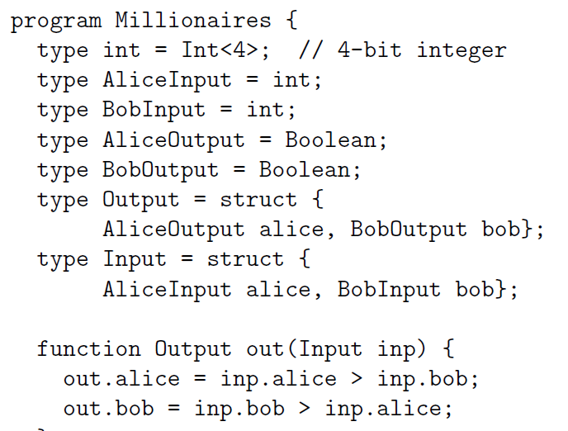
Fairplay
Bob
Alice
SFDL Compiler
SFDL Compiler
Circuit
(SHDL)
SFDL Program
Garbled Tables Generator
Dahlia Malkhi, Noam Nisan, Benny Pinkas and Yaron Sella [USENIX Sec 2004]
Garbled Tables Evaluator

Slide 18
Faster Garbled Circuits
Circuit-Level Application
Circuit Structure
Circuit Structure
GC Framework (Generator)
GC Framework
(Evaluator)
Enc_{x00, x11}(x2₁)
Enc_{x01,x11}(x2₁)
Enc_{x01,x10}(x2₁)
Enc_{x20, x21}(x3₀)
Enc_{x21,x21}(x3₀)
Enc_{x21,x20}(x3₁)
x2₁
Enc_{x20, x31}(x4₁)
Enc_{x21,x31}(x4₁)
Enc_{x21,x30}(x4₀)
x3₁
Enc_{x40, x31}(x5₁)
Enc_{x41,x31}(x5₀)
Enc_{x41,x30}(x5₀)
Enc_{x40, x51}(x6₁)
Enc_{x41,x51}(x6₀)
Enc_{x41,x50}(x6₀)
x4₁
Enc_{x30, x61}(x7₁)
Enc_{x31,x61}(x7₀)
Enc_{x31,x60}(x7₁)
x5₁
x6₀
x7₁
Gates can be evaluated as they are generated: pipelining
Gates can be evaluated in any topological sort order: parallelizing
Garbled evaluation can be combined with normal execution

Slide 19
Results: Performance
Binary gates per millisecond
100,000 gates per second

Slide 20
Results: Scalability
Largest circuit executed
(non-free gates)

Slide 21




Applications
Private Personal Genomics
Privacy-Preserving Biometric Matching
Private AES Encryption
Private Set Intersection

Slide 22
Heterozygous Recessive Risk
Alice
 | A | a
A | AA | Aa
a | aA | aa
carrier
Bob
cystic fibrosis
Alice’s Heterozygous Recessive genes: { 5283423, 1425236, 839523, … }
Bob’s Heterozygous Recessive genes: { 5823527, 839523, 169325, … }
Goal: find the intersection of A and B

Slide 23
Bit Vector Intersection
Alice’s Recessive genes:
{ 5283423, 1425236, 839523, … }
Bob’s Recessive genes:
{ 5823527, 839523, 169325, … }
[ PAH, PKU, CF, … ]
[ 0, 0, 1, 0, 0, 0, 1, 0, 1, 1, 0]
[ 0, 0, 1, 0, 0, 0, 0, 0, 1, 0, 0]
. . .
AND
AND
AND
. . .
Bitwise AND

Slide 24
Scaling
Length of bit vector:
number of possible values
(2^{L} where L is number of bits for each value)
Other private set intersection problems:
Do Alice and Bob have any friends in common?
Data mining problems: combine medical records across hospitals
Two companies want to do joint marketing to common customers
Cooperative financial fraud detection, network analysis, etc.

Slide 25
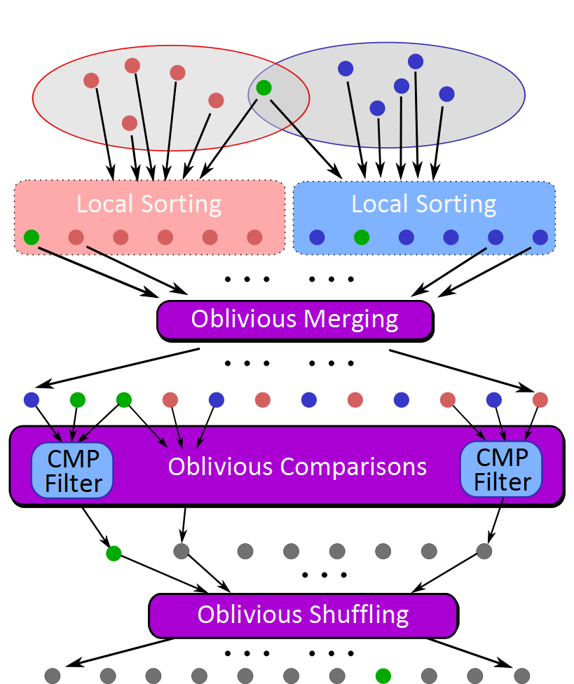
Sort-Compare-Shuffle
Sort: Take advantage of total order of elements
Compare adjacent elements
Shuffle to hide positions

Slide 26
Sort-Compare-Shuffle
Sort: Take advantage of total order of elements
Compare adjacent elements
Shuffle to hide positions

Slide 27
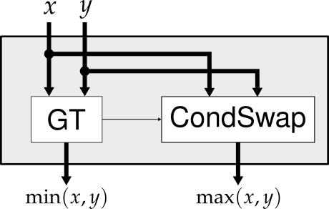
Bitonic Sorting
1
1
1
1
1
4
2
2
2
4
9
3
3
3
3
2
4
4
7
4
5
5
5
4
4
4
4
4
5
5
3
9
9
7
7
2
7
7
9
9

Slide 28
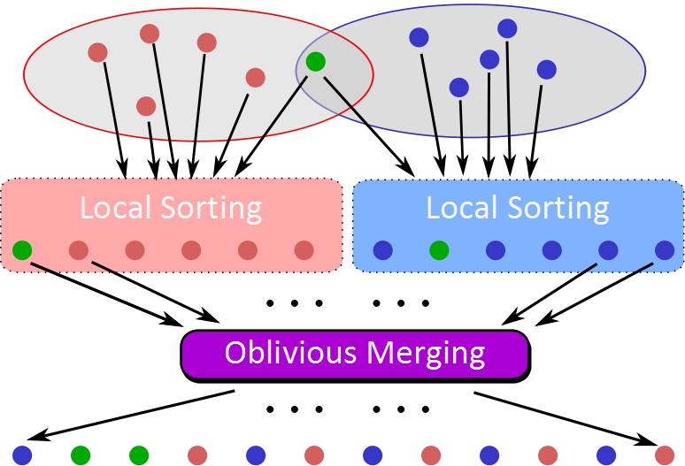
CMP
Filter
CMP
Filter
CMP
Filter
…

Slide 29
CMP3
Filter
CMP3
Filter
CMP3
Filter

Slide 30
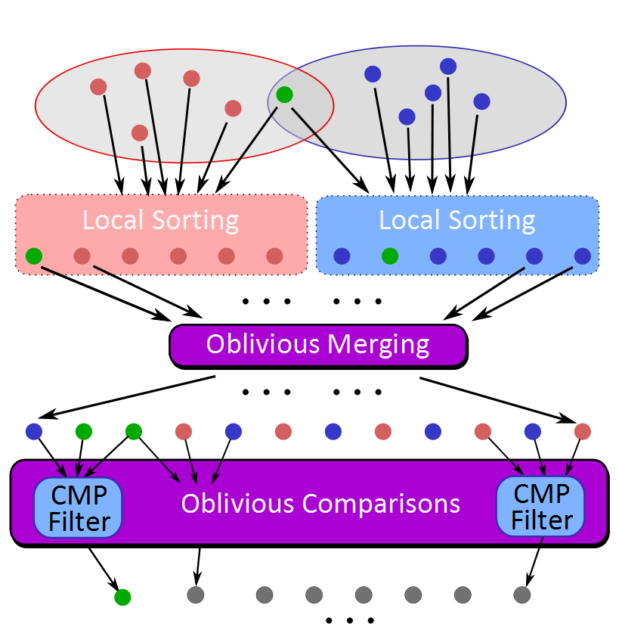
Can’t reveal results yet! Position leaks information.

Slide 31
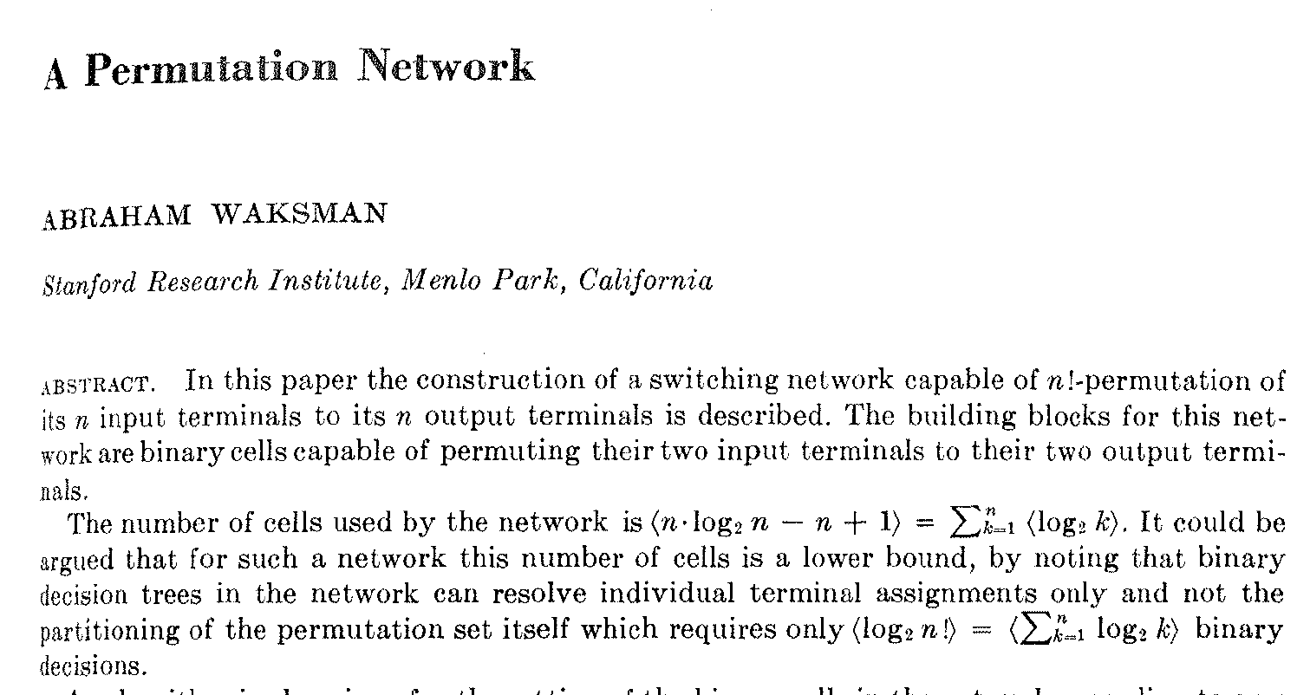
Journal of the ACM, January 1968

Slide 32
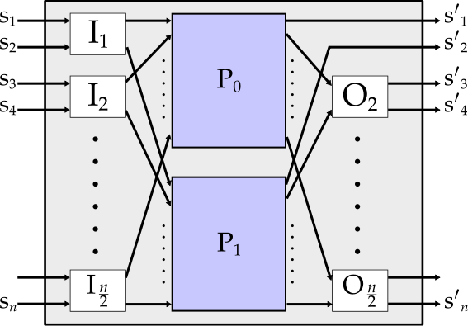

Waksman Network
Same circuit can generate any permutation:
select a random permutation, and pick swaps

Slide 33
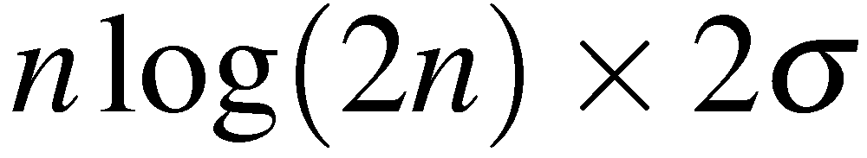
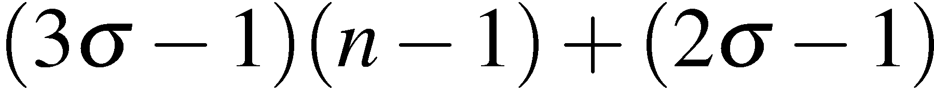
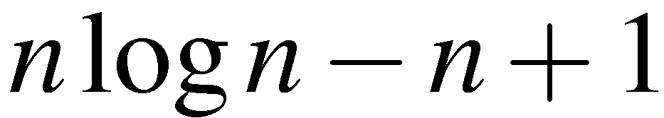
Private Set Intersection Protocol
Gates to generate and evaluate
Free

Slide 34
Private Set Intersection Results
Seconds
Set Size (each set)
32-bit values

Slide 35
Problem | Best Previous Result | Our Result | Speedup
Private Set Intersection (contact matching, common disease carrier) | Competitive with best custom protocols, scales to millions of 32-bit elements
Hamming Distance (Face Recognition) | 213s [SCiFI, 2010] | 0.051s | 4176
Levenshtein Distance (genome, text comparison) – two 200-character inputs | 534s [Jha+, 2008] | 18.4s | 29
Smith-Waterman (genome alignment) – two 60-nucleotide sequences | [Not Implementable] | 447s | -
AES Encryption | 3.3s [Henecka, 2010] | 0.2s | 16.5
Fingerprint Matching (1024-entry database, 640x8bit vectors) | ~83s [Barni, 2010] | 18s | 4.6
NDSS 2012
USENIX Security 2011
NDSS 2011
Notes:
Applications
biometric identification (5x speedup) [NDSS 2011]
Hamming distance (4000x), Edit distance (30x), Smith-Waterman,
AES Encryption (16x) [USENIX Sec 2011]
private set intersection (faster than best custom protocols) [NDSS 2012]

Slide 36
Threat Models
All results so far
Semi-Honest Adversary: follows the protocol as specified, but tries to learn more from the protocol execution transcript
Malicious Adversary: can do anything, guarantees correctness and privacy
Reasonable performance, unreasonable assumptions
Reasonable assumptions, unreasonable performance
Known methods (e.g., cut-and-choose) for converting semi-honest to malicious, but too expensive for practical applications.

Slide 37
Semi-Honest is Half-Way There
Privacy
Nothing is revealed other than the output
Correctness
The output of the protocol is indeed f(x,y)
Generator
Evaluator
Malicious-resistant OT
As long as evaluator doesn’t send result back, and a malicious-resistant OT is used, privacy for evaluator is guaranteed.
Semi-Honest GC
How can we get both correctness, and maintain privacy while giving both parties result?

Slide 38
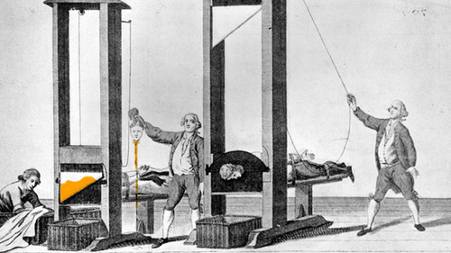
Dual Execution Protocols
(for when semi-honest is only semi-good-enough)

Slide 39
Dual Execution Protocol
Alice
Bob
generator
first round execution (semi-honest)
evaluator
z=f(x, y)
evaluator
second round execution (semi-honest)
generator
z'=f(x, y)
fully-secure, authenticated equality test
z, learned output
wire labels
z’, learned output
wire labels
Pass if z = z’ and correct wire labels
[Mohassel and Franklin, PKC’06]

Slide 40
Security Properties
Correctness: guaranteed by authenticated, secure equality test
Privacy: Leaks one (extra) bit on average
adversarial circuit generator provides a circuit that fails on ½ of inputs
Malicious generator can decrease likelihood of being caught, and increase information leaked when caught (but decreases average information leaked): at extreme, circuit fails on just one input

Slide 41
Proving Security: Malicious
Show equivalence
Ideal World
Real World
A
B
A
B
x'
y '
Trusted Party in Ideal World
y '
x'
Secure Computation Protocol
Corrupted party behaves arbitrarily
Adversary receives:
f (x‘, y‘)
Standard Malicious Model: can’t prove this for Dual Execution

Slide 42
Proof of Security: One-Bit Leakage
Ideal World
Controlled by
malicious A
A
B
x'
y '
Trusted Party in Ideal World
g ∈ R → {0, 1}
g is an arbitrary Boolean function selected by adversary
Adversary receives:
f (x‘, y') and g(x‘, y‘)
Can prove equivalence to this for Dual Execution protocols

Slide 43
Implementation
Alice
Bob
generator
first round execution (semi-honest)
evaluator
z=f(x, y)
Recall: work to generate is ∼3x work to evaluate!
evaluator
second round execution (semi-honest)
generator
z'=f(x, y)
fully-secure, authenticated equality test
z, learned output
wire labels
z’, learned output
wire labels
Pass if z = z’ and correct wire labels

Slide 44
Best reported malicious protocol [PSSW09]

Slide 45
Scalability

Slide 46
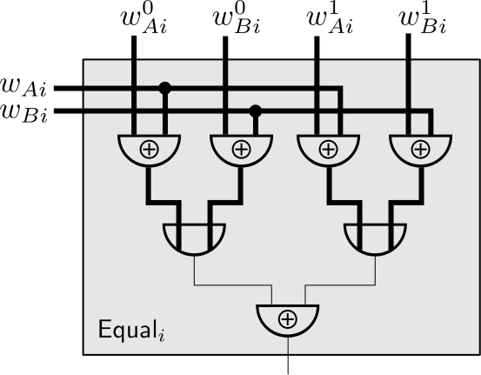
Delayed Revelation
Goal: do not reveal output to either party, unless the equality test passes
Solution: check equality of output wires using a secure circuit that outputs results
This circuit is also executed as a Dual Execution protocol!

Slide 47
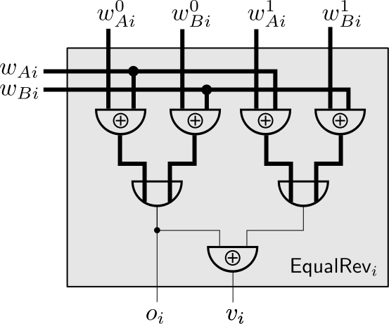
Progressive Revelation
Goal: Provide a (weak) fairness property: malicious party learns at most one more output bit than other party
Solution: reveal (matching) output bits one at a time, in randomly permuted order

Slide 48
Biggest Open Question
Circuit structure can be checked by evaluator (including free XORs)
Design circuit to limit malicious generator’s ability to partition input space.
Challenge: can lie about inputs also
Can we leak less than one bit on average?

Slide 49
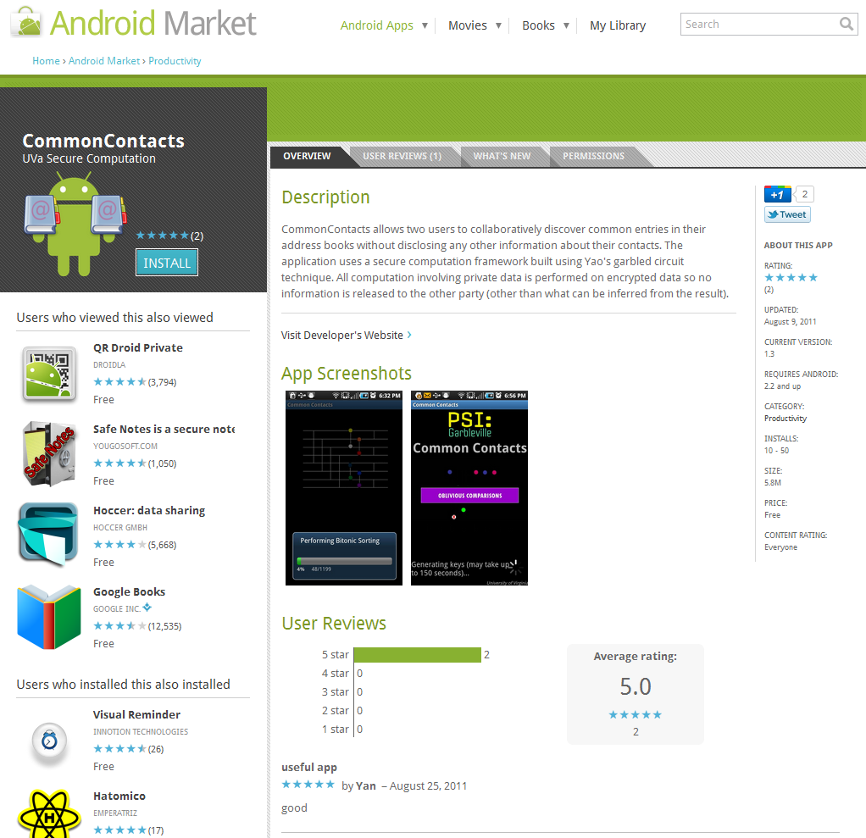

Slide 50

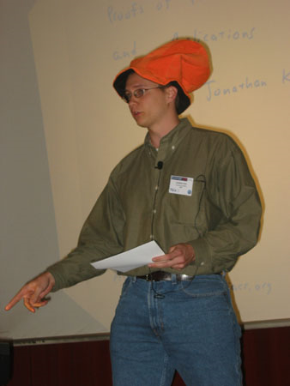
Yan Huang
(UVa Computer Science PhD Student)
Jonathan Katz
(University of Maryland)
Funding: NSF, MURI (AFOSR), Google

Slide 51
Summary
www.MightBeEvil.org
evans@cs.virginia.edu
first round execution (semi-honest)
z=f(x, y)
z'=f(x, y)
second round execution (semi-honest)
fully-secure, authenticated equality test
z = z’
Pipelined execution and circuit-level optimizations can make semi-honest garbled circuit protocols efficient and scalable
Dual execution provides full correctness and maximum one-bit average leakage against fully malicious adversaries, almost free with dual-core, ∼40-50% overhead with one core.

Slide 52
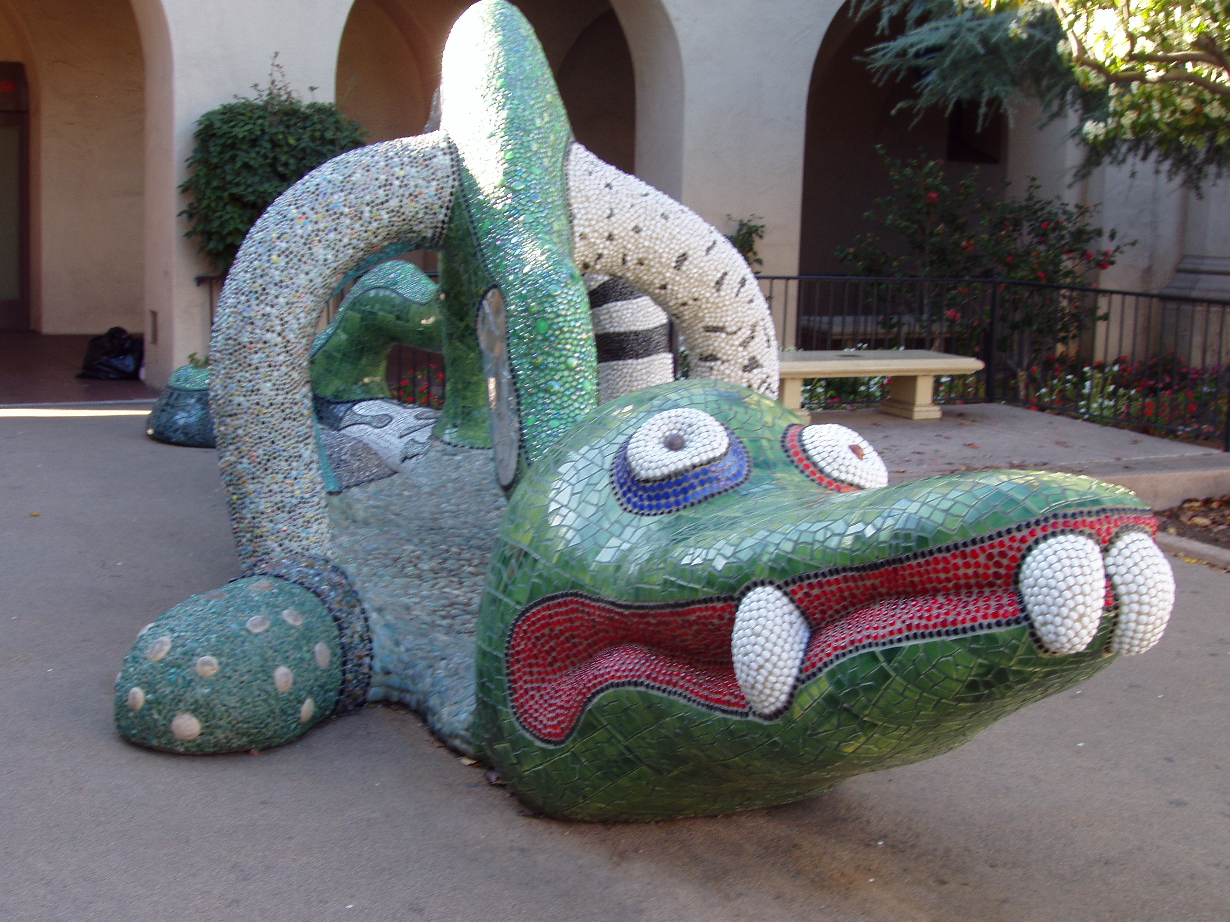
mightbeevil.com

