Slide 1
International Organizations & Their Data
2010 ICPSR Social Sciences Data Fair
November 10, 2010

Slide 2
Our Presentation Outline
undata Overview
Demonstration
World Bank Data Overview
Demonstration
Questions
Notes:
Thanks for taking the time to respond to my survey. In doing so, you definitely have made this our presentation rather than mine alone! Yay!

Slide 3
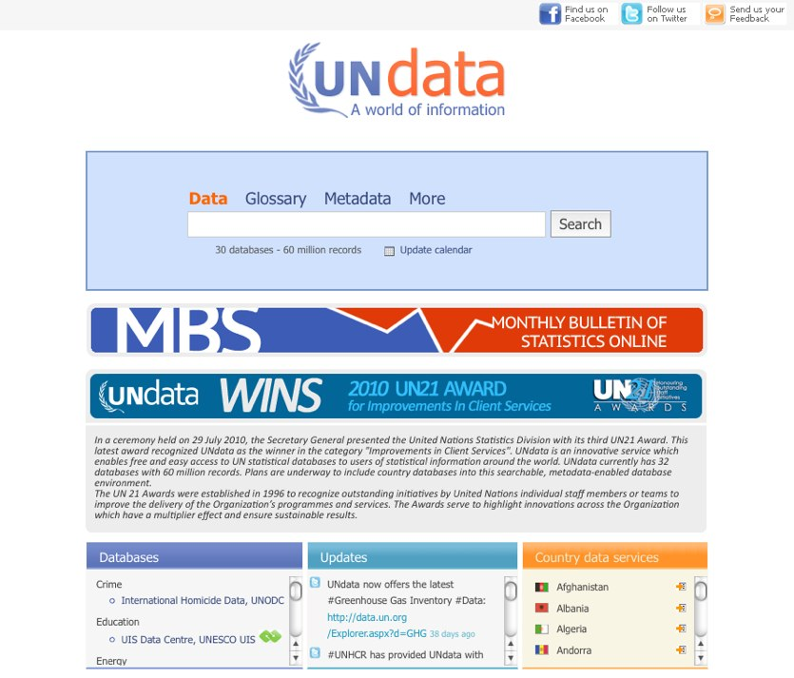
undata
What is it?
Portal to data from 20 different UN bodies and special agencies
What’s it good for?
Data landscape: which group collects what
Casual data needs with short time periods, common indicators
Persistent, table-level URLs for emailing, citing in papers
Advantages
No access limits: free, platform independent, downloads in common and/or non-proprietary formats
Very liberal terms of use: citation requested

Slide 4
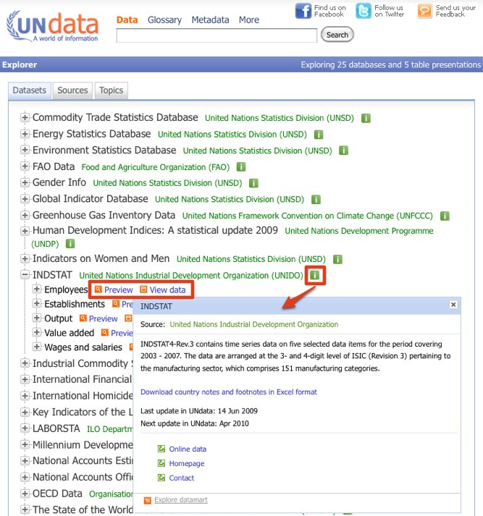
undata: Data Explorer
Use Cases
You already know what you’re looking for, at least in part
Pros
Directory structure supports speedy browsing of available data
Cons
Inefficient for any other uses; likely preferred by librarians, experienced researchers

Slide 5
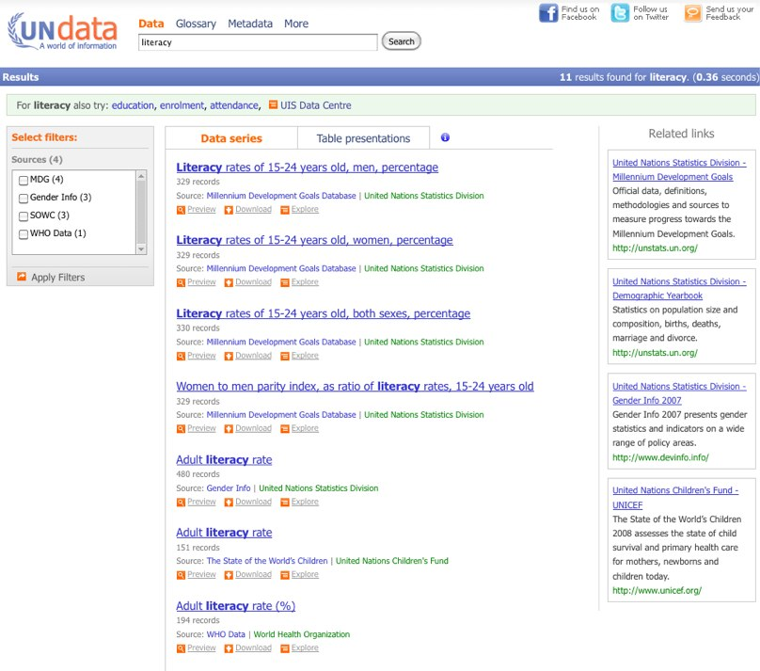
undata: Basic Search
Use Cases
Topic searches
Pros
Path of least resistance
Spelling corrections, alternative terms suggested
Zero result searches bring up full-text search option
Cons
Basic search designed for casual user, but understanding search results presumes knowledge user may not have
Privileging some indicators in search results would help
Notes:
Basic Search is a keyword search of indexed fields: countries, years, subject areas and databases
Site look-and-feel suggests full-text search; little misleading
Show search for

Slide 6
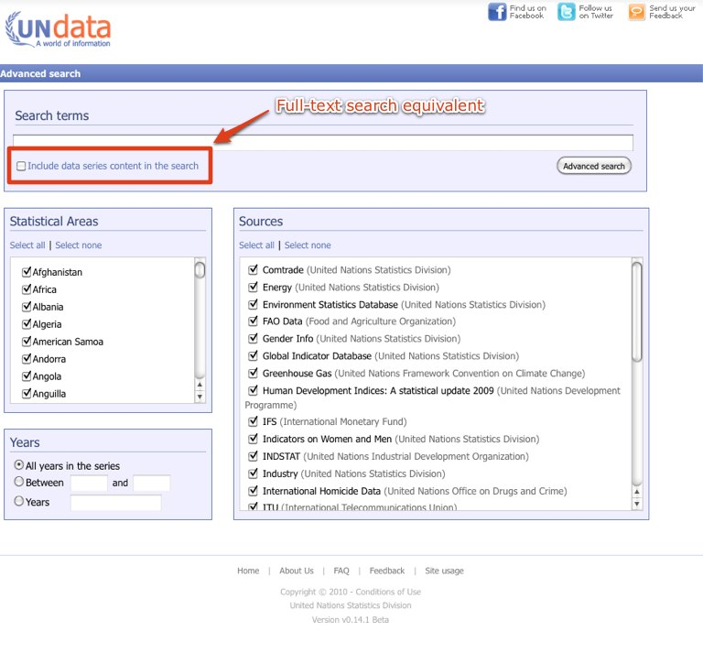
undata: Advanced Search
Use Cases
User who knows enough to want to set parameters on search, including full-text of undata data series
Pros
Intuitive layout
Cons
May be simpler to use basic search and refine on results screen
Editorial Comment
I never use this – other features accomplish same ends in a way that matches my workflow better

Slide 7
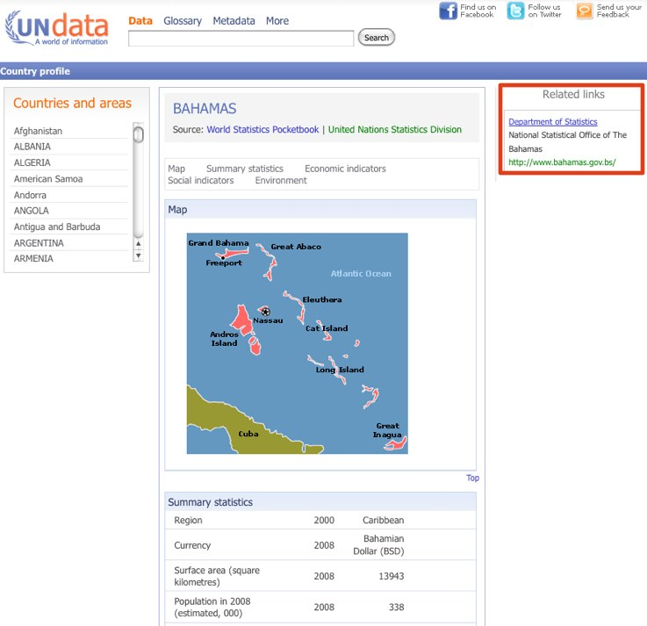
undata: Country Profiles
Use Case
User needs an overview of current conditions in a country
Pros
Good overview
Links to National Statistical Offices
Cons
Neither detailed nor particularly unique
Distracts from the much more useful search by country which returns all data for that country in undata
Editorial Comment
For this use case, I go to the CIA World Factbook first

Slide 8
undata: Bonus Features
Venues for updates on content
Twitter: when new data uploaded
Facebook
Many users posted data questions and most have been answered
Still skeptical of value for librarians or instructors
Editorial Comment
In a resource abundant, attention scarce environment, I value the Twitter notifications because it helps to keep undata on my radar as well as alert me to specific updates
Notes:
Break here to search for sustainable tourism

Slide 9
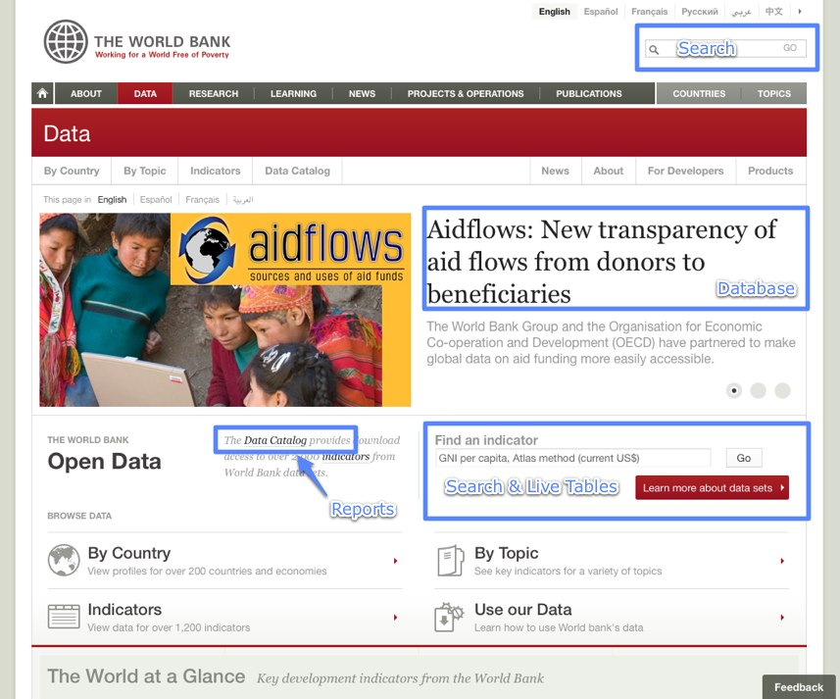
World Bank Data (WBD)
What is it?
A portal that aggregates direct data access, individual databases and links to statistical reports.
What’s it good for?
Searching World Bank databases
Embedding live tables into syllabi and research guides
Advantages
No access limits: free, platform independent, downloads in common and/or non-proprietary formats
Liberal terms of use: citation requested, some datasets may have more limits someday

Slide 10


WBD: Terminology
Databank
the software platform used to deliver some databases; same software as fee-based World Development Indicators
API
A way for other websites to get data directly and add their own interfaces
Data Catalog
Table of contents
Widgets / Embedding /
Live tables you can embed on web pages, syllabi, research guides

Slide 11
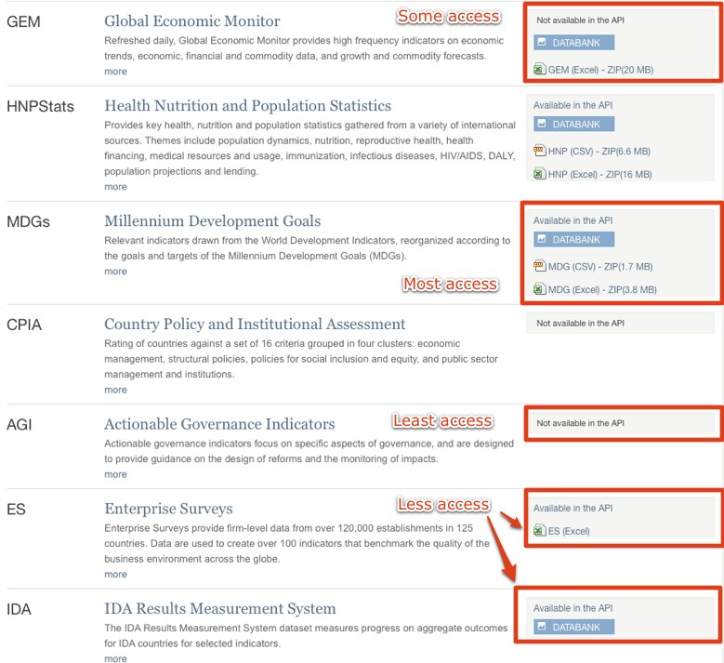
WBD: Major Databases
Use Cases
User needs a database she already knows about
Pros
Big three available – World Development Indicators, Global Development Finance, Africa Development Indicators
Less well-known databases much easier to discover
Cons
Indicators in those databases are also available other ways; potentially confusing
Databank software not perfect
Differing levels of access

Slide 12
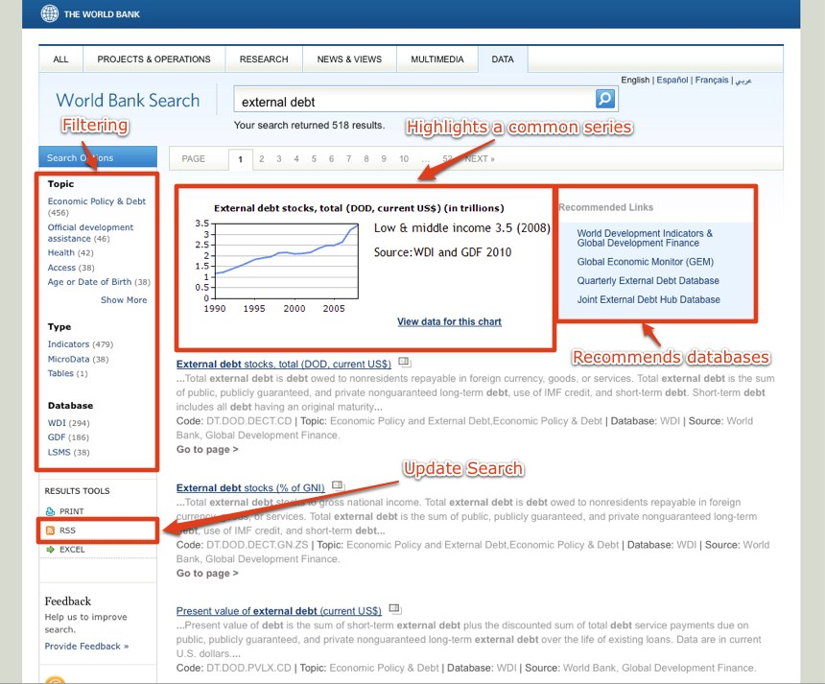
WBD: Search
Use Cases
Topical search
Pros
Results layout privileges basic data, includes links to databases, provides filtering options
Includes RSS feed for search so that you are alerted as data is updated
Cons
There’s a lot of information to take in; users, especially casual users may be overwhelmed

Slide 13
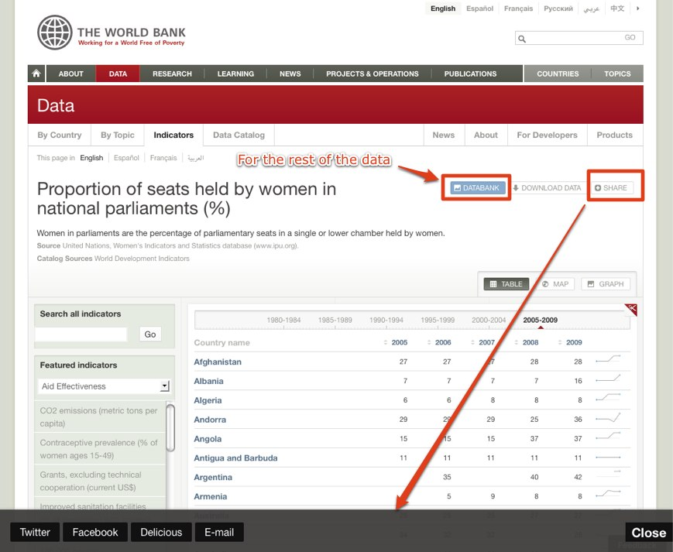
WBD: Select an Indicator
Use Cases
User has a specific indicator she’s interested in
Pros
Search has auto-suggest that displays indicators that match search terms
Cons
It’s matching on series titles, not keyword therefore only suitable for fairly knowledgeable users

Slide 14
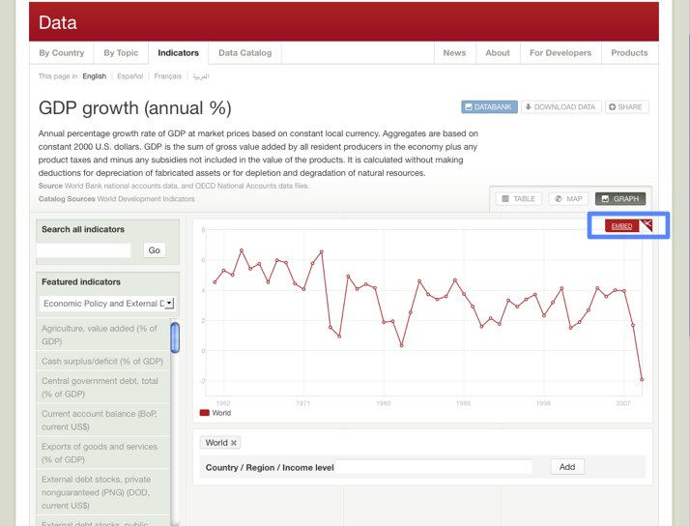
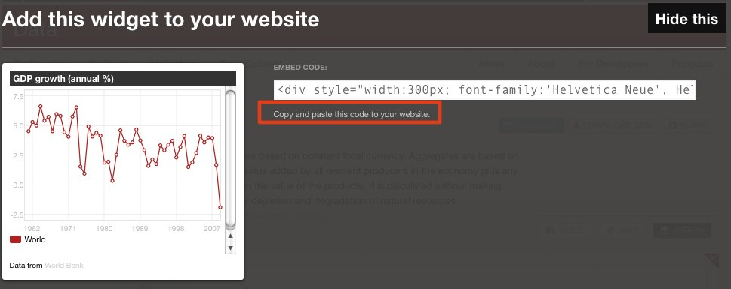
WBD: Working with Live Tables
Use Cases
Syllabi and research guides
Researchers looking for regularly updated data
Pros
User interface
Easy to embed or link to
Cons
Limited time ranges
Editorial Comment
Not always clearly denoted

Slide 15
WBD: Bonus Features
Includes microdata
Filter option in Data Catalog
Includes limited sub-national data
You could use the API to pull data from the World Bank for local preservation
Notes:
Break here to search for sub-national data or political indicators.

Slide 16
Conclusion
undata is a destination for casual users
undata is a reference tool for experienced users
WBD may be a destination for all users
WBD provides tools particularly useful for instructors and librarians

Slide 17
Contact Information
Amy West
westx045@umn.edu
Twitter: @amyewest
Del.icio.us: umdatalib

