Slide 1

Students Analyzing Data in the Large Lecture Class: Active Learning with SDA Online Analysis
by Jim Oberly, Department of History, University of Wisconsin-Eau Claire
For presentation to the 2010 ICPSR Social Science Data Fair
Photo Credit: UW-Eau Claire News Bureau

Slide 2
ICPSR Data in the Classroom
ICPSR Set-Ups for ANES
ICPSR Online Learning Center
ICPSR Research Paper Competitions
SDA analysis and retrospective conversion of popular datasets
Use # 1… Instructor lecture illustrations and/or simulations
Use # 2… student term-papers

Slide 3
The Current Classroom Setting
Wi-fi nearly universal in academic buildings
Larger and larger class-size sections, especially in introductory classes
Widespread use by students of laptops and notebooks, and now, handheld PDAs in class
Challenge: how to engage students in active learning and take advantage of the current classroom setting?

Slide 4


One drawback to the current classroom setting: Student “multi-tasking” in class
“Wide Web of diversions gets laptops evicted from lecture halls” Washington Post March 9, 2010
“Top ten do’s and don’ts for classroom laptop use” USA TODAY “College: The Blog” October 19, 2010
Photo Credits: UW-Eau Claire News Bureau

Slide 5
One solution…for at least some classes
Organize a class around a big question or set of questions and have the students engage in a 50-minute scholarly enterprise of finding a scholar’s work and then testing the propositions of that scholar by using SDA of the scholar’s dataset
Example of a “big” question: Was the American Civil War a “necessary” war?
Rephrased: if the war was about saving the Union and the destruction of slavery, could the Union have been saved and the nation spared a war by a peaceful abolition because of economic reasons?

Slide 6
Counterfactual assumption by past historians that the South would have abolished slavery in a decade or so after 1860 because it was an anachronistic institution and un-economic.
Charles W. Ramsdell, “The Natural Limits of Slavery Expansion,” Southwestern Historical Quarterly 33, No. 2 (1929): 91-111
James G. Randall, “The Blundering Generation” Mississippi Valley Historical Review 27, No. 1 (1940): 3-28
Nobel Prize winner Robert Fogel, and co-author Stanley Engerman tried to test this
counterfactual in 1974. Time on the Cross: The Economics of American Negro Slavery (Boston: Little Brown, 1974).
They also made their data available to students to check their findings via ICPSR

Slide 7
Some propositions from Profs. Fogel & Engerman about the economics of plantation slavery in the Antebellum South—
1.--the slave system was not “economically moribund” on
the eve of the Civil War and purely economic factors would
not have led to its abolition
2. --price trends of slaves reflected “rational” (within an evil system) expectations that the institution would continue
3. --prices of slaves were also rational in that differentials existed for age, gender, skill
4. --Owners took care not to break up families by sale; individuals sold were done so at an age they would normally leave their households…

Slide 8
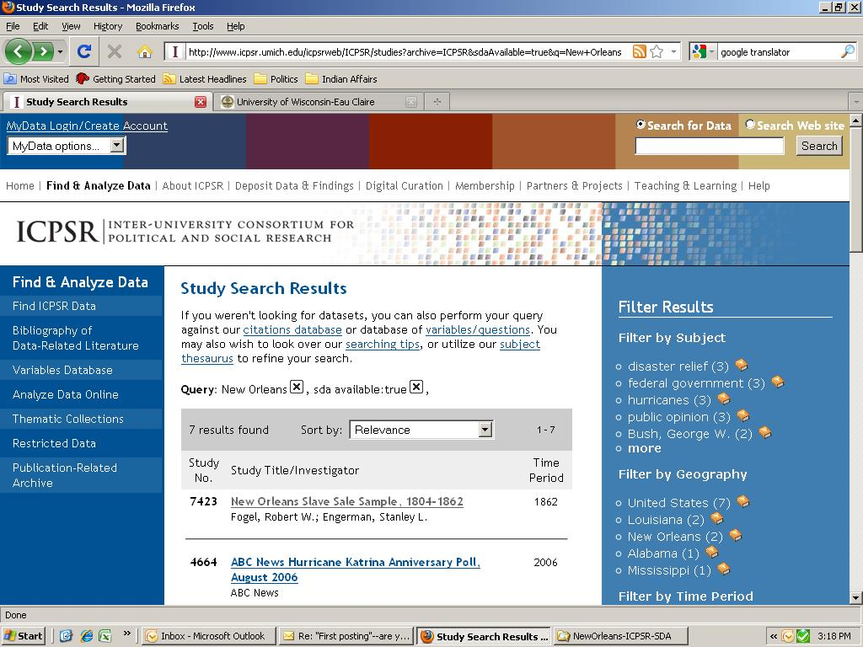

Slide 9
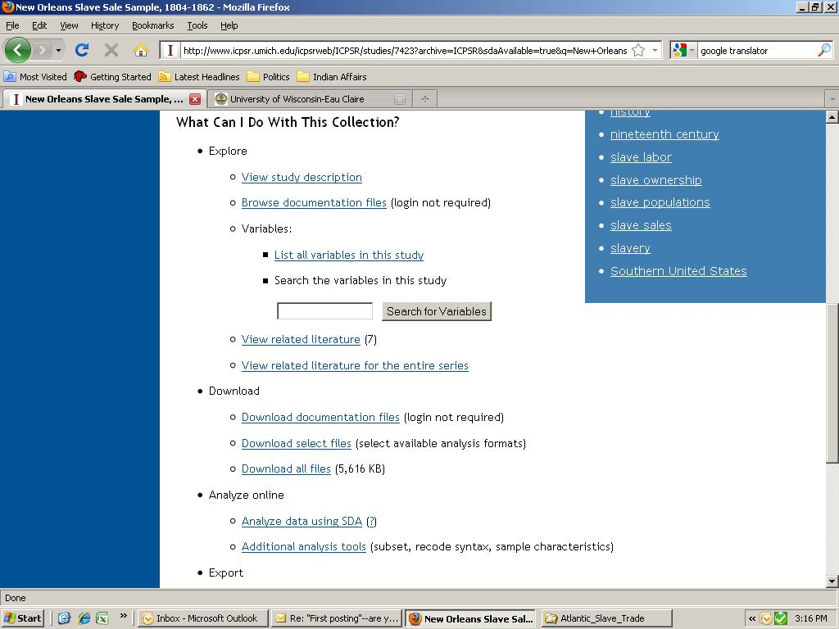

Slide 10
New Orleans Slave Sale Sample, 1804-1862
Fogel, Robert W.; Engerman, Stanley L.
Summary: This study includes data on slave sales that occurred on the New Orleans slave market between 1804-1862. For each sale, information was recorded on the date of the sale, the number of slaves on the invoice, the geographical origin of the buyer and seller, the sale price, and characteristics of the slaves sold (age, sex, family relationship, and occupation). The information presented for each transaction was obtained from the notarized bills of sale in the New Orleans Notarial Archival Office.
This study is provided by Resource Center for Minority Data (RCMD).
What Can I Do With This Collection?
Explore
View study description
Browse documentation files (login not required)
Variables:
List all variables in this study
Search the variables in this study
Analyze online
Analyze data using SDA Go ahead…click here….
Additional analysis tools (subset, recode syntax,
sample characteristics)

Slide 11
At this point in the class, I take a few minutes to demonstrate how to use SDA
(Statistical Data Analysis) online, working from the ICPSR website.
I also take a few minutes to talk with the class about the proposition that the
slave system was evil but also that the prices paid for human beings tell us
about the expectations of the owners. It was the actions of the slave-owners that
led to secession and war in 1860-1861.
Note: my school is an ICPSR member so if my students access SDA in class,
they are doing so from a recognized ISP address. If they later work off-campus,
they will need to get a “MyData” account.

Slide 12
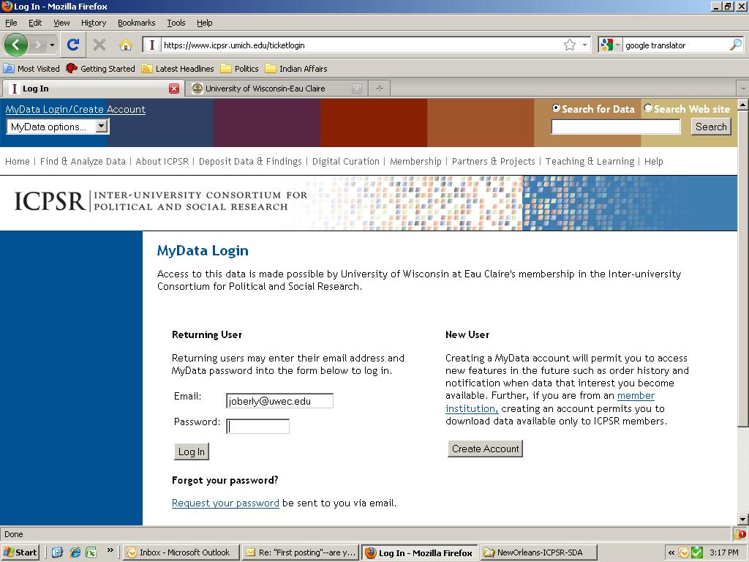

Slide 13
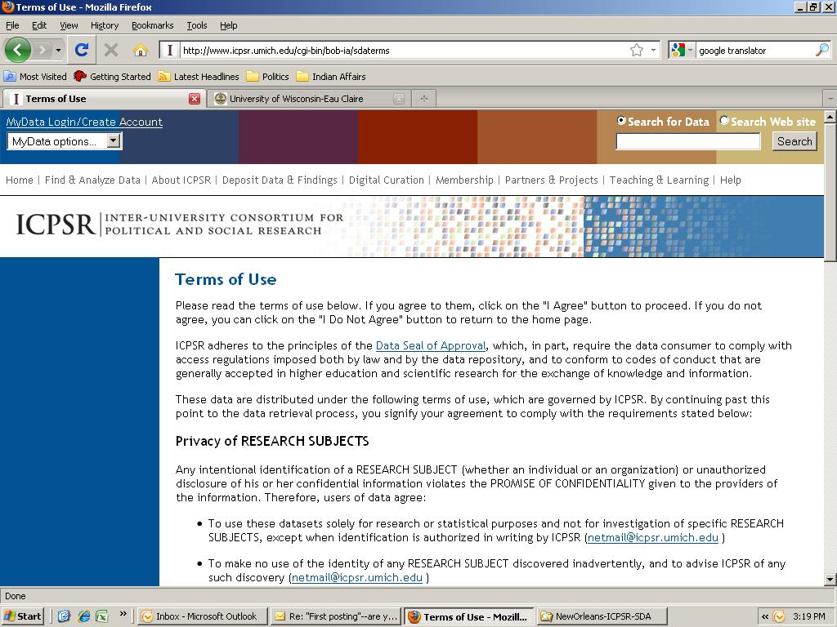

Slide 14
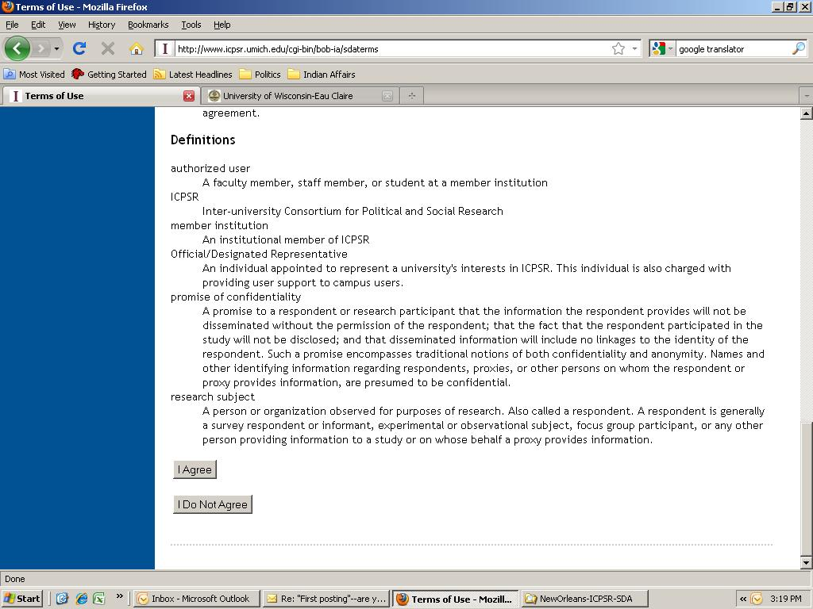
Click on “I Agree” to launch SDA

Slide 15
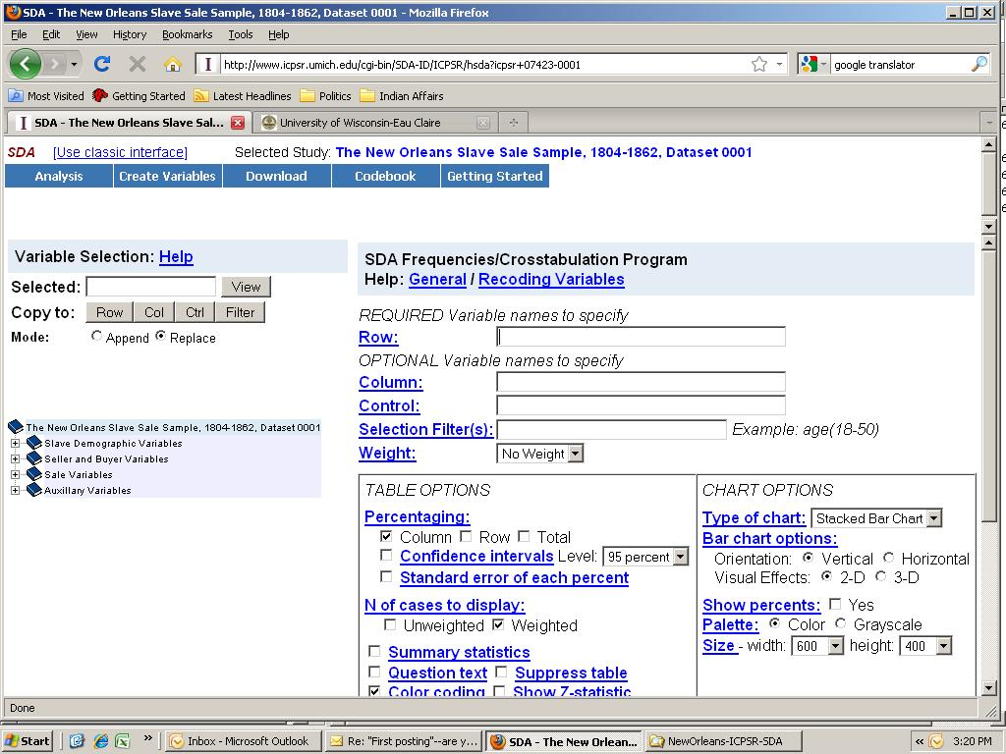

Slide 16
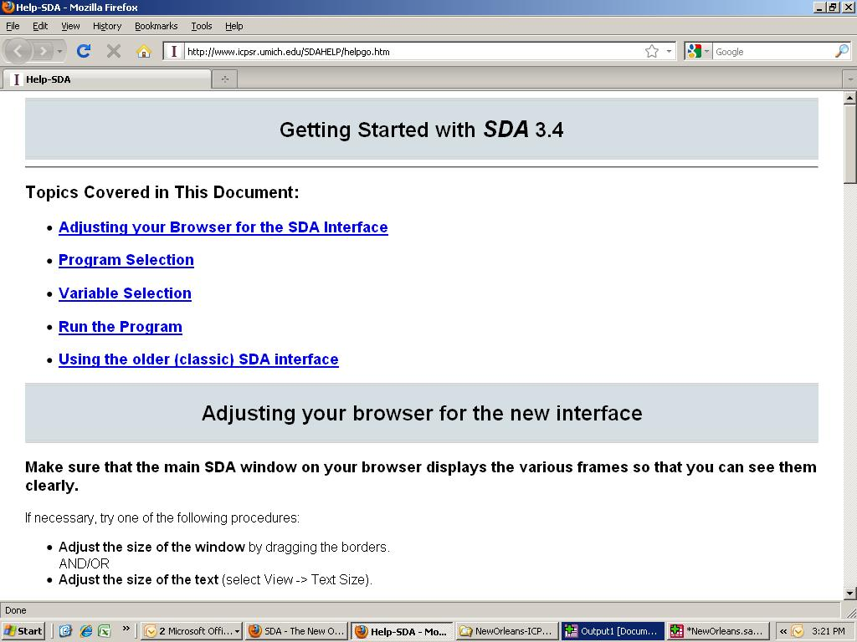

Slide 17
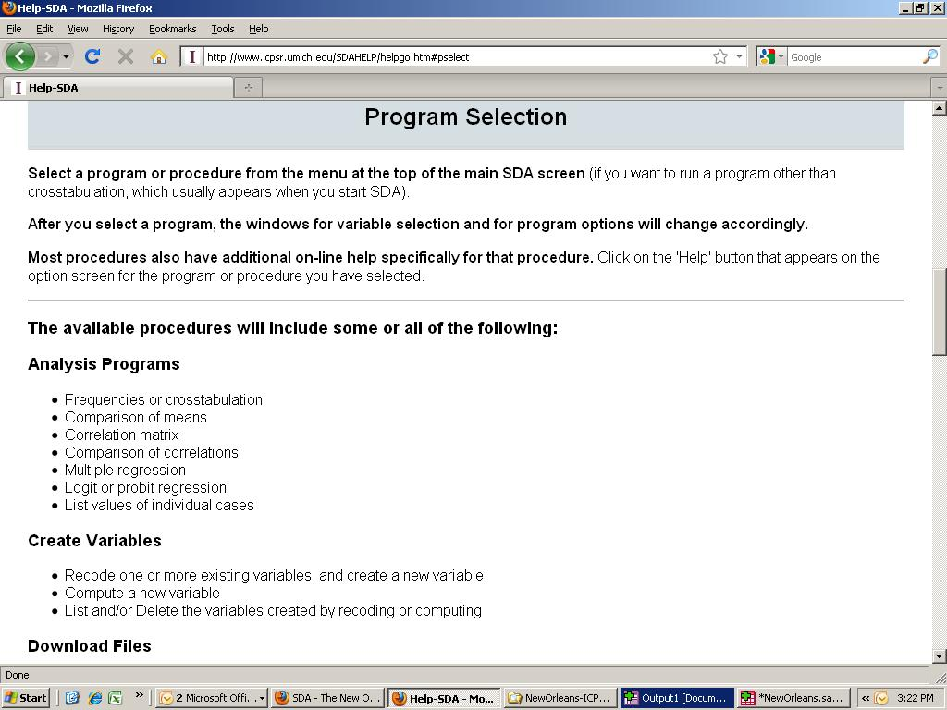

Slide 18
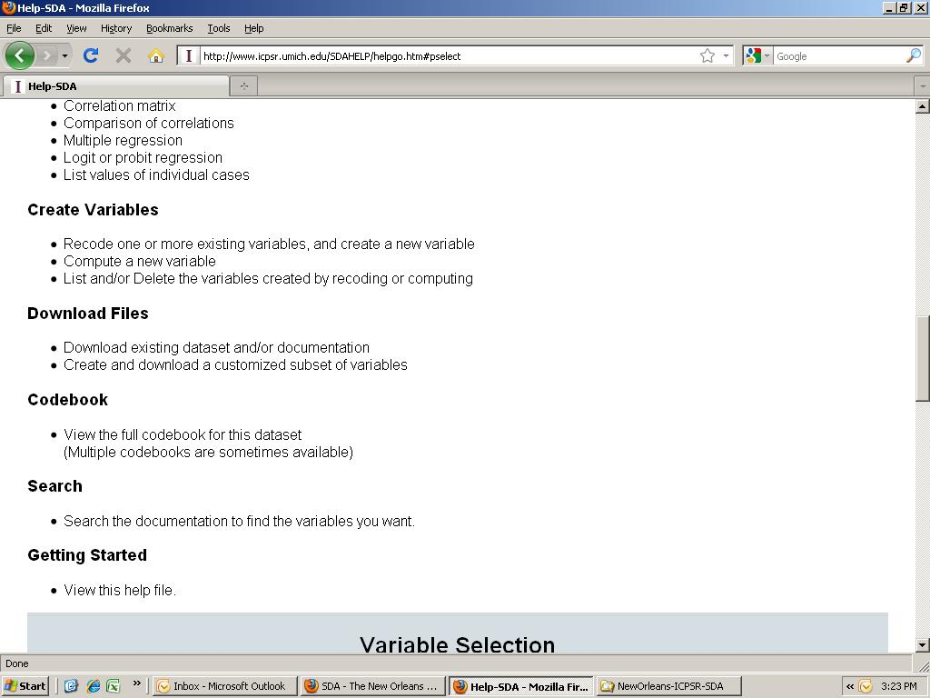

Slide 19
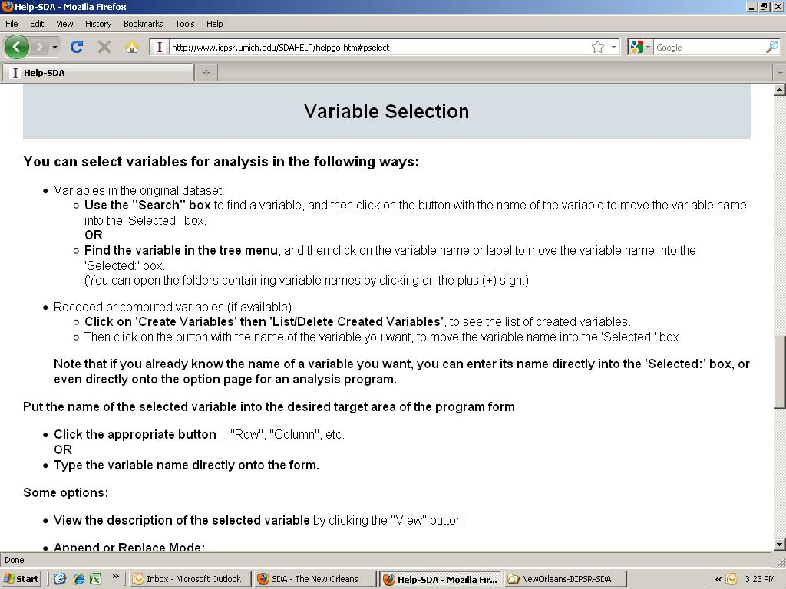

Slide 20
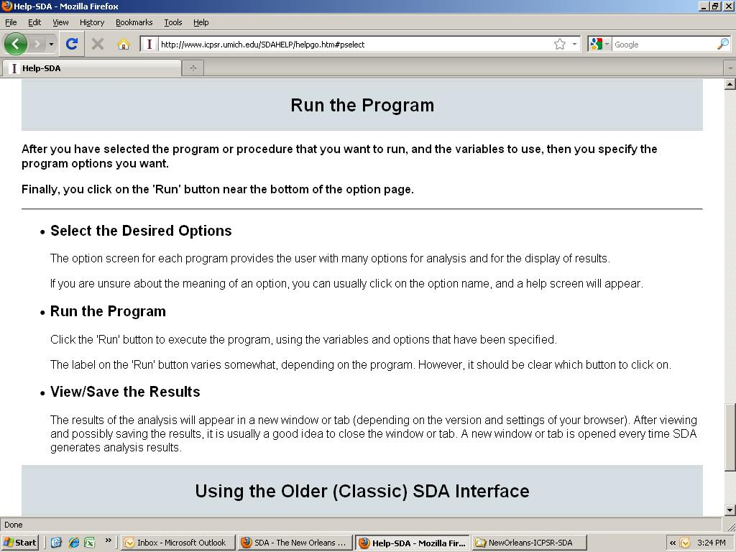
Let’s see the
Codebook

Slide 21
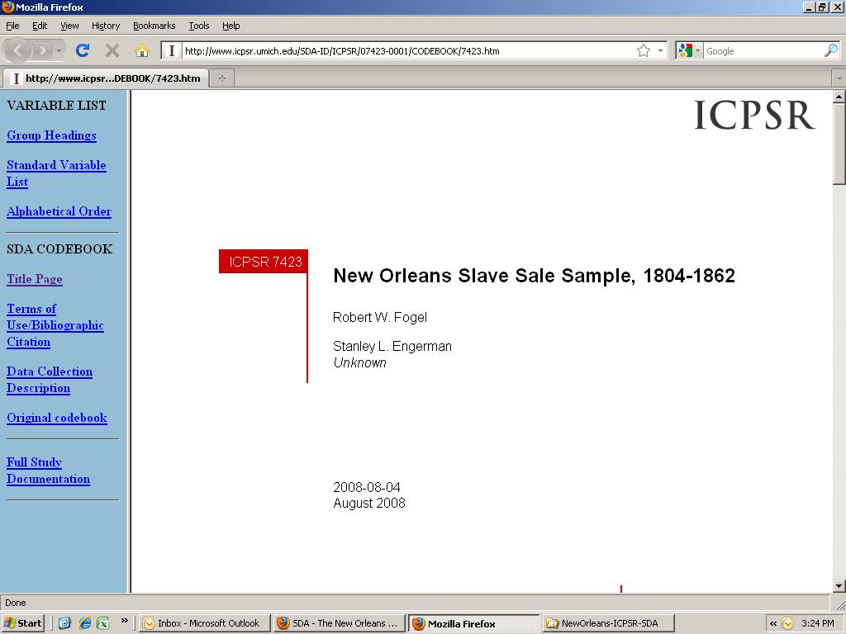

Slide 22
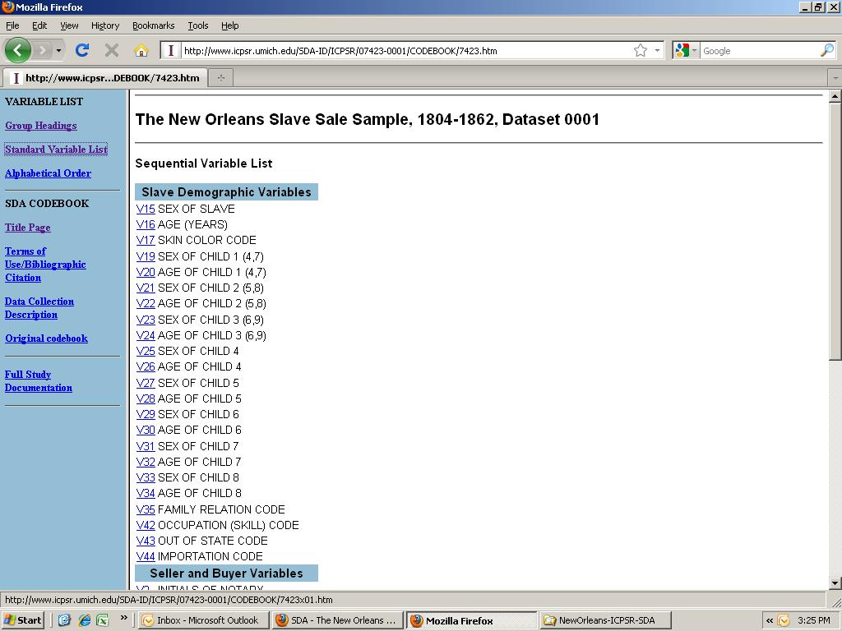

Slide 23
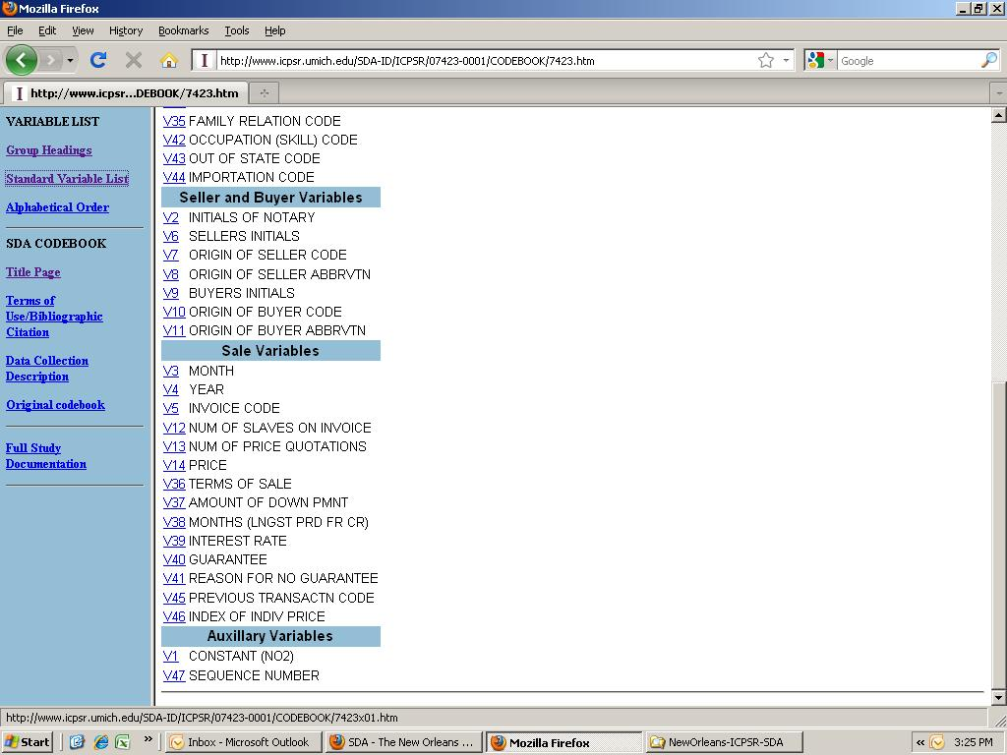

Slide 24
Now it is time to organize the class into small groups and assign specific research tasks. Assume a class of 50 students, divided into groups of 5 (this can be expanded easily with larger classes by
assigning groups to check one another’s work).
Remember the questions:
# 1–the slave system was not “economically moribund” on the eve of the Civil War and purely economic factors would not have led to its abolition
SDA Test: Compare Means-- price (V14) by year (v4). Also, graph it.

Slide 25
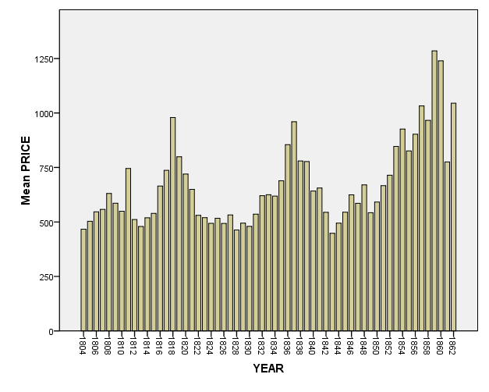
Chart: Price of Persons Sold over time in the New Orleans Slave Market, 1804-1862

Slide 26
Class discussion….Ask the team assigned to research and present on this graph:
Question # 1– is there any pattern you see in the distribution of prices over time between 1804 and 1862?
Question # 2—do you see any indication in the immediate years before the Civil War that the price of slaves was declining?

Slide 27
# 2. --price trends of slaves reflected “rational” expectation that the institution would continue
Test: Graph price of cotton year-by-year while the New Orleans slave market was operating, 1804-1861. Source: Historical Statistics of the United States: Millenial Edition
Bonus variants on question # 2: Did the price of slaves ever fall in the New Orleans slave market at times of political crisis? In the spring of 1850 before the “Compromise
of 1850? In the late fall of 1859 after John Brown’s Raid? Right before (or after)
the election of Abraham Lincoln?
Test: Use the “Selection Filter” on SDA to isolate year (V4) and month (V3) to narrow
the prices examined.

Slide 28

Cotton prices 1804-1861 (cents/pound of raw cotton)
 | Table Cc205-266. Wholesale prices of selected commodities: 1784-1998
Year | Cotton, raw
 | Cole and Hammond
 | Cc222
 | Dollars per pound
1804 | 0.20
1805 | 0.23
1806 | 0.22
1807 | 0.22
1808 | 0.19
1809 | 0.16
1810 | 0.16
1811 | 0.16
1812 | 0.11
1813 | 0.13
1814 | 0.15
1815 | 0.21
1816 | 0.30
1817 | 0.27
1818 | 0.24
1819 | 0.24
1820 | 0.17
Source: Historical Statistics of the United States:
Millenial Edition, accessed at :
http://hsus.cambridge.org/HSUSWeb

Slide 29
Question for group presenting data on the price of cotton, 1804-1862:
Do you see any patterns or trends? What relationship, if any, do you see between the trends in the price of cotton and in slave prices?

Slide 30
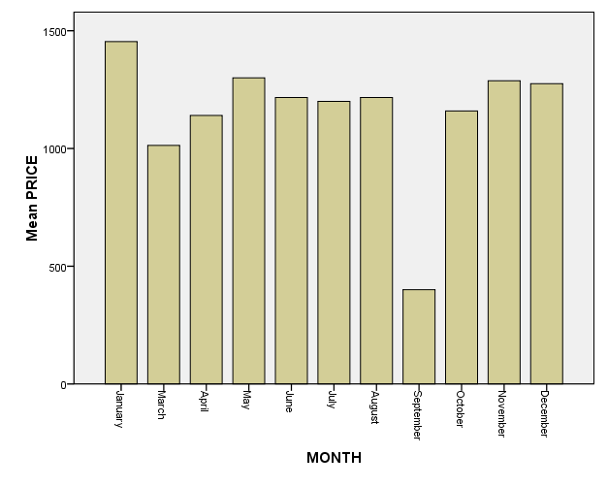
New Orleans slave-sale prices by month, 1859
Date of John Brown’s raid on
Harper’s Ferry,
Oct. 16, 1859
Question: your
interpretation of the
effect of the Harper’s
Ferry raid on New
Orleans slave-sale
prices?

Slide 31
#3. --prices of slaves were also rational in that differentials existed for age, gender, skill
Tests: Compare Means of price (V14) by:
Age (V16)
Sex (v15)
Occupation (V42)
Bonus: Use the Recode on Occupation (V42) to produce means of prices for
skilled and unskilled persons (students will have to decide what was skilled or unskilled slave labor in antebellum Louisiana)

Slide 32
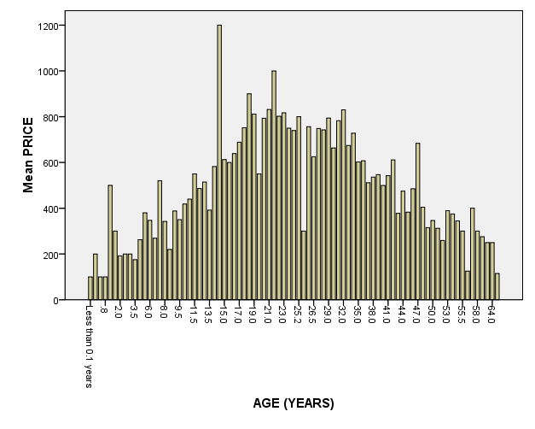
Chart of price of persons by age, New Orleans slave-sale market, 1804-1862
Question: what
pattern do you see?
Any exceptions or
anomalies?
Question: how
do you explain
the pattern(s) you
see?

Slide 33
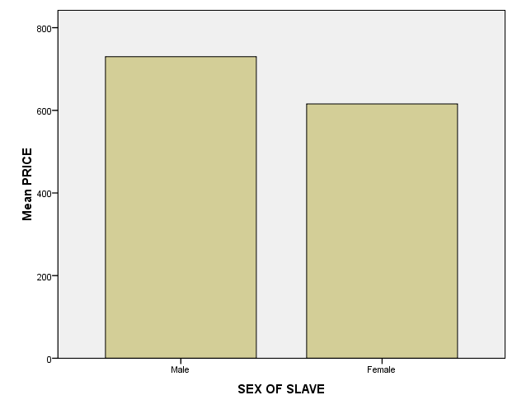
Chart of price of persons by sex, New Orleans slave-sale market, 1804-1862
Question: what do you
see in the chart? How do you
explain it?

Slide 34
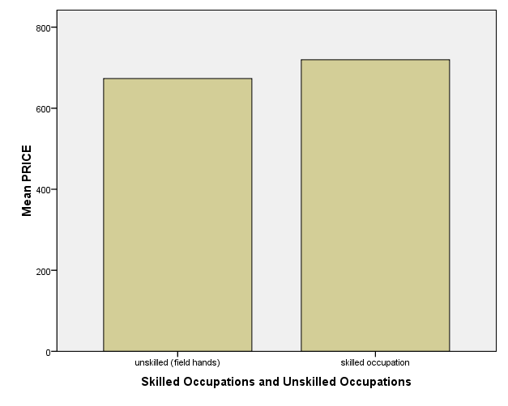
Chart of price of persons by skill, New Orleans slave-sale market, 1804-1862
Question: what do
you see in the chart
to the left? How do
you interpret it?

Slide 35
4. --Owners took care not to break up families by sale; individuals sold were done so at an age they would normally leave their households…
Test: Run a frequency tabulation on Family Relationship (V35)
Family Relation |  | Frequency | Percent
 | Husband and wife | 38 | .8
 | Husband, wife, and 1-3 children | 33 | .7
 | Siblings | 24 | .5
 | Mother and children, with separate prices reported for each | 15 | .3
 | Father and child | 2 | .0
 | Granddaughter | 3 | .1
 | Husband, wife, and four or more children | 12 | .2
 | Mother and four or more children | 22 | .4
 | Total | 149 | 3.0
 | No family relation indicated | 4860 | 97.0
Total |  | 5009 | 100.0
Question: How do you interpret the data in the table at the left? What does it mean that 97% of the persons sold had “no family relation”?

Slide 36
4. --Owners took care not to break up families by sale; individuals sold were done so at an age they would normally leave their households…
Test: Instead of checking Family Relation (V35), run a frequency tabulation on Number of Slaves on Invoice (V12)
Number of slaves per invoice | number of invoices | total slaves sold on invoices
1 | 2725 | 2725
2 | 720 | 1440
3 | 285 | 855
4 | 214 | 856
5 | 133 | 665
6 | 158 | 948
7 | 111 | 777
8 | 53 | 424
9 | 62 | 558
10 | 56 | 560
11 | 67 | 737
12 | 30 | 360
14 | 45 | 630
15 | 15 | 225
16 | 16 | 256
18 | 18 | 324
19 | 19 | 361
21 | 36 | 756
24 | 24 | 576
25 | 25 | 625
26 | 26 | 676
28 | 28 | 784
31 | 31 | 961
38 | 36 | 1368
39 | 27 | 1053
40 | 18 | 720
46 | 31 | 1426
Total | 5009 | 21646
Question: how do you interpret
the table to the right? How does
it compare with the table for
Family Relation? What are
the implications for the
difference between V35 and V12?

Slide 37
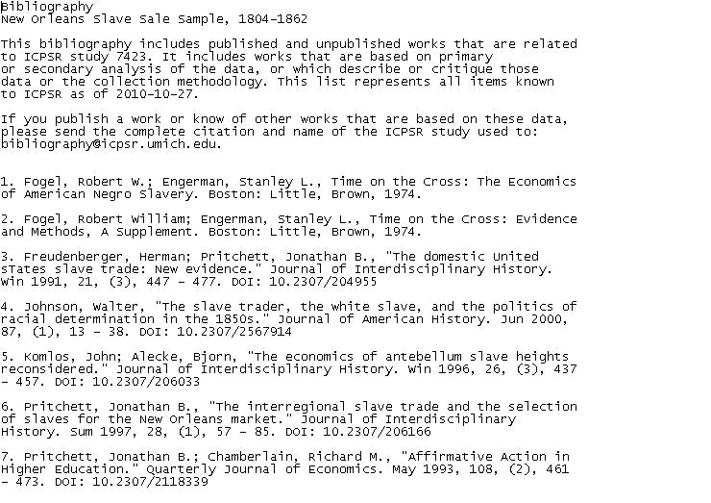
Refer students to the valuable “ICPSR Bibliography of Data-Related Literature”

Slide 38
Questions? Comments? Observations? Ask your questions in real time of the Webinar moderator, or if you are viewing this presentation at a subsequent data, feel free to email me at: joberly@uwec.edu
Thanks for participating in this ICPSR Data Fair Webinar.

