Slide 1
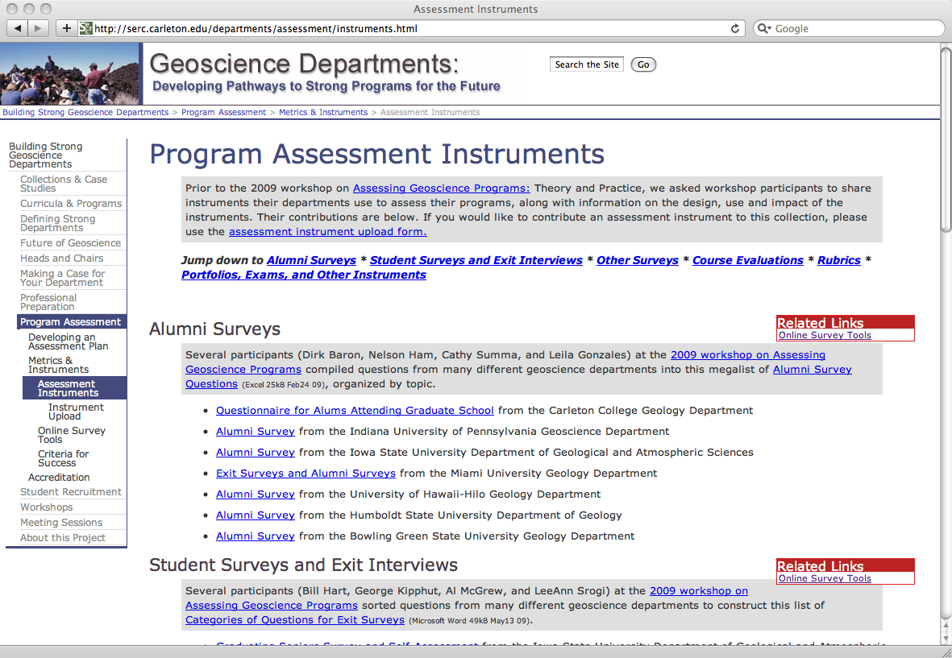
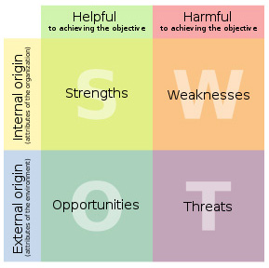
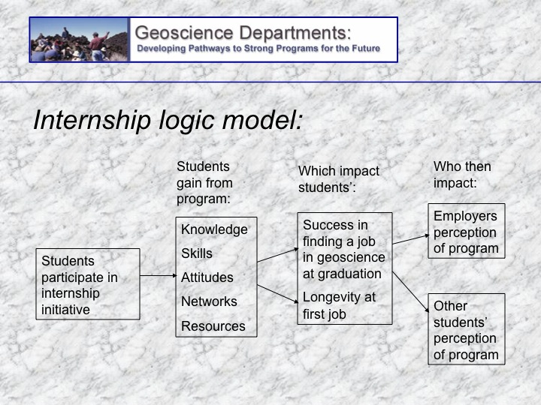
Bringing Together Design and Evaluation to Understand Student Learning
Cathryn A. Manduca, Carleton College; Tim Bralower, Pennsylvania State University; Diane Clemens-Knott, California State University-Fullerton; Diane Doser, University of Texas-El Paso; Geoff Feiss, College of William and Mary (retired); Heather Macdonald, College of William and Mary; Carol Ormand, Carleton College; Dallas Rhodes, Georgia Southern University; Randy Richardson, University of Arizona; Mary Savina, Carleton College
We can understand what students’ are learning in geoscience programs from two points of view: by analyzing what we are teaching and by analyzing how students’ thinking changes as a result of our programming. To continually improve undergraduate geoscience education within a department requires that these two types of analysis be brought together with an understanding of the goals of the program.
Aligning Offerings :
Teaching to the Goals
Assessing Learning: Measuring Program Success
The alignment of program goals with course offerings lies at the heart of designing strong educational programming. Developing a matrix with learning opportunities on one axis and learning goals on another or a curriculum map showing the pathways of students through the curriculum to the awarding of a degree are two techniques that support this alignment.
Strong alignment of goals and programming does not ensure that students are mastering the desired knowledge and skills. An investigation into the response of the students to the programming is also required . Increasingly, all academic institutions are being asked to assess student learning within their programs. Assessment data can answer questions like “Is our well-designed program working as intended?” or “Are the students learning what I think I am teaching?”
Setting Goals
Articulating the goals of a program is the first step toward understanding if students are achieving the desired learning. Performing a SWOT analysis or imagining the ideal student on the day of graduation can initiate a discussion of program goals.
Benefits of the Matrix Approach
Faculty learn about each other’s teaching styles and courses.
Faculty feel relieved at not having to try to teach every skill in their own courses.
Students feel well prepared for capstone experiences.
Strengths , Weaknesses Opportunities, Threats
Lest you think of this as strategic planning run amok, this activity was highly valued by travelling workshop participants.
Curriculum Maps show the students’ experience at a glance providing a platform for discussion
Departments have taken a wide variety of approaches to answering these questions including exit interviews and examinations, portfolios, and rubrics to evaluate senior level work, field work, and research presentations. Logic models can be used as a tool for designing program evaluation.
Geoscience departments offer a wide variety of majors and inter-departmental programs reflecting a range of program goals from the development of geologists, geographers, geochemists, biogeoscientists and geophysicists for work in industry, government research and academia to the development of policy makers, environmental consultants, teachers, and sustainability experts.
http:serc.carleton.edu/departments
This work is funded by NSF grants: DUE-0817353 and DUE-0817265

