Slide 1
ICPSR Data Fair ~ Small Data Archives: Data from the Pew Research Centers
Presented by Libbie Stephenson, UCLA
libbie@ucla.edu Web: http://dataarchives.ss.ucla.edu
Mobile web: http://dataarchives.ss.ucla.edu/mobile/

Slide 2
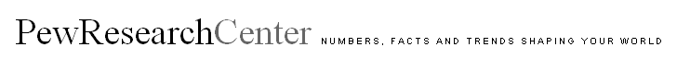
“Fact Tank” on “issues, attitudes and trends
International focus in research, but largely deals with United States
Polling, research, news analysis
Reports, forums, briefings
Does not take positions
http://pewresearch.org/
Pew Research Center is a subsidiary of the Pew Charitable Trust
Notes:
Can browse main pages for what’s hot and interesting, but the real “meat” is in the individual research centers. (Go to the projects section.)
I especially like the knowledge quizzes. These can be used with students to ask them what they “know” on the issues and this can lead into the data, how it is collected, what it may or may not mean, what conclusions one can draw and so forth.
There a number of interactive visualizations

Slide 3
Pew Research Themes
Start at http://pewresearch.org/databank/datasets/
Pew Research Center for the People & the Press Data Archive
Pew Hispanic Center Dataset Download
Pew Global Attitudes Project Dataset Download
Pew Internet & American Life Data Downloads
Social & Demographic Trends Dataset Download
Pew Forum on Religion & Public Life Dataset Download
Notes:
The Pew Research Centers focus on 6 areas of work By going to the main Pew site you can see a listing of each of them
Pew Research Center for the People & the Press Data Archive
Pew Hispanic Center Dataset Download
Pew Global Attitudes Project Dataset Download
Pew Internet & American Life Data Downloads
Social & Demographic Trends Dataset Download
Pew Forum on Religion & Public Life Dataset Download

Slide 4
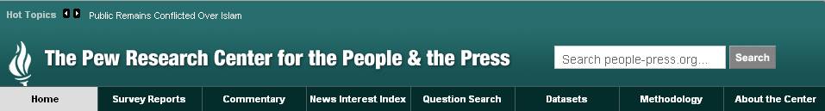
http://people-press.org/
Focused on attitudes about politics, news media and public policy
Monthly polls
News Interest Index
Survey reports
Question search tool via Roper iPOLL
Datasets
Notes:
Studies attitudes toward politics, the press and public policy issues. Done through monthly polls.
News Interest Index to see how people are responding to issues in the news. The News Coverage Index catalogues the news from top news organizations across five major sectors of the media: newspapers, network television, cable television, radio and the internet. It is part of a Project for Excellence in Journalism. The news stories are cataloged and indexed to identify the top stories of the week and then they survey people to find out their reactions and responses to these stories. Reports are similar to the survey reports and could be used as course readings.
Survey Reports contain many tables that undergrads like and can be used in classes to demonstrate points.
Also includes lots of details on how the survey was conducted. These can be shared and/or emailed to others. The reports can also be printed, so could be used in course readings.
The Pew centers offer various ways to search by questions asked in the polls. This question search is actually provided by the Roper Center and for those of you who subscribe to Roper you will be familiar with Roper’s iPOLL question level search tool. If you do a similar search in iPOLL, you will retrieve questions from many different polling agencies, not just Pew. There is a Roper polls session during the data fair and if you are interested in knowing more I recommend that you listen in to that one too.

Slide 5
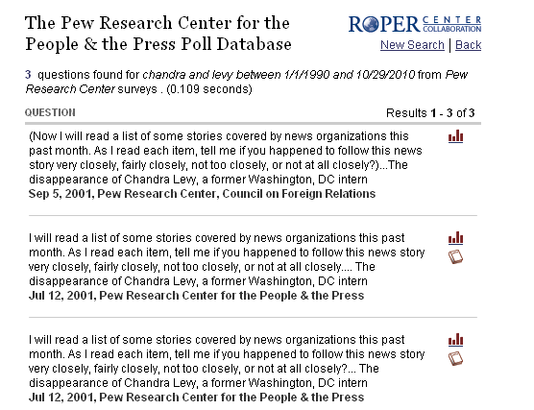
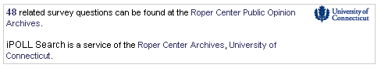
Pew Question Search
Results using the Pew Question Search
Additional results at Roper
Notes:
How it works: The total reflected on the search page is a combination of the Pew surveys and other polling institutions. So the data available on a topic available from Roper is broader and may be very useful for comparisons or to inform on a topic in greater depth.

Slide 6
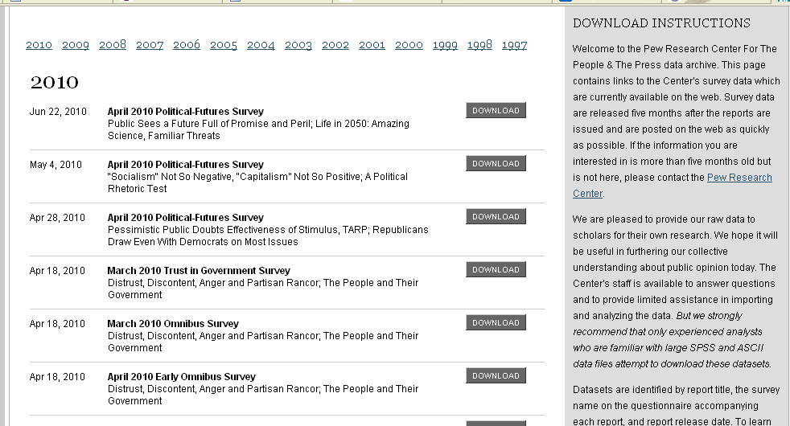
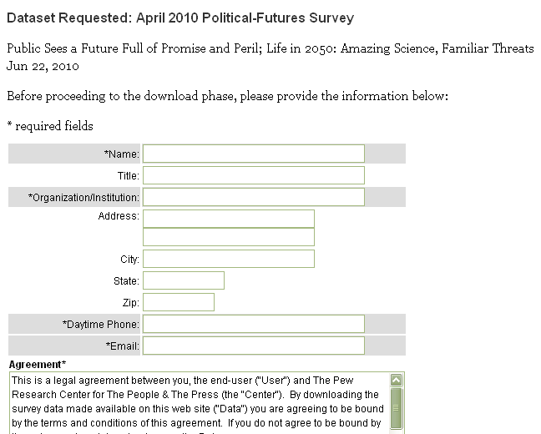
Datasets from People and the Press
http://people-press.org/dataarchive/
Notes:
As you can see here, the data archive at this center has data going back to 1997 and you can download any of the files. Data are released 5 months after the poll is taken. Each time you download a file you need to complete a registration form and agree to their usage conditions.
I really wish there were a way to register once and then download anything, like there is at Roper. The data come as one file that is zipped, so you have to uncompress the file to get the dataset, codebook, and questionnaire. There is always a weight variable included that needs to be used in analysis and its use is discussed in the documentation.

Slide 7
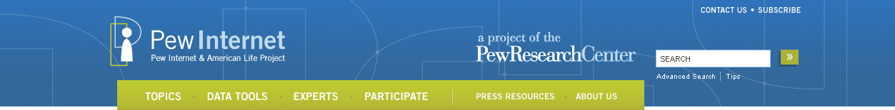
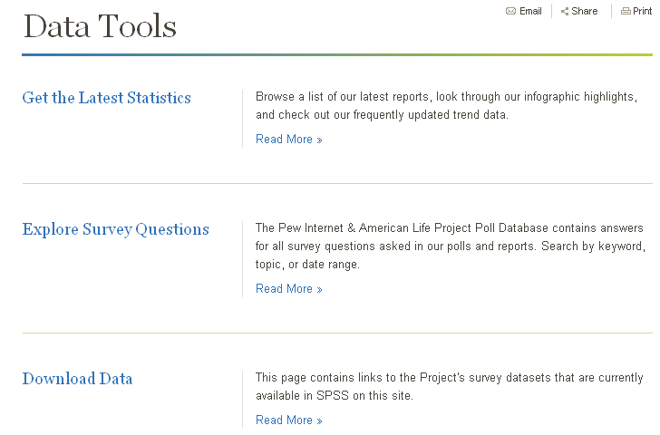
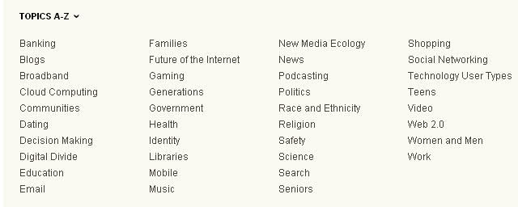
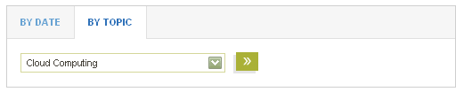
http://pewinternet.org/
Explore data tools, browse by topic, search by date and topic
Notes:
Internet and American Life research center: This might be my favorite of the pew data sites : exploring the impact of the internet on families, communities, work and home, daily life, education, health care, and civic and political life.
In addition to using the question search I showed you earlier you can choose specific topics, or go directly to the Data Tools page. In looking just at statistics, instructors might be interested in the Infographics feature (demo) All the graphics information is linked to suggested reports and readings .
One of the things I like a lot about their data is that you can search by year and by topics to see all the studies done on a particular topic (demo)
It is a great site for students who want something focused on technology.

Slide 8
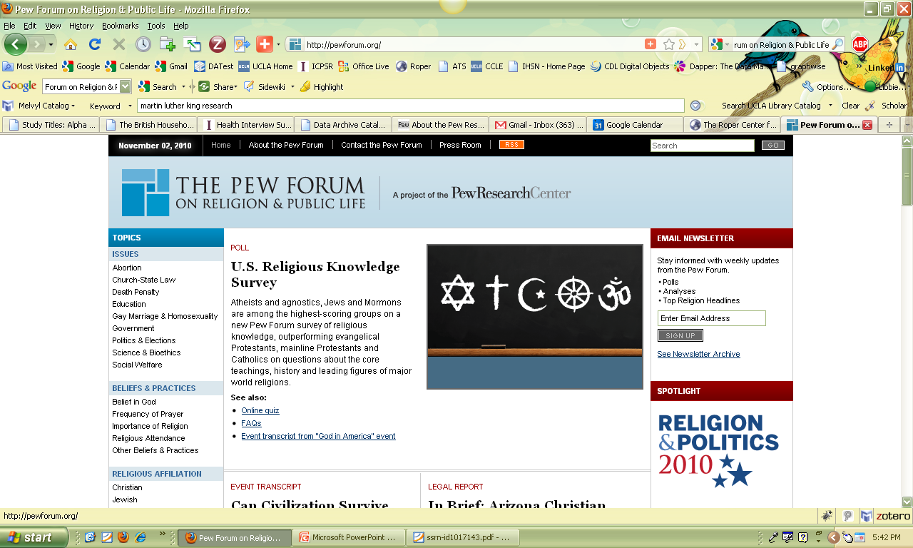
Topics: Hot issues, beliefs and practices, religious affiliation, demographics
International in scope
Analysis of polls and research – reports & graphics
Question search based on iPOLL
Datasets arranged by year
http://pewforum.org/
Notes:
seeks to promote a deeper understanding of issues at the intersection of religion and public affairs.
religion and American society, from the shifting religious composition of the U.S. to the influence of religion on politics.
role religion plays in world affairs
Pew Forum analyses—including public opinion poll reports, demographic reports, research studies, legal reports and graphics—on an array of topics and issues at the intersection of religion and public life.

Slide 9
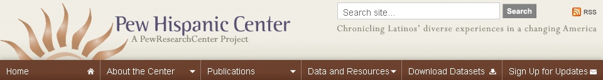
Hispanic population in US; impact of Latinos
Focus on demography, economics, education, identity, immigration, labor, politics, remittances
Question level search; Search publications by topic/year
Survey reports and data, State/county database, interactive map, profiles
http://pewhispanic.org/
Notes:
In California this is a heavily used part of the Pew resources – used quite a bit in classes, especially undergrads.
Key word and question level search, state by state profiles – very cool. Can download reports, data , etc. as with the other pew centers.
Seeks to improve understanding of the U.S. Hispanic population and to chronicle Latinos' growing impact on the nation.
Demography - The patterns of Hispanic population growth and settlement across the United States.
Economics - The wealth, well-being and wages of Latinos over time and in comparison to others.
Education - The outcomes and the factors that produce them as well as Latino views on education policy issues.
Identity - Attitudes towards a variety of matters shape the ways that Latinos see themselves and their place in U.S. society.
Immigration - The foreign born as a factor in population growth, their origins and characteristics.
Labor - Hispanic's role in the labor force and the impact of business cycles on their employment and wages.
Politics - Levels of participation, views on policy issues and partisan loyalties.
Remittances - The billions of dollars sent home by Latino immigrants, how they are sent and how they are spent.

Slide 10
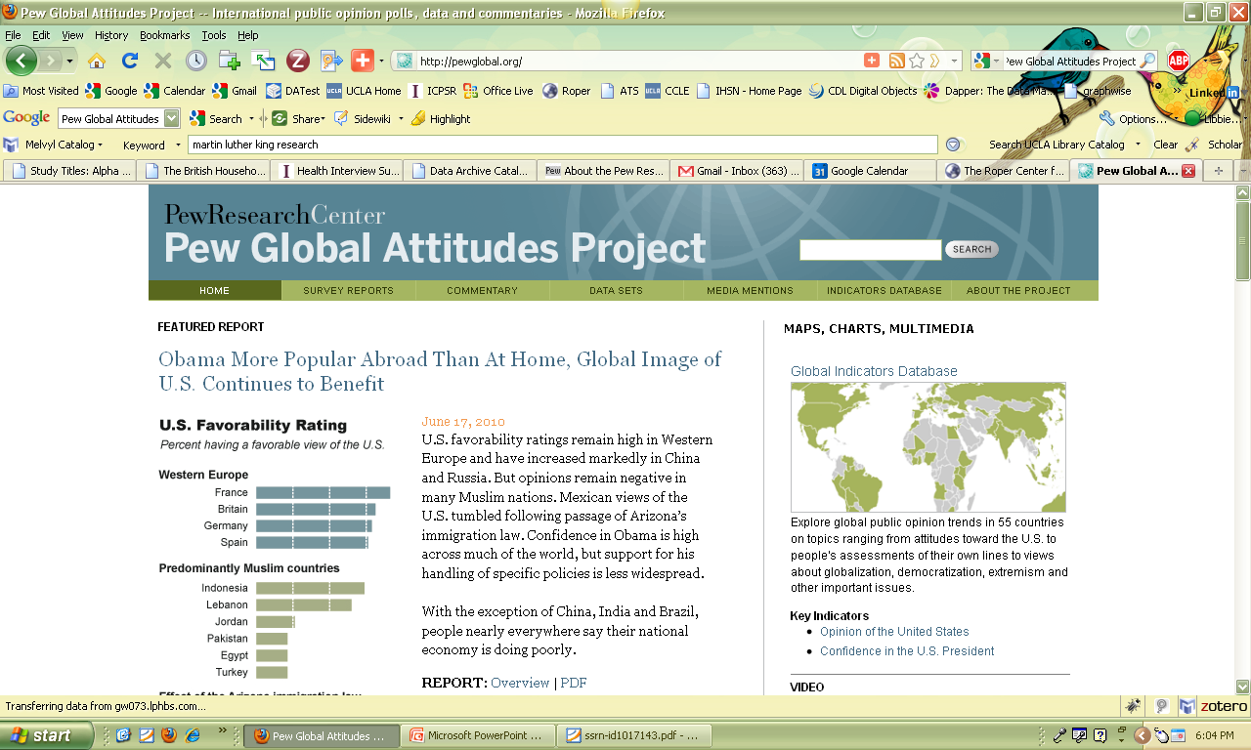
General public opinion, quality of life, state of the world, important issues
International – 57 countries
Reports, commentaries, data
Key indicators database
http://pewglobal.org/
Notes:
public opinion surveys around the world on a broad array of subjects ranging from people’s assessments of their own lives to their views about the current state of the world and important issues of the day. More than 240,000 interviews in 57 countries have been conducted as part of the project’s work.
numerous major reports, analyses, and other releases, on topics including attitudes toward the U.S. and American foreign policy, globalization, terrorism, and democracy.
Like this one somewhat because it is co-chaired by Madeleine Albright who is one of my icons. If she is part of it I know it will be good.
I like the commentaries because they are short and to the point; nice graphics.
Reports are in depth and as with other pew reports could be used in courses.

Slide 11
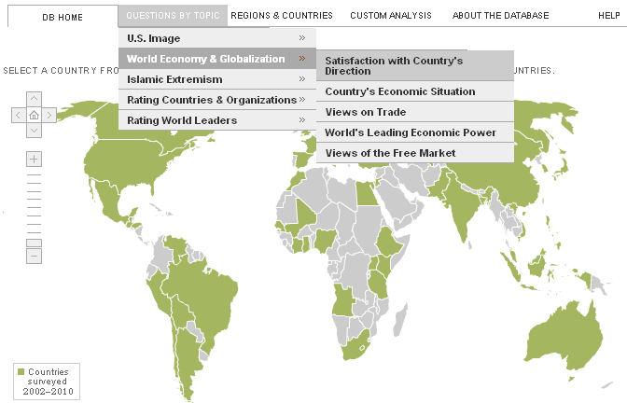
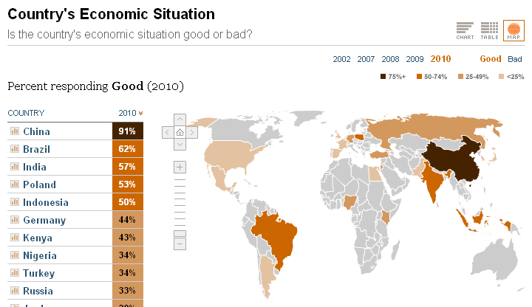
Global Attitudes – Key Indicators
Notes:
Can produce tables, chart or map by topics, and can change year in display. Could be very nice tool to use in class.
Can also do a custom analysis by topic and country or can compare countries over time. Can also show trends for specific country.

Slide 12
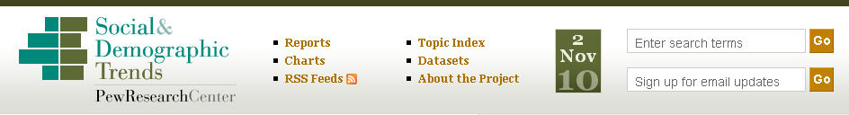
Social attitudes and behaviors: family, community, health, finance, work and leisure
Reports, data
Chart gallery, topic index, key word search
Question search can be displayed with a chart
Charts can be browsed by topic
http://pewsocialtrends.org/
Notes:
studies behaviors and attitudes of Americans in key realms of their lives, including family, community, health, finance, work and leisure.
Point out “all things census” – useful place to look at what is coming up from ACS and 2010 census taken in the US, but also censuses elsewhere.
Chart gallery – fun topics and thought provoking. Could be used to start a class discussion leading into using data.
Has wide variety of topics and students often find something they want to use for assignments.
Problem is that charts and tables do not come as excel files, as is the case for the other Pew centers. So user does need to download whole dataset.
Key word search will yield both datasets and reports
Question search developed by Roper – can make chart or retrieve full report

Slide 13
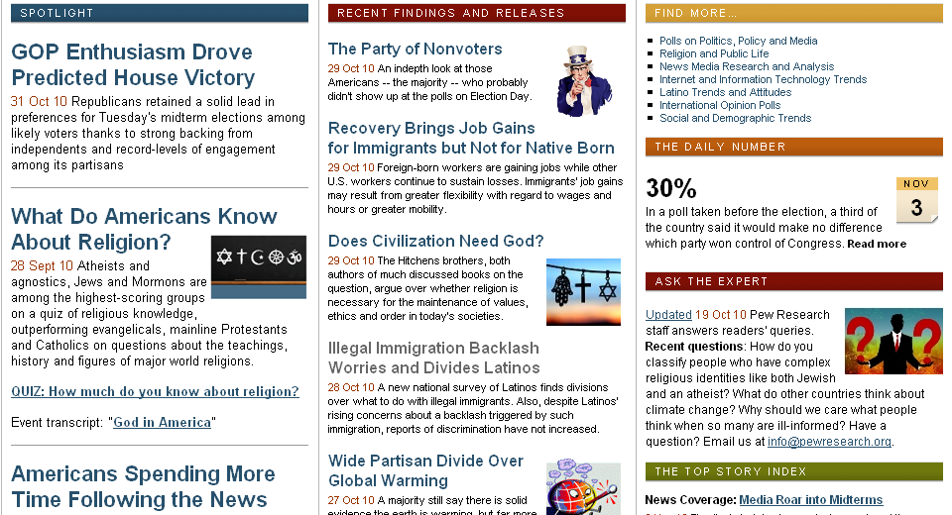
Notes:
So that’s what I wanted to show you about the Pew Research materials. There’s a lot there that can be used in instruction and research. I wish that they were utilizing tools such as SDA for online analysis as you can do with studies at ICPSR. And I wish that the tables they create in their reports could be downloaded as excel files because undergrads can use them more easily that way. There is also no way to search among all the tables they generate, so you have to go through the reports one by one. That being said, this is a terrific resource and one that compliments what you can get at ICPSR. And keep in mind that other studies funded by the Pew Charitable Trust are often archived at ICPSR.

