Slide 1

Introduction to Satisfiability Solving with Practical Applications
SAT/SMT Summer School at MIT, Cambridge 2011
Niklas Een

Slide 2
SAT solvers
Inner workings

Slide 3
The SAT problem
A literal p is a variable x or its negation ¬x.
A clause C is a disjunction of literals: x₂ ∨ ¬x₄₁ ∨ x₁₅
A CNF is a conjunction of clauses:
(x₂ ∨ ¬x₄₁ ∨ x₁₅) ∧ (x₆ ∨ ¬x₂) ∧ (x₃₁ ∨ ¬x₄₁ ∨ ¬x₆ ∨ x₁₅₆)
The SAT-problem is:
Find a boolean assignment
such that each clause has a true literal
First problem shown to be NP-complete (1971)

Slide 4
What’s a clause?
A clause of size n can be viewed as n propagation rules: a ∨ b ∨ c
is equivalent to:
(¬a ∧ ¬b)  c
(¬a ∧ ¬c)  b
(¬b ∧ ¬c)  a
Example: Consider the constraint
t = AND(x, y)
x=0  t=0
y=0  t=0
x=1 and y=1  t=1
¬x  ¬t
¬y  ¬t
x ∧ y  t
{x, ¬t}
{y, ¬t}
{¬x, ¬y, t}
¬t ∧ y  ¬x

Slide 5
Example
{3, 6, -7, 8}
{1, 4, 7}
{-8, 4}
{-1, -3, 8}
{-3, -4, -8}
{-1, -2, 3, 4, -6}
{3, 6, -7, 8}
{1, 4, 7}
{-8, 4}
{-1, -3, 8}
{-3, -4, -8}
{-1, -2, 3, 4, -6}
{3, 6, -7, 8}
{1, 4, 7}
{-8, 4}
{-1, -3, 8}
{-3, -4, -8}
{-1, -2, 3, 4, -6}
Unit clause (BCP)
. . .
{3, 6, -7, 8}
{1, 4, 7}
{-8, 4}
{-1, -3, 8}
{-3, -4, -8}
{-1, -2, 3, 4, -6}
Another unit clause (more BCP)
{3, 6, -7, 8}
{1, 4, 7}
{-8, 4}
{-1, -3, 8}
{-3, -4, -8}
{-1, -2, 3, 4, -6}
CONFLICT! (backtrack)
. . .

Slide 6
Search Components
Decision heuristic
Static (x₁, x₂, x₃...)
State based
Shortest non-satisfied clause, most common literal etc.
History based
Pick variables that lead to conflicts in the past.
Propagation
Backtracking
Decision heuristic
Propagation
Backtracking
Search Tree
x₃=1
x₁=1
x₁=0
x₈=0
x₄=1
Conflict
x₈=0

Satisfying Assignment

Slide 7
Search Components
Decision heuristic
Propagation
Unit propagation (”BCP”)
Unate propagation
Probing/Dilemma
Equivalence classes
Backtracking
{3, 6, -7, 8}
{1, 4, 7}
{-8, 4}
{-1, -3, 8}
{-3, -4, -8}
{-1, -2, 3, 4, -6}
{3, 6, -7, 8}
{1, 4, 7}
{-8, 4}
{-1, -3, 8}
{-3, -4, -8}
{-1, -2, 3, 4, -6}
Unate (pure literal)
x₁=1
x₁=0
 x₆=0 x₇=1
 x₆=0 x₄=0
 x₆=0

Slide 8
Search Components
Decision heuristic
Propagation
Backtracking
Flip last decision (standard recursive backtracking)
Conflict analysis:
Learn an asserting clause
[...]
dpll(assign){
”do BCP”;
if ”conflict”: return FALSE;
if ”complete assign”: return TRUE;
”pick decision variable x”;
return dpll(assign[x=0])
|| dpll(assign[x=1]);
}
a=1
b=1
c=1
● May be expressed in any variables, not just decisions.
● Must have only one variable from the last decision level.
Asserting clause: {¬a, ¬b, ¬c}
Asserting clause: {¬a, ¬c}
Conflict
What if b was irrelevant?
Notes:
Decisions: a, b, c [conflict]
Simplest asserting clause: ~a | ~b | ~c
A better analysis might have given ~a | ~c
Backjumping goes back to a instead of b and inserts the clause there

Slide 9
Search Components
Decision heuristic
Propagation
Backtracking
Flip last decision (standard recursive backtracking)
Conflict analysis:
Learn an asserting clause
Backjumping
No recursion
Can be viewed as a resolution strategy, guided by conflicts.
Together with variable activity, most important innovation.
dpll(assign){
”do BCP”;
if ”conflict”: return FALSE;
if ”complete assign”: return TRUE;
”pick decision variable x”;
return dpll(assign[x=0])
|| dpll(assign[x=1]);
}
forever{ − CDCL procedure
”do BCP”
if ”no conflict”:
if ”complete assign”: return TRUE;
”pick decision x=0 or x=1”;
else:
if ”at top-level”: return FALSE;
”analyze conflict”
”undo assignments”
”add conflict clause”
}
Notes:
Decisions: a, b, c [conflict]
Simplest asserting clause: ~a | ~b | ~c
A better analysis might have given ~a | ~c
Backjumping goes back to a instead of b and inserts the clause there

Slide 10
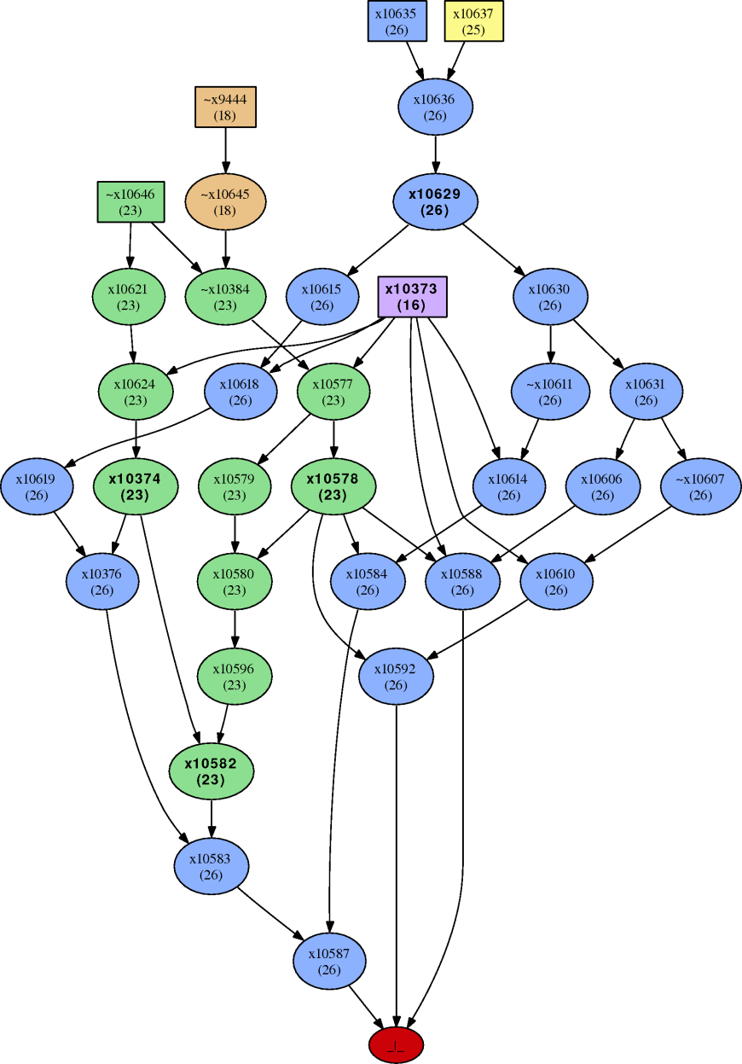
Conflict Analysis – Graph View
Conflicting clause:
{¬x10587, ¬x10592, ¬x10588}
One option:
– Trace back to decision variables
– Would learn:
{x10646, x9444, ¬x10373 , ¬x10635 ¬x10637}
Other option:
– Stop earlier
– Asserting if only one literal left at the highest decision level
– Keep expanding nodes from that level

Slide 11
Conflict Analysis – Resolution View
Decision | Implications
¬a | −
¬b | c
¬d | e, ¬f
Clause Database
[...]
{c, a, b}
{¬f, ¬e, d, b}
{e, d, ¬c, b, a}
{f, ¬e, ¬c}
[...]
Clause Database
[...]
{c, a, b}
{¬f, ¬e, d, b}
{e, d, ¬c, b, a}
{f, ¬e, ¬c}
[...]
reason for c
reason for ¬f
reason for e
start with the conflicting clause
resolve with reason of last assigned literal
conflicting clause
{f, ¬e, ¬c}
{¬f, ¬e, d, b}
keep resolving until only one literal of last decision level
resolve on f
{¬e, d, ¬c , b}
{e, d, ¬c, b, a}
Conflict Clause Minimization:
Continue to resolve if result is a strict subset
Resolution:
{x, A} res. {¬x, B} = {A, B}
resolve on e
{d, ¬c, b, a}
Done!
or not?
blue = last decision level
Notes:
or not = conflict clause minimization

Slide 12
Variable Activity
The VSIDS activity heuristic:
Bump literals of the learned (conflict) clause
Decay by halfing activity periodically
Modified activity heuristic:
Bump variables of all clauses participating in analysis
Decay after each conflict
Effect:
Give preference to the very latest conflicts(Berkmin/VMTF)
Longer memory (15000 decays before minimal float value)

Slide 13
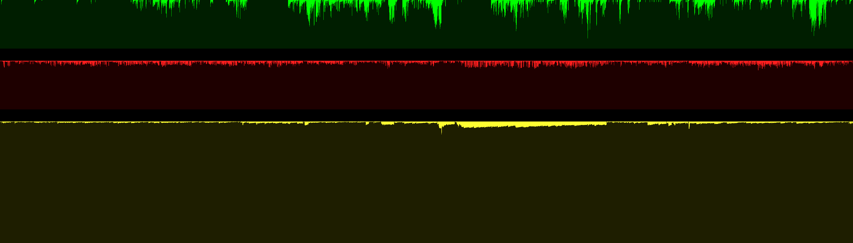
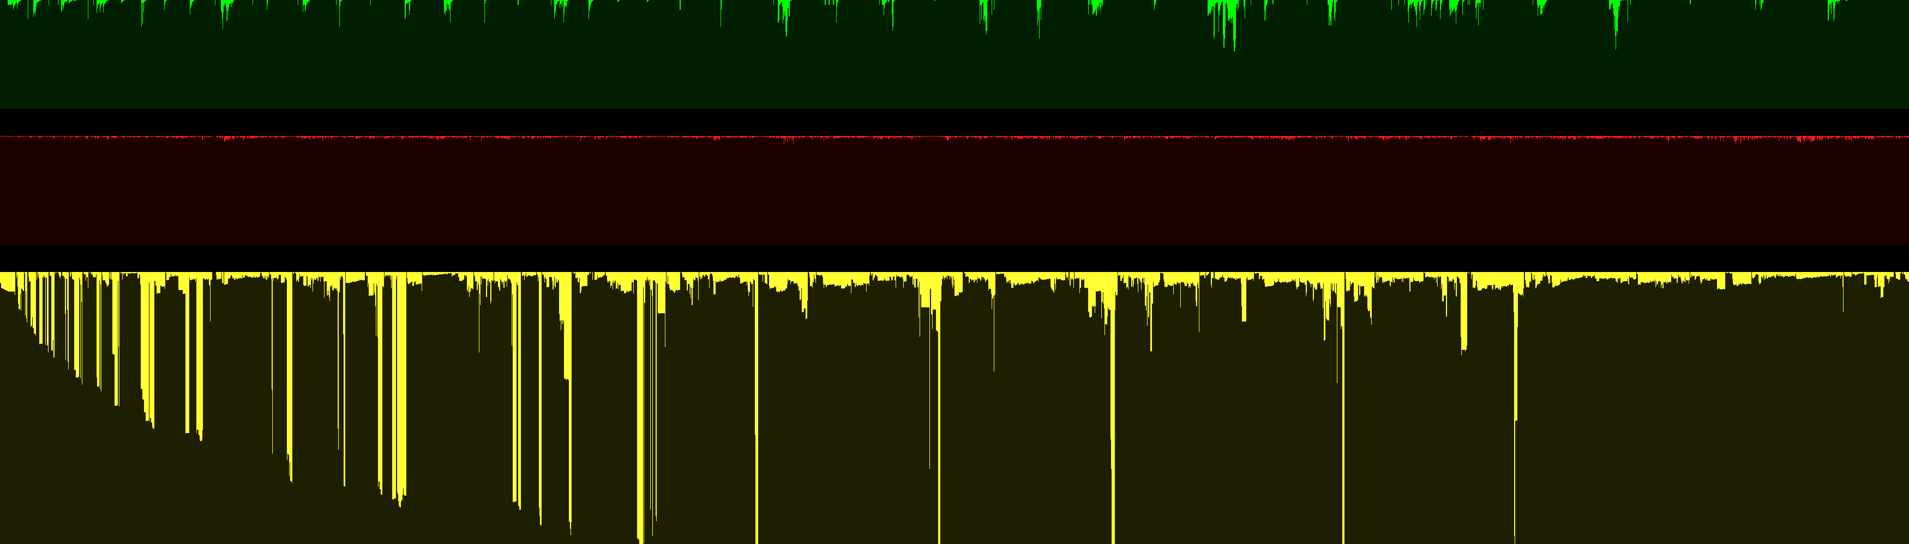
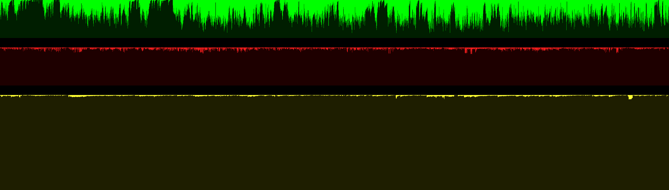
Execution of CDCL Solver
Green – Activity of decision variable
Red – Length of learned clause
Yellow – Decision depth when conflict occurred
Notes:
Conflict nests
Long clauses are not useless
Industrial problems ”sparse”.

Slide 14
Other Techniques
Two watched literals
not moved during backtrack;
migrate to silent places
improves with length of clauses
most BCP in learned clauses (often 90%), which are long
Restarts with polarity memoization
frequent restarts, except sometimes: 1, 1, 2, 1, 1, 2, 4, 1, 1, 2, 1, 1, 2, 4, 8...
not real restarts
compresses assignment stack => more focus on active variables
Conflict-clause deletion
remove clauses that don’t participate in conflict analysis
handles subsumed clauses better than original scheme (based on length)
CNF preprocessing
variable elimination
subsumption, self-subsuming resolution

Slide 15
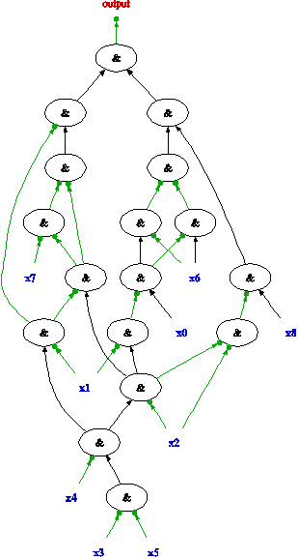
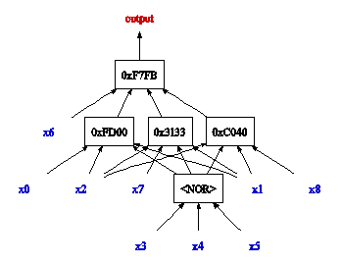
Other Techniques (cont.)
Better CNF generation
If problem on circuit form:
Technology mapping for CNF
Fanout aware variable elimination
Certain constraints (e.g. cardinality constraints) have known efficient encodings.
Improvements to incremental SAT
Domain specific adjustments
Method | Approx. #conflicts (Charactersitics)
BMC | 100
Interpolation | 1,000 (clause deletion, proof logging)
PDR | 10,000 (local problems, limited proof logging)
SAT-sweeping | 100,000 (local problems)

Slide 16
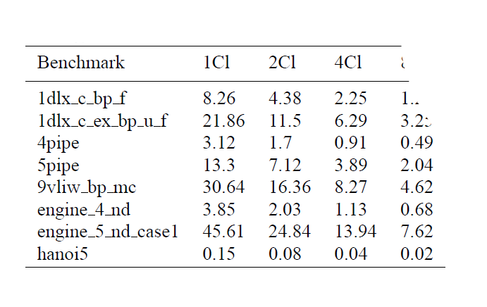
SAT Research
Practical SAT is an experimental science.
There are three types of papers:
The conclusion is wrong.
The conclusion is correct, but not for the stated reasons.
The conclusion is correct, the stated reasons are valid, but the experimental data does not support it.
It is hard to improve the CDCL algorithm.

Slide 17
Applying SAT solvers
Solving puzzles

Slide 18
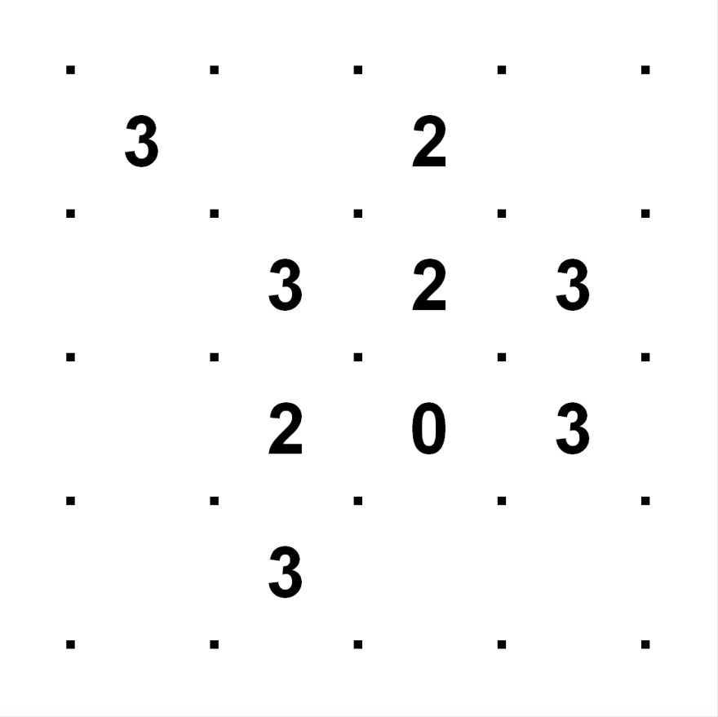
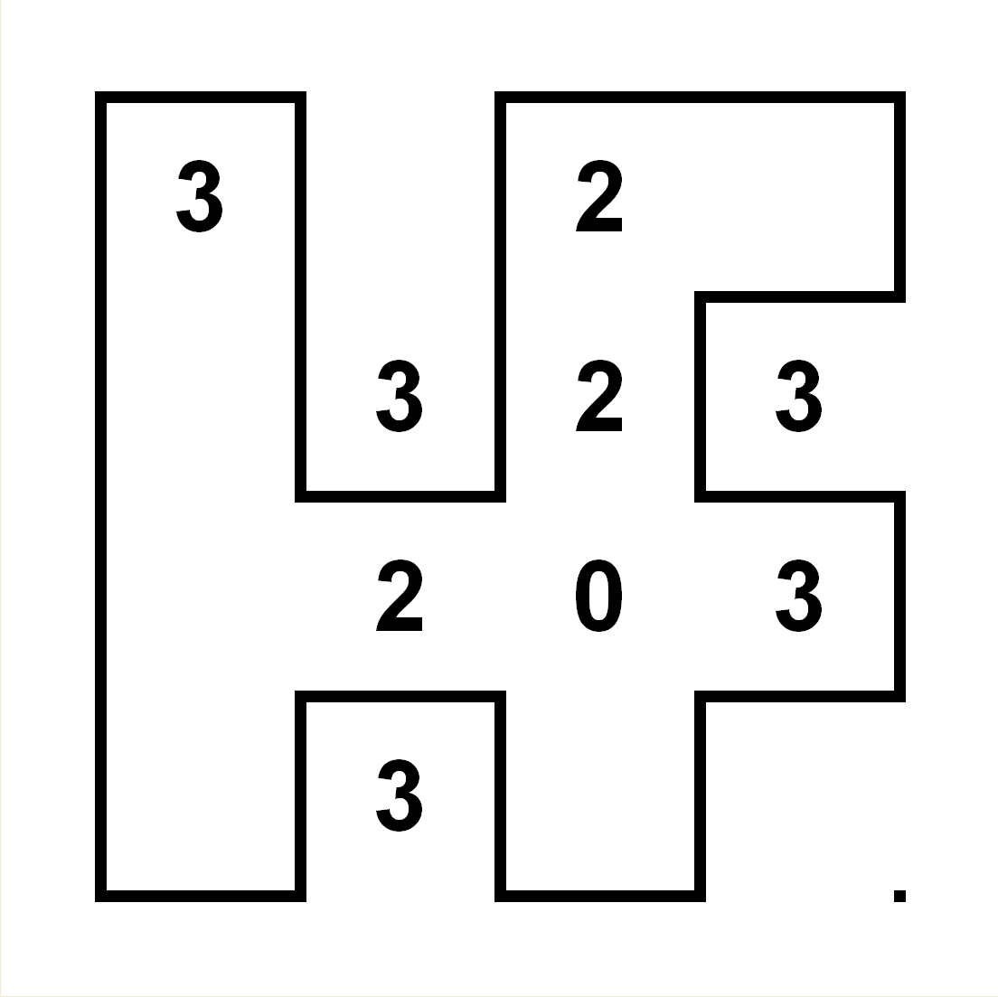
Slither Link
Rules
Each number must be surrounded by that many edges.
All edges must form a single closed loop.

Slide 19

Slither Link
Rules
Each number must be surrounded by that many edges.
All edges must form a single closed loop.
Constraints
Rule 1 is easily expressed:
Let e₁, e₂, e₃, e₄ be the edges around a number k.
Encode in CNF: card(e₁, e₂, e₃, e₄) = k
An approximation of rule 2 can be enforced locally:
Every crossing should have either zero or two edges.
Encode as: card(e₁, e₂, e₃, e₄) = 0 or 2
e₁
e₄
e₂
e₃
e₁
e₃
e₂
e₄
Example. k =1: {e₁, e₂, e₃, e₄}, {¬e₁, ¬e₂}, {¬e₁, ¬e₃}, {¬e₁, ¬e₄}, {¬e₂, ¬e₃}, {¬e₂, ¬e₄},{¬e₃, ¬e₄}
Local loop constraint.
{¬e₁, ¬e₂, ¬e₃}, {¬e₁, ¬e₂, ¬e₄}, {¬e₁, ¬e₃, ¬e₄}, {¬e₂, ¬e₃, ¬e₄}, {e₁, e₂, e₃, ¬e₄}, {e₁, e₂, ¬e₃, e₄}, {e₁, ¬e₂, e₃, e₄}, {¬e₁, e₂, e₃, e₄}

Slide 20
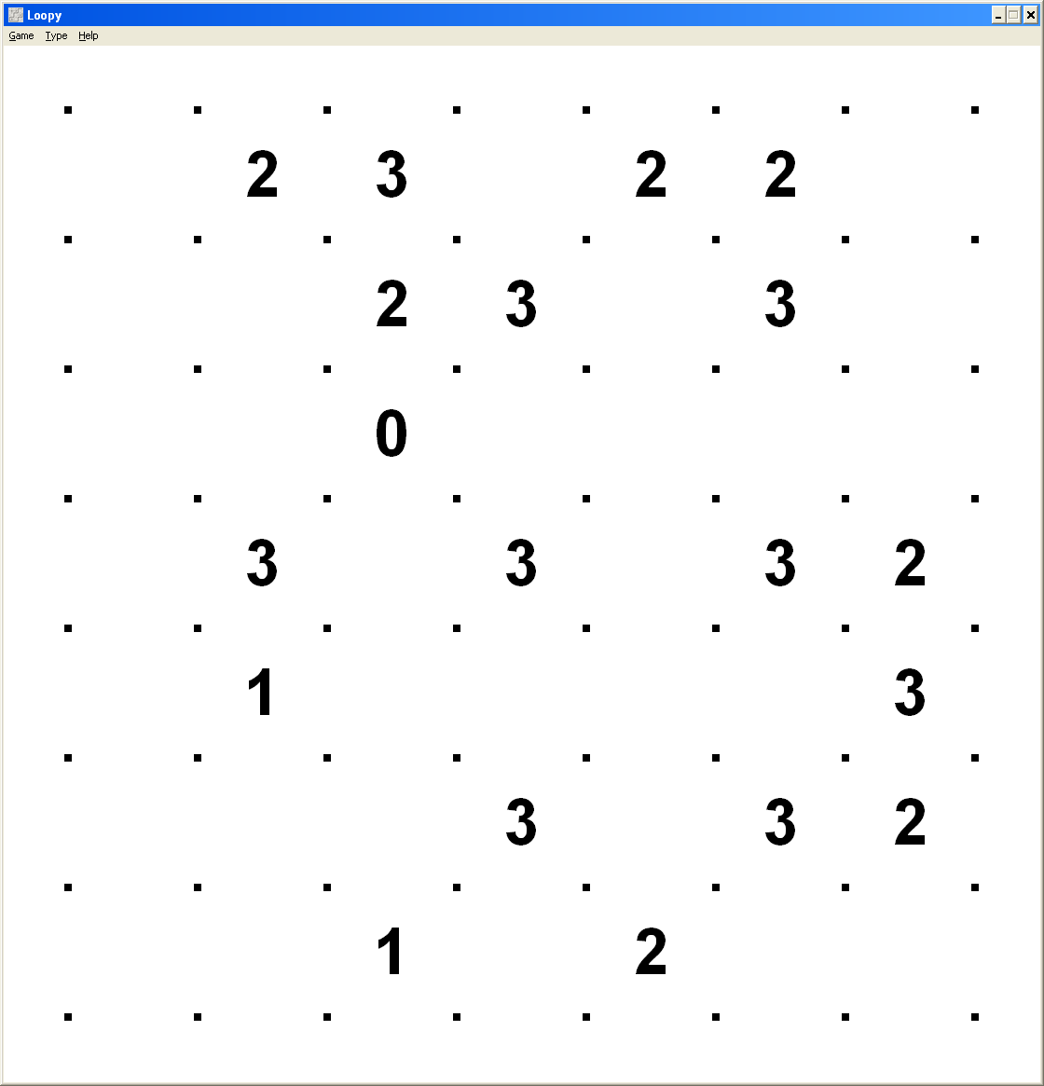
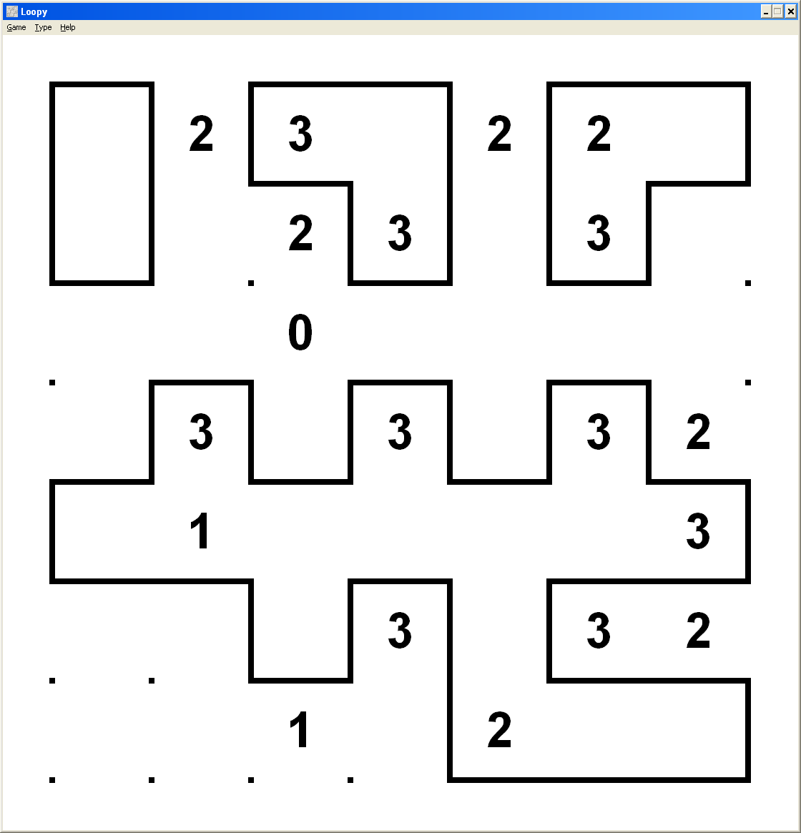
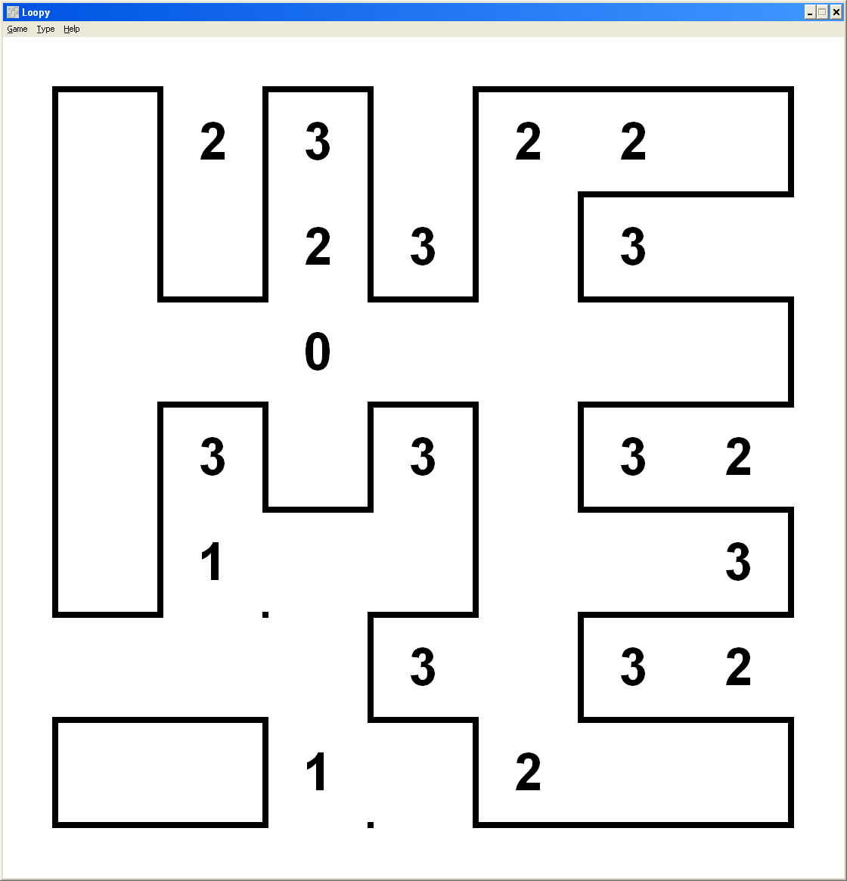
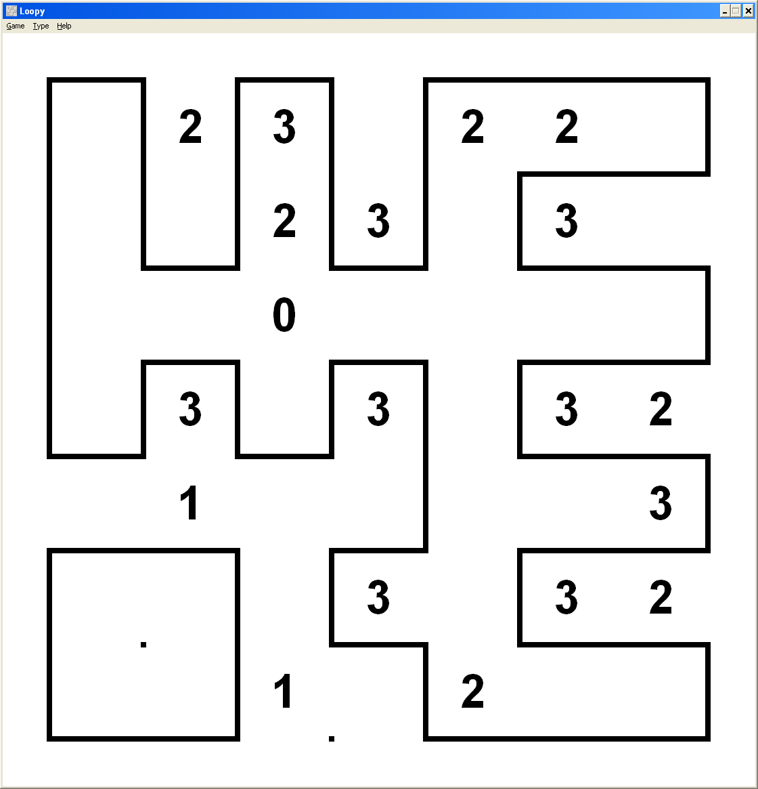

Slither Link (cont.)
Lets run it...
...close, but no cigar.
But with a CEGAR!
Refine by prohibiting these particular cycles.
Repeat
Repeat
Done!

Slide 21
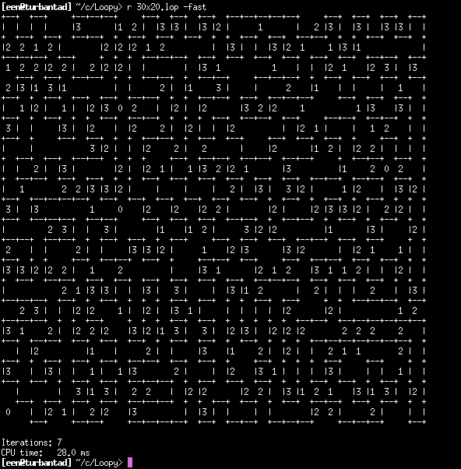
Slither Link (cont.)
Incremental solution works well for larger sizes too.
Exercise: Formulate a SAT encoding that will solve Slither Link non-incrementally (one SAT call only).

Slide 22
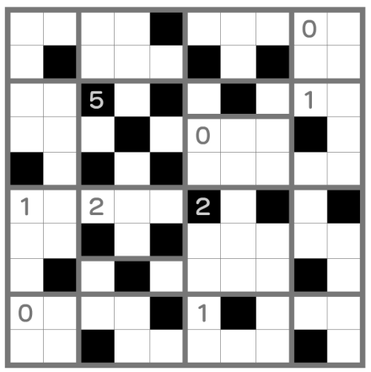
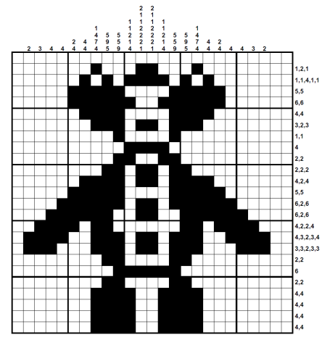
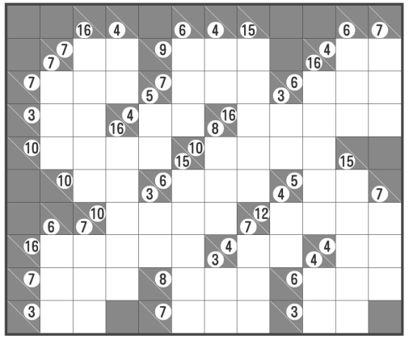
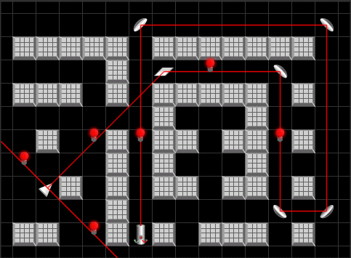
Other nice puzzles
Heyawake
Hanjie
Kakuro
Reflections
...try one with SAT
http://games.erdener.org/laser/

Slide 23
Applying SAT solvers
Verification

Slide 24
Incremental SAT
MiniSat API
void addClause(Vec<Lit> clause)
bool solve(Vec<Lit> assumps)
bool readModel(Var x) − for SAT results
bool assumpUsed(Lit p) − for UNSAT results
The method solve() treats the literals in assumps as unit clauses to be temporary assumed during the SAT-solving.
More clauses can be added after solve() returns, then incrementally another SAT-solving executed.

Slide 25
Allows for...
Refinement loop
More clauses can be added with addClause()
Restricted clause deletion
Clauses can be tagged by an activation literal ”a”:
{¬a, p₀, p₁, ..., p_{n}}, {¬a, q₀, q₁, ..., q_{m}}, . . .
Activated by passing a as part of assumps to solve()
Deleted by addClause({¬a})
Poor-mans proof logging
If we have several sets of clauses A₁, A₂,... with different activation literals a₁, a₂,..., assumpUsed() tells us which sets were used for proving UNSAT
Also works for output of cones of logic in a circuit
₁
₂
₃
AIG
primary inputs

Slide 26
Bit-level Verification
Design is given as a netlist of:
AND gates
PIs
Flops
Wires can be comp-lemented. A special output is marked as the property.
Primary
Inputs
Property
Output
…
Combinational
Logic
Flip-
Flops
…
…

Slide 27
Bounded Model Checking
Unroll the design for 1, 2, 3, etc. time-frames.
Check if the property can fail in the last frame.
Primary Inputs
t=0
t=1
t=2
t=3
t=4
. . .
Initial
State
Bad
Bad
Bad
Bad
Bad
for k in 1..:
p_{bad} = CNF(logic cone of Bad_{k})
if (solve({p_{bad}}))
return CounterExample
addClause({¬p_{bad}})
Questions
Why grow trace ”forward”?
Increase by more than one frame at a time?
How about SAT preprocessing?
Better just skip incremental SAT?

Slide 28
Conclusions
SAT-solvers are implication engines.
Clauses are the ”assembly language” of propositional reasoning.
Two important techniques of CDCL solvers are:
Conflict analysis
Variable activity
Most applications use incremental SAT and encode an abstraction of the real problem.

