Slide 1

Data Management Plans
ICPSR Data Fair November 8, 2010
Katherine McNeill, MIT Libraries

Slide 2
Introduction
Goals for the session:
Major U.S. funder requirements
Resources available
Service models
Caveats: selective, U.S.-focused
Note: data sharing requirements vs. data management plans vs. data management activities

Slide 3
History
Tradition of exchanging information for scientific progress
Sharing of social science electronic data files throughout the 20th century (e.g. ICP[S]R founded in 1962)
History of data professionals
More recently increased attention to research data in other disciplines
Funder desire to provide access to the products of funded research

Slide 4
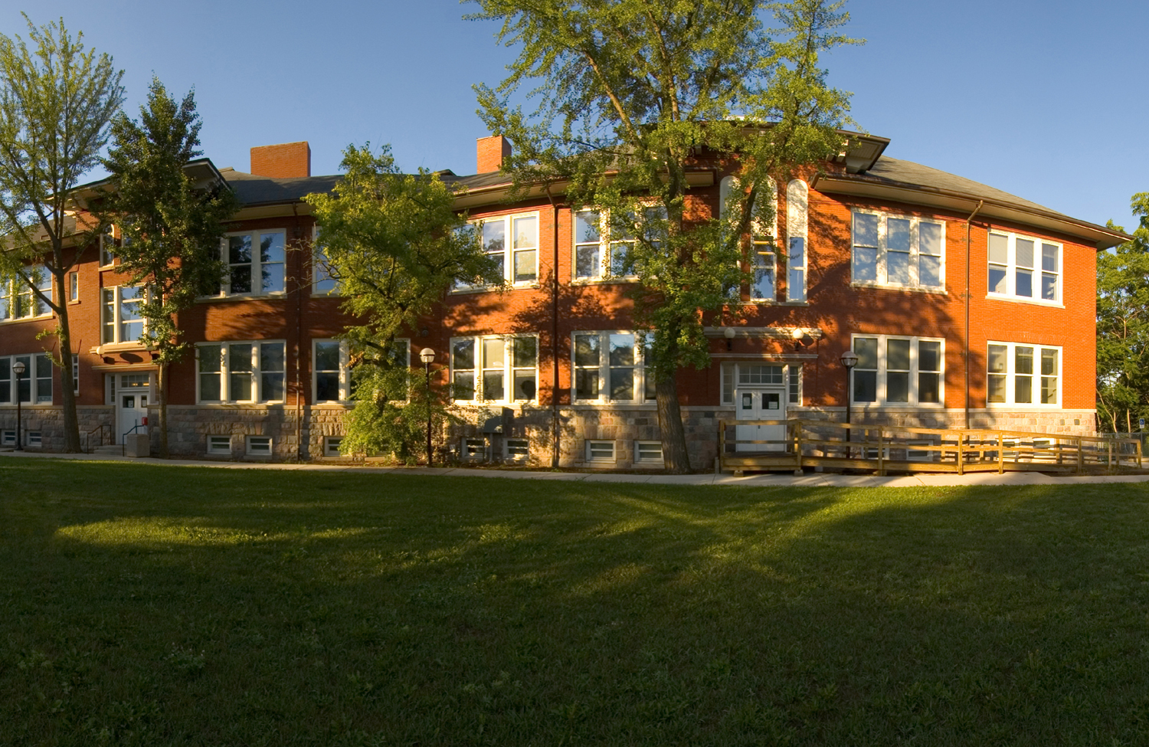
Major U.S. Funder Requirements

Slide 5
U.S. Legal Foundation
1999: U.S. Office of Management and Budget amended OMB Circular A-110 was amended to require Federal awarding agencies “to ensure that all data produced under an award will be made available to the public through the procedures established under the Freedom of Information Act”

Slide 6
National Science Foundation
NSF: Dissemination and Sharing of Research Results
New implementation of existing policy on data sharing: as of January 18, 2011
Requires 2-page data management plan with possible components
Further requirements for specific NSF Directorates or Divisions, e.g. Division of Social and Economic Sciences (SES) Data Archiving Policy

Slide 7
National Institutes of Health
NIH Data Sharing Policy
Most recent policy: 2003
Researchers funded at ≥$500,000 expected to include a plan for data sharing

Slide 8
National Institute of Justice
NIJ Data Resources Program
Archive: National Archive of Criminal Justice Data at ICPSR:
Applies to most grants but some exceptions are granted

Slide 9
Other Funders
U.S. Federal Agencies:
Funding Agency and Data Management Guidelines (U. of Minnesota Libraries)
Data Sharing and Replication (Gary King, Harvard University)
U.K. Research Councils and Wellcome Trust: Data Management Plans (Digital Curation Centre)

Slide 10
Resources

Slide 11
What Should be in a Data Management Plan?
Consult your requirements…otherwise:
Description of project and data to be collected
Standards to be applied
Plans for short-term storage/data management
Legal and ethical issues
Access policies and provisions
Provisions for long-term archiving
Assigned data management responsibilities
Note: Any funder requirements for content should prevail

Slide 12
ICPSR Guidelines for Effective Data Management Plans
Elements of a data management plan
Other data management plan examples in various disciplines
Lists of resources and related sites

Slide 13
Data Management Guides
Academic libraries:
Cornell
MIT
University of Edinburgh
University of Minnesota
Data Archives/Services:
Australian National Data Service: Data Management Planning
Finnish Social Science Data Archive: Data Management Planning
U.K. Data Archive: Create & Manage Data

Slide 14
Manuals
ICPSR Guide to Social Science Data Preparation and Archiving (pdf)
UKDA: Managing and Sharing Data (pdf)
Australian National University: Data Management Manual (pdf)
CIESIN: Geospatial Electronic Records
Oak Ridge National Laboratory: Best Practices for Preparing Environmental Data Sets to Share and Archive

Slide 15
Templates for Plans
Digital Curation Centre:
Template for a Data Management Plan (Word)
DMP Online
Relu-DSS: Project Communication and Data Management Plan (Word)
University of Melbourne: Research Data Management Plan Template (Word)

Slide 16
Service Models

Slide 17
Academic Library Support
Interdisciplinary librarian group: web guide, workshops, and consulting (MIT and University of Minnesota)
Dedicated Data Curation Center: (Purdue U.)
Any librarian (UC Davis Health Science Libraries)
Scholarly communication officer (Binghamton U.)
Partnerships with various other campus service providers (Cornell)
Partnership between Data Library and Research Computing (University of Edinburgh)

Slide 18
Other Models
National Data Service: Australian National Data Service
Funder Support: U.K. Data Archive
Sponsored research administration: University of Michigan Data Sharing Resource Center in partnership with the library
Inter-university collaborations: Canadian Association of Research Libraries Data Management Working Group
Professional society: IASSIST Data Management & Curation Good Practice Action Group

Slide 19
Conclusion

Slide 20
Discussion
Opportunity to collaborate across disciplines and partner with other service domains
Latitude vs. structure?
Greater attention vs. clerical task?
Who will be responsible for data management?
How does support for a specific requirement fit into a broader data management service?

Slide 21
Further Reading
National Science Board's Long-Lived Digital Data Collections Enabling Research and Education in the 21st Century
NSF: Cyberinfrastructure Vision for 21st-Century Discovery (pdf)
National Academies: Ensuring the Integrity, Accessibility, and Stewardship of Research Data in the Digital Age
ARL: E-Science and Data Support Services (pdf)
For more: National Data Management Reports (U. Minnesota Libraries)

Slide 22
Conclusion
Use requirements as a jumping-off point for broader conversations about data management services
Collaborate with others in and out of your department and institution
Thank you! Questions and comments?

