Slide 1
Estimation of alternative splicing isoform frequencies from RNA-Seq data
Ion Mandoiu
Computer Science and Engineering Department
University of Connecticut
Joint work with Marius Nicolae, Serghei Mangul, and Alex Zelikovsky

Slide 2
Outline
Introduction
EM Algorithm
Experimental results
Conclusions and future work

Slide 3
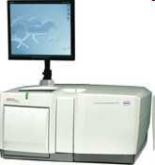
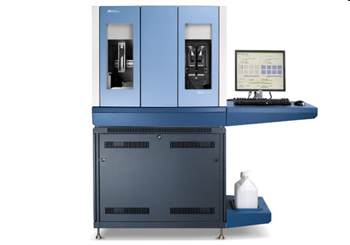
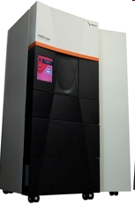
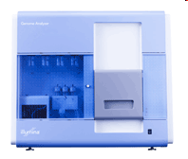
Ultra-High Throughput Sequencing
2nd generation of sequencing technologies deliver several orders of magnitude higher throughput compared to classic Sanger sequencing
Shorter reads!
Roche/454 FLX Titanium
400bp reads
Up to 600Mb/run
ABI SOLiD
50-75bp reads
Up to 300Gb/run
Illumina Genome Analyzer
100-150bp reads
Up to 38Gb/run
Helicos HeliScope
25-55bp reads
Up to 35Gb/run
Notes:
3
-SBS: Sequencing by Synthesis
-SBL: Sequencing by Ligation
-Challenges in Genome Assembly: The short read lengths and absence of paired ends make it difficult for assembly software to disambiguate repeat regions, therefore resulting in fragmented assemblies.
-New Type of sequencing error: in 454 including incorrect estimates of homopolymer lengths,
‘transposition-like’ insertions (a base identical to a nearby homopolymer is inserted in a nearby nonadjacent location) and errors caused by multiple templates attached to the same bead

Slide 4
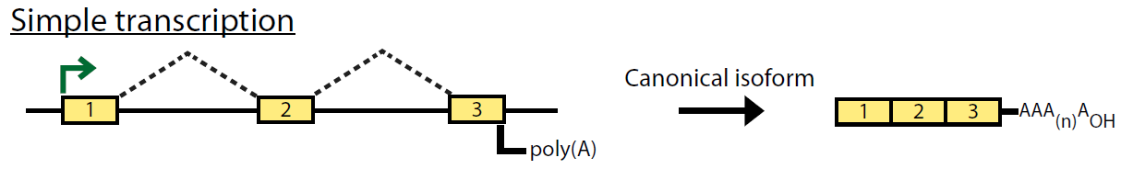
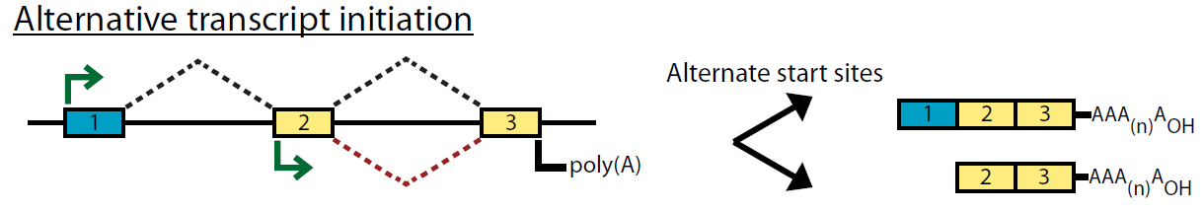
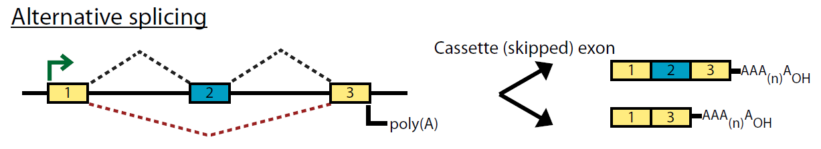
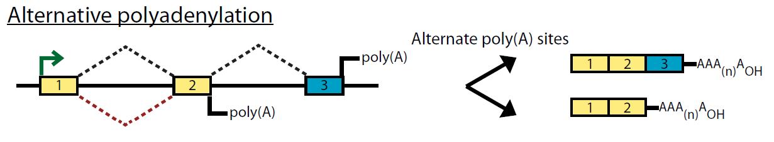
Alternative Splicing
[Griffith and Marra 07]

Slide 5
RNA-Seq
Make cDNA & shatter into fragments
Sequence fragment ends
Map reads
A
B
C
D
E
Gene Expression (GE)
Isoform Discovery (ID)
Isoform Expression (IE)
A
B
C
A
C
D
E

Slide 6
Gene Expression Challenges
Read ambiguity (multireads)
What is the gene length?
A
B
C
D
E

Slide 7
Previous approaches to GE
Ignore multireads
[Mortazavi et al. 08]
Fractionally allocate multireads based on unique read estimates
[Pasaniuc et al. 10]
EM algorithm for solving ambiguities
Gene length: sum of lengths of exons that appear in at least one isoform
➔ Underestimates expression levels for genes with 2 or more isoforms [Trapnell et al. 10]

Slide 8
Read Ambiguity in IE
A
B
C
D
E
A
C

Slide 9
Previous approaches to IE
[Jiang&Wong 09]
Poisson model + importance sampling, single reads
[Richard et al. 10]
EM Algorithm based on Poisson model, single reads in exons
[Li et al. 10]
EM Algorithm, single reads
[Feng et al. 10]
Convex quadratic program, pairs used only for ID
[Trapnell et al. 10]
Extends Jiang’s model to paired reads
Fragment length distribution

Slide 10
Our contribution
EM Algorithm for IE
Single and/or paired reads
Fragment length distribution
Strand information
Base quality scores

Slide 11
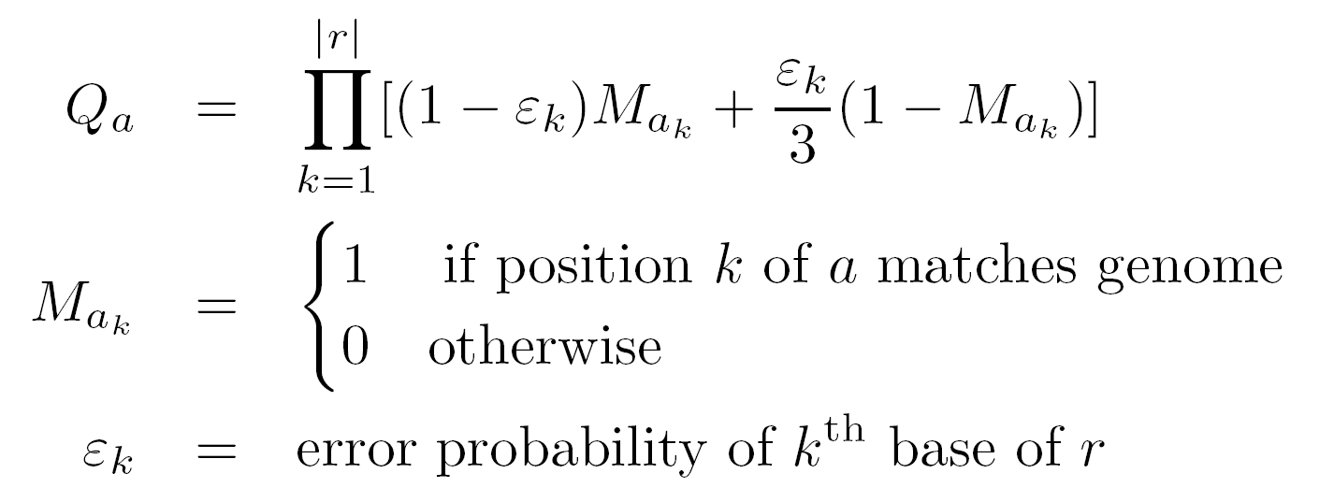
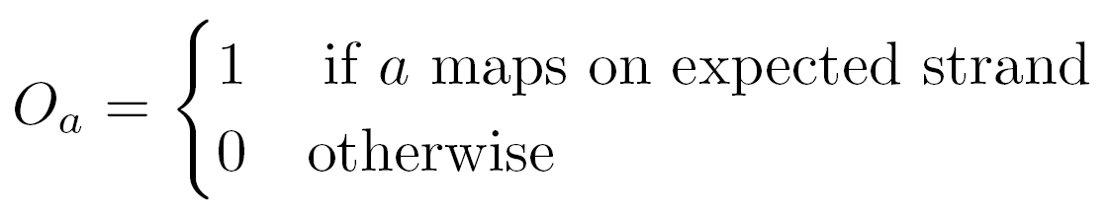
Read-Isoform Compatibility
Notes:
Key concept, stronger words
More details
Graph obtained by mapping the reads on to the transcript library
Some reads are compat .with one iso (like first read) some with multiple isoforms (like second)
- Animate O formula and Q formula (error prob comp from qual scores)

Slide 12
Fragment length distribution
Paired reads
F_{a}(i)
i
A
A
A
B
B
B
C
C
C
j
A
A
A
C
C
C
F_{a} (j)

Slide 13
Fragment length distribution
Single reads
i
A
A
A
B
B
B
C
C
C
j
A
A
A
C
C
C
F_{a}(i)
F_{a} (j)

Slide 14
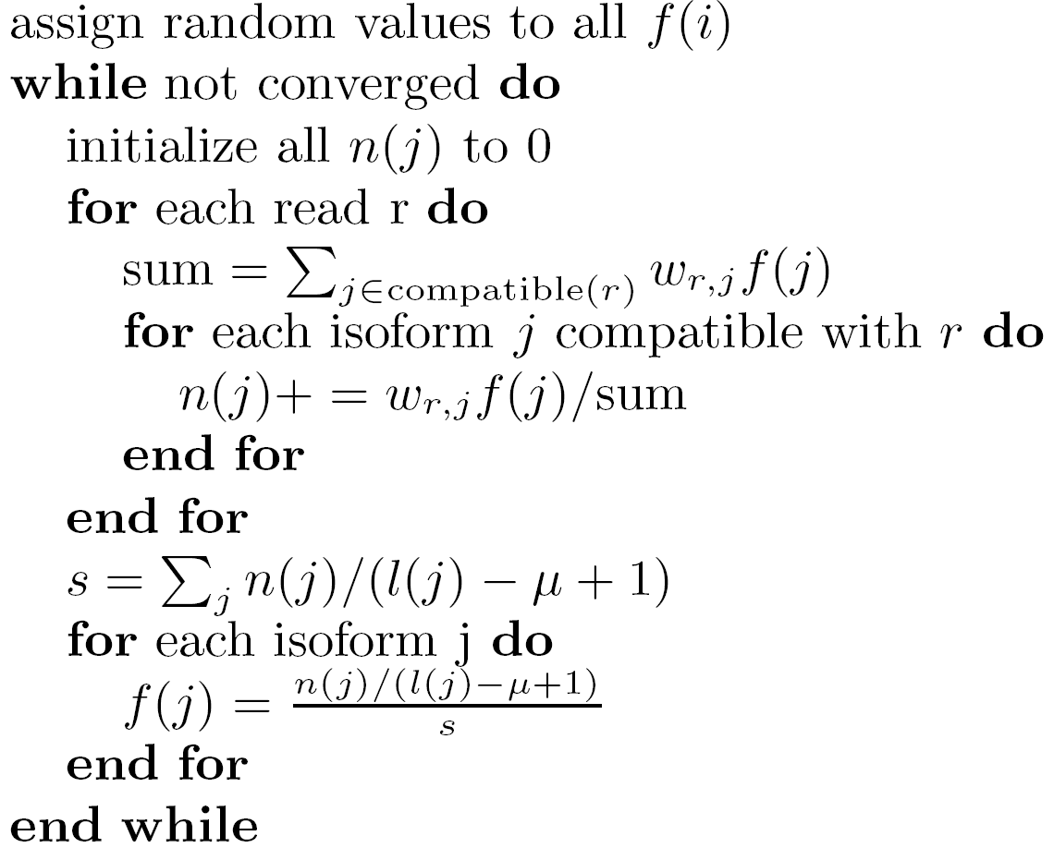
IsoEM algorithm
E-step
M-step

Slide 15
Speed improvements
Collapse identical reads into read classes
(i1,i2)
Reads
(i3,i4)
(i3,i5)
(i3,i4)
LCA(i3,i4)
i1
i2
i3
i4
i5
i6
Isoforms

Slide 16
Speed improvements
Run EM on connected components, in parallel
i2
i4
i1
i3
i5
i6
Isoforms

Slide 17
Simulation setup
Human genome UCSC known isoforms
GNFAtlas2 gene expression levels
Uniform/geometric expression of gene isoforms
Normally distributed fragment lengths
Mean 250, std. dev. 25

Slide 18
Accuracy measures
Error Fraction (EF_{t})
Percentage of isoforms (or genes) with relative error larger than given threshold t
Median Percent Error (MPE)
Threshold t for which EF is 50%
r²

Slide 19
Error Fraction Curves - Isoforms
30M single reads of length 25

Slide 20
Error Fraction Curves - Genes
30M single reads of length 25

Slide 21
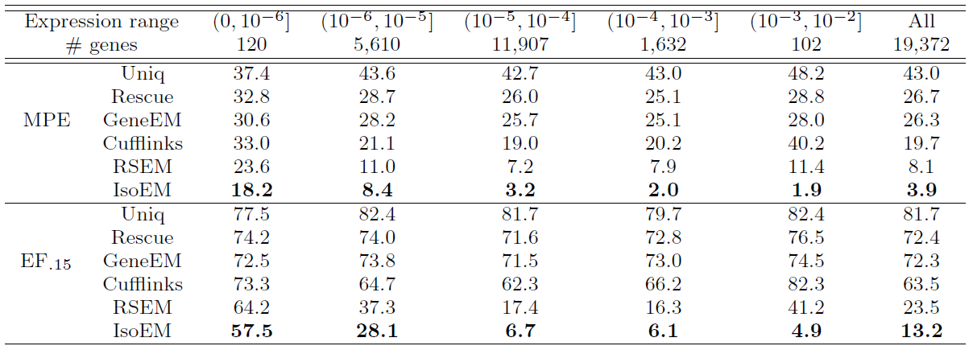
MPE and EF₁₅ by Gene Frequency
30M single reads of length 25

Slide 22
Validation on Human RNA-Seq Data
≈8 million 27bp reads from two cell lines [Sultan et al. 10]
47 AEEs measured by qPCR [Richard et al. 10]

Slide 23
Read Length Effect on IE MPE
Fixed sequencing throughput (750Mb)
Single Reads Paired Reads

Slide 24
Read Length Effect on IE r²
Fixed sequencing throughput (750Mb)

Slide 25
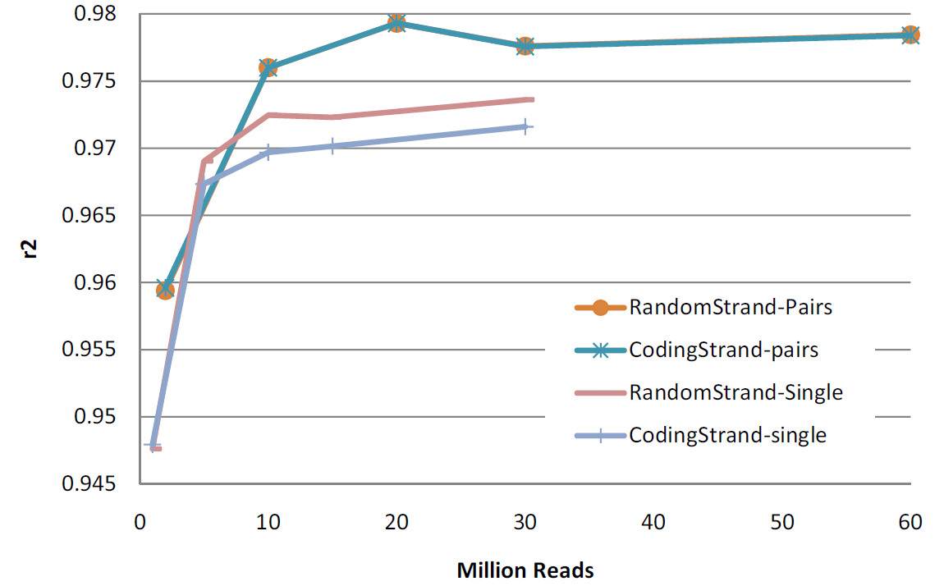
Effect of Pairs & Strand Information
75bp reads

Slide 26
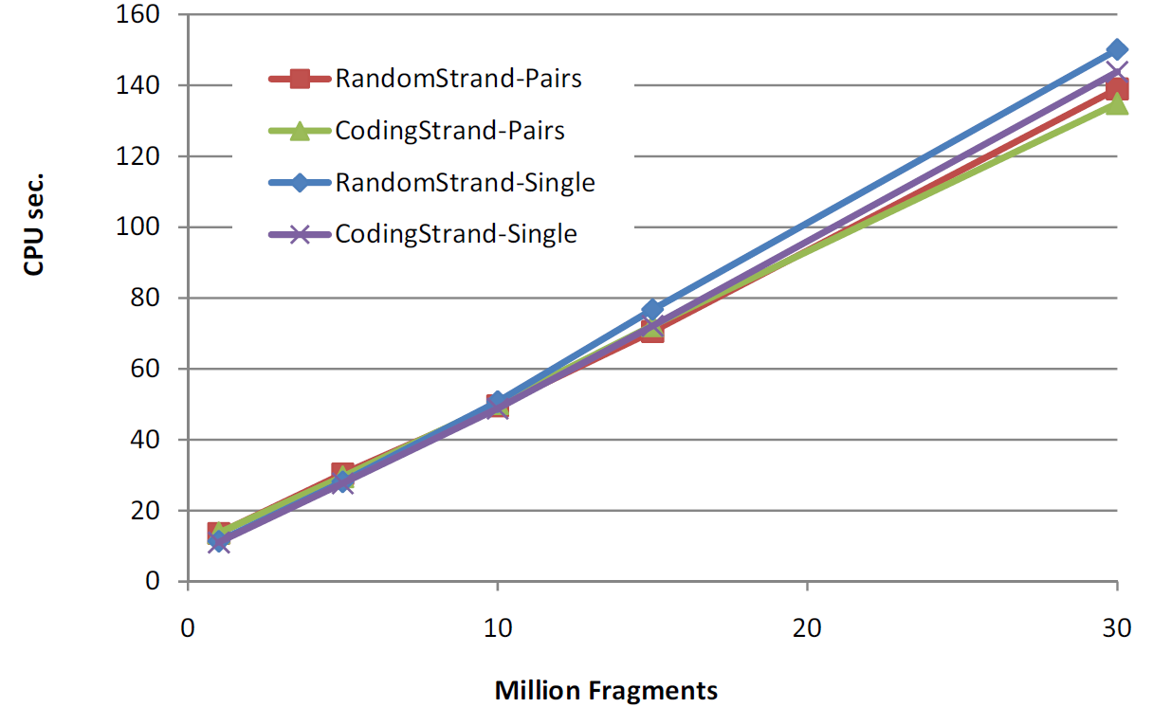
Runtime scalability
Scalability experiments conducted on a Dell PowerEdge R900
Four 6-core E7450Xeon processors at 2.4Ghz, 128Gb of internal memory

Slide 27
Conclusions & Future Work
Presented EM algorithm for estimating isoform/gene expression levels
Integrates fragment length distribution, base qualities, pair and strand info
Java implementation available at
http://dna.engr.uconn.edu/software/IsoEM/
Ongoing work
Comparison of RNA-Seq with DGE
Isoform discovery
Reconstruction & frequency estimation for virus quasispecies
Notes:
Comparison with alternative protocol for measuring gene expr called digital gene expr
The techniques behind isoem are applicable to reconstruction & freq est for virus quasispecies

Slide 28
Acknowledgments
NSF awards 0546457 & 0916948 to IM and 0916401 to AZ

