Slide 1


GOES-R Proving Ground CIRA / RAMMB Progress Report
10 January 2011
National Center Interactions
WFO Interactions
ORI Case Study
Conferences and Meetings

Slide 2
NHC Interaction
NHC Fact Sheet
NHC Proving Ground Experiment 2010 debriefing on 13 Jan 2011

Slide 3
SPC Interaction / Synthetic Imagery
Note: CIRA upgraded to a new cluster – resulting in significant faster production of the real-time NSSL-WRF synthetic imagery
Changed real-time synthetic imagery production
- From: 6.185 µm, 6.95 µm, 7.34 µm, 10.35 µm (running real-time since May 2010)
- To: 6.95 µm, 7.34 µm, 8.50 µm, 10.35 µm, 12.3 µm
- all bands now running for 25 hour periods (12 Z to 12 Z)
- 6.95 µm and 10.35 µm are done by 10 UTC
- 7.34 µm, 8.5 µm, 12.3 µm are completed by 1515 UTC.
- Additional channel difference products will be created in the future:
12.30 µm – 10.35 µm, 12.3 µm – 8.5 µm, 10.35 µm – 8.50 µm
Synthetic imagery also available at 3 WFOs: BOU, PUB, RIW

Slide 4
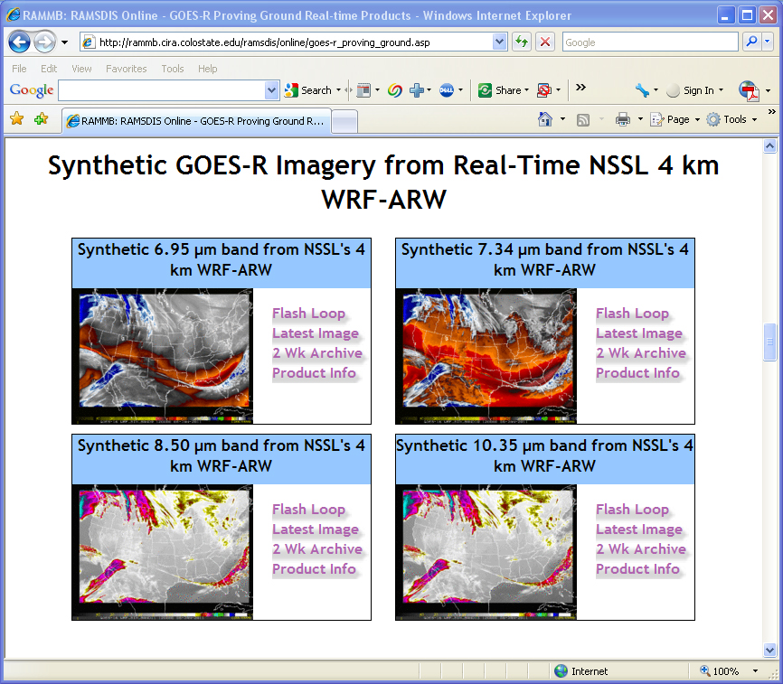
NSSL-WRF Synthetic ABI Imagery
New bands are displayed on CIRA/RAMMB real-time webpage
http://rammb.cira.colostate.edu/ramsdis/online/goes-r_proving_ground.asp
Notes:
- data being sent via the central region LDM to Pueblo, Riverton, and Boulder, and is being displayed on their AWIPS (currently 10.35 and 6.95 bands, from 12Z to 06Z)
- the transition has been made to the new cluster, and now the imagery is completely finished generating by 0930 UTC each night. this is relevant because the mid shift forecasters can use the output to assist with their morning forecast package
- we're also generating the 8.5 and 12.3 bands, and will soon be creating channel differences (8.5-10.35 and 10.35-12.3). SPC has requested these, so as part of the 2011 Spring Experiment, we'll be sending them 10.35, 6.95, and these 2 differences, and will extend the times out to the full 36-hour forecast. All of this output should be ready by the beginning of the Spring Experiment activities each morning.
- we should be able to easily provide this data to the HPC as part of their Proving Ground...I assume they use either NAWIPS or AWIPS too.

Slide 5
Synthetic Imagery – WFO BOU feedback
We are receiving more feedback from WFO BOU
Note
From: Eric Thaler [mailto:Eric.Thaler@noaa.gov] Sent: Friday, November 12, 2010 11:04 AM To: Lindsey, Daniel Cc: Ed Szoke Subject: Re: simulated imagery
Daniel, WOW!!!! I am working the short term desk today and noticed the same thing (synthetic imagery picking up on the low clouds northeast of Denver) and am most impressed!!!! It also did a decent job picking up some of the clouds in the mountains. Have you noticed that it "sees" the cities? Eric

Slide 6
OPC / HPC
Participated in OPC/HPC teleconference on 07 Dec 2010
CIRA and CIMSS will provide synthetic cloud/moisture imagery for the OPC Proving Ground
Current SPC products cover sufficient off-shore areas for OPC
RGB Air Mass Product:
From GOES – Sounder for HPC
From MSG for OPC (same as the NHC product)
Product demonstration will be transitioned
from GoogleEarth to N-AWIPS

Slide 7
WFO Interactions
New CIRA PG product installation packages available at:
ERHQ / WFO BUF and BOU: MODIS snow and cirrus
ERHQ / WFO BUF: GOES low cloud fog
WFO MTR: ORI
WFO GJT: GeoColor
WFO PUB RIW: improved transmission of synthetic imagery after feedback from the WFOs (less data)
MODIS Proving Ground data reduction: WFOs only receive imagery in case it covers their entire forecast area

Slide 8
Other Progress
N-AWIPS: Evaluation of SPORT true color conversion to 7 bit
AWIPS / WES data archive:
7 days of west coast rain/snow events (17 – 24 Dec 2010):
PG products, models, observation, satellite data
Procured new Linux box for GeoColor and MODIS imagery processing at CIRA
GeoColor GOES-West imagery now available every 15 min
(instead of 30 min)
Work continues with Geoffrey Stano / SPORT for a specialized GOES-R lightning product overlay GeoColor product
Notes:
8
8

Slide 9
Quick look at ORI imagery during the California pre-Christmas big rains
Images from 17-18 December 2010

Slide 10
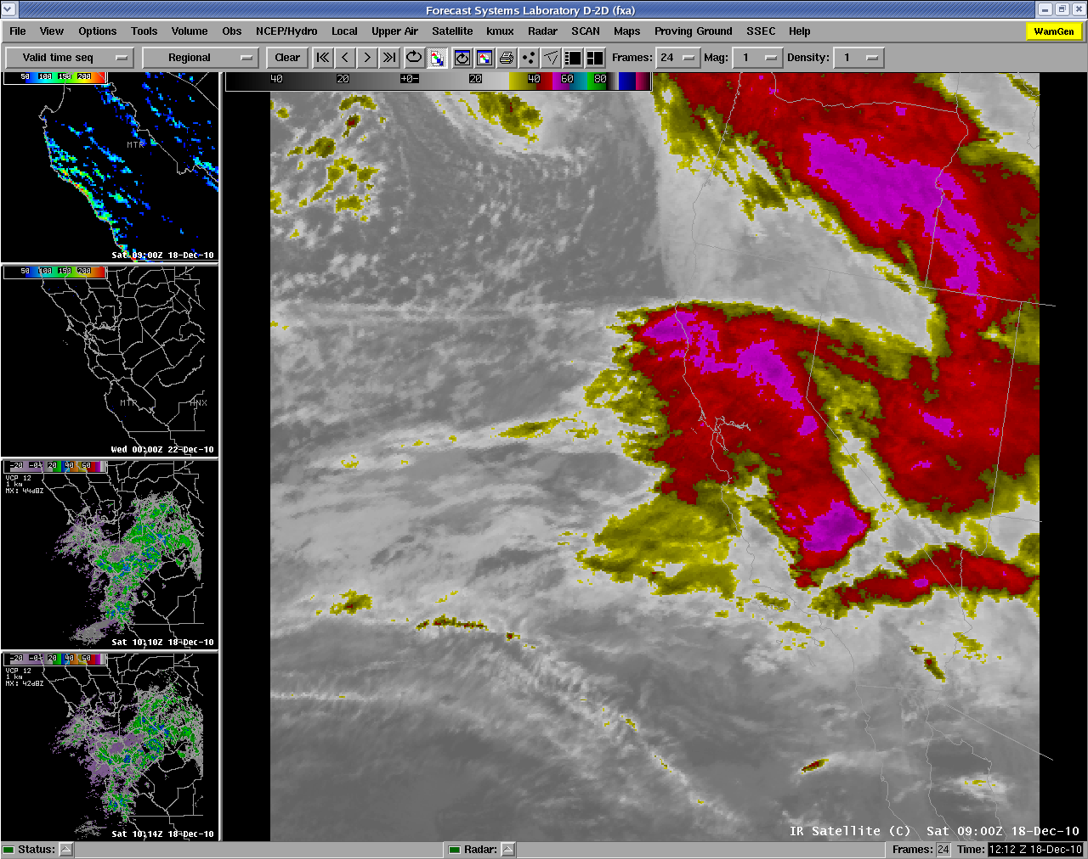
IR imagery on AWIPS for 09z/18 Dec – onset of 1st big precip

Slide 11
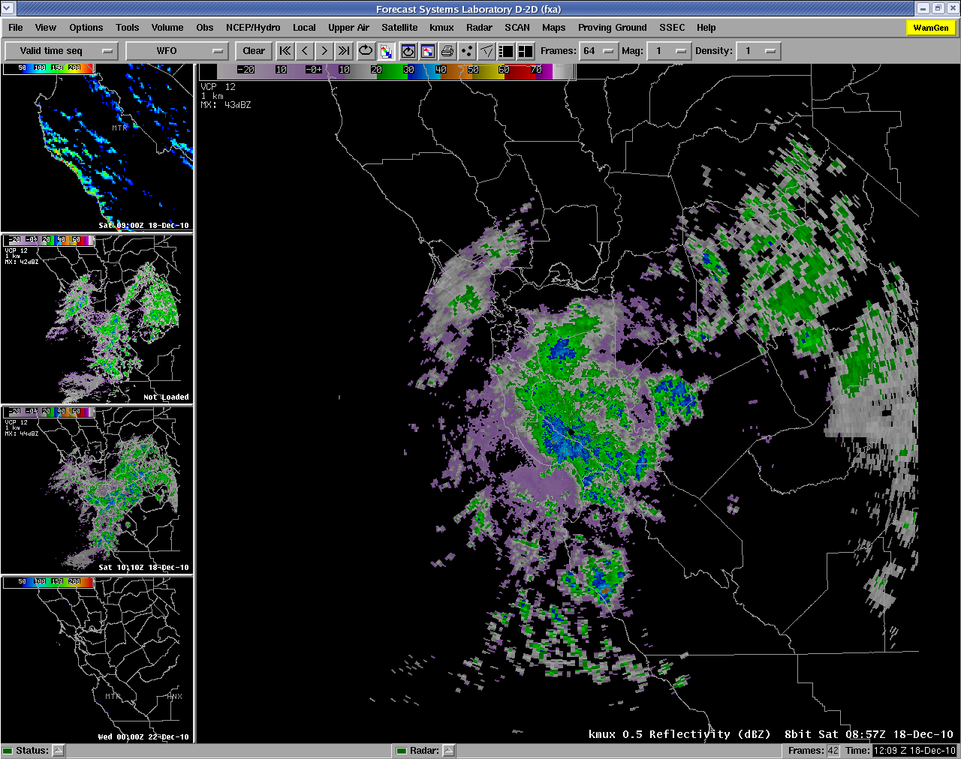
Radar imagery also at 09z/18 Dec from WFO/Monterey

Slide 12
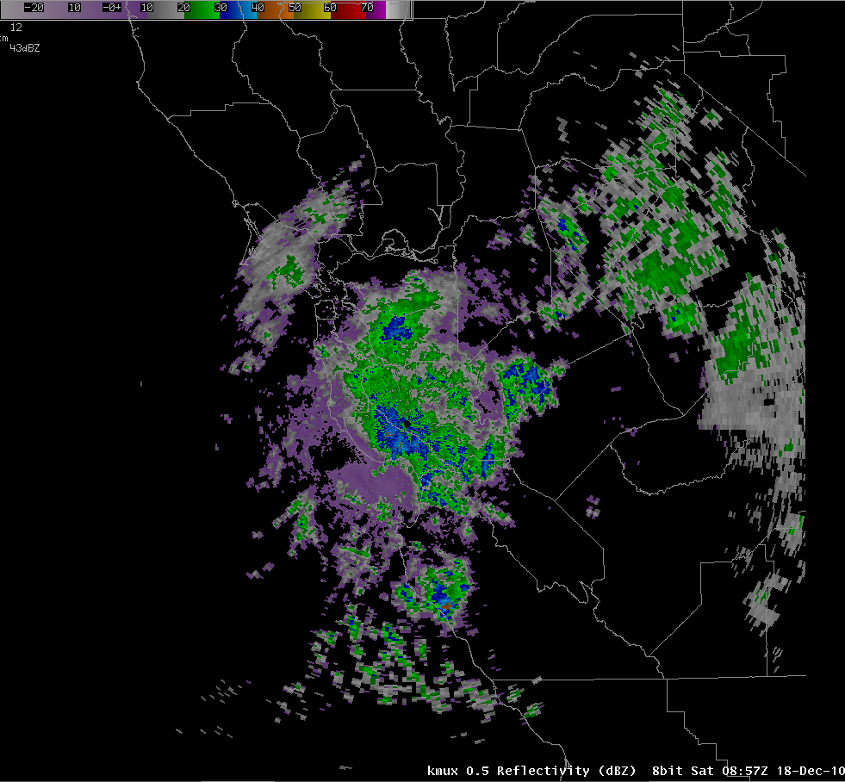
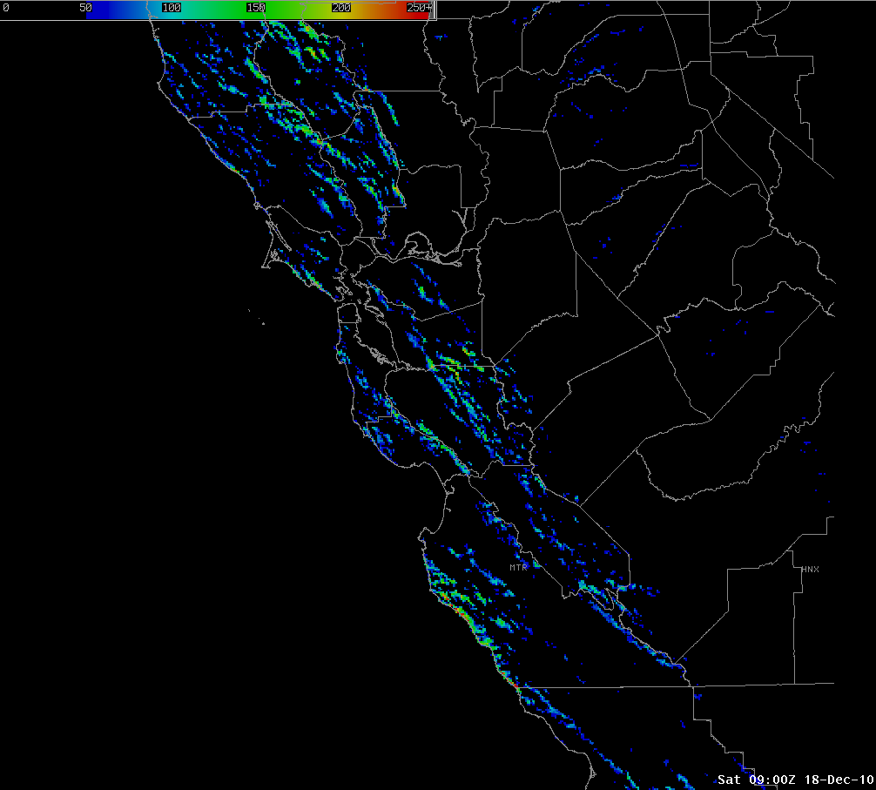
Comparison of radar and ORI imagery for 09z/18 Dec
The ORI imagery has far more detail of course than the radar and highlights the areas where the heaviest orographic-induced precipitation is occurring. Also, areas out of radar range are still covered by the ORI product (for example, in the ovals shown on the imagery).

Slide 13
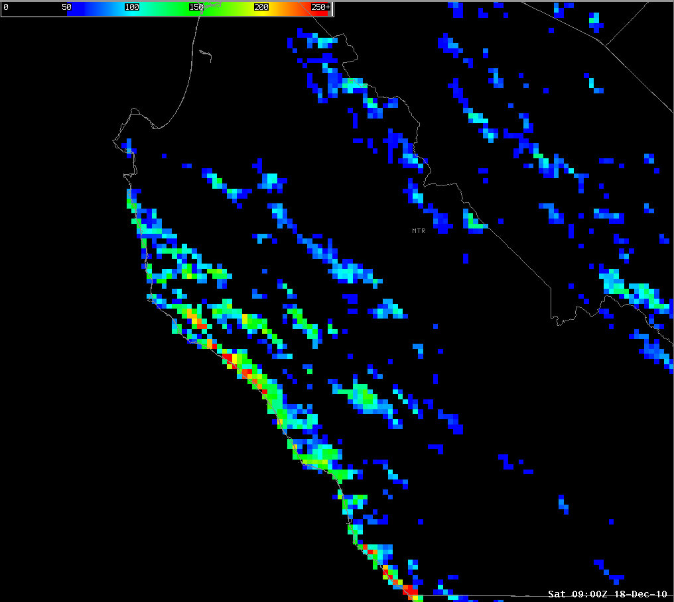
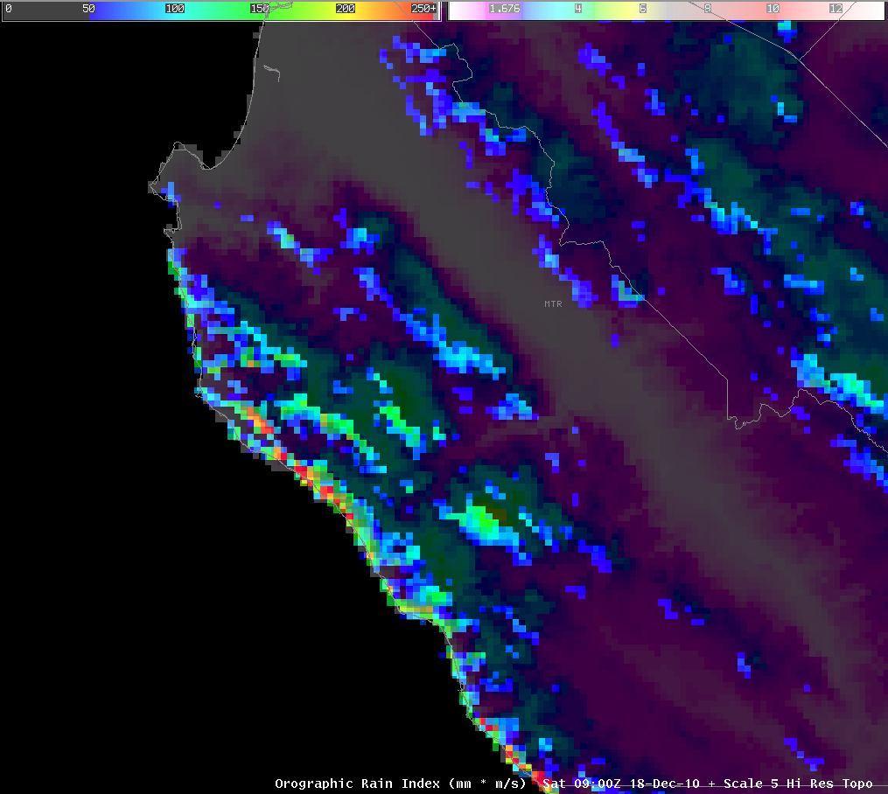
Comparison of zoomed ORI imagery and ORI combined with a topography image, from AWIPS for 09z/18 Dec
This zoomed ORI imagery on the left and then the same image combined with a topographic image on the right further illustrate the detail shown by the ORI product.

Slide 14
The 24-h observed precipitation estimate indicates the sharp increase in precipitation that fell along the coastal mountains (and of course over the inland mountains as well).

Slide 15
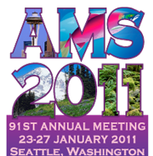
Conference / Meetings
12 Jan 2011: AWIPS II Technical Interchange Meeting (TIM) telecon
13 Jan 2011: NHC Proving Ground Hurricane Experiment 2010 debriefing telecon
AMS 2011: Seventh Annual Symposium on Future Operational Environmental Satellite Systems:
Ed Szoke,R.Brummer, M.DeMaria, H.Gosden, S.Miller, D.Molenar:
An overview of CIRA’s contribution to the GOES-R Proving Ground
Mark DeMaria, J. Knaff, M. Brennan, J. Beven, N. Demetriades, R.DeMaria, A.Schumacher, J. Kaplan: Tropical Cyclone Rapid Intensity Change Forecasting Using Lightning Data during the 2010 GOES-R Proving Ground at the National Hurricane Center
End of Jan 2011: Steve Miller visit to NRL and WFO MTR for technical discussions on Proving Ground and other topics.
March 2011: Paper submission to Interdepartmental Hurricane Conference: Mark DeMaria, J. Knaff, M. Brennan, J. Beven: 2010 NHC Proving Ground Hurricane Experiment.
Notes:
15
15

