Slide 1


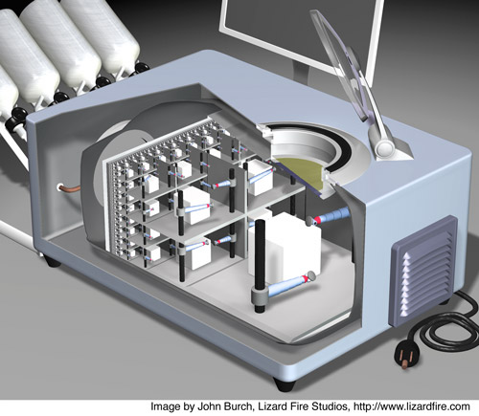
Self Replicating Mechanical Systems MAS.S62 FAB² ^{3.6.12}
0] Complexity Per Cost
1] Exponential Manufacturing
2] Swarm Robotics
3] Reconfigurable Robotics
4] Self Replicating Systems

Slide 2

Cost Per Resolution Element
The Case for Printed Electronics
…Can we use this map as a guide towards future directions in fabrication?

Slide 3
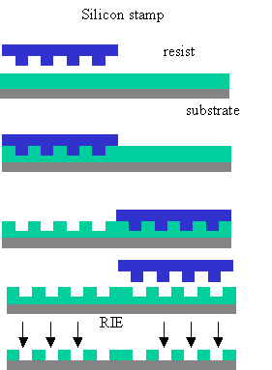
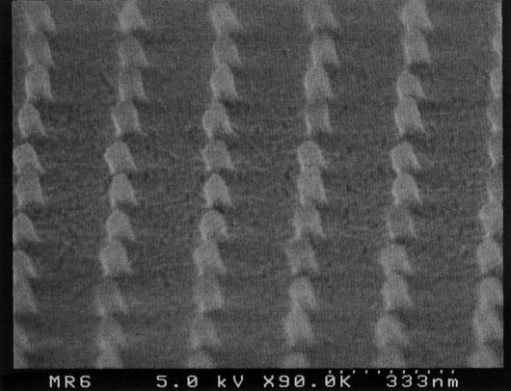
Imprint Lithography
Stephen Chou (Michigan/Princeton) et. al.

Slide 4
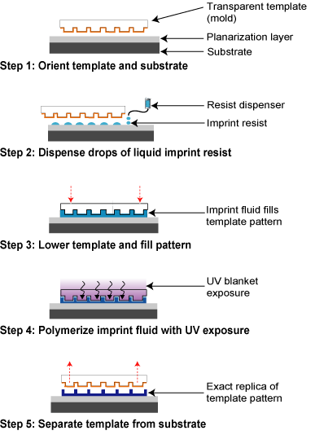
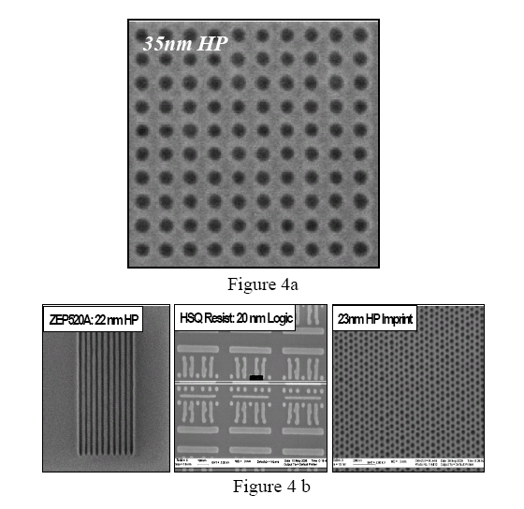
Step & Flash Lithography
http://www.molecularimprints.com/Technology/technology2.html

Slide 5
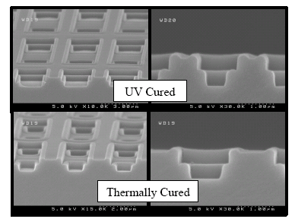
MultiLayer Step and Flash Lithography
Emerging Lithographic Technologies X, edited by Michael J. Lercel,
Proc. of SPIE Vol. 6151, 61510J, (2006) · 0277-786X/06/$15 · doi: 10.1117/12.655604
Proc. of SPIE Vol. 6151 61510J-1

Slide 6
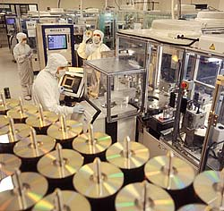
DVD6 Disk Replication
3 second replication time.
~ 3 cents per disk
20 GB Data
Pit Size: 0.25 um
www.panasonic.com

Slide 7
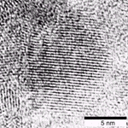
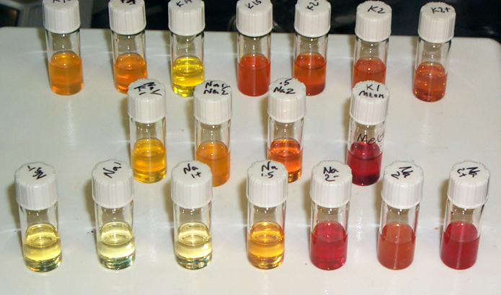

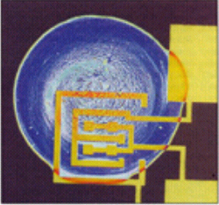
NanoTectonics
All-Printed All-Inorganic Transistors Solution Based Inorganic Semiconductor Chemistry
Ridley et al., Science, 286, 746 (1999)
Science 297,416 (2000)
Molecular Machines (Jacobson) Group - MIT
www.media.mit.edu/molecular

Slide 8
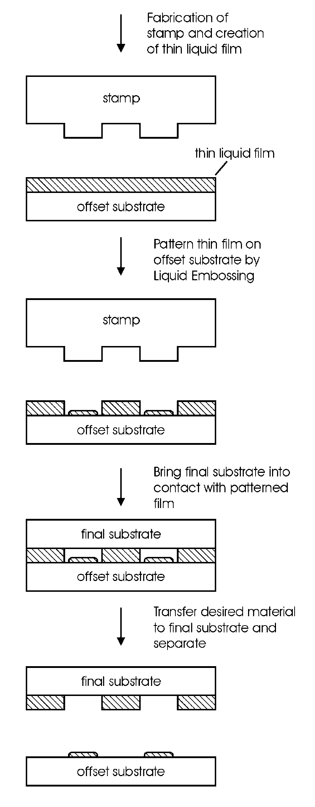
Department of
Mechanical Engineering
Offset Liquid Embossing (OLE)

Slide 9
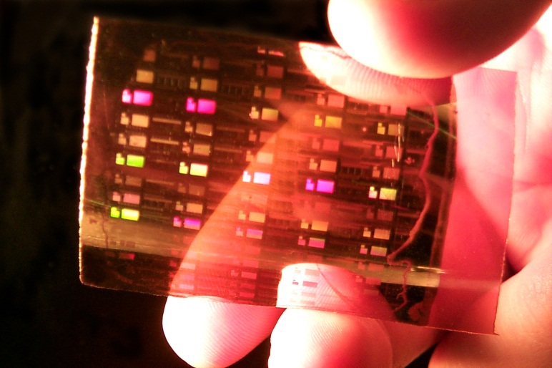
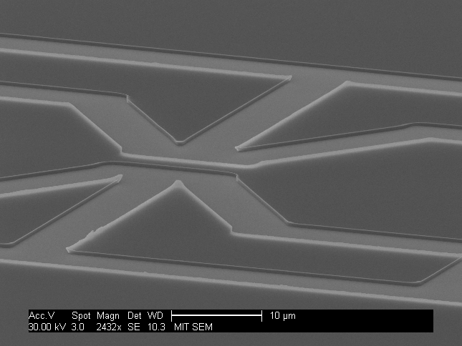
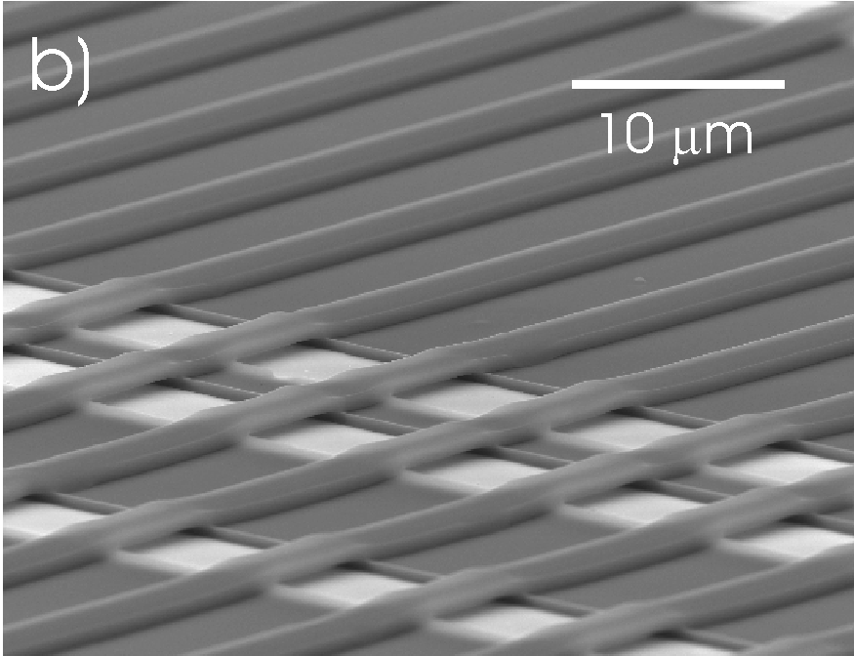
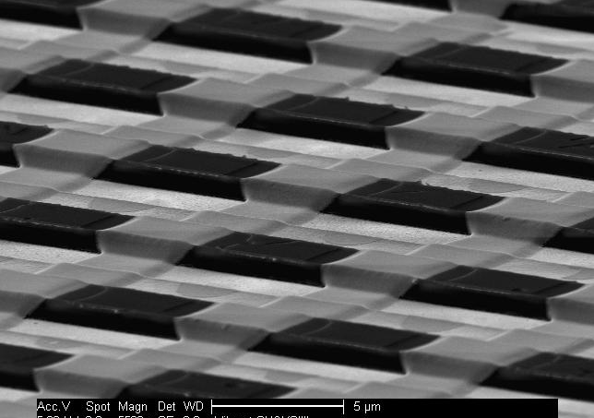
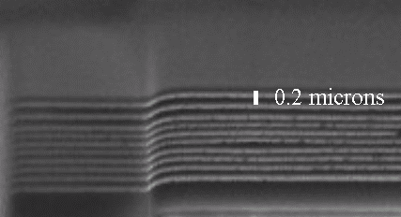
Department of
Mechanical Engineering
NANOTECTONICS
All Printed-All Inorganic Logic Elements
Multilayer Liquid Assembly
Bulthaup et. Al. APL 79(10): 1525 (2001)
Molecular Machines (Jacobson) Group

Slide 10
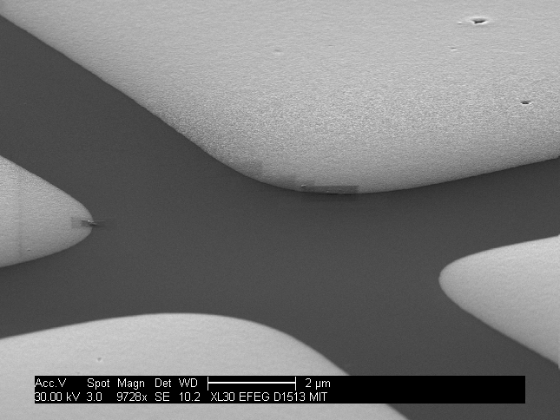
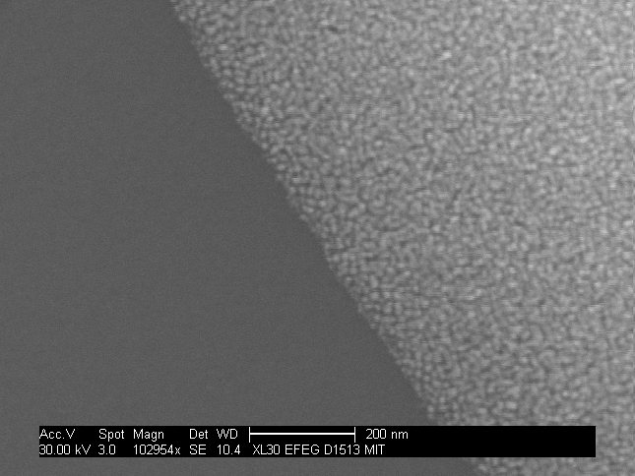
Offset Liquid Embossed Gold
2 μm
200 nm

Slide 11
Exponential Replication Stamp and Shrink
MIT
MIT
MIT
MIT
MIT
Stretched
Elastomeric
Sheet
MIT
MIT
MIT
MIT
MIT
MIT
MIT
MIT
MIT
MIT

Slide 12
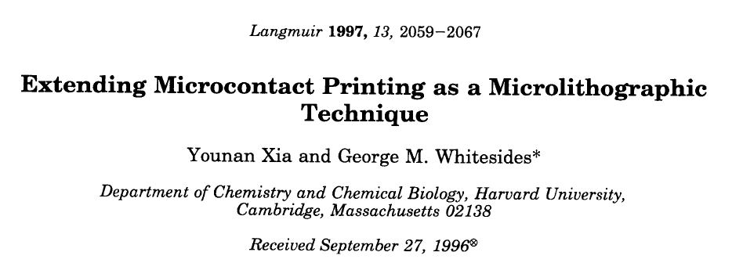
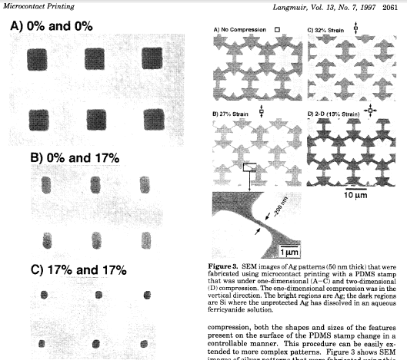
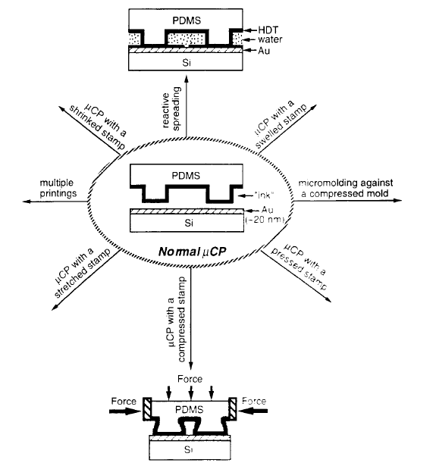
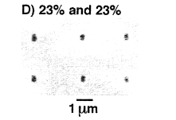

Slide 13
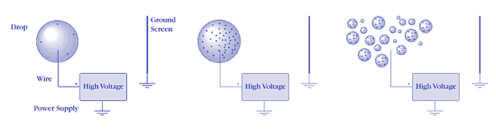
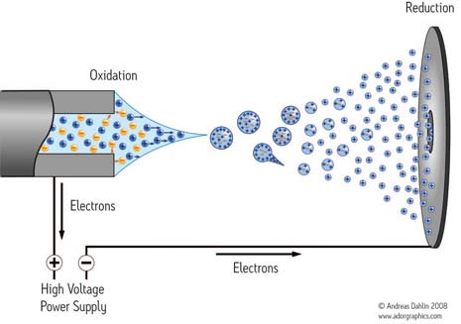
Electrospray
http://www.newobjective.com/electrospray/
http://www.waters.com/waters/nav.htm?cid=10073251&locale=en_US

Slide 14
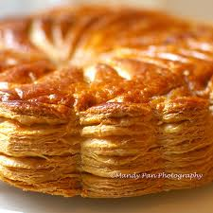
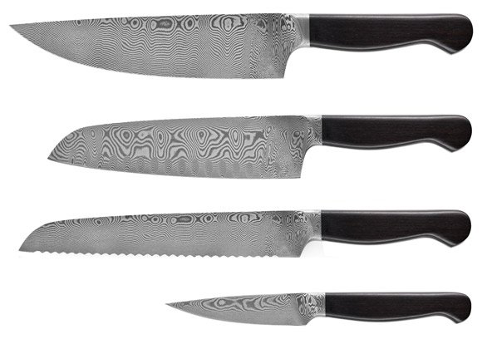
Geometric Scaling Manufacturing
Puff Pastry
Damascus Steel
J.A. Henckels
http://www.youtube.com/watch?v=x9sE0cisM58

Slide 15
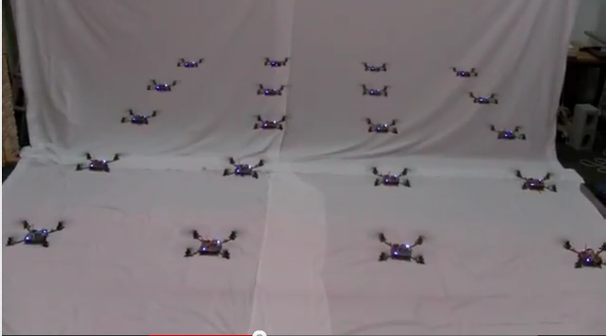
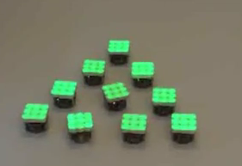
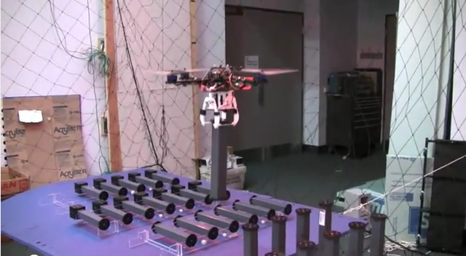
Swarm Robotics
Quadcoptor
http://www.youtube.com/watch?v=YQIMGV5vtd4
http://www.youtube.com/watch?v=lZgRfXXeDwM
http://www.youtube.com/watch?v=W18Z3UnnS_0

Slide 16
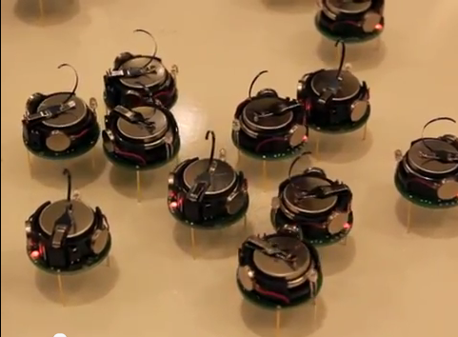
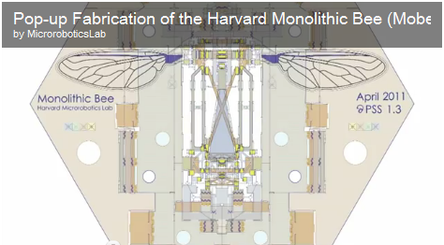
Building Swarms
Kilobot
http://www.youtube.com/watch?v=qBUFX41e1mc
Harvard – Mobee
Pop-up Fabrication
http://micro.seas.harvard.edu/

Slide 17
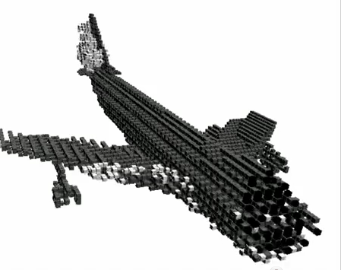
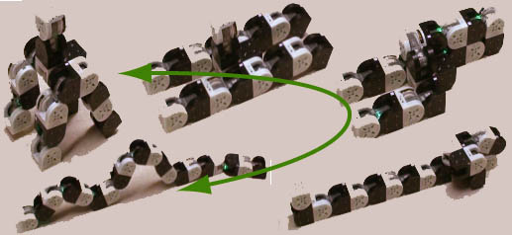
Reconfigurable Robotics
Reconfigurable Snake robot-MTRAN
http://www.youtube.com/watch?v=4oSavAHf0dg&NR=1
http://www.youtube.com/watch?v=gq3rkMHCwnE
http://www.youtube.com/watch?v=rTcp2UkgvSk

Slide 18
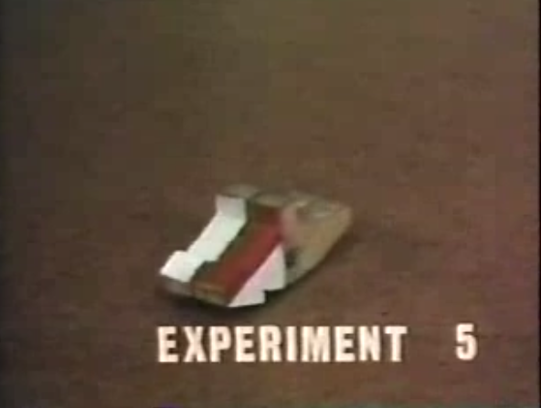
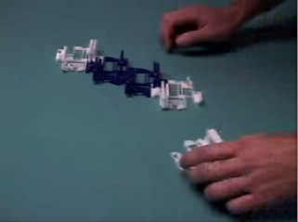
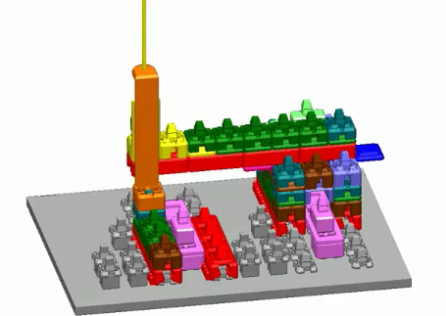
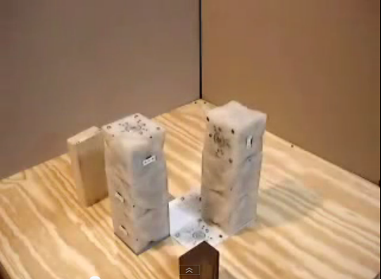
Self Replicating Systems
Penrose
Griffith
Lipson
http://www.youtube.com/watch?v=7rwXiVb2QEk
http://www.youtube.com/watch?v=LumLzSQE5Vw

Slide 19
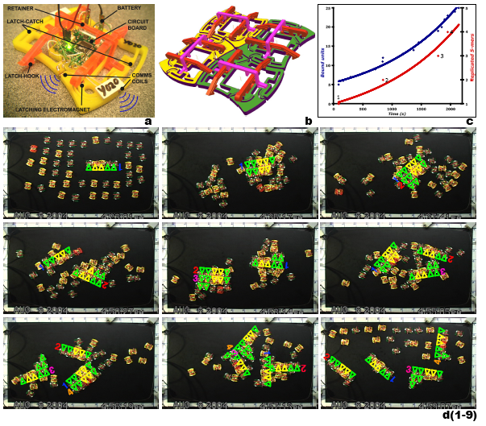
Stochastic Self Replicating Systems
St
Saul Griffith, Dan Goldwater,
JosephM. Jacobson NATURE|Vol 437|29 September 2005

Slide 20
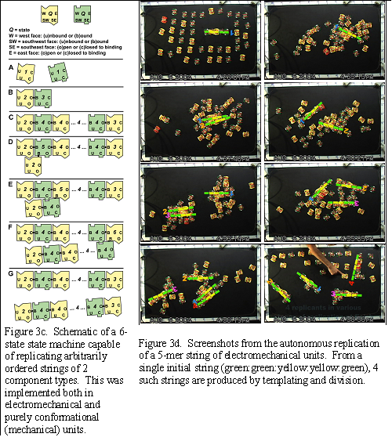
Saul Griffith, Dan Goldwater,
JosephM. Jacobson NATURE|Vol 437|29 September 2005

Slide 21
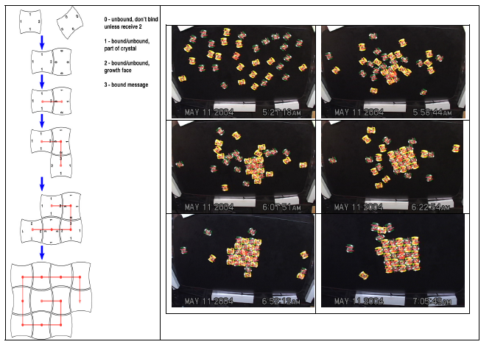
Saul Griffith, Dan Goldwater,
JosephM. Jacobson NATURE|Vol 437|29 September 2005

Slide 22
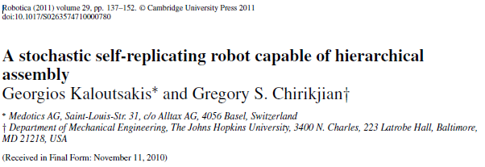
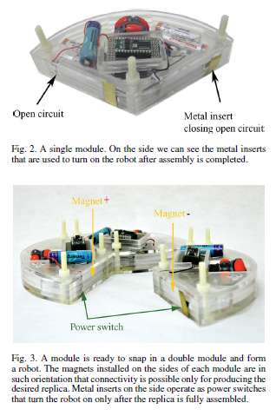
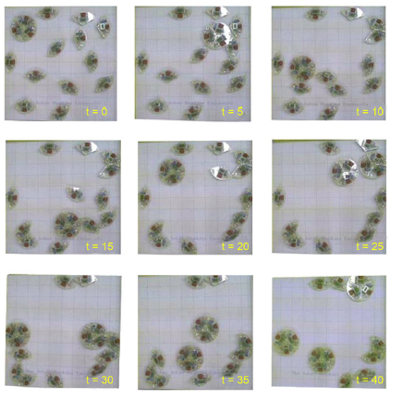
See also: Evolvable physical Self replicators
http://www.mitpressjournals.org/doi/pdf/10.1162/artl_a_00056

Slide 23
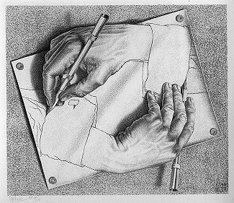
BEGINNING
http://en.wikipedia.org/wiki/File:DrawingHands.jpg

