Slide 1

Tracing Data Errors Using View-Conditioned Causality
Alexandra Meliou*
with Wolfgang Gatterbauer*, Suman Nath§, and Dan Suciu*
*University of Washington, §Microsoft Research

Slide 2

General Problem Setting
Data
Transformations
Outputs
…
…
If one or more of the outputs are deemed erroneous, can we find the tuples in the base data responsible for that error?
Correcting those can fix even more potential errors in the output.
Provenance helps narrow down the candidate tuples in the input data. The challenge is to identify the input tuples that can best explain the observed errors.

Slide 3

Focus: Context Aware Recommendations
Data
Transformations
Outputs
Is Walking?
Periodicity
true
Accelerometer
HasSignal?
Is Driving?
false
GPS
Speed
Cell Tower
Rate of Change
Alone?
Avg. Strength
true
Audio
Light
Zero crossing rate
Is Indoor?
false
Spectral roll-off
Avg. Intensity
Is Meeting?
false
sensor data
What caused these errors?
0.016 | True | 0.067 | 0 | 0.4 | 0.004 | 0.86 | 0.036 | 10
0.0009 | False | 0 | 0 | 0.2 | 0.0039 | 0.81 | 0.034 | 68
0.005 | True | 0.19 | 0 | 0.03 | 0.003 | 0.75 | 0.033 | 17
0.0008 | True | 0.003 | 0 | 0.1 | 0.003 | 0.8 | 0.038 | 18
Sensors may be faulty or inhibited
It is not straightforward to spot such errors in the provenance

Slide 4
Contributions
Introduce view-conditioned causality and responsibility for tracing errors in views and transformations to source data
The presence of errors is often obvious in the transformations but not the source data (post-factum cleaning)
Non-trivial reduction of causality and responsibility computation to a satisfiability problem
An optimized conversion algorithm that reduces the SAT problem size
Illustration of effectiveness in a real-world classifier-based recommendation system using mobile sensor data
High average precision, and almost 90% correction ratio in some cases

Slide 5

Running Example
Input variables can be from a continuous or discrete domain
Example:
Input
Results in output
error
But what if we know that the first classifier should evaluate to true, and the second to false?
Ground truth:
Notes:
Z_1=\tt{true}\\
Z_2=\tt{true}

Slide 6
View-Conditioned Causality
Refer to the paper for the formal definitions
A set of input variables is a counterfactual cause, if changing their values results in the correct output for all transformations, and the set is minimal.
Example:
Evaluate to:
Ground truth:
Counterfactual causes:
Change:
Gives output:
changing values
ground
truth
Notes:
Z_1 &=& (X_1<5)\wedge(X_3=4)\vee \neg X_2\\
Z_2 &=& (X_1>2)\wedge(X_3\geq 4)

Slide 7
View-Conditioned Causality
Refer to the paper for the formal definitions
A variable is a cause if it is a part of a counterfactual cause
If is a counterfactual cause, is a contingency for
Responsibility:
The smaller the contingency set, the higher the responsibility
Example:
Evaluate to:
Ground truth:
Counterfactual causes:
Change:
Responsibility:
causes

Slide 8
Our Approach to Post-Factum Cleaning
Compute all causes and rank them by their responsibility.
Use the ranking as an indicator for error tracing
But: Computing responsibility is hard for general Boolean formulas [Eiter et al. 2002], and even for conjunctive queries [PVLDB 2010]
Transform causality into a satisfiability problem and use highly optimized SAT solvers, which are very efficient in practice
We explain how we do this in 4 main steps

Slide 9
Reduction to SAT
Map continuous input to Boolean partition variables
When the intervals are non-overlapping, we can easily model their correlation with a constraint
Example (cont.):
Non-overlapping intervals for
At least one is true + No two are true together
= exactly one is true
Example (cont.):
Notes:
\Phi_1:Z_1 &=& (X_1<5)\wedge(X_3=4)\vee \neg X_2\\
&=& (X_{[1,1]}\vee X_{[1,2]}\vee X_{[1,3]})\wedge X_{[3,2]}\vee X_2\\
\Phi_2:Z_2 &=& (X_1>2)\wedge(X_3\geq 4)\\
&=& (X_{[1,3]}\vee X_{[1,4]}\vee X_{[1,5]})\wedge (X_{[3,2]}\vee X_{[3,3]})

Slide 10
Reduction to SAT
Running Example:
Input values:
a. Construct a Boolean formula whose satisfying assignments produce the correct output
b. Construct a Boolean formula whose satisfying assignments satisfy , and also change the value of
Ground truth:
Example (cont.):
All satisfying assignments of cause each to evaluate to its ground truth
(hard constraint)
Example (cont.):
is a cause iff the following formula is satisfiable:
Current assignment of
Negate current assignment of

Slide 11
Computing Responsibility with MaxSAT
Running Example:
Input values:
Construct “soft” constraints to find minimum contingency set
Ground truth:
(soft constraint)
Example (cont.):
A partial MaxSAT solver tries to satisfy as many conjuncts of the soft constraint as possible, and thus produces an assignment as similar to the given one as possible
Minimum contingency

Slide 12
Experimental Setup
Three individuals using our context-aware recommendation system on their mobile devices over a period of 3 weeks
Dataset:
800 different instances of user activity
150 total hours of data during the 3 weeks
The users recorded erroneous outputs, as well as whether sensors happened to be inhibited
SAT reduction implemented in Java, output exported in standard DIMACS CNF and WCFN formats
MiniSat (http://minisat.se/) and MiniMaxSat ([Heras et al. 2008]) solvers

Slide 13
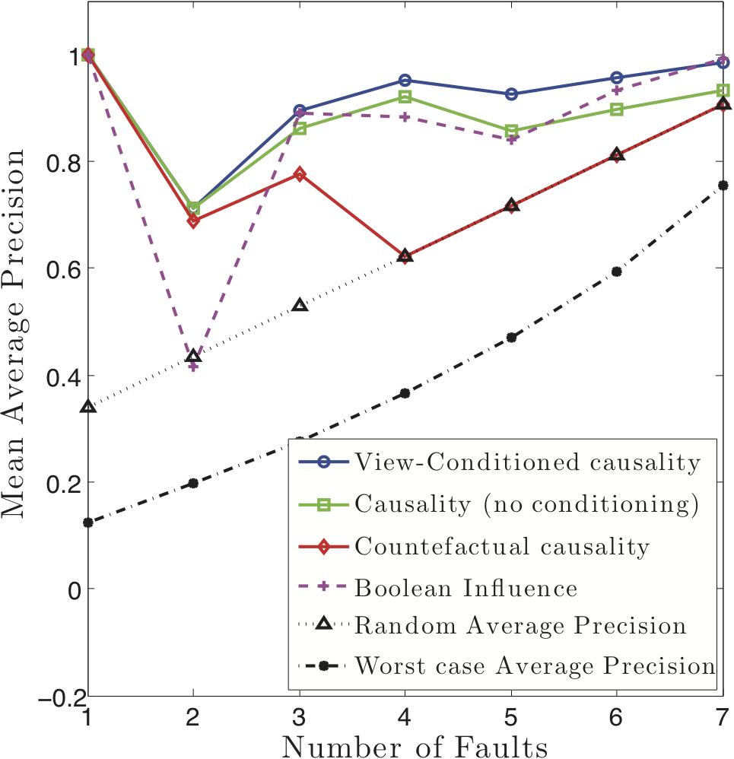
Average Precision
View-Conditioned causality produces more accurate error rankings than other approaches
800 different instances
5 sensory inputs
8 extracted features (variables)
3 users
Average precision is a metric of quality of a ranking.
If all erroneous variables are ranked first, then average precision is 1.
In the presence of many errors the avg precision of all rankings increases
Simpler causality schemes
Static analysis of lineage

Slide 14
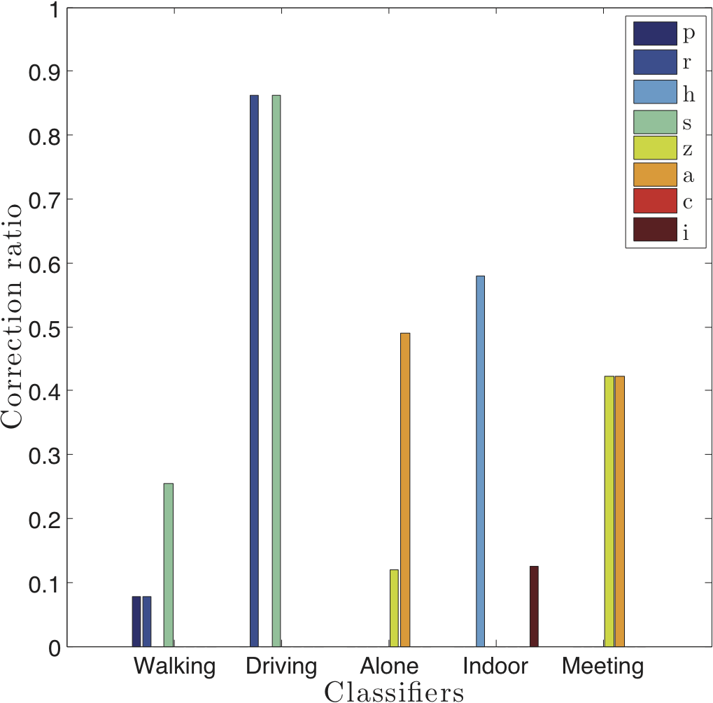
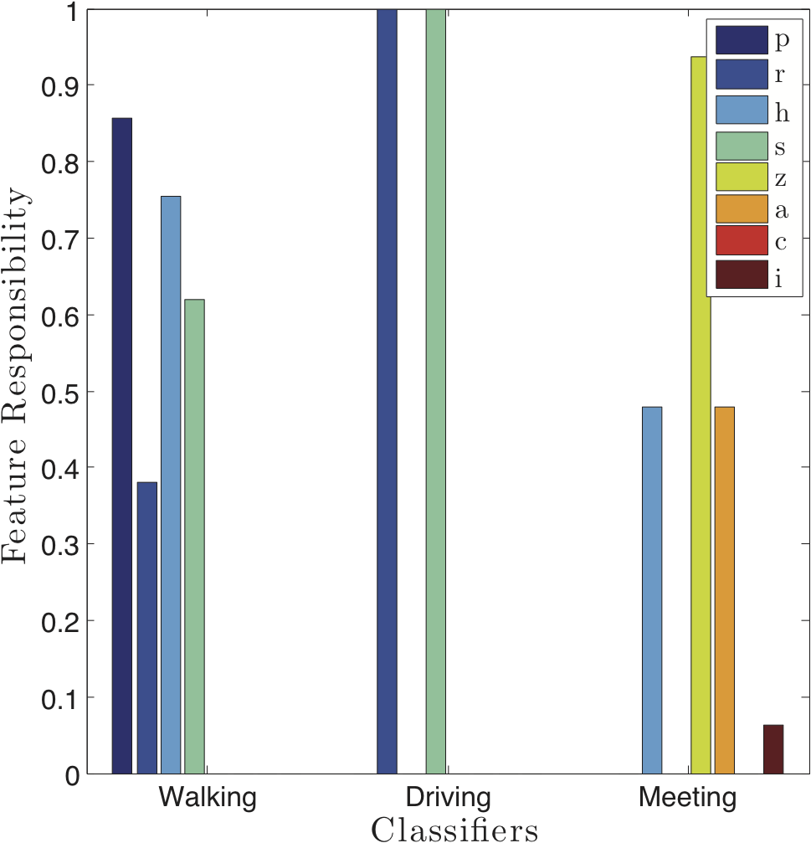
Corrections
We select the highest responsibility variable, remove it from the evaluation of all classifiers, and record the portion of errors that get corrected per classifier
Driving has reliable features (low responsibility), means they are almost never causes of error
Walking has no reliable features
Avg responsibility per variable, per classifier
variables
almost 90% correction ratio for “driving”!
high resp.
But we can only fix few “walking” errors (?)
reason
responsibility=0

Slide 15

Conclusions
Defined view-conditioned causality (VCC) and demonstrated its effectiveness in post-factum cleaning
Results show that VCC successfully identifies causes of error
Described a non-trivial reduction to a satisfiability problem
Also in the paper
Optimization of formula size (we achieve orders of magnitude improvement)
Scalability experiments
Questions?

Slide 16
Additional Graphs

Slide 17
Improving the CNF Size
Naïve construction
Optimized construction

Slide 18
SAT Solver Runtime

