Slide 1
Strategies for Transitioning into Entrepreneurship
Fuqua Career Management Center
May 17, 2012
Lisa Schwartz Insert Name
Insert Name Insert Name

Slide 2
Agenda
Introduction
[insert item]
[insert item]
Questions & Answers

Slide 3
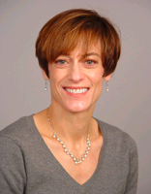
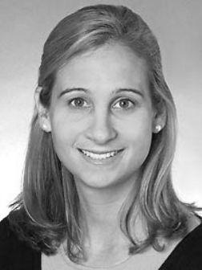
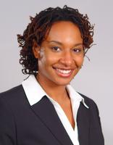

Facilitators:
Lisa Schwartz
Sr. Career Consultant
Stephanie Nelson
Senior Director of Recruiting & Marketing
Meara Kirsch
Meara Kirsch
Jodi Smith
Performance Mgmt Analyst
Meara Kirsch
Human Resources Professional

Slide 4
Questions and Answers
Lisa Schwartz
Sr. Career Consultant
Stephanie Nelson
Senior Director of Recruiting & Marketing
Jodi Smith
Performance Mgmt Analyst
Meara Kirsch
Human Resources Professional

Slide 5








Online and Print Resources
http://www.careerleader.com/alumni/fuqua.html

Slide 6
Thank You!
Questions or Concerns?
Please email: alumni-careers@fuqua.duke.edu

