Slide 1
Time Management: Getting the right work done first
Alumni Centra Session
Thursday, September 30, 2010
Lisa Schwartz
and
Guest Speaker Catherine McCarthy

Slide 2

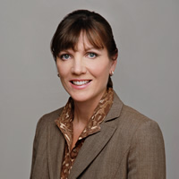
A Better Way of Working
Catherine McCarthy
Chief Operating Officer
The Energy Project

Slide 3


Slide 4


Slide 5


Slide 6
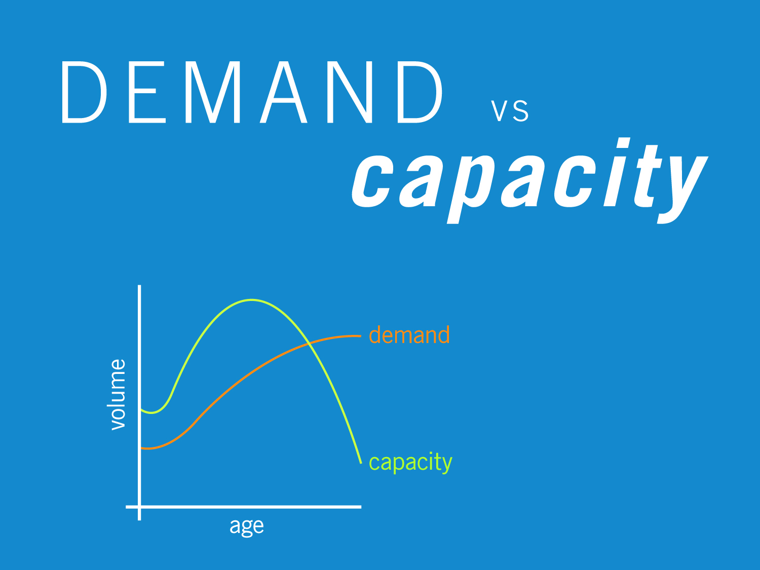

Slide 7
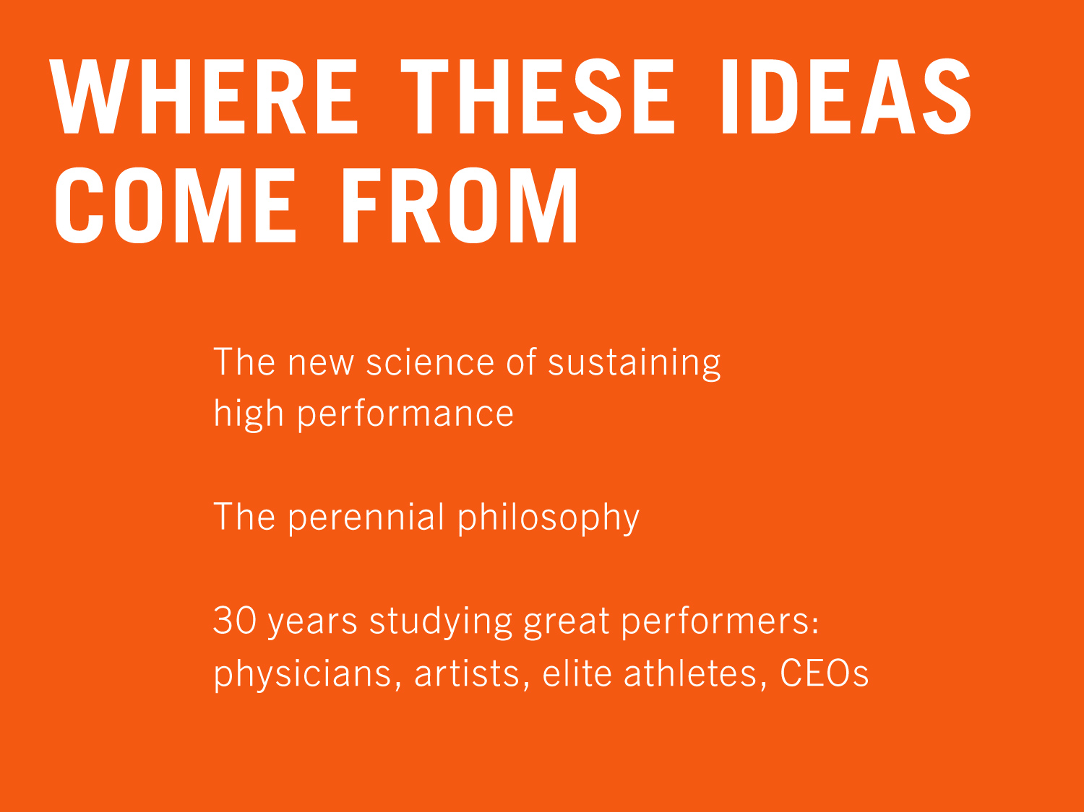

Slide 8
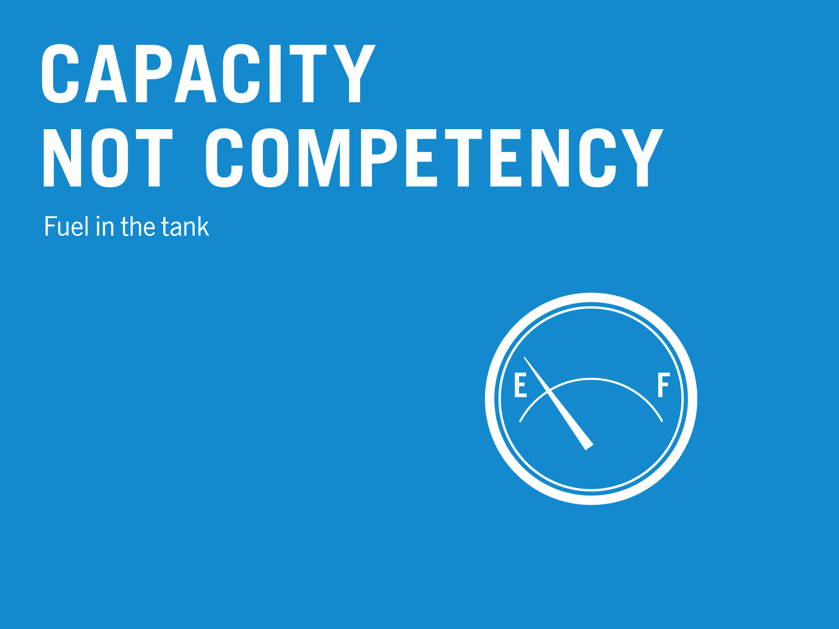

Slide 9
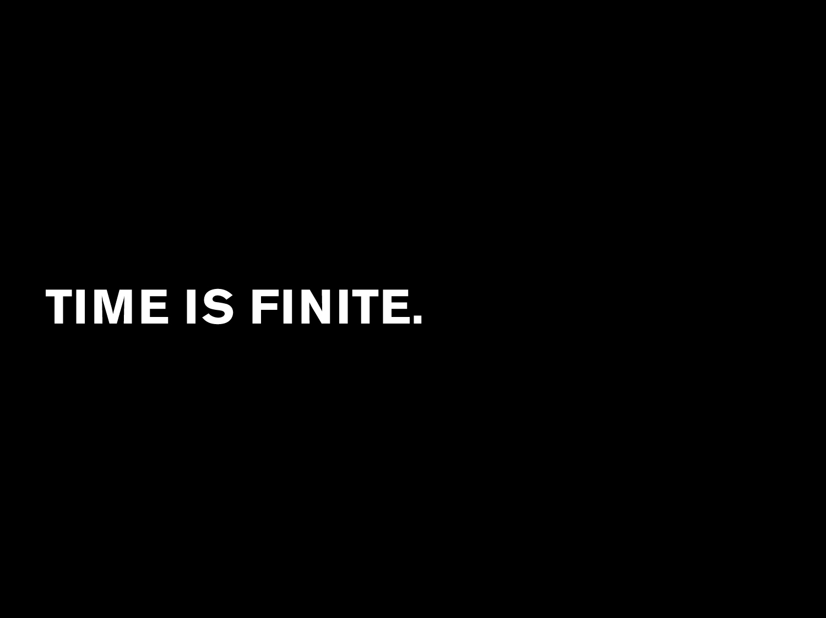

Slide 10


Slide 11


Slide 12


Slide 13


Slide 14


Slide 15


Slide 16


Slide 17


Slide 18
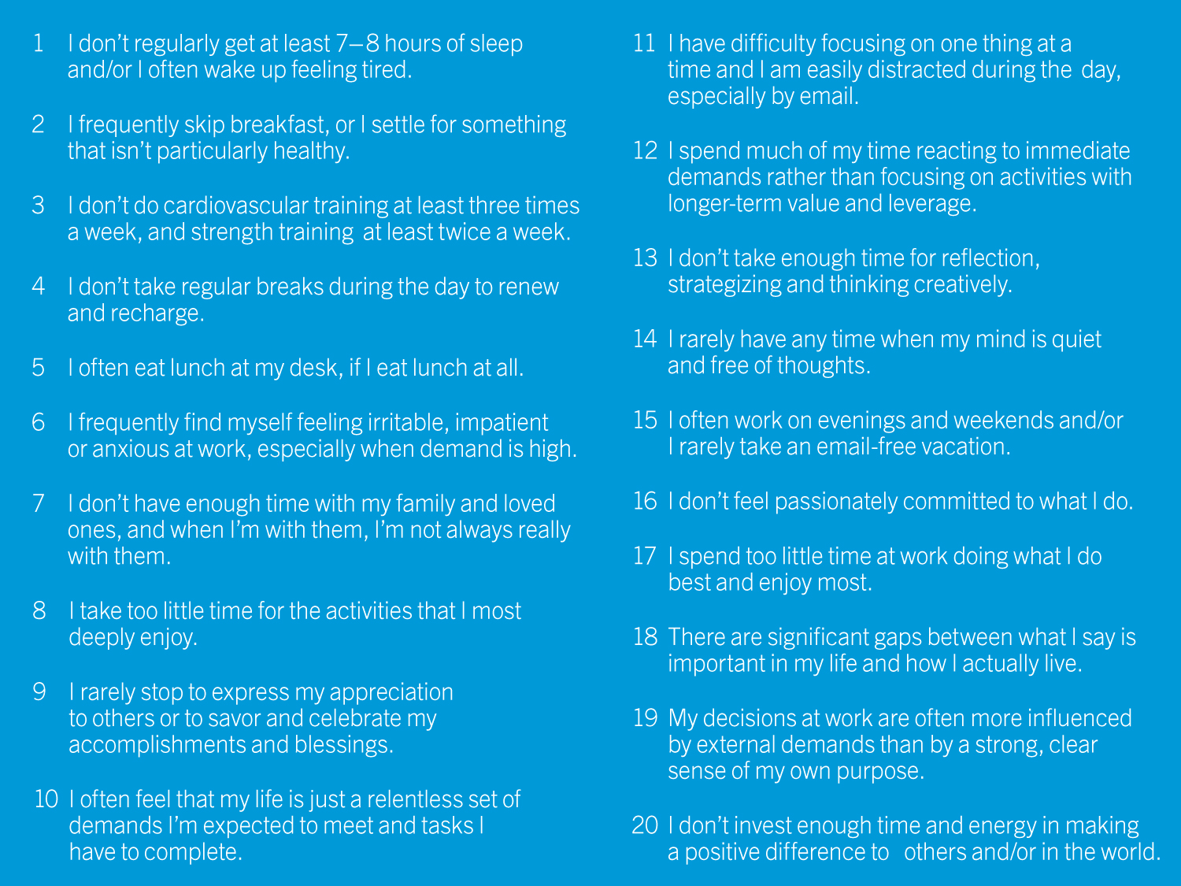

Slide 19


Slide 20
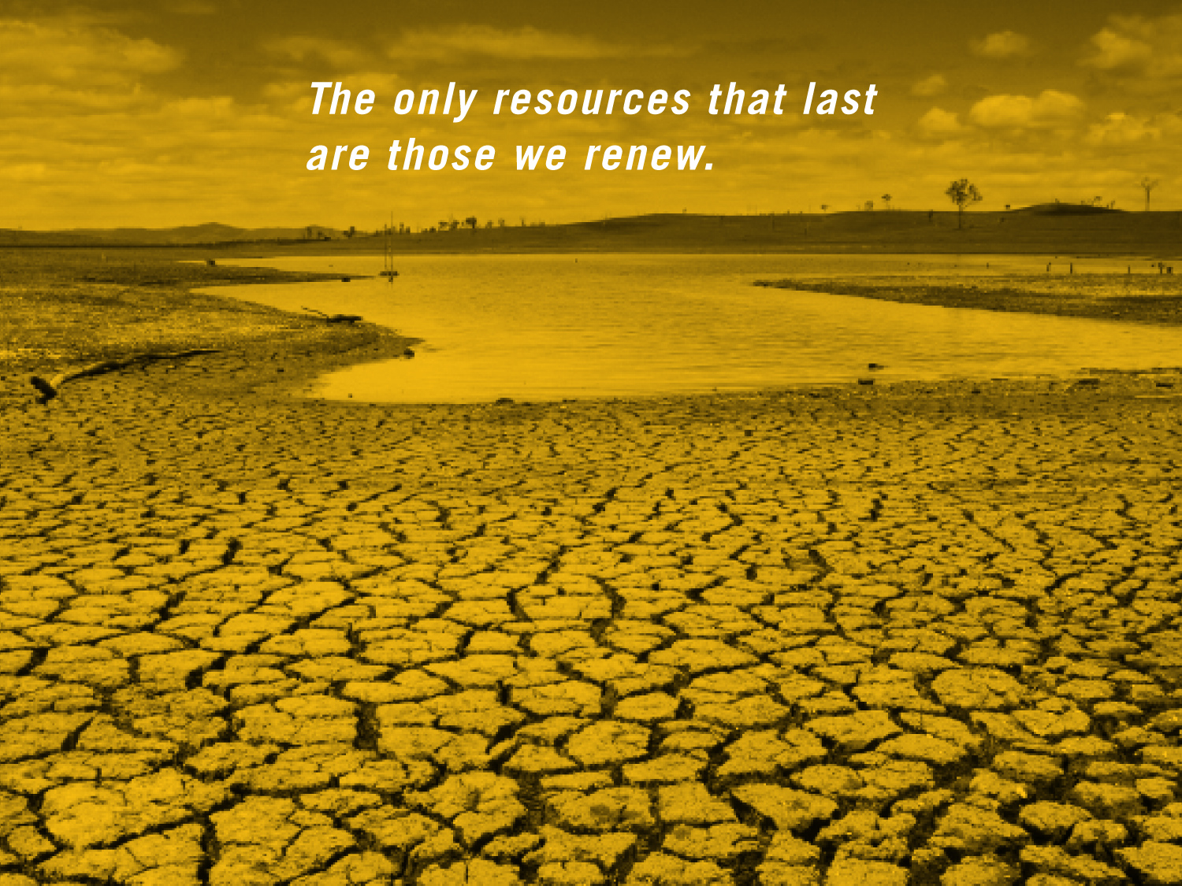

Slide 21


Slide 22


Slide 23
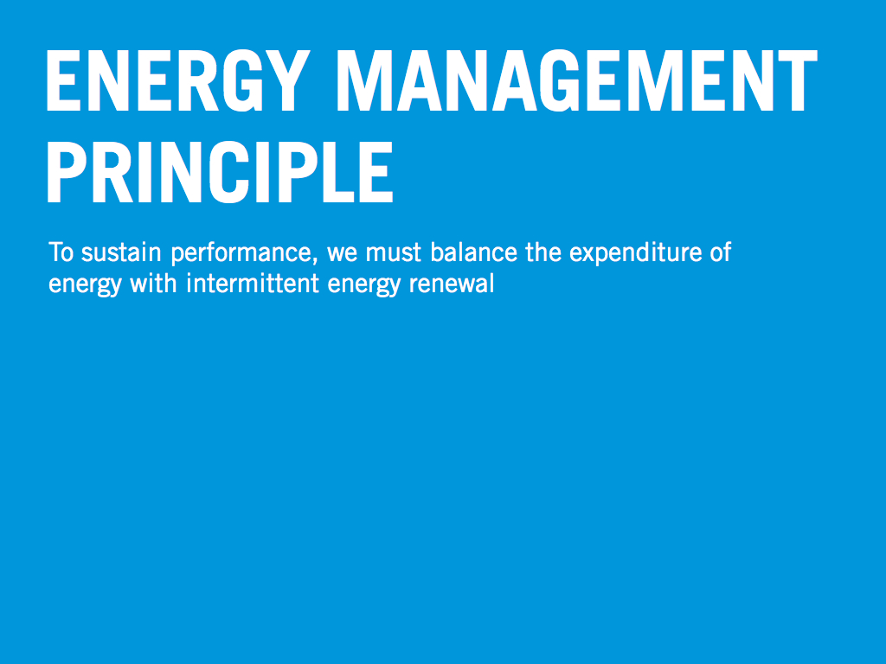

Slide 24
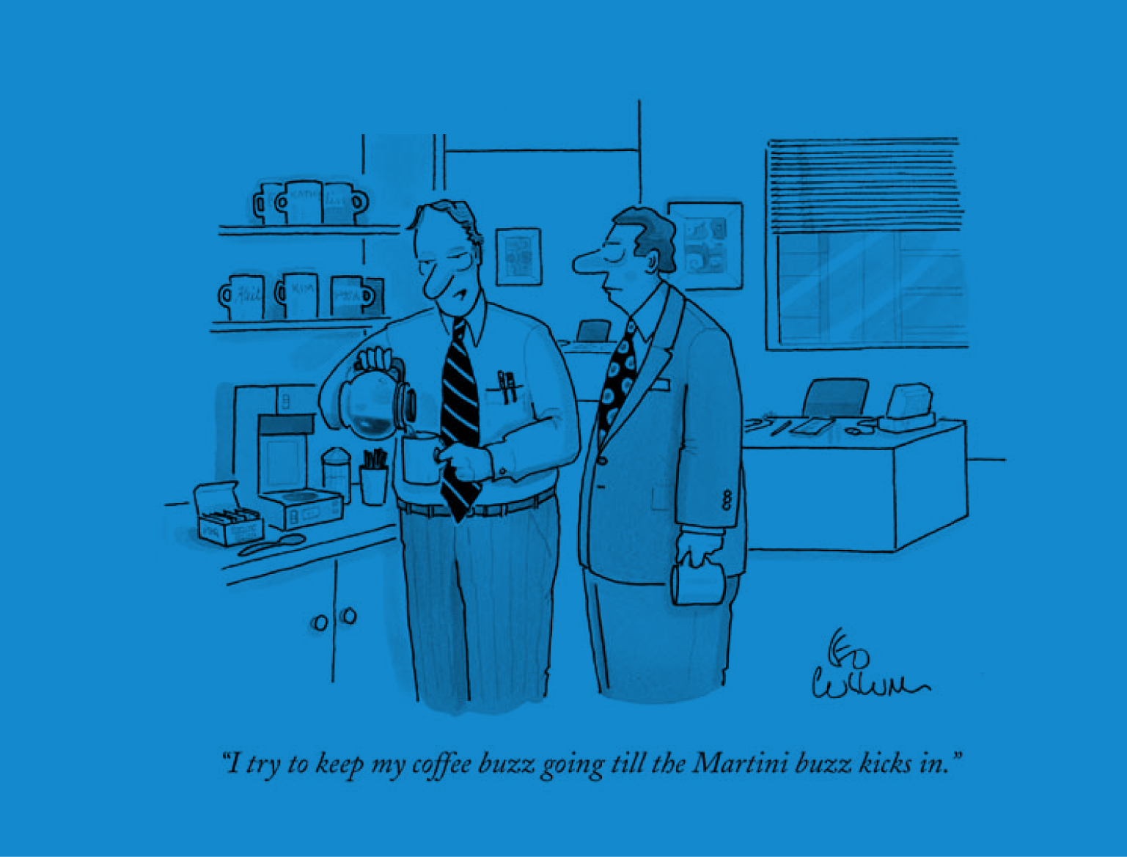

Slide 25


Slide 26


Slide 27


Slide 28


Slide 29

T
E
N
T
P
S
V
E
I
I
G
A
I
V
E
O

Slide 30
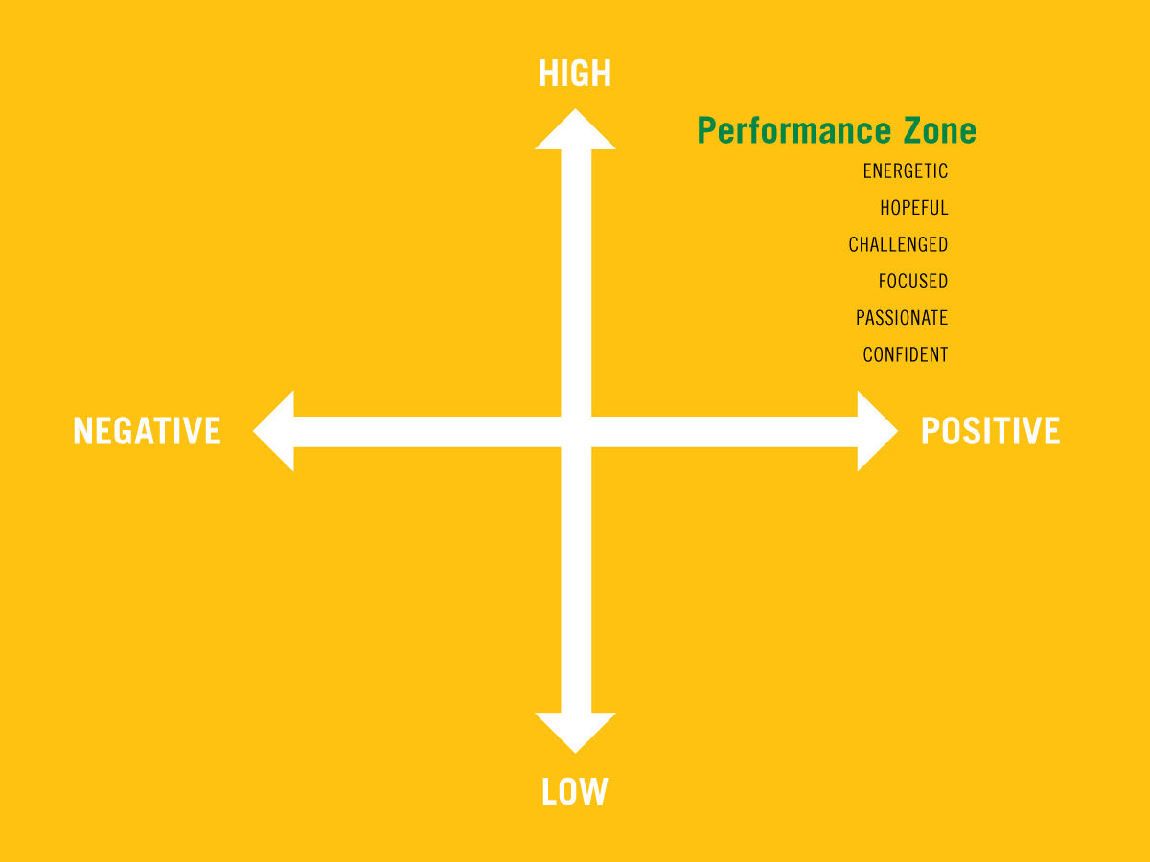

Slide 31


Slide 32
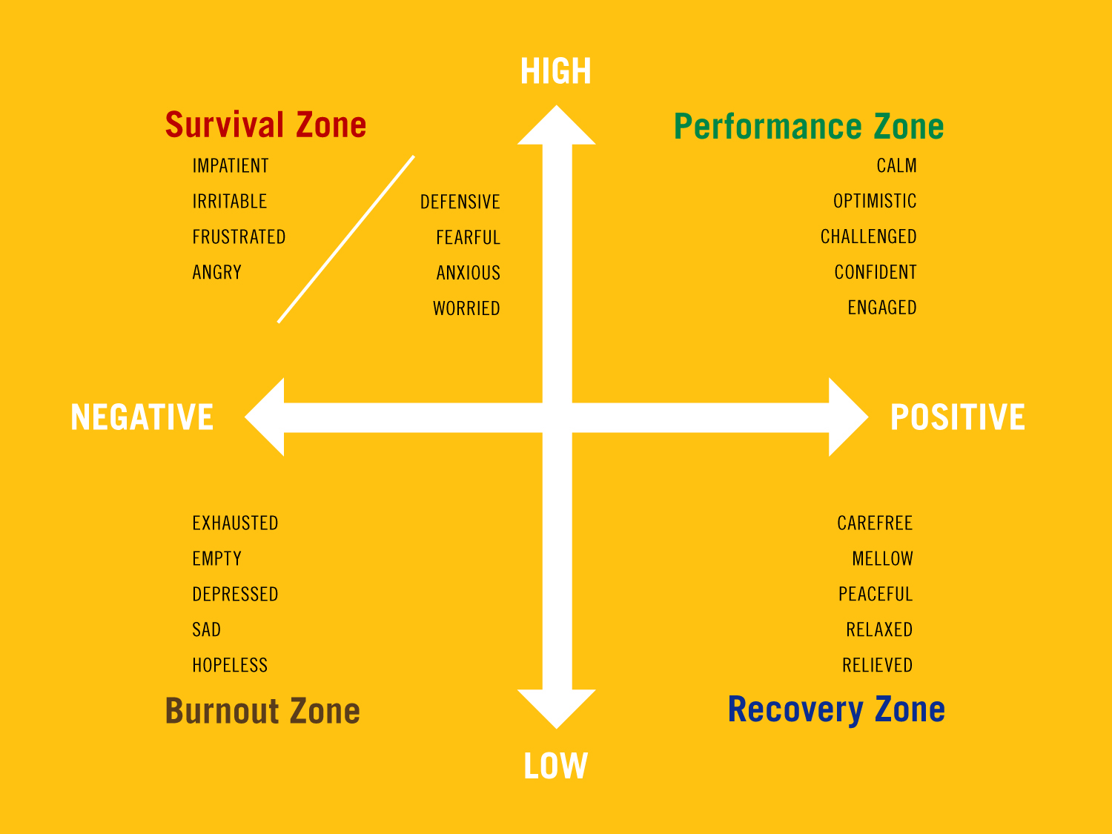

Slide 35
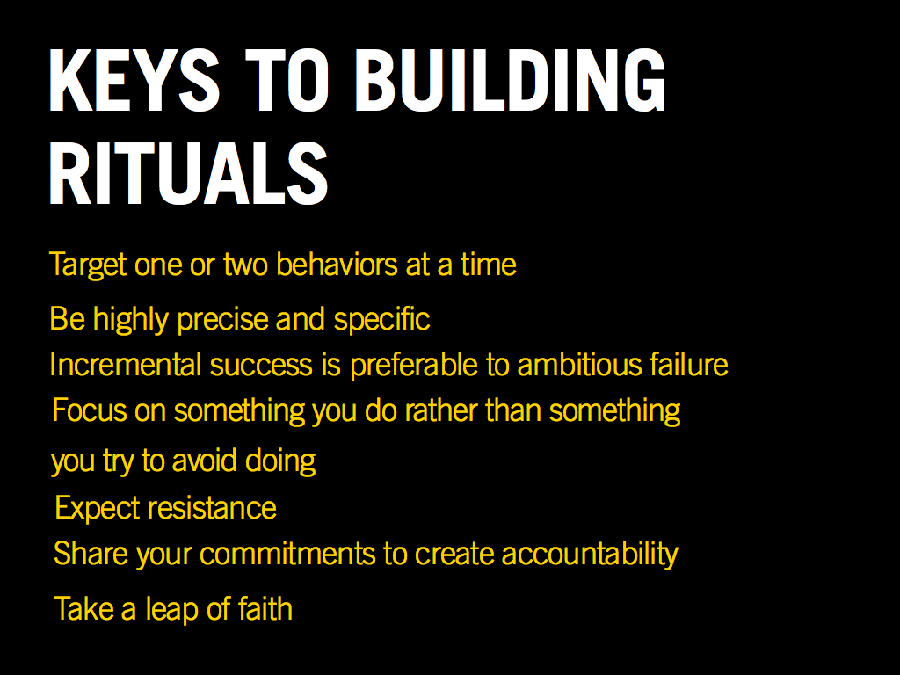

Slide 36


Slide 37


Slide 38
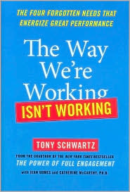
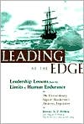
Leading at the Edge: Leadership Lessons from the Extraordinary Saga of Shackleton's Antarctic Expedition by Dennis N. T. Perkins, Margaret P. Holtman (With), Catherine McCarthy

Slide 39


