Slide 1


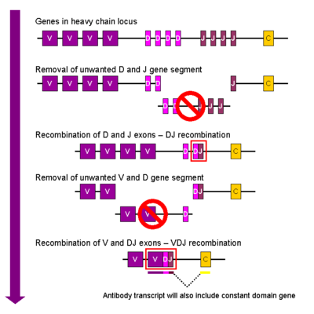
Self Evolving Systems MAS.S62 FAB² ^{5.1.12}
1] Immune System
2] Cell Based Systems
3] Self Evolving hardware
4] Genetic Algorithms

Slide 2
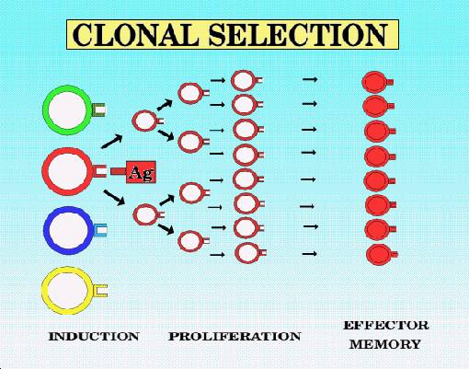
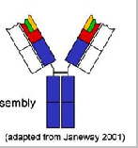
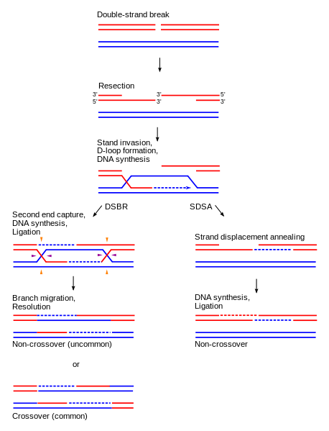
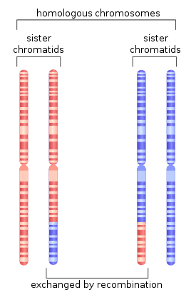
Key Elements of Evolution:
Diversity Library Generation - > Selection -> Amplification
3×10¹¹ combinations
http://pediaview.com/openpedia/Homologous_recombination
http://laikaspoetnik.wordpress.com/2008/12/
http://en.wikipedia.org/wiki/V(D)J_recombination

Slide 3

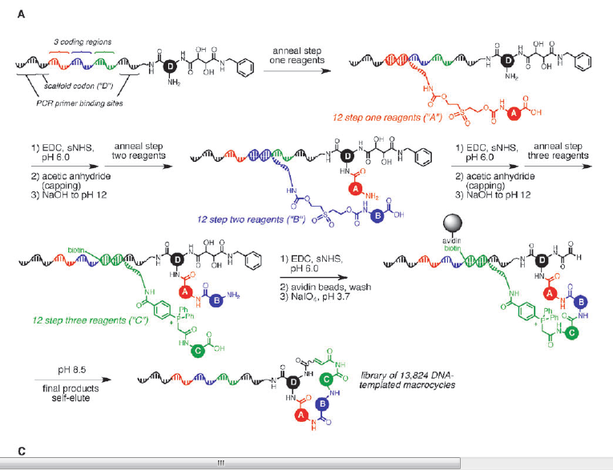

Slide 4
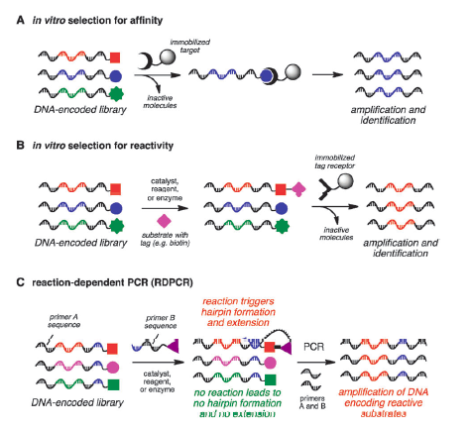
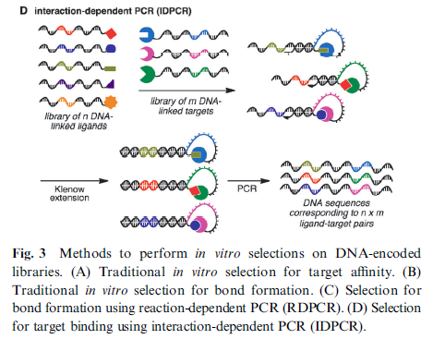

Slide 5
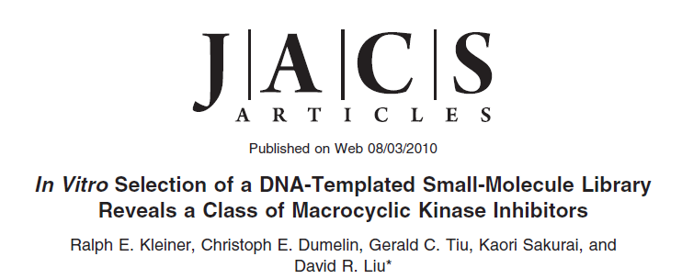
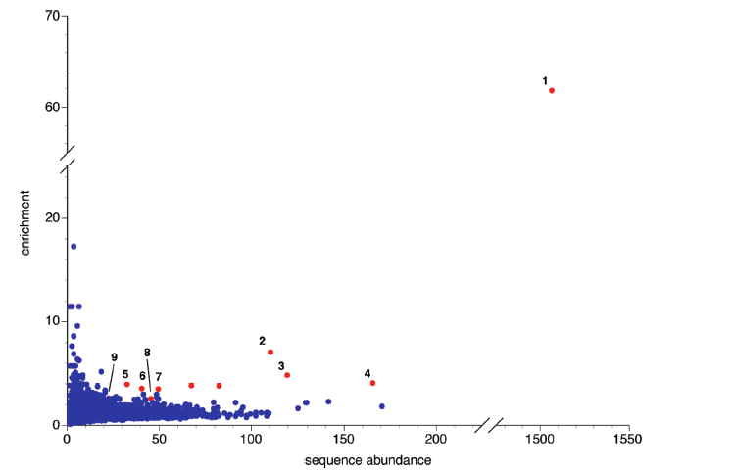
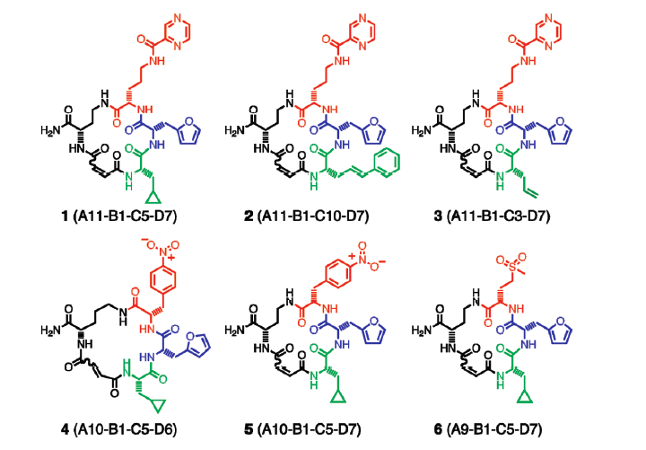

Slide 6
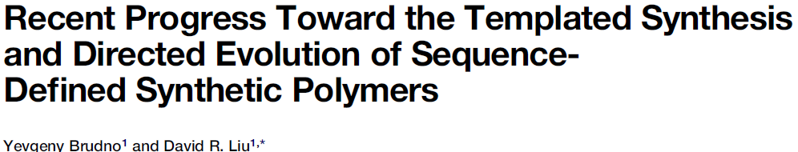
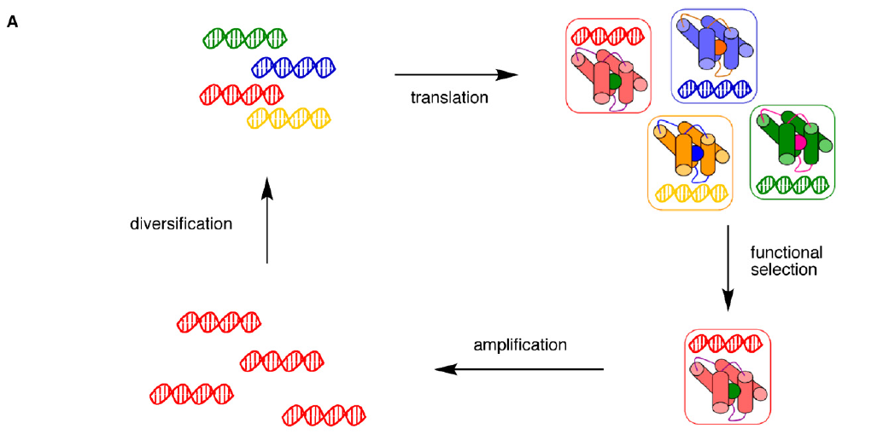
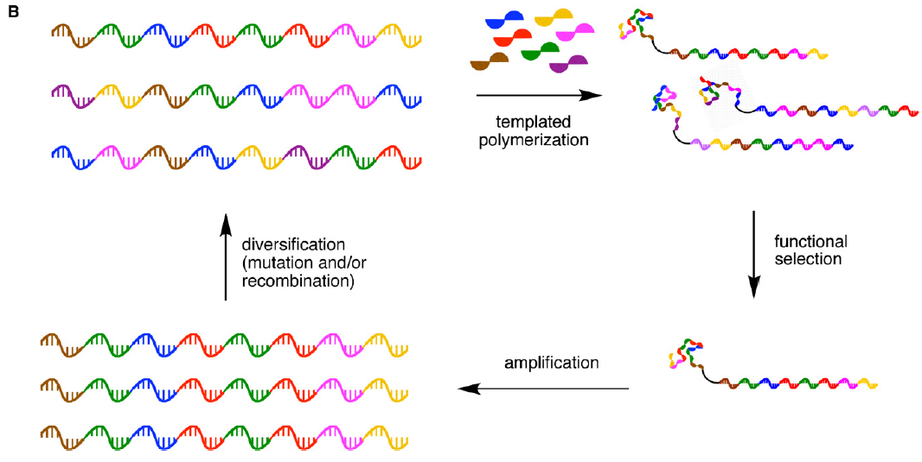
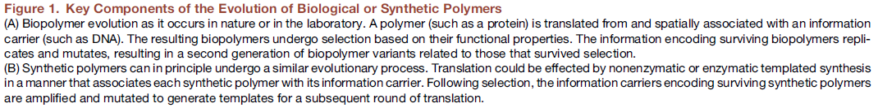

Slide 7
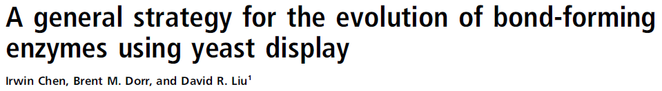
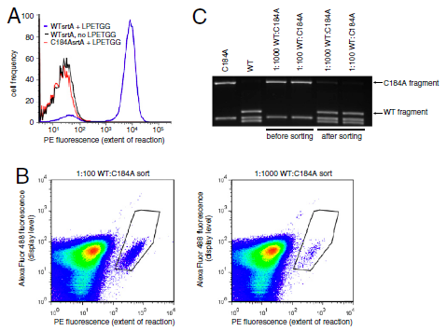
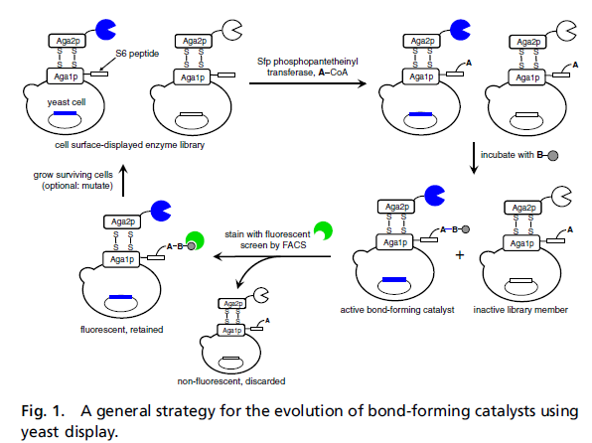
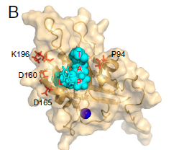
8 Rounds of Selection - > 140X increase in Sortase A mediated LPETG Coupling Efficiency

Slide 8
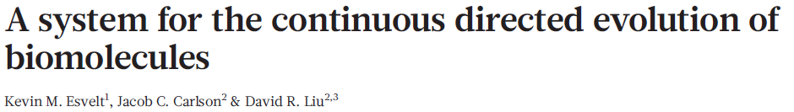
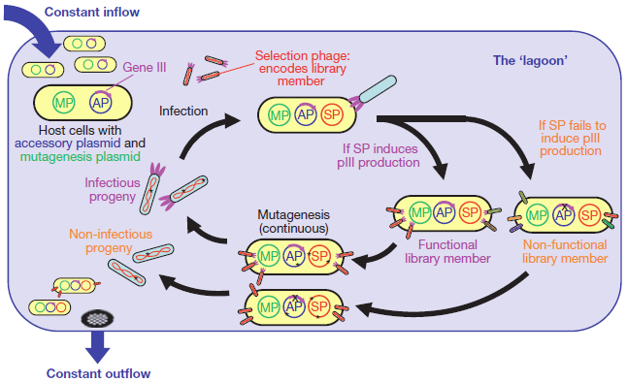
200 rounds of protein evolution over 8 days

Slide 9
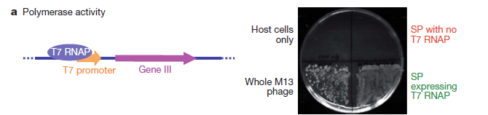
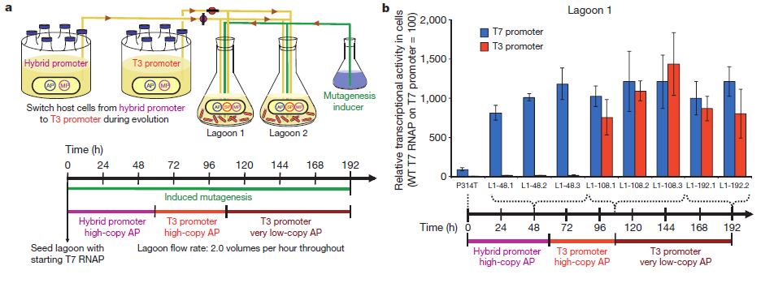
T7 RNAP is highly specific for its promoter sequence
(TAATACGACTCACTATA), and exhibits virtually no detectable
activity on the consensus promoter of the related bacteriophage T3
(AATTAACCCTCACTAAA, differences underlined)21,22

Slide 10
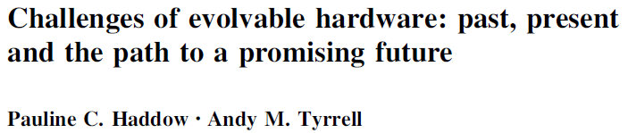
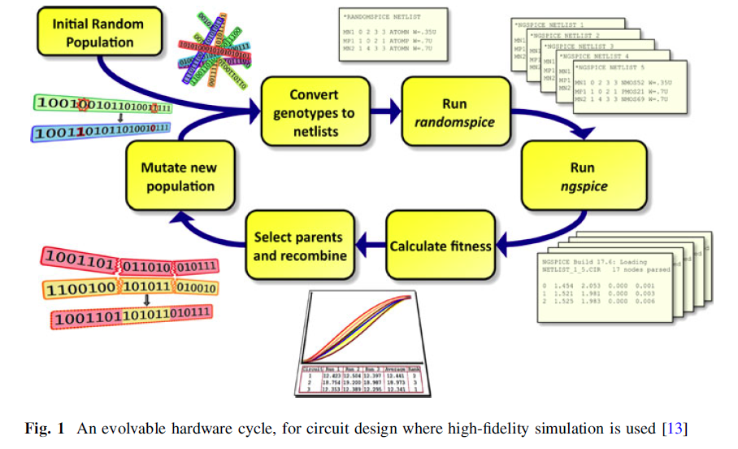

Slide 11
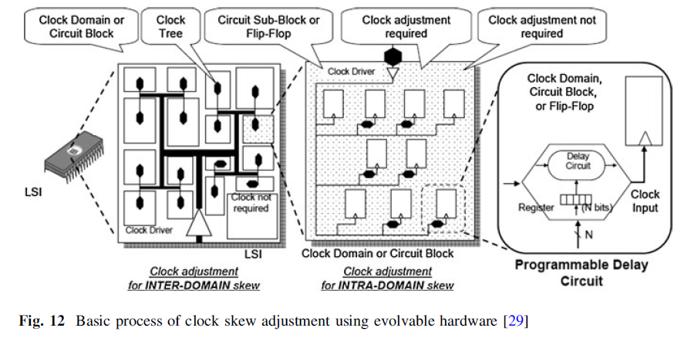
Clock Skew Correction

Slide 12
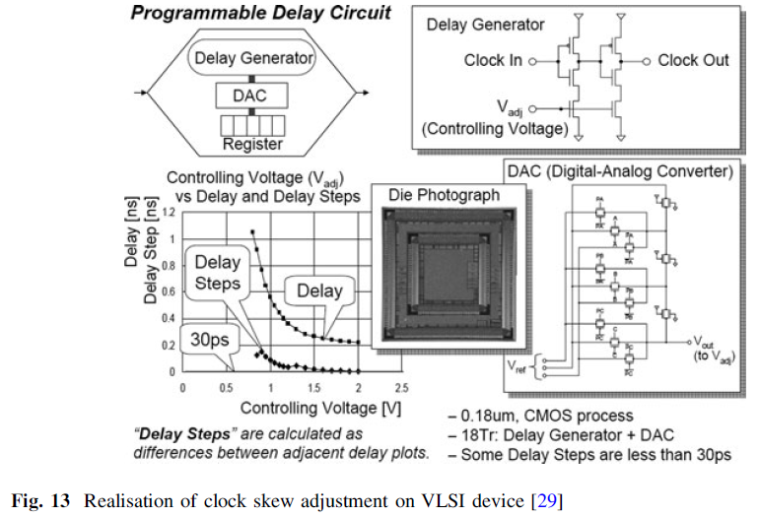
Clock Skew Correction
The device can run at be increased (in the paper by 25%) but that also the supply voltage can be
reduced while maintaining a functioning chip (in some cases by more than 50%).

Slide 13
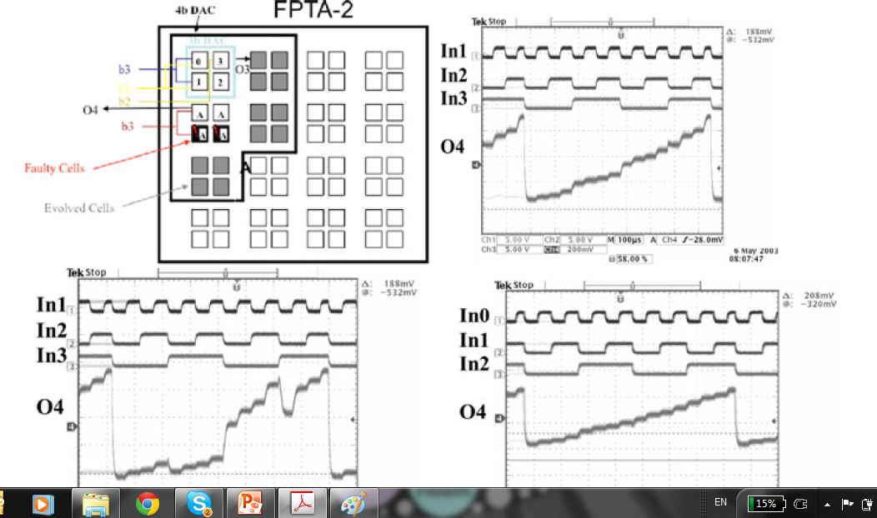
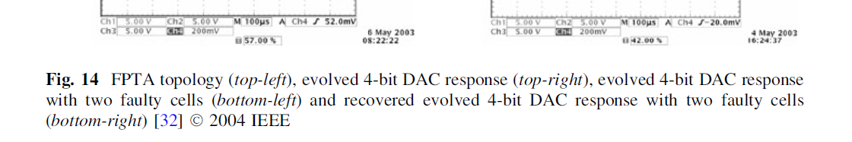
4 Bit DAC

Slide 14
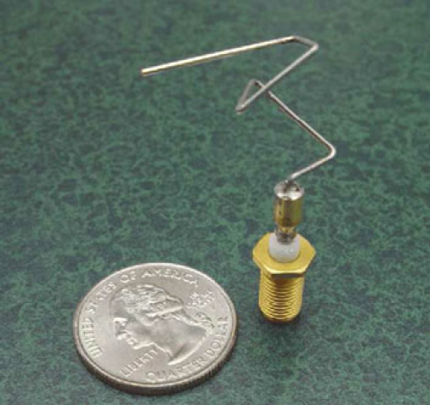
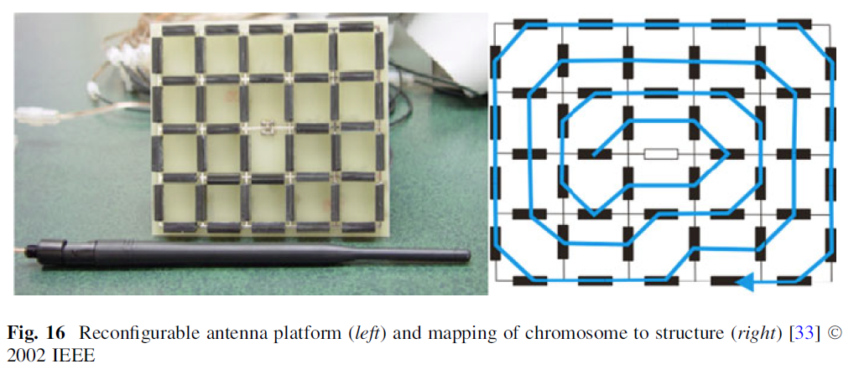

Slide 15
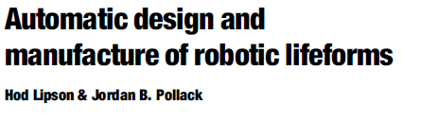

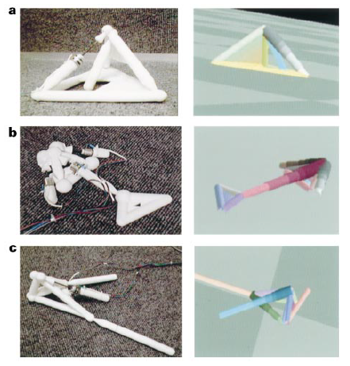
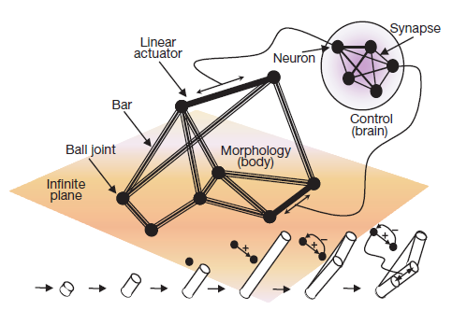

Slide 16
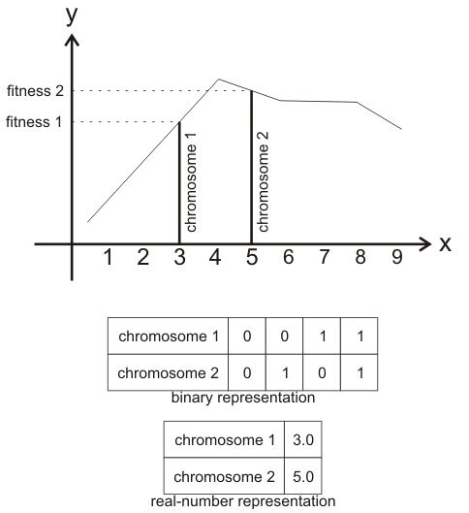
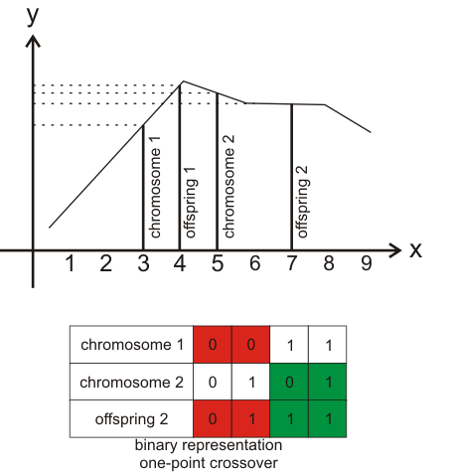
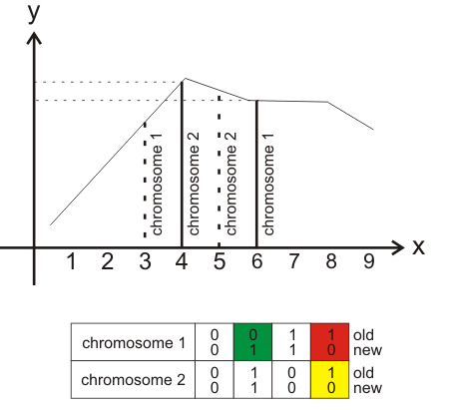
Genetic Algorithms
http://www.codeproject.com/Articles/26203/Genetic-Algorithm-Library

