Slide 1

Society for Risk Analysis Workshop 3: Application of Web-based Risk Assessment Information System (RAIS)
RAIS
The Risk Assessment Information System
Leslie Galloway, University of Tennessee/Oak Ridge National Laboratory
Debra Stewart, University of Tennessee/Oak Ridge National Laboratory
Katie Tucker, Ingenium/Oak Ridge National Laboratory
Copyright © 2009 The University of Tennessee All Rights Reserved

Slide 2
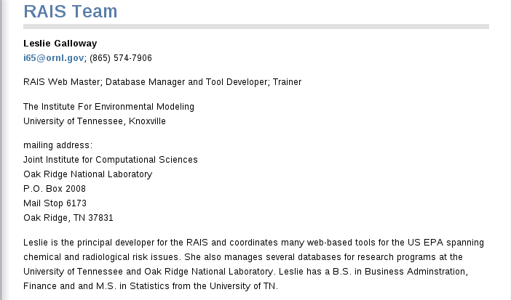
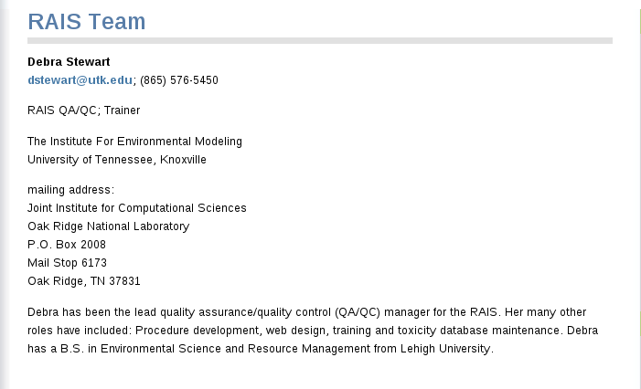
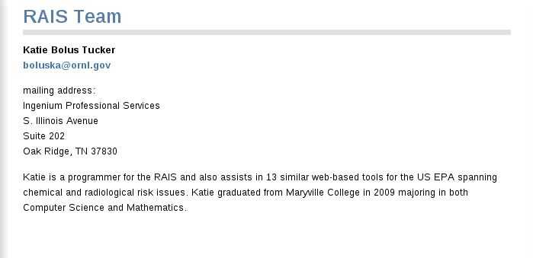
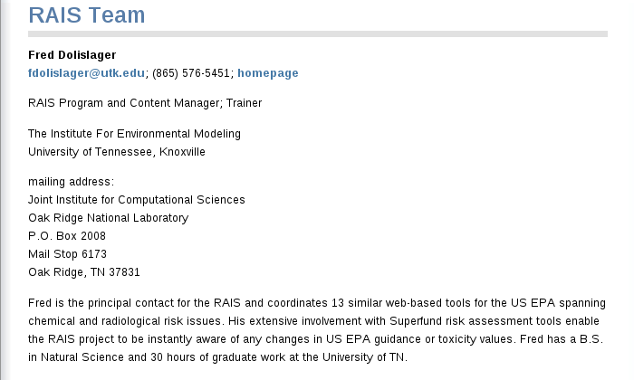
Instructors

Slide 3
Schedule
RAIS Overview/Navigation
Homepage
Tutorials
User’s List
Risk Guidance
What’s New
Document Search
Glossary
Support
Navigation – Tools and EPA Tools
Data Assessment
ARARs – Federal and State
Chemical Data Profiles
Ecological Benchmarks
Background Values
PRGs – Chemical and Radiological
Practice Session #1
Toxicity Assessment
Toxicity Profiles
Toxicity Values – Chemical and Radiological
Toxicity Metadata
Radionuclide Decay Chain
Practice Session #2
Risk Characterization
Risk Models
Chemical Risk Calculator
Practice Session #3

Slide 4
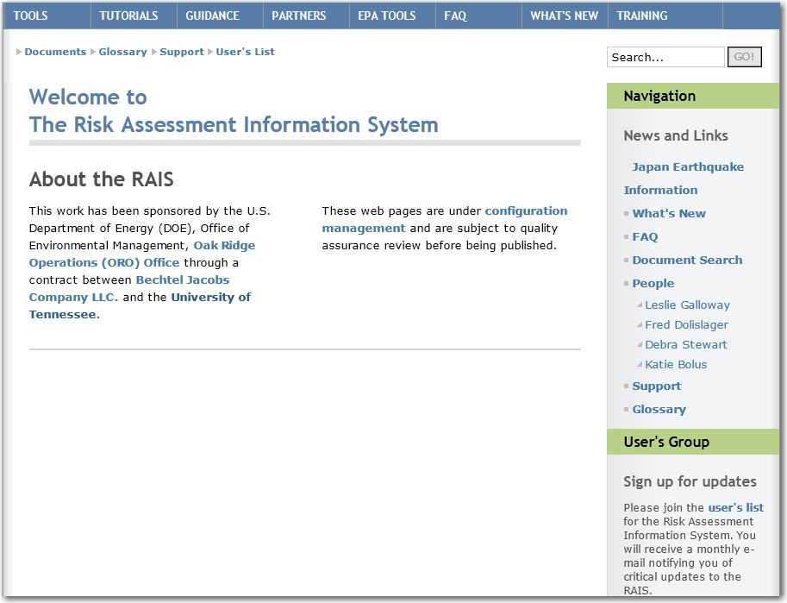
http://rais.ornl.gov/

Slide 5
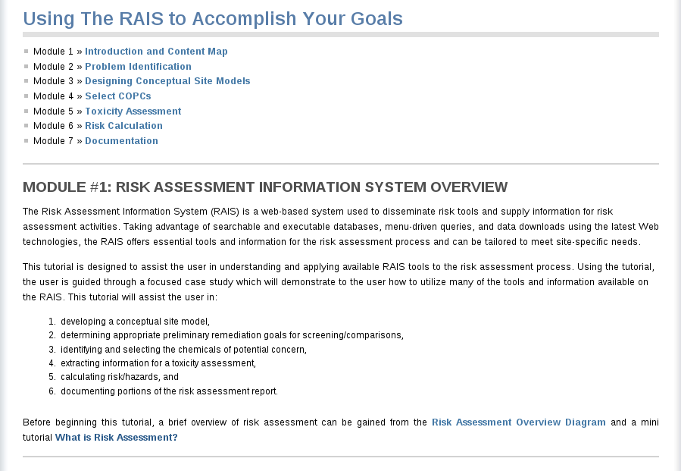
Tutorials

Slide 6
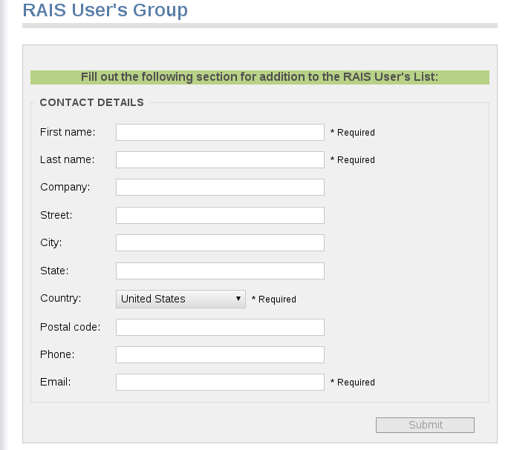
User List

Slide 7
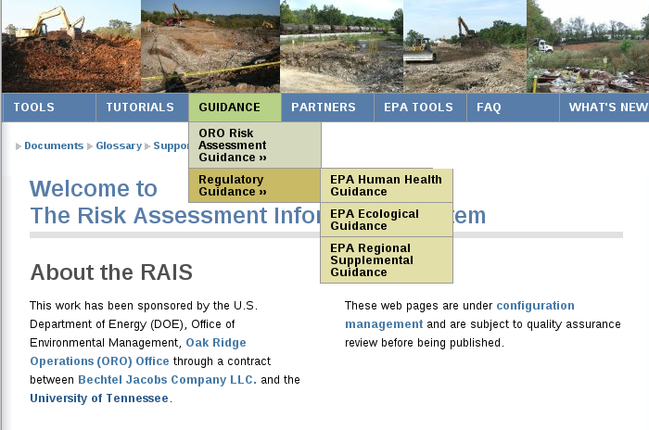
Risk Guidance

Slide 8
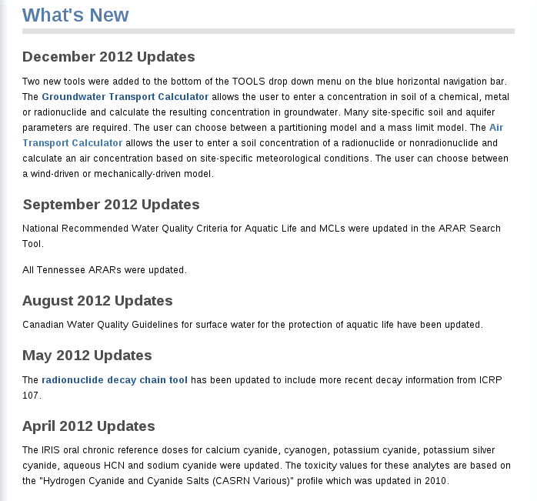
What’s New

Slide 9
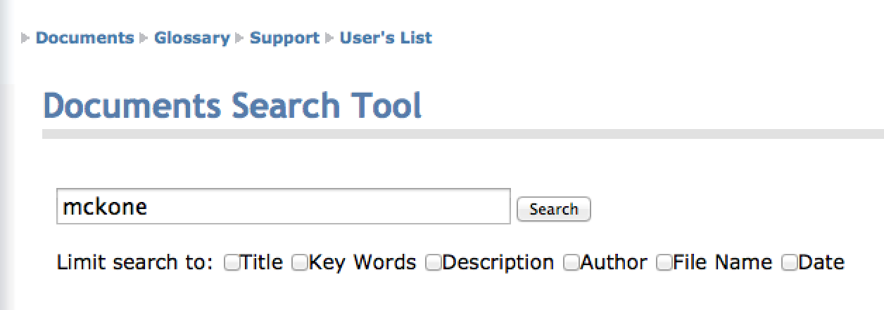
Document Search

Slide 10
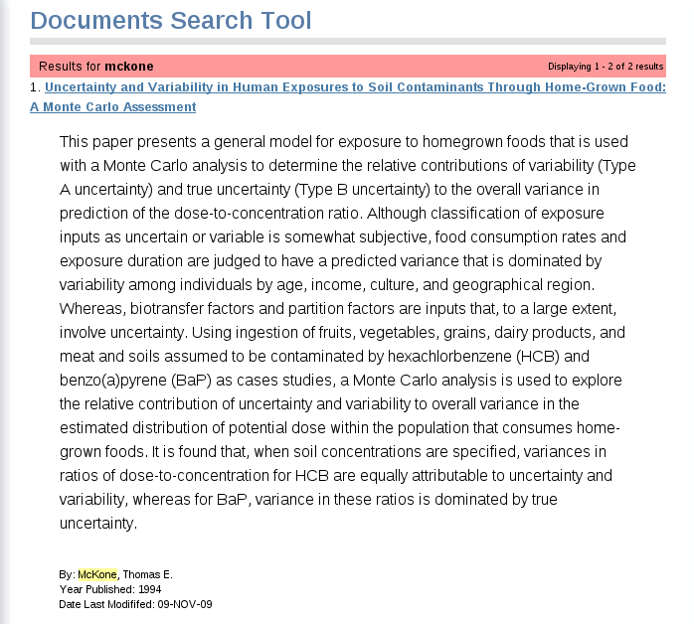
Document Search

Slide 11
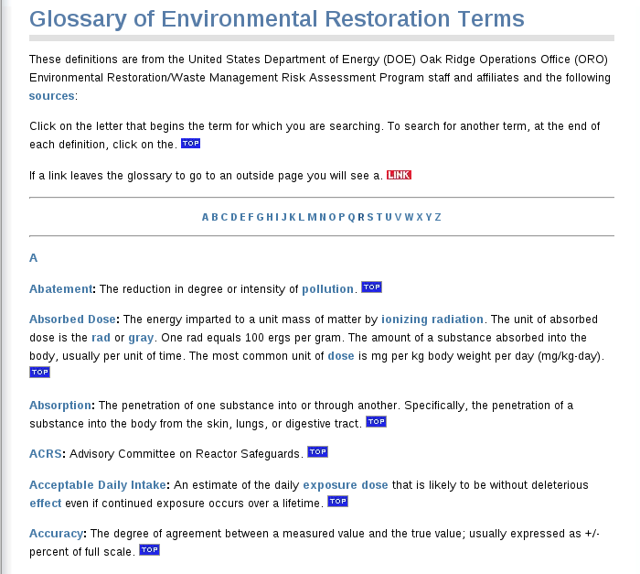
Glossary

Slide 12
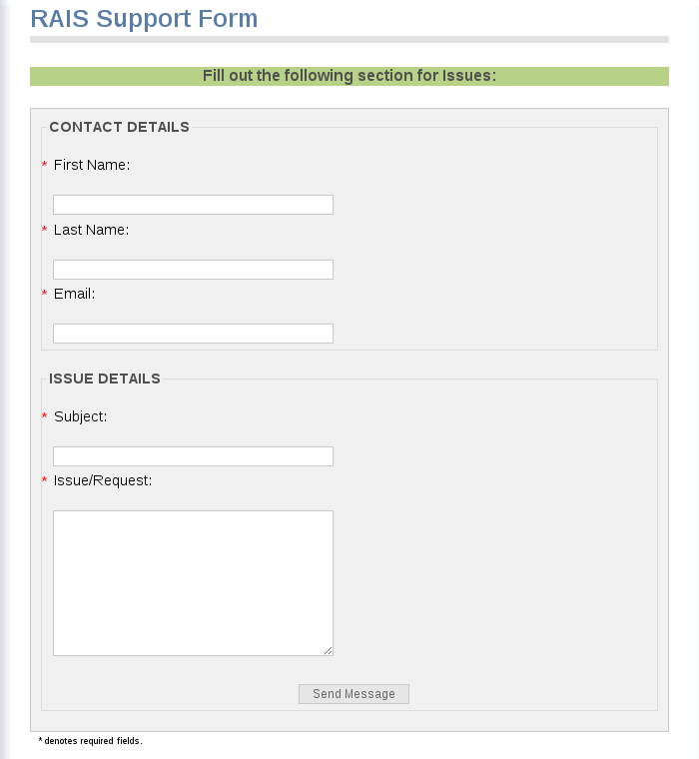
Support

Slide 13
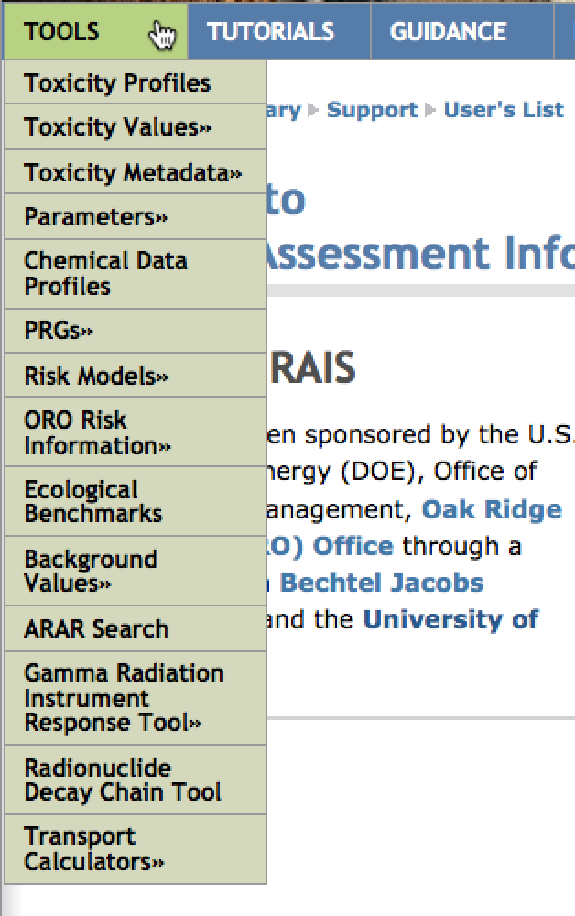
Navigation - Tools

Slide 14
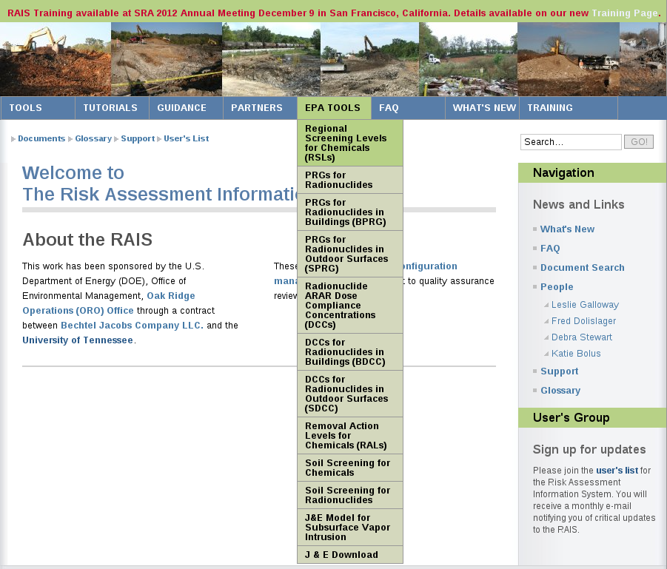
Navigation – EPA Tools

Slide 15
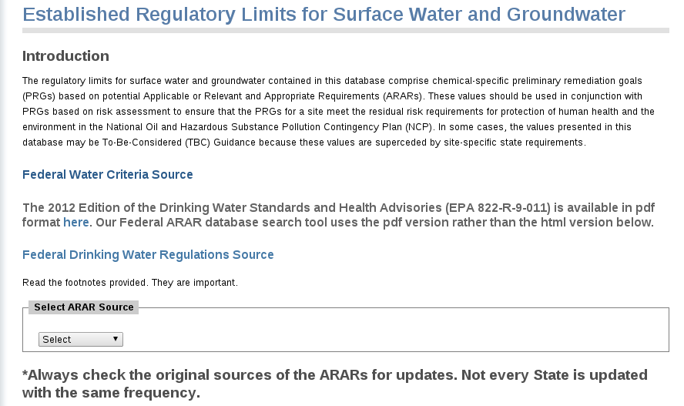
Data Assessment - ARARs

Slide 16
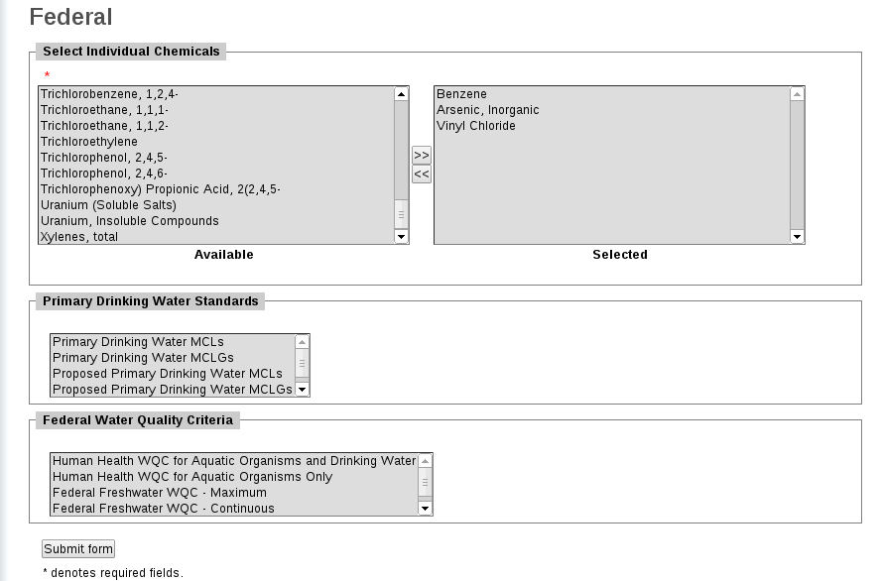
Data Assessment – Federal ARARs

Slide 17
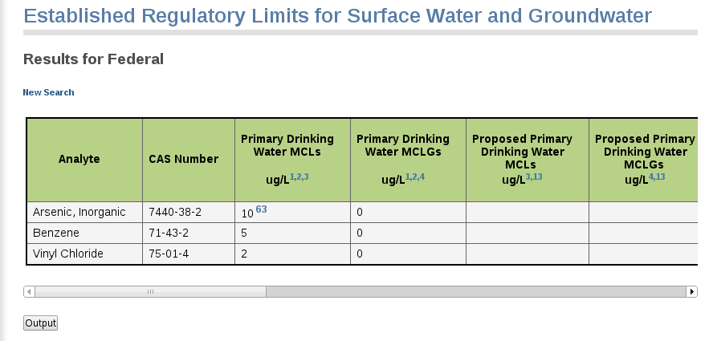
Data Assessment – Federal ARARs

Slide 18
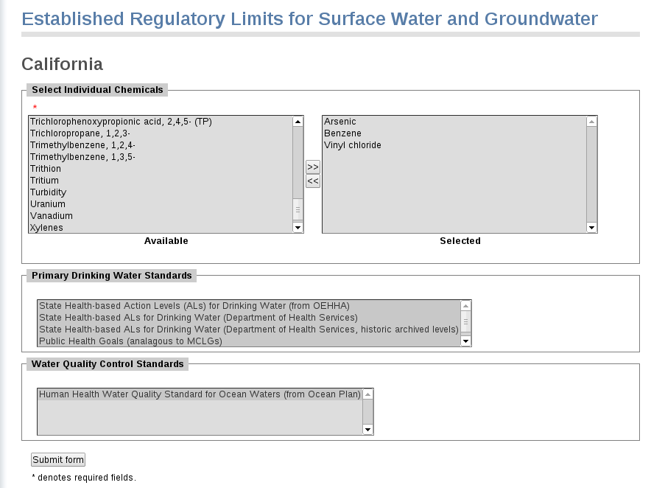
Data Assessment – CA ARARs

Slide 19
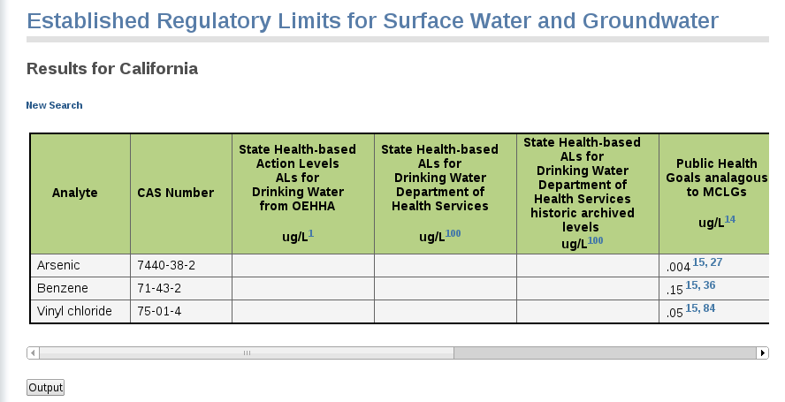
Data Assessment – CA ARARs

Slide 20
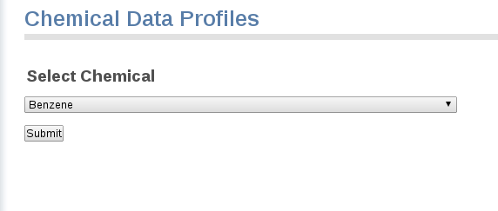
Chemical Data Profiles

Slide 21
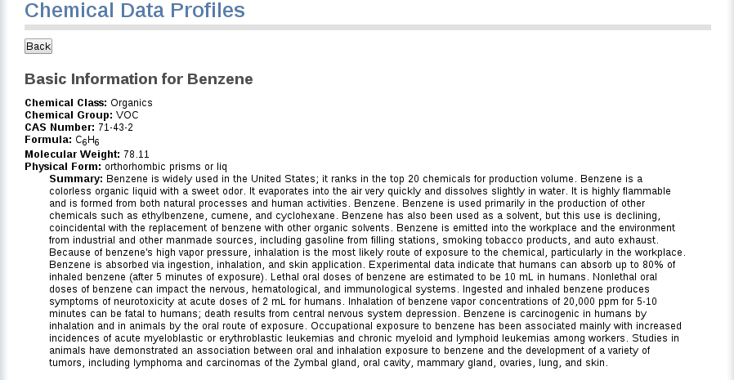
Chemical Data Profiles

Slide 22
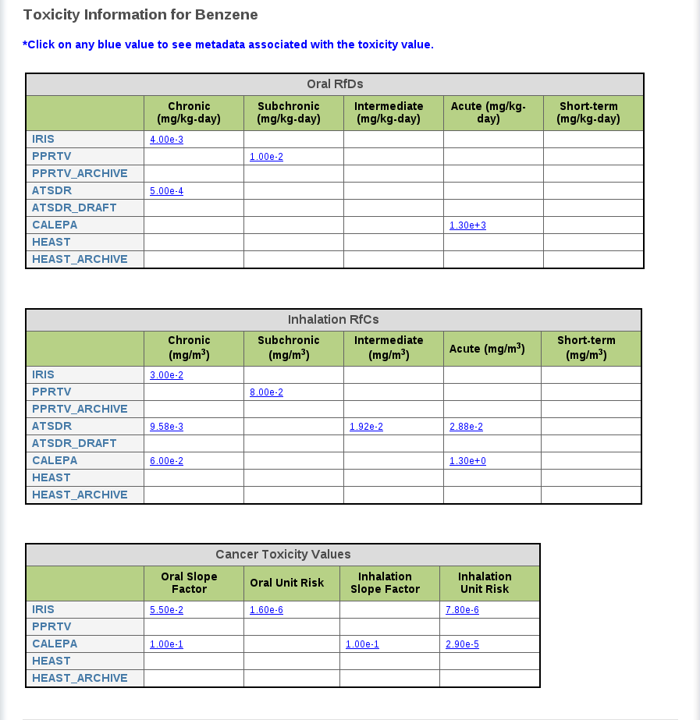
Chemical Data Profiles

Slide 23
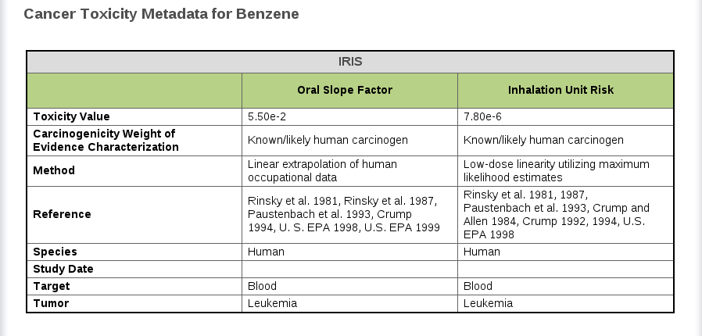
Chemical Data Profiles

Slide 24
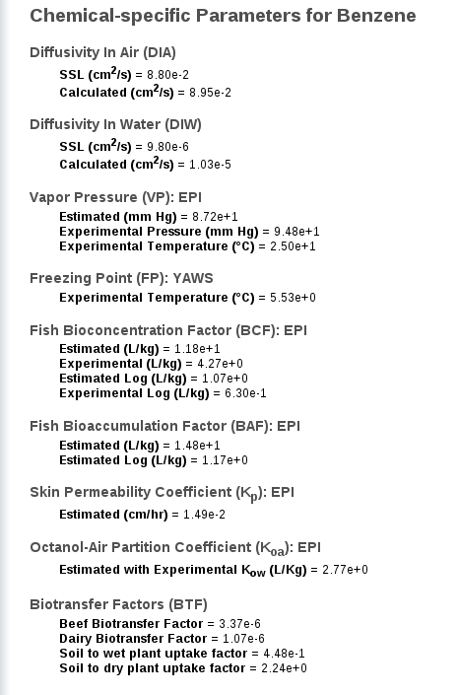
Chemical Data Profiles

Slide 25
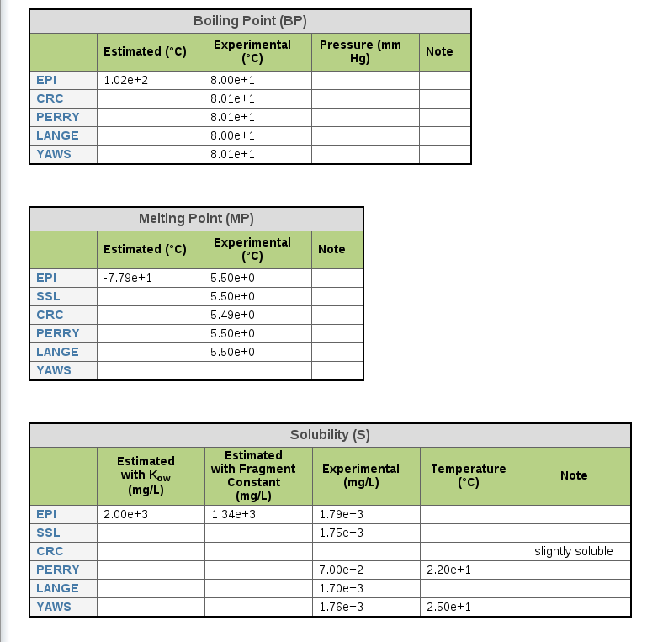
Chemical Data Profiles

Slide 26
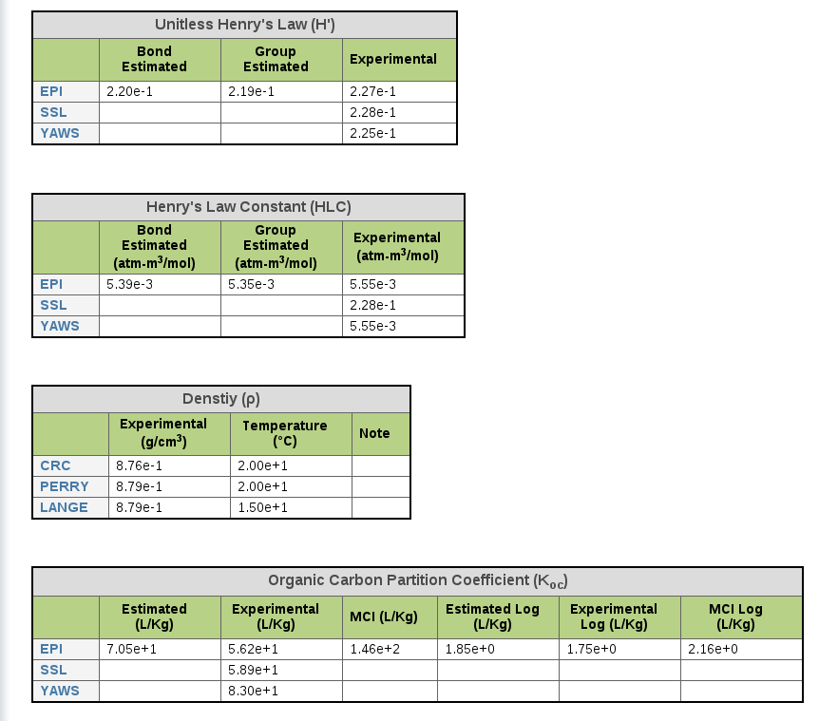
Chemical Data Profiles

Slide 27
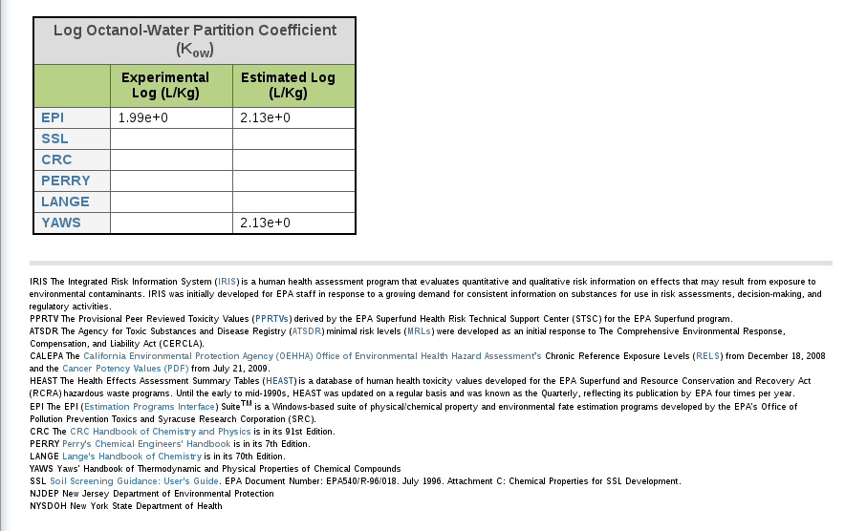
Chemical Data Profiles

Slide 28
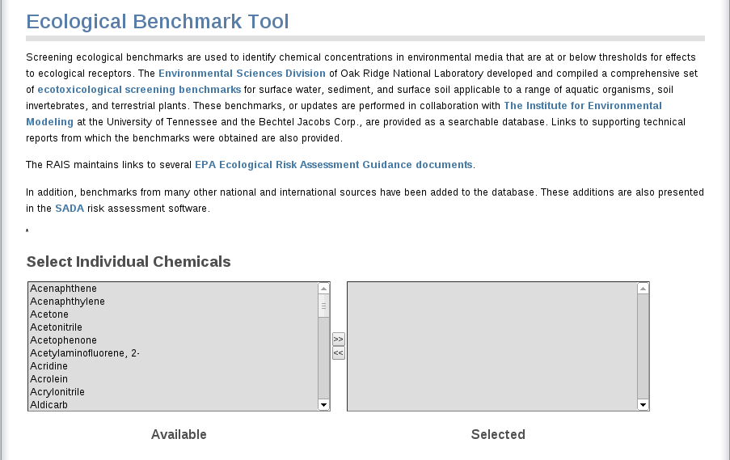
Ecological Benchmarks

Slide 29
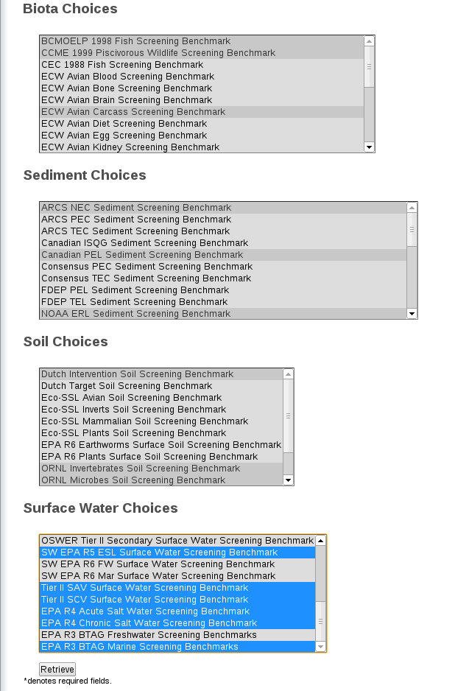
Ecological Benchmarks

Slide 30
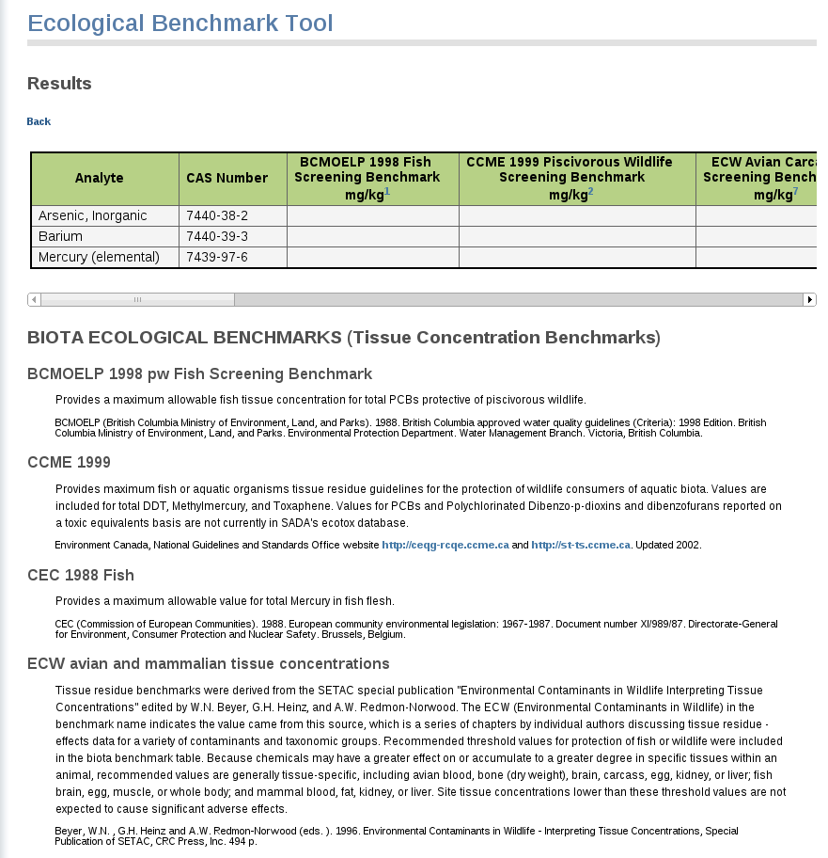
Ecological Benchmarks

Slide 31
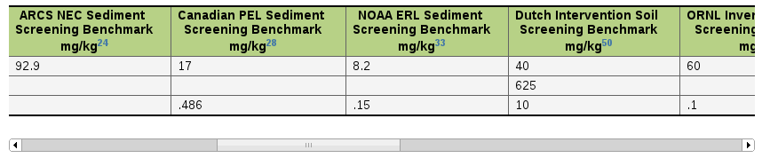
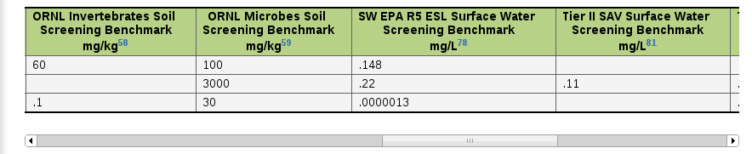
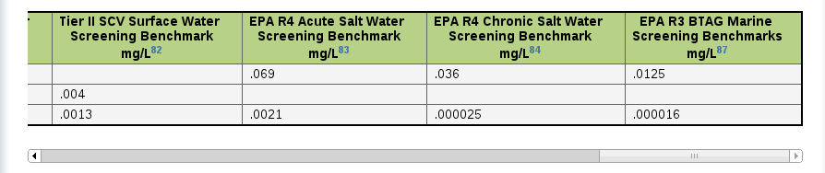
Ecological Benchmarks

Slide 32
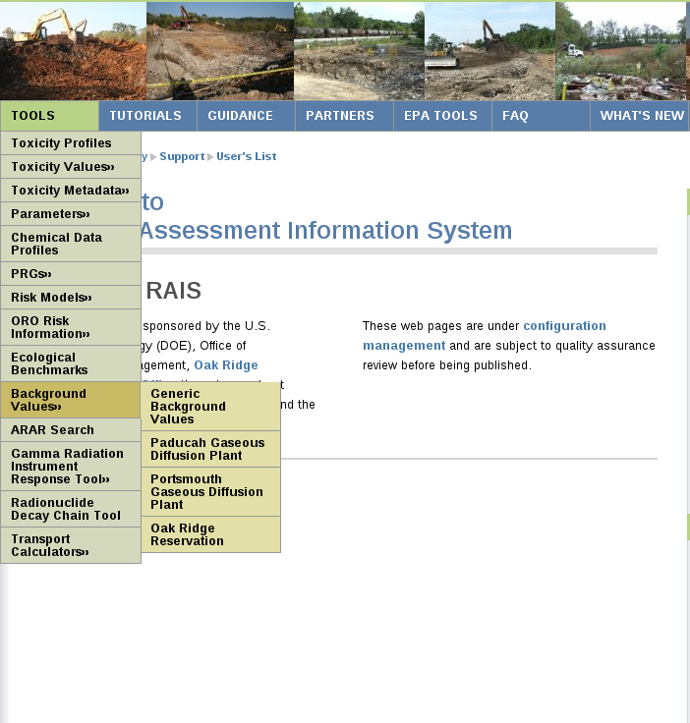
Background Values

Slide 33
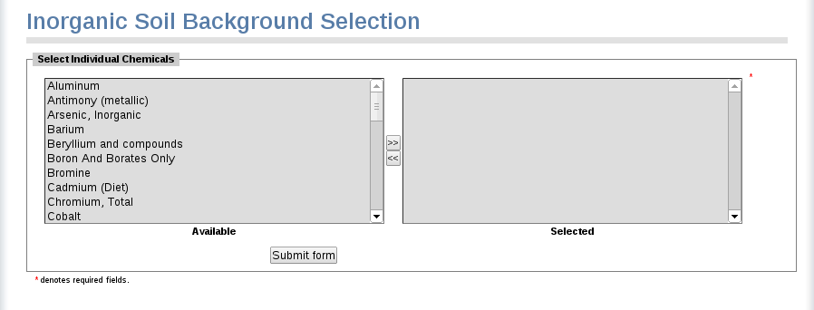
Background Values

Slide 34
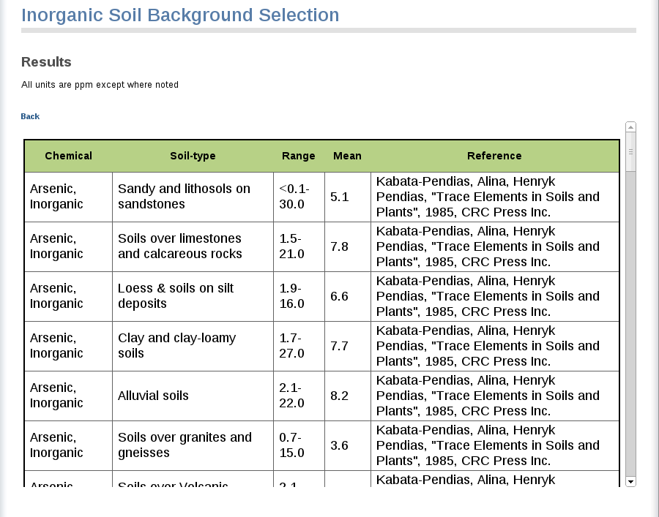
Background Values

Slide 35
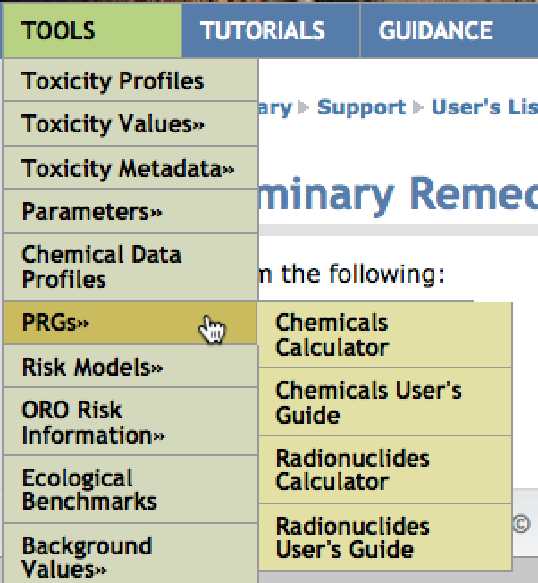
Preliminary Remediation Goals (PRGs)

Slide 36
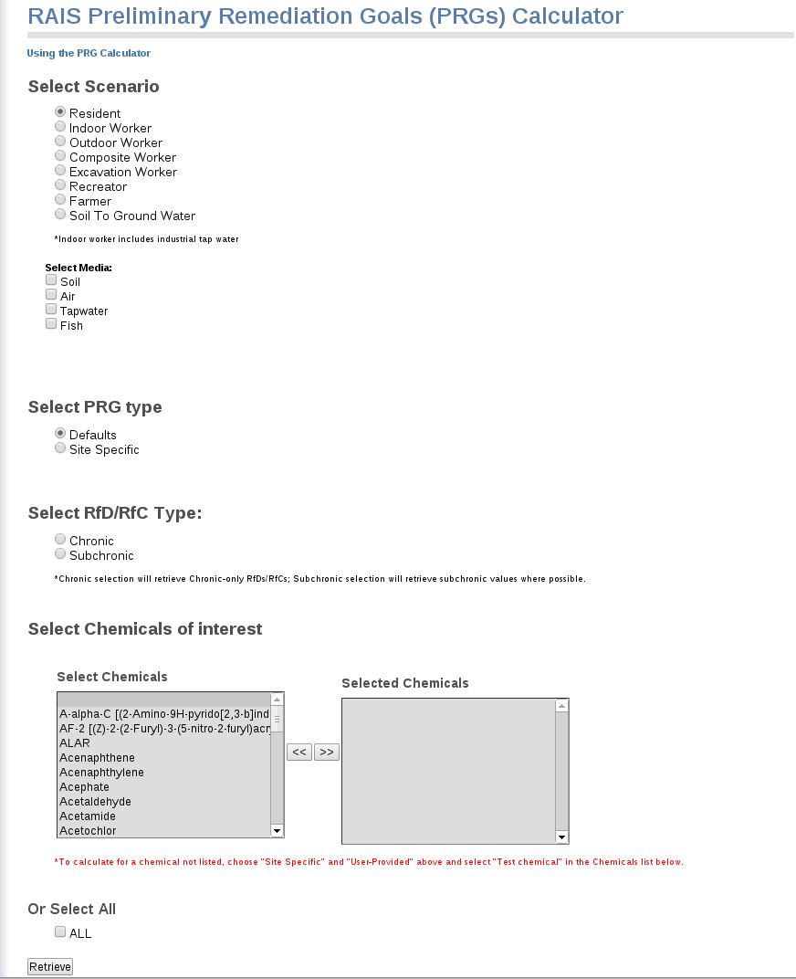
Chemical PRGs

Slide 37
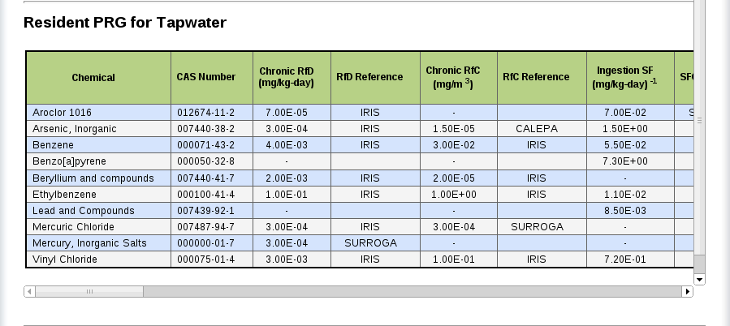
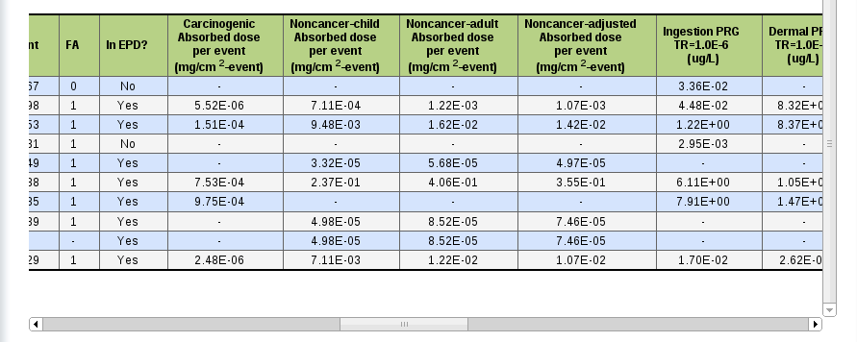
Chemical PRGs

Slide 38
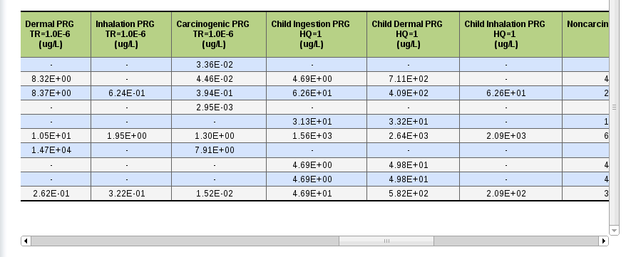
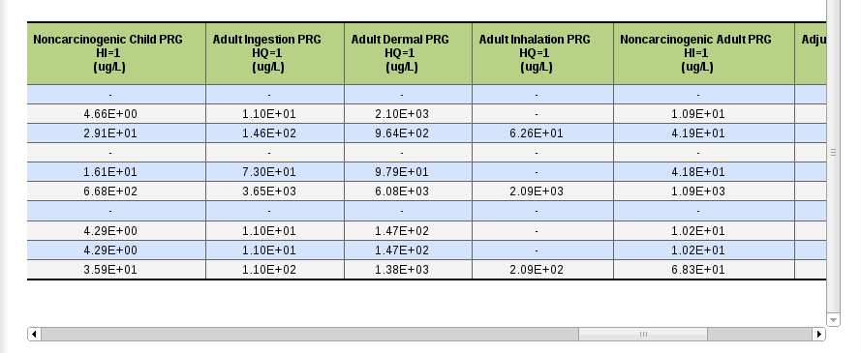
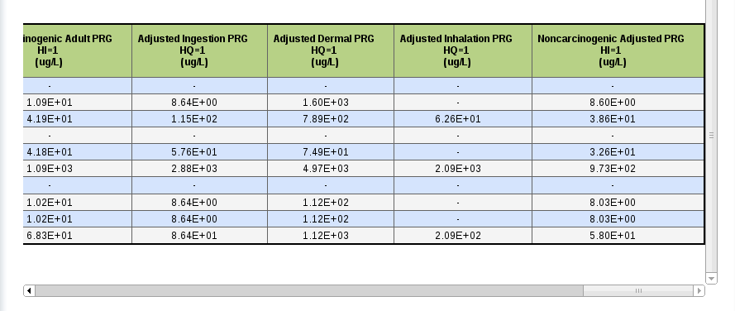
Chemical PRGs

Slide 39
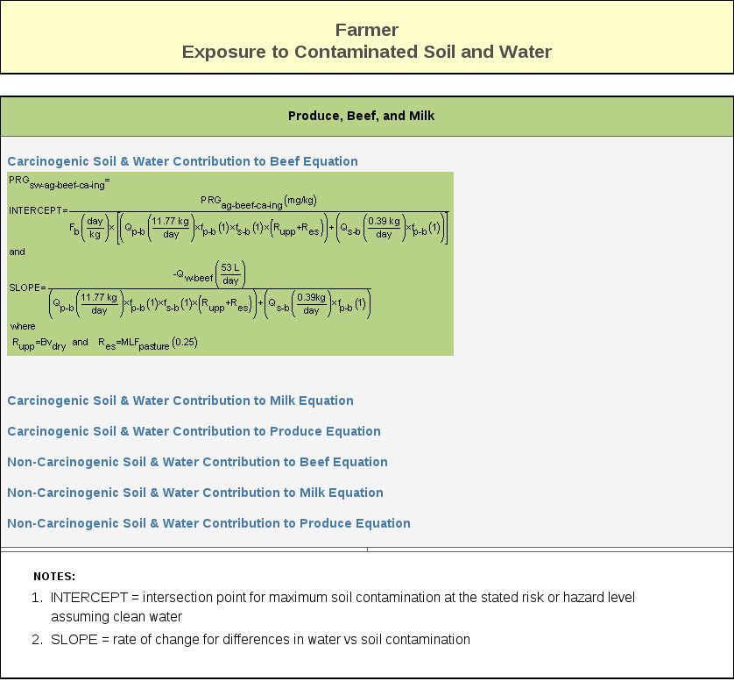
Chemical PRGs

Slide 40
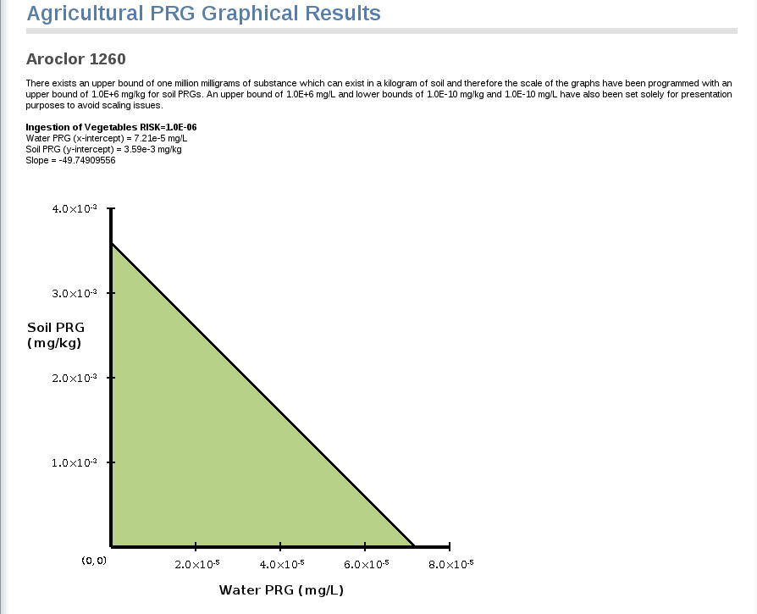
Chemical PRGs

Slide 41
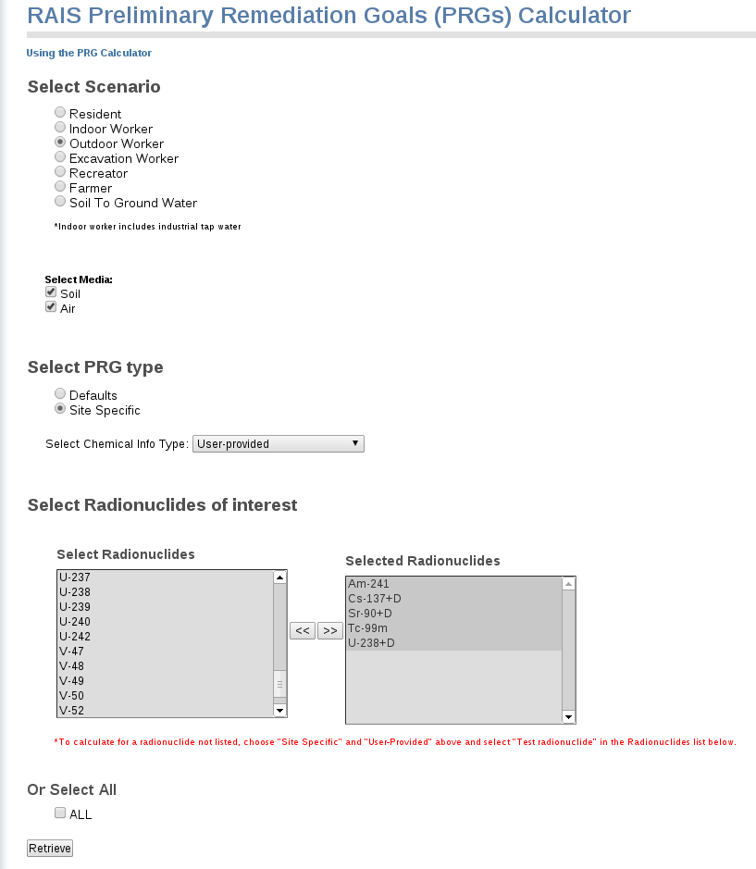
Radiological PRGs

Slide 42
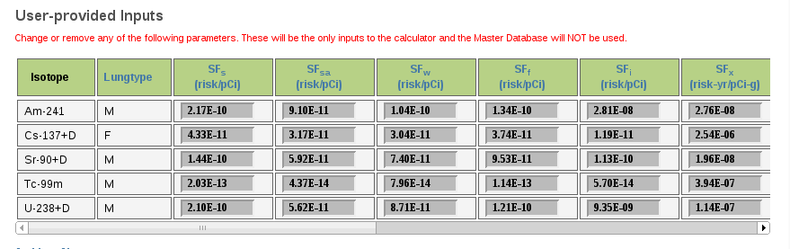
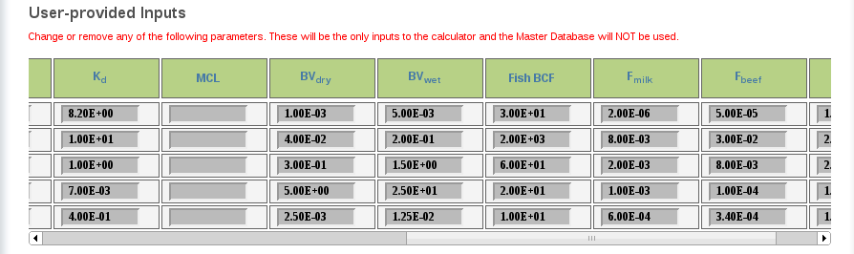
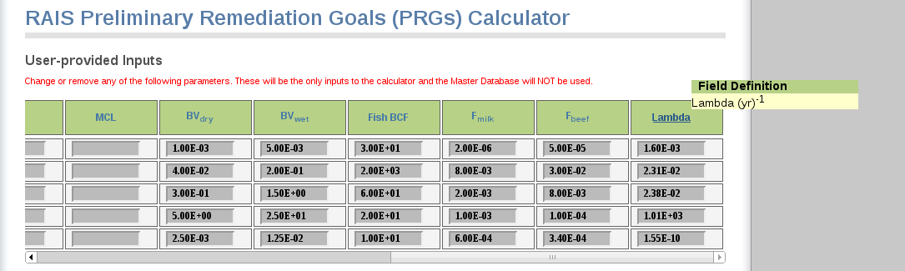
Radiological PRGs
Notes:
Add a red circle here around the hover item…

Slide 43

Radiological PRGs

Slide 44


Radiological PRGs

Slide 45

Radiological PRGs

Slide 46


Radiological PRGs

Slide 47

Data Assessment Practice
Your San Francisco 0.5 acre residential site in alluvial soil and groundwater has the following contaminants:
Benzene in soil at 50 mg/kg
Arsenic in soil at 5 mg/kg
Toluene in groundwater at 5 ug/L
Screen against PRGs, Primary MCLs, and generic background to determine the COPCs.

Slide 48

Data Assessment Practice Results
When getting ARAR make sure you use California for Primary Drinking Water MCL.
When calculating soil PRG select San Francisco for PEF and VF. All others are default.
When getting soil background make sure to get mean for proper soil type.

Slide 49

Toxicity Profiles

Slide 50

Toxicity Profiles

Slide 51

Toxicity Values

Slide 52

Chemical Toxicity Values

Slide 53

Radiological Toxicity Values

Slide 54

Chemical Toxicity Metadata

Slide 55

Chemical Toxicity Metadata

Slide 56

Radionuclide Decay Chain

Slide 57

Radionuclide Decay Chain

Slide 58

Radionuclide Decay Chain

Slide 59
Toxicity Assessment Practice
Aldrin, Ametryn, Dieldrin, ethylbenzene, vinyl chloride are your COPCs.
What is the common RfD target organ for these chemicals? ________________
What would you need to be concerned about if all COPC concentrations were less than PRG? _______________________________________________________
What’s the only known human carcinogen? ___________________
What is the primary use of vinyl chloride? _____________________
What contaminant is found in cigarette smoke? _________________
Which COPC has the most toxic oral slope factor?_________________ inhalation unit risk? ____________ RfD___________, RfC_________?

Slide 60
Toxicity Assessment Practice Results
Aldrin, Ametryn, Dieldrin, ethylbenzene, vinyl chloride are your COPCs.
What is the common RfD target organ for these chemicals? Liver
What would you need to be concerned about if all were less than PRG? The additive effect of multiple chemicals on one organ may pose a risk even if all of the COPCs are below target hazard quotient.
What’s the only known human carcinogen? Vinyl chloride
What is the primary use of vinyl chloride? To make PVC
What contaminant is found in cigarette smoke? Ethylbenzene
Which COPC has the most toxic oral slope factor? Aldrin , inhalation unit risk? Aldrin , RfD? Aldrin, RfC? Vinyl chloride.

Slide 61

Risk Models

Slide 62

Chemical Risk Calculator

Slide 63

Chemical Risk Calculator

Slide 64

Chemical Risk Calculator

Slide 65

Chemical Risk Calculator

Slide 66

Chemical Risk Calculator

Slide 67

Chemical Risk Calculator

Slide 68

Chemical Risk Calculator

Slide 69

Chemical Risk Calculator

Slide 70


Chemical Risk Calculator

Slide 71



Chemical Risk Calculator

Slide 72


Chemical Risk Calculator

Slide 73

Chemical Risk Calculator

Slide 74


Risk Characterization Practice
You developed the following CSM for your 50 acre site in San Francisco. Your site is an adult prison where average served sentence is 30 years and guards average employment is 10 years. The prison was built in a former chemical processing facility. Perform the risk assessment for each potential landuse for the following soil and air data. Hint: no children are present; adjust ED; prisoners don’t get 2 weeks of vacation.

Slide 75


Risk Characterization for Inmates

Slide 76


Risk Characterization for Guards

Slide 77
Risk Characterization Analysis
What receptor is likely to exhibit systemic effects from exposure to ambient air, the guards or inmates? _________________
Is soil exposure to guards and inmates likely to result in harmful systemic effects? _______
What chemical is driving cancer risk for guards and inmates exposed to air? _________
What chemical is driving cancer risk for guards and inmates exposed to soil? ____________
What could be done for the guards to lower cancer risk to 1E-05? _____________________

Slide 78


Risk Characterization Results for Inmates
For the inmate, I used resident landuse and only entered exposure parameters for adult (16-30yrs). I put zeros in for all other age cohorts. ED was 30 yrs, EF was 365 d/yr, ET was 24 hrs. Change Climatic Zone to San Fran for VF and ED. Change As to 50 acres.

Slide 79
Risk Characterization Results for Guards
For the inmate, I used resident landuse and only entered exposure parameters for adult (16-30yrs). I put zeros in for all other age cohorts. ED was 30 yrs, EF was 365 d/yr, ET was 24 hrs. Change Climatic Zone to San Fran for VF and ED. Change As to 50 acres.

Slide 80
Risk Characterization Analysis Results
What receptor is likely to exhibit systemic effects from exposure to ambient air, the guards or inmates? inmates
Is soil exposure to guards and inmates likely to result in harmful systemic effects? No
What chemical is driving cancer risk for guards and inmates exposed to air? Benzidine
What chemical is driving cancer risk for guards and inmates exposed to soil? Chloroform
What could be done for the guards to lower cancer risk to 1E-05? Lower ED, lower EF, wear respirators, etc.

