Slide 1
The Quote Request Model Joanne Woytek
Notes:
1

Slide 2

Acquisition is a Team Effort

Slide 3
Why Use the Quote Request Tool
Only recommended method for:
Determining what is available on SEWP
Providing and documenting Fair Opportunity
Verifying quotes
Tracking progress and issues
Obtaining the optimum assistance
Sharing RFQs and quotes with colleagues
Creating on-line credit card orders
Notifying Contract Holders of award status

Slide 4
Best Practices for Obtaining Quotes
Check that the requirements are in scope
If in doubt, particularly for service related requirements, send Statement of Work (SOW) and/or Requirements statement to help@sewp.nasa.gov
Ensure technical requirements are up to date and feasible
Use Market Research to ask general research questions – especially for unusual or complex issues
Describe requirements as fully as possible
Provide adequate time for a response
A requirement that took months to develop cannot be responded to in days
If inadequate responses, contact help@sewp.nasa.gov for assistance

Slide 5
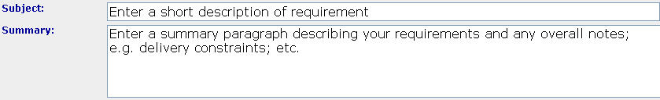
Types of Requests
Current tool only lists 2 types of requests
Market Research and Request A Quote
Next Version will have 3 types: Market Research, Request for Information (RFI) and Request for Quote (RFQ)
Distinguish between an RFI and RFQ in the summary section

Slide 6
Market Research vs. Request a Quote
The only real difference between Market Research and Request A Quote is that responses to Market Research requests are not verified.
Market Research is best used for general research questions

Slide 7
Overlooked/Misunderstood Features
Subject
Agency RFQ ID/Name
Include Previous Quote Numbers
OCONUS
E-mail notification options
Contact Information

Slide 8
Subject / Summary
Subject line should not read “Enter a short description of requirement”
Be descriptive
Be attention getting
Be truthful
“You have won the Ethiopian Lottery” will probably not work
Contract Holders rely on subject line to determine if RFQ is an opportunity
Customers can use the Subject line to locate Quote Requests

Slide 9
Agency ID
Optional field
Can be used to provide a second identifier for the Quote Request
SEWP assigns a unique Quote Request Number when the request is submitted
Searchable

Slide 10

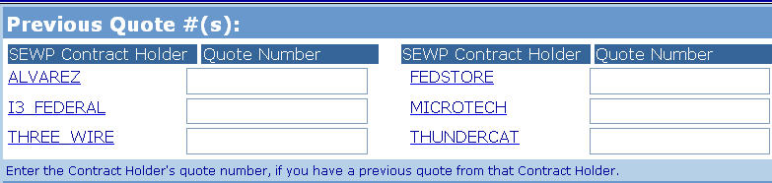
Previous Quote Numbers
Optional field
Speeds up Quote process when one or more Contract Holders have provided preliminary quotes
Notifies company that provided quote

Slide 11

OCONUS
Optional field
Notifies contract holder if some or all of the order involves oversea requirements
Provide details in the Summary box and/or attachments

Slide 12
E-mail attachments
Default is to receive an email notification only when a response is submitted
If “Yes” is checked, the submitted quotes will be attached to the notification
Note that Contract Holders cannot send quotes directly to customer
Next version will have more and clearer options

Slide 13
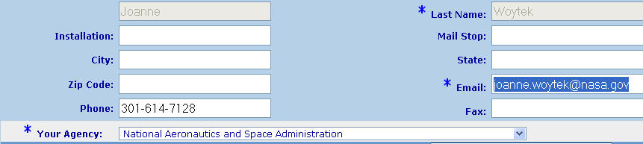
Contact Information
Fill in all fields, even though they are optional
The more information on your location => the better the chance for a response

Slide 14
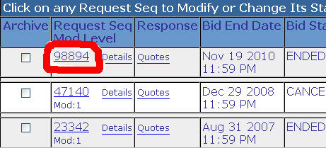
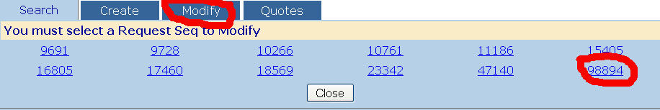
Modification of Quote Requests
Either select the Request number in the initial Search Tab:
Or select Request number in Modify Tab

Slide 15
Modification Options
Either modify selected Request or select from the following:
Copy to New Request: Uses selected Request as a Template to start a new Request
Cancel this Request: This will notify solicited Contract Holders that the request has been canceled
New version will provide a quick option for canceling, reopening and extending RFQs

Slide 16
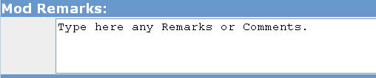
Modification of Requests
Be sure to update the Reply date:
Note that Extension can be less than 24 hours
Summarize the changes made in the Modify Remarks box:

Slide 17
Quote Verification Process
User must compare line items on quote with verification file
On Quote Page, select “Print this Page” in upper right corner
All Verification files are printed off
At a minimum, open the quote being selected for award
Check the information in the quote against corresponding verification file
Ignore the 5 Variable CLINS
SEWP-Z: fee
Travel
Delivery
Open Market: must total less than $3000
Credit
If Quote does not match verification file
Ignore Quote
Notify help@sewp.nasa.gov

Slide 18
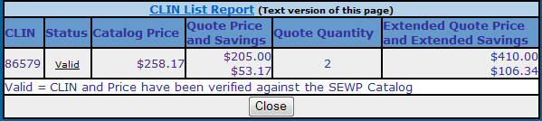
Quote Verification
Verification File
Verifies items on contract & properly priced
Shows Discount Off Contract Price

Slide 19
Quotes
Quotes (including mods) must pass through the SEWP Program Office
Ensures Fair Opportunity
Avoids customer from unsolicited updates and late submissions
Ensures all quotes have a corresponding verification file
If an quote is emailed/faxed other than by the SEWP Program office; contact help@sewp.nasa.gov
Do not instruct vendors to send quotes directly
They are not allowed to – all quotes must go through the Program Office/on-line tool
Option in tool to receive quotes via email

Slide 20
Partial-ity
Partial Quote Responses
Contract Holders must reply with a full response to the requirements
Customer can notify the Contract Holders that partial responses are allowed; Place notification in the Summary box of the Request
If a partial response is received and was not specified as allowable by the customer:
Disregard the quote
Notify help@sewp.nasa.gov
Partial Orders
An order should be based on an entire quote
To split a quote into multiple orders and/or only award part of the quote, submit a new and separate RFQ(s) to get refreshed quotes for the partial orders
If you split a quote into multiple orders, Contract Holder may elect to not accept the order

Slide 21
SEWP Fee on Quotes
Fee can be quoted either:
As a separate line item (SEWP-Z CLIN)
As part of the product prices (similar to GSA)
Delivery order should match the selected quote
E-mail confirmation will provide fee included on an order – informational only
Fee is calculated separately for every order and each mod
Example: $5 M order with three $3 M mods will have $40,000 in fees
Fee is based on fee at the time of the initial order or at the time of a mod – whichever is lower at that time
Surcharge
Order Amount | Fee Percentage
$0 to $2,222,222 | 0.45%
$ 2,222,222 and up | Capped at $10,000
Effective November 1, 2010
Notes:
21

Slide 22
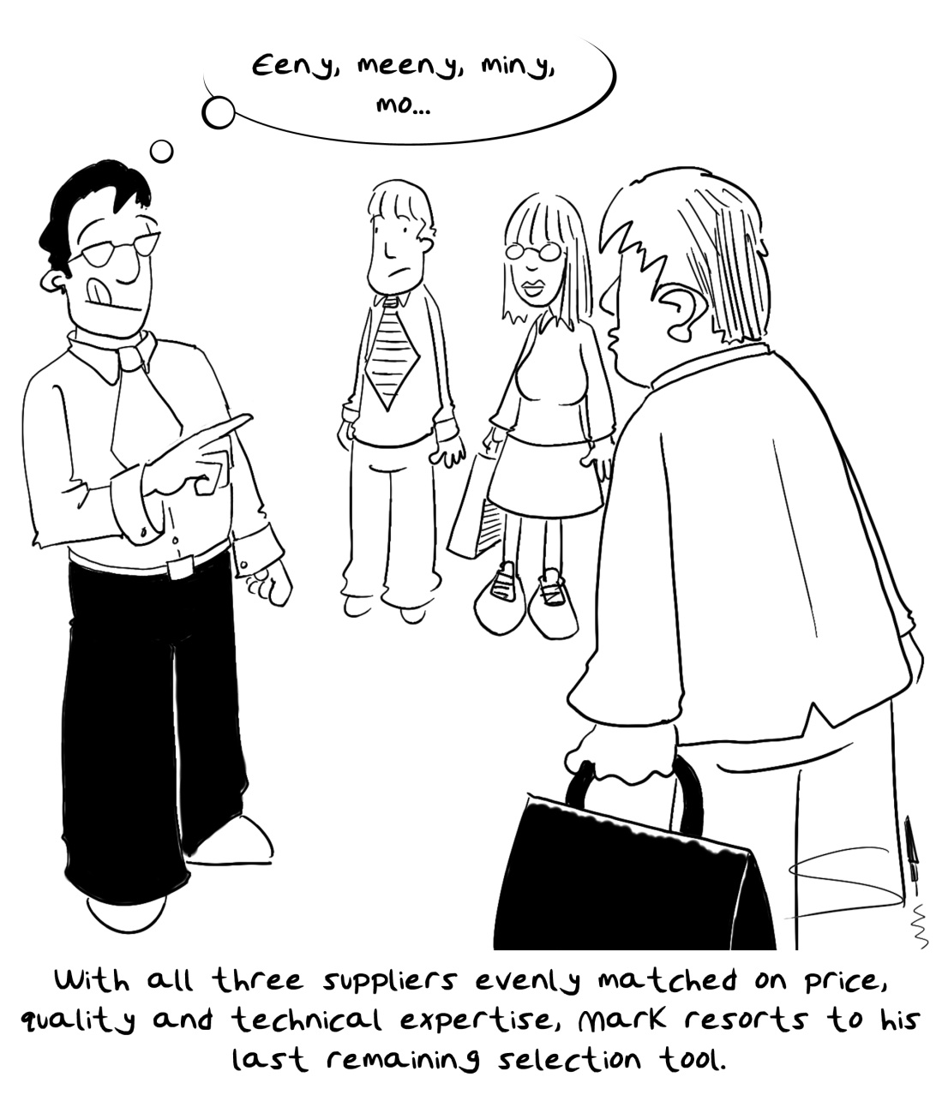
Selection

Slide 23
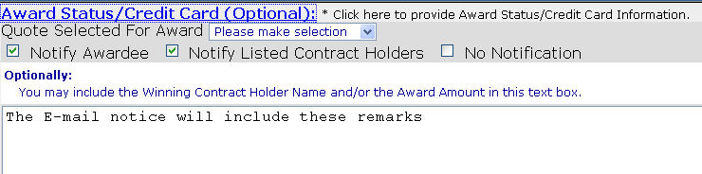
Award Process
Award Notification:
By default; the non-awardees are only told they are not selected
To provide award information; e.g. the awardee and dollar amount, add that information in the remarks box
Debriefs are not required for orders under $5 Million

Slide 24
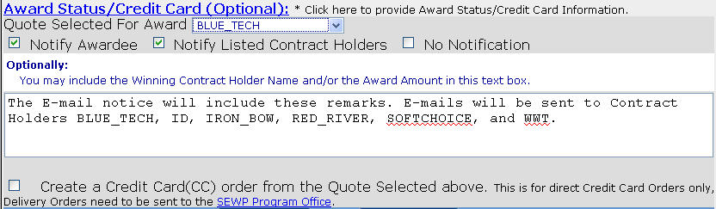
On-line Credit Card
Do not include credit card number
Up to 2 additional files may be attached

Slide 25
SEWP Program Office
Prior to submitting a request
Assistance with scope and availability issues
Upon submission of a request
First submission is checked to ensure no pricing data included
Later submissions are randomly checked – if pricing data is added, quote request will be canceled
No check is made automatically for scope or other issues
Contract holders will notify Program Office if a request may be out of scope
Post due date
Assistance with inadequate responses

Slide 26
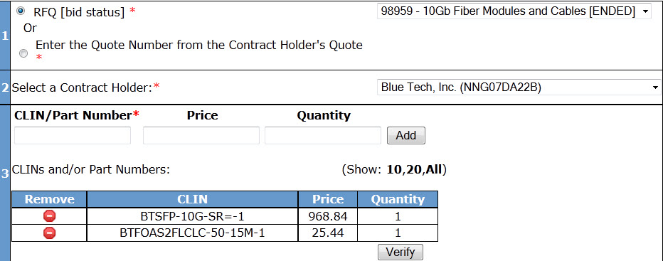
Quote Verification Tool
Verifies and displays quoted line item information from the catalog.
Confirms authorized reseller status
Provides savings total and percentage off the SEWP catalog price

Slide 27
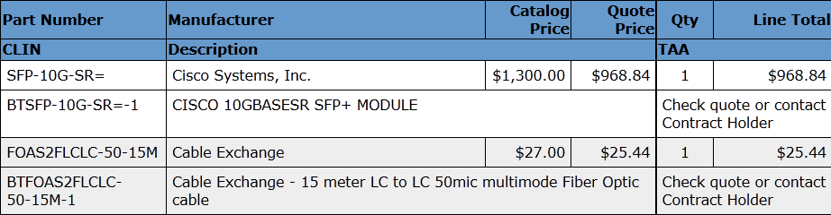
Quote Verification Tool
Full Description – can be copied and paste
TAA Info
Pricing info

Slide 28
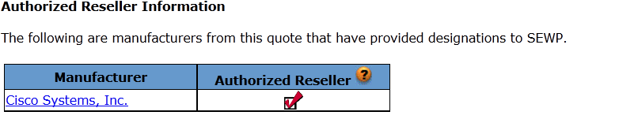
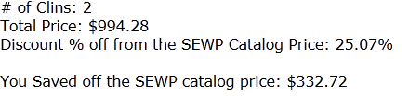
Quote Verification Tool
Authorized Reseller Information
Summary of Savings

