Slide 1


Does Financial Aid Impact Student Retention Among Pell Grant Recipients in Louisiana?
Review of Findings for the Governance Commission Kevin Crockett, President/CEO October 24, 2011

Slide 2




About the research partnership

Slide 3
Project outcomes for Louisiana
Custom policy research
Assist in advancing policy changes as needed
Develop report shells based on findings
Develop internal capacity to analyze and monitor data in the future

Slide 4

The Research Questions

Slide 5
Research questions: Pell Study
How does the level and mix of financial assistance affect fall-to-fall same school student retention in Louisiana among Pell Grant recipients?
Can we observe differences in the retention of Pell Grant recipients versus students in other financial classifications (needy non-Pell recipients and no-need students)?

Slide 6
Research questions: Pell Study
Can we identify flex points in the size and composition of financial aid awards where additional dollars yield diminishing or no returns? Can we help Louisiana package aid more efficiently by eliminating “overpayment” to some students and shifting that money to students who might otherwise be inclined to drop out?

Slide 7
Research questions: Pell Study
How does the GO Grant interact with the Pell Grant in terms of impact on student retention?
What is the best use of the state’s financial aid investment in TOPS Scholarships and GO Grants?

Slide 8
Additional planned research
Replicate the Louisiana study in Oklahoma to make certain these patterns are not idiosyncratic
Analyze potential differences in the Oklahoma and Louisiana data sets resulting from a need-sensitive state aid program versus a largely merit-sensitive program

Slide 9
Additional planned research
Community college completion study (150% time)
Study the impact of changes in financial aid over time

Slide 10

The Data Set and Methodology

Slide 11
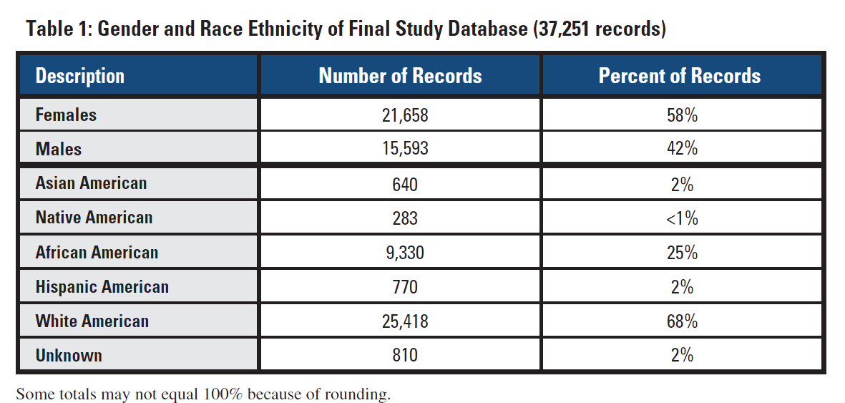
Final study database: 37,251 records

Slide 12
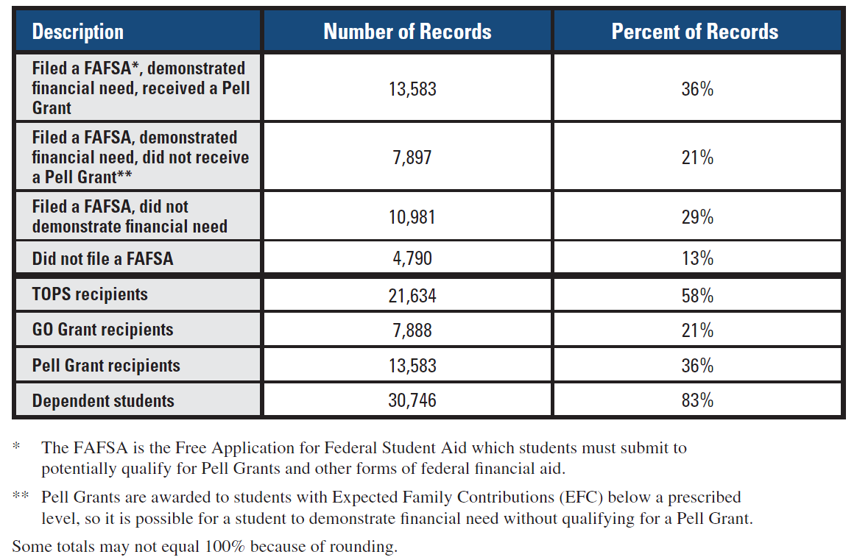
Final study database (37,251 records) continued

Slide 13

Key finding #1 In predicting fall-to-fall same school retention, high school grade point average was the strongest academic preparation variable

Slide 14
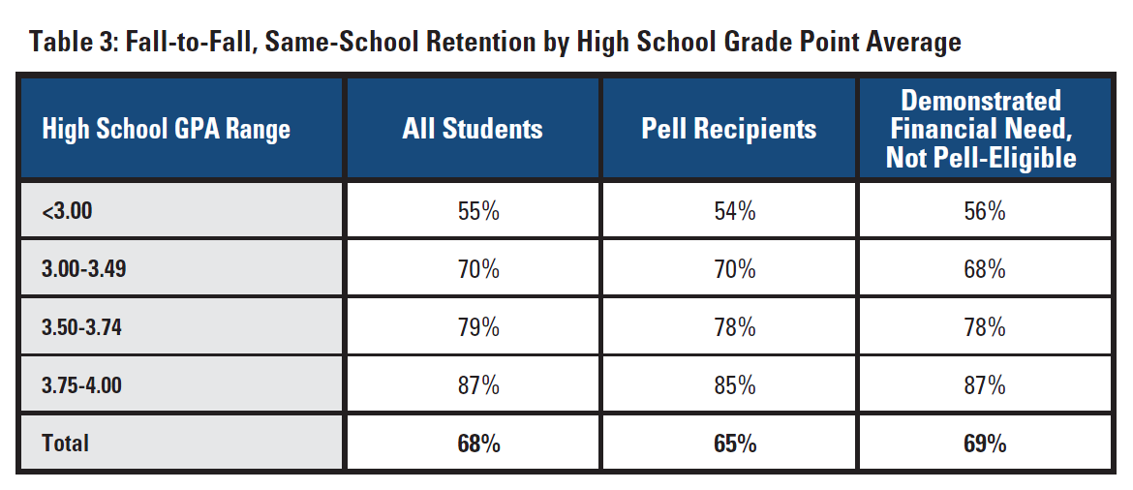

Slide 15

This parity in performance is encouraging given the vast difference in family income between the Pell students ($24,675) and students with demonstrated financial need without Pell Grants ($59,887)

Slide 16

Key finding #2 After controlling for high school performance, financial aid matters in predicting which Pell Grant students retain

Slide 17
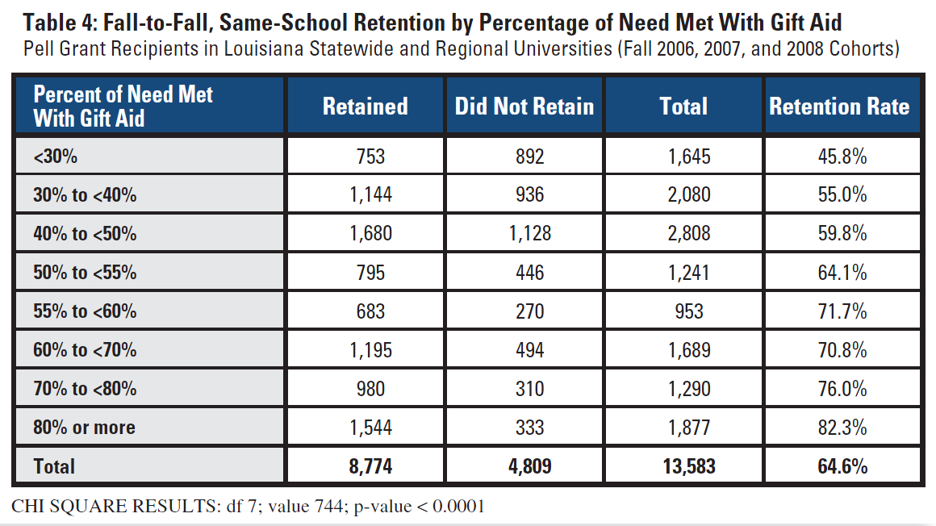
Increasing the gift percentage from <30 percent to 55-<60 percent corresponds to a 26 percentage point increase in the retention rate, while increasing the percentage of need met with gift aid from 55 to <60 percent to 70-<80 percent increases retention by only 4 points.

Slide 18

Key finding #3 Pell recipients who also received the Louisiana GO Grant had stronger overall financial aid awards and retained at higher rates

Slide 19
Adding the Go Grant alone increases the percentage of need met with gift aid by 14 percentage points and provides a 5.6 percentage point improvement in retention
All pairwise comparisons of means are significant except for retention rate between Pell+TOPS and Pell+GO+TOPS

Slide 20

Key finding #4 A simulation showed that you could improve retention by increasing the GO Grant to $4,000 and targeting it at students with weaker overall financial aid awards

Slide 21
Simulation parameter
We repackaged student’s GO Grants in the range of $0 to $4,000 with a target of meeting 55 percent of need with gift aid
In some cases, $4,000 grants were not sufficient to bring a group of students up to the 55 percent of need met w/gift target
In other cases, totally eliminating their GO Grants did not bring them down to the 55 percent
We took the resulting financial aid package for each subset and estimated a new retention rate based on actual historical behavior of students who had received that level of financial assistance with that level of academic preparation

Slide 22
The simulation results show that you could increase retention and it would be cost-neutral*
Gift % | Actual Results (2007-08 and 08-09) |  | Simulated Results |  | Change
 | Retention % | # Students | Retention % | # Students | Retention % | # Students
<30% | 41% | 138 | 57% | 192 | +16% | +54
30-40 | 56% | 445 | 62% | 496 | +6% | +51
40-50 | 59% | 1,037 | 64% | 1,121 | +5% | +84
50-55 | 63% | 567 | 65% | 590 | +2% | +23
55-60 | 72% | 442 | 67% | 412 | -5% | -30
60-70 | 69% | 808 | 69% | 806 | -- | -2
70-80 | 74% | 664 | 74% | 669 | -- | +5
80+ | 81% | 1,145 | 77% | 1,083 | -4% | -62
* The simulation at 55% actually projected a two-year savings of $780,000

Slide 23
We are suspect that you would really lose the 62 students in the 80%+ category

Slide 24
Policy Implications

Slide 25
Policy implications
Everything should be done to restore original GO Grant funding levels
Maintain the campus-based status of the GO Grant
Increase the maximum GO Grant to $4,000 and target it towards students who have less than 55%-60% of their need met with gift aid
Ascertain campus ability to package according to this rule

Slide 26
Discussion and Questions

Slide 27


