Slide 1
Immunization Package - Manager’s Menu
Amy Groom, MPH
IHS Immunization Program Manager
Amy.Groom@ihs.gov

Slide 2
Some basic tips
To go back to a previous screen, enter “^” (shift 6)
To save changes and exit, hit the F1 key and “E” in quick succession
To quit and go back to the previous screen WITHOUT saving changes, hit the F1 key and “Q” in quick succession

Slide 3
RPMS Immunization Package
MENU SYSTEM
PAT Patient Menu …
REP Report Menu …
MGR Manager Menu …

Slide 4
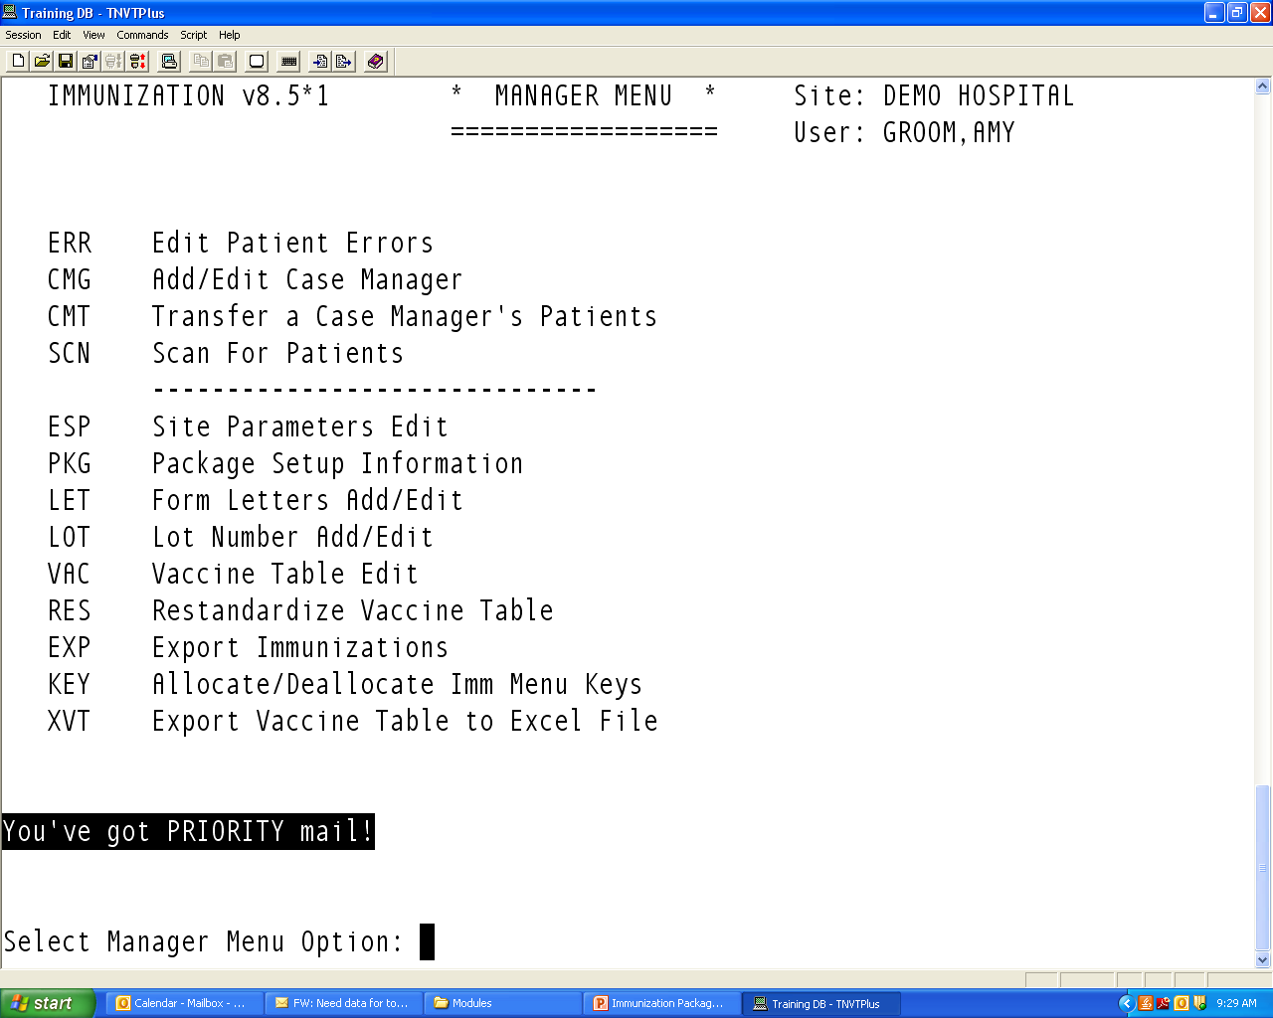
Manager’s Menu

Slide 5
Site Parameters
1) Default Case Manager.........: TSUI,GLEN M
2) Other Location...............: DEMO HOSPITAL NASHVILLE NON-IHS
3) Standard Imm Due Letter .....: Official Immunization Record
4) Official Imm Record Letter...: Official Immunization Record
5) Facility Report Header.......: CIHA HOSPITAL
6) Host File Server Path........: /m/
7) Minimum Days Last Letter.....: 30 days
8) Minimum vs Recommended Age...: Recommended Age
9) ImmServe Forecasting Option..: #3, WITH 4-Day Grace, HPV through 18
10) Lot Number Options...........: NOT Required, Default Low Supply Alert=50
11) Pneumo, Flu, Zoster Options ......: Pneumo: 65 yrs Flu: All ages (>6 mths);Zoster: Yes
12) Forecasting (Imms Due).......: Enabled
13) Chart# with dashes...........: No Dashes (123456)
14) User as Default Provider.....: No
15) ImmServe Directory...........: C:\Program Files\Immserve84\
16) GPRA Communities.............: 1 Communities selected for GPRA
17) Inpatient Visit Check........: Disabled
18) High Risk Factor Check.......: Enabled (Smoking included in Pneumo)
19) Import CPT-coded Visits......: Disabled
20) Visit Selection Menu.........: Disabled (Link Visits automatically)

Slide 6
Forecasting
For Children/Adolescents
All options conform to ACIP recommendations
All options forecast Tdap, MCV4 for 11-18 year olds
Booster dose of Mening at 16 yrs
HPV for all females 11-18 yrs
HPV for males WHO RECEIVE A DOSE
Option to forecast Influenza for All or for <19 years and 50+
For Adults
Hep A & B only for adults who received a dose < 18 years
Pneumo at 65+ (can choose to forecast starting at earlier age)
Option to forecast pneumo for high risk, with/without smoking
Option to forecast HPV for 19 – 26 females
Option to forecast Zoster for everyone 60 yrs+

Slide 7
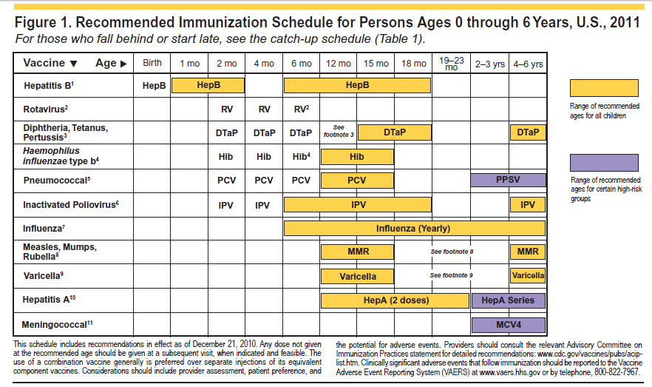

Slide 8
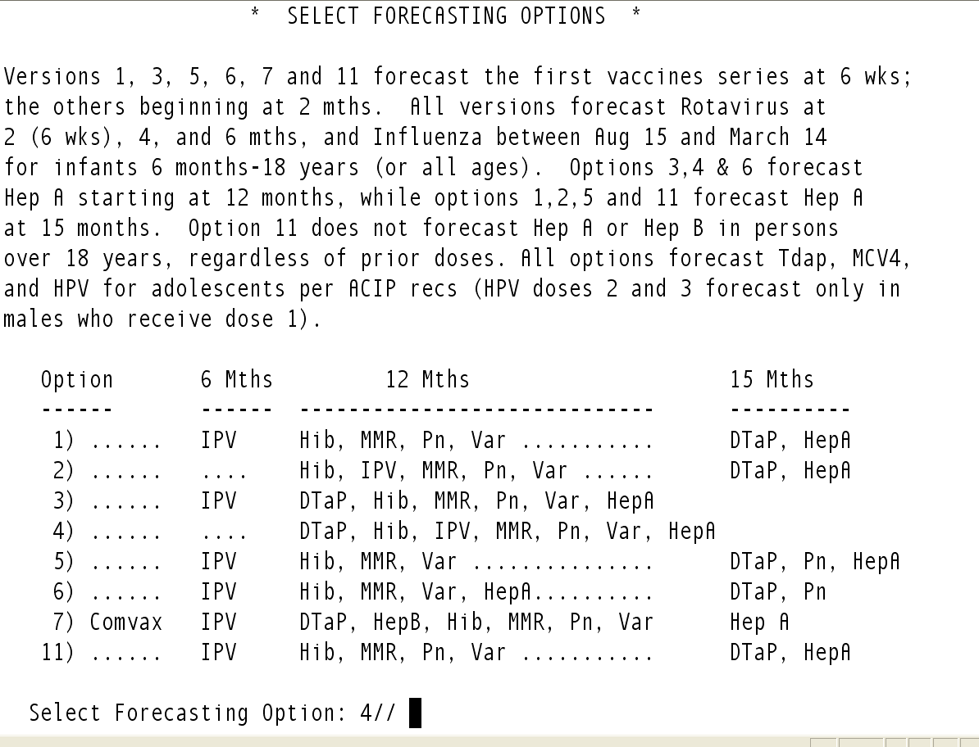

Slide 9
Adult Pneumococcal Vaccine “Pneumovax”
Automatically forecast at age 65
Can set to younger
Forecast another dose if ...
dose #1 given before age 65
Forecasts for High Risk patients (if enabled – ESP # 18)
19-65 year olds with 2 visits coded with ICD-9 codes considered “high risk” in past 3 years
Option to forecast for Smokers as part of High Risk

Slide 10
High Risk ICD-9 Taxonomy for Pneumo
ICD 9 Code | Definition
042.0-043.09, 044.9 | HIV infection
250.00-250.93 | Diabetes
303.90-303.91 | Alcohol Dependency
428.0-428.9, 429.2 | CHF
492.0-492.8 | Emphysema
493.00-493.91 | Asthma
494.0-496. | Bronchiectasis, CLD, COPD
501-505 | Pneumoconioses
571.0-571.9 | Chronic Liver Dis.
581.0-581.9 | Nephrotic Syndrome
585. | Renal Failure
865.00 - 865.19 | Spleen Injury
996.80-996.89 | Transplant
V42.0-V42.89 | Kidney Transplant
V58.1-V58.11 | Chemotherapy
V67.2 | Chemotherapy f/u

Slide 11
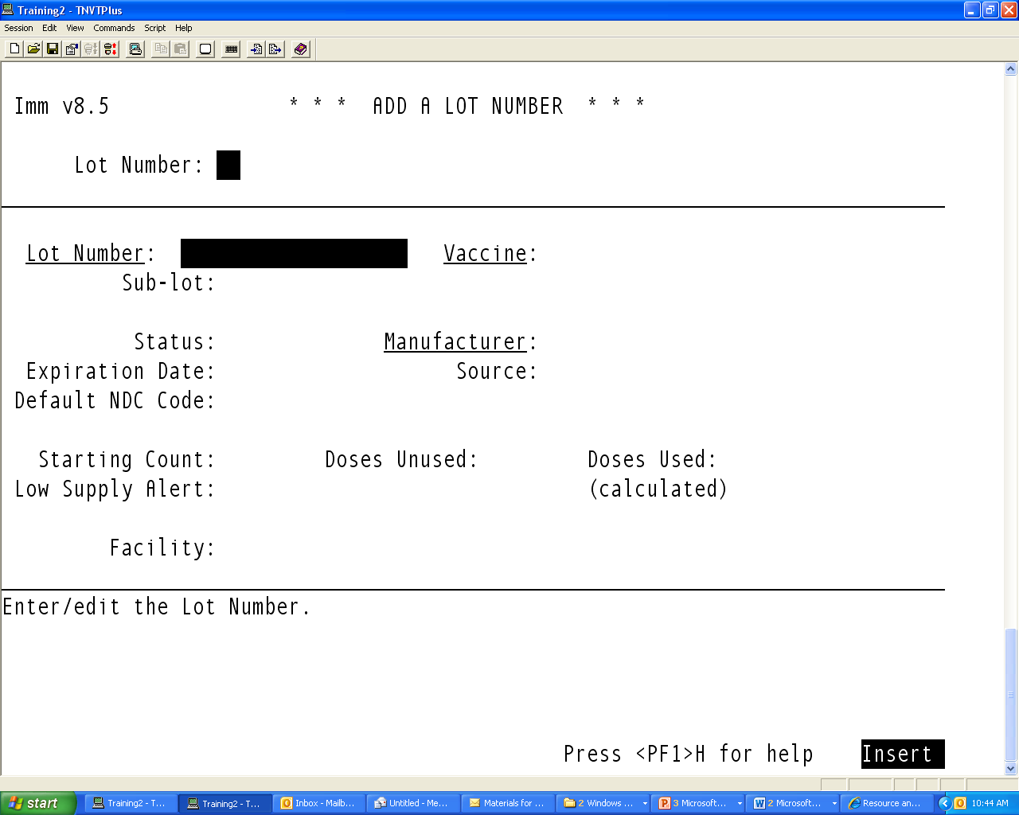

Slide 12
Form Letters

Slide 13
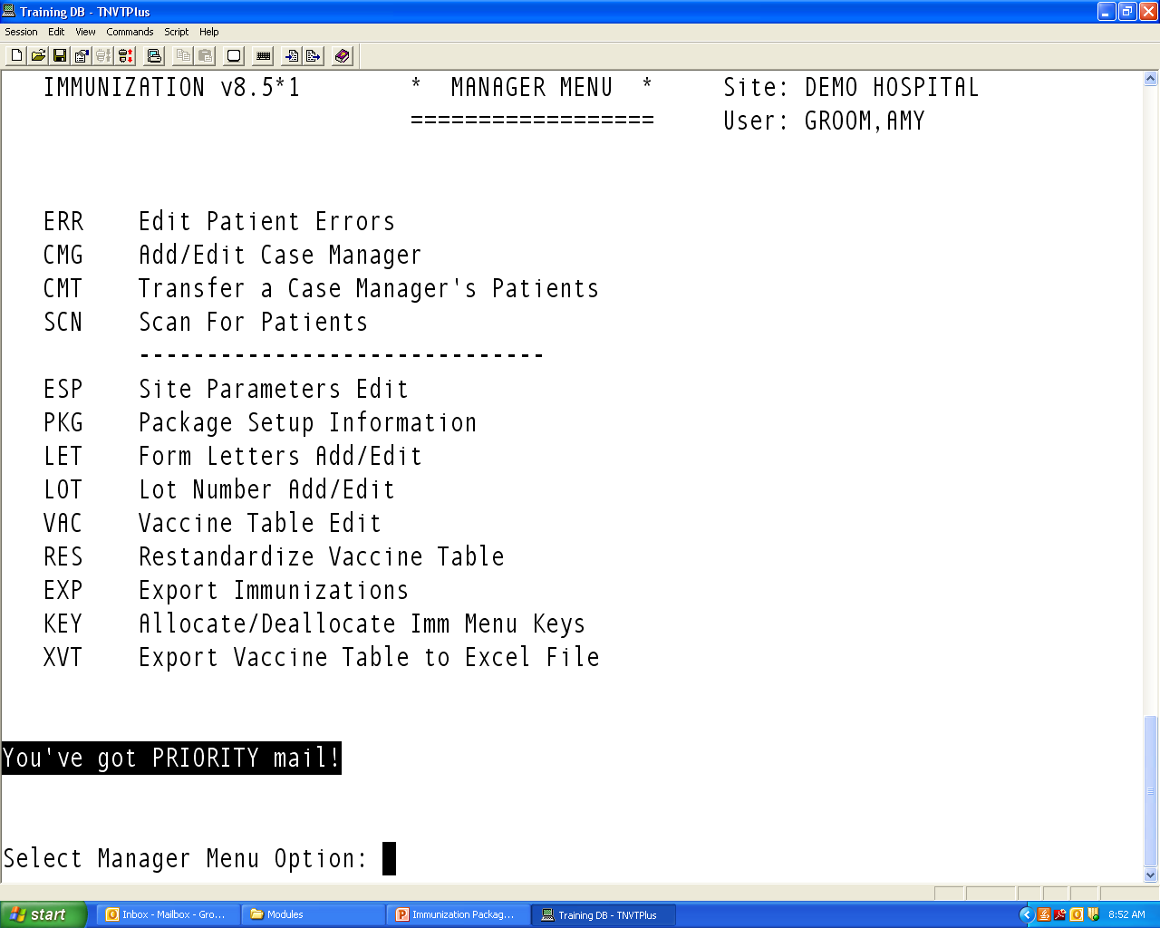
Creating Form Letters for Reminder Recall

Slide 14
Creating a New Form Letter
Type in name for new form letter
At prompt “Are you entering [your new letter name] as a new BI letter?” type “Y”
Choose template to work from
Standard Due Letter
Official Immunization Record
Standard Due letter – forecast first

Slide 15
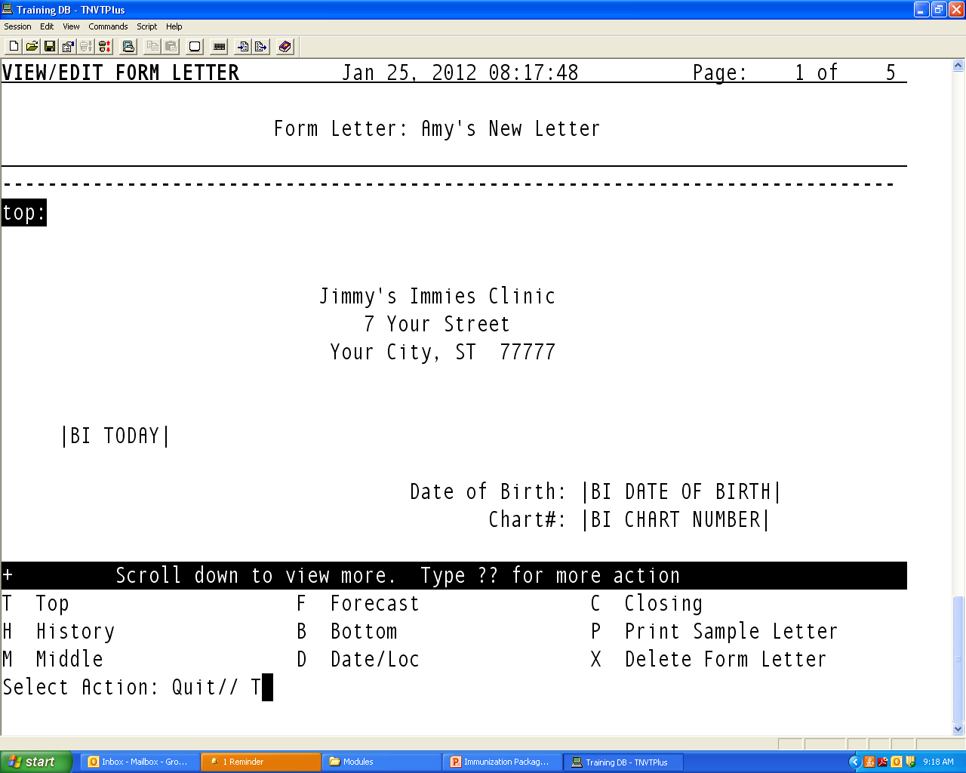
Editing a Letter
Select a the section you want to edit – e.g. “Top”.

Slide 16
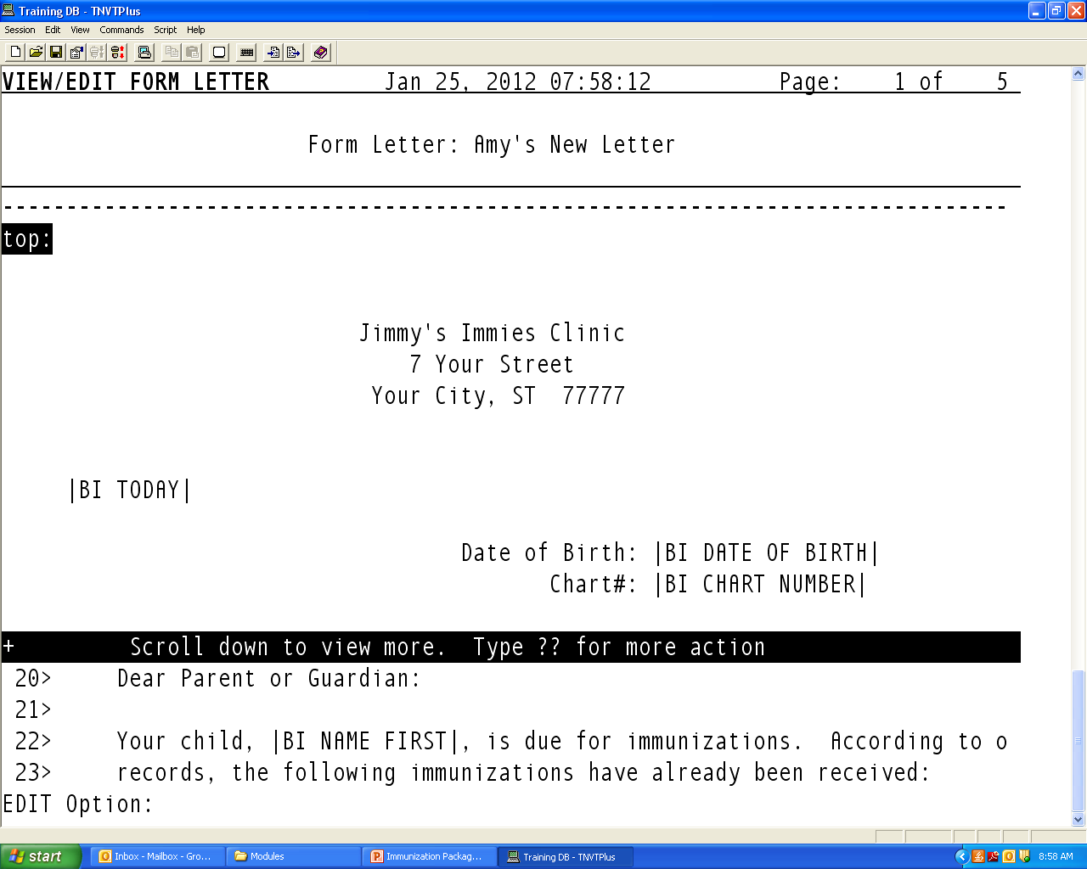
When editing the letter, if your screen looks like this . .
You need to switch from LINE EDITOR to SCREEN EDITOR

Slide 17
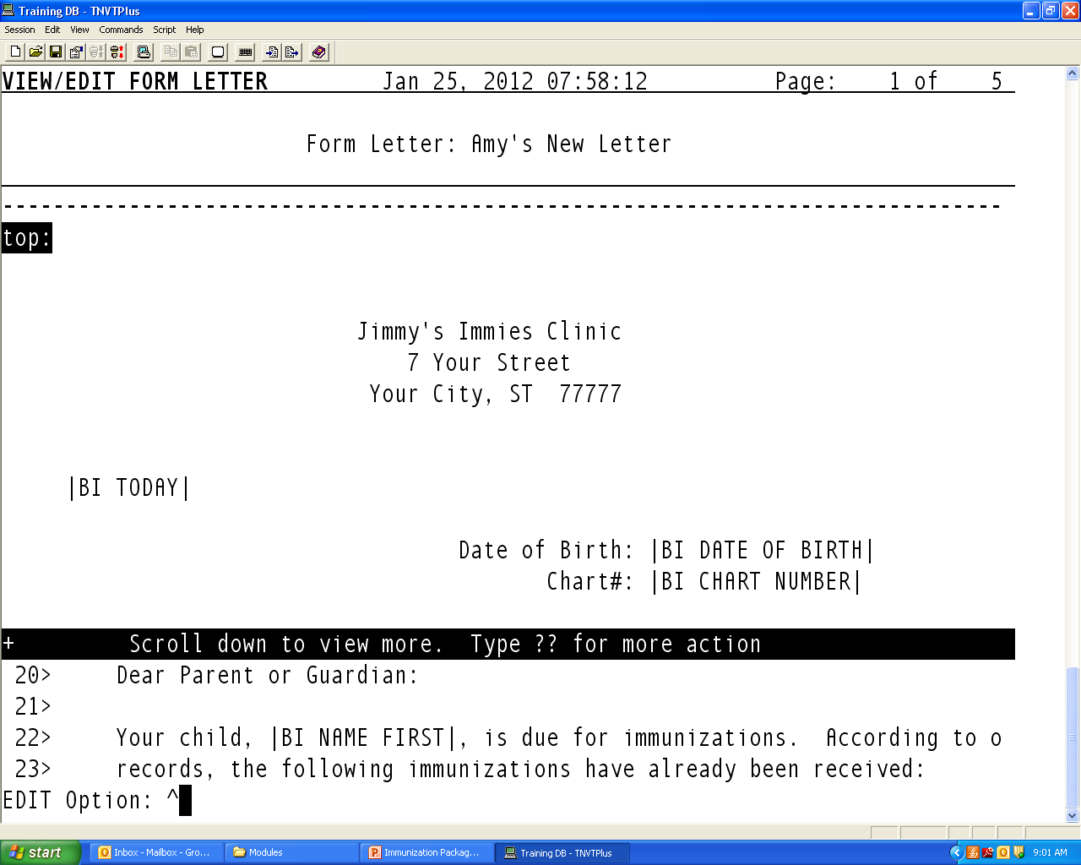
Switching from Line Editor to Screen Editor
At the prompt, enter “^” (Shift 6) to go back to previous screen
Enter “^” again to go back to main MGR’s menu page

Slide 18

At the main MGR Menu, type ^tbox

Slide 19
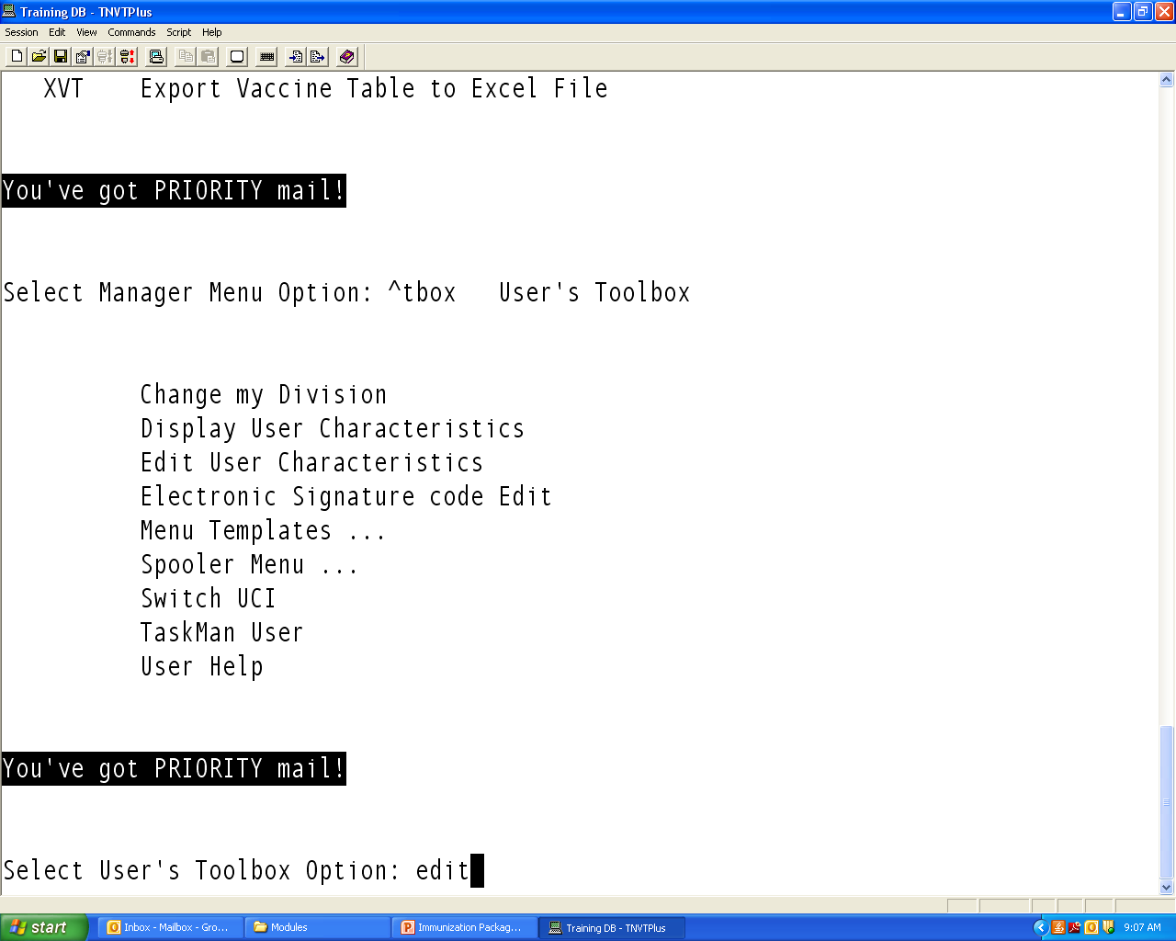
Select “Edit User Characteristics”

Slide 20
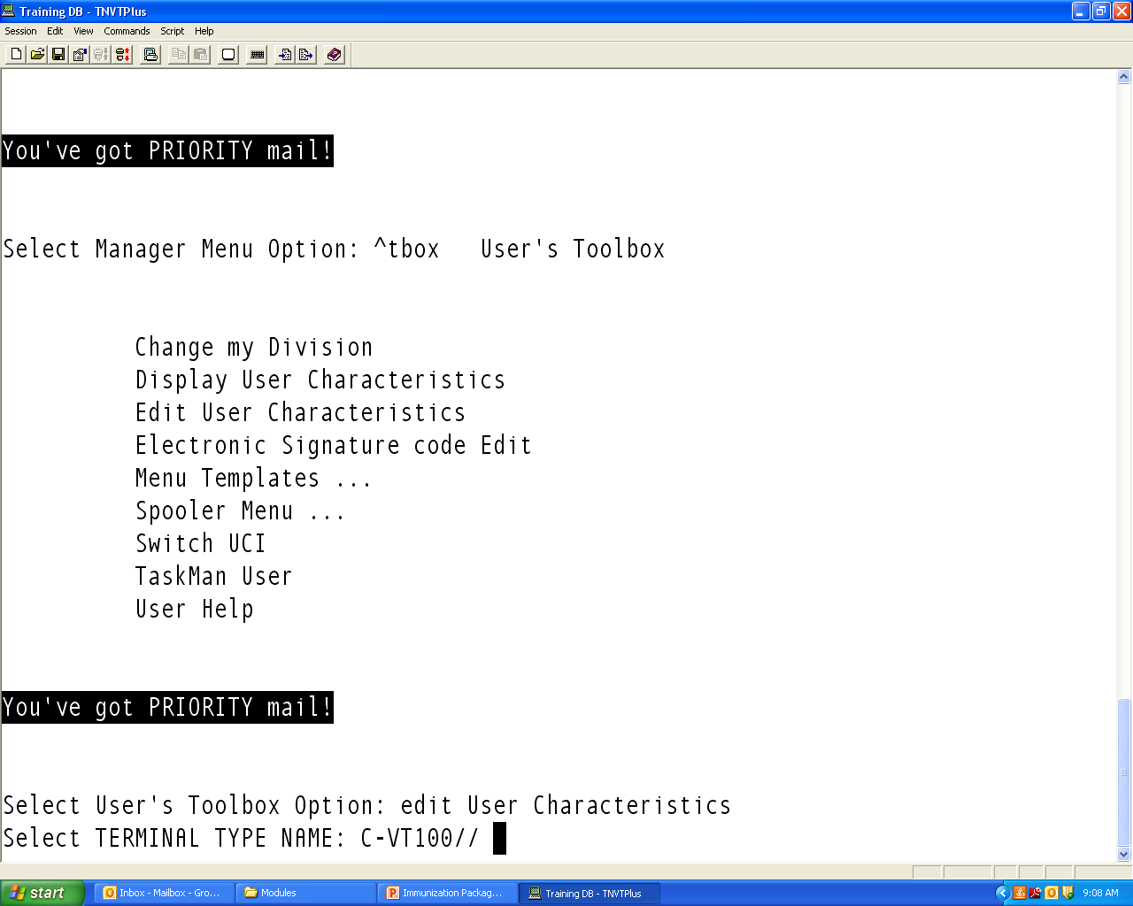
Hit “enter” to accept default Terminal Type

Slide 21
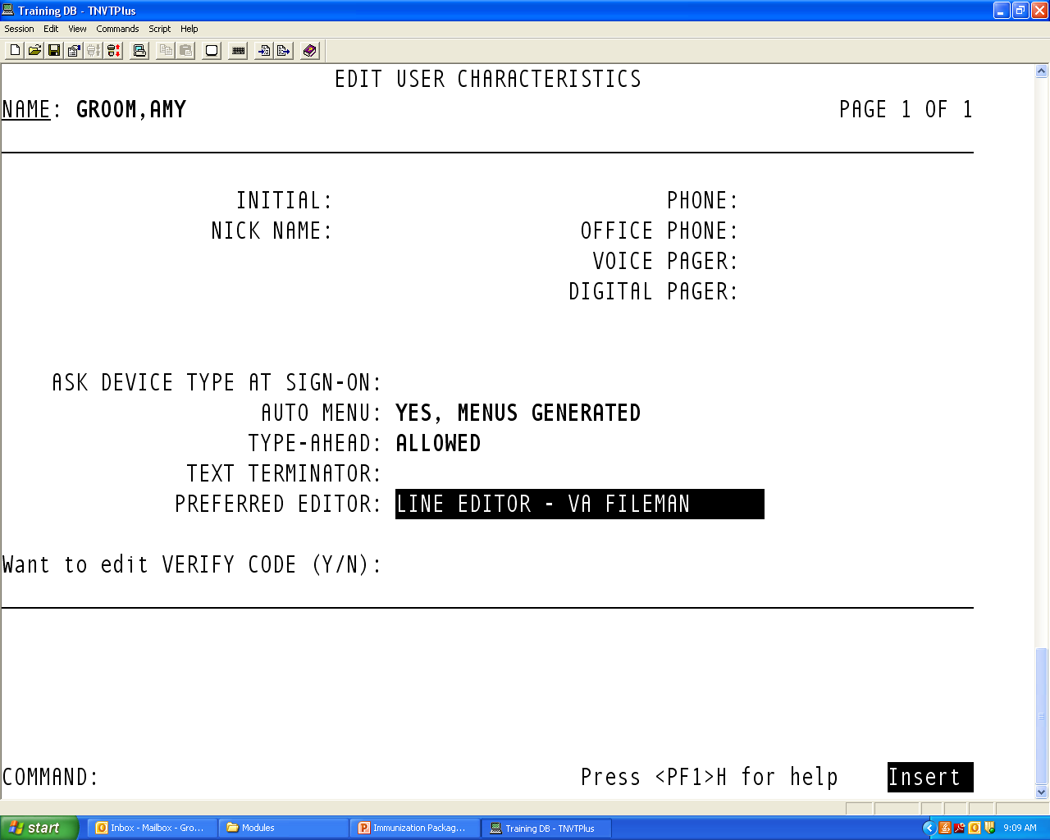
Using arrow keys, scroll down to “Preferred Editor”
Type “S” to switch to Screen Editor

Slide 22
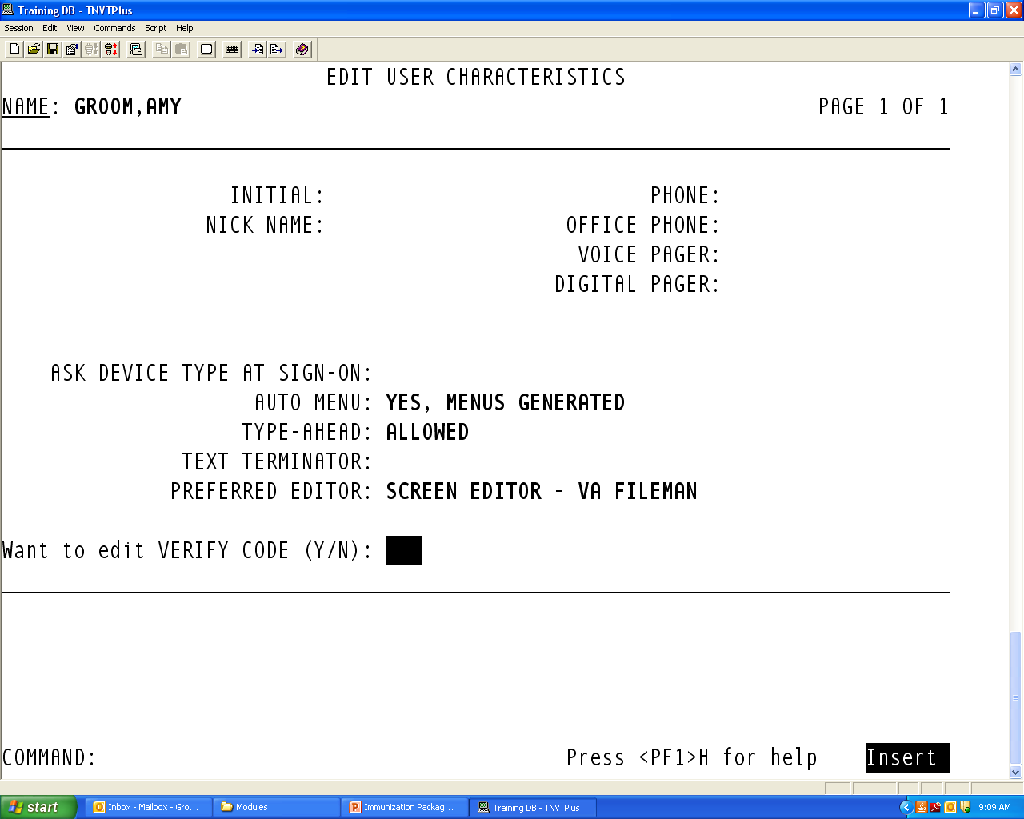
To save change and exit, hit the F1 key and E in quick succession

Slide 23
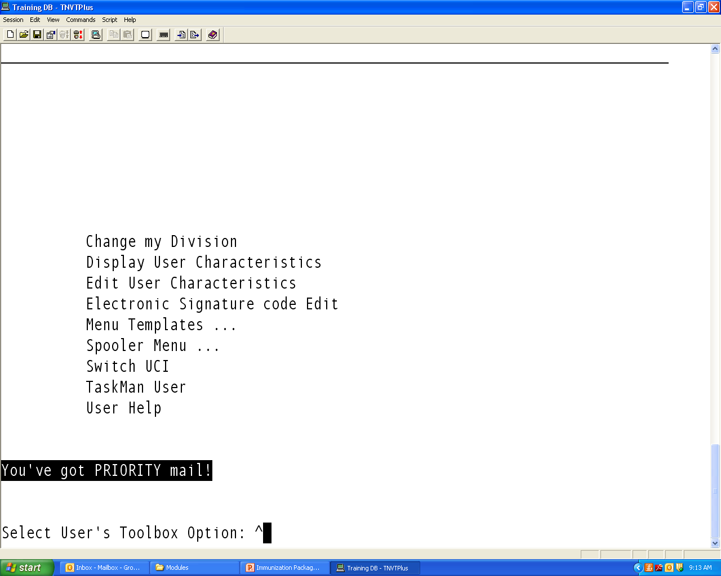
This will take you back to this screen.
To return to the MGR menu, enter “^” at each screen until you get there

Slide 24
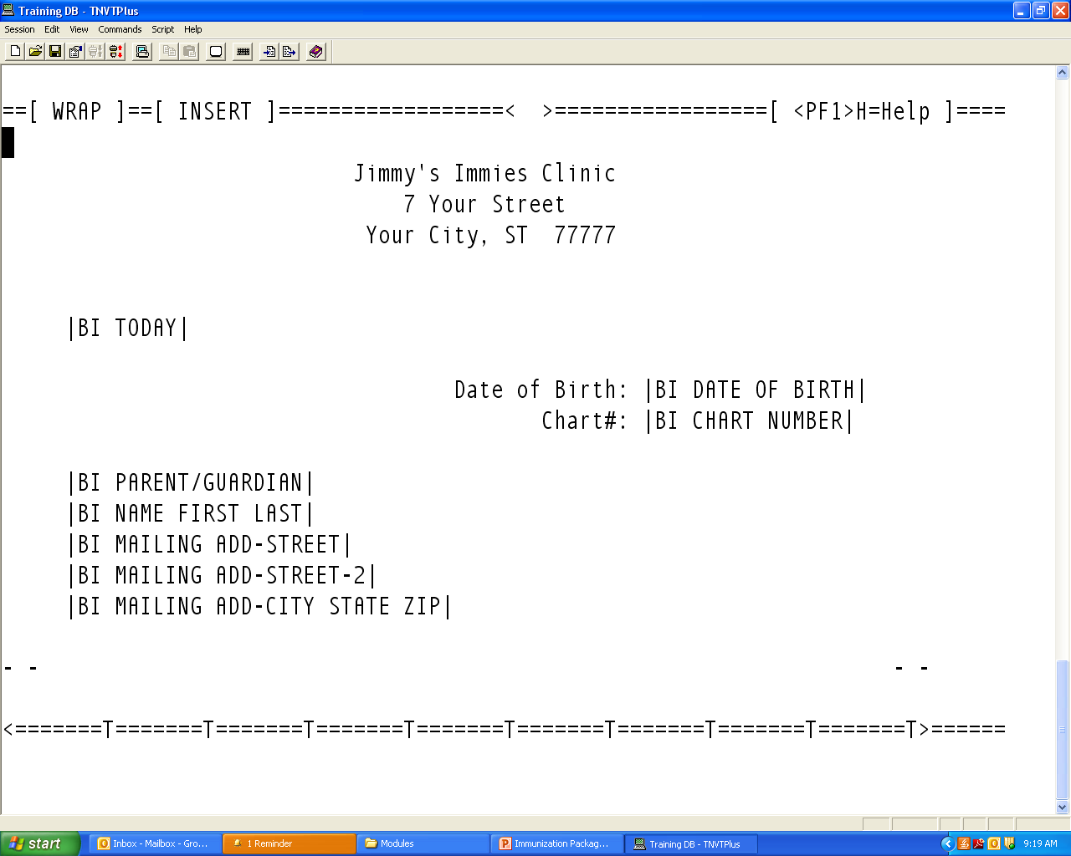
When you open the letter to edit, in Screen Editor, your screen should now look like this.
Use the arrow keys to move the cursor where you want to make changes

